Slide 1
ESG and Sustainable Investment Wellesley Banana Blast June 29, 2022
Judith Moore
Notes:
Welcome and thanks for joining.
My disclaimer: You’re going to get more information than you probably wanted on Sustainable Investment. And less information than you probably need.
________________________________________________________________
I can sum up everything I have to say in 3 points:
1. We are on the cusp of an extraordinary environmental and economic transformation. Trillions of dollars are going to be needed to transition our energy, agricultural, and infrastructure systems. Those trillions will only be found if the private sector steps up and changes its investment practices.
2. And every time you interact with a bank, an insurance company, a credit card company, or your pension fund or 401K administrator, you are interacting with a financial institution that is making deliberate choices about how to invest your money
3. Every spend you and they make has an impact—so its time we try to make that impact as positive as possible through better and more informed choices.

Slide 2
Contents
What is ”ESG” and sustainable investing: definitions
Evolution
Wellesley’s Responsible Investment policy
Reporting
What you should ask yourself
What you can ask your advisor
Resources to help you on the road
Notes:
I’m going try to cover in brief things like the terms that are used, the history of sustainable investment, reporting, and questions you should ask.
Why are these important?
There are a lot of terms flying around. Although practitioners might argue they are different, in fact, they are often used interchangeably. For example, Wellesley uses the term “Responsible Investment”
Why is the history important? Because many money managers will argue there just isn’t enough information yet about how Sustainable Investments perform. We have decades of experience we can refer to.
Why is reporting important? Because it provides YOU the information you need about where your money is going. It is a form of accountability for the investor/money manager.

Slide 3
Terminology
Notes:
First, Although the terms are frequently muddled or mixed up, I view ESG investing as a subset of all good investing, including Sustainable Investing
ESG refers to “Environment, Social, and Governance” assessment and standards. This is when investments—whether bonds or equities or alternatives are assessed for their quality of management in each of these 3 areas.
In the Investing community, ESG is the fastest-growing segment of the asset management industry.
But this area is new and a bit of a wild west. Critics say some companies and investors are using the loosely defined terms to “greenwash,” or make unrealistic or misleading claims, especially about their environmental credentials.

Slide 4
What is Sustainable Investing?
There is no single term to describe sustainable investing and terms are often used interchangeably.
Sustainable Investing
Ethical Investing
Green or Blue Investing
Values-based Investing
Impact Investing
Mission-Based Investing
Social Investing
Triple Bottom Line Investing
Responsible Investing
Socially Responsible Investing
ESG Investing
Notes:
Many of these names are used just to describe the practice of investing with consideration for specific issues. But now they are being blended under “Sustainable Investing. “
Sometimes the preferred terms vary by geographic region and some are subsets of others--like green investing may be part of impact investing etc.
Some of these terms are no longer commonly used or are phasing out like triple bottom line investing. This also adds to the confusion.

Slide 5
Key Definitions
Historically SRI used exclusionary criteria--screening out investments based on moral or ethical considerations--Now it is evolving into a more positive process—Screening IN investments to support values.
SRI
(Socially Responsible Investing)
“Know Why You Own It”
ESG
(Environmental, Social and Governance)
“Know What You Own”
The systematic and explicit inclusion of ESG risks in investment screening. This is now becoming a mainstream investment practice
Impact Investing
“Know What It Does”
Stewardship
or Engagement
“Know How to Change It”
Investing to to generate specific, measurable and positive social and/or environmental outcomes. This IS the new horizon.
Investors committing to interact with corporations or issuers to positively influence their behaviour.
Notes:
Investment managers use multiple approaches to analyse their investments. But for Sustainable investment it really falls into 4 broad areas.
Your banks, insurance companies, NGOs and almost all institutional investors are consciously choosing or NOT choosing to pursue these approaches.
SRI: Socially responsible investment: “KNOW WHY YOU OWN IT”. Historically, this has focused on negative, or exclusionary criteria; screening out investments based on moral or ethical considerations. Examples of asset managers include Everence, Pax, Trillium, Calvert, and many others. Issues like Apartheid, Nuclear power, Armaments
ESG: “KNOW WHAT YOU ARE INVESTED IN” The systematic assessment of Environmental Social and Governance concerns in investment processes is now becoming mainstream and you will see mutual fund offerings listed – But….they must be queried carefully. Goldman Sachs, BNY Mellon examples
IMPACT INVESTING: “KNOW WHAT IT DOES” This is Investing to generate specific, measurable and positive social and/or environmental outcomes. This IS the new horizon. Affirmative Investment is an example of an impact investor
STEWARDSHIP/ENGAGEMENT: “KNOW HOW TO CHANGE IT.” With engagement Investors work to positively influence corporate or issuer behaviour. In Affirmative we frequently worked with potential investees to get certain changes, for example in reporting.

Slide 6
Evolution

Slide 7
Lekdijk Bovendams Water Board bond, 1624
Notes:
Sustainable investing has been with us for many years and will be for many years to come.
This perpetual Dutch water bond was issued in 1624 to rebuild a key dike after a devastating flood. Yale University holds the bond and still collects Euros 15 a year in interest paid out by the Water Board
In 2014, DC Water in Washington issued a $350 million Century bond specifically to fund part of the DC Clean Rivers Project. The proceeds are being used for an overflow tunnel and for green infrastructure, including rain gardens, permeable pavement on streets and alleys, and two green infrastructure parks in the Rock Creek sewer-shed. It pays 4.8% annually in interest and doesn’t mature until 2114

Slide 8
Sustainable Investing: Evolution
Modern origins of investing for impact stretches over centuries. This is a representative list only.
Pre-1960
1970s
1980s
1990s
2000-2010
2010-2022
1960s
Faith-based investors considered broad societal impacts of their financial decisions and avoided “sin” stocks in funds.
1890: Quaker Friends Fiduciary “no sin” investments.
1928: First publicly offered fund: Pioneer Fund’s “sin” screen is used to screen out investments in alcohol, tobacco and gaming. [Pioneer is now part of Amundi]
Social and cultural transformations, such as anti-war, civil rights, women’s rights etc. Environmental and social movements proactively engaged with companies.
1967: First shareholder advocacy targeting Kodak (US).
Environmental movements (Earth Day) and societal reactions to war, sweatshops, climate etc. Consumer movements and corporate responsibility.
1971: First SRI mutual fund launched, Pax World Balanced Fund.
1973: Interfaith Center for Corporate Responsibility (ICCR) - ESG shareholder advocacy.
Anti-apartheid campaigns and environmental and social catastrophes (Chernobyl nuclear disaster, Bhopal and
Exxon Valdez oil spill (Alaska)).
1987: Brundtland Commission defines “sustainability”.
Earth Summit, Kyoto Protocol, increased popularity of sustainable funds. Societal reactions to working conditions, such as child labor. Strengthening of stakeholder engagement.
1999: Global Reporting Initiative (GRI) established.
1999: Dow Jones Sustainability Index (first global sustainability benchmark index).
Growth of sustainable and impact investing, including impact bonds.
2000: Carbon Disclosure Project (CDP) launched.
2006: PRI launched with
4T AUM (AuM at 103.4T in 2021).
2007: UN’s IPCC report links human action to global warming.
2008: World Bank becomes first institution to issue a green bond.
2013: Sustainability Accounting Standards Board (SASB) publishes first industry standards.
2015: Paris Agreement signed by 197 countries; Sustainable Development Goals adopted by UN; TCFD launched.
2020: EU Taxonomy for sustainable activities.
2021: Sustainable Finance Disclosure Regulation (SFDR) launched.
Faith-based “sin" screens
Development and awareness of CSR
Move to positive selection
Expansion beyond activism
Mainstreaming sustainable investment
Global standards and regulation
Notes:
DON’T try to read all of this.
Although Sustainable Investing is NOT a new concept, it IS evolving.
In the 1960’s and before, the sustainable investment community was mostly made up of Faith-based groups—like the Quakers or Christian Brothers.
In the 1970’s and ’80’s Environmental and Social concerns and exclusions came in—think anti-apartheid, anti-war, and anti-nuclear divestment movements.
In the 1990’s, transparency and accountability began to enter into the mix—Global Reporting Initiative, and the Dow Jones Sustainability Index were launched.
In the early 2000’s, CDP launched its carbon accounting and reporting platform for corporations to “come clean”. The UN launched PRI, and Impact and Green bonds were born. These bonds may not be something you can invest in, but Your Bank, Pension Fund, and Insurance company should be.
2020’s—are about regulation. Europe is further ahead than the US: for example, the Sustainable Finance Disclosure Regulation requires all companies to report how they are (or are not) integrating environmental, social, and governance concerns in their portfolios. Anyone selling into the EU market must make these disclosures—this affects many US companies.
The SEC has proposed a new rule that requires public companies to report their climate-related risks, emissions, and net-zero transition plans. In addition, the SEC is fining companies marketing their funds as integrating ESG analysis and concerns but aren’t actually doing it. The SEC is becoming much more activist!

Slide 9
Who is driving Sustainable Investment?
WE ARE. Boomers, Millennials, and GenXs
Institutional investors, such as our Banks, Insurance Companies and Pension funds
Mission-driven institutions: foundations and endowments
Family offices
Faith-based organizations
Retirement plan sponsors/participants
Some companies (B Corporations, etc.)
Notes:
Who is Driving Sustainable Investment? WE ARE
This graph is showing a slow growth in retail investing—which is most of us who are in mutual funds and individual equity and bond selections.
Most Sustainable Investment is in under the management of Institutional Investors, such as pension funds, universities, foundations and insurers. BUT ultimately this is US, too.
Example: Wellesley’s Endowment is managed by a consulting group like NEPC or RVK. (i.e. Wellesley’s Trustees don’t have ”stock pickers” on staff. ) But WE are the contributors to Wellesley’s Endowment and Wellesley gives direction to NEPC et al. on how they want to money invested.
“Fiduciary Responsibility” has been long used as an excuse by Large institutional investors -- arguing that fiduciary duty was limited to maximizing investment returns irrespective of environmental or social impacts, or broader governance issues like corruption. But evidence has grown that ESG issues do indeed have positive financial implications—in addition to societal benefits-- and the tide is shifting.

Slide 10
Examples of ESG Criteria and Engagement in Investing

Slide 11
ESG Concerns
ESG criteria
The Goal of ESG is to Identify Risks and Opportunities, support Quality Businesses, and to push for Positive Change
Environment
Social
Governance
Climate change
Air and water pollution
Energy efficiency
Sustainable procurement (supply chain)
Water management
Land and marine management
Deforestation and Biodiversity
Raw materials sourcing
Clean technology
Worker Diversity, equity and inclusion
Workplace health and safety
Labor relations
Product integrity
Human rights/community relations
Indigenous people’s rights
Health and access to medicine/COVID response
Privacy and data security
Board composition, diversity and independence
Shareholder rights and voting structure
Executive compensation
Lobbying and Political contributions
Transparency and disclosure
(including reporting)
Business ethics and policies
Anti-corruption policies
Audit committee structure
Whistleblower schemes
Notes:
Environment, Social, and Governance analysis isn’t rocket science. But in ESG analysis it tends to be BACKWARD LOOKING: What has been the company’s performance RECORD in these areas.
ESG issues are often interlinked, and it can be challenging to classify an ESG
issue as only an environmental, social, or governance issue
Environment usually refers to the external impacts of production or operations, like carbon emissions, water and air pollution, supply chain management, Energy efficiency, etc.
Social tends to refer to the working environment: Worker diversity, worker rights, health and safety, etc.
Governance usually is looking at how the company conducts itself: what is its board composition, is it diverse, do they have strong ethics and anti-corruption policies, etc.
One of the reasons investment analysis have been slow to incorporate ESG concerns is that they are frequently what we call externalities, and it is difficult to assign monetary value for this characteristics when determining the company value. For example, what is the cost of high worker turn-over. Surely there is one, but how to value?

Slide 12
Examples of Engagement Approaches
Voting Proxies
Vote on proposals brought forth by the company or other shareholders
In the US, it is an essential measure of good corporate governance and required of mutual funds.
Not binding but sends a signal and puts pressure on the company.
Majority votes are rare; 30% is often viewed as “successful.”
Dialogue Participation
Opportunity for investors to learn how a company is addressing ESG issue and to gather more information.
Opportunity for the company to learn about shareholder concerns.
Agreements can be reached to strengthen company’s policies or practices.
Shareholders may file resolutions if dialogue unsuccessful.
Shareholder Resolutions
Various regulatory requirements depending on country.
US Example: Filer must hold $2,000 in stock; proposals no longer than 500 words and proof of ownership document confirming shares held over a year; shareholder (or designated representative) must be present in person at the Shareholder Meeting to read the proposal aloud; etc. All shareholders can vote “in favor,”, “against” or “abstain.”*
Notes:
So what are the tools that YOU have as an individual investor.
These are engagement approaches used by Asset Managers large and small, but they can be used by you, too.
Almost every month, you probably get proxy voting requests on all kinds of issues and probably just delete them from your In –box. This is how shareholders can provide input into how the company is run.
Companies also offer “dialogues” to their shareholders, which may not actually be DIALOGUES, but they give you information on their approach and forward strategies.
And Shareholder resolutions—which are usually included on the proxy forms
An old example:
1966-67 KODAK - Shareholders in Eastman Kodak (Unitarians, United Church of Christ, Methodists, and TIAA/CREF sponsored a shareholder resolution that Kodak had a responsibility to the African-American residents of Rochester, NY, and should provide them with a proportionate share of Kodak’s available jobs. This passed at the annual shareholders meeting—and –hopefully-was enacted.

Slide 13
VOTE YOUR PROXIES !
If you are a shareholder of a corporation, you have a say through your vote.
It may seem like your share of the vote is too small to matter BUT it is essential that company boards hear shareholders concerns:
Binding resolutions can concretely reshape the course of a company.
Corporate board elections can change a board from crony boards to those with a longer-term and wider impact focus.
Investors have been organizing efforts to vote in women and vote out board members who deny climate change.
Even the nonbinding proposals such as advisory votes on compensation practices can help change the incentives of company executives.
The range of items up for vote on a proxy ballot is an opportunity for YOU to weigh in on the governance and direction of a company you own a piece of.
Notes:
It may seem like your share of the vote is too small to matter BUT it is essential that company boards hear shareholders concerns:
Binding resolutions can concretely reshape the course of a company.
Corporate board elections can change a board from being crony boards to those with a broader focus.
Investors have been systematically organizing efforts to vote in women and vote out board members who deny climate change.
Even the nonbinding proposals such as advisory votes on compensation practices provides feedback and can help change the incentives of company executives.
However small your share, It is an opportunity to weigh in on the governance and direction of a company.
So… VOTE YOUR PROXIES
BE ENGAGED

Slide 14
Wellesley’s Responsible Investment Policy
Consistency with its social mission and values
Screen managers for their ethical, investment, operational and performance standards.
Divesting over time from its fossil fuel Investments. No new investments are being made.
Wellesley believes in active engagement and votes their proxies.
As a member of the college community, we can request that the Subcommittee on Investment Responsibility of the Board of Trustees invest endowment assets according to our specific social values.
https://www.wellesley.edu/investmentoffice/initiatives
Notes:
There isn’t much information there. The only clear approach that Wellesley is disclosing is exclusionary—stepping away from fossil fuels. Hopefully their strategy is more more nuanced than that—and includes more Sustainability considerations.
The word “Sustainability” doesn’t appear. It doesn’t have to, but Its unclear what the criteria for screening managers (like NEPC) actually is—they screen for “ethical, investment, operational, and performance standards.” ESG performance is probably a key part of that. But there is no information as to whether there is a proactive strategy for addressing future sustainability.
In 2021, fossil fuel holdings made up 2.9% of the portfolio, down from 3.7% in 2020. But they admit that in fact fossil fuel stocks have declined in value and other sectors have increased in value so it doesn’t tell us a lot about divestment progress.
A committee comprised of trustees, students, faculty and staff set the proxy voting policies.
As alumnae, We have the right to ask for more information AND to request that they invest in line with our values (whatever they may be).

Slide 15
Reporting
Notes:
Reporting –to you--by your advisor, your bank, your pension fund is an essential part of the Sustainable investment process.
Each of these entities should be publicly reporting their progress and sustainability strategy.
And there are many voluntary channels for them to report now, such as through the Global Reporting Initiative, the Principles for Responsible Investment, the CDP. Each has its own standards and framework.
One of the unifying frameworks for reporting the performance of the companies (corporations) and Investment Houses is the UN Sustainable Development Goals, which were established in 2015.

Slide 16
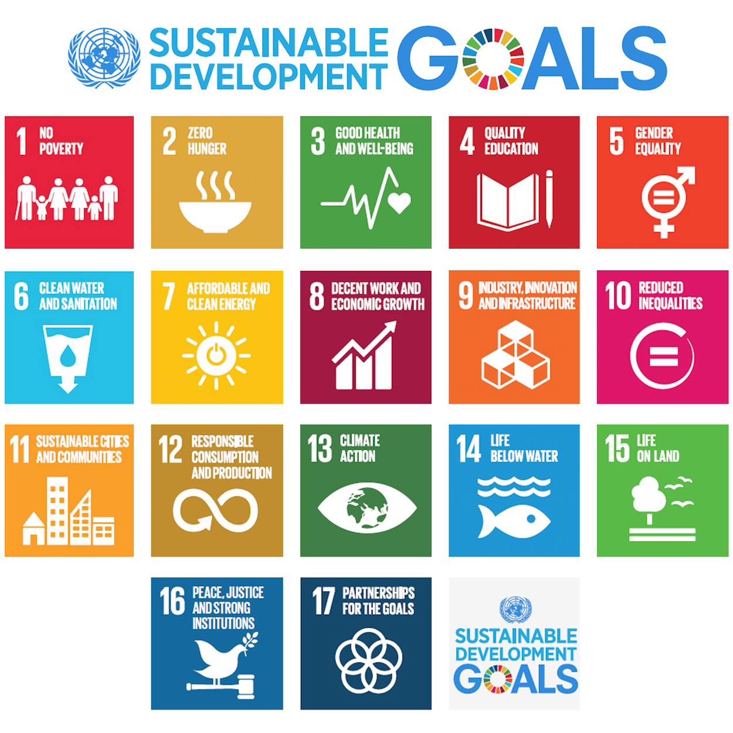
Institutional Investors/Big Corporations are being asked to report ON their contribution to the UNSDGs.
End poverty, protect the planet, and ensure peace and prosperity.
It is estimated that there is a USD 2.5 trillion annual gap in investments to achieve the SDGs by 2030¹.
The UN Sustainable Development Goals (SDGs) were adopted in 2015 by all UN Member States.
17 goals with 169 targets designed to achieve a better and more sustainable future for everyone by 2030.
We wont make it. But that doesn’t mean we don’t all need to do our part.
The scale of the global sustainability challenge is beyond the capacity of the public sector alone.
It is essential that private money be channeled into sustainable finance to fund the transition to a low-carbon and inclusive economy.
Notes:
This of the most interesting developments (Institutional Investors and Big Corporations reporting their contribution to the UNSDGs
The SDGs are a universal call to action to end poverty, protect the planet, and ensure that by 2030 as many people as possible enjoy peace and prosperity. WE HAVE A LONG WAY TO GO..
They are
1: Reduction in Poverty
3: Health and Wellbeing
4: Quality Education
5: Gender Equality
7: Affordable Energy
8: Decent Work and Economic Growth
9: Industry, Innovation and Infrastructure
10: Reduced Inequality
11: Sustainable Cities
12: Responsible Consumption and Production
13: Climate Action
14. Life under Water
15. Life on Land
16. Peace and Justic
17. Parternships
.

Slide 17
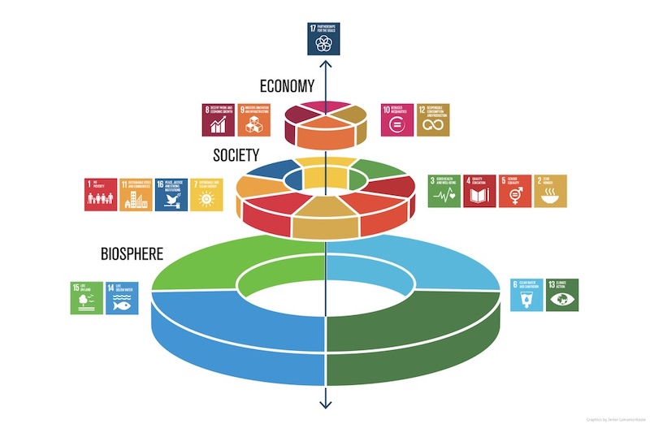
SDG Relationships
On a macro level, all investors affect the SDGs through their own choices and lending.
Reporters are expected to tag SDGs that are material to the entity’s type*. For Banks they could be:
1: Reduction in Poverty
3: Health and Wellbeing
4: Quality Education
5: Gender Equality
7: Affordable Energy
8: Decent Work and Economic Growth
9: Industry, Innovation and Infrastructure
10: Reduced Inequality
11: Sustainable Cities
12: Responsible Consumption and Production
13: Climate Action
Some SDGs will be more material for some investments than others.
Example: SDGs 1, 4, 5, 7 and 10 are material for community banks etc.
BUT it is IMPORTANT to remember that all SDGs influence each other.
Graphic by the Stockholm Resilience Center
Notes:
This is my favorite representation of the SDGs, because it shows the SDGs NOT as a line of independent boxes but as a nested interrelationship.
They are integrated. And action in one area depends on and influences success in other areas.
The Biosphere underlays it all and we are finally waking up to its fragility.
Society exists within, is constrained by, manages, and changes the biosphere.
And the economy is a social construct built on each of the other layers and deeply dependent on the natural and social capital contained within them.
Progressive companies / Responsible companies / competitive companies are beginning to recognize that their shareholders and clients want to know what THEY are doing to support the goals for a sustainable future.
Ask for and Look for reports from the companies you are involved with. It is a form of accountability—a window into how they view their role in the world.

Slide 18
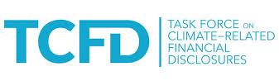
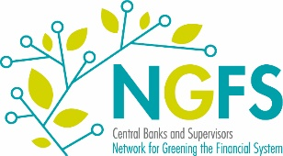
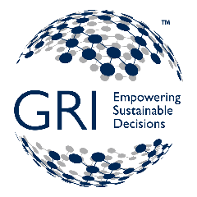
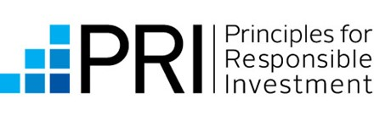
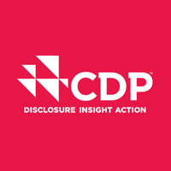
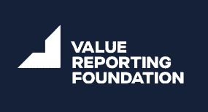
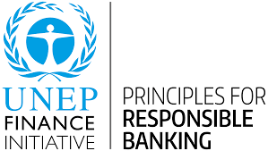
Frameworks and Standards for Reporting
9,946 companies across 162 countries have pledged to adopt sustainable and socially responsible policies and publicly report on them. | TCFD seeks to capture carbon intensity and risk in corporate operations. Nearly 800 organisations accounting for USD 188tn AUM are official supporters. Many more investment houses are struggling to report according to their framework. | Network of Central Banks and Supervisors for Greening the Financial System. 116 Central Banks, Regulators, and other key agencies who are developing environmental and climate risk management in the financial sector. US Federal Reserve is a member | Launched in 1997, it is the first and most adopted global standard for sustainability reporting. | Launched in 2006, now has about 7,000 signatories pledging to incorporate ESG into their corporate decisions and strategies. Many—but not all-- company reports are public.
Founded in 2009, an Investor-focused organization working on mobilizing the $100 trillion bond market for climate change solutions through the Climate Bonds Standard and Certification Scheme, Policy Engagement and Market Intelligence work. | Founded in 2000 and working with more than 590 investors with over $110 trillion in assets on environmental disclosure. Over 10,000 organizations disclosed data through CDP in 2020, including more than 9,600 companies and over 940 cities, states and regions. | Formed in 2021 by the merger of The International Integrated Reporting Council and the Sustainability Accounting Standards Board offering resources to help businesses and investors develop a shared understanding of enterprise value, including Integrated Thinking Principles, Integrated Reporting Framework and SASB Standards –adopted in over 70 countries. | Launched with 130 banks from 49 countries, representing USD 47tn in assets in September 2019. | The Institutional Investors Group on Climate Change is a European group for investor collaboration on climate change and progress towards a net zero and resilient future by 2030. This is made up mainly of pension funds and they are in close partnership with US Investor Networks such as Ceres’ INCR
Notes:
DON’T TRY TO READ ALL THIS!
This is a just a quick take on some of the many frameworks and standards that companies, supranational agencies, and countries are being asked to measure themselves against and report according to the metrics put forward
The goal of all is greater insight into the strategies and social and environmental footprints of the groups we are putting our money with. Each of these groups and others can be resources for you if you want to learn more. In a number of cases at least part of their site content is publically available.
I’ll also leave you with more resources at the end for reading and research.

Slide 19
The EU Taxonomy
https://ec.europa.eu/info/business-economy-euro/banking-and-finance/sustainable-finance/eu-taxonomy-sustainable-activities_en
“Taxonomy-aligned” investments must meet three conditions:
Make a substantial contribution to at least one of six environmental objectives:
Do no significant harm to any other EU environmental objective:
Meet minimum social safeguards
Climate change mitigation
Climate change adaptation
The sustainable use and protection of water and marine resources
The transition to a circular economy
Pollution prevention and control
The protection and restoration of biodiversity and ecosystems
Sustainable use and protection of water and marine resources
Transition to a circular economy
Pollution prevention and control
Protection and restoration of biodiversity and ecosystems
Defined in reference to the:
UN Guiding Principles on Human Rights
OECD guidelines
ILO core labour conventions
NOTE: Some jurisdictions are now developing their own taxonomies (i.e., Bangladesh, Canada, China, Malaysia, Mexico, Mongolia, South Africa, UK etc.). We need to ask the US to do so, as well.
Notes:
If your want to do some research on your own this is a very useful site.
The EU taxonomy Addresses “greenwashing” by setting out criteria for determining if an activity is environmentally sustainable. It is a classification system.
The Taxonomy only applies to EU entities, but the site is open, and if you have a question as to whether an activity or enterprise can be considered green, they have guidance.
Rules for most sectors came into effect this month, covering things like steel plants, electric cars and building renovations. The rules for gas and nuclear energy are delayed because of intense lobbying from governments who disagree on whether the fuels help fight climate change. The European Commission HAS proposed a green label for some gas and nuclear, however.
ANY US fund selling in the EU as “sustainable” needs to acknowledge the EU taxonomy.

Slide 20
Questions to ask yourself and your advisors

Slide 21
Know where you and your advisors/banks stand
Knowing where you stand in terms of your personal values and ethics helps in charting out your portfolio
Be patient. You CAN transition to a portfolio that is more focused on sustainability principles gradually. It may seem like a slow shift, but with more and more companies becoming articulate about sustainability, it is becoming easier and easier for you to find advisors and good investments.
KNOW your personal priorities. And DEMAND transparency on the part of the institutions where you put your money.

Slide 22
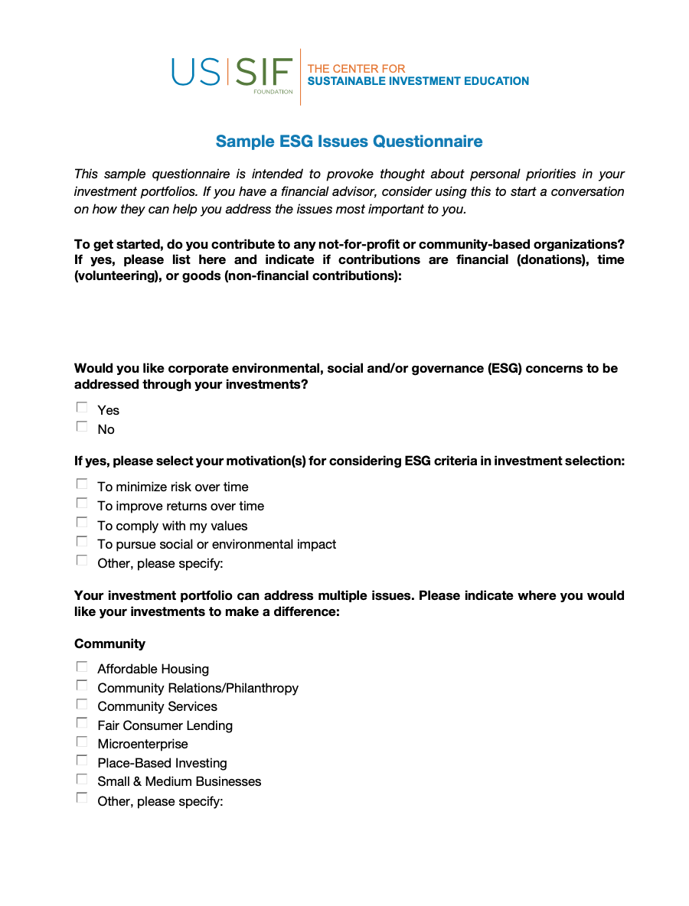
Questions to ask yourself
https://www.ussif.org/education
Are there issues you particularly care about?
In your community? (in particular you can ask your banks)
Affordable Housing
Community services
Microenterprises
Small and Medium-sized businesses
Place-based lending
Etc.
In your Environment?
Climate Change
Mitigating climate change
Adapting to Climate Change
Fossil fuel divestment
Green Building
Water conservation
Etc.
Are there products you want to avoid (weapons, tobacco, gambling, etc.)?

Slide 23
Questions to ask yourself (Cont.)
https://www.ussif.org/education
In your society?
Diversity and Equality incl. Racial Justice
Health and Safety
Labor Relations
Human Rights
Gender-lens
Avoiding repressive or terrorist regimes. Etc.
Regarding Corporate Governance?
Executive pay
Political Contributions and lobbying
Transparency and anti-corruption, etc.
Products you want to Avoid?
Alcohol and Tobacco
Animal Testing
Gambling
Nuclear or fossil fuels
Weapons and Fire-arms

Slide 24
Questions to ask your advisors, bank, or pension fund representatives
Do you offer “sustainable,” “ESG”, or “impact” investment portfolios or choices?
(What are they?)
Does your company have a sustainable investment or “ESG” policy?
(May I see it?)
What exclusion policies does your company have? (Arms? Tobacco? Prostitution?)
(May I see them?)
How can I create a sustainable investing portfolio according to my values?
(Can I make selective substitutions? )
How can I know that my money is going where I want– do you have sustainability or impact reports for your funds—and for MY investment portfolios?
Do you have reports on your company’s corporate Sustainability Performance?
(Are they aligned to particular standards like GRI or TCFD?)

Slide 25
A few Resources
US SIF: The Forum for Sustainable and Responsible Investment
The leading group working on advancing sustainable investing across all asset classes. Their mission is to rapidly shift investment practices toward sustainability, focusing on long-term investment and the generation of positive social and environmental impacts. They have an extensive financial directory of advisors, banks and credit unions, and other practitioners. USSIF.org
First Affirmative Financial Network
A network of independent investment advisors committed to making sustainable choices available for individual investors and can help you find an advisor. https://www.firstaffirmative.com/
UN PRI: The UN Principles for Responsible Investment (PRI)
An international organization that works to promote the incorporation of environmental, social, and corporate governance factors (ESG) into investment decision-making. Members must report annually. Many permit their reports to be public. https://www.Unpri.org
Notes:
I’ve tried to include sources that put significant information up in the public domain.
The US SIF has educational materials, a directory of asset managers and advisors, and research on its web.
First Affirmative is a network of independent financial advisors committed to sustainable investment.
PRI is the global organization charged with promoting ESG—most proactive companies are members—check to see if your bank or investment house reports to them and if you can access their “transparency report”

Slide 26
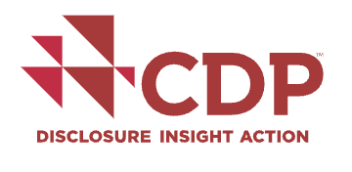
A few Resources (2)
As You Sow is a non-profit foundation that promotes corporate social responsibility through shareholder advocacyand legal strategies. www.asyousow.org
As You Sow’s Invest Your Values helps you screen mutual funds and ETFs against specific environmental, social, and governance issues.
The Fossil Free Funds website, in partnership with Morningstar, looks at the climate impact of funds. There are five other “Invest Your Values” online tools:
Deforestation Free Funds, which may be of interest if you are concerned about rainforest destruction and the palm oil exposure of funds.
Gun Free Funds, which shows how your money might be invested in gun manufacturers and gun retailers.
Gender Equality Funds, which screens funds using company performance on 12 key gender equality indicators.
Weapon Free Funds, which shows how your money might be invested in weapons of war.
Tobacco Free Funds, which shows if your fund has tobacco companies, and if they are promoting tobacco to kids.
CDP runs a global environmental disclosure system. Each year CDP helps thousands of companies, cities, states and regions to measure and manage their risks and opportunities on climate change, water security and deforestation. Much (but not all) of their information is public. www.cdp.net
Carbon Tracker is a non-profit tank dedicated helping institutions and individuals understand the climate risks. They provide in-depth analysis on the impact of the energy transition on capital markets. You can register on their site for free and access their research, including company assessments and research on the energy transition. https://carbontracker.org
Notes:
AS YOU SOW is a highly respected advocacy and research group.
CDP is the Grandmother of carbon accounting for corporations
Carbon tracker is a good independent ranker of climate performance.
There is lots, lots more. Google away.
GO AT ‘EM. Good luck!

Slide 27
Disclaimer
The information provided in this presentation does not constitute investment advice from ImpactARC LLC nor its representatives. This slide presentation is provided only for informational purposes and is not available for public distribution. This presentation shall not be distributed outside of the Wellesley Class of 70, 71, and 72 alumni participants.
The firms or organizations that are discussed herein should in no way be considered endorsements nor solicitations.
The information in this presentation should not be construed as an offer to invest, provide investment advice, nor a form of marketing.

