Slide 1
Madison County Bus Driver’s
Pre-Trip

Slide 2
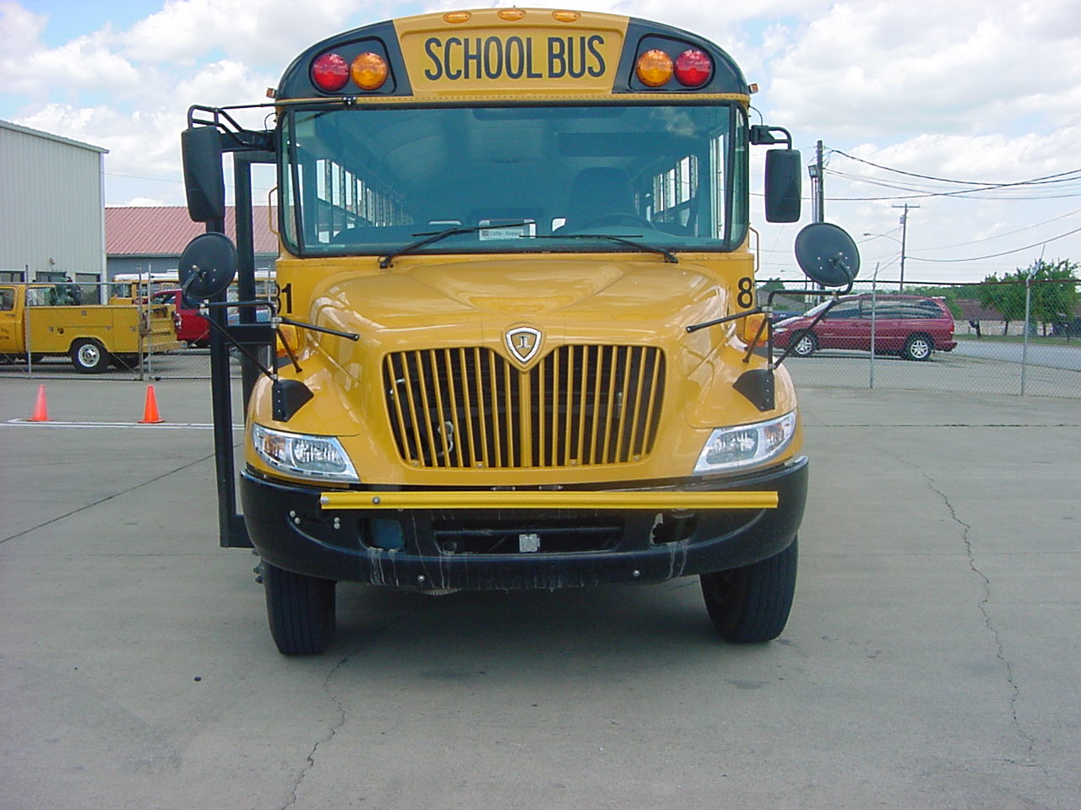
Bus is level. Frame is not warped.

Slide 3
No obstacles around bus
No obstacles around bus
.

Slide 4
Light lens covers and reflectors. None are cracked, broken, or missing. All are clean and proper color.
.

Slide 5
Crossing gate is mounted and secure, not cracked or broken and moves freely.
.

Slide 6
Engine block heater not connected
.

Slide 7
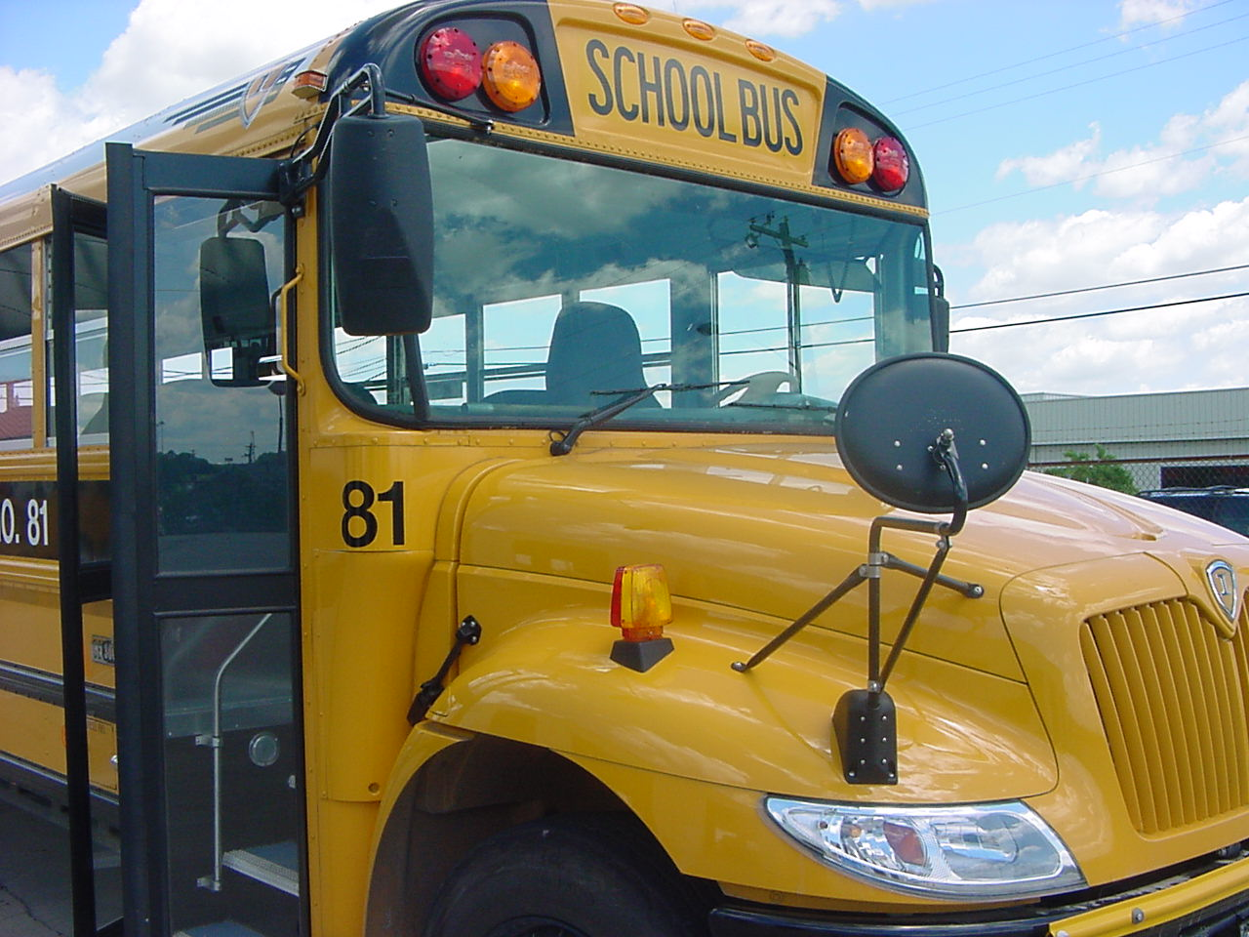
Mirrors and brackets are mounted and secure, none broken or broken, seals are good, they are clean, electrical connection is good and there is no signs of arcing.

Slide 8
Windshield is not obstructed, no cracks visible, it is clean and Seal is in good condition.

Slide 9
Wiper is mounted and secure, spring tension is good, rubber is not cracked or torn, washer hose is mounted and secure, has no cracks or holes and I see no leaks.
.

Slide 10
Hood latch is mounted and secure No damage.

Slide 11
Mud flaps are mounted and secure. No damage. Not obstructing tire.

Slide 12
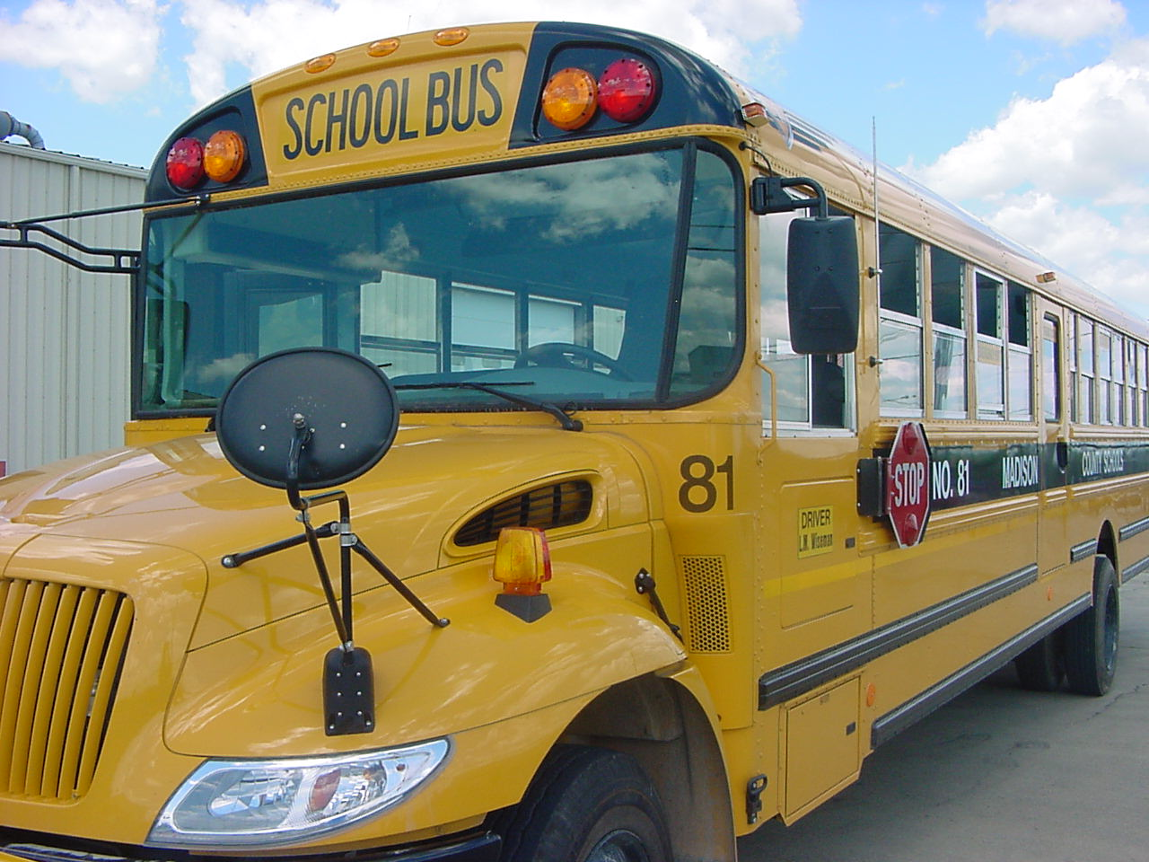
. Mirrors and brackets are mounted and secure, none cracked or broken, seals are good, they are clean and electrical connection is good, no signs of arcing.

Slide 13
Windshield not obstructed, not cracked and it is clean, seal is good.

Slide 14
Wiper is mounted and secure, spring tension is good, rubber is in good condition, washer hose mounted and secure has no crack or holes and see no leaks..

Slide 15
Hood Latch mounted and secure. No damage.

Slide 16
Mud flaps mounted and secure. NO damage. Not obstructing tire.

Slide 17
No damage visible on hood.

Slide 18
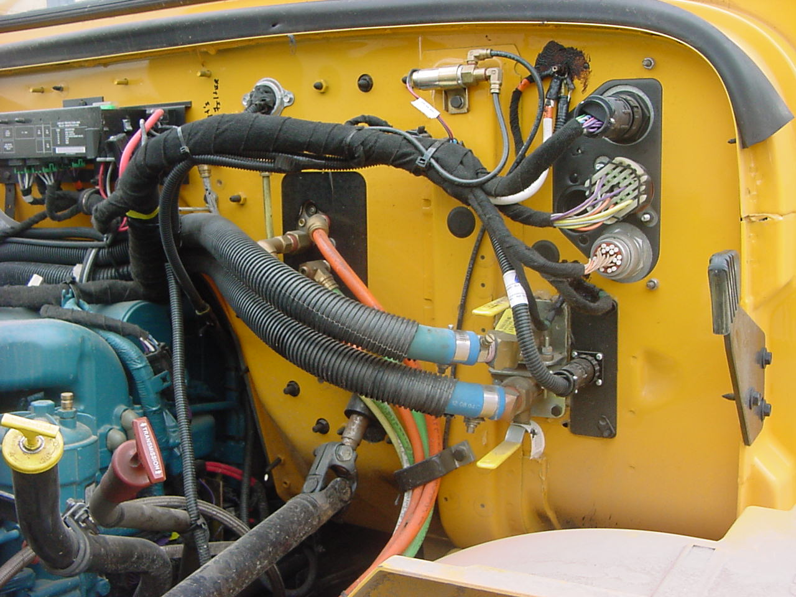
Electrical wiring harness is covered, no damage as far as I can tell, mounted and secure, no signs of arcing.
Electrical wiring harness is covered, no damage as far as I can tell, mounted and secure, no signs of arcing.
Electrical wiring harness is covered, no damage as far as I can tell, it is mounted and secure, no signs of arcing.

Slide 19
. Air hoses are mounted and secure, no cracks or holes and I hear no leaks
.

Slide 20
Heater hoses and cut-off valves are mounted and secure no cracks or holes, I see no leaks and cut-off valves move freely.

Slide 21
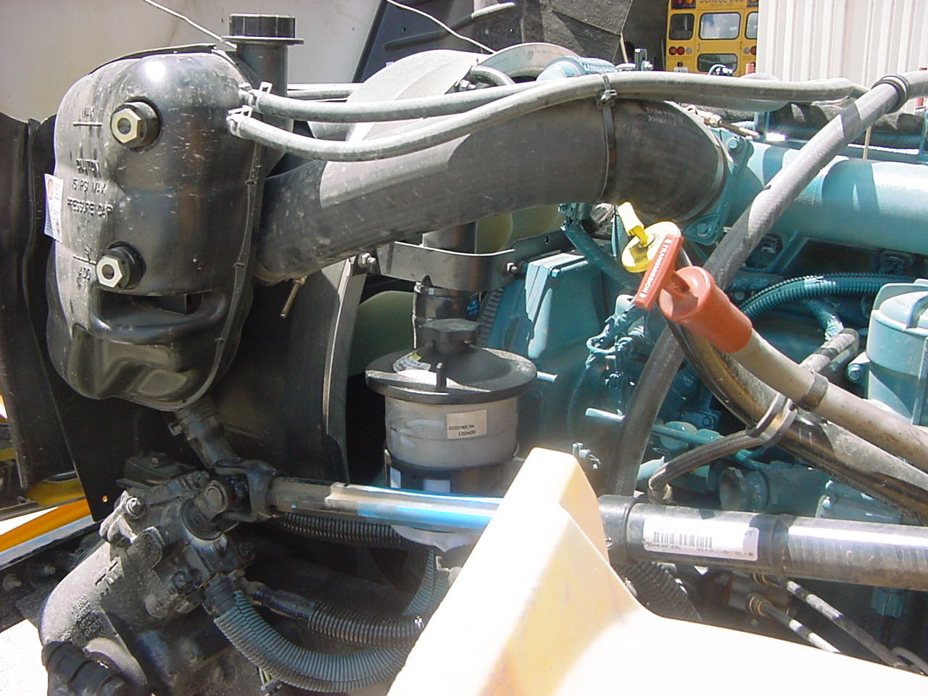
Bus needs to be running to check ,transmission fluid, should read between the add and full marks, level is ok..

Slide 22
The oil level should read between the add and full marks, level is ok.

Slide 23
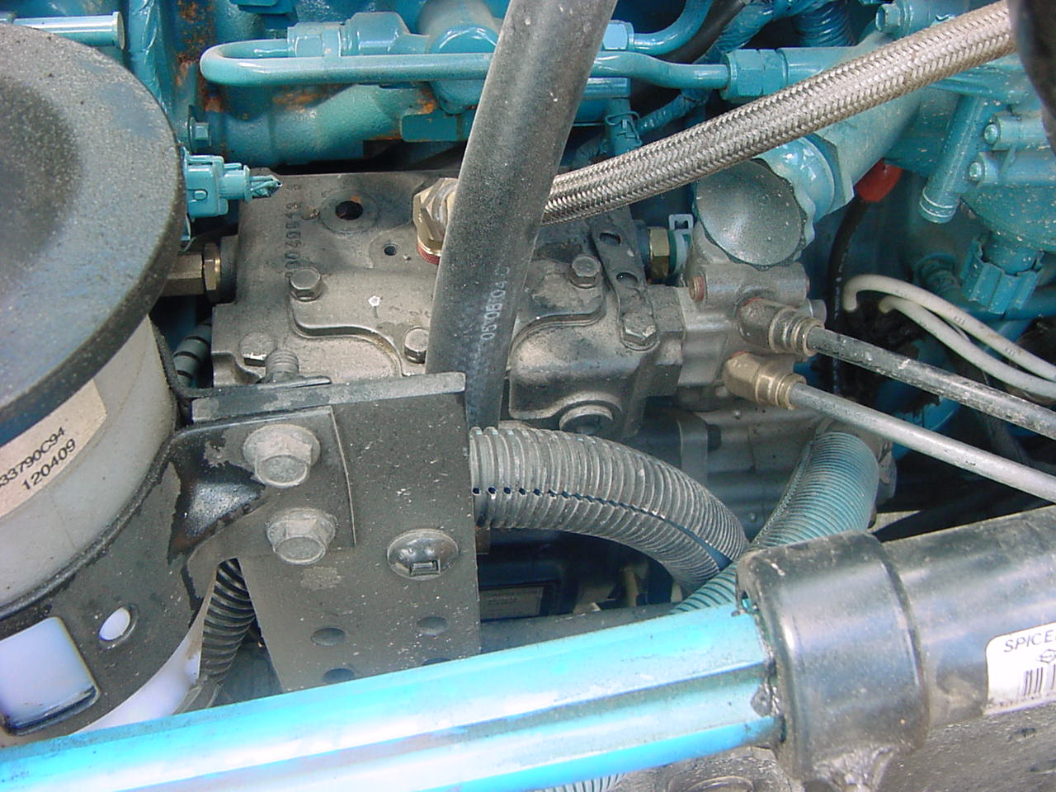
Air compressor is mounted and secure. It has no cracks or holes and I hear No leaks. Air compressor is mechanical driven.

Slide 24
Air lines are mounted and secure, no cracks or holes and I hear no leaks.

Slide 25
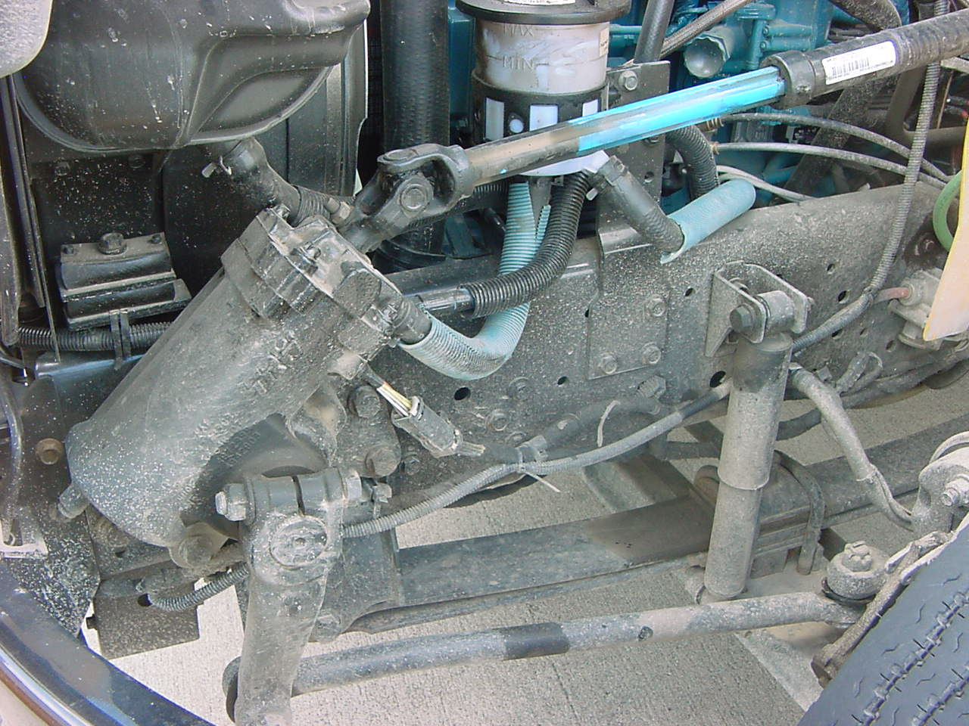
Power steering pump is mounted and secure, it has no cracks or holes and I see no leak. It is mechanical driven.

Slide 26
Power Steering reservoir is mounted and secure, Level is ok reading between min. and max. Cap is on tight and it has a hot and cold reading and I see no leaks.

Slide 27
Power steering hoses, are mounted and secure, no cracks or holes and I see no leaks

Slide 28
Top radiator hose is mounted and secure, has no cracks or holes and I see no leaks.

Slide 29
Reservoir is mounted and secure. Coolant level is good reading between the eye checks and the cap is on tight.

Slide 30
Water return lines and water line are mounted and secure, no cracks or holes and I see no leaks.

Slide 31
Steering column is mounted and secure, it is not cracked , bent or loose and the universal joints are ok.

Slide 32
Power steering box is mounted and secure , has no cracks or holes and I see no leaks.

Slide 33
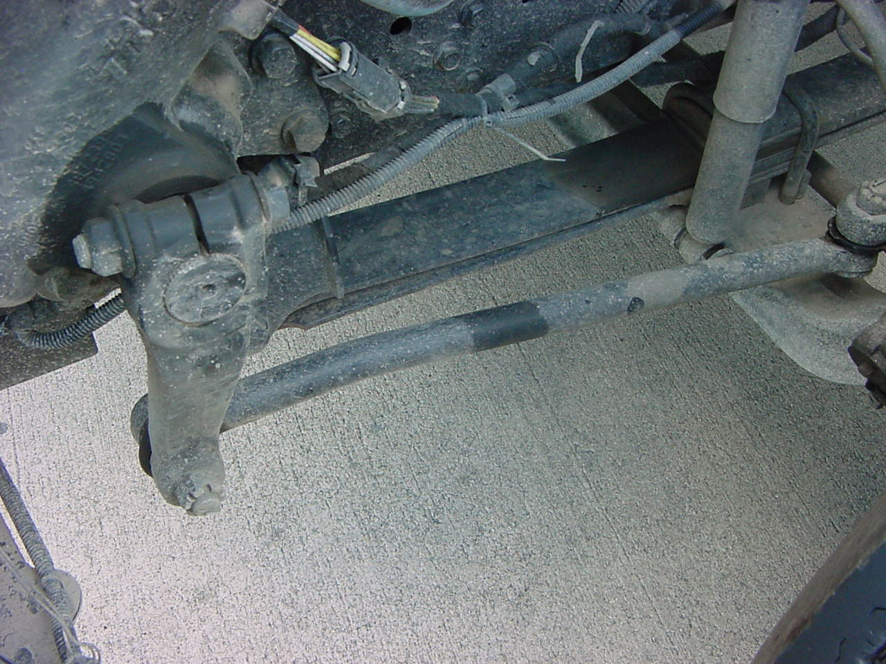
Pittman arm is mounted and secure, not cracked or bent and cotter pins is in place.

Slide 34
Drag link is mounted and secure, not cracked or bent and cotter pin is in place.

Slide 35
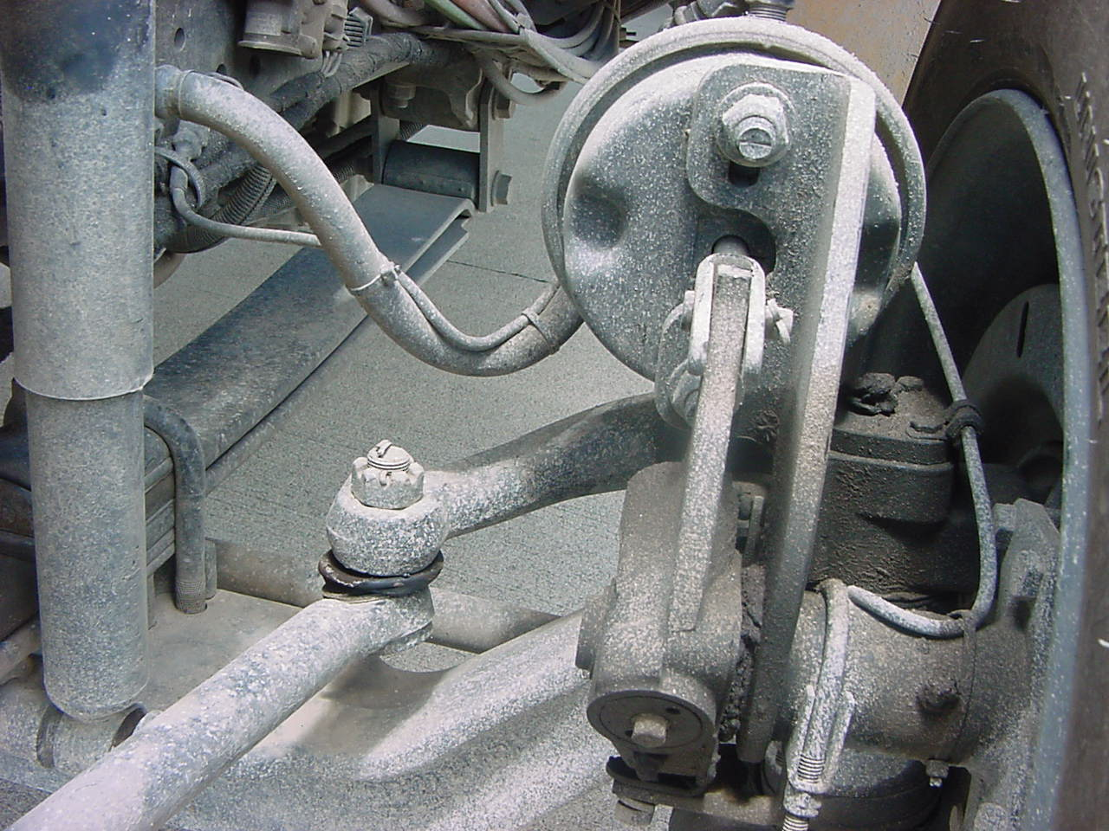
Drag link steering arm is mounted and secure, not cracked or bent and the cotter pin is in place

Slide 36
Steering ring knuckle is ok as far as I can tell.

Slide 37
Front and rear spring shackles are mounted and secure , not cracked or bent .

Slide 38
Leaf springs are mounted and secure, not cracked or broken and has no missing parts..

Slide 39
U bolts are mounted and secure , no damage

Slide 40
Shock absorber top and bottom mounts are secure. It’s fully extended and I see no leaks.

Slide 41
Tie Rod end is mounted and secure, it is not cracked or bent and the cotter pin is in place.

Slide 42
ABS line
Air line
Air chamber, air line and ABS line .are mounted and secure , has no cracks, holes or dents and I hear no leaks.

Slide 43
Cotter pin
Push pin
Slack adjuster is mounted and secure, push pin is not cracked or bent. cotter pin is in place, if more than 1” inch slack adjustment is required.

Slide 44
Brake drum and shoes are ok as far as I can tell; they are covered. There are no heat cracks, thin pads, excessive rust, dust, grease or oils.

Slide 45
No cracks, welds or rust visible on rim.

Slide 46
No visible cuts, bruises, blisters or bulges on inside of tire.

Slide 47
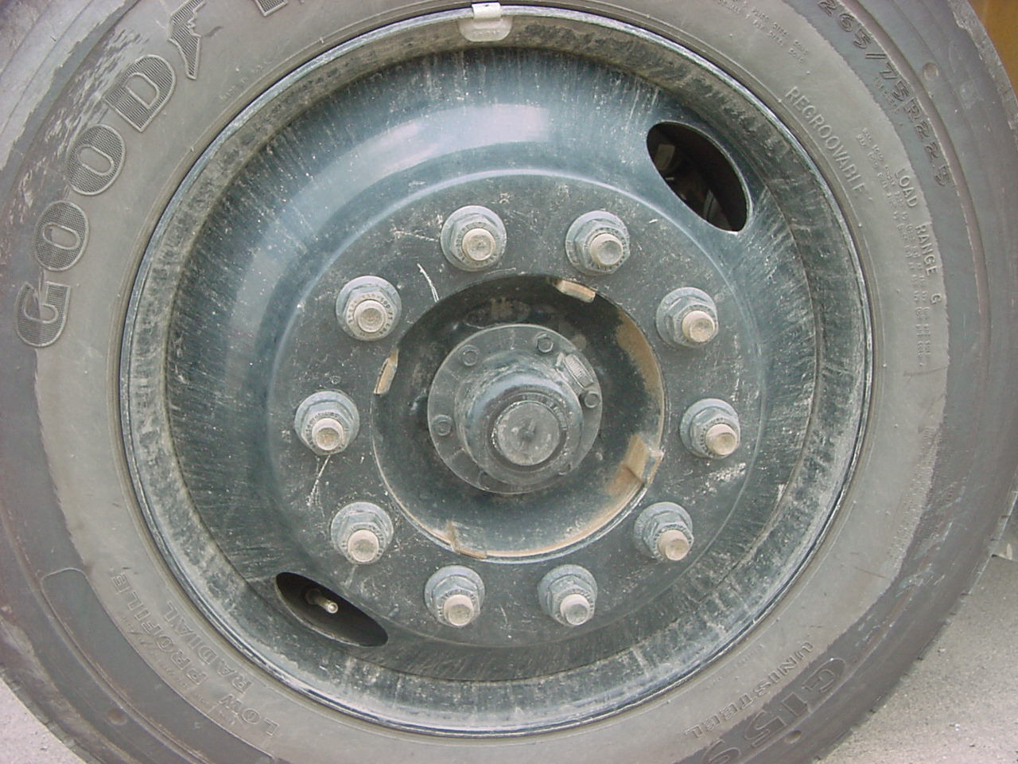
Tire tread must be at least 4/32” tread on front tire. It can not be a recapped, mismatched, or regrooved tires.

Slide 48
No visible cuts, bruises, blisters or bulges on tire.

Slide 49
No cracks, welds or excessive rust visible on rim

Slide 50
Lug nuts are tight, no excessive rust and none are missing.

Slide 51
Valve stem has no cracks or holes and cap is in place. I hear no leaks.

Slide 52
Hub oil seal is mounted and secure and I see no leaks and the level is ok.

Slide 53
Tire inflation is ok. Should be inflated to 100 to 110 psi.

Slide 54
Radiator has no visible cracks or holes and I see no leaks.

Slide 55
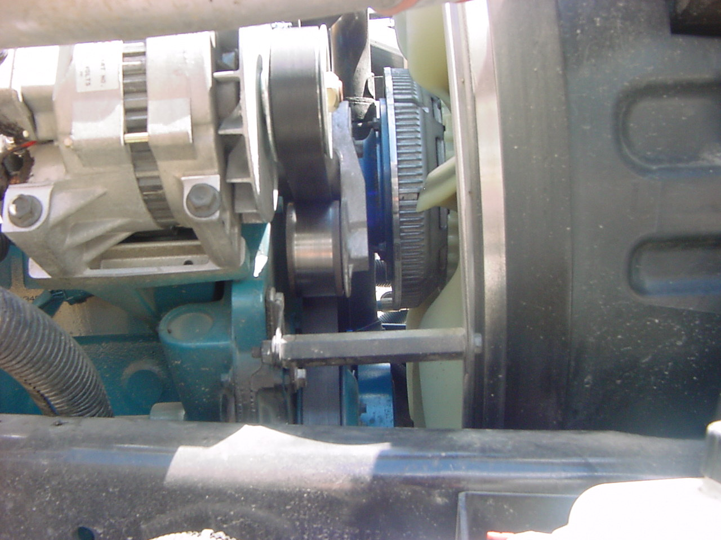
Can not check serpentine belt for play because it is self adjusting. If it were the V-Type belt it could not have more than 3/4’ play or it would have to be adjusted. This serpentine belt is not frayed, cracked , worn . The fan is belt driven.

Slide 56
Alternator and wires are mounted and secure. No damage visible. Alternator is belt driven, and connections are tight. There are no signs of arching.

Slide 57
Bottom radiator is mounted and secure, has no cracks or holes and I see no leaks.
Water pump is mounted and secure, no cracks or holes and I see no leaks. It is belt driven.

Slide 58
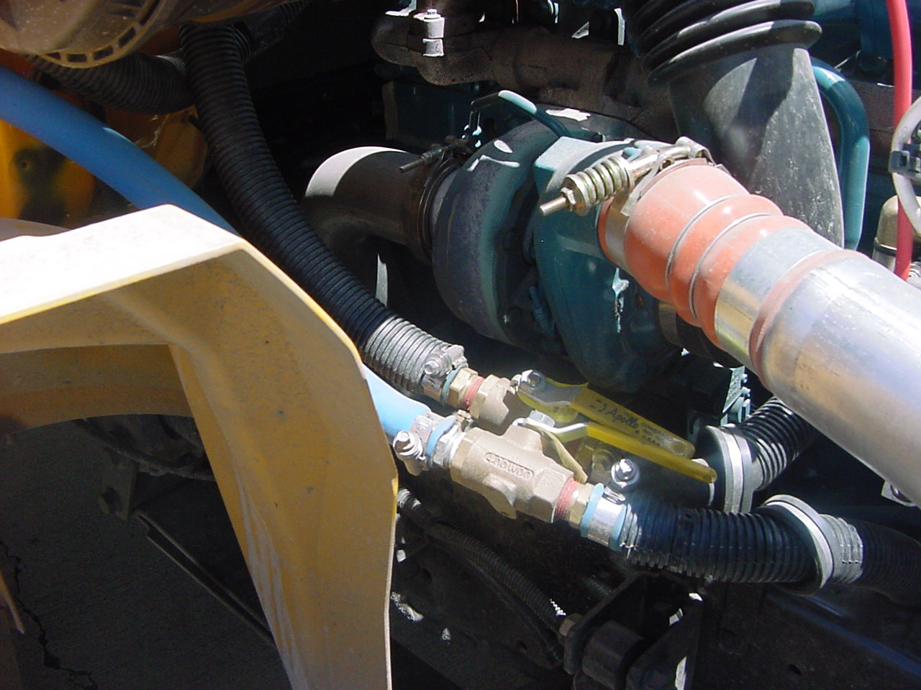
Exhaust clamp is in place. No excessive rust or holes to exhaust system under the hood.

Slide 59
Heater hoses are mounted and secure, have no cracks or holes and I see no leaks. Cut off valves move freely.

Slide 60
Windshield washer fluid reservoir is mounted and secure, no leaks, connections are good and the cap is on tight.

Slide 61
Front and rear spring shackles are mounted and secure , not cracked or bent.

Slide 62
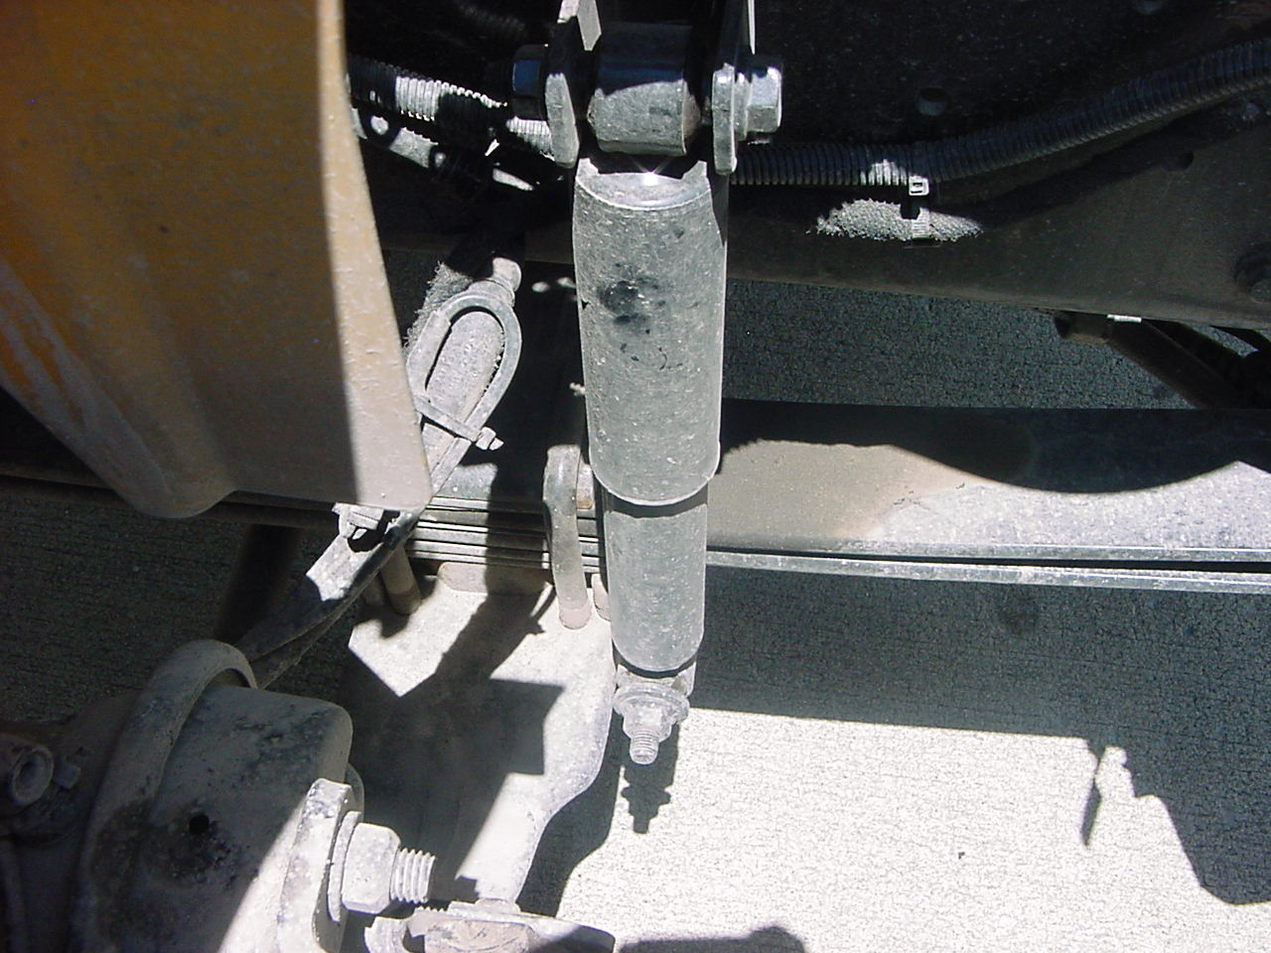
Leaf springs are mounted and secure, not cracked or broken and has no missing parts.

Slide 63
U bolts are mounted and secure, no damage.

Slide 64
Shock absorber, top and bottom mounts are mounted and secure, it is fully extended and I see no leaks.

Slide 65
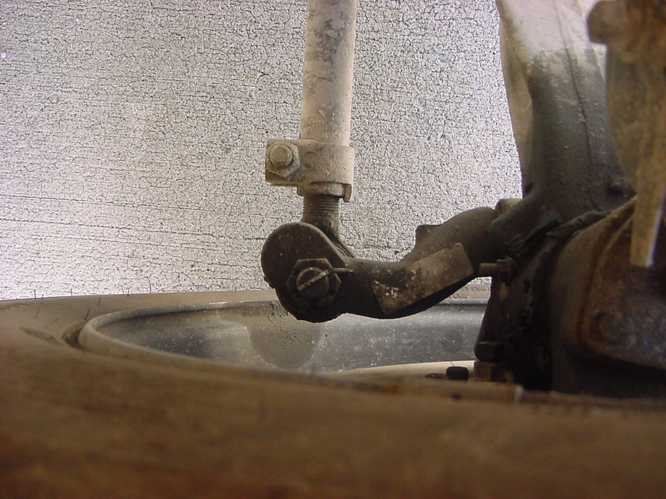
Tie rod end is mounted and secure, not cracked or bent and the cotter pin is in place.

Slide 66
Tie Rod Steering arm is mounted and secure, not cracked or bent and cotter pin is in place.

Slide 67
Steering ring knuckle is ok as far as I can tell.

Slide 68
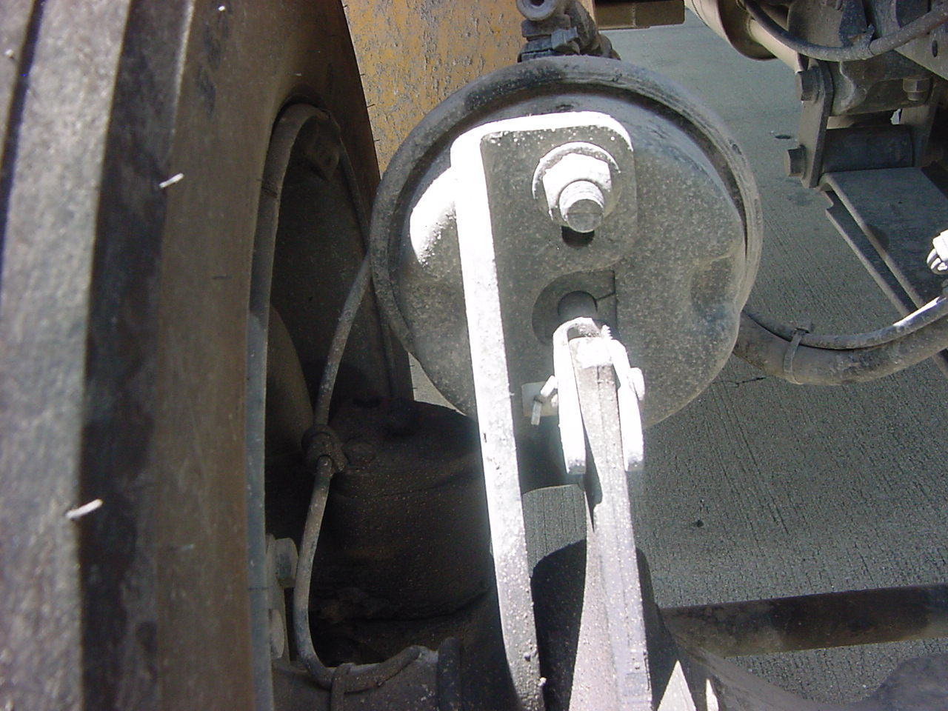
Air line
ABS line
Air Chamber , Air line, and ABS line are mounted and secure, has no cracks, holes or dents and I hear no leaks.

Slide 69
Cotter pin
Push pin
Slack adjuster is mounted and secure, push pin is not bent or cracked. Cotter pin is in place. If there was more than 1” play then adjustment is required.

Slide 70
Brake drum and shoes are mounted and secure, there are no thin pads, heat cracks, excessive rust , dust, grease or oils.

Slide 71
No cracks, welds, or excessive rust visible on rim.

Slide 72
No visible cuts, bruises, blisters or bulges on inside of tire.

Slide 73
Must be at least 4/32” tread on front tire. No recapped, mismatched, or regrooved tire on front.

Slide 74
No visible cuts, bruises, blisters or bulges on tire.

Slide 75
No cracks, welds or excessive rust visible on rim

Slide 76
Lug nuts are tight, no excessive rust and none are missing.

Slide 77
Valve stem has no cracks or holes , I hear no leaks and the cap is on tight.

Slide 78
Hub oil seal is mounted and secure and I see no leaks, the level is ok

Slide 79
Tire inflation is ok, should be inflated to 100 to 110 psi.

Slide 80
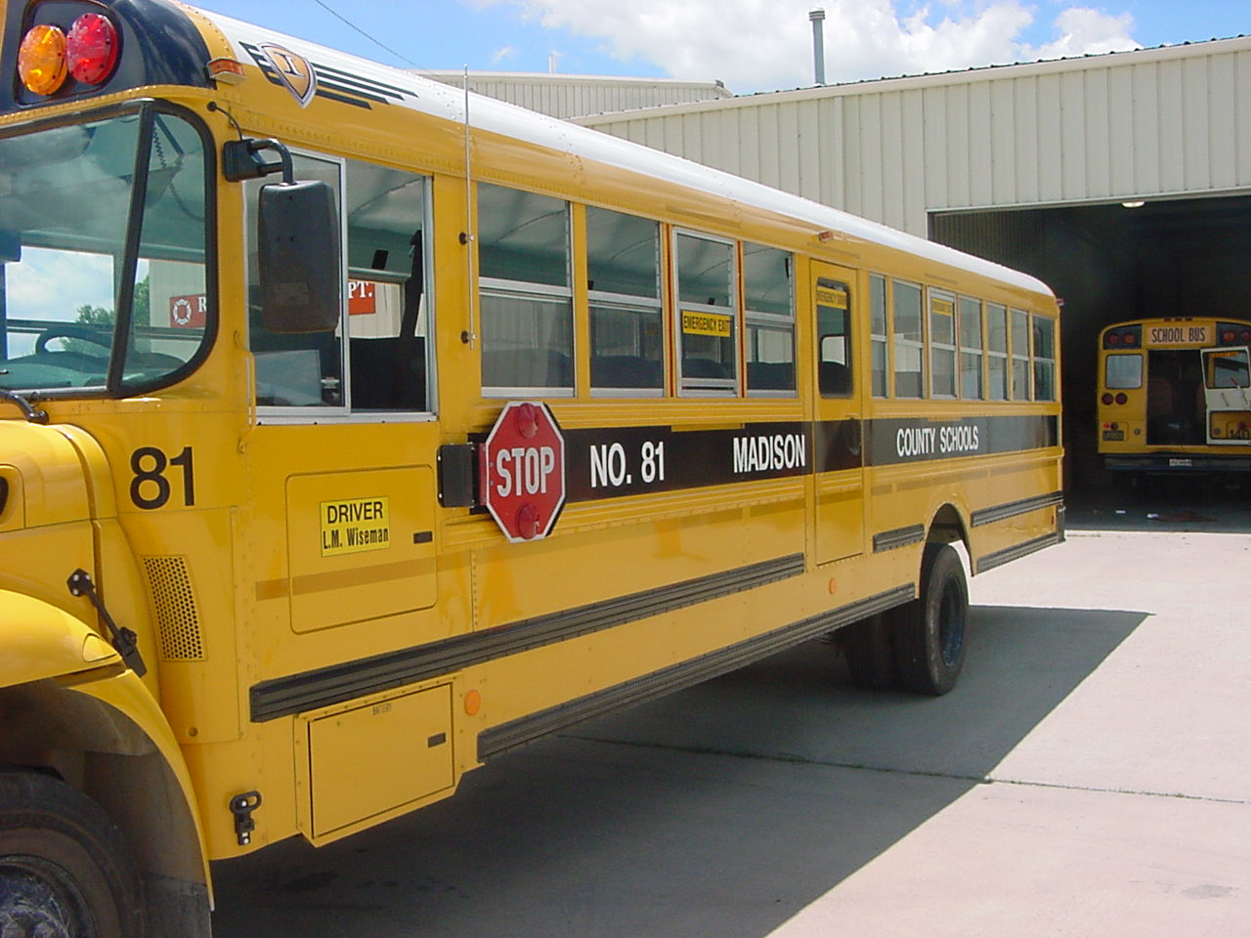
Fasten hood latch on right and left side.

Slide 81
Light lens covers, windows, reflective tape and reflectors, they are all mounted and secure , there is none cracked broken or missing. The Emergency exits are properly labeled.

Slide 82
Indicate fuse box and there are 2 extra fuses.

Slide 83
Stop arm lens covers are not cracked, broken or missing. I hear no leaks around boot. Cable is not frayed or worn. 3 cotter pins are in place and electrical connections are good and no signs of arcing.

Slide 84
Battery box is mounted and secure. Batteries have no leaks or corrosion. Cables are connected to the battery posts. The black lever is to pull batteries out to check.

Slide 85
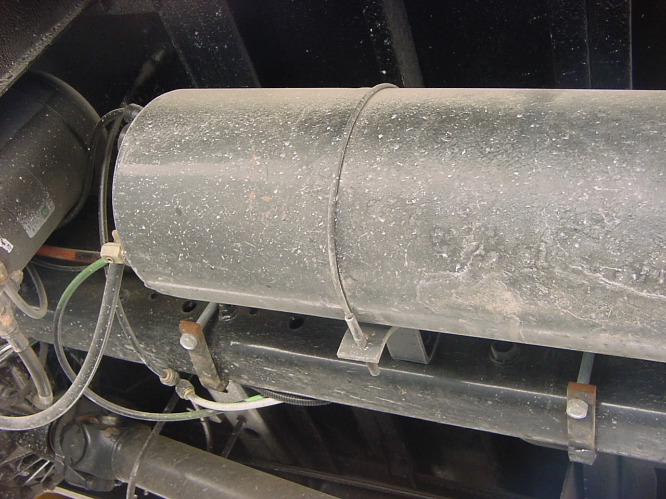
Air tanks and lines are mounted and secure and I hear no leaks.

Slide 86
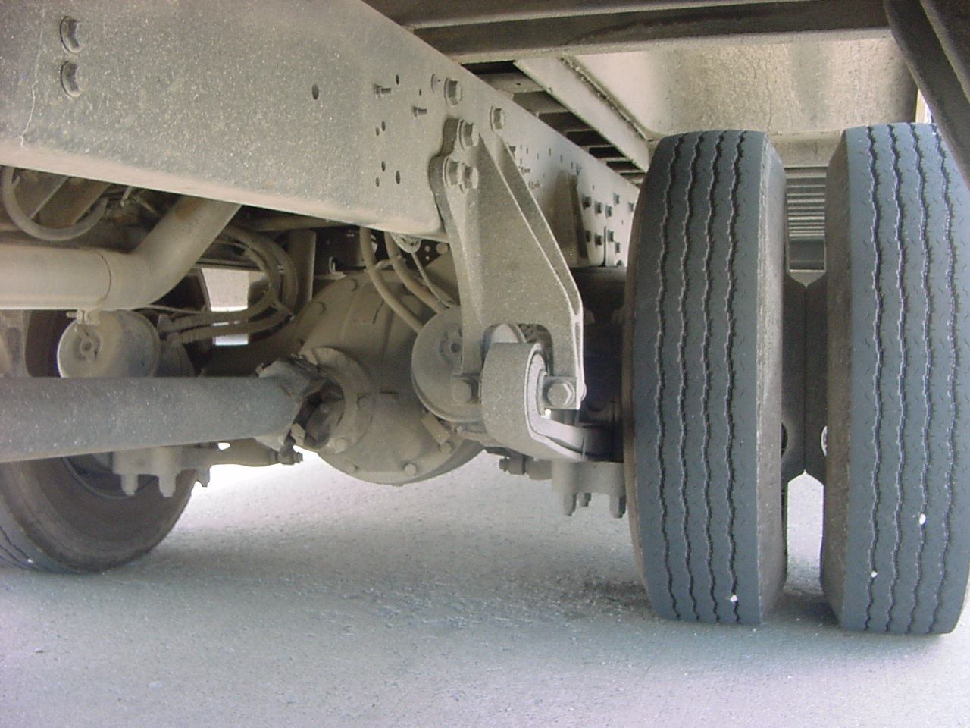
Frame is ok as far as I can tell, there are no cracks, broken welds, holes or other damage.

Slide 87
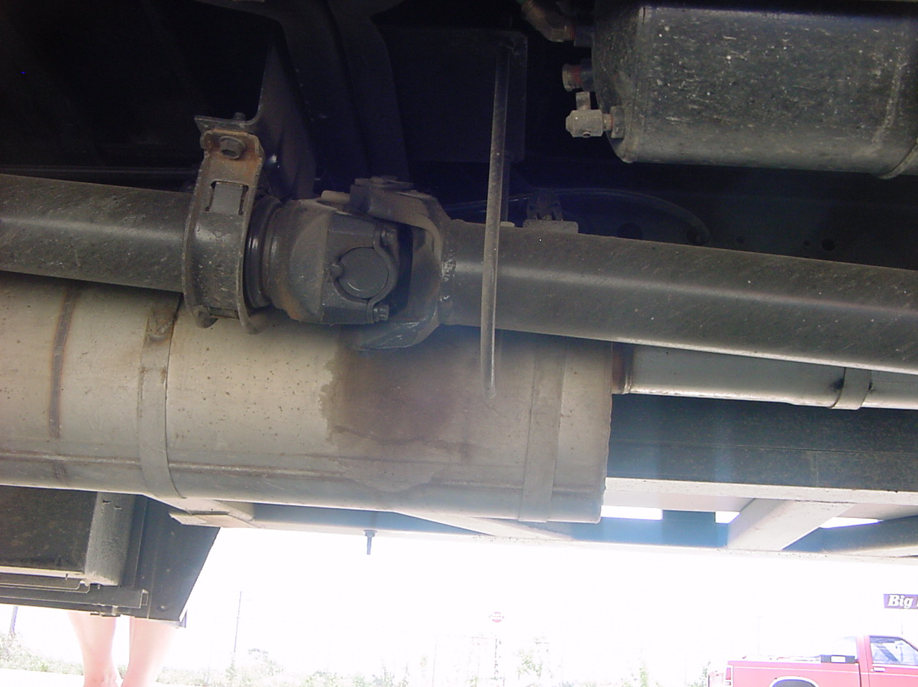
Drive shaft is not bent or cracked, has 3 midshaft bearings, 4yolks or shaft guards, and 5 universal joints and there are no obstructions in the couplings..

Slide 88
Muffler and exhaust pipe are mounted and secure. There is no excessive rust or hole in the exhaust.

Slide 89
2 air chambers and 2 air lines are mounted and secure with no cracks, holes or dents and I hear no leaks.

Slide 90
There are two slack adjusters, they are mounted and secure, push pin is not bent or cracked, cotter pin in place and if they were to have more than 1” play they would need to be adjusted.

Slide 91
Side Emergency door opens and closes freely. The rubber seal is in good condition. The door is also properly labeled.

Slide 92
Front spring bracket is mounted and secure not bent or cracked.

Slide 93
Leaf springs are not cracked, broken or has no missing parts.

Slide 94
2 U bolts are mounted and secure , no damage as far as I can tell, I can not see them.

Slide 95
Brake drum and shoes are ok as far as I can tell. They are covered. I can have no heat cracks, excessive rust,brake dust, grease or oils or thin pads.

Slide 96
No cracks, welds or excessive rust visible on rims as far as I can tell.

Slide 97
No visible cuts, bruises, blisters or bulges on insides of tires as far as I can tell.

Slide 98
Tires must have at least 2/32” tread on rear tires. I can have recapped or regrooved tires but cannot have any mismatched on the rear.

Slide 99
These are bud tires. There is NO spacer and there is no obstruction between tires.

Slide 100
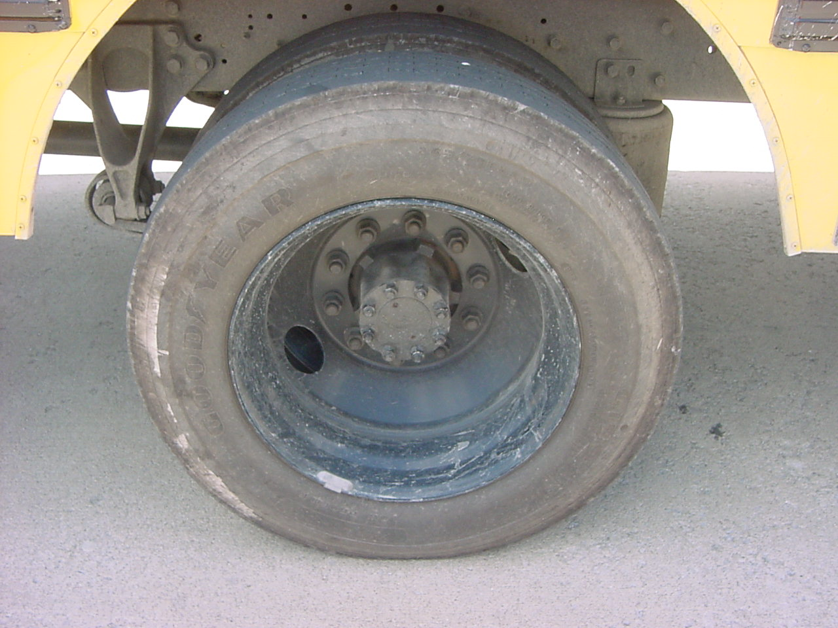
No visible cuts, bruises, blisters or bulges on outside of tire.

Slide 101
No cracks, welds or excessive rust visible on rim.

Slide 102
Lug nuts are mounted and secure, no excessive rust and none are missing.

Slide 103
BOTH valve stems have cap in place, no cracks or holes and I hear no leaks.

Slide 104
Hub oil seal is mounted and secure, I see no leaks and the level is good.

Slide 105
Tire inflation of both tires are ok, should be inflated to approx. 100 to 110 psi.

Slide 106
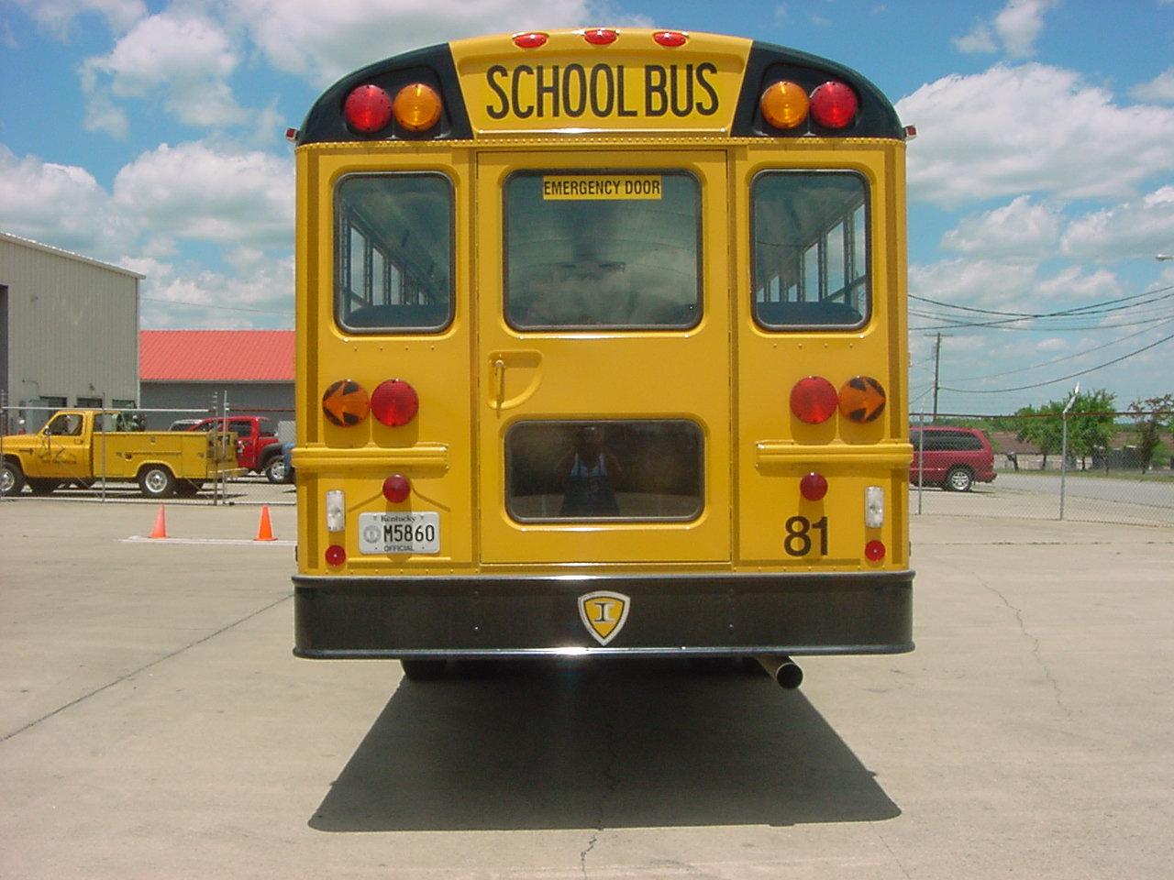
Bus is level and frame is not warped.

Slide 107
All light lens covers, reflectors, windows,reflective tape are mounted and secure, none cracked broken or missing and all are of the proper color.

Slide 108
Emergency door opens and closes freely, rubber seal is in good condition and the door is properly labeled.

Slide 109
License plate is mounted and secure.

Slide 110
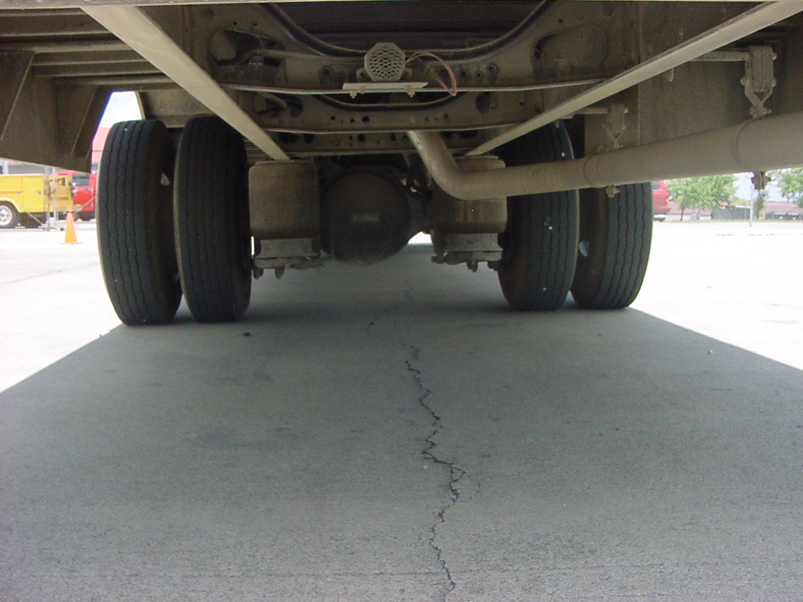
There are no fluid leaks visible under the bus.

Slide 111
Air spring assembly is mounted and secure. No cracks or holes and I hear no leaks.

Slide 112
Shock absorber top and bottom mounts are mounted and secure and it is fully extended and I see no leaks.

Slide 113
Exhaust pipe is mounted secure has no excessive rust or holes.

Slide 114
0” to 2” overhang on the exhaust pipe.

Slide 115
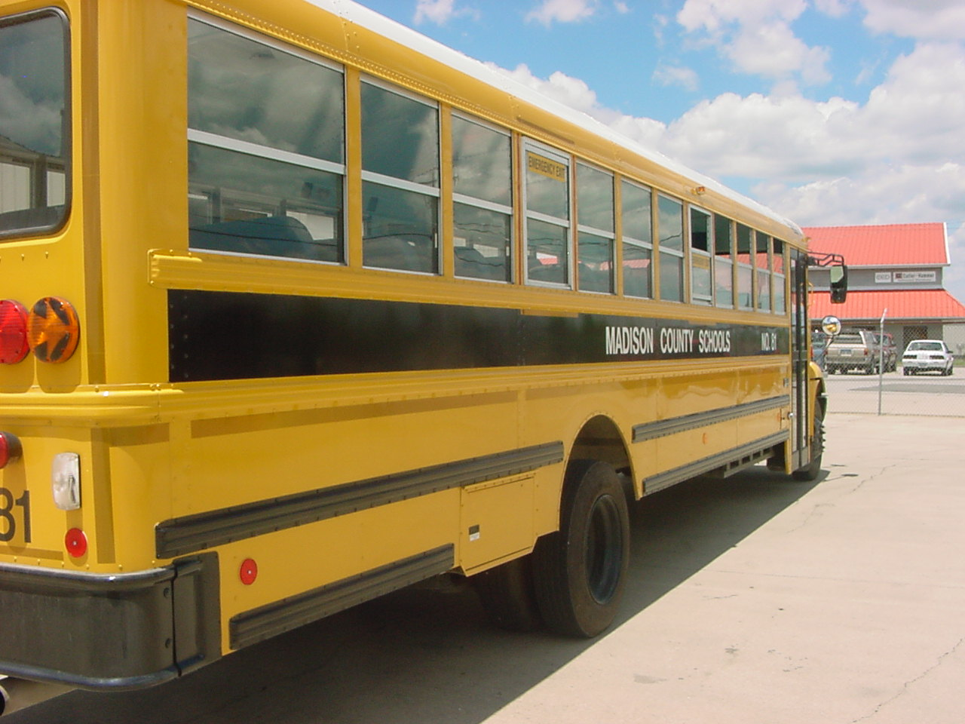
All light lens covers, windows, reflective tape and reflectors are mounted and secure , none are cracked broken or missing and the emergency windows are properly labeled.

Slide 116
Three Reflective Triangles are present

Slide 117
Rear spring bracket or shackle is mounted and secure, not cracked or broken.

Slide 118
Leaf springs are not cracked, broken or has no missing parts

Slide 119
2 U bolts are tight as far as I can tell. I can not see them.

Slide 120
Brake drum and shoes are ok as far as I can tell. They are covered. I can have no heat cracks, excessive rust, brake dust, grease or oils or thin pads.

Slide 121
No cracks, welds or rust visible on rims as far as I can tell.

Slide 122
No visible cuts, bruises, blisters or bulges on insides of tires as far as I can tell.

Slide 123
Tires must have at least 2/32” tread on rear tires. Recapped and Regrooved are allowed but NO mismatches.

Slide 124
These are bud tires. There is NO spacer.

Slide 125
No visible cuts, bruises, blisters or bulges on outside of tire.

Slide 126
No cracks, welds or rust visible on rim.

Slide 127
Lug nuts tight, no excessive rust and none are missing.

Slide 128
BOTH valve stems have cap in place, no visible damage and I hear no leaks.

Slide 129
No leaks visible in hub oil seal. Nuts are tight and none are missing.

Slide 130
Tire inflation of both tires are ok, should be inflated to approx. 100 to 110 psi.

Slide 131
Fuel tank cage is in place, mounted and secure.

Slide 132
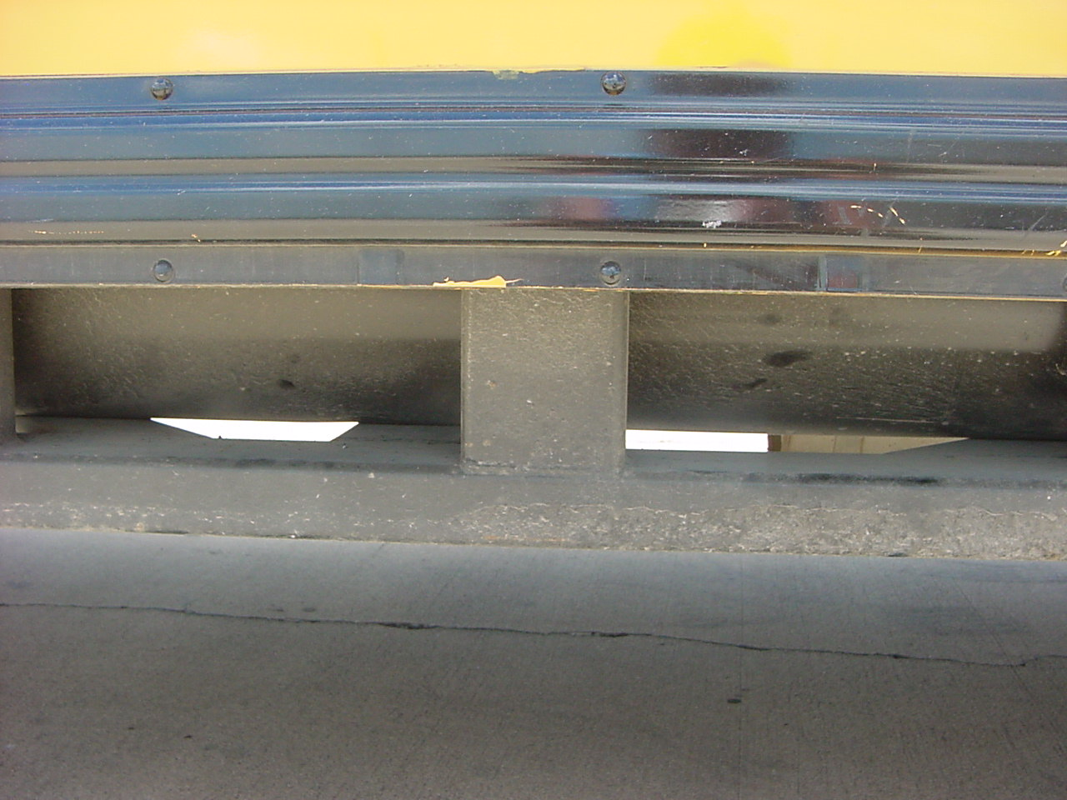
Fuel Tank is mounted and secure, no moisture on bottom, no leaks visible.

Slide 133
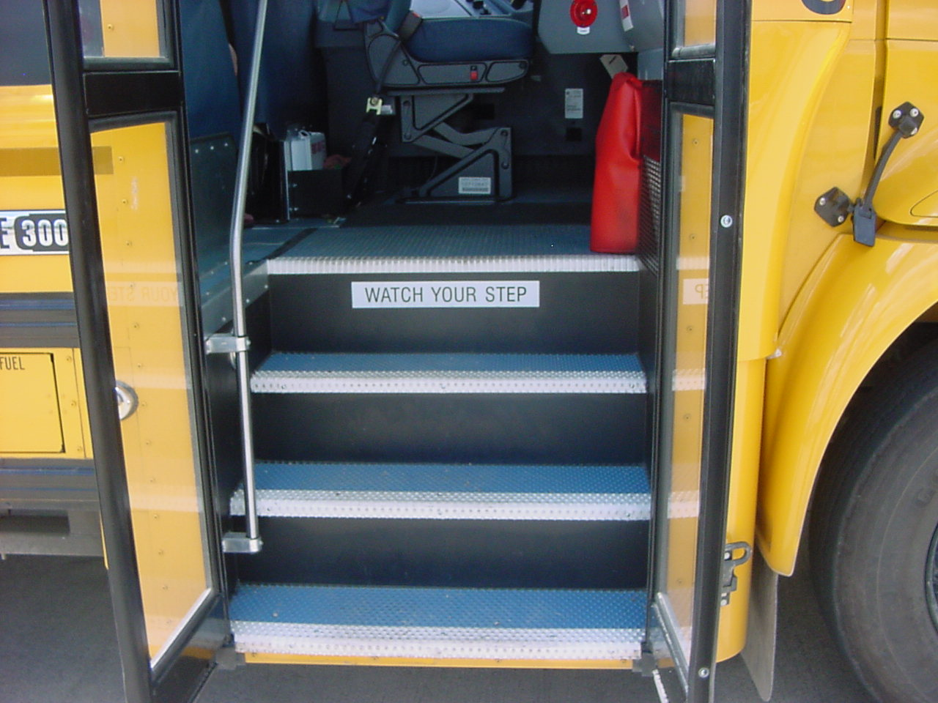
Fuel Cap is tight, no leaks visible, and gasket is in place.

Slide 134
Glass is clean, not cracked or broken. Rubber is in good condition. Door opens and closes.

Slide 135
Stepwell light lens is not cracked or broken or missing.

Slide 136
Handrail is mounted and secured.

Slide 137
No broken steps and no cuts or tears in the floor coverings on the steps.

Slide 138
Fire extinguisher is charged and in the green. No obstructions in the hose. Pin is in place.

Slide 139
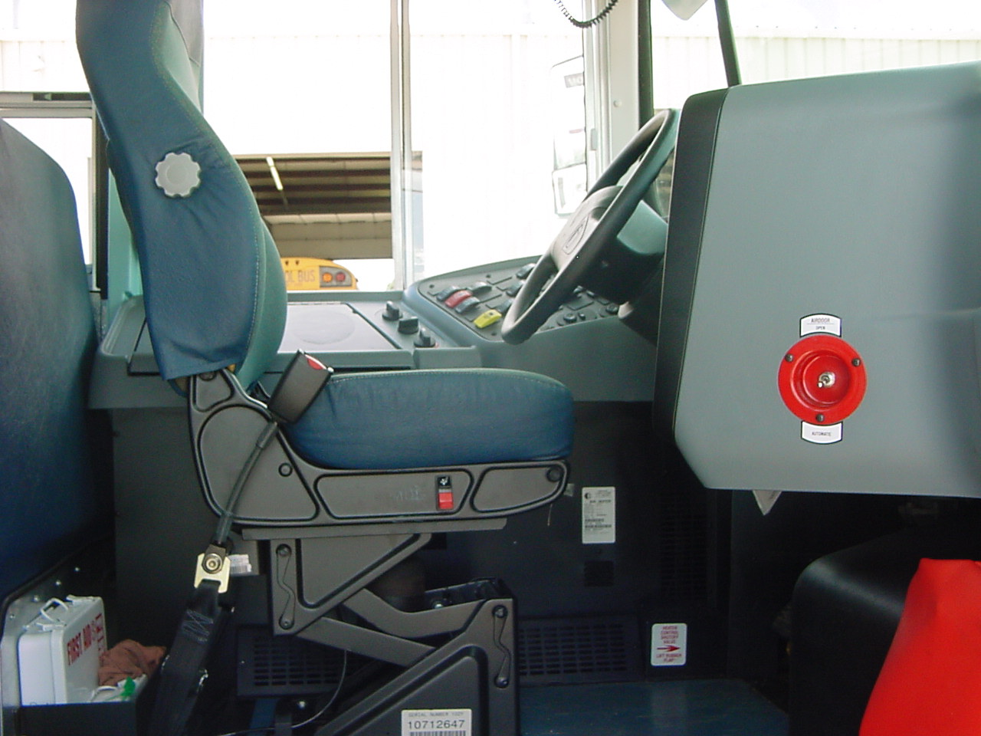
Manual door switch is in the manual position and I am going to switch it to automatic

Slide 140
I have a first aid kit and a body fluid clean-up kit.

Slide 141
Web cutter is ok. In driver’s box on left.

Slide 142
Driver’s seat is mounted and secure.

Slide 143
Sit down and fasten seat belt. “Seat belt works” - adjust if needed.

Slide 144
Adjust steering wheel if needed.
Make sure PARK break is on

Slide 145
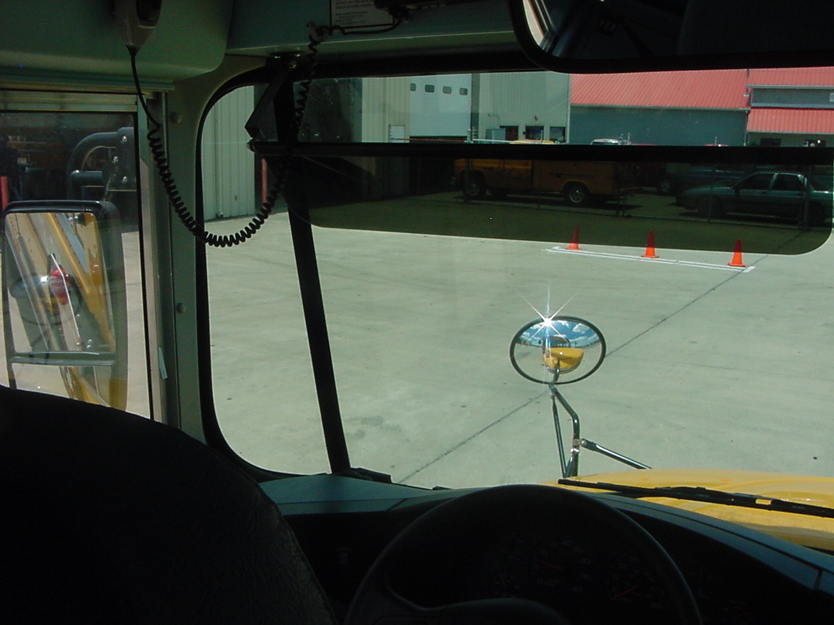
Start bus - close door- turn headlights on. Look out toward front of bus.

Slide 146
Mirrors are clean and adjusted so I can see.

Slide 147
Windshield is clean not cracked or broken and the rubber seal is good.

Slide 148
Less than 2” play in a 20” steering wheel. (Indicate throttle on end of buttons.)

Slide 149
Horn works.

Slide 150
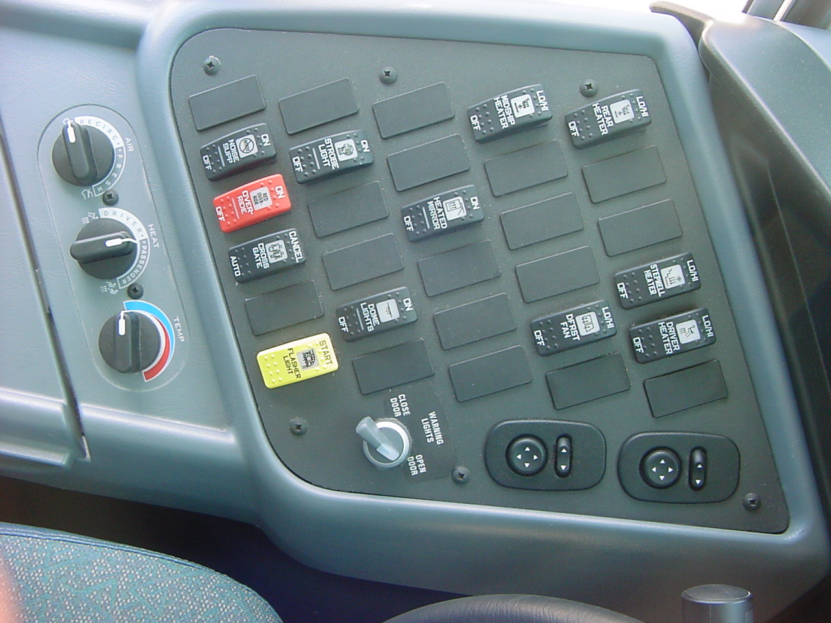
Air, heat, and temperature gauges.

Slide 151
Noise suppressor - on, off ( must have heater on to check) and indicator light does work

Slide 152
Emergency over-ride on and off and the indicator light does work.

Slide 153
Cross Gate cancel and it does work(work with emergency over-ride switch on).

Slide 154
Flasher Light or student loading lights (push on).

Slide 155
Strobe light - on, off and indicator light does work.

Slide 156
Dome light - on, off , all dome lights are working and indicator light does work

Slide 157
Heated Mirror - on, off and indicator light does work

Slide 158
Midship Heater - high, low, off

Slide 159
Defrost Fan - high, low, off

Slide 160
Rear Heater - high, low, off

Slide 161
Stepwell Heater - high, low, off

Slide 162
Driver Heater - high, low, off

Slide 163
Three way door switch, Close door, warning lights and open door switch.

Slide 164
Mirror adjusters.

Slide 165
Check heater cutoff (yellow handle by left foot) NO leaks, handle moves freely.

Slide 166
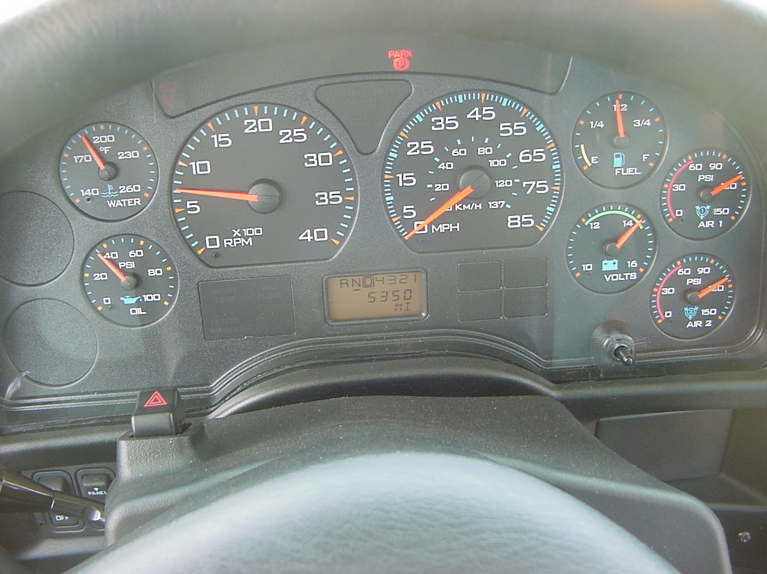
Water Temperature Gauge

Slide 167
Oil pressure gauge and it does work. (rev engine).

Slide 168
RPM gauge or Tachometer and it works. (rev engine)

Slide 169
Speed Odometer

Slide 170
Fuel gauge

Slide 171
Voltmeter and it is reading between 12 and 14 in the green.

Slide 172
Primary Air gauge

Slide 173
Secondary Air gauge

Slide 174
Indicate
Headlight switch
Park break
Ignition gear panel

Slide 175
Safety Check
Park brake on
Gear in Neutral
Cover service break with foot

Slide 176
Park Break Check
Put in gear
Give fuel
Raise engine RPM to 1500.
Bus should not move
“Park brake is on.”

Slide 177
Stop Motor
Turn key to ACC
Walk to back of bus to deactivate alarm
Ask if the “wheels need to be chocked.”

Slide 178
LAB Check
Turn ignition key on.
Push in parking brake.
Watch air pressure gauges for 1 minute after air level stabilizes.
“With no brakes applied air should not leak off more than 2 PSI per minute.

Slide 179
LAB check continued
Hold service brake pedal down for 1 minute.
“Should not leak off more than 3 PSI.
Pump service brake.
“Lights and buzzer should come on at 65 to 60 PSI.
Pump service brake until button pops out.
“Spring brake engages between 10 to 40 PSI.

Slide 180
Building PSI
Check gear selector is in Neutral
Park brake is on
Cover the service brake pedal with foot.
Start engine
Build air to 120 PSI - Use throttle (1500 RPM)
Be sure to turn throttle off before shutting engine off.

Slide 181
Explain Governor
Under Normal running conditions, when my air pressure drop to 90PSI or below my governor will cut and rebuild my air pressure back up 120-125 PSI.

Slide 182
Inside of Bus Check
Shut engine off
Leave key on
Walk to back of bus
No damage, cuts or tears visible in floor covering or seats.
Seats are mounted and secure not broken.

Slide 183
Back Emergency Exit
“door opens and closes freely, Properly labeled.”
“Rubber gasket is in good condition and the warning buzzer works.”

Slide 184
Checking the back of seats
No cuts, tears or damage visible on backs of seats.
Seats are mounted and secure and not broken.
Stop at Emergency roof hatch.

Slide 185
Emergency Hatch/Windows
Emergency hatch opens and closes freely, alarm sounds, seal is in good condition and it is properly labeled. Strobe light is working.
Emergency windows open and close freely, alarm sounds, seal is in good condition and they are properly labeled.

Slide 186
Check side door
Door opens and closes freely, rubber seal is in good condition, alarm sounds and it is properly labeled.

Slide 187
Emergency Hatch/Windows
Emergency hatch opens and closes freely, alarm sounds, seal is in good condition and it is properly labeled. Strobe light is working.
Emergency windows open and close freely, alarm sounds, seal is in good condition and they are properly labeled.

Slide 188
Return to drivers Seat.
Sit downs buckle up. Safety tug Park Brake and start your bus.

Slide 189
Mr. Webber
Will you step outside and assist me with my lights?

Slide 190
While at Front
Right
Bright
Left
Dim
Hazard
Warning
Petal to the floor
Open the door

Slide 191
While he is in the rear
Right
Left
Hazard
Warning
Petal to the floor
Open the door
Reverse - then back to neutral

Slide 192
When Mr. Webber returns
“All my indicators and stepwell light were working. Were my outside lights working?”
MADE BY: DANA E. CLARK, HEAD DRIVER TRAINER
MADISON CO. SCHOOLS

