Slide 1
KENTUCKY TEACHERS’ RETIREMENT SYSTEM
Presented by Cumberland County Board of Education
Kristi Willen, CFO

Slide 2
2
185
10
What’s in a number?
243
162
12.855

Slide 3
Kentucky Teachers’ Retirement System
Recognizing the Value of Your Sick Days:
It’s a Win/Win Situation!
Your Sick Leave Payment is paid to you by the Board of Education…AND is added to your Final Average Salary!

Slide 4
Recognize the Value of Your Sick Leave
How is Sick Leave Calculated?
Daily Rate X Percentage Paid X Number of Unused Sick Days = Sick Leave Payment
**Example**
$54,000/185 = $291.89 Daily Rate
$291.89 X 30% = $87.57
162 Sick Days at Retirement=$14,186.34
185 Sick Days at Retirement=$16,200.45
237.5 Sick Days at Retirement =$20,797.00

Slide 5
$20,797.00 is added to your last year of salary when KTRS calculates your retirement annuity.
Last year contract salary = $54,000.00
Sick Leave payment = $20,797.00
Total last year salary = $74,797.00
Plus+ the Cumberland County Board of Education pays you $20,797.00 at the time of your retirement!!!

Slide 6
How to calculate your retirement. . .
Total Service Credit X Total Multiplier X FAS =Annual Benefit
Service Credit is total number of years an employee has contributed into KTRS
Multiplier is the value for each year of service credit earned with KTRS
Final Average Salary (FAS)
27 years OR age 55 = High 5 FAS
27 years AND age 55 = High 3 FAS

Slide 7
Multipliers
Years of Entry Prior Entry After Entry After
Service to 7/01/02 7/01/02 7/01/08
1-10 2.5% 2.0% 1.7%
10.01-20 2.5% 2.5% 2.0%
20.01-26 2.5% 2.5% 2.3%
26.01-30 2.5% 2.5% 2.5%
30+ 3.0% 3.0% 3.0%
** Service prior to 1983/84 is multiplied at 2.0%

Slide 8
EXAMPLE A *with 0 Sick Days
Years of Service Service Credit Multiplier Total
1988-89 to 2014-15 27.00 2.5% 67.5%
School Year Salaries: 10-11 $52,000
11-12 $52,000
12-13 $52,000
13-14 $53,000
14-15 $54,000 (salary at 27 years)
$263,000 / 5 = $52,600
Final Average Salary = $52,600

Slide 9
EXAMPLE A (continued)
$52,600 X 67.5% = $35,505.00 Annual Benefit
$35,505 / 12 = $2958.75 Monthly Benefit
(Option I)
$35,505 / $54,000 = 66% of Last Salary
**Federal taxes and Health Insurance are the only deductions that come out of check.

Slide 10
EXAMPLE B *with 100 sick days
Years of Service Service Credit Multiplier Total
1988-89 to 2014-15 27.00 2.5 67.5
School Year Salaries: 10-11 $52,000
11-12 $52,000
12-13 $52,000
13-14 $53,000
14-15 $54,000
plus sick leave payment $ 8757.00
$271,757/5 = $54,351.40
Final Average Salary = $54,351.40

Slide 11
EXAMPLE B *with 100 sick days (continued)
$54,351.40 X 67.5% = $36,687.20 Annual Benefit
$36,687.20/ 12 = $3057.27 Monthly Benefit
(Option I)
$36,687 / $54,000 = 68% of Last Salary
**Federal taxes and Health Insurance are the only deductions that come out of check.

Slide 12
EXAMPLE C *with 237.5 sick days
Years of Service Service Credit Multiplier Total
1988-89 to 2014-15 27.00 2.5 67.5
School Year Salaries 10-11 $52,000
11-12 $52,000
12-13 $52,000
13-14 $53,000
14-15 $54,000
plus sick leave payment $20,797.88
$283,797 / 5 = $56,759.58
Final Average Salary = $56,759.58

Slide 13
EXAMPLE C (continued)
$56,759.58 X 67.5% = $38,312.72 Annual Benefit
$38,312.72 / 12 = $3,192.73 Monthly Benefit
(Option I)
$38,312.72 / $54,000 = 71% of Last Salary

Slide 14
Example A / B / C Comparison
Sick Days Annual Benefit Monthly Benefit
0 $35,505.00 $2,958.75
100 $36,687.20 $3,057.27
237.5 $38,312.72 $3,192.72
**Difference between 0 and 237.5 sick days is $2,807.72 a year or $233.97 a month for the remainder of benefit period.
**plus a check for $20,797.88

Slide 15
Example A / B / C Comparison
If you are age 52 when you retire and live until age 72; $2,807.72 X 20 years = $56,154.40 (not including COL increases) plus the $20,797.88.
That equals $76,952.28 more in your bank account over a 20 year period after retirement !!!

Slide 16
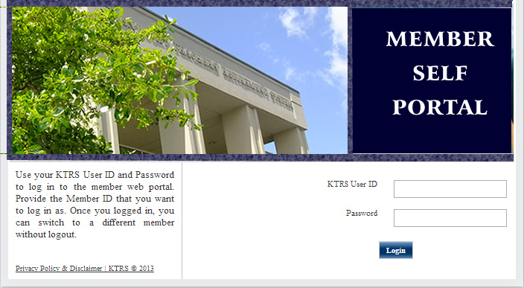
Your on-line access for …
Active Members
Retired Members
16
Notes:
{This is how you will access your benefits. We have instituted this because it is easier to use and because more you are retiring, calling, etc}

Slide 17
Kentucky Retirement System
Phone Number 1-800-618-1687
502-848-8500
Web Address www.ktrs.ky.gov
Retirement Estimates
Retirement Options
Insurance Information
Retirement Seminars
Pre-Retirement Seminar
1 month prior*

