Slide 1
PowerSchool
Attendance and Attendance Reports

Slide 2
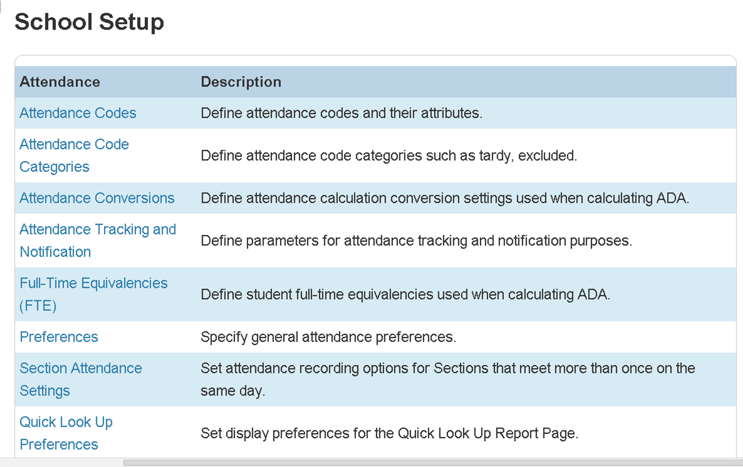
Attendance Set Up
Start Page>School

Slide 3
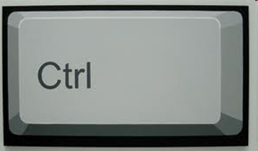
Quick Tip
When clicking on a blue field link in the program if you hold
It will then open up the link in new tab
The field link

Slide 4
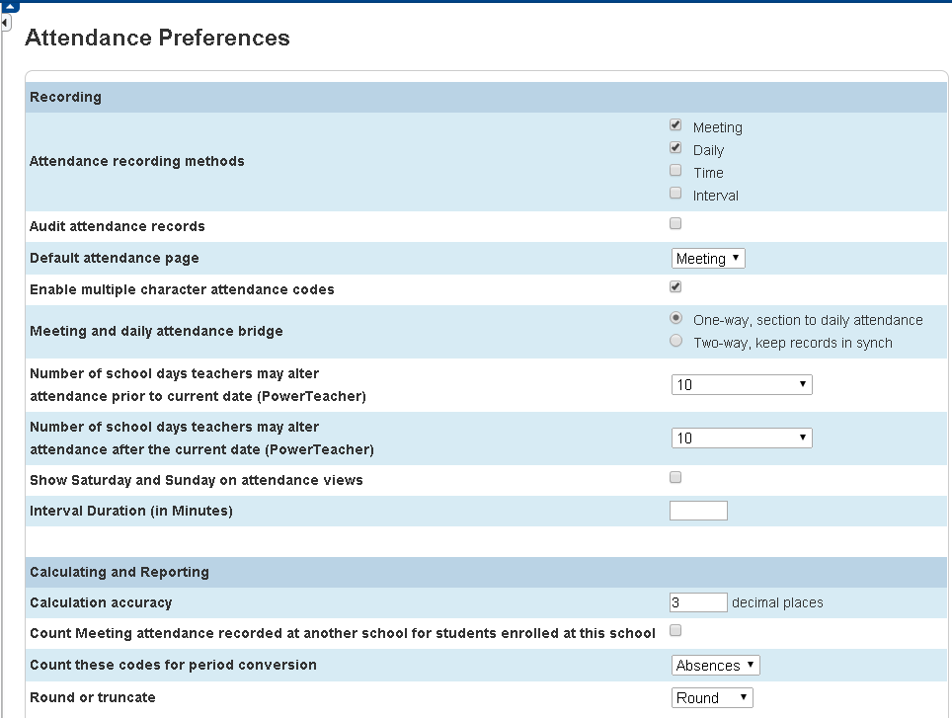
Preferences
Recording methods to choose
# of days teacher can alter attendance

Slide 5
Attendance Process
Office marks if parent call or activity (can also mark future attendance- PA)
Teachers mark attendance
Office run Teacher Attendance report
Office run Absentee report
Update attendance as needed

Slide 6
Daily Attendance
Way 1
Way 2

Slide 7
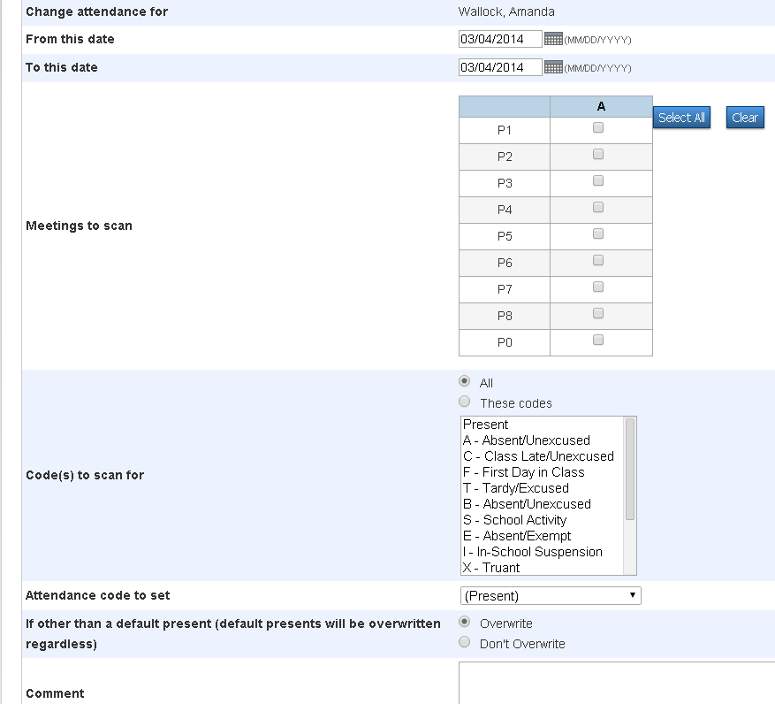
Meeting Attendance (Way 1)
Chose attendance dates
Chose attendance code
Add comment

Slide 8
Meeting Attendance (Way 2)
Chose attendance code
Click cell to input code and click on
to add
comment
Make sure click submit!

Slide 9
Attendance Today

Slide 10
Attendance Today Attendance
Can quickly change individual attendance from here-Make sure click submit!

Slide 11
Attendance Reports
Start Page>Attendance

Slide 12
Attendance Under Reports

Slide 13
Reports
Teacher Attendance Submission Status
NONE done
SOME done
ALL done

Slide 14
Power Teacher Attendance

Slide 15
Absentee Report
Can search for specific codes
Pull only A’s to check if need to fix
If making calls click on “Include Verification Line” at bottom

Slide 16
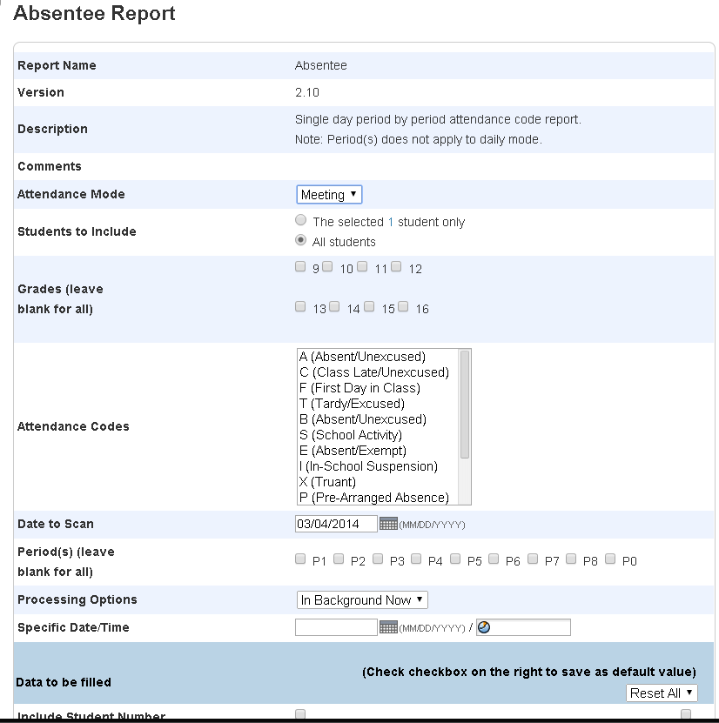
Absentee Report
Click codes
(cntrl key)

Slide 17
Absentee Report Result (with Verification Line)
You can go to the individual student screen to do attendance or click function to chose a group and function. (Great place to use the cntrl quick tip)

Slide 18
Hold Ctrl key as you click on each name to select multiple students.
Then click on functions at the bottom and do attendance to mass change a group of students attendance

Slide 19
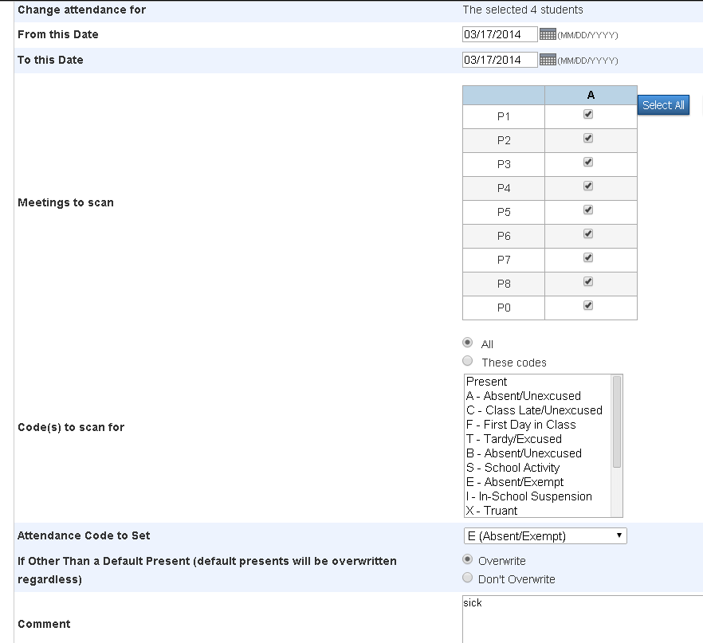
Can change for one day or multiple days

Slide 20
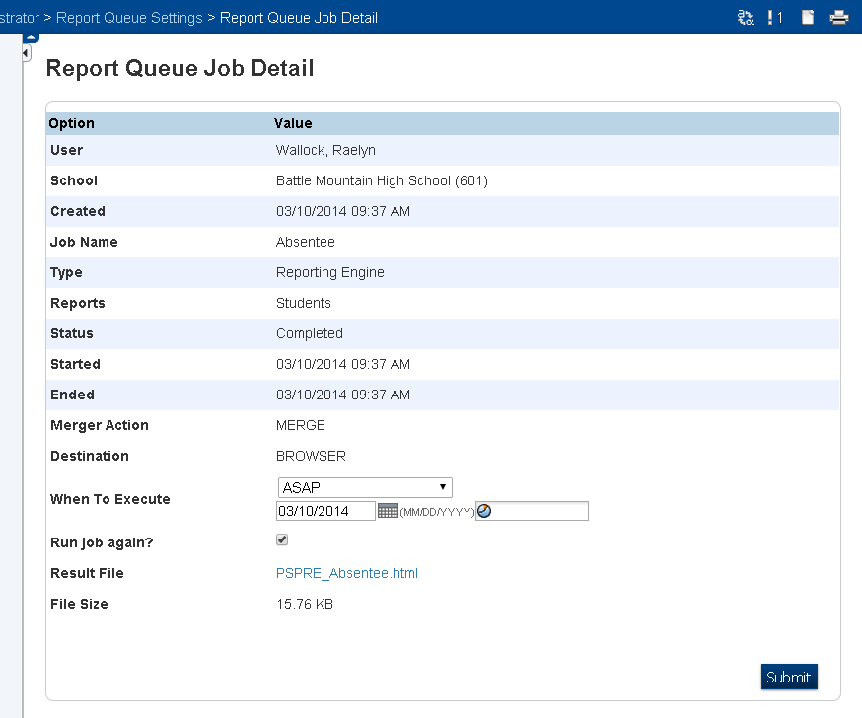
Quick Tip
Click to go to Print Queue
Check to run same job over again

Slide 21
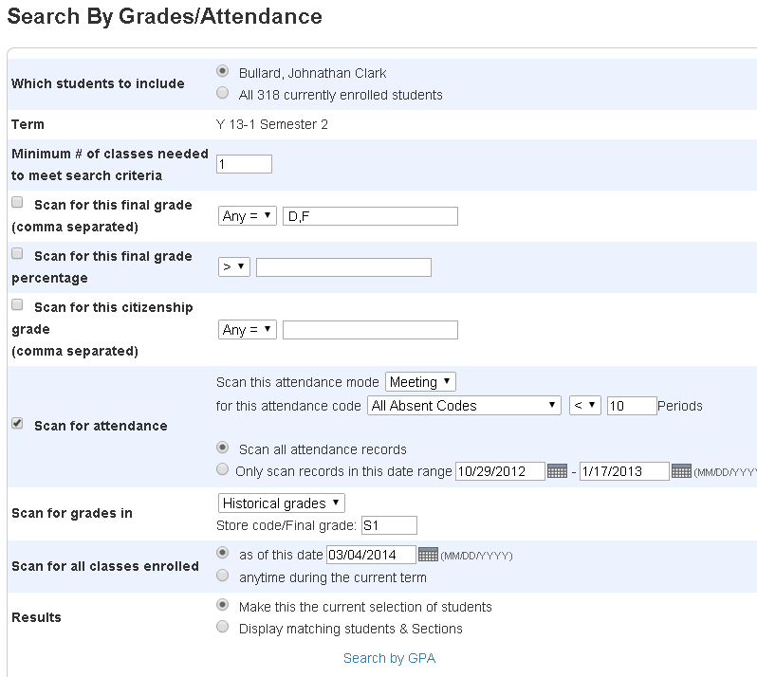
Search by Grades/Attendance

Slide 22
Attendance Count
Pick what code or codes you want to pull
Will give you list of all the students and instances of the code

Slide 23
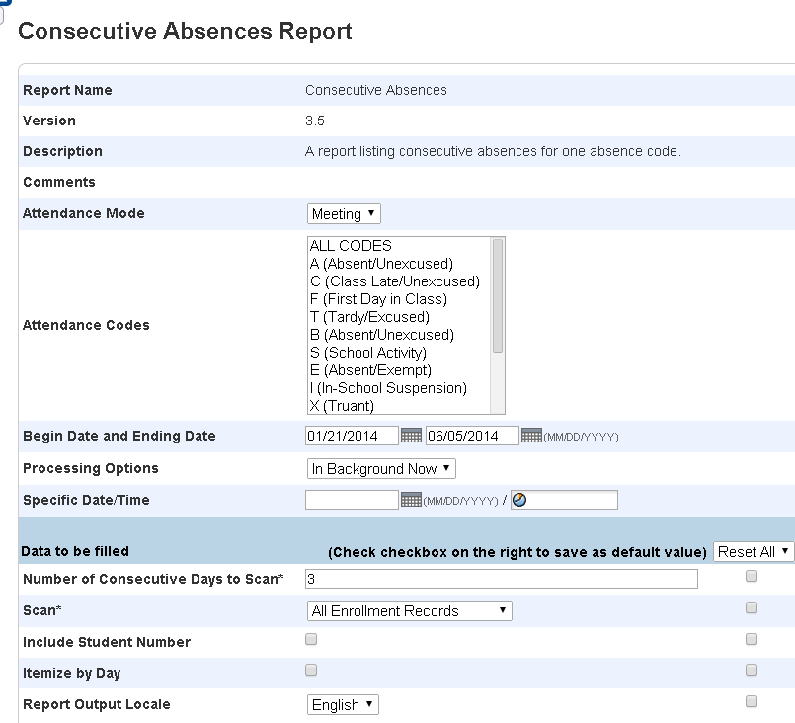
Consecutive Absences

Slide 24
Consecutive Absences Results
Gives each period missed number requested or above and beg. And ending date of occurrences

Slide 25
Perfect Attendance
Start on start page and select what grade level (or all) that you want to find perfect attendance for. Go to group function drop down menu and click Search for Perfect Attendance.
(this will just give you the group of students – can click on#)

Slide 26
Great Printing Tip
An easy way to print out a detail of student’s absences, go to Quick Lookup screen and select the total absences link. Then you will get a list of absences by sections/course, as well as the date of absence and reason.

Slide 27
Quick and Easy Attendance Sample

Slide 28
Weekly Attendance Summary Report
Can run this weekly for teachers to verify
Can make it available for teachers to correct, or for you to do after they correct on sheet
There is a way to do this from Power Teacher- if feel they will do it- we don’t
Sign and return to office with corrections
Tip- Run in a color to make easy to find etc. (we call ours “Golden Rods”)

Slide 29
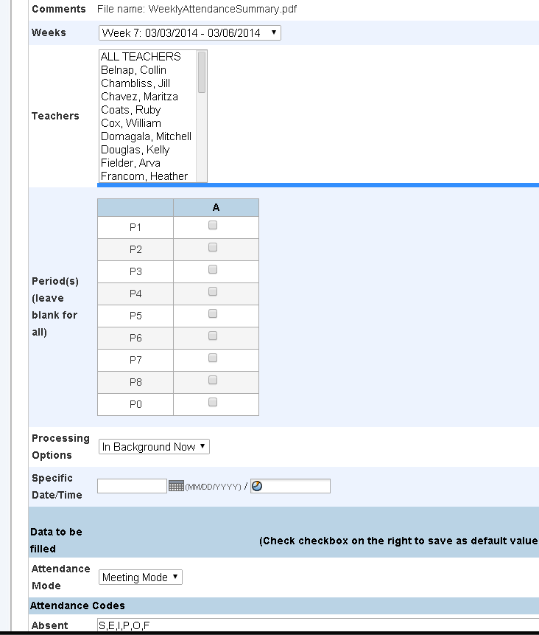
Start page>Reports>Weekly Attendance Summary (M)
Can select one, many, or all teachers
Weekly Verification
Make sure correct week
Pick all attendance codes in correct category: Absent,(S,E,I,P,O,F)Unexcused(A,B,X), and Tardy (U,T,C)

Slide 30
Class Attendance Audit
We use this for our Official Attendance
Depending on requirements may need to run report with DOB, ethnicity etc.
Teachers can also run this report through Power Teacher
Calculates membership totals
Can be run for vocational classes for reporting purposes too!

Slide 31
Class Attendance Audit Sample

Slide 32
Student Attendance Audit

Slide 33
Monthly Student Attendance

Slide 34
Attendance Summary by Grade

Slide 35
State ADA

Slide 36
ADA
ADA/ADM by Date — this report shows attendance and membership information shown as total number of students attending school each day compared to total number of students who are enrolled each day for the specified date range given.
ADA/ADM by Student — this report shows attendance and membership information shown as total number of days attended compared to the total number of days enrolled for each individual student for the specified date range given.
ADA/ADM by Minute — this report shows attendance and membership information shown as the total minutes attended compared to the total minutes enrolled, aggregated for all students for the specified date range given.

Slide 37
Enter and Exit Lists
Enter: In search students: entrydate>8/23/2010 then list students and include last name, first name , grade level, entry date, entry code. This gives all students entering the school after that date
Exit: /exitdate>8/1/2010;exitdate<6/3/2011 then list students and include last name, first name , grade level, entry date, entry code, exit date and exit code. This gives all students exiting the school between those dates.

Slide 38
Class Attendance Quick Tip
To work with the group of students in all of the selected teacher's classes listed in the schedule: click Make all students listed above the current selection. The Group Functions page appears.
Great way to take or check attendance for just one teacher go here and click on one of the icons under attendance

