Slide 1
Chapter 70
Massachusetts School Funding Formula

Slide 2
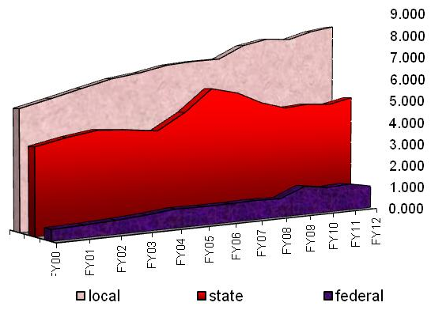
Massachusetts School Revenues FY00-FY12
(in billions)
School spending is primarily a local enterprise. Chapter 70 represents $3.99B of Massachusetts school revenue (FY12). Districts have wide latitude within this amount to spend according to their needs.

Slide 3
Presentation Objectives
The participants will be able to:
  State the purpose of the Chapter 70 statute.
  Explain the basic three step process of calculating C70 aid.
  Identify the six key factors that impact C70 and articulate why districts receive varying levels of state assistance.
  Describe the target local share and how it is applied to calculate a community’s required local contribution.
  Differentiate between foundation aid and Chapter 70 aid.
Notes:
The goal of this packet is to allow participants to achieve the above objectives.

Slide 4
Chapter 70 is the Commonwealth’s school funding statute
It is the intention of the general court, subject to appropriation, to assure fair and adequate minimum per student funding for public schools in the commonwealth by defining a foundation budget and a standard of local funding effort applicable to every city and town in the commonwealth.
Chapter 70, Section 1
The statute seeks to ensure adequate and equitable school funding for all Massachusetts public school students.
Adequacy
That every district be provided with sufficient resources to prepare all students to succeed
Equity
That the state and local shares of school funding be determined consistently with regard to local capacity to fund schools
Notes:
Historical Milestones Leading to Current Iteration of C70 Formula
Chapter 70 statute
http://www.malegislature.gov/Laws/GeneralLaws/PartI/TitleXII/Chapter70
Education Reform Act of 1993 - Adequacy
--Signed into law following the McDuffy court decision
--Established the "foundation budget“ to bring all schools to a foundation level of spending. The level differs among communities depending on local demographic and economic factors.
--The Governor and Legislature committed to bring all districts up to foundation within 7 years and were able to achieve this by FY2000.
--Established a minimum local contribution with current chosen level of local spending as the starting point
--Each year this was increased by the municipal revenue growth factor (MRGF).
--Resources
http://www.doe.mass.edu/edreform/edreformreport/erprogrpt597-1.html#foundation
http://www.doe.mass.edu/lawsregs/litigation/mcduffy_hancock.html
Aggregate Wealth Model , 2007- Equity
--Changes were made to the method of calculating the local contribution.
--The model uses property wealth and income to determine the municipality’s ability to contribute to the school district.
--Annual targets are calculated.
--Cities/towns are gradually being moved to their targets over time.
--Goal of taxpayer equity – that similar communities are required to contribute similarly
--Resources
http://finance1.doe.mass.edu/chapter70/chapter_awmw.html

Slide 5
Chapter 70: Three Basic Steps
Foundation Budget
minus Local Contribution
= State Aid (“C70 aid”)
A district’s Chapter 70 aid is determined in three basic steps:
  It defines and calculates a foundation budget, an adequate funding level for each district, given the specific grades, programs, and demographic characteristics of its students.
  It then determines an equitable local contribution, how much of that “foundation budget” should be paid for by each city and town’s property tax, based upon the relative wealth of the community.
  The remainder is funded by Chapter 70 (c70) state aid.
Local Contribution + State Aid = a district’s Net School Spending (NSS) requirement. This is the minimum amount that a district must spend to comply with state law.
Notes:
--Aid is derivative of the city/town’s local contribution, allocated to each district to which it belongs. That is, the local contribution is calculated first, and then the remainder of the foundation budget is made up by the state in aid to each district.
--Compliance With Net School Spending Requirements (http://finance1.doe.mass.edu/chapter70/compliance.html)
The Commonwealth's school finance statute, Chapter 70 of the General Laws, establishes an annual "net school spending" requirement for each Massachusetts school district. Failure to comply with this requirement may result in non-approval of a municipality's tax rate, enforcement action by the Attorney General, or loss of state aid.
Detailed data about prior year expenditures and current year budgets are submitted annually on each school district's End-of-Year Pupil and Financial Report. Once a district's information has passed ESE review, its compliance report is published on this web site.

Slide 6
Districts receive different levels of Chapter 70 aid, because their community’s ability to pay differs.
Notes:
--The six factors on the following slide are the main determinants of a district’s Chapter 70 aid.
--All of the FY14 figures used in the presentation are drawn from the Governor’s FY14 budget proposal, released in January.

Slide 7
Key Factors in School Funding Formula
Foundation Budget
Enrollment
Wage Adjustment Factor
Inflation
Local Contribution
Property value
Income
Municipal Revenue Growth Factor
These six factors work together to determine a district’s c70 aid. Both the foundation budget and local contribution are calculated annually to reflect current local conditions.
Notes:
--The foundation budget is a district-based measure, while the required local contribution is a municipal measure.
--For the most part, these factors are not controllable by the district.
--Because of the interaction of these factors, it is difficult to project local contribution and resulting aid.
--Politics could be stated as the 7th “x” factor. Depending on state finances and political preferences, the level of state funding available impacts local contribution and aid.

Slide 8
Foundation budgets reflect meaningful differences in enrollment, student characteristics, and geographic differences in wages.
Foundation Budget
minus Local Contribution
= State Aid (“C70 aid”)
Notes:
What differentiates these districts?
--Different mix of students (i.e. grade levels, ELL population, low income students, vocational program).
--Wage adjustment factor (WAF) of more than 1.00 (100%).
Any given year's foundation enrollment is a count of the number of pupils for whom a school district is financially responsible, on October 1st of the previous year. How the foundation budget is calculated: http://finance1.doe.mass.edu/chapter70/chapter_cal.html
Wage Adjustment Factor
--Gives a district credit for having higher school costs if it is located in a geographic area where average wages are higher than in other areas of the state. In theory, it is more expensive for them to attract teachers and other staff to come to work there, because the cost of living is higher.
--A district's wage factor is a percentage that is applied to the eight salary-related functional categories in the foundation budget.
--Massachusetts is one of the few states in the country to use such a factor.
--Calculated using the latest available average wage data from the state’s Department of Employment.
--Reflects a town’s own average, but is much more heavily weighted to the average of the “labor market area” the town is located in. The labor market area for a district is compared to the state average and weighted at 80%.The town's factor is weighted at 20%. The distance above or below the state average is then divided by three to determine the wage adjustment factor.
--There are 23 labor market areas used. There are real differences in these averages, which represent the combined total for all industries both private and public.

Slide 9
Foundation budget rates reflect differences in the cost of educating different types of students.
Foundation Budget
minus Local Contribution
= State Aid (“C70 aid”)
The Governor’s FY14 budget proposes to increase the out of district special education rate by $10,000 to $35,848.
Base Components
Costs Above the Base
Notes:
--A district's foundation budget is derived by multiplying the number of pupils in fourteen enrollment categories by cost rates in eleven functional areas.
--Each pupil generates a specific cost in each functional category. The costs are higher at the upper grades. They are also higher in the limited English and vocational programs. Special education and low-income increments add substantial costs as well.
--Rates are adjusted each year in accordance with the inflationary factor specified in statute. (FY14 inflation factor: 1.55%)
--In general, the foundation budget seems to have kept pace with spending, except for two areas:
--Benefits
--Out of district sped tuition

Slide 10
Foundation Budget
FY14 Statewide Foundation Budget by Spending Category
Foundation Budget
minus Local Contribution
= State Aid (“C70 aid”)
Sixty-nine percent of statewide foundation is instructional in nature.

Slide 11
Local Contribution
Establishing local ability to pay
Foundation Budget
minus Local Contribution
= State Aid (“C70 aid”)
The foundation budget is a shared municipal-state responsibility.
Each community has a different target local share, or ability to pay, based on its property values and residents’ incomes.
Prior to this policy, required local contributions had become less linked to ability to pay. A process was established in 2007 to move each community from its 2006 baseline to its new target.

Slide 12
Determining each community’s target local share starts with the local share of statewide foundation.
Foundation Budget
minus Local Contribution
= State Aid (“C70 aid”)
Calculate statewide foundation budget.
Statewide Foundation Budget
$9,814,248,554
Determine local share of statewide foundation.
59% Local Contribution
$5,790,406,644
41% State Aid
$4,023,841,910
Statewide, determine percentages that yield ½ from property and ½ from income.
Property Effort
$2,895,203,322
Income Effort
$2,895,203,322
Property and income percentages are applied uniformly across all cities and towns to determine the combined effort yield from property and income.
Notes:
--From MassBudget, “the state expects that each municipality can contribute the same share of local resources to the foundation budget by setting uniform contribution rates.”
--Local contribution/local share is a municipal measure.

Slide 13
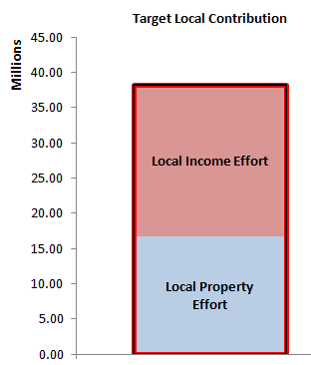
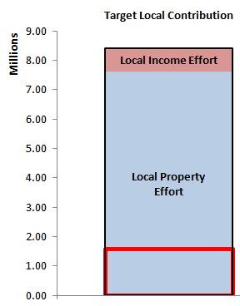
Individual communities’ target local shares are based on local property values and income, and foundation budget.
Foundation Budget
minus Local Contribution
= State Aid (“C70 aid”)
To determine local effort, apply the property and income percentages to the municipality’s
  Total Property Value
  Total Resident Income
Local Property Effort
+ Local Income Effort
Combined Effort Yield (CEY)
Target Local Share = CEY/Foundation budget
  Capped at 82.5% of foundation
  In FY14, 126 of 351 communities are capped (prelim).
Chelmsford
Truro
Target Local Share
Notes:
--The charts demonstrate that while the same property and income rates are applied to each city/town, this results in a different mix of property and income effort in each municipality depending on their ability to pay.
--In this example, Chelmsford has a fairly equal mix of property and income effort, slightly favoring income.
--Truro, a community on the Cape, has property effort that far outweighs its income effort.
--Target local share is a measure of local ability to pay relative to the community’s student population.
--Truro’s CEY exceeds its foundation budget, so it is capped at 82.5% target local share (red line).

Slide 14
Getting Closer To the Target Contribution
Determining the Upcoming Year’s Required Local Contribution
Foundation Budget
minus Local Contribution
= State Aid (“C70 aid”)
Preliminary Contribution
= Prior Year Contribution x Municipal Revenue Growth Factor (MRGF)
MRGF: Calculated annually by the Department of Revenue, it quantifies the most recent annual percentage change in each community's local revenues, such as the annual increase in the Proposition 2½ levy limit, that should be available for schools
Required Contribution
Municipalities who have been required to contribute more than their target:
  Reduce by the effort reduction percent (100% in FY14, prelim).
Municipalities who have been required to contribute less than their target:
  If the preliminary contribution is below by less than 2.5%, the preliminary contribution becomes the new requirement.
  If the preliminary contribution is below by more than 7.5%, an additional 3% is added to the preliminary contribution. For those below by between 2.5 and 7.5%, 2% is added.
Notes:
--This is the process to move each community from their 2006 baseline to its target local share.
--These parameters are preliminary based on the Governor’s budget proposal. State revenue availability and political preferences determine the required contribution parameters, and therefore impacts how quickly cities and towns move to their targets.

Slide 15
Each community transitions to its target local share at a different pace.
Foundation Budget
minus Local Contribution
= State Aid (“C70 aid”)
Notes:
--The six factors referenced earlier impact how quickly each community approaches its target. State revenue available to increase C70, and political preferences, also impact the result.
--Under the Governor’s proposal, all communities who were required to contribute more than their target local share were moved all the way down to their targets. Because the local contribution drives aid, the more local effort is reduced to target, the more aid is needed to ensure districts can spend at their foundation budgets.

Slide 16
Reaching the Targets Over Time
Local contribution and aid targets were first defined in FY07, with a projected five-year phase-in. Phase-in was slowed by the state revenue crisis.
House 1 Chapter 70 (FY14) proposal fully implements the effort-reduction targets for the first time.
241 communities with required excess effort are reduced by 100% of that excess, amounting to $202 million in lower required contributions.
110 communities have required contributions below their targets, and are moved closer by their MRGFs, plus:
  an additional 2% if below by 2.5 to 7.5% (n=44), or
  an additional 3% if below by more than 7.5% (n=20).
  Additional contributions total $28 million.

Slide 17
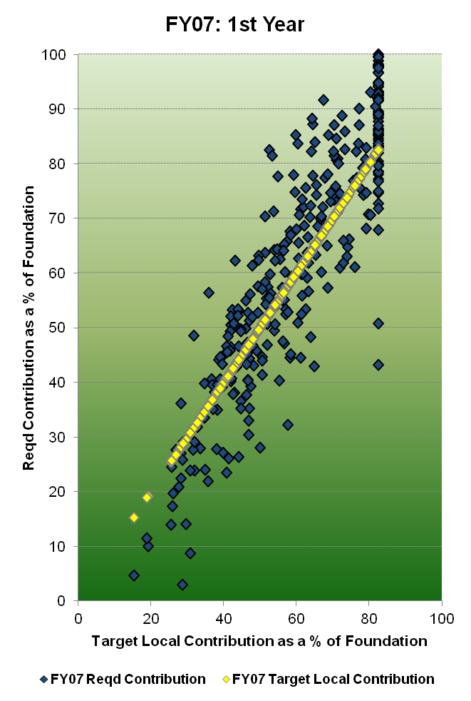
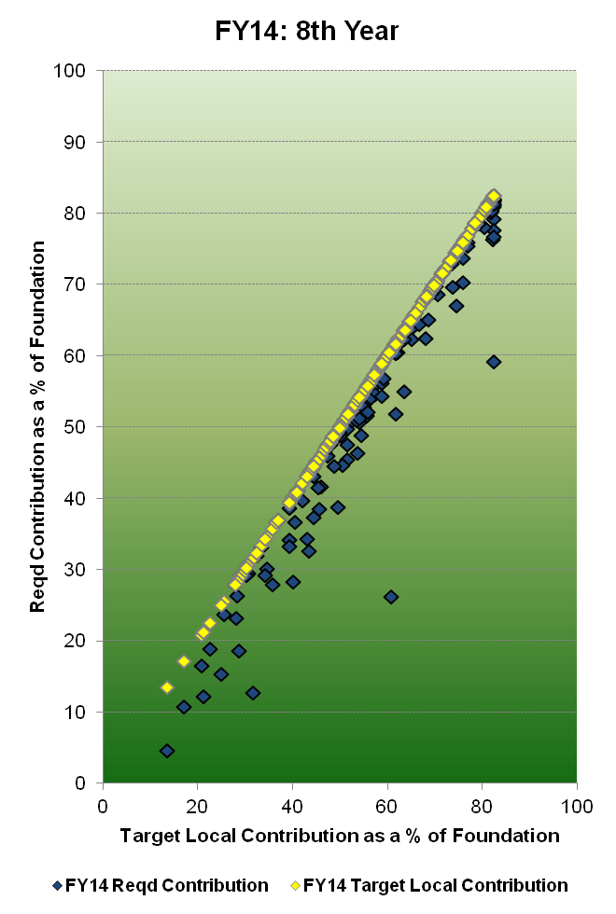
Reaching the Targets Over Time
Notes:
--These two plots show the distribution of communities as they each approach their targets. In FY07, few districts were at their targets (yellow dots/line). The goal is for all communities to be on the line (at target). In FY14 (prelim), all communities required previously to spend at a level greater than their target were brought down to the yellow line.

Slide 18
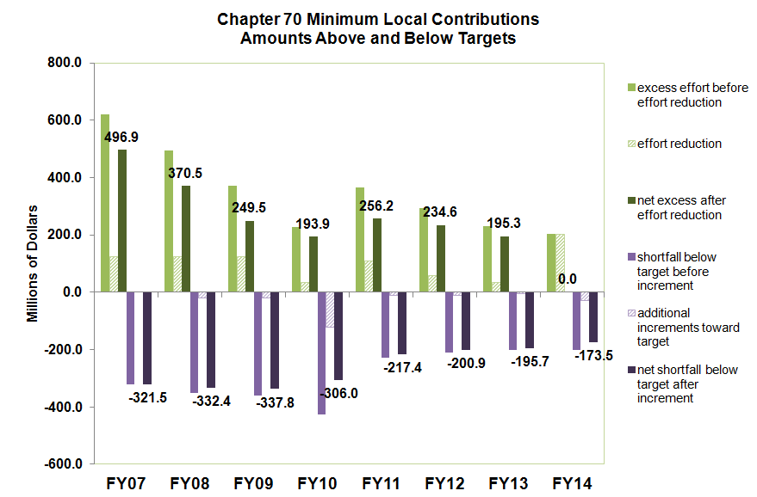
Reaching the Targets Over Time
Notes:
--The graph shows the aggregate local contribution above and below local targets.
--In other words, the green lines show how much extra effort (in $) is being required of municipalities above their calculated target (ability to pay).
--The purple lines show the gap (in $) below municipalities ability to pay. These communities are currently being required to contribute less than what they can afford.

Slide 19
The city or town’s required local contribution is allocated among the districts in which it is a member.
Foundation Budget
minus Local Contribution
= State Aid (“C70 aid”)
Town of Berkley
Allocation is in direct proportion to the share of its total foundation budget.
Notes:
--The last step before calculating aid is to distribute a town’s local contribution amongst all districts to which it belongs (i.e. a town district, an academic regional, a vocational, an agricultural school).
--This is done in direct proportion to the share of the town’s foundation budget belonging to each district.
--The major factor in changes in required local contribution is changes in foundation budget proportion attributable to each district. In other words, if Berkley were to lose students at the town district, while Somerset Berkley were to pick up kids, therefore its share of foundation budget were to grow, it would take a larger share of the town of Berkley’s total required contribution.

Slide 20
FY14 Chapter 70 Aid Calculation
Preliminary
Foundation Budget
minus Local Contribution
= State Aid (“C70 aid”)
Start with prior year’s aid
  FY13 c70 (statewide: $4.173B).
Add together the prior year’s aid and the required local contribution (Row 1 and 3).
If the combined amount is minus than foundation budget:
  Foundation aid provides additional funding for districts to spend at foundation levels (Row 4).
  179 operating districts
If it is greater than foundation budget:
  Chapter 70 aid is held harmless at the prior year’s level.
  District receives at least $25 per pupil in additional aid over FY13.
Notes:
--Foundation aid is the core of the C70 formula.
Why? Because the goal of the formula is for the local contribution + aid to equal a district’s foundation budget, so ensuring that each district receives enough aid to meet that benchmark is key.
--There are other policy goals that officials can address through other mechanisms built into the formula over the years. Examples: ensuring each district receives some additional funding through a per pupil aid increase.

Slide 21
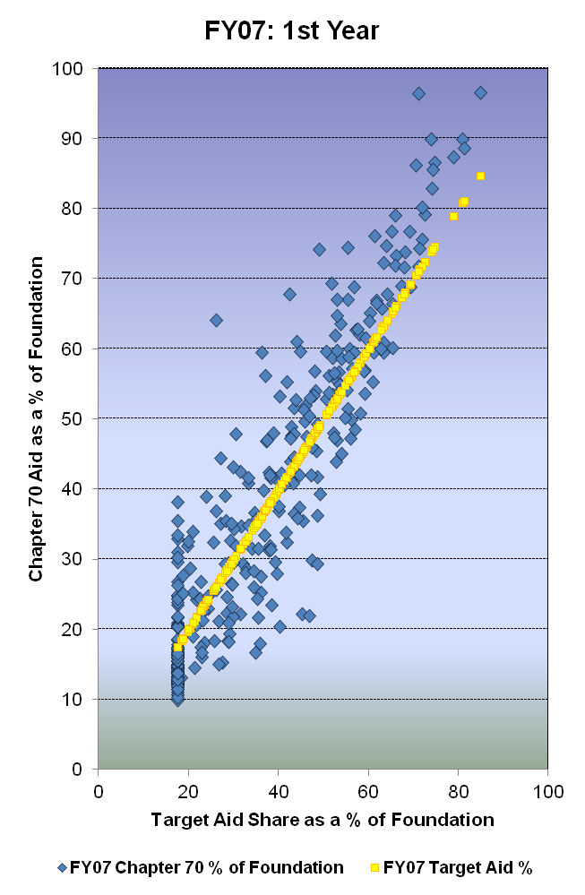
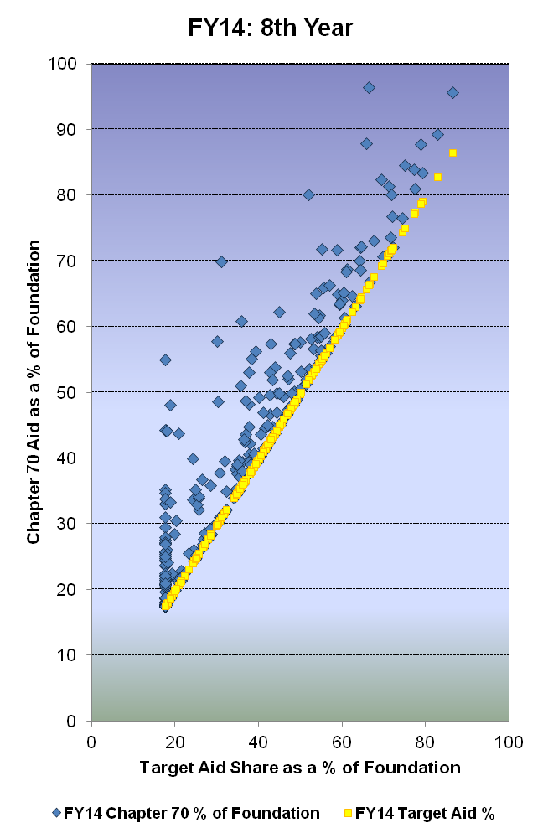
Reaching the Targets Over Time
Notes:
--These plots show the flip side of the previous ones. Again, the goal is to get a tight distribution around the yellow line (the target aid shares of each district). In the preliminary FY14 proposal, all districts are at least at their target aid shares, and many are above, receiving excess aid (aid above target).

Slide 22
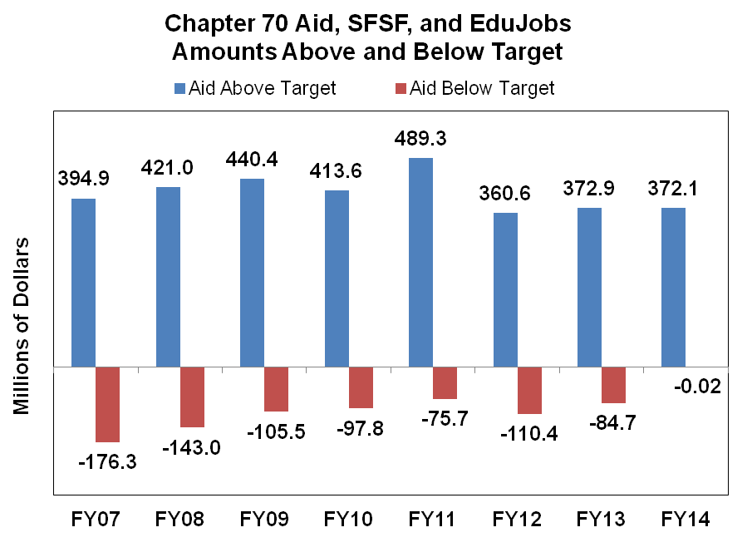
Reaching the Targets Over Time
*FY10, 11 and 12 includes SFSF and EduJobs federal stimulus funds.
Notes:
FY10
As the state budget situation deteriorated in late FY09 into FY10, a sizeable infusion of federal stimulus dollars, through the state fiscal stabilization fund (SFSF) program, has helped avoid even more drastic reductions to Chapter 70 funding. $412 million was used to make the final FY09 payment in June. The FY10 formula relies upon $168 million of additional SFSF grant money, which prevents 151 operating districts from falling below their foundation budgets.
http://finance1.doe.mass.edu/chapter70/chapter_10.html
FY11
As in the past two fiscal years, state fiscal stabilization fund (SFSF) grants help avoid deeper reductions. These grants fall from $172 million in FY10 to $75 million in FY11. The net result in combined Chapter 70 and SFSF funding is a four percent cut for 275 of 328 operating districts, with the combined total falling from $4,041,701,404 to $3,926,155,830, a reduction of $115,545,574 (-2.86%).
http://finance1.doe.mass.edu/chapter70/chapter_11_jun.html
FY12
The formula replaces all of the $20.7 million in FY11 federal "sfsf" grants with Chapter 70 aid, and funds an additional $119.0 million in foundation aid. However, the $200.5 million in education jobs grants which were run through the formula in FY11 were one-time stimulus monies and are not folded into the FY12 base. This means that statewide, total aid falls from $4.072 billion to $3.991 billion, a reduction of $81.5 million or two percent.
http://finance1.doe.mass.edu/chapter70/chapter_12.html

Slide 23
Net School Spending v. Actual NSS
Required Net School Spending (NSS)
Chapter 70 Aid
+ Required Local Contribution
District’s NSS Requirement
NSS requirement is legal funding obligation for each district.
  Remains fully in effect and will be enforced
  Aid penalties result from non-compliance
“Actual” NSS
Computed each year from each district’s End of Year Financial Report
  Includes operating expenditures
  Includes municipal indirect costs such as insurance, maintenance and administration
  Excludes non-appropriated funds such as grants and revolving funds
  Excludes capital spending
Notes:
--All of these calculations are based on required spending, not actual spending. For districts that spend well in excess of what they are required to do, the requirement is not as meaningful for compliance purposes.
--The state tracks each district’s obligation to meet net school spending, intended to capture costs id’d in the foundation budget.
--To that end, it does not include certain costs, including transportation and capital items.
--It is supposed to reflect local appropriations, so it does not include spending from grants and revolving funds.

Slide 24
Most districts spend in excess of their NSS spending requirement.

Slide 25
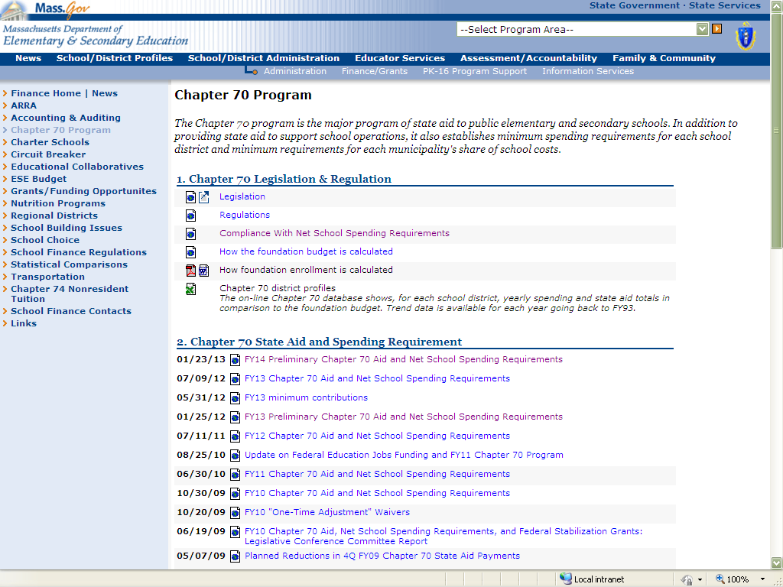
Chapter 70 Website http://finance1.doe.mass.edu/chapter70/
FY14 link

Slide 26
Chapter 70 Contact Info
Melissa King, 781-338-6532, mking@doe.mass.edu
Roger Hatch, 781-338-6527, rhatch@doe.mass.edu

