Slide 1
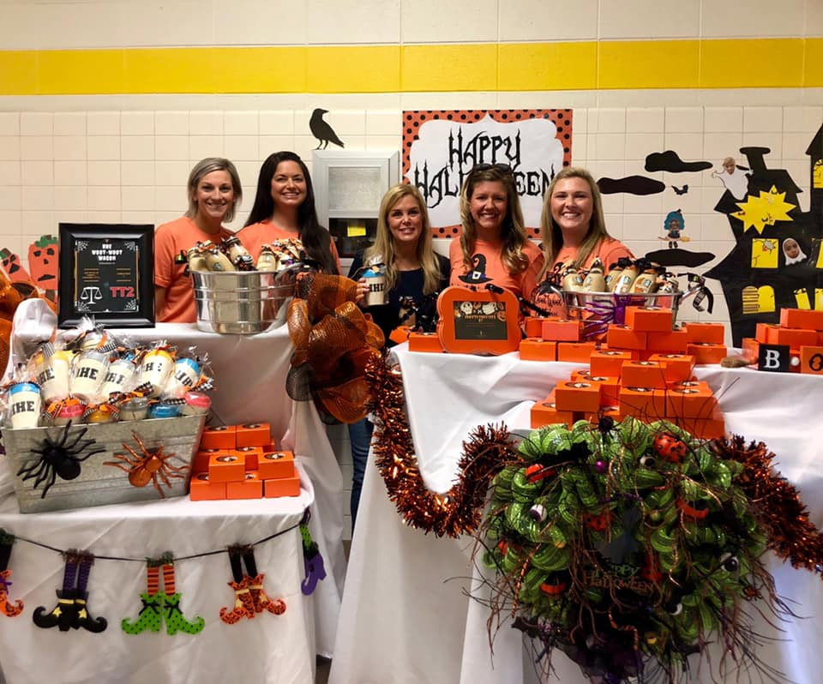
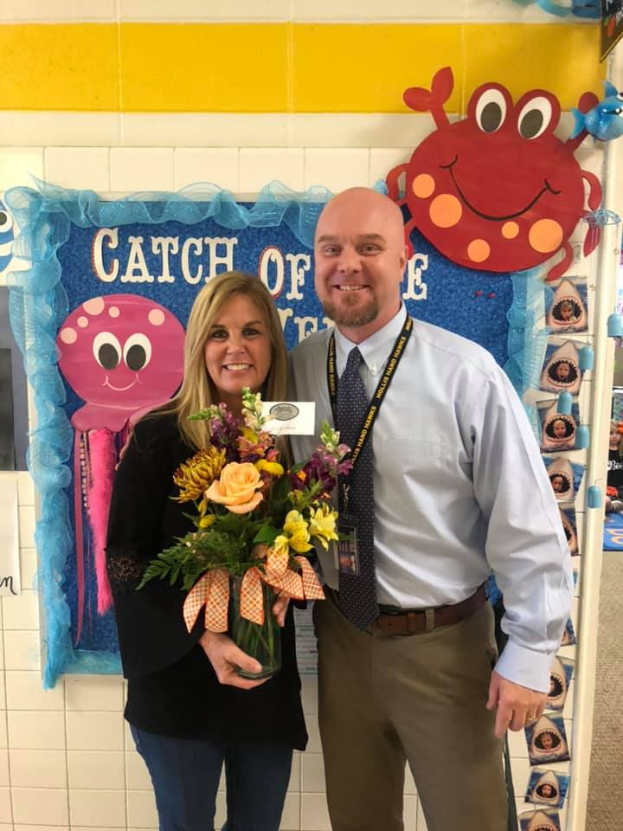
School Contact Information:
(706) 883-1580
Hollis Hand PTO News
August 2019
October 2019
A HUGE Thank You!
Read-A-Thon was a tremendous success! Thanks to all the students and families that supported our school during this fundraiser.
UPCOMING EVENTS:
10/31: Fall Parties @ 1:30 in classrooms
Thanksgiving Day lunch information will be sent home in Tuesday Folders closer to time.
Thanksgiving Nov 25-29
PTO Meeting: November 4th 6pm, Media Center
Congratulations to our Teacher of the Year!
Jill Kemp was named Teacher of the Year for Hollis Hand Elementary! The hard work and dedication of our teachers make our school the best!
Woot Woot Wagon
This Month’s Woot Woot Wagon was spondered by:
Lonnie J. Haralson, IV P.C. Attorney at Law
&
Tumble Town 2
Donuts Provided By: Harvest Coffee and Bakery
Thank you so much for helping us to reward our teacher for their hard work! Find out how you can sponsor these events by contacting Ashley Delong: Ashleyabd2010@gmail.com or Caralyn Burns: caralynburns@gmail.com
PTO Volunteers Needed:
BINGO / Spaghetti Supper Night: Please contact Claire Hollstrom or Kendra DeVane to volunteer for this event. clairehollstrom@yahoo.com or jkdevane@gmail.com. This has been rescheduled to February. More information will come home in Tuesday folders closer to time.
All fall parties will be at 1:30 on Oct 30th.

