Slide 1
Bringing Alternative Learning to You
Ashley Ruka - Principal, South Washington Alternative High School
Nick Falde - Principal, SoWashCo Online
May 5, 2022

Slide 2
Purpose
Outcomes
The goal of our presentation is to provide context so that we can request board approval to submit our Alternative Learning Center application during the board’s next business meeting.
Understand historical context of Alternative Programs in the state and South Washington County.
Understand the current structure of alternative programming in South Washington County Schools.
Obtain a broader understanding of Alternative Learning Centers (ALCs) vs. Alternative Learning Programs (ALPs) and programming connected to each
Notes:
Ashley

Slide 3
History of Alternative Programs
Alternative schools were first approved by the Minnesota Legislature in 1987 to serve high school students struggling in traditional schools.
The purpose of the law was to provide alternatives for at-risk students and statute established eligibility for students and created a means to serve them.
Area Learning Centers (ALCs) have more extensive requirements than Alternative Learning Programs (ALPs).
Over time, these programs have served hundreds of thousands of students.
Notes:
Ashley

Slide 4
History of Alternative Programs (Cont.)
Minnesota defines at-risk and student eligibility to attend alternative programs very broadly. Statute states that:
These are programs of choice.
School personnel cannot mandate a student’s attendance to an alternative program.
Programs work with each individual student to develop a plan to bring them to graduation.
The continual learning plan (CLP) is created for each student and it establishes support for the student in grade promotion and completion of a high school diploma.
Notes:
Ashley
Break this down….
Maybe include our own history…. Reference Charlie

Slide 5
SWAHS Current Structure as an Alternative Learning Program
Enrollment comes from Park, East Ridge and Woodbury High Schools.
Day Program - five periods a day with an advisory twice a week.
Achievement Lab- Hybrid learning option. Students are in the building two half days a week along with individual online work done at home.
Work-based learning, internship opportunities in partnership with the Access Program.
Notes:
Ashley

Slide 6
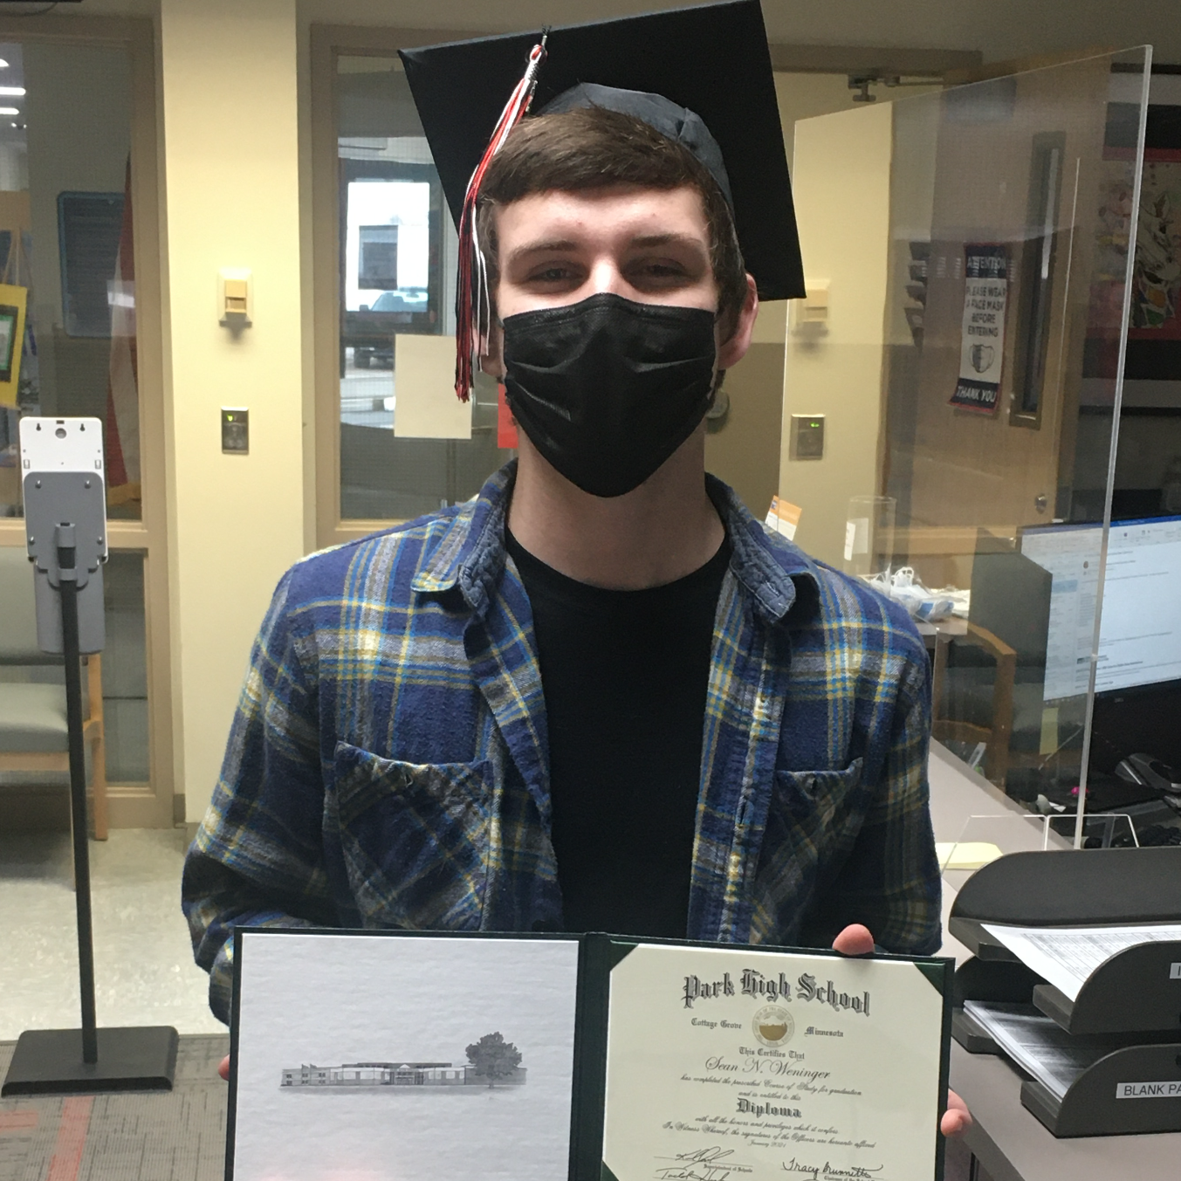
Alternative Options
Information from 123A.05 State-Approved Alternative Program Organization, Subdivision 1. Governance
Alternative Learning Program
May elect to only serve district students
Focus may be on a specific student need (chemical health, truancy, academic need, etc.)
Hours and calendar are optional
Summer programming offered to those enrolled during the school year
Alternative Learning Center
Two or more districts in cooperation
Comprehensive programming at middle and high school levels
Learning year programming offered at both levels
May offer targeted services when previous three items are met
Notes:
Nick
Emphasis on the support of students and staff
Minnesota Statute 123A.05, Subdivision 1, defines the types of alternative programs that Minnesota authorizes:
• Area Learning Centers
• Alternative Learning Programs
• Contracted Alternative Programs
In addition to these programs, a separate program is available for Area Learning Centers. Minnesota Statute 123A.06 states that “a center may also provide programs and services for elementary and secondary pupils who are not attending the state-approved alternative program to assist them in being successful in school.” The Department has defined these as Targeted Services programs at the K-8 level.

Slide 7
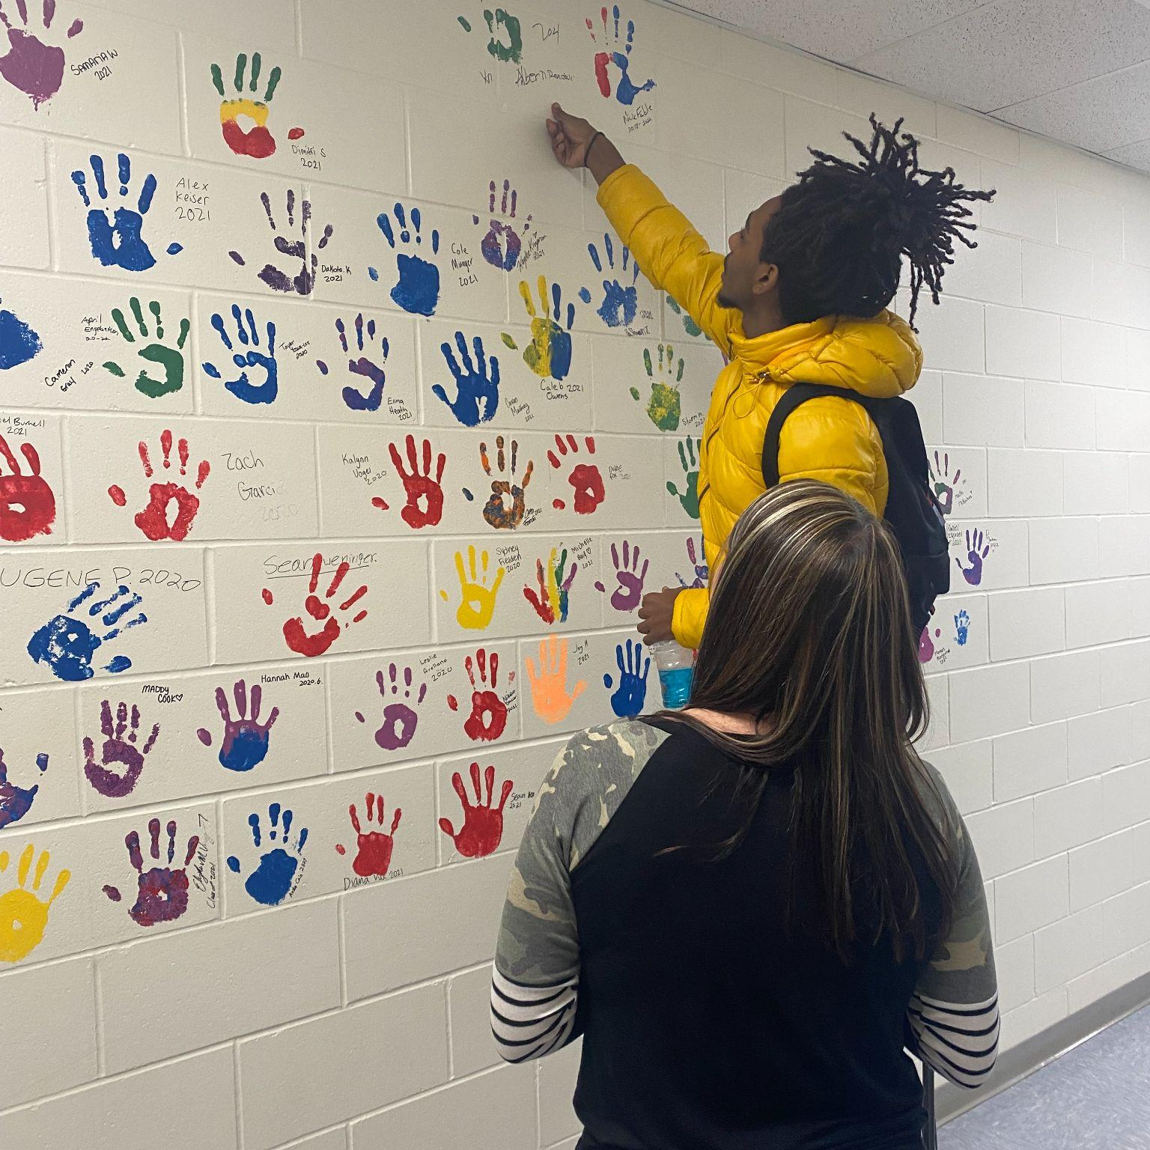
Why Alternative Learning Center vs Alternative Learning Program?
Increased Opportunities for Students
Middle Level Programming Options
Pilot next year in one middle school and look to expand thereafter
Collaborative professional development opportunities via our partnership with Roseville Public Schools
Continued multi-program approach to alternative learning
More expansive and efficient Targeted Services programming for students K-8 (current partnership with Northeast Metro 916)*
Notes:
NIck

Slide 8
Targeted Services
What is Targeted Services?
Programming operated outside of the school day
Designed differently to meet the needs of K-8 students
Students are invited to attend based on meeting a component of the state’s at-risk criteria
Must have an alternative learning center (ALC) within your district or partner with another ALC in order to operate Targeted Services
Why operate Targeted Services?
Provides reimbursable opportunities for students who may benefit from additional support in certain areas (math, reading, social emotional opportunities).
Can create experiences for students and staff not available during the school year (field trips, career interest tours, collaborative summer partnerships)
Can be self sustaining
Revenue generated in Targeted Services is used to support similar services the following year.
Additional funding is dedicated to Alternative Learning Options, which also includes Targeted Services.
Currently 10% of Targeted Services funds go to Northeast Metro 916 to act as our ALC. ($26,000+ in 19/20 SY)
Note: Once ALC application is approved, Targeted Services application can be submitted for approval.
Notes:
NIck

Slide 9
Cooperation with another school district
From Statute: An area learning center is encouraged to cooperate with a service cooperative, an intermediate school district, a local education and employment transitions partnership, public and private secondary and postsecondary institutions, public agencies, businesses, and foundations.
This partnership will consist of a professional development model to provide support and expand our options around collaboration with another Alternative High School (Fairview Alternative High School, Roseville Area Schools) focused on college and career readiness skills for our future graduates.
Notes:
Ashley

Slide 10
Collaborative Professional Development
Currently: June 2021 - June 2022 Planning for Implementation of ALC
Discussion about professional development needs
Development of interdistrict partnership
Preparations for ALC application with the state with board approval
Year 1: July 2022 - June 2023 Implementation of Professional Development
June/July 2022 - Principal Collaboration to develop professional development plan (Possible EdCamp, focus on CLRT and AVID as best practice strategies, trauma-informed education)
Targeted Services discussion
Year 2: July 2023 - 2024 Continuation of Collaboration/Professional Learning
Year 3: July 2024-June 2025 Reflect/Re-Assess/Re-Vision
Comprehensive needs assessments completed by both schools.
Reflection and re-visioning for the next three years.
Notes:
No financial burden…
Ashley

Slide 11
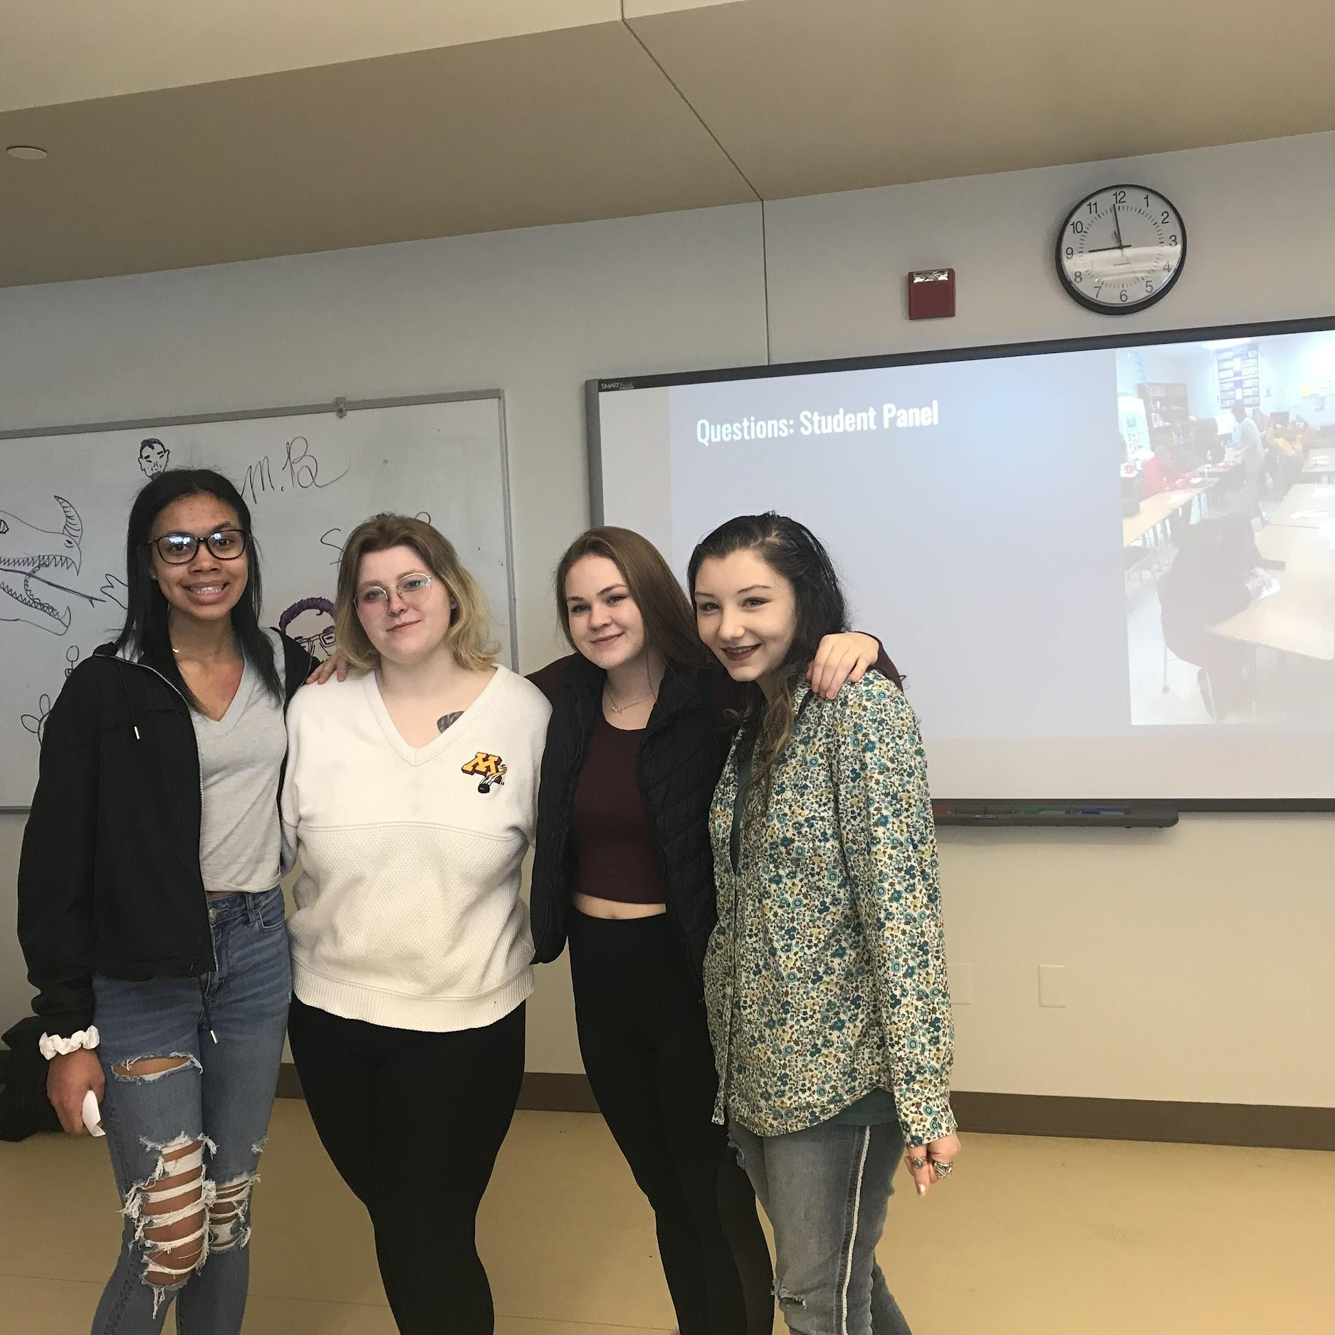
Process Timeline
October 2020
Presentation given to members of executive cabinet and AHS staff on the difference between ALPs and ALCs
October 2020 - January 2021:
Fairview Alternative High School (Roseville), reaches out to discuss the possibility of partnering
Begin the ALC application process.
October 2021
Reviewed draft application with MDE Alternative Programs Leadership
December 2021
Developed collaborative school board presentation with Fairview Alternative High School
Notes:
Nick
Shrink Timeline up

Slide 12
Process Timeline
February 2022
Fairview Alternative High School and South Washington Alternative High School cooperative agreement approved by Roseville Areas Schools School Board
May 2022
South Washington Alternative High School presentation given to SoWashCo school board
Notes:
Nick
Shrink Timeline up

Slide 13
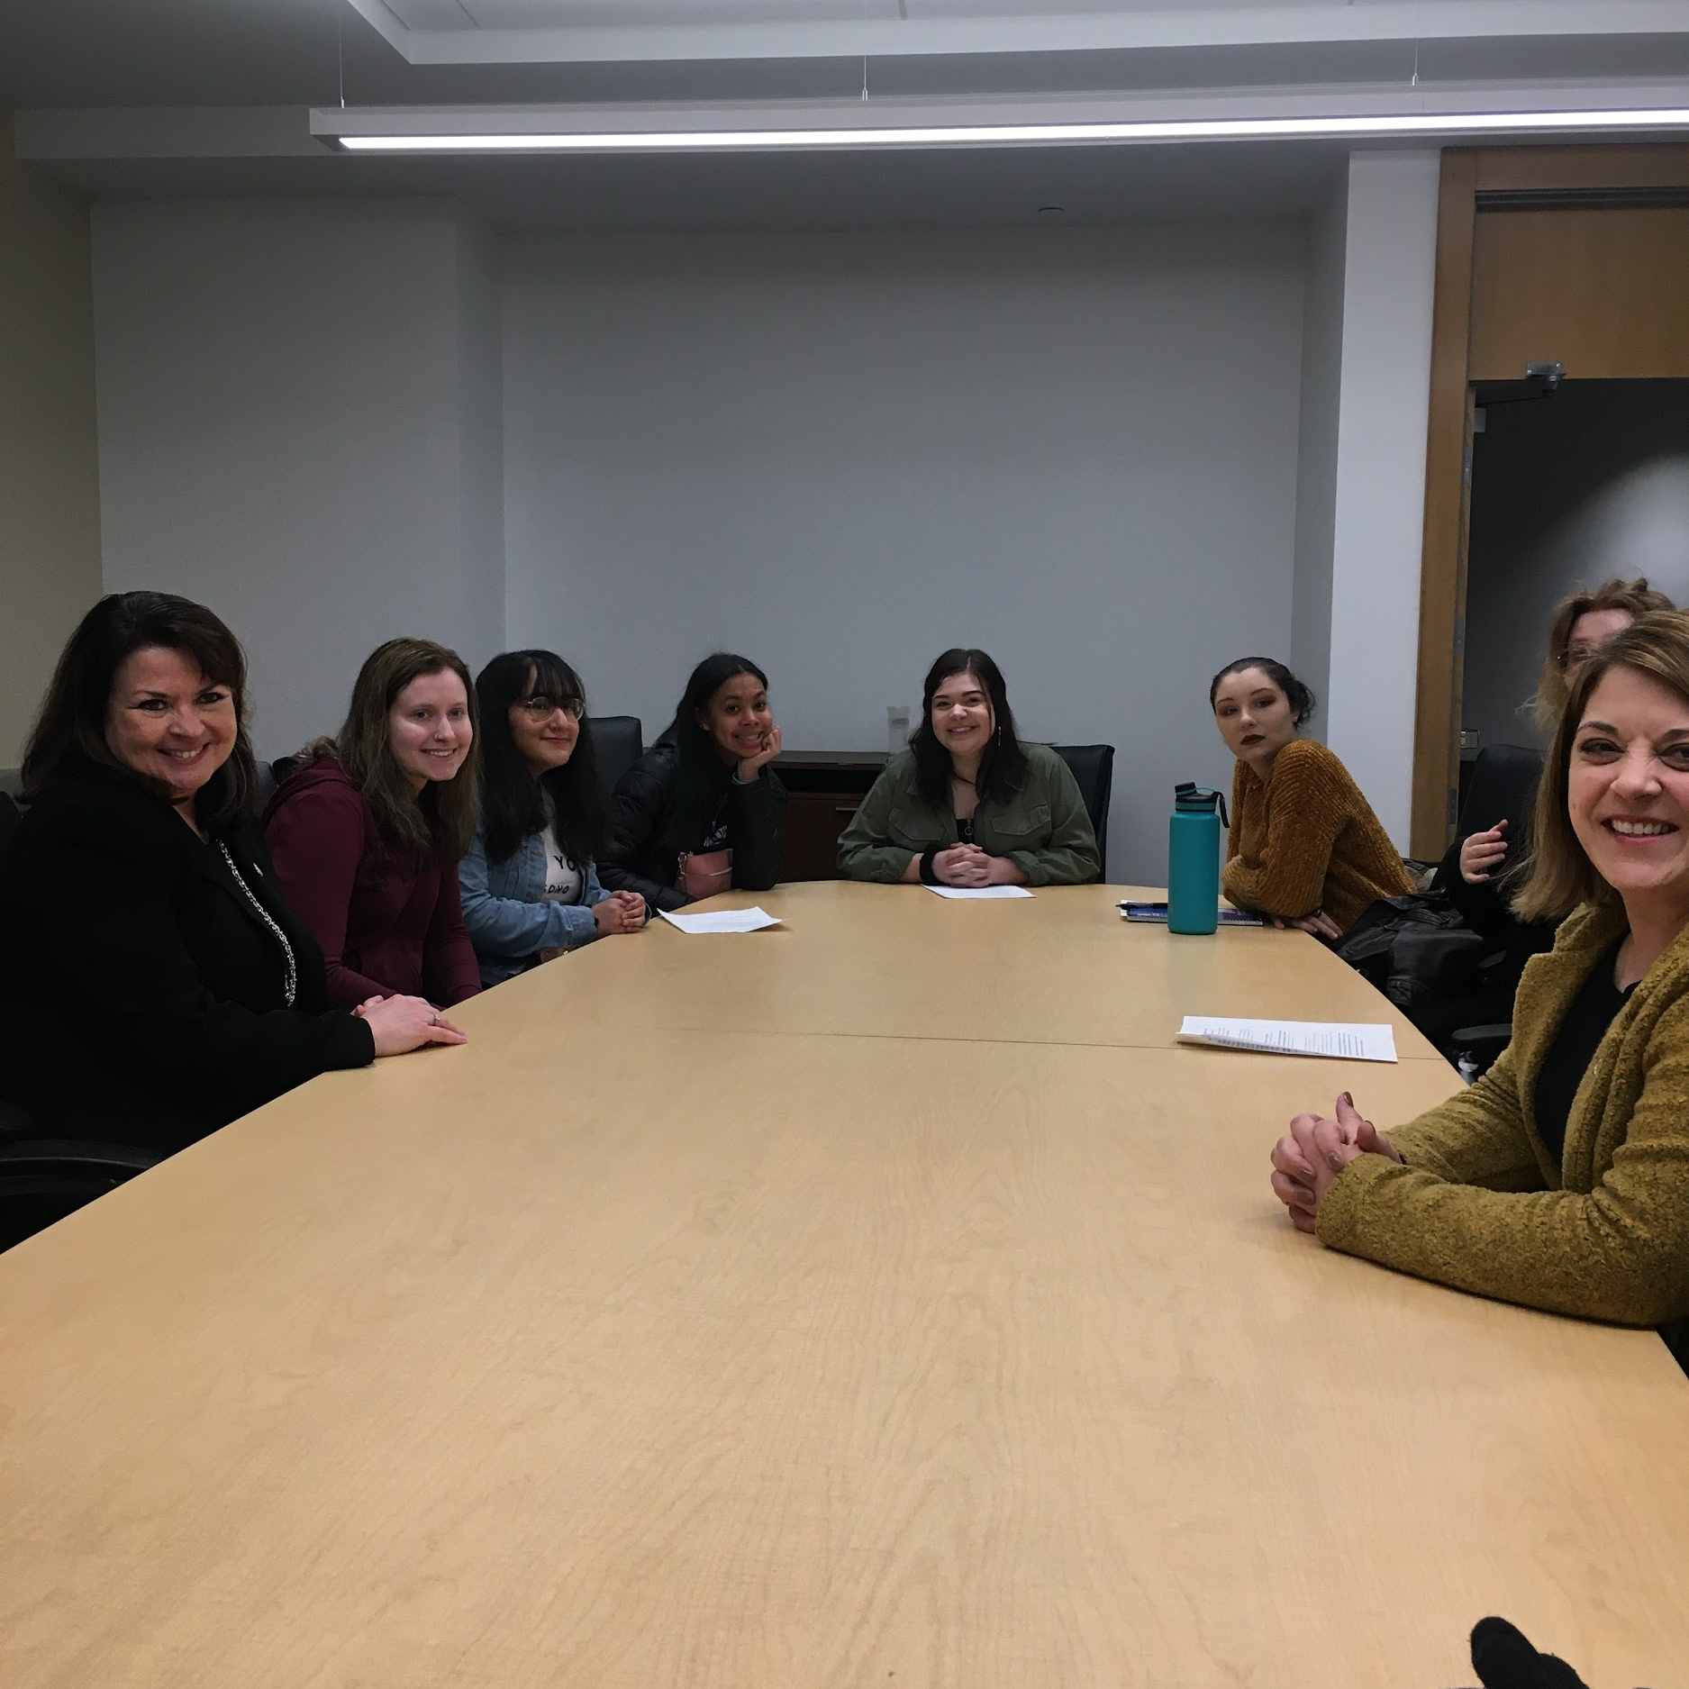
Where are we at?
ALC Application and Programming
ALC application is complete and ready to be submitted
Enrollment systems are in place
Multi-program approach toward learning
Day Program
Achievement Lab
Early Middle College Program
Working on development of a middle school pilot site for the 2022-23 school year
Once ALC approved, complete application for administering targeted services wholly within South Washington County
Notes:
Ashley and Nick

Slide 14
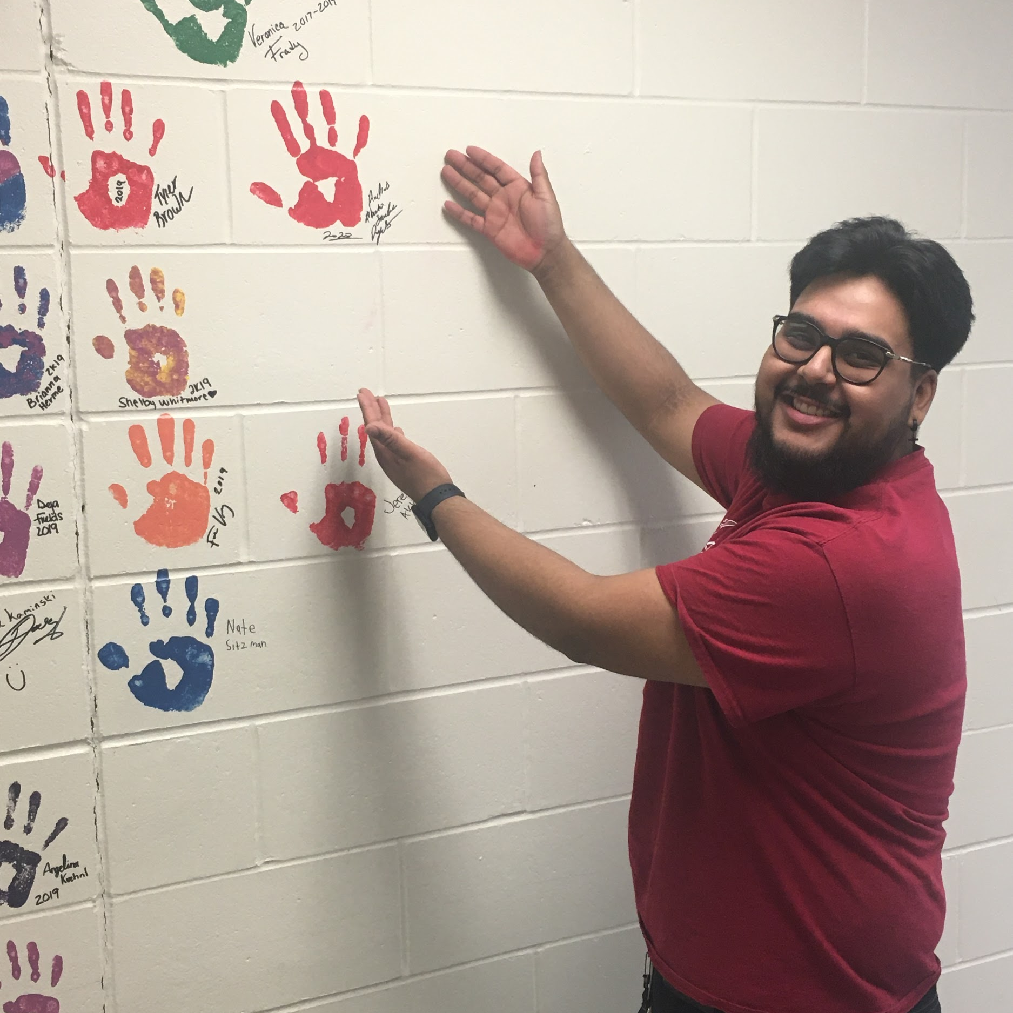
Where we are going?
South Washington Alternative High School
As our district continues to grow, there is a need for our programs to grow so that we can proportionally serve our district’s population of students. Under the umbrella of an ALC will be able to do this more comprehensively.
Long-range facilities plan will assist in addressing physical space needs that will allow us to serve more students. This could include:
Potentially housing a middle school component in the future.
Doubling our current enrollment.
Expansion of innovative learning opportunities with art, science, STEM learning spaces and additional community partnerships.
Stronger emphasis on career and college readiness with additional career and technical education classes.
Notes:
Ashley

Slide 15
Questions

