Slide 1
Fall 2019 Class Presentation
LBUSD Graduation Requirements
College/University Admission Requirements
Preparing for College
Time Management
Class of 2022
Sato Academy of Mathematics and Science
1100 Iroquois Avenue,
Long Beach, CA 90815
(562) 598-7611
September 14, 2018

Slide 2
Post secondary Options
Post secondary Education
Apprenticeship/Certificate/Vocational Programs
Community College
4-year College (including military academies)
Employment
Military Enlistment
Other: Gap Year Program
https://gapyearassociation.org/
https://www.teenlife.com/category/gap-year/
http://usagapyearfairs.org/programs/

Slide 3
LBUSD Graduation Requirements
Subject Area # of Credits Important Notes
English 40
History/Social Science 30
Mathematics 40
Physical Education 20 If fitness test is not passed in 9th or 10th, must take Fitness Conditioning in 11th and/or 12th
Science 20 One year of Physical and one year of Biological Science
Fine Arts or World Language 10 The Intro to Design class meets this requirement
Electives 60
TOTAL: 220 credits
Additional Requirement: Pass Algebra 1 (You’ve met this requirement if you passed it in 8th grade)

Slide 4
College /
University
Admission
Requirements

Slide 5
California State University (CSU) calstate.edu/apply University of California (UC) admission.universityofcalifornia.edu/freshman/requirements/index.html A-G Requirements
Subject # of Years
A History 2 One year of World History + One year of USH
B English 4
C Mathematics 3 Algebra 1, Geometry, Algebra 2, or above
D Laboratory Science 2 One Biological and One Physical
E Language Other than English 2 Two years of the same language
F Visual / Performing Arts 1 Intro to Design will meet this requirement
G College Preparatory Elective 1 Extra year of above areas or an approved
course.

Slide 6
Preparing for College: What to do now?
Aim for grades acceptable by colleges, universities, internship programs, and scholarships.
Know your post-secondary options – what to do after high school
Start or continue exploring careers
Start or continue doing extracurricular activities
Continue with test prep

Slide 7
GRADES
Letter Grades Point Value
A = 4 B = 3
C = 2 D = 1
F = 0
A, B, C, & D are passing grades, credits will be earned.
CAUTION:
1. Certain courses require a grade of “C” to advance to the next level (ex world language).
2. No credits will be earned for courses repeated to improve a “D” grade.

Slide 8
Honors / AP Grade’s Point Values
Letter Grade Point Value
A 5
B 4
C 3
D 2
F 0

Slide 9
How to Calculate a Grade Point Average (GPA)
Course Grade Point Value
Algebra A 4
English C 2
Biology D 1
PE F 0
Computer Apps B 3
Total Points 10
Divide Total Points (10) by # of Courses (5)= 2.0 GPA

Slide 10
CREDITS
A passing grade will give you:
1 semester = 5 credits
1 school year = 10 credits
9th 7 classes x 10 credits = 70
10th 7 x 10 = 70 10th grade 140 credits
11th 7 x 10 = 70 11th grade 210 credits
12th 7 x 10 = 70 12th grade 280 credits
TOTAL: 280 credits

Slide 11
How are grades earned?

Slide 12
Schoolwork
What are they?
Classwork
Assignment / Homework
Tests / Quizzes
Projects

Slide 13
Completing schoolwork: What do you gain?
Acceptable grades (C or better)
Knowledge
Develop good Work ethics / Professionalism

Slide 14
Grades
indicate your progress or lack of it
indicate your mastery of the lesson
are part of the criteria for colleges/universities, scholarship committees, and employers

Slide 15
Gain Knowledge
When schoolwork is done,
learning continues.
lesson learned from class discussion and lecture will add on to previous knowledge.
you will have the opportunity to check for understanding and seek clarification when needed.

Slide 16
Work Ethics / Professionalism
Completing schoolwork:
provides the opportunity to develop work ethics / professionalism.
is equivalent to being productive in performance evaluation, the process by which an employee is rated based on a company’s rating scale of a what a worthy employee is.

Slide 17
What happens when schoolwork is not completed/done and turned in?
Low / Failing grades
May put high school graduation at risk
Will not meet college/university admission requirements
Will not meet scholarship requirements
Work permit may not be approved
Poor letter of recommendation
Limited or may not qualify for internship programs
May have to attend summer school

Slide 19
Activities / Extracurriculars
Activity / Extracurricular Meeting Day Time
____________________ ___________ _____
____________________ ___________ _____
____________________ ___________ _____
__________________ __________ _____
How are your grades?
Do you stay up late at night completing your homework?
Are you able to complete your homework and turn it in on time?
Do you feel that you have too much to do?

Slide 20
Find / Create a study place at home
Good lighting
Table /Chair
Noise free
Clutter free

Slide 21
Supplies
Pens/ pencils / eraser
Paper
Textbook / handout if needed
Computer / laptop if needed

Slide 22
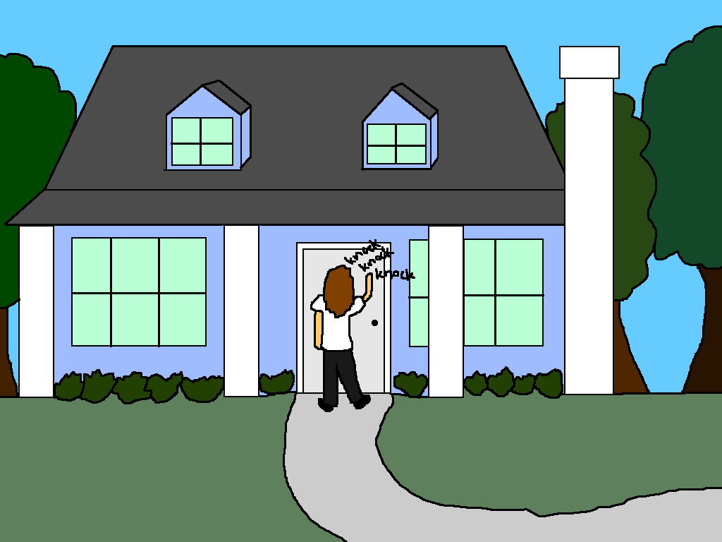
What time do you get home?
Monday ________________
Tuesday ________________
Wednesday ________________
Thursday ________________

Slide 23
Divide Your Time
Mon / Wed Tues / Thurs
30 minutes
30 minutes
30 minutes
30 minutes
30 minutes
30 minutes
30 minutes
30 minutes

Slide 24
Give yourself a break
Take 5 or 10 minutes break in between the 30 minutes block.

Slide 25
What about weekends?
These are your days off if you completed your homework and other required work.
If there are projects or left over homework to do, dedicate about 1 or 2 hours between Friday, Saturday, and Sunday.

Slide 26
What time is bedtime?
8 to 9 hours is the recommended sleep time for adolescents.
Example: If you need to wake-up at 5 am to get ready and be in school on time, you need to sleep around 8 pm the night before to get at least 9 hours of sleep.

Slide 27
What if homework is not complete?
Things to think about:
Do you understand the homework (lesson, instruction, etc)?
Do you feel you have too much on your plate?
Have you taken advantaged of homework help?
Get

Slide 28
Where to get help
Teachers – talk to your teachers if you need help or clarification.
You can talk to them personally or through school loop mail.
Most teachers are available on Tues & Thurs from 8:55 am to 9:25 am
Friday from 7:50 am to 8:25 am
Homework Help in Rm. A-4
Tuesday & Thursday from 7:50 am to 9:25 am
Tuesday, Wednesday, & Thursday during lunch
Thursday after school from 3 to 4 pm

