Slide 1
Getting Control of Online Purchasing MSBO Annual Conference April 2021
Digital Transformation of Educational Procurement
Sharon Raschke, Dexter Community Schools
Jalen Almodovar, Amazon Business - Education
AMAZON BUSINESS CONFIDENTIAL

Slide 2
Intro Learn best practices in managing online purchasing for your school district. Learn how to guide purchasing practices within your district and establish effective internal controls.
Get Control of Online Purchasing
AMAZON BUSINESS CONFIDENTIAL AB_2.0_2019Sep01

Slide 3
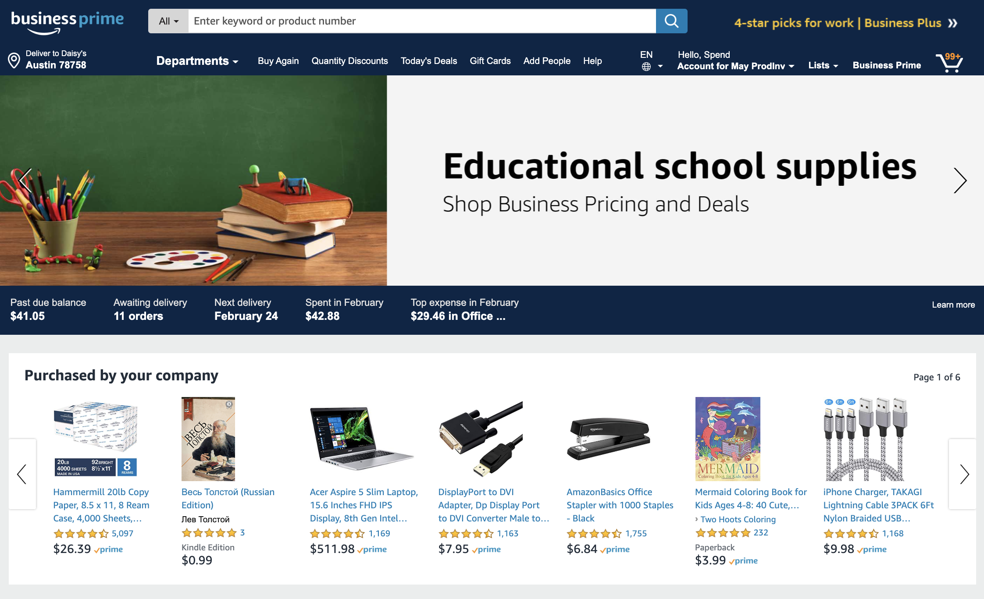
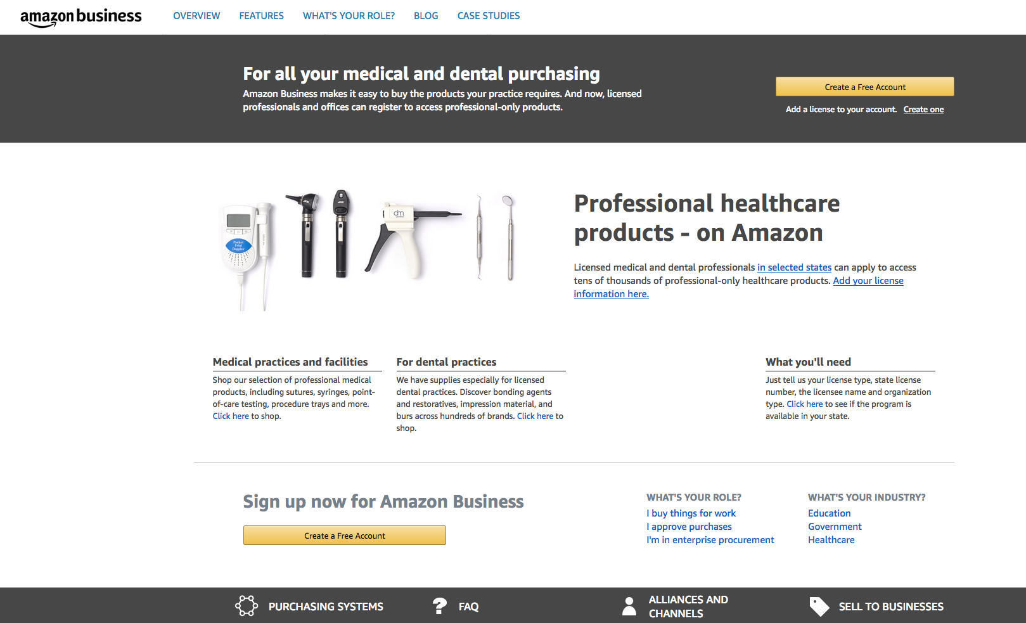
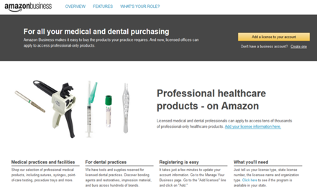
Agenda
Amazon Business
Journey with Dexter Community Schools
Resources
Call to Action
FPO
Amazon Business confidential

Slide 4
Amazon Business - Education
A user-friendly online buying experience makes finding and purchasing supplies easy and built-in tools make approvals effortless. More than 80% of orders are reviewed by the appropriate school or district approver.
Consolidate misc. spend into one channel. Administrators can set guidelines for buyers and simply monitor compliance. Use purchase order or district purchasing card to make it even simpler for those in your organization to purchase and for administrators to reconcile invoices and track spending. Assure tax exempt upfront to avoid after the fact hassle.
Stretch your budget further with business-only pricing, discounts and flexible payment options. Plus, get supplies faster so you are ready for wherever the learning journey leads.
Invoice or Purchasing Card

Slide 5
Starting the Conversation
Jalen called Dexter Community Schools regarding spend taking place on the consumer side of Amazon vs. Amazon Business. Sharon gave Jalen an ear full. “Ready to pull the plug”
We had an open conversation regarding the challenges and opportunities of Amazon Business in Dexter and correspondingly for K-12 across Michigan

Slide 6
Look inside the Day-to-Day Operations
Individuals using P-Cards to order from Amazon & Amazon Business
Managing orders for building secretaries via links, emails, sticky notes
Request for reimbursement
Charged tax for school related purchases

Slide 7
Overview of our conversation
Pain Points:
Goals:
To harness the popularity, convenience and power of Amazon
Apply tax exemption to all Amazon purchases
Reduce expense report reimbursements
Restrict shipments to personal homes
Controlling Amazon as it grows
Visibility to Amazon use
Charged tax for purchases
Shipping costs

Slide 8
Actionable Steps
How do we get to our North Star?
Analyze utilization over multiple years Business review to identify patterns in spend for the district
Demonstration of Amazon Business - Education Since joining in 2016, we addressed changes for Dexter Community Schools and Amazon Business
Training & Project Planning Strategic engagement to have a plan that we can follow
Implementation Customizing the account to fit specific requirements

Slide 9
Centralized Account Structure and Approval Workflow
Account
Dexter Community Schools
Groups
Central office
High school
Middle school
Elementary school
User
Bookkeeper/ Secretary
Bookkeeper/ Secretary
Bookkeeper/ Secretary
Bookkeeper/ Secretary
Users
Staff
Staff
Staff
Staff

Slide 10
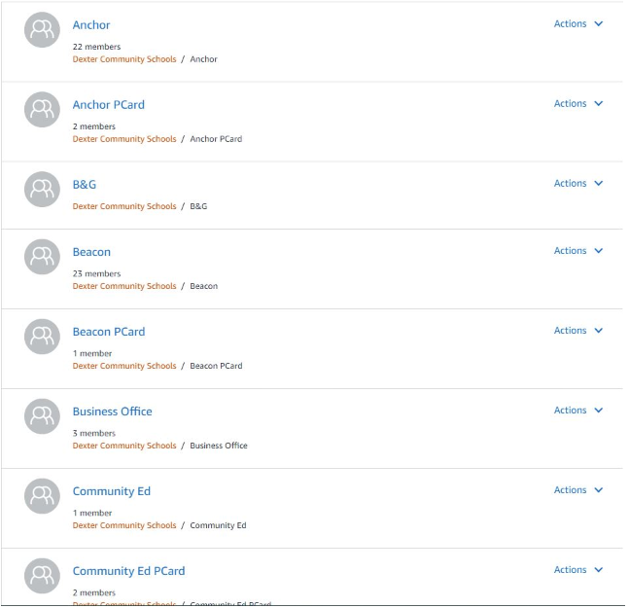
Group Structure
Value:
Clean Reporting
Customized Education Workflow
Flexibility for Payment Methods
Internal Controls

Slide 11
Account Authority
Establish ownership of the district email domain
Benefits
Account Authority is a feature that consists of several policies that allow Amazon Business customers to establish their ownership of a business account and increase control over accounts and users to reduce unauthorized spend and enforce best practices.
Unlock powerful account administrative actions to increase control, stay compliant, and reduce personal or other unauthorized purchases
Provides an efficient path for users to merge their existing business accounts under the centralized account
Decreases risk by preventing the creation of non-compliant accounts in the future

Slide 12
Payment Options
Payment Flexibility with Amazon Business
Purchasing Card
Use your existing purchasing card program. PFM/BMO is the P-Card program available to schools through MSBO
Amazon Business Pay by Invoice
If you still use purchase orders Amazon Business can accommodate your PO process
Footnote: ¹Depending on plan

Slide 13
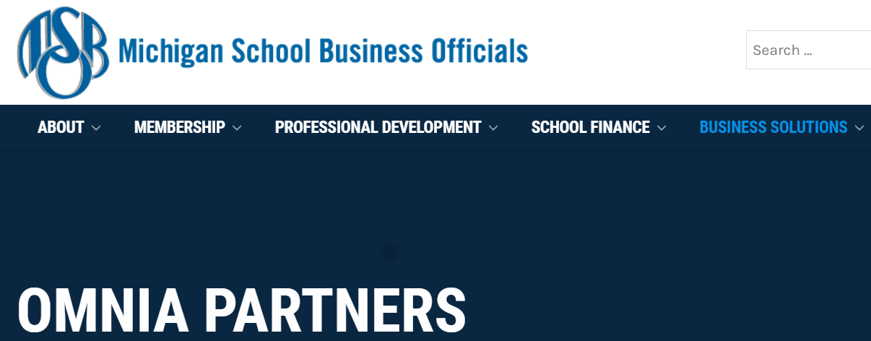
OMNIA Partners
All OMNIA Partners, Public Sector, are competitively solicited and publicly awarded using applicable procurement laws and regulations.
Amazon was awarded a contract via Prince William County Public Schools for an On-line Marketplace making Amazon available to all public schools
Meet bid requirements when purchasing with Amazon Business

Slide 14
Typical education customers can save enough in shipping costs to recover the price of Business Prime, depending on their planned Amazon Business spend:
Public Sector
Business Prime Pricing
Price: Public Sector Enterprise : +100 = $3,499 Medium : Less than 100 = $1,299
Small: Up to 10 = $499 Essentials: Up to 3 = $179
Single membership for the entire business
Business Delivery
Free Two-Day Shipping
Free One-Day Shipping
Free Same-Day Delivery*
Free Consolidated Shipping
Amazon Day Delivery*
*For eligible orders
Pricing Benefits
Progressive Discounts
Prime Exclusives
Prime Day Deals
Procurement Benefits
Spend Visibility powered by Amazon QuickSight
Guided Buying
2 authors
5 readers
Prefer, Restrict, Block
Payment Benefits
Extended Terms for Pay by Invoice with eligible membership plans upon approval
5% Back or 90 Day Terms
For Amazon Business Prime American Express Card Members: Choose 5% Back or 90 days to pay interest free, during checkout at Amazon.com and Amazon Business (U.S.). Subject to credit approval. Terms Apply. See americanexpress.com/AmazonBusinessCardTerms
Flat 60 Days

Slide 15
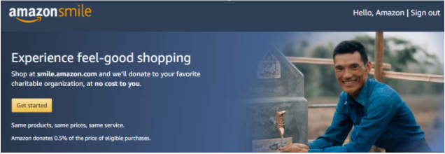
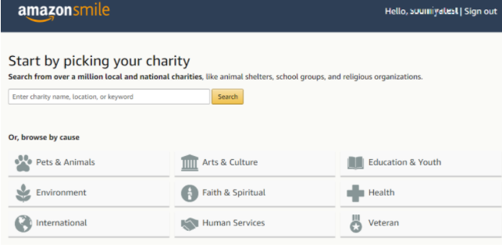
ELIGIBLE
What is AmazonSmile?
When you shop on AmazonSmile, the AmazonSmile Foundation will donate 0.5% of the purchase price of eligible products to the charitable organization of your choice, which could be the foundation established for your organization which could be your public school district itself.
One Organization Per Tax ID
Set your school up as a charitable organization. Have your employees connect your organization one-time to their Amazon Business login. You can internally decide to record the donation to general fund or a special revenue fund.
See your chosen Organization
Any time you are logged into AmazonSmile, your charity is displayed below the search bar. Use the drop down to see how much your shopping has contributed.
Purchase through AmazonSmile
Go to: smile.amazon.com

Slide 16
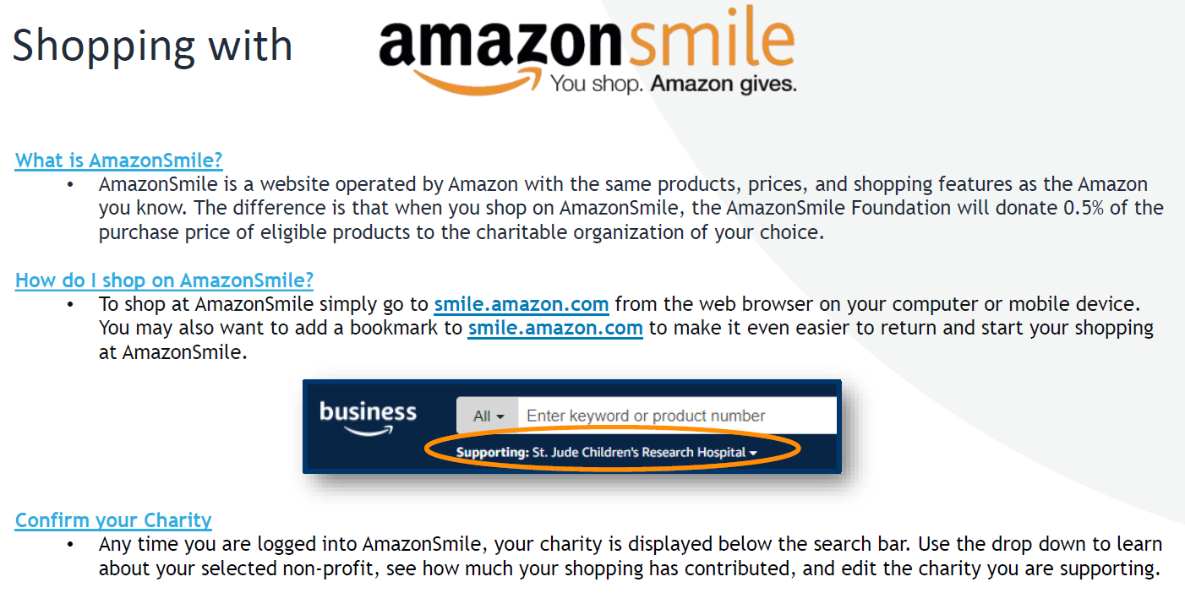

Slide 17
Impact on Faculty/Staff
Reduce Time
Provided tool for the district to use for purchasing with Amazon
Formal Process
Cost Savings
Larger Catalog
Amazon Business confidential

Slide 18
Where are we today
Changes to account set up for Dexter Community Schools
Use new tax exempt set up
Set up groups with Education Approval Workflow
Standardized shipping addresses per group
Set up AmazonSmile connection
Enabled Debarred vendor settings to meet the requirements
Weekly-meeting cadence with business office coordinator
Rolling out the entire district

Slide 19
Looking Forward
Strategic partnership to maintain Internal Controls and cost savings
District Relaunch on a Centralized Account
Spend Analysis – Competing Vendors
Amazon team can help you look at your primary vendors
Education Market Development
Amazon has an ear to the education community and striving to make Amazon Business the go-to for Educators.

Slide 20
Recap: Internal Control
Centralized Account Strategy
Education workflow
One blanketed tax exemption
Account Authority/ “Claim the Domain”
Shipping
Payment method
Debarred Sellers
Business Analytics

Slide 21
What Now?
Resources
Action item
Amazon Business - Education
Contact Sharon for open dialogue
Name: Sharon Raschke
Email: Raschkes@dexterschools.org
Direct: 734.424.4107
Refer to Dexter Community Schools – Amazon Business Procedures for a template
Contact Jalen to discuss strategic partnership for your district
Name: Jalen Almodovar
Email: jalenalm@amazon.com
Direct: 737.402.8921
Amazon Business confidential

Slide 22
Thank You

