Slide 1
Acadience Reading Middle-of-Year Results

Slide 2
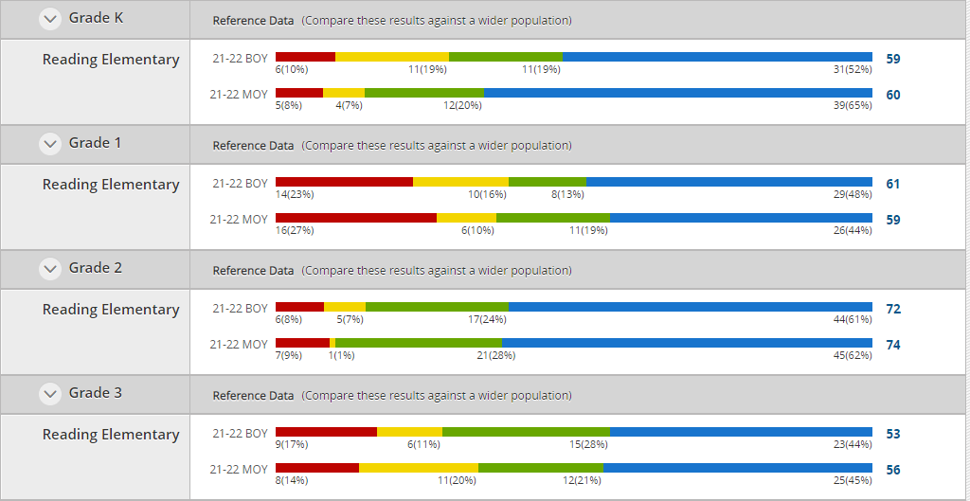

Slide 3
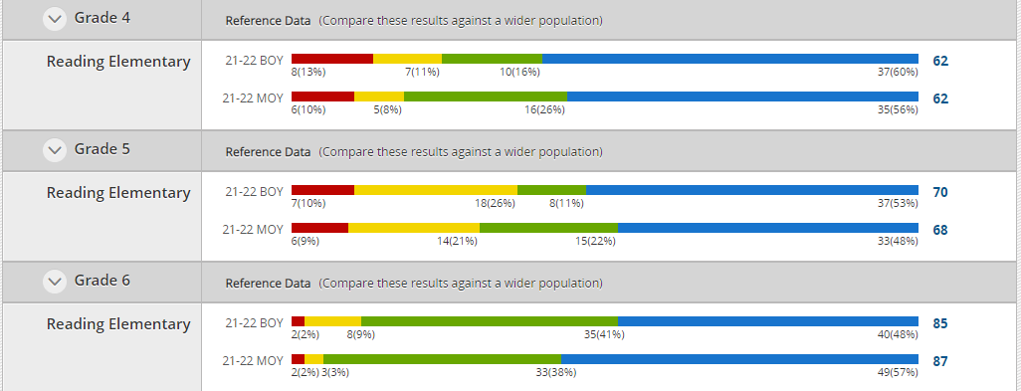

Slide 4
Acadience Math Middle-of-Year Results

Slide 5
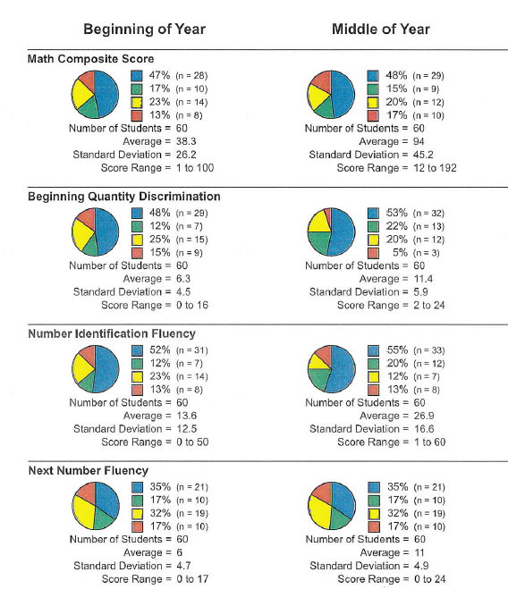
KINDERGARTEN
Math Composite Score results are very similar to BOY.
Beginning Quantity Discrimination = +15%
Number Identification Fluency = +11%
Next Number Fluency scores are identical to BOY.

Slide 6
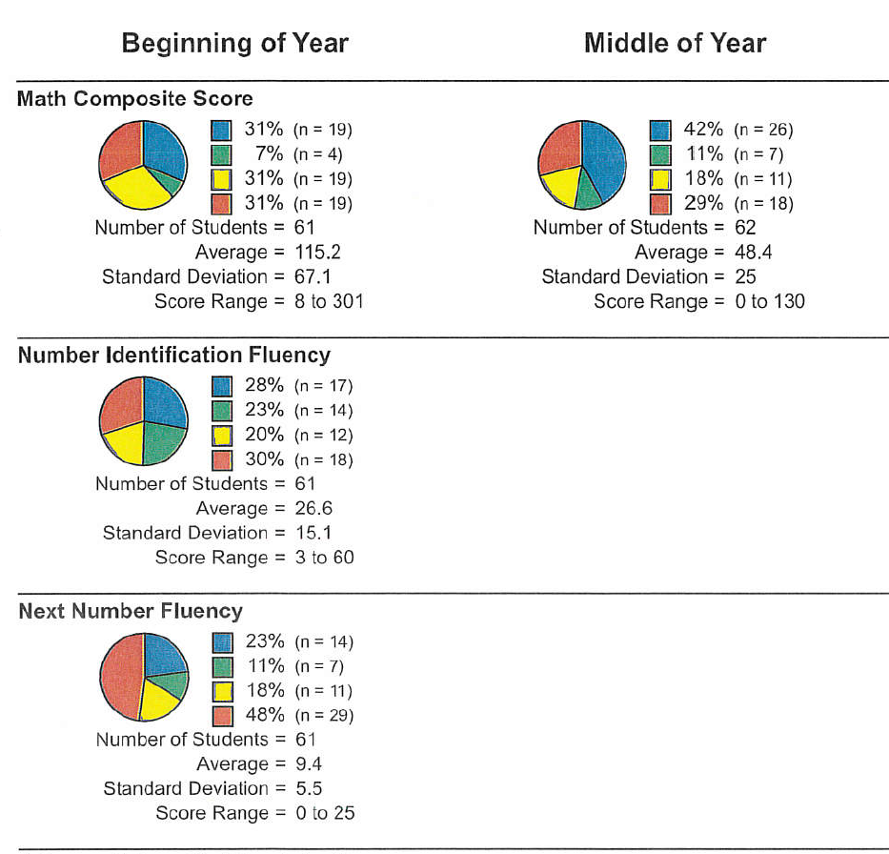
FIRST GRADE
Math Composite Score = + 15%
Number Identification Fluency and Next Number Fluency subtests are not administered again after BOY.

Slide 7
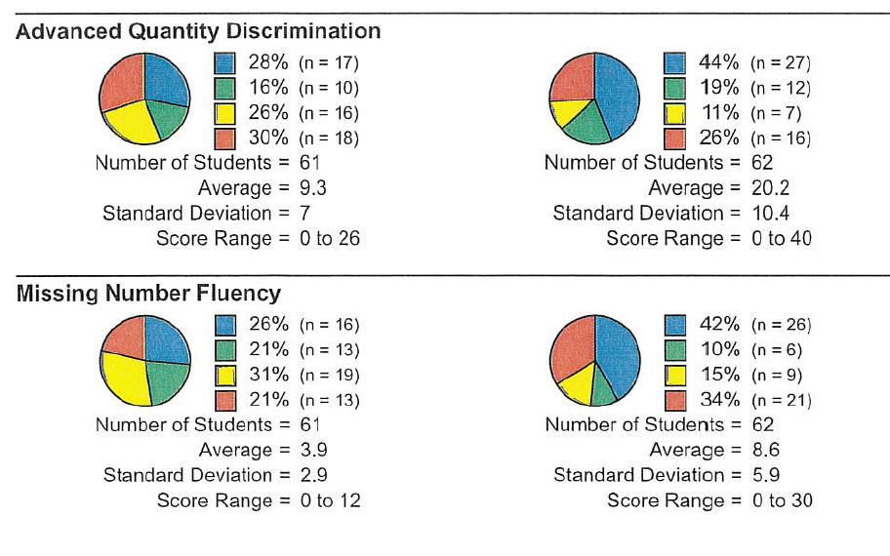
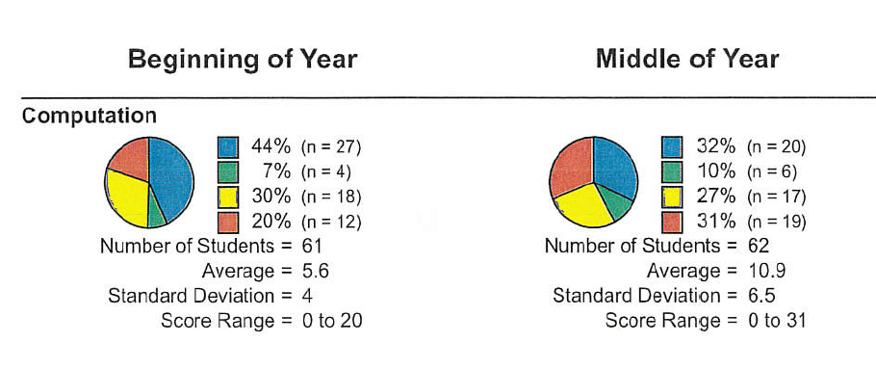
FIRST GRADE
Advanced Quantity Discrimination = +19%
Missing Number Fluency = +5%
Computation scores have dropped even though the average correct is up

Slide 8
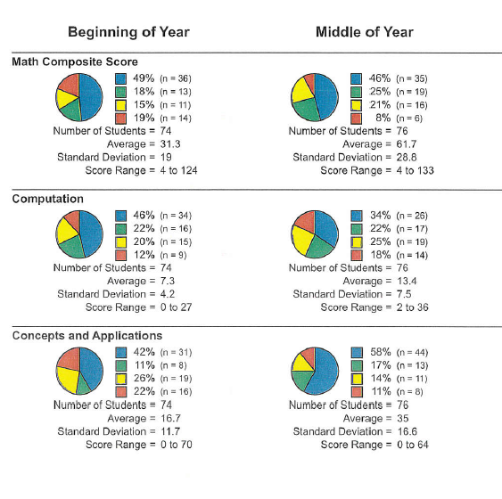
SECOND GRADE
Math Composite Scores = +4%
Computation scores have dropped slightly even though the average correct is up
Concepts and Applications = +22%

Slide 9
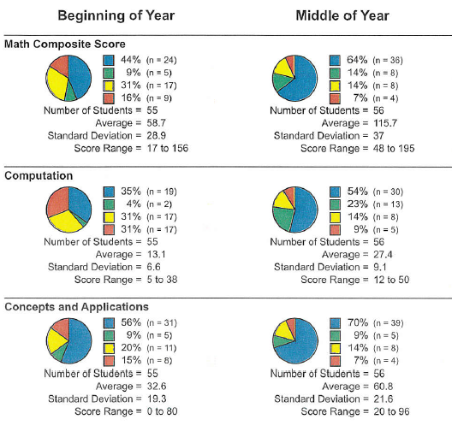
THIRD GRADE
Math Composite Score = +25%
Computation = +38%
Concepts and Applications = +14%

Slide 10
Climate Surveys
No Data Yet…we are collecting these surveys from students this week

Slide 11
ST Math Progress
Students have solved 466,109 puzzles this year.
All 485 students have signed in. This chart shows how many are signed in daily.
13 classes are on track – but 8 classes are not…yet

Slide 12
13 classes are on track – but 8 classes are not…yet
Class Table
Grade | Average % Progress | Average Week Minutes | Average Week Puzzles | This Year Puzzles
2nd Grade | 53 | 70 | 69 | 37637
2nd Grade | 46 | 69 | 62 | 36239
5th Grade | 52 | 59 | 54 | 31211
Kindergarten | 59 | 42 | 64 | 27876
Kindergarten | 55 | 44 | 61 | 27392
Kindergarten | 53 | 43 | 60 | 26562
5th Grade | 38 | 50 | 40 | 23517
3rd Grade | 43 | 56 | 54 | 23250
5th Grade | 37 | 41 | 42 | 22912
1st Grade | 44 | 37 | 48 | 22217
6th Grade | 25 | 32 | 33 | 22063
3rd Grade | 38 | 44 | 49 | 21488
2nd Grade | 27 | 35 | 35 | 20355
4th Grade | 22 | 44 | 28 | 20142
6th Grade | 22 | 38 | 28 | 19982
3rd Grade | 35 | 52 | 44 | 19694
4th Grade | 20 | 43 | 26 | 19659
1st Grade | 37 | 43 | 38 | 17535
1st Grade | 28 | 33 | 31 | 14229
6th Grade | 10 | 18 | 13 | 8781

