Slide 1
Sayreville Board of Education Business Meeting
Tuesday, December 20, 2016

Slide 2
CALL TO ORDER

Slide 3
PLEDGE TO THE FLAG

Slide 4
PUBLIC NOTICE
Take notice this public meeting of the Sayreville Board of Education was e-mailed to The Home News Tribune and the Star Ledger in accordance with Chapter 231, Public Law 1975. Further in accordance with N.J.S.A. 10:4-6 to 10:4-21, a copy of this notice was posted outside the Board Secretary's Office and a copy was also filed with the Clerk of the Borough of Sayreville.

Slide 5
ROLL CALL

Slide 6
STUDENT COUNCIL REPORT
Zachary Corby

Slide 7
PRESENTATIONS
Football Champions – K. Ciak & J. Walsh
iSTEAM – Sergeant First Class Johnson
2017-18 Cafeteria Budget – S. Jenkins

Slide 8
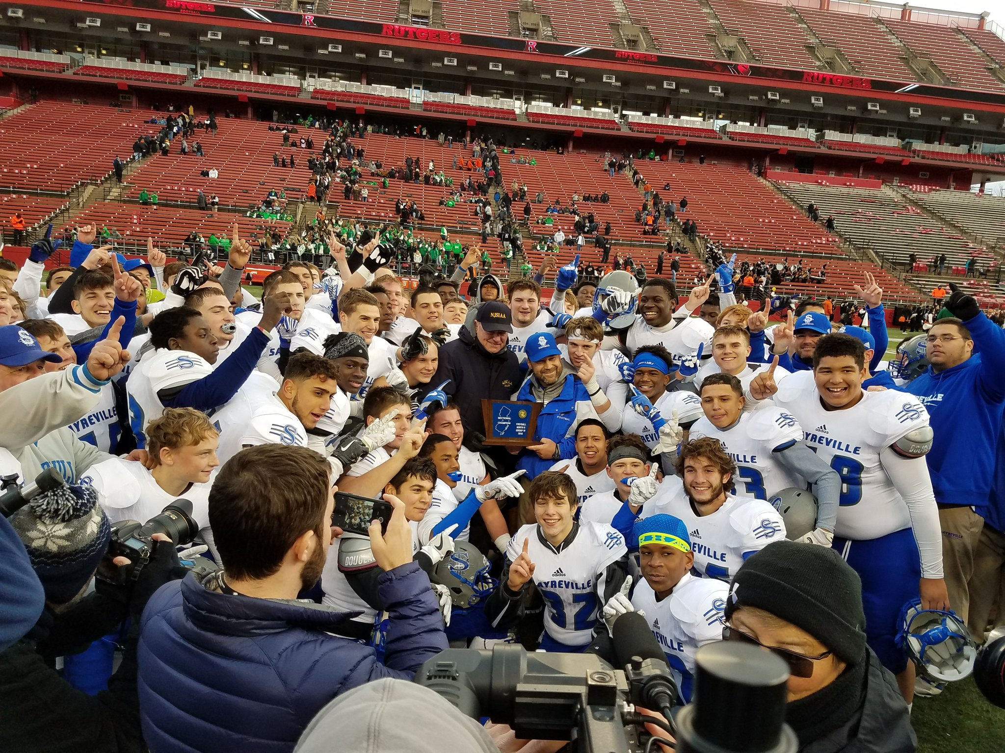
Congratulations to our Group IV North 2 State Football Champions and Coach of the Year!

Slide 9
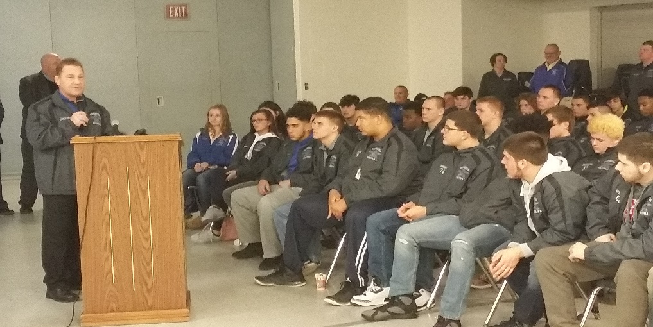
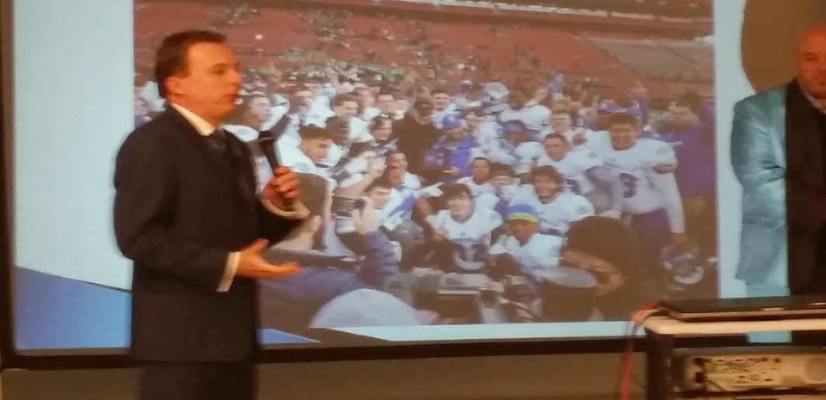
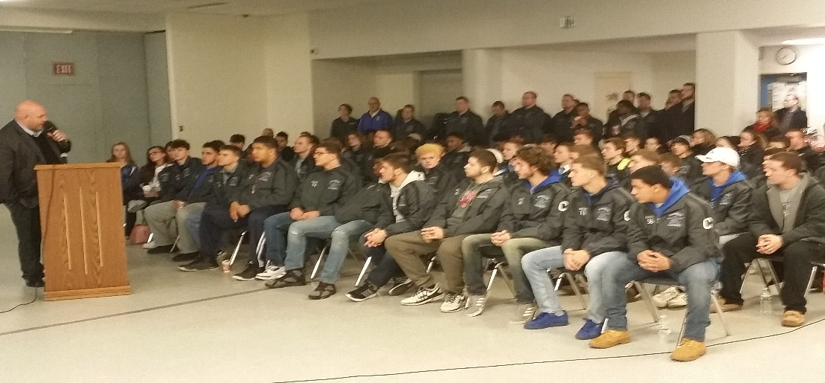
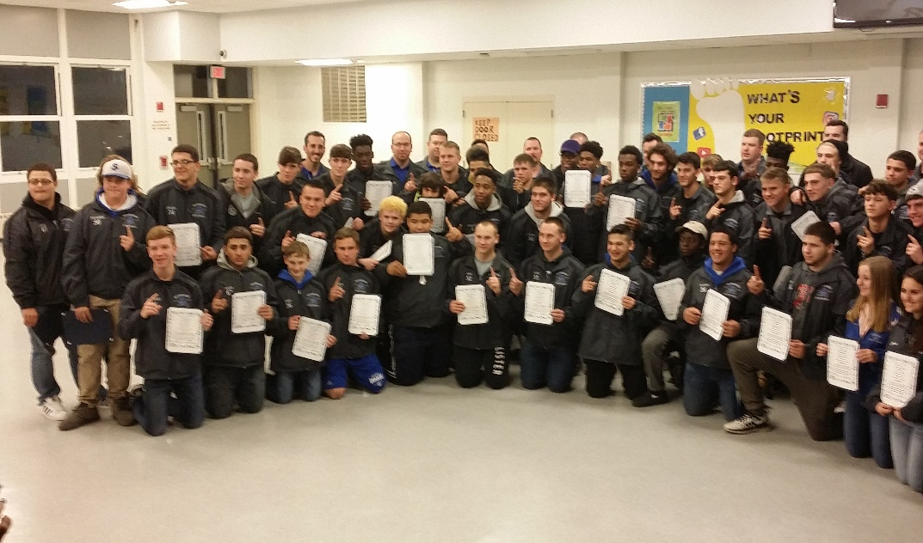
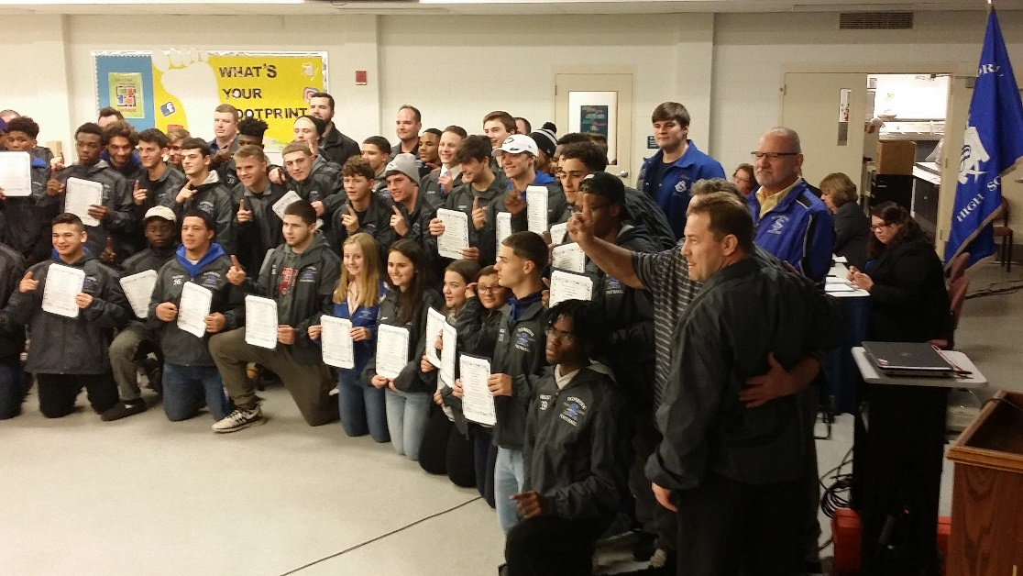

Slide 10
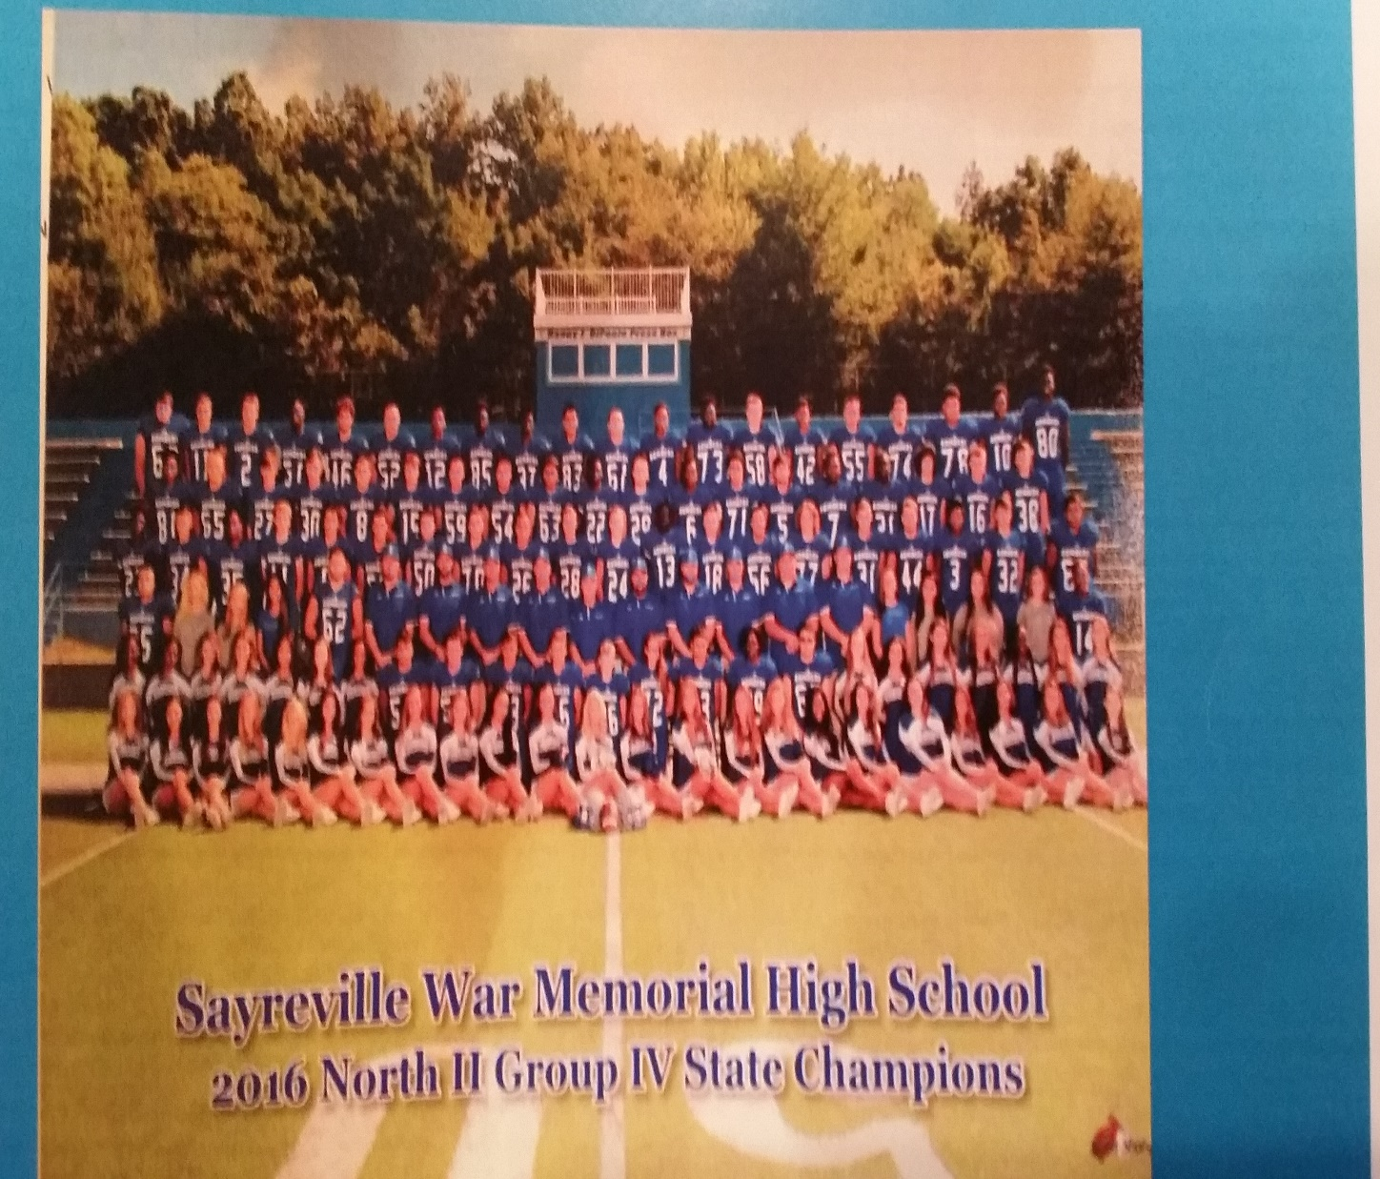
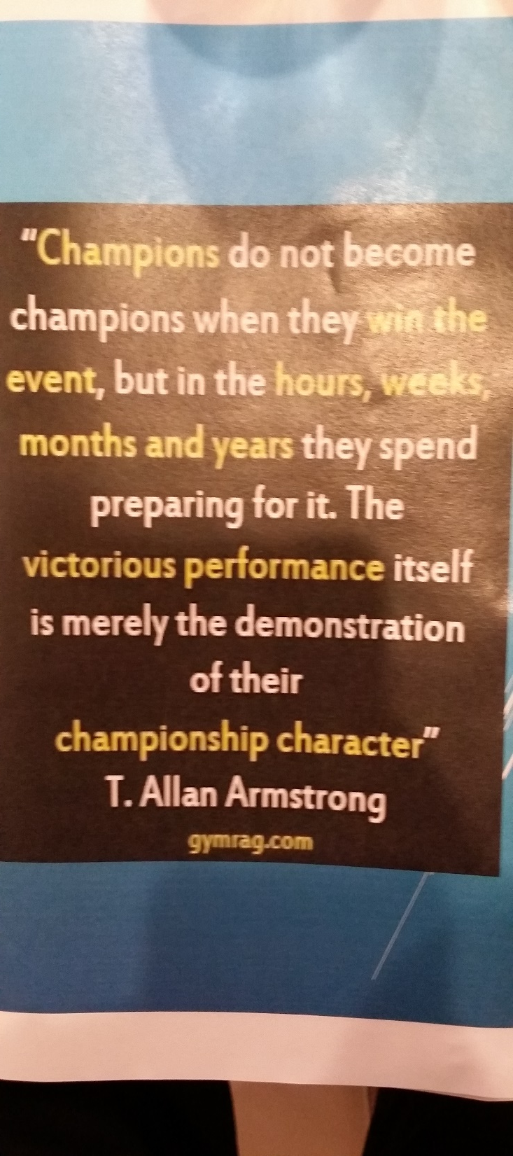

Slide 11
CORRESPONDENCE
Monthly Technology Work-Order Report
Monthly Maintenance Work-Order Reports

Slide 12
APPROVAL OF MINUTES
Minutes of the Regular Meeting and Executive Session of December 6, 2016

Slide 13
SUPERINTENDENT’S REPORT HIGHLIGHTS
A – VISION 2030 FINANCE & INFRASTRUCTURE
#12 Approval of non public school technology purchases on page 3.
#13 Approval of a tuition contract with South Brunswick Board of Education for student I.D. # 4125011302 to attend Bright Beginnings Learning Center at a prorated cost of $66,445.00 for the 2016-17 school year, effective September 28, 2016 on page 3.
#14-15 Approval of resolutions to refund all or a portion of the outstanding callable Refunding School Bonds, Series 2007 of the School District issued in the original principal amount of $10,000,000 and dated January 4, 2007 on pages 3-13.
#16 &21 Approval of several building permits, some for a fee in accordance with the district Use of Facilities Fee Schedule on pages 13-14 and the Addendum.

Slide 14
A – VISION 2030 FINANCE & INFRASTRUCTURE
#17 Approval of Joint Transportation Agreements with the Perth Amboy and South Amboy Boards of Education for school year 2016-2017 on page 14.
#18 Approval of the cancellation of a bus route to the Cranford Achievement Academy for the 2016-17 school year on page 14.
#19 & 22 Approval of student trips with transportation costs on pages 14-15 and the Addendum.
#20 Approval of bedside tutoring for three students who are hospitalized, and to purchase assistive communication technology on page 15.

Slide 15
B – VISION 2030 STUDENT ACHIEVEMENT
#1 Approval of the admission of a Kindergarten Student ID#296095 to Wilson Elementary School on page 15.
#2 Approval of new courses for the 2017-2018 school year on page 15.
Foundations of Math and Science 10
Foundations of Language Arts and Social Studies 10
#3-13 Approval of a co-curricular trips and activities on pages 15-16.

Slide 16
C – VISION 2030 Governance
#1 Approval of the December 2016 HIB Report, including any investigations and/or recommendations for action provided by the Superintendent on pages 17-18.
#2 Approval of several revised policies and regulations for a Second Reading on page 18.
Regulation R1330 - Use of School Facilities
Policy 4112.2 - Certification
Policy 4112.4 - Employee Health
Policy 4212.4 - Employee Health
Policy 4112.6 - Personnel Records
Policy 4212.6 - Personnel Records

Slide 17
D – VISION 2030 PERSONNEL
#1& 12-13 Approval of the resignation of a physical education/health teacher at SMS, a special education teacher at SWMHS, and a cafeteria manager at SWMHS on page 19 and the Addendum.
#2-3 Approval of several leave of absences and modifications to previously approved LOAs for the 2016-17 and one for the 2017-18 school year on pages 19-20.
#8 & 15 Approval to hire one tenure track teacher, one replacement teacher, and three replacement guidance counselors for the 2016-17 school year on page 21 and the Addendum.
#9 &17-18 Approval to hire five substitute teachers and two substitute part-time paraprofessionals for the 2016-17 school year on page 22 and the Addendum.
#10 approval of professional days on pages 22-24.
#11 Approval of several teachers to work as Sayreville University presenters during the 2016-17 school year on page 24-25.
#16 Approval to hire two part time paraprofessionals and one bus aide on the Addendum.

Slide 18
MOVEMENT OF SUPERINTENDENT’S REPORT ONTO BOE AGENDA
A – VISION 2030 FINANCE & INFRASTRUCTURE
Discussion Item: Committee Report
B – VISION 2030 STUDENT ACHIEVEMENT
Discussion Item : Committee Report
C – VISION 2030 GOVERNANCE
Discussion Item : Committee Report
D – VISION 2030 PERSONNEL
Discussion Item : Committee Report

Slide 19
PUBLIC PARTICIPATION (AGENDA ITEMS ONLY)*

Slide 20
SUPERINTENDENT’S REPORT APPROVAL
A – VISION 2030 FINANCE AND INFRASTRUCTURE
B – VISION 2030 STUDENT ACHIEVEMENT
C – VISION 2030 GOVERNANCE
D – VISION 2030 PERSONNEL

Slide 21
PUBLIC PARTICIPATION

Slide 22
Upcoming Meeting Dates
Tuesday, January 3, 2017

