Slide 1
Sayreville Board of Education Business Meeting
Tuesday, March 21, 2017

Slide 2
CALL TO ORDER

Slide 3
PLEDGE TO THE FLAG

Slide 4
PUBLIC NOTICE
Take notice this public meeting of the Sayreville Board of Education was e-mailed to The Home News Tribune and the Star Ledger in accordance with Chapter 231, Public Law 1975. Further in accordance with N.J.S.A. 10:4-6 to 10:4-21, a copy of this notice was posted outside the Board Secretary's Office and a copy was also filed with the Clerk of the Borough of Sayreville.

Slide 5
ROLL CALL

Slide 6
STUDENT COUNCIL REPORT
Zachary Corby

Slide 7
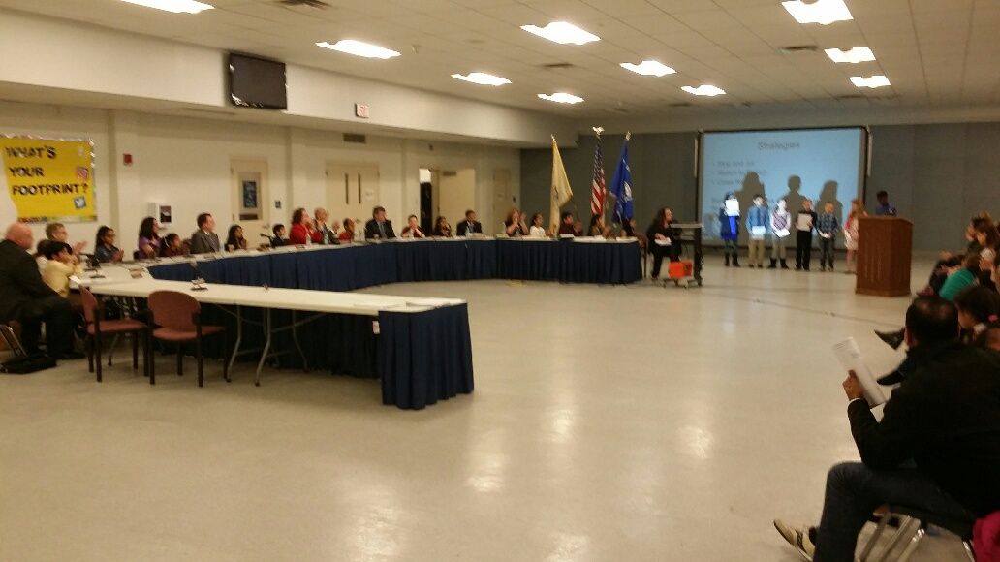
PRESENTATION
Let the Children Lead
Samsel Kids' Reading CAFÉ – Ms. Coyle and Ms. Aloisio

Slide 8
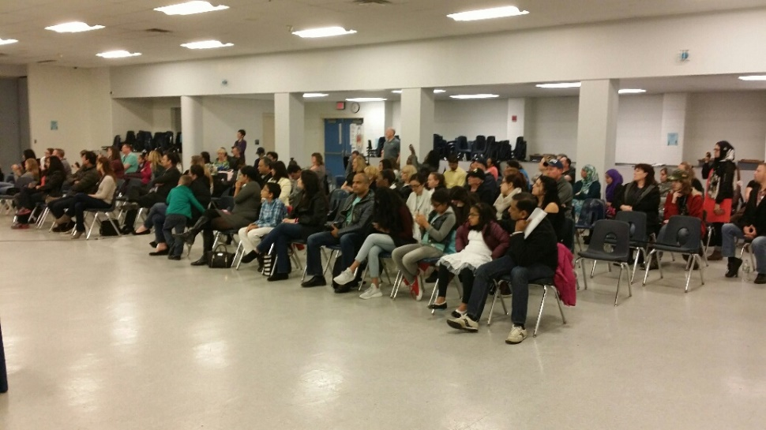
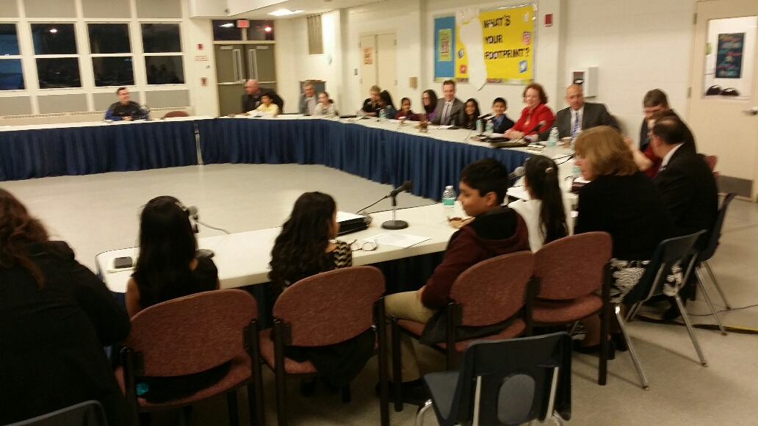
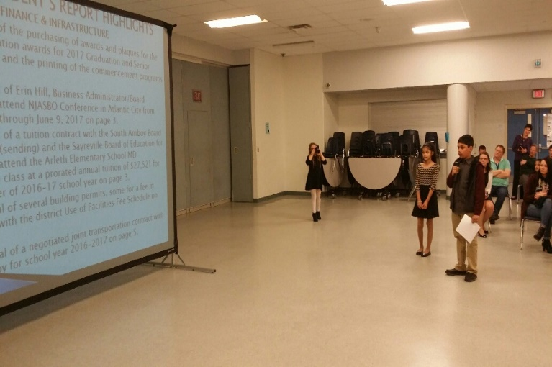
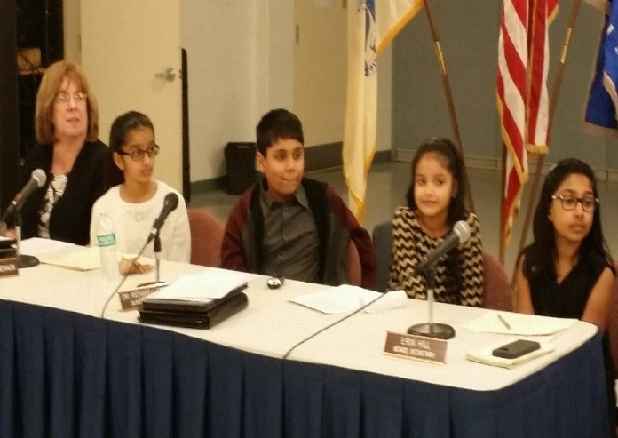
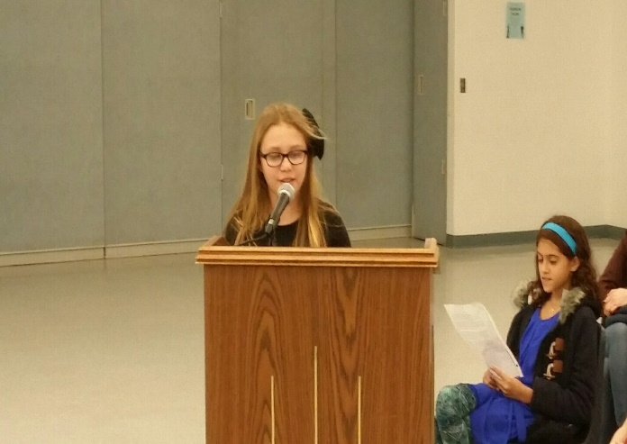
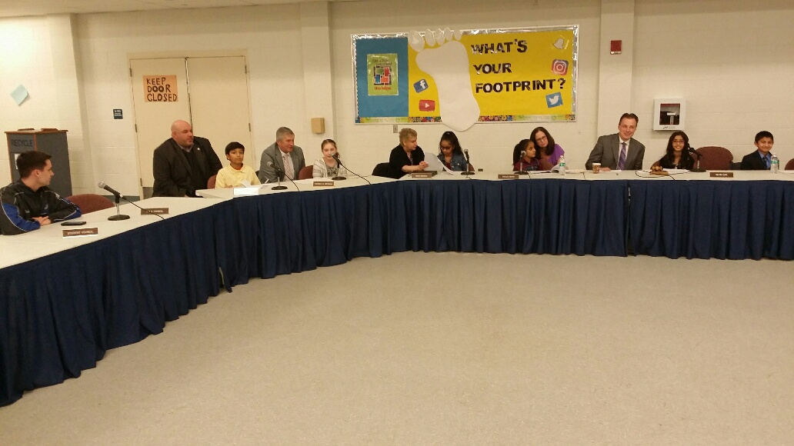
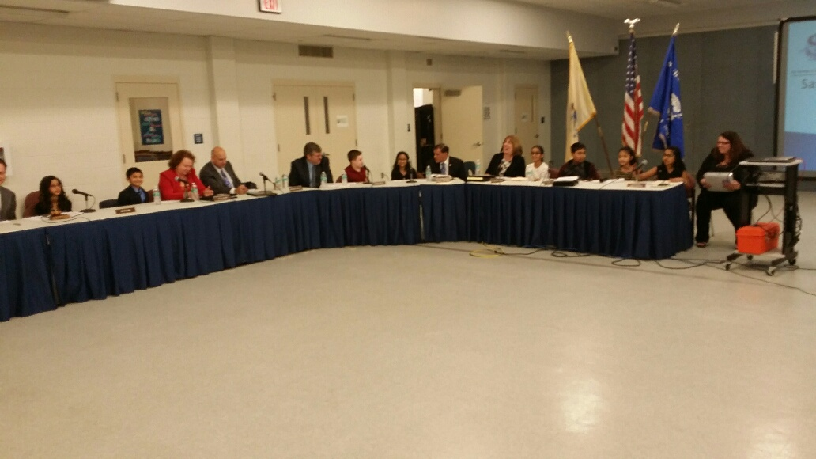

Slide 9
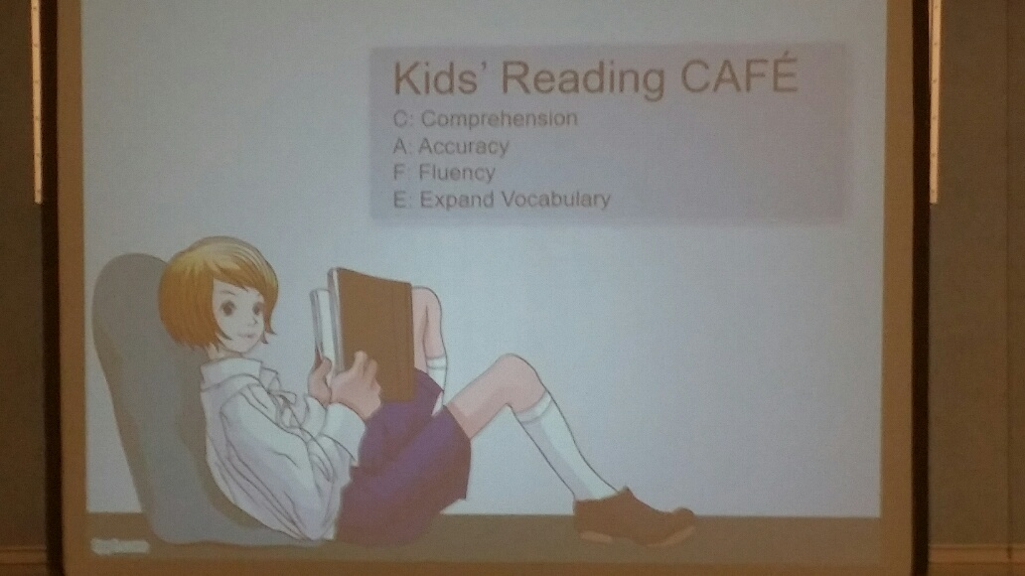
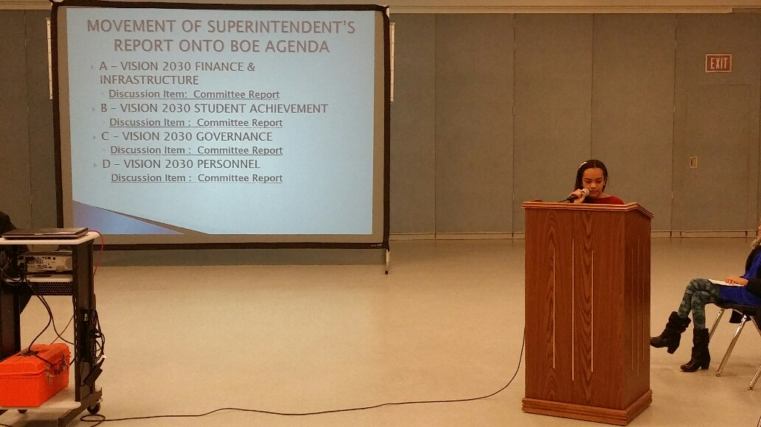

Slide 10
CORRESPONDENCE
Monthly Technology Work-Order Report
Monthly Maintenance Work-Order Reports

Slide 11
APPROVAL OF MINUTES
Approval of the Regular & Executive Session of March 7, 2017

Slide 12
SUPERINTENDENT’S REPORT HIGHLIGHTS
A – VISION 2030 FINANCE & INFRASTRUCTURE
#12 Approval of the purchasing of awards and plaques for the Board of Education awards for 2017 Graduation and Senior Awards Night, and the printing of the commencement programs on page 3.
#13 Approval of Erin Hill, Business Administrator/Board Secretary, to attend NJASBO Conference in Atlantic City from June 7, 2017 through June 9, 2017 on page 3.
#14 Approval of a tuition contract with the South Amboy Board of Education (sending) and the Sayreville Board of Education for a student to attend the Arleth Elementary School MD Kindergarten class at a prorated annual tuition of $27,521 for the remainder of 2016-17 school year on page 3.
#15 Approval of several building permits, some for a fee in accordance with the district Use of Facilities Fee Schedule on pages 3-4.
#16 Approval of a negotiated joint transportation contract with South Amboy for school year 2016-2017 on page 5.

Slide 13
SUPERINTENDENT’S REPORT HIGHLIGHTS
A – VISION 2030 FINANCE & INFRASTRUCTURE
#17-18 Approval of several student trips with transportation costs and a revision to a previously approved trip on pages 5-6.
#19 Approval of one private out of district tuition contract for a student with a disability, bedside tutoring for a hospitalized student, and para professional services for students participating in after school activities at SMS, as well as those participating in the Spring Unified Sports Basketball season on page 6.
#20 Approval to withdraw $360,000 from Capital Reserve for the purpose of renovating the cluster classrooms at the Truman Elementary School on the Addendum.

Slide 14
B – VISION 2030 STUDENT ACHIEVEMENT
#1-3 Approval of co-curricular activities on page 7.

Slide 15
C – VISION 2030 Governance
#1 Approval of the second and final reading of Policy/Exhibit E5141.21 and Regulation R5141.21, Administering Medication on page 7. (Withdraw)

Slide 16
D – VISION 2030 PERSONNEL
#1-2 &12 Acceptance of the retirements of Stephen Fischer, Physical Education/Health Teacher at Wilson Elementary School and Lorraine Lukowski, Art Teacher at Wilson Elementary School, effective July 1, 2017 and Julia McKenna, Resource Teacher for the District, effective April 1, 2017on page 7 and the Addendum.
#3-4 Approval of the resignation of the Administrative Secretary in the Central Registration Department and Substitute Coordinator and a CO-OP Student working in the Library at the Samsel Upper Elementary School on page 8.
#5-6 & 13 Approval of several leave of absences and modifications to previously approved LOAs for the 2016-17 and 2017-18 school years on pages 8-9 and the Addendum.
#7-8 &15 Approval to hire a preschool teacher and two Lunchroom/Playground Aides for the 2016-17 school year and a replacement school counselor for the 2017-18 school year on page 9 and the Addendum.
#9 Approval to restore the 2016-2017 salary increment for an administrator for the 2017-2018 school year, without back pay and not retroactively, effective July 1, 2017 on page 9.
#11 Approval of professional days on pages 10-12.

Slide 17
MOVEMENT OF SUPERINTENDENT’S REPORT ONTO BOE AGENDA
A – VISION 2030 FINANCE & INFRASTRUCTURE
Discussion Item: Committee Report
B – VISION 2030 STUDENT ACHIEVEMENT
Discussion Item : Committee Report
C – VISION 2030 GOVERNANCE
Discussion Item : Committee Report
D – VISION 2030 PERSONNEL
Discussion Item : Committee Report

Slide 18
PUBLIC PARTICIPATION (AGENDA ITEMS ONLY)*

Slide 19
SUPERINTENDENT’S REPORT APPROVAL
A – VISION 2030 FINANCE AND INFRASTRUCTURE
B – VISION 2030 STUDENT ACHIEVEMENT
C – VISION 2030 GOVERNANCE
D – VISION 2030 PERSONNEL

Slide 20
PUBLIC PARTICIPATION

Slide 21
Upcoming Meeting Dates
Tuesday, April 18, 2017
Tuesday, May 2, 2017

