Slide 1
Sayreville Board of Education Business Meeting
Tuesday, June 12, 2018
See the video
See the Agenda
See the Addendum

Slide 2
CALL TO ORDER

Slide 3
PLEDGE TO THE FLAG

Slide 4
PUBLIC NOTICE
Take notice this public meeting of the Sayreville Board of Education was e-mailed to The Home News Tribune and the Star Ledger in accordance with Chapter 231, Public Law 1975. Further in accordance with N.J.S.A. 10:4-6 to 10:4-21, a copy of this notice was posted outside the Board Secretary's Office and a copy was also filed with the Clerk of the Borough of Sayreville.

Slide 5
ROLL CALL

Slide 6
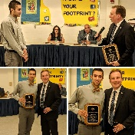
STUDENT COUNCIL REPORT
John Lewis

Slide 7
PRESENTATION
Performance by “Traffic on Washington” – Mr. James Craft
Computer Science Video – “Hack the Ville” – Ms. Atiyah Conry
Boys’ Golf Team – GMC White Division Champions
Boys’ Spring Track Team – GMC White Division Champions
Girls’ Spring Track Team – GMC White Division Champions
Pay for Play – Dr. R. Labbe

Slide 8
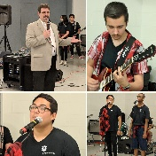
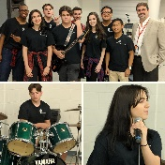
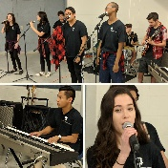
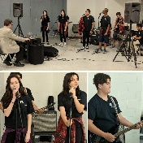
“Traffic on Washington” – Mr. James Craft

Slide 9
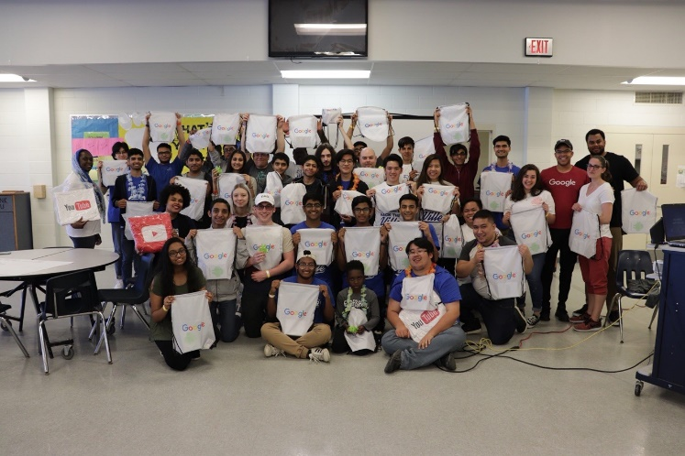
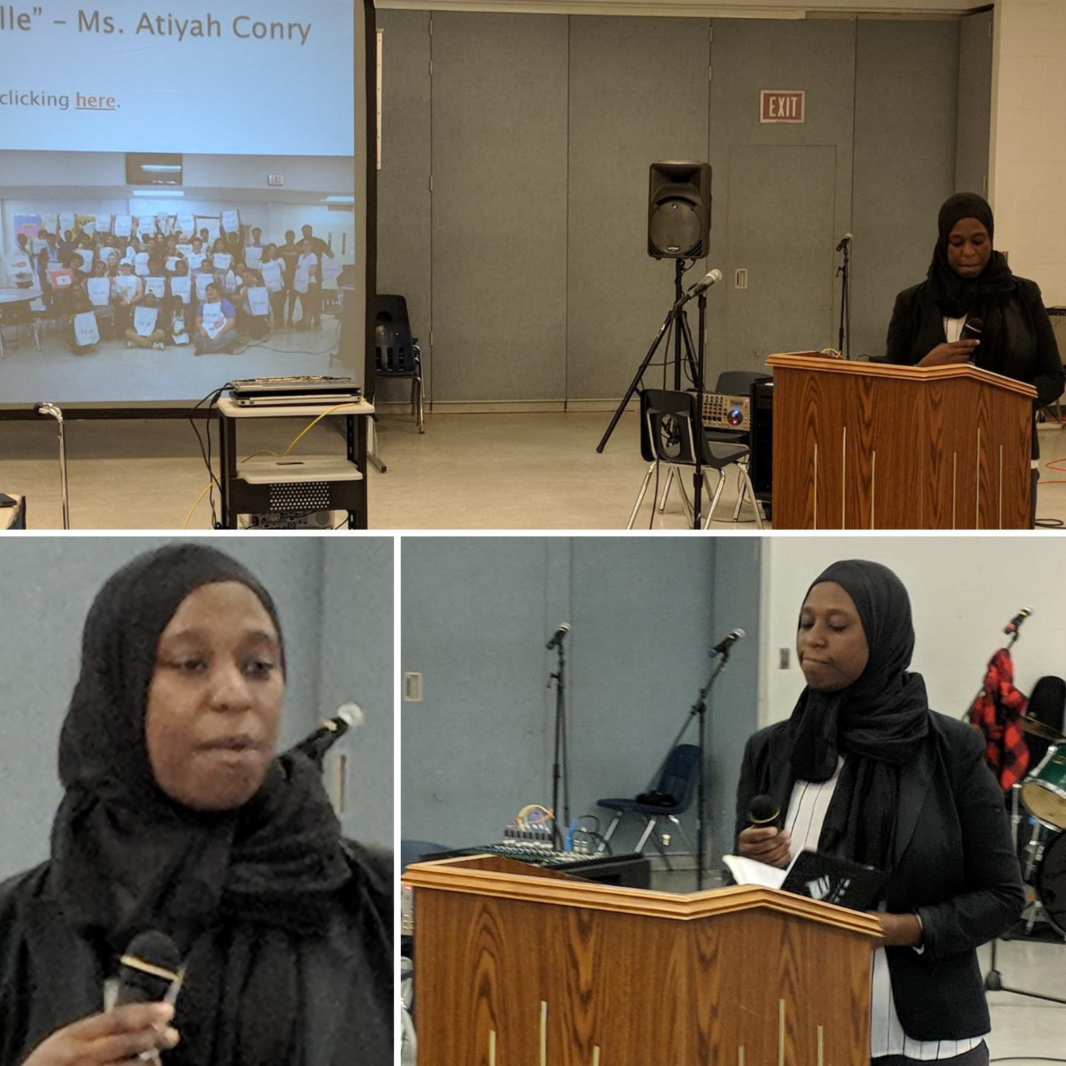
“Hack the Ville” – Ms. Atiyah Conry
See the video by clicking here.

Slide 10
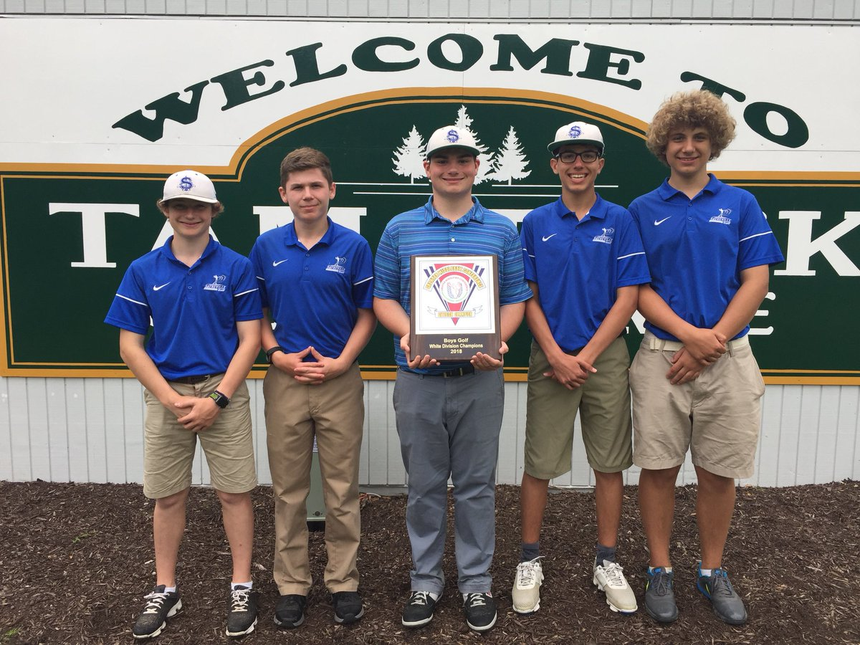
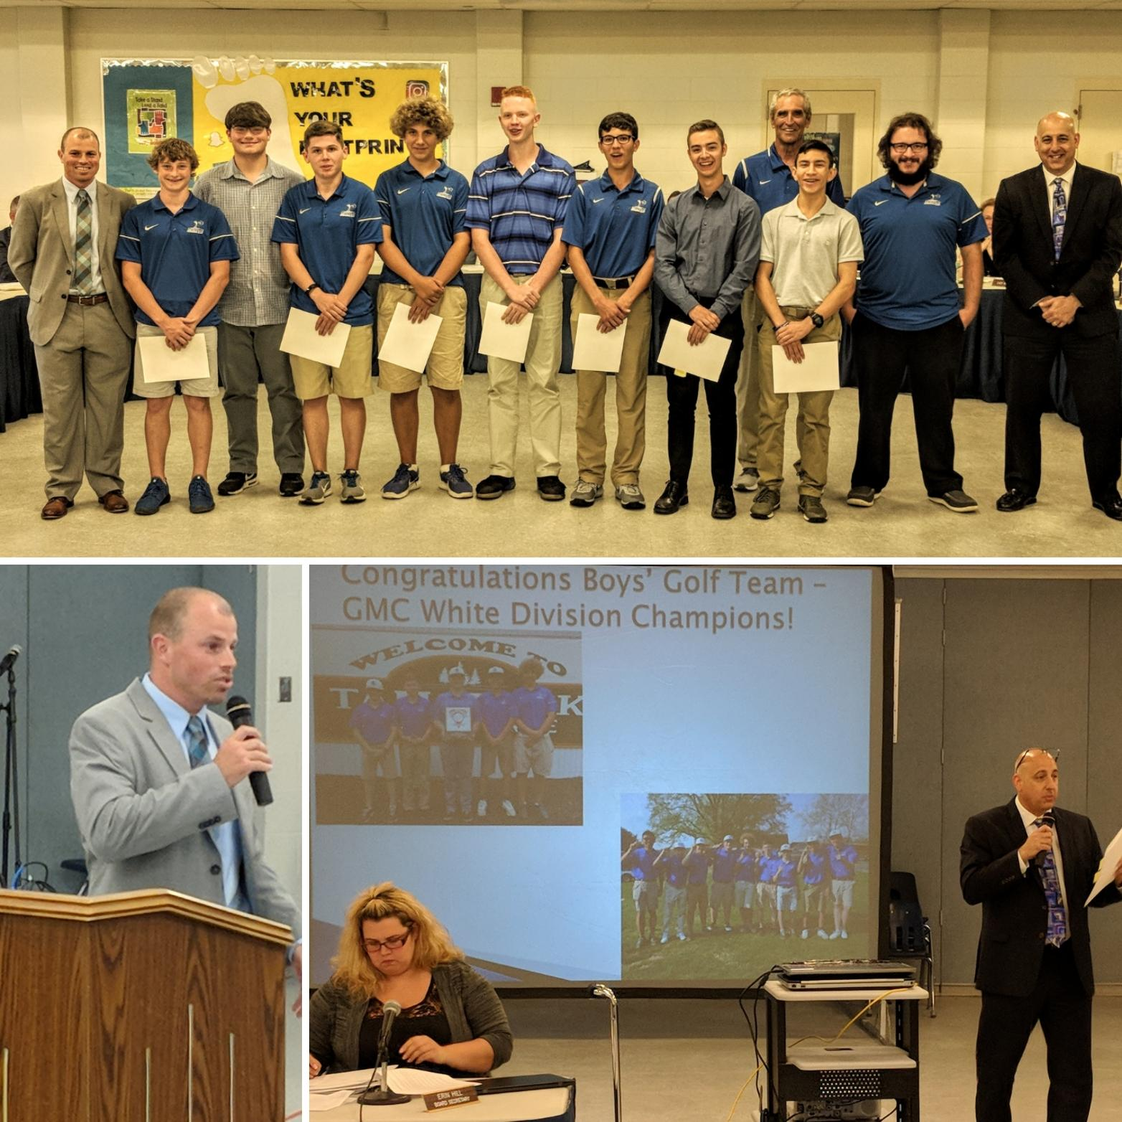
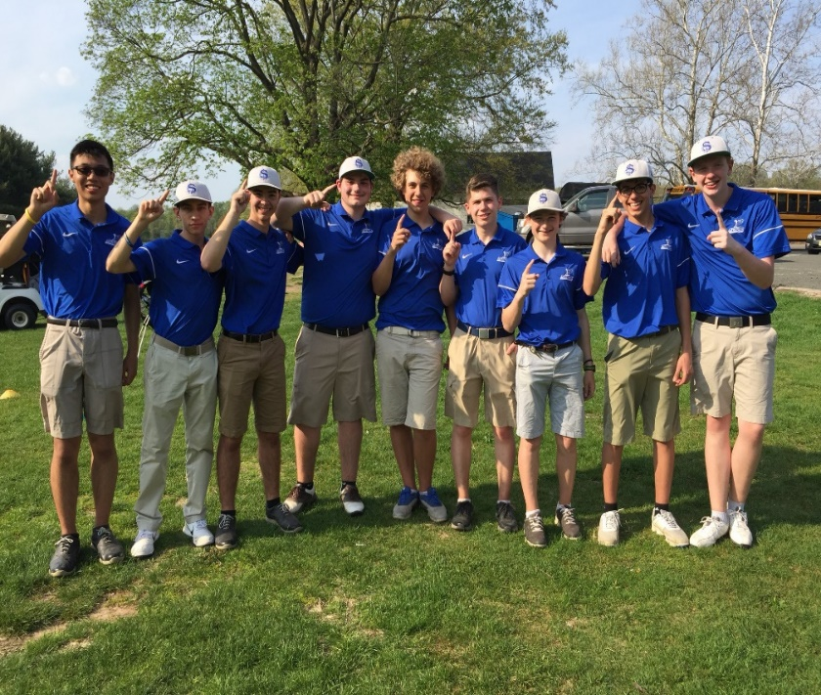
Congratulations Boys’ Golf Team – GMC White Division Champions!

Slide 11
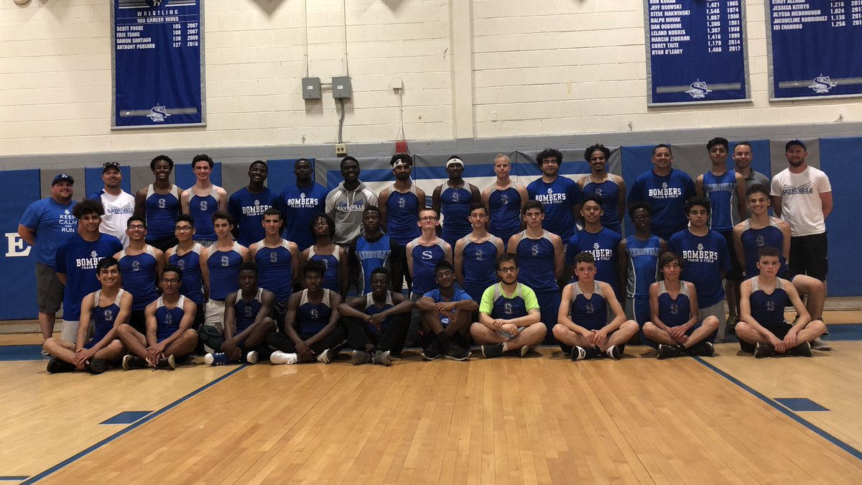
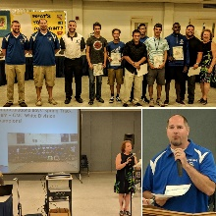
Congratulations Boys’ Spring Track Team – GMC White Division Champions!

Slide 12
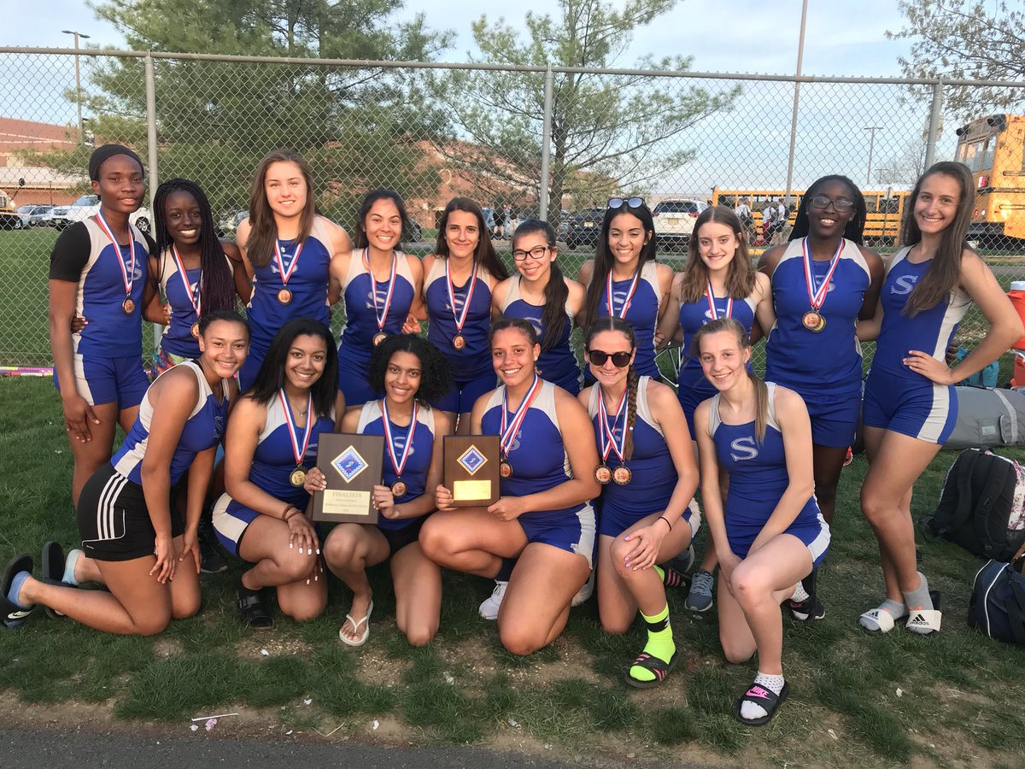
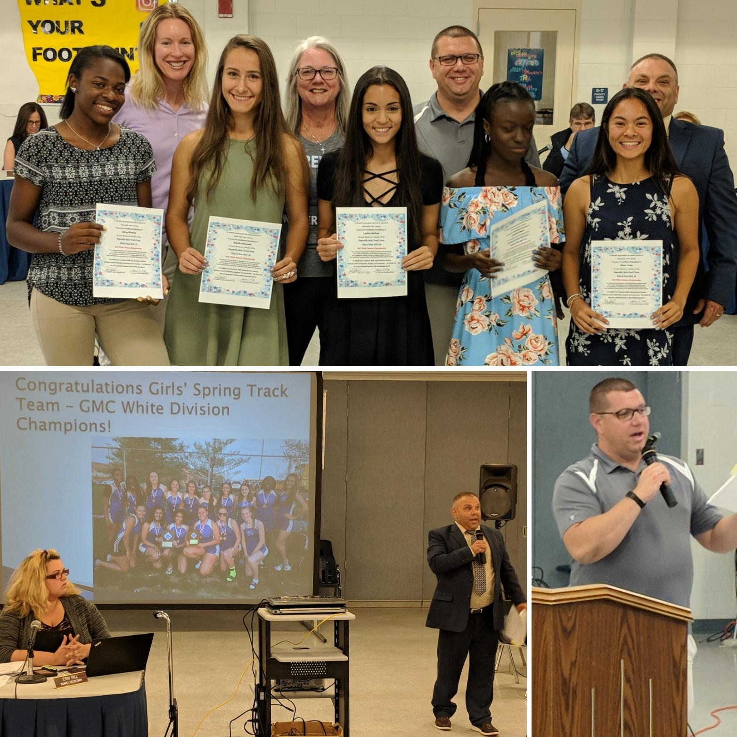
Congratulations Girls’ Spring Track Team – GMC White Division Champions!

Slide 13
Pay for Play
What is it “pay for play” or “pay to participate?”
A public education policy or practice which requires the parents of students to pay extra fees to participate in athletics or other extracurricular activities.
Primarily used to pay for the costs to run the programs or activities.
Earliest reported implementation dates back to 2004.
The ACLU has threatened many districts nationwide that such policies discriminate against minorities and other students living at or slightly above the poverty level.

Slide 14
School Districts in our Area
It is estimated that about 10-15% of public school districts in New Jersey have adopted and are implementing some type of Pay for Play policy.
In Middlesex County only 2 out of 25 public school districts have a Pay for Play policy.
South Brunswick
East Brunswick
Several, such as Old Bridge, Monroe, and Dunellen, attempted to adopt one but due to the fierce opposition they received from parents, opted not to.

Slide 15
Feedback East Brunswick
It helped the district keep sports when the NJDOE made excessive state aid cuts.
The fees charged and collected helped to offset the cost of athletics and extra-curricular activities.
They have experienced no impact in student participation levels, which have not decreased.
Free and reduced lunch students are exempt from the fees.
Have a system that automatically checks lunch status during the registration process.
They experienced minor resistance the first year or two, but nothing major.
It is now just accepted. Thus, they receive very few comments about it.

Slide 16
Feedback from South Brunswick
Use the Community Pass software system to implement their policy since its adoption in the 2012-2013 school year.
Annual subscription fee quoted June 2017 was $5,247.00.
There is also an additional transaction fees based on usage.
In 2012-2013 they started with a $300.00 family cap. It was reduced to $250.00 in 2013-2014 and has not been changed since then.
With the exception of their Summer Institute, they have an alternate price schedule for students participating in the free or reduced lunch program. The fee is reduced to $0.00 for these students upon completion of the registration process.
For Summer Institute, only in district families that report “hardship” and request assistance are assessed on a case by case basis.
If approved, a 75% reduction for families on free lunch, or 50% reduction for families on reduced lunch is given.

Slide 17
In the 2016-2017 school year they have experienced a 5% increase from the previous school year in payments received for all school district programs.
This includes Pay to Participate, Summer Institute, Option II and Summer Programs.
The total payments collected for these programs was $980,819 as of June 30, 2017.
Since 2012-2013, they have seen a 20% increase in participant registrations which can be attributed to the increase in programs offered each year.

Slide 18
South Brunswick Model - Pay to Participate at SBHS
Name of Program | Fee | Online registration/payment dates | More Information | Included in $250.00 Pay to Participate Cap
Pay to Participate Athletics Fall -Winter -Spring | $75.00 for each | Registration will open after final cuts are made and must be completed prior to first official game of the season | Information will be given to students from Athletics | Yes
Pay to Participate All Clubs//Organizations and the following Performing Arts Groups: Jazz Group Percussion Ensemble Small Ensemble String Quartets Pirandello Players Play | $25.00 | Must pay after attending second meeting | No transfers or refunds. Print and submit payment receipt to advisor. | Yes
Pay to Participate Marching Band | $75.00 | August 17 to September 1 | Information will be given to students from Athletics | Yes
Pay to Participate Color Guard | $75.00 | August 17 to September 1 | Information will be given to students from Athletics | Yes

Slide 19
Pay to Participate Advanced Placement Courses | $50.00 | October 15 -November 15 | Information will be given to students by Assistant Principal for Academic Leadership | Yes
Fall Senior Parking | $12.00 | August 19 | Information will be sent with electronic summer mailing | Yes
Spring Senior Parking | $12.00 | January 27 to February 5 | Information will be sent with electronic summer mailing | Yes
PSAT Exams (October 15th) | $24.00 | August 1 to September 30 | Information will be sent with electronic summer mailing | No
Advanced Placement Exams for May | $93.00 | January 15 to February 29 A late fee of $45.00 will be charged from March 1-March 15 | Information will be given to students by Assistant Principal for Academic Leadership | No

Slide 20
Pay to Participate at Crossroads MS
Name of Program | Fee | Online registration/payment dates | More Information | Included in $250.00 Pay to Participate Cap
Pay to Participate Athletics Fall -Winter -Spring | $75.00 for each | Registration will open after final cuts are made and must be completed prior to first official game of the season | Information will be given to students from Athletics | Yes
Pay to Participate All Clubs –Active and Extra-curricular | $25.00 | varies | Information will be given out from Activity Coordinator in Friday Folder | Yes
Pay to Participate Academic Teams | $75.00 | Varies | Information will be given out from Activity Coordinator in Friday Folder | Yes
Pay to Participate Band, Orchestra, Vocal Ensemble | $75.00 | August-June | Information will be given out from Music Director | Yes
Pay to Participate Handbell Ensemble, Flute Ensemble, Men’s or Women’s Ensemble | $50.00 | August -June | Information will be given out from Music Director | Yes
Pay to Participate Hershey Park Trip | $280.00 | February | Information will be given out from Music Director | No

Slide 21
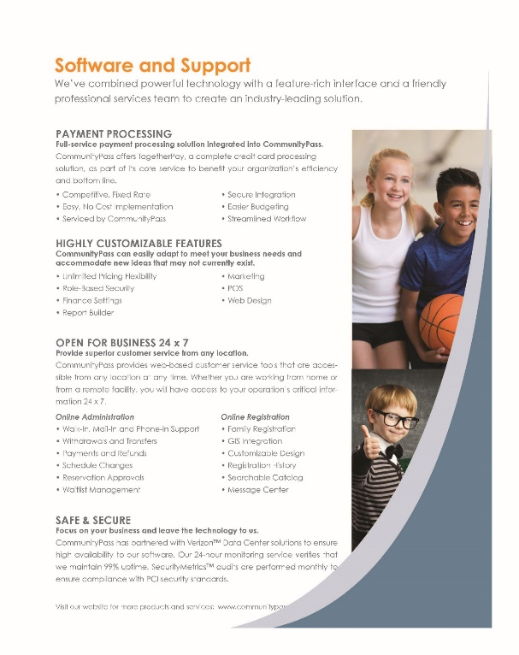
Community Pass

Slide 22
Participation at SWMHS
Athletics by Season | Number of Stus.
Fall | 315
Winter | 263
Spring | 187
Multi-Sport Athletes | 209
Total | 556
Club/Activity | Number of Stus.
Class Councils | 40
DECA | 53
Echo Lites Newspaper Club | 15
Fall Drama | 75
FBLA | 172
HS Band | 98
HS Jazz Band | 20
International Society | 50
Literary Magazine | 15
Math Honor Society | 60
National Business Honor Society | 26
National Honor Society | 43
Odyssey of the Mind | 25
Quo Vadis Year Book Club | 15
Spanish Honor Society | 103
Spring Musical | 132
Student Council | 70
TIGS | 90
Total & Other clubs | 800
Other | # Stus.
PSAT Testing | 388 x $20
AP Testing | 359 x $96
Parking | 130
Total

Slide 23
Participation at SMS
Athletics by Season | Number of Stus.
Fall | 109
Winter | 94
Spring | 94
Multi-Sport Athletes | 67
Total | 230
Club/Activity | Number of Stus.
Chorus | 136
Instrumental Band | 183
HS Marching Band | 30
Community Service | 80
Odyssey of the Mind | 30
Newspaper | 25
Literary Magazine | 25
Student Council | 90
Arts Middle School | 20
Total & Other clubs | 619

Slide 24
Hypothetical in Sayreville
The below calculations represent the total possible participants multiplied by
$50 per Sport and Band, $25 per club, $100 parking, and the cost of the AP ($96) and/or PSAT ($20) test, subtracted by 37%, which is the percentage of free and reduced students.
Activity | SWMHS | SMS | TOTAL
Sports | 17,514 | 7,275 | 24,789
Band | 46,62 | 5,765 | 10,427
Clubs | 12,317 | 6,395 | 18,712
Tests | 32,341 |  | 32,341
Parking | 13,000 |  | 13,000
TOTAL | $79,834 | $19,435 | $99,269

Slide 25
Importance of Extracurricular Activities – to name a few…
Research empirically indicates that students who participate in extracurricular activities perform better in school.
Student express that they feel like more of a part of the school community due to greater engagement in the total school program.
Students demonstrate increased learning as evidenced by higher GPA.
Students demonstrate better behavior, particularly when participating in an activity, as evidenced by teacher and administrator feedback.
Research indicates that students demonstrate increased proficiency in “soft skills” as a result of participating in extracurricular activities.
Organization
Time management
Leadership
Etc.
Research indicates that principles and values acquired through extra-curricular activities, such as work ethic, dedication, commitment, responsibility, sacrifice, etc. transcend into the classroom, home, and workplace.

Slide 26
Equality vs Equity
Having equal programs for all students is not enough.
All students deserve the same opportunities to participate in school related activities despite their socio-economic status.
Parents of students who are slightly above the poverty line and not eligible for free and reduced lunch may not be able to afford or want to pay for their children to participate in extracurricular activities.
Some students are cut or quit programs. Will they pay?
Per season about 407 students that signed up for an athletic program at the high school were cut or quit.

Slide 27
Recommendations
If we are going to begin the process of having parents pay an extra fee for additional services, programs, and activities begin with the following:
Parking - $13,000
Testing - $32,341
National Club (OM/FBLA/DECA) Trips - $30,000
Field Trips (Excluding CBI for SPED) - $8,000
Prom and Other Trips - $15,000
TOTAL - $98,341

Slide 28
CORRESPONDENCE
Monthly Technology Work-Order Report
Monthly Maintenance Work-Order Reports

Slide 29
APPROVAL OF MINUTES
Minutes of the Regular and Executive Session of May 15, 2018.

Slide 30
SUPERINTENDENT’S REPORT HIGHLIGHTS
A – VISION 2030 FINANCE & INFRASTRUCTURE
#2 Approval to pay CME $4,500 for the purpose of evaluating and making recommendations for improvements to correct drainage problems on and surrounding the baseball field located at Sayreville War Memorial High School, on page 2.
#4 Approval to accept a generous donation of a digital graphics drawing monitor valued at $694 from contributions received by DonorsChoose.org from various individuals and organizations, on page 2.
#7 should have stated $2,354
#9 Approval to appoint Management International (“Firm”) as Board AHERA Designated Person and Environmental Consultant for the period of July 1, 2018 through June 30, 2019 and pay them a maximum of $3,750 plus the standard billing rates for 2018-2019 per agreement for additional services, on page 3.

Slide 31
#11 Approval of a contract with Center for Responsive Schools, Inc. to provide training in the Responsive Classroom® approach from July 23, 2018 through July 26, 2018 at cost of $21,000, which will be paid with Title IIA funds, on page 5.
#23-25 Approval of the 2018-19 Lunch, Breakfast, and Cafeteria Prices on pages 7-10.
#26 Approval of the 2018-19 certificated and non certificated substitute rates on page 11.

Slide 32
B– STUDENT ACHIEVEMENT
#2-3 Approval of co-curricular trips and activities on page 17.

Slide 33
C – VISION 2030 Governance
#2 Approval of the below noted new times for the Project Before Preschool Program on page 19.
#3 Approval of the revised job description for the Director of Special Projects, on the Addendum.
 | REGULAR | EARLY DISMISSAL | DELAYED OPENING
Full Day | 9:20-3:00 | 9:20-1:00 | 10:50-3:00
A. M | 9:20-11:50 | 9:20-10:50 | 10:50-12:30
P.M | 12:30-3:00 | 11:30-1:00 | 1:20-3:00

Slide 34
D– VISION 2030 PERSONNEL
#9 and 32-33 Approval to hire certificated and non certificated staff for 2017-18 and 2018-19 school years on page 22 and the Addendum.
#10 Personal Finance and not “Fitness”
#12-15, 17-18, and 23 Approval of Middle School Credit Completion Summer School personnel, part-time secretaries to work after school session has concluded and during the summer, nurses and school counselors to work during the summer, and staff for the Camp XL (Extended School Year Program) on pages 24-27.
#24 and 31Approval to renew the employment of certificated principals, vice principals, supervisors, directors, assistant superintendents, and the business administrator for the 2018-19 school year on pages 27-28 and the Addendum.
#25 Approval to transfer two administrators for the 2018-19 school year on page 28.
#30 Approval to hire the below non certificated administrators for the 2018-19 school year on the Addendum.
Christa Brown, Director of Food Services
Lori Howell, Director of Transportation
#35 Approval to transfer four teacher for the 2018-19 school year on the Addendum.

Slide 35
PUBLIC PARTICIPATION (AGENDA ITEMS ONLY)*

Slide 36
SUPERINTENDENT’S REPORT APPROVAL
A – VISION 2030 FINANCE AND INFRASTRUCTURE
B – VISION 2030 STUDENT ACHIEVEMENT
C – VISION 2030 GOVERNANCE
D – VISION 2030 PERSONNEL

Slide 37
DELEGATE TO THE NEW JERSEY SCHOOL BOARDS ASSOCIATION
Mr. Ciak

Slide 38
COMMITTEE REPORTS

Slide 39
BOARD DISCUSSION

Slide 40
PUBLIC PARTICIPATION

Slide 41
Upcoming Meeting Dates
Tuesday, June 26, 2018
Tuesday, July 17, 2018

