Slide 1
Sayreville Board of Education Business Meeting
Tuesday, October 16, 2018
See the video.
See the Agenda
See the Addednum

Slide 2
CALL TO ORDER

Slide 3
PLEDGE TO THE FLAG

Slide 4
PUBLIC NOTICE
Take notice this public meeting of the Sayreville Board of Education was e-mailed to The Home News Tribune and the Star Ledger in accordance with Chapter 231, Public Law 1975. Further in accordance with N.J.S.A. 10:4-6 to 10:4-21, a copy of this notice was posted outside the Board Secretary's Office and a copy was also filed with the Clerk of the Borough of Sayreville.

Slide 5
ROLL CALL

Slide 6
STUDENT COUNCIL REPORT
John Lewis

Slide 7
PRESENTATION
Perfect Attendance Awards - BOE Members
State of the School Address
2017-18 Goal Achievement & 2018-19 Goals – Dr. Labbe
Finance and Infrastructure Accomplishments and Goals – Ms. Hill
Technology Accomplishments and Goals – Mr. Glock-Molloy
Human Resources Accomplishments and Goals – Dr. Aguiles
Student Achievement Accomplishments and Goals – Dr. Shediack

Slide 8
2017-18 Perfect Attendance Recipients
Baylis, Linda Jackson-McBurse, Monica Santiago, Olga
Cherry, Dawn Jedrusiak, Anna Skibik, Mark
Coglianese, Stacey Jurczak, Alicja Soares, Katarzyna
Coleman, James Law, Thomas Sylvester, Joan
Goscienski, Joseph Mozdzen, James Twardos,Ronald Gwidz, Magdalena Palma, Patsy Wonaszek, Thomas
Hill, Erin Rivera, Anthony Zurawski, Edward

Slide 9
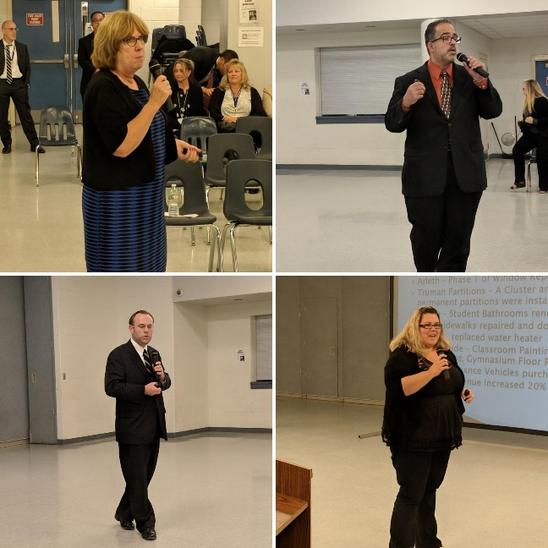
Sayreville Public Schools State of the Schools Address
Presented by: Dr. R. Labbe, Dr. M. Shediack, Ms. E. Hill, Mr. Glock-Molloy, & Dr. Aguiles

Slide 10
OVERVIEW
Purpose – To provide the school community with the current level of thoroughness and efficiency of our educational programs, services, and business operation.

Slide 11
2018 State of the Schools Address
Overview – Dr. Labbe
2017-18 Goal Achievement & 2018-19 Goals – Dr. Labbe
Finance and Infrastructure Accomplishments and Goals – Ms. Hill
Technology Accomplishments and Goals – Mr. Glock-Molloy
Human Resources Accomplishments and Goals – Dr. Aguiles
Student Achievement Accomplishments and Goals – Dr. Shediack

Slide 12
2017-18 Goals
FINANCE:
Increase catering revenue in food services by 4%.
We increased this by about 21%.
Add funds to the maintenance reserve account annually by generating advertising revenue through the district website and other mediums.
We sold website and bus advertisements
Increase the amount of money in capital reserve by June 30, 2018 in order to fund the following capital improvement projects: Refurbishing of Boys and Girls Locker Rooms at the Sayreville Middle School and the completion of the Truman School Partition C-7.
We transferred up to $1,000,000 in the Capital Reserve Fund and $1,000,000 in the Maintenance Reserve Fund in June.

Slide 13
FACILITIES:
Complete Phase 2 of the Arleth Window Project.
Is scheduled to be finished prior to the end of the school year.
Resurface the high school turf athletic field by August 1, 2018.
Completed in August
Investigate solutions to renovate the multi-sport area baseball and field hockey field) adjacent to the War Memorial High School Stadium and adopt a recommendation by June 2018.
On May 15th, we met with CME to develop a multi-tiered plan to assess the SWMHS Baseball Field drainage. We recently received the findings and recommendations.

Slide 14
TECHNOLOGY:
Increase the number of instructional classroom devices in order to implement them on 1:1 ratio in grades 1-3 by end of 2018-2019 budget cycle.
We achieved a 1:1 ratio in grades K-5 at the beginning of October.
Implement a stakeholder driven annual evaluation, review, and approval process of software systems used in the district by the end of the 2017-2018 school year.
Has been developed and is being employed.
Continue to make upgrades to Virtual Server infrastructure so that it will be complete by the end of the 2018-2019 school year.
We purchased and are in the process of installing a new virtual server, switches, and Wifi access points.
Increase targeted technology training programs aligned to district initiatives within Sayreville University starting in the 2017-2018 school year.
Provided a number of targeted trainings, particular introductory training for the new Oncourse student information system.
Purchase and implement a new district student information software, which includes the successful migration of student data and the development and coordination of effective.
Purchased and installed Oncourse and successfully migrated all student information data from Power School to it.

Slide 15
STUDENT ACHIEVEMENT:
Students in Pre-K through tenth grade will show improvement in their overall literacy skills as evidenced by 62% of the students in grade three meeting or exceeding expectations as measured on the ELA PARCC assessment. (2016-2017 baseline is 54%).
Did not accomplish. Only 54% met or exceeded expectations. However, this is one percent better than last year.
Students in Pre-K through ninth grade will show improvement in their overall mathematic skills as evidenced by 56% of the students in grade five meeting or exceeding expectations on the Math PARCC assessment. (2016-2017 baseline is 51%).
Did not accomplish. Only 49% met or exceeded expectations.

Slide 16
STUDENT ACHIEVEMENT:
Increase academic achievement of English language learners (ELL) as evidenced by the percentage of ELL students meeting or exceeding standards on the WIDA Access 2.0 as measured by the overall composite score.
Accomplished. The percentage of students “Expanding, Bridging, and/or Reaching” English proficiency increased by 3.91%.
Increase the academic achievement of all students through effective instruction, a challenging rigorous curriculum, and multiple pathways for students to meet their individual needs by:
Developing curriculum maps to enhance the district math and science (STEM) curriculum guides to ensure vertical and horizontal alignment.
Ongoing
Improving the college and career readiness of students by establishing career academies at the high school for implementation in September 2018.
Accomplished. We will implement Fact and the SBA Academies this September.

Slide 17
CULTURE AND CLIMATE:
Increase student engagement in the “whole school program” district-wide by creating additional clubs and activities related to student interests in preschool through 12th grade and by implementing Career Academies in grades 10-12.
Accomplished. We implemented the FACT and SBA Academies in September
Ongoing. Hackathon, AFJROTC program, Unified Sports, academic and related arts co-curricular activities after school activities.
Increase the percentage of parents and community members that participate in school functions through the creation of Family Nights and Unified Sports designed to engage community members and students in collaborative activities.
Ongoing. PTO meetings and functions, curriculum and related arts oriented activities, PROUD meetings and workshops, POAC workshops, Sayreville "Parent University" workshops, Standards-Based Report Card and School Security workshops were offered. Unfortunately, parent turn-out for some of these activities continued to be low.

Slide 18
Increase staff retention by conducting exit interviews for all employees who resign from the district in order to determine reasons for their departure and to develop strategies to address them.
While slightly more staff members have resigned comparted to last year, Dr. Aguiles conducts regular exit interviews when such have been granted.
Increase career advancement opportunities for staff by implementing Cohort 1 of the Leadership Academy and by providing other building and district-wide opportunities for certificated and non-certificated staff to expand their leadership skills, as measured by interest demonstrated in formal and informal internal leadership positions and promotions.
Accomplished. 12 members of Leadership Academy Cohort 1 successfully completed the program. Cohort 2 will begin in October.

Slide 19
Promote student-led school climate changes that result in the cultivation of more inclusive, safe, and connected school communities; and the potential decrease in incidences of harassment, intimidation, and bullying by exploring and eventually implementing a variety of new preventative resources, school activities, and projects.
Accomplished. To develop the social and emotional skills of our students and to prevent HIB, we implemented the Responsive Classroom character education program and the Playworks recess program in all elementary schools, including Samsel. We continued to professionally develop and train our staff via Sayreville University and actually began doing the same for teachers in other district, which provided the district with revenue. A popular addition this year was "Drop In" workshops during teacher lunches and preps.

Slide 20
2018-19 Goals
FINANCE:
Increase the catering revenue in food services by 9% from $29,200 in 2017-18 to $32,000 by the end of the 2018-19 school year.
Secure funding in the 2019-20 Budget to purchase enough technology devices (iPads, Chromebooks, etc.) to ensure a 1:1 student to device ratio in grades 6-12.
Secure funding in the 2019-20 Budget to purchase 3 additional busses for the purpose of reducing out-of-district contractor costs and eliminating all remaining single bussing routes in the district.
Increase the amount of money in Capital and Maintenance Reserve accounts by January 1, 2019 in order to fund all existing building renovation projects, including but not limited to the refurbishing of the Boys and Girls Locker Rooms at the SMS, the purchase and installation of new hot water heaters at SWMHS and SUES, reparations to the SUES roof, and the installation of the Truman School Partition in Room C-7.

Slide 21
FACILITIES:
Complete the renovation of the SWMHS athletic complex by replacing the track and repairing the multisport field used for baseball, field hockey, and marching band practice by the end of August 2019.
Construct the remaining secure retention vestibules at the Eisenhower, Wilson, Arleth, and Truman Elementary Schools by the end of August 2019.
Develop an approved BOE plan to install solar panels across the district.
Utilizing the data from the Master District Facility Assessment Report, develop a plan for the continued use of the Selover School.

Slide 22
TECHNOLOGY:
Increase the number of instructional classroom devices in order to implement them on 1:1 ratio in grades 4-5 by end of the 2018-2019 school year.
Continue to upgrade the virtual server infrastructure, wireless access point infrastructure, and the network switch infrastructure by the end of the 18-19 school year.
Deploy a single sign-on solution to all compatible software packages by the end of the 18-19 school year.
Increase unified security camera coverage to all exterior walls and doors by the end of the 18-19 school year.
Budget for funding to provide district staff with access to a staffed technology district helpdesk for the purpose of providing immediate support or routing of support by the start of the 2019-20 school year.
Budget for funding to hire an additional Technology Engineer, and to increase the number of dedicated technology coach positions to one per building using certificated teaching staff by the start of the 2019-20 school year.
Form a unified technology, professional development, curriculum, operations and facilities technology training committee by the end of the 18-19 school year.

Slide 23
STUDENT ACHIEVEMENT:
Students in Pre-K – 12th Grade will show improvement in their overall literacy skills as evidenced by 63% of the general education students in grade 10 meeting or exceeding expectations as measured on the New Jersey Student Learning Assessment – ELA. (2017-2018 baseline is 57.5%)
Students in Pre-K – 12th Grade will show improvement in their overall mathematic skills as as evidenced by 43.2% of the students enrolled in Algebra I meeting or exceeding expectations as measured on the New Jersey Student Learning Assessment - Algebra I. (2017-2018 baseline is 33.2%)
Students in Pre-K – 12th Grade will show growth in their overall literacy and mathematical skills as evidenced by a 2% increase in the number of students who meet the multiple criteria to exit the Elementary Academic Support program by June 2019. (Baseline for 2017-2018 school year was an exit rate of 27%)

Slide 24
CULTURE AND CLIMATE:
Increase employer retention rate by developing hiring pipelines through Frontline Central to recruit and hire the most credentialed, proficient, and principled candidates with tangible and intangible qualities and characteristics that are in alignment with a Sayreville Bomber, and to improve and expedite the hiring process for all new personnel, including substitutes.
Increase the proficiency, competency, and efficacy of staff by offering more choices in selecting training options for professional development in-services, in addition to stress reduction offerings, and by providing building specific professional development as requested by building ScIP committees and/or administrators/supervisors.
Increase career advancement opportunities for staff by implementing Cohort 2 of the Aspiring Administrator branch of the Leadership Academy and by creating and implementing a Teacher Leader branch by the end of the 2018-19 school year.
Promote student-led school climate changes that result in the cultivation of more inclusive, safe, and connected school communities; and the potential decrease in incidences of harassment, intimidation, and bullying by expanding the SWMHS Career Academy, and by implementing the Responsive Classroom character education program at SUES, the Medal of Honor character education program at SMS, and the Playworks structured recess character education program in grades K-5.

Slide 25
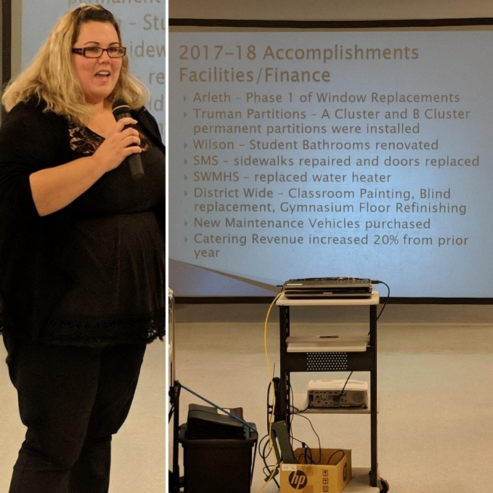
Sayreville Public Schools Vision 2030
State of the Schools Finance & Infrastructure

Slide 26
2017-18 Accomplishments Facilities/Finance
Arleth – Phase 1 of Window Replacements
Truman Partitions – A Cluster and B Cluster permanent partitions were installed
Wilson – Student Bathrooms renovated
SMS – sidewalks repaired and doors replaced
SWMHS – replaced water heater
District Wide – Classroom Painting, Blind replacement, Gymnasium Floor Refinishing
New Maintenance Vehicles purchased
Catering Revenue increased 20% from prior year

Slide 27
2018-19 Goals/Plans Facilities/Finance
Wilson – finished student bathroom renovations and renovated two faculty bathrooms
Arleth – Phase 2 of the Windows will be done, under budget!
Eisenhower – Replaced door frame
Truman – plan for the C7 cluster (last remaining partition) to become permanent partition
SUES – repaired sidewalk for handicap accessibility, added handicap accessibility to playground, repaired dumpster pad, Bus Parking Area, Security Vestibule
SMS – repaired sidewalks, replaced courtyard doors, Security Vestibule
SWMHS – Turf Field replacement, Baseball Field Improvements, Water Heater Replacement, Security Vestibule
Payroll/Personnel/Accounting Software Conversion

Slide 28
2019-20 Budget Development Calendar
October 16, 2018 – State of the Schools Address
December 7, 2018 – All Budget Data Due in Systems 3000
December 18, 2018 – Food Services Presentation and Submission of Preliminary Budget to BOE
January 2, 2019 – BOE Reorganization
January 8, 2019 – Balanced Preliminary Budget Submitted to BOE
January 22, 2019 - Schools, Curriculum & Instruction, and Athletics Presentations
February 5, 2019 – Special Education, Technology, and Transportation,
February 19, 2019 – Buildings and Grounds, Capital Projects, and Personnel Presentations
March 5, 2019 – BOE Approval of Preliminary Budget
March 19, 2019 – Let the Children Lead
March 26, 2019 – Submission of Preliminary Budget to DOE
April 23, 2019 – County DOE Approval of Preliminary Budget
May 7, 2019– Public Hearing and BOE Adoption of Final Budget
May 13, 2019 – Submission of BOE Adopted Budget to the DOE
May 17, 2019 – Submission Tax Certificate to County Board of Taxation
Dates subject to change based on Board Meeting Schedule Approved at January 3rd Reorganization Meeting

Slide 29
Sayreville Public Schools Vision 2030
State of the Schools Technology Department

Slide 30
2017-2018 Information, Technology, & Operations Accomplishments
HIB Management System
Analytics module for Evaluation, SGO, and Lesson Plan System
Visitor Management System
New Firewall and Security Application Suite
Secondary Internet and WAN connections
New Copiers
Expansion of Achieve 3000
Media Center Upgrades
Computer Lab upgrades
16 Interactive Flat Panels
1200 additional student devices
Grades 1-3 1:1 classroom devices
Implementation of standards based grading grades 3-5
Paperless forms
New Student Information System Purchased
Increased Security Camera coverage and upgrades to security camera system
Emergency Public Address Speakers for Selover

Slide 31
2018-2019 Information, Technology, & Operations Improvements
Implement, train, and customize a new OnCourse Student Information System (In Progress)
Purchase, configure, and deploy new networking switches and wireless access points to all buildings (In Progress)
1:1 devices expanded from K-3 to PreK-5 (HS at 1.49:1, MS is at 1.26:1)
Purchase, configure, migrate and deploy new virtual server infrastructure
Purchase, configure, and deploy a server backup appliance (In Progress)
Implement and identification card process for students at the middle school and high school (In Progress)
Purchase, configure, and deploy video enabled security door stations
Purchase, configure, and deploy additional surveillance cameras (In Progress)
Pilot a learning management system at the high school (In Progress)
Purchase, configure, and deploy Emergency Management platform (In Progress)
Purchase, train, and implement walkthrough metal detectors at all buildings (In Progress)
Train multiple administrative staff members in NJDOE School Safety Training Program
Media Center and Computer Lab Upgrades to computers (In Progress)

Slide 32
Anticipated Future Needs
Replacement Door Access Control System
Increased and Replacement Surveillance Cameras
Additional/Replacement Interactive Flat Panels
Additional Student Devices for 1 to 1 classroom devices
(HS at 1.49:1, MS is at 1.26:1)
Anticipated need 1100 device
Expansion of Learning Management Pilot to additional Grade Levels
School Safety Specialist
Samsung Chromebooks
Implemented: 2013
End of Support: March 2018 (qty. 2600)
iPad 2s
Implemented: 2011
End of Support: Fall 2016 (650)
Printer upgrades
Implemented: 2001 (HP 4100)
End of Support: 2018
Additional Technology Support Staff
Additional Technology Instructional Staff

Slide 33
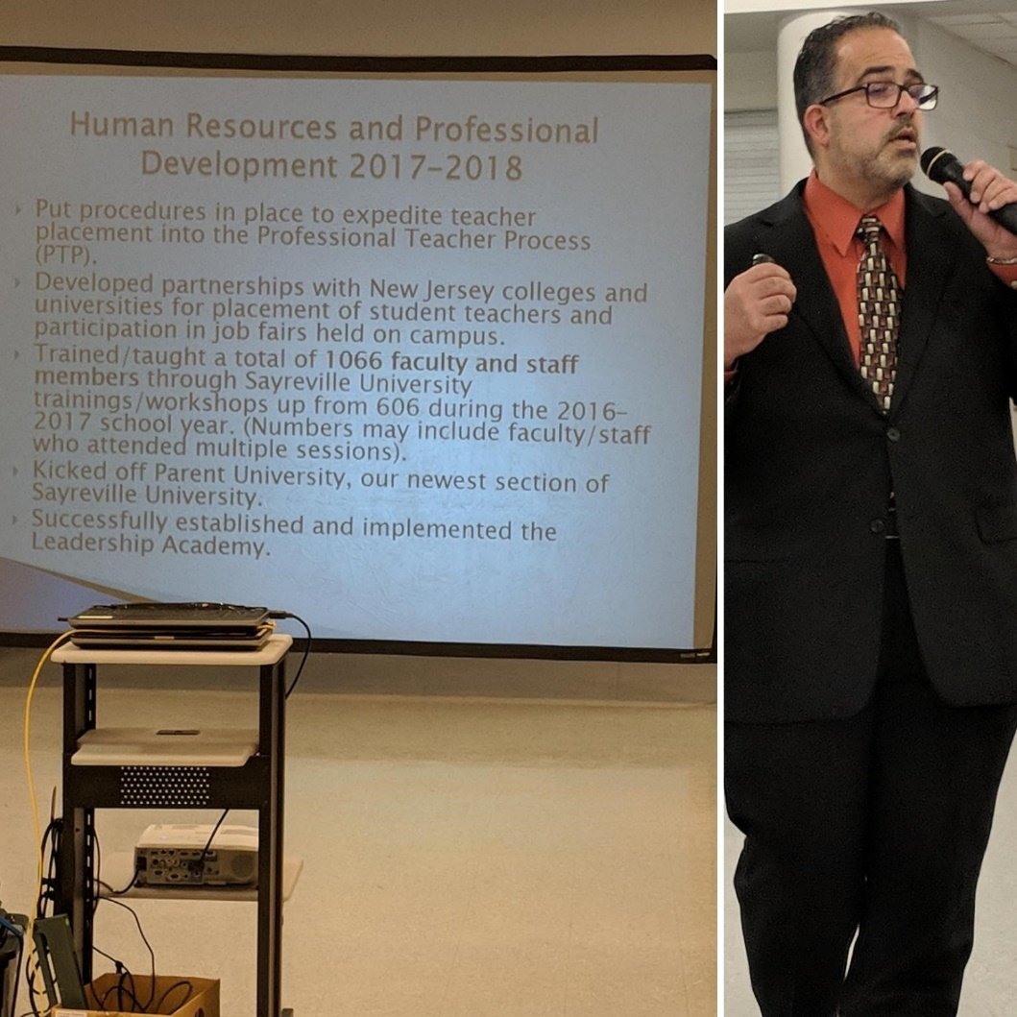
State of the Schools Human Resources
Presented by Dr. Aguiles

Slide 34
Human Resources and Professional Development 2017-2018
Put procedures in place to expedite teacher placement into the Professional Teacher Process (PTP).
Developed partnerships with New Jersey colleges and universities for placement of student teachers and participation in job fairs held on campus.
Trained/taught a total of 1066 faculty and staff members through Sayreville University trainings/workshops up from 606 during the 2016-2017 school year. (Numbers may include faculty/staff who attended multiple sessions).
Kicked off Parent University, our newest section of Sayreville University.
Successfully established and implemented the Leadership Academy.

Slide 35
Human Resources and Professional Development 2018-2019
Developing Hiring Pipelines through Frontline Central to improve and expedite hiring process for substitutes, certificated & non-certificated staff.
2nd Leadership Academy will begin October 2018
Establishing a pathway for student teacher to substitute in district after they have completed their student teaching hours.
Provide building specific professional development as requested by building ScIP committees and/or administrators/supervisors.

Slide 36
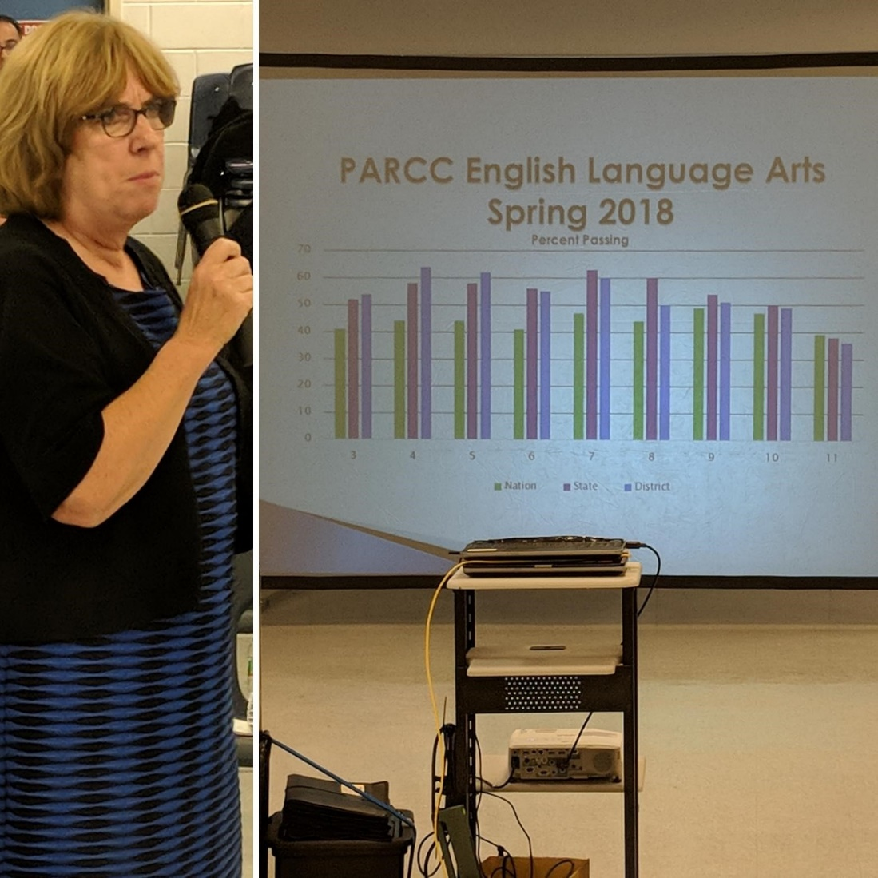
State of the Schools Student Achievement
Presented by Dr. Marilyn Shediack

Slide 37
PARCC English Language Arts Spring 2018 Percent Passing

Slide 38
PARCC English Language Arts Comparison 2015 – 2018 Percent Passing

Slide 39
PARCC English Language Arts Proficiency by Race

Slide 40
English Language Arts Proficiency by Program

Slide 41
PARCC Mathematics Spring 2018

Slide 42
PARCC Mathematics Comparison 2015 - 2018

Slide 43
PARCC Mathematics All Grades Proficiency by Race

Slide 44
Mathematics Proficiency by Program

Slide 45
Proficiency by Gender

Slide 46
AP Comparisons
 | 2012 | 2013 | 2014 | 2015 | 2016 | 2017 | 2018
Total Enrollment | 364 | 377 | 367 | 322 | 387 | 359 | 393
Total # of Exams | 194 | 240 | 215 | 189 | 336 | 356 | 358
# of Scores 3+ | 161 | 189 | 163 | 140 | 207 | 218 | 246
$ of Scores 3+ | 83% | 79% | 76% | 74% | 62% | 61% | 69%

Slide 47
Mean SAT Scores Class of 2018
 | Critical Reading |  | Math |  | Writing |  | NEW SAT 2017 |  | SAT 2018
 | 2015 | 2016 | 2015 | 2016 | 2015 | 2016 | EBRW (Verbal) | Math | EBRW (Verbal) | Math
4-Year College Bound | 521 | 522 | 559 | 553 | 522 | 520 | 553 | 562 | 566 | 575
2-Year College Bound | 440 | 422 | 471 | 450 | 431 | 414 | 483 | 502 | 482 | 493
Total Students | 491 | 481 | 526 | 511 | 488 | 477 | 532 | 539 | 543 | 552
State | 500 | 495 | 511 | 514 | 499 | 492 | 539 | 537 | 530 | 526

Slide 48
Five Year Trends Average ACT Scores
 | Total Tested |  | English |  | Mathematics |  | Reading |  | Science |  | Composite
Grad Year | District | State | District | State | District | State | District | State | District | State | District | State
2014 | 30 | 26,182 | 21.4 | 22.8 | 23.4 | 23.7 | 21.2 | 23.1 | 21.6 | 22.4 | 22.0 | 23.1
2015 | 46 | 30,263 | 19.2 | 22.9 | 21.8 | 23.7 | 20.6 | 23.3 | 20.4 | 22.6 | 20.6 | 23.2
2016 | 41 | 33,646 | 20.7 | 22.7 | 22.9 | 23.3 | 22.0 | 23.5 | 21.7 | 22.5 | 22.0 | 23.1
2017 | 62 | 35,257 | 22.8 | 23.8 | 24.1 | 23.8 | 23.7 | 24.1 | 22.9 | 23.2 | 23.5 | 23.9
2018 | 64 | 32,590 | 24.0 | 23.8 | 24.9 | 23.6 | 24.5 | 24.0 | 23.8 | 23.0 | 24.4 | 23.7

Slide 49
Are Our Students Ready for College?

Slide 50
Looking Back: 2017 -2018 Initiatives
Standards-Based Grading K – 5
Fountas & Pinnell Classroom K – 2
ELL Tutorial Program 6 - 12
Twenty five new and revised curriculum guides
Science materials to support NGSS K – 5
Sheltered Instruction Observation Protocol (SIOP) to support English Language Learners
New sequence of HS Science courses – Physics grade 9
High School Academies – Foundations of Academic and Community Training in Education (FACT) and Sayreville Business Academy (SBA)
Playworks

Slide 51
Looking Ahead: 2018 - 2019 Initiatives
Leveled Literacy Intervention for Academic Support Program
Achieve 3000 grades 3 – 5
Academic Support Mathematics teacher at Samsel
Online Algebra I modules
Career and Technical Education (CTE)
New ELL materials in grades 6 – 8
Responsive Classroom in all K – 5 schools
NJ Teacher to Teacher coaching K - 5
BASF Science Education Grant
Rutgers University Behavioral Healthcare at Samsel and Middle School

Slide 52
CORRESPONDENCE
Monthly Technology Work-Order Report
Monthly Maintenance Work-Order Reports

Slide 53
APPROVAL OF MINUTES
Approval of the Regular & Executive Session of august 28, 2018.
Approval of the Regular & Executive Session of September 17, 2018.

Slide 54
SUPERINTENDENT’S REPORT HIGHLIGHTS
A – VISION 2030 FINANCE & INFRASTRUCTURE
#16-18 Approval of the donation of an Apple iPod Touch 6th generation with accessories valued at $235.00, from the Arleth PTO, dictionaries from the South Amboy/Sayreville Rotary Club to Grade 3 pupils as part of the club’s “Dictionary Project,” and five Hewlett-Packard 11G5 Celeron 11.6 Chromebooks valued at $950, which was received by Stephen Gluchowski from Donors Choose on page 3.
#19-20 Approval of the application and acceptance of the New Jersey Child Assault Prevention Grant in the amount of $4,524, and the 2018-2019 BASF Science Education Grant in the amount of $5,000 on page 3.
#24 Approval of purchase of metal detectors from Grainger through the NJ State Contract # #19-FLEET-00566 for a total cost of $29,412.32 on page 5.
#27 Approval of a resolution to pay CME $18,500 for engineering professional services related to the reconstruction of the multipurpose (baseball, field hockey, and marching band) field at Sayreville War Memorial High School on page 5.

Slide 55
B – VISION 2030 STUDENT ACHIEVEMENT
#1-9 Approval of co-curricular trips and activities, on page 19-21.

Slide 56
C – VISION 2030 Governance
#2 Approval of the District School Calendar (attached) for the 2019-20 school year on page 21.
#3 Approval of 2018-19 District Goals on pages 22-23.
Approval of 2019-20 Budget Development Calendar
#4 Approval of the 2019-20 Budget Development Calendar on pages 23-24.
#6 Approval of the annual Veteran’s Day resolution honoring, celebrating, and thanking current and previous armed services members for their service and the sacrifices they have and continue to make for our country on page 25.

Slide 57
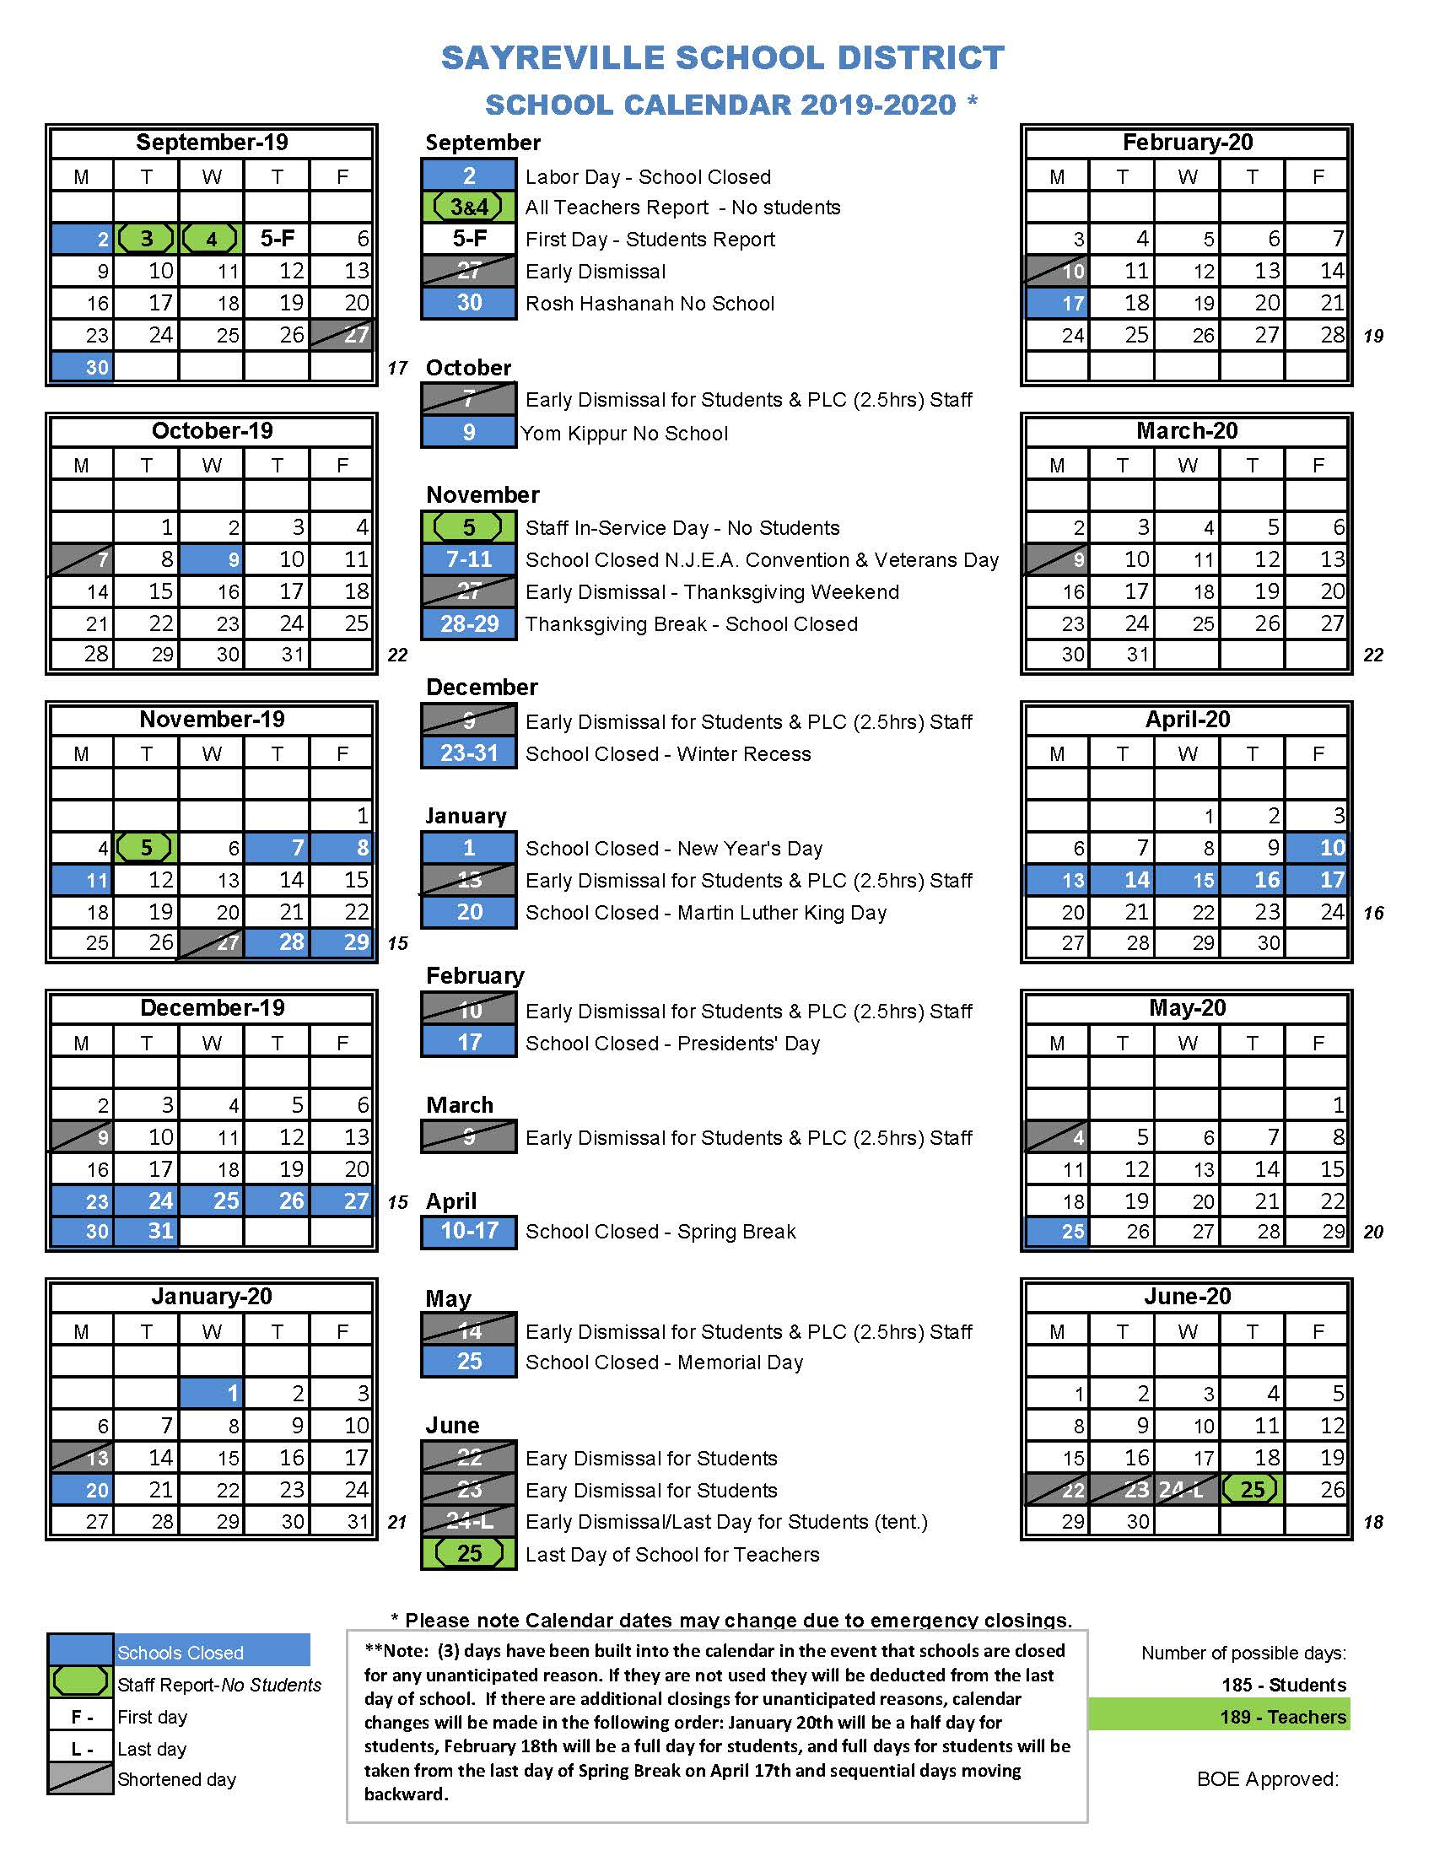
2019-20 Calendar

Slide 58
D– VISION 2030 PERSONNEL
#1 Acceptance of the retirements of Susan Bythell, Math Teacher at SMS, and Barbara Morris, Paraprofessional at Eisenhower, effective January 1, 2018 on page 26.
#6 & 7 Approval to appoint new certificated and non certificated staff for the 2018-19 school year on pages 28-29 and the Addendum.
# 8-9 Approval to transfer non certificated staff for the 2018-19 school year on page 29.
#15-16 Approval of the Unified Sports Advisors for the 2018-19 school year and the fall 2018 coaches on pages 30-31.
#17-24 Approval of GED and SPED teachers and substitutes to work in the fall Literacy and Math Academies, the Title 3 Tutorial Program, the Adult Immigrant English as a Second Language Program, and Tier 3 Intervention Services on pages 31-36.

Slide 59
PUBLIC PARTICIPATION (AGENDA ITEMS ONLY)*

Slide 60
SUPERINTENDENT’S REPORT APPROVAL
A – VISION 2030 FINANCE AND INFRASTRUCTURE
B – VISION 2030 STUDENT ACHIEVEMENT
C – VISION 2030 GOVERNANCE
D – VISION 2030 PERSONNEL

Slide 61
DELEGATE TO THE NEW JERSEY SCHOOL BOARDS ASSOCIATION
Mr. Ciak

Slide 62
COMMITTEE REPORTS

Slide 63
BOARD DISCUSSION

Slide 64
PUBLIC PARTICIPATION

Slide 65
Upcoming Meeting Dates
Tuesday, November 20, 2018
Tuesday, December 18, 2018

