Slide 1
Sayreville Board of Education Business Meeting
Tuesday, March 5, 2019
See the video
See the Agenda
See the Addendum

Slide 2
CALL TO ORDER

Slide 3
PLEDGE TO THE FLAG

Slide 4
PUBLIC NOTICE
Take notice this public meeting of the Sayreville Board of Education was e-mailed to The Home News Tribune and the Star Ledger in accordance with Chapter 231, Public Law 1975. Further in accordance with N.J.S.A. 10:4-6 to 10:4-21, a copy of this notice was posted outside the Board Secretary's Office and a copy was also filed with the Clerk of the Borough of Sayreville.

Slide 5
ROLL CALL

Slide 6
STUDENT COUNCIL REPORT
John Lewis

Slide 7
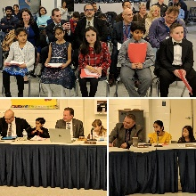
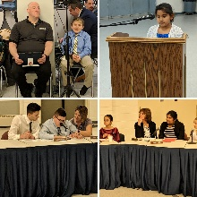
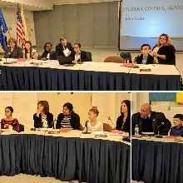
PRESENTATION
Let the Children Lead
Welcome Samsel students and staff!
Sayreville Little League – Challenger Division

Slide 8
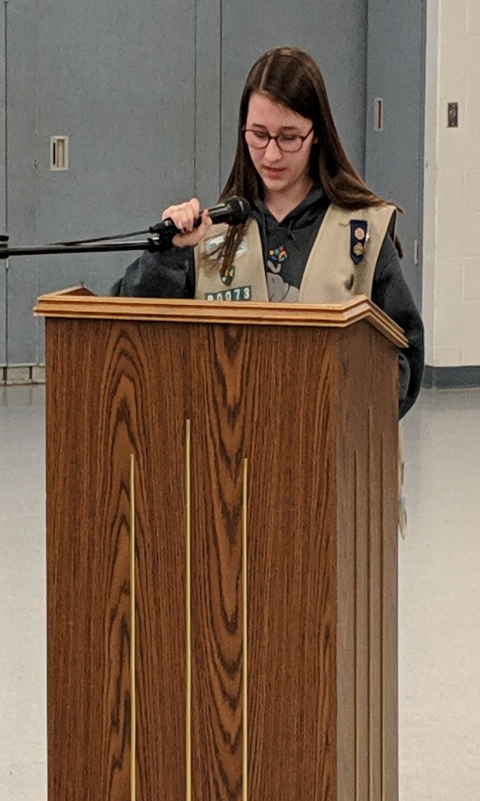
Sayreville Little League – Challenger Division
We are so proud of you Megan Corby!

Slide 9
CORRESPONDENCE
Monthly Technology Work-Order Report
Monthly Maintenance Work-Order Reports

Slide 10
APPROVAL OF MINUTES
Minutes of the Regular and Executive Session of February 19, 2019.

Slide 11
Highlights – Mr. Esposito
We would like to take this opportunity to commend and congratulate the following Sayreville War Memorial High School (SWMHS) art students who have artwork on display at the George Street Playhouse in New Brunswick:
Sophy Castro – Digital Arts
Hope Clemens – Advanced Art
Ella Kuchta – Intro to Art
Tisha Madhok – Advanced Art
Angela Pistilli – Advanced Art
Makenzie Smith – Intro to Art
Raigan Stokes-Carter – Digital Art
They are part of a group exhibition sponsored by the Art Educators of New Jersey. Sophy Castro’s submission was chosen for the official flyer. Additionally, we would like to congratulate the students in Ms. Mojzsis’ Advanced Art Class at SWMHS who created prints of moths that will be included in two art galleries in Australia. The Moth Migration Project is a collaborative exhibition that will be on display at the Bundaberg Regional and Gympie Regional Galleries in May.
Finally, we would like to commend and congratulate Mrs. Barbara Coyle, ASI Teacher at the Samsel Upper Elementary School and April Magistro, ASI Teacher at the Wilson Elementary School, who were recently chosen by the New Jersey Department of Education (NJDOE) to be 2018 Exemplary Elementary Teachers. According to the NJDOE, they were selected because of their exceptional teaching and leadership abilities, as well as for having such a positive impact on students, colleagues, and the school community.

Slide 12
SUPERINTENDENT’S REPORT HIGHLIGHTS
A – VISION 2030 FINANCE & INFRASTRUCTURE
#4 & 12-14 Approval to accept the generous donations of furniture from DonorsChoose.org for a classroom project called “Comfy Counseling;” and 30 inch and 24 inch pedestal fans, a basketball hoop and net, and paint and stencils for the playground from the Wilson School PTO, on page 2 and the Addendum.
#6 Approval to accept the Advanced Computer Science Competitive Grand funding for FY2019 in the amount of $47,900, on pages 2.
#7 Approval of a resolution authorizing the district to sell through GovDeals disposed of obsolete textbooks and technology equipment on page 3.

Slide 13
B– STUDENT ACHIEVEMENT
#3 Approval of new quarterly elective courses to be offered beginning in September 2019 at the Sayreville Middle School, on page 6.
#2 & 4-7 Approval of co-curricular activities, including but not limited to the below on page 6.
Sayreville Credit Completion Summer School Program at the Middle School from July 8, 2019 through August 15, 2019.
Summer Enrichment Program at Samsel Upper Elementary School from July 1, 2019 through August 9, 2019.
Camp XL Extended School Year Integrated Summer Program at Samsel Upper Elementary School from July 8, 2019 to August 8, 2019.
Attendance of the SWMHS Boys and girls Cross Country Teams at the Disney Cross Country Classic at the ESPN Wide World of Sports Complex in Orlando, Florida from October 2 – October 6, 2019.

Slide 14
C – VISION 2030 Governance
#2 Approval the revised District School Calendar for the 2019-2020 school year, on page 8.
#3 Approval of the revised job description for High School Principal, on page 8.
#4 Approval of agreements between the SBOE and SEA settling Unfair Labor Practice Complaints CO-2019-076 and CO-2019-169, on the Addendum.

Slide 15
D– VISION 2030 PERSONNEL
#1 Acceptance of the retirement of Ann Cosentino, Assistant Cook at the SWMHS, effective May 1, 2019 on page 8.
#7 Approval to appoint a new paraprofessional in the Project Before preschool program for the 2018-19 school year on pages 9-10.
#8-9 Appointment of teachers to work in the Reach for the Stars Academy and to write curriculum during the 2018-19 school year on page 11.

Slide 16
PUBLIC PARTICIPATION (AGENDA ITEMS ONLY)*

Slide 17
SUPERINTENDENT’S REPORT APPROVAL
A – VISION 2030 FINANCE AND INFRASTRUCTURE
B – VISION 2030 STUDENT ACHIEVEMENT
C – VISION 2030 GOVERNANCE
D – VISION 2030 PERSONNEL

Slide 18
DELEGATE TO THE NEW JERSEY SCHOOL BOARDS ASSOCIATION
Mr. Ciak

Slide 19
COMMITTEE REPORTS

Slide 20
BOARD DISCUSSION
Share one thing that you would change about the Sayreville Public Schools and why.

Slide 21
PUBLIC PARTICIPATION

Slide 22
Upcoming Meeting Dates
Tuesday, March 19, 2019
Tuesday, April 9, 2019

