Slide 1
Bienvenidos
A DELAC!
March 9, 2022
Notes:
David

Slide 2
Our Why / Nuestro Porque
“To give our best so that those we serve are inspired and empowered to become their true best.”
“Dar lo mejor todos los días para que aquellos quienes servimos estén inspirados y empoderados para convertirse en su mejor versión”
Notes:
Gio

Slide 3
Recordatorios de Zoom / Zoom Reminders
Presentence antes de hablar.
Verifique que su función de silencio esté activada al ingresar
Los chats se graban y tenga en cuenta que también se captura el chat privado
Ingrese todas las preguntas en el chat durante la sesión. Estaremos monitoreando durante la reunión.
Esta presentación de zoom se grabará.
Recuerde permanecer en mute cuando no esté hablando.
Las preguntas específicas de su hijo (a) pueden hacerlas después de la reunión con fines de confidencialidad.
Introduce yourself when speaking.
Verify that your mute feature is on when logging in.
Chats are recorded and note that private chat is also captured.
Enter all questions in the chat box during the session. We will be monitoring during the meeting.
This zoom presentation will be recorded.
Remember to stay muted when you are not speaking.
Questions specific to your child can be address after the meeting for confidentiality purposes.
Notes:
GIo

Slide 4
Women’s History Month
Notes:
Ana

Slide 5
Agenda
Titulo 1
Disciplina Positiva
Exámenes Estatales
ELACs
Consejero/equipo administrativo
Adelantos
Title 1 - Dr. Harris
Disciplina Positiva
State Testing
ELACs
Counselor/admin team for each site
Updates
Notes:
Ana - Dar la bienvenida al Dr. Harris.

Slide 6
Title I Information
Agenda
What is Title I?
Goals of Title I
Parent Rights
Parent Involvement
School Achievement Data
School Plan for Student Achievement (SPSA)
Title I Allocations
Parent Involvement Policy / School Compact
Notes:
Title I Announcements - Dr. Harris

Slide 7
What is Title I?
Title I is a program that provides additional academic support and learning opportunities for students at schools with high percentages of socioeconomically disadvantaged children.
The program is intended to help ensure that all students meet state academic standards.

Slide 8
Goals of Title I
Increase academic achievement.
Provide direct instructional support to students.
Provide professional development for teachers.
Promote parent education and involvement.

Slide 9
Parent Rights
Ask for meetings and trainings.
Review the results of annual parent involvement effectiveness survey.
Review the school’s achievement data.
Review the parent involvement plan in the Single Plan for Student Achievement (SPSA).
Review and modify the site Title I Parent Involvement Policy and Home/School Compact.

Slide 10
Parent Involvement
The School Site Council (SSC) provides parents with an opportunity to be involved in the academic program of the school.
The SSC develops, monitors, and evaluates the Single Plan for Student Achievement (SPSA) to implement programs and services that support students.

Slide 11
Student Achievement Data
Schools use data to align curriculum to state and district academic standards.
Schools adjust instructional practices based on the findings of the assessment data.

Slide 12
School Plan for Student Achievement (SPSA)
Parents are informed about the school’s curriculum in English/ Language Arts and Math, as well as other core subjects.
Parents also receive information about the assessments used to measure student progress in these academic areas.

Slide 13
Title I Allocations
Schools are allocated Title I funds on the basis of the percentage of students eligible for free/reduced lunch.
Schools in AVUHSD receive Title I funds if forty percent (40%) or more of the student population is eligible for free or reduced lunch.

Slide 14
Title I Allocations
Approximately one percent (1%) of a school’s total Title I budget is for parent involvement activities (Resource 30103).
Schools in Comprehensive Support and Improvement (CSI) have additional district support and funds
Additional Targeted Support & Improvement (ATSI) schools have additional district supports

Slide 15
Parent Involvement Policy / School Compact
Every Title I school, in collaboration with parents, MUST review and give input on a site level Title I Parent Involvement Policy and Home/School Compact each year.

Slide 16
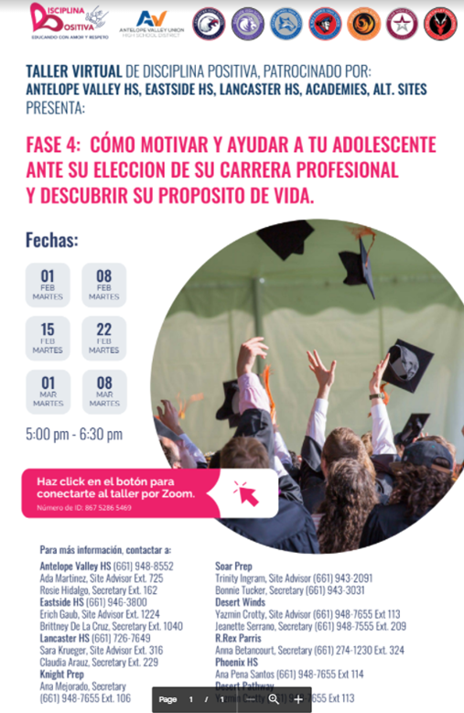
Disciplina Positiva with Tony Orozo and Guests
March 2021 workshops
Calenadar with Padlet and Video Recordings of Parent Workshops:
EL Site Directory for Disciplina Positiva Parent Workshops.
Palmdale High School - Zoom Link & Flyer
Knight HS & Littlerock HS - Zoom Link & Flyer
Highland & Quartz Hill High School - Zoom Link & Flyer
Antelope Valley HS, Eastside HS, Lancaster HS, Academies, Alt. Sites
Disciplina Positiva - Spring 2022 Workshops - Zoom Link in Flyers!
Notes:
David - Guest - Tony Orozco !! 9:30 am (approximate)

Slide 17
State testing
Pruebas Estatales
ELPAC / Examen ELPAC
English Learner students only / Solo para estudiantes de aprendices de inglés
Feb. 28 - March 18
SAT Test /Examen SAT
11th grade students only / solo estudiantes de 11 grado
March 2 / 2 de marzo
CAASPP
Students in grades 8th & 11th / estudiantes en grados 8 y 11
March/April - Marzo/Abril
AP Testing / Examen AP
Test for students in AP classes / Examen para estudiantes en clases de AP
April - Abril
Khan Academy - website to help with
Notes:
Ana

Slide 18
ELAC Dates Fechas de ELAC
3-16-22
6:30pm
4-12-22
3:00 pm
3-30-22
1:30 on
3-30-22
12:00 pm
3-11-22
6:00pm
4-28-22
9:00 am
3-17-22
8:30 am
3-15-22
1:30 on
DELAC
4-13-22
9:00am
Notes:
Ana

Slide 19
Site Directories
DELAC
4-13-22
9:00am
Notes:
Ana

Slide 20
Adelantos
Updates
El 12 de marzo, se recomiendan máscaras, no se requieren, para los estudiantes y el personal de K-12
Nuestro primer día de clases con máscaras opcionales será el lunes 14 de marzo
El uso de mascarillas sigue siendo una opción para todos los estudiantes o miembros del personal que deseen usar una en cualquier momento.
Las políticas estatales no cambian los requisitos federales, que aún incluyen máscaras en el transporte público, como el transporte escolar.
Todavía se requiere el uso de máscaras para todos mientras estén en el interior de la escuela hasta esa fecha.
On March 12, masks are recommended, not required, for K-12 students and staff
Our first school day with optional masks will be Monday, March 14th
Mask wearing continues to be an option for every student or staff member who wishes to wear one at any time.
State policies do not change federal requirements, which still include masks on public transit like school busing.
Masking is still required by all while indoors on school grounds until that date.
Notes:
Ana

Slide 21
Platiquemos! Let’s Talk!
Actualice sus números de teléfono o correo electrónico
Please update your phone numbers and or emails
Informe a su escuela de cambios
Let your school know of changes
Extraemos informacion de PowerSchool
We pull information from the PowerSchool
Notes:
Gio

Slide 22
Important Dates ~ Fechas Importantes
3/11 - New Masking Mandate ~ Nuevo Mandato de Mascaras
3/21-3/25 - Spring Break ~ Vacaciones de Primavera
4/6 - Student Free Day ~ Dia Libre del Estudiante
4/13 - DELAC@ 9:00 AM
Notes:
Ana

Slide 23
Tiene Preguntas?
Any Questions?
Enlace /Link
Notes:
Ana
https://docs.google.com/forms/d/e/1FAIpQLSeppZBAxxttUpJpIXpyarAWzVbRmUWIcRx43HlkXvKOeqlipg/viewform?usp=sf_link

Slide 24
Ideas para el Siguiente DELAC!
Ideas for Next DELAC!
Programa Migrante
Independent Study
Préstamos para el escuela - Consejero
SAT - which universities need it
Notes:
Gio

Slide 25
Gracias! Thank you!

