Slide 1

Anne Henshaw
SEPAC President
Anne Henshaw is an NISD stakeholder and an educational advocate who serves students with disabilities and their families seeking inclusion, accommodations, accessibility, and equity in education. After the birth of her son, she became focused on disability rights, justice, self-determination, and equity for people with disabilities. She firmly and passionately believes students with and without disabilities should be in classrooms and community spaces together, receiving every service and support to which they are entitled. Anne is founder and/or facilitator of several disability advocacy support networks. She is an active member of NDSC, NDSC Advocacy Coalition, and COPAA. Anne is a Texas Partner in Policymaking Graduate 2020, former National Center for Learning Disabilities Parent Advisory Council member, former PATH Parent Leader, a former Northwest ISD Parent Leader, and is actively involved in systems change in her community. She has trained parents and family members as well as presented to her local advocacy groups on IEPs, Special Education in Texas, and Inclusion. She attends trainings and conferences year-round including but not limited to Person Centered Thinking and Planning, Wrightslaw, TCASE, NDSC Convention, and The Arc of Texas offerings. She and her family love to work both locally, statewide, and nationally to advocate for legislation that positively affects disability issues as well as civil and social justice issues. She is a University of Texas at Austin graduate who loves to write, loves to travel, has been married for 17 years, and has a giant dog who sleeps all day. Anne and her husband Carl have two beautiful, amazing, unique, and hilarious children who are 7 and 9 years old, one of whom happens to be neurodiverse.

Slide 2
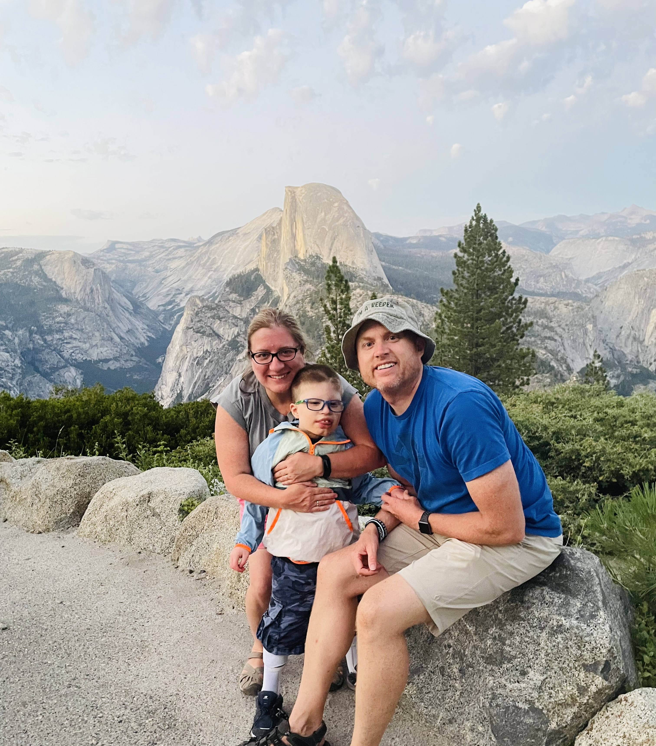
Michelle Lunday
SEPAC Vice President
Michelle Lunday is a parent to a second grader in our district. She is a strong supporter of NISD, it’s teachers, and public education. She is a 2018 graduate of Texas Partners in Policymaking and Leadership NISD, a member of the NISD Long Range Planning Committee, NISD Council of PTAs SAGE Chair, and Lakeview Elementary PTA Treasurer. Michelle is also involved with Hear MY Voice which is a non-profit that is conducting research and providing awareness for Augmentative and Alternative Communication, and she has a passion for helping parents understand the process.

Slide 3
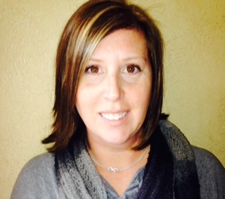
Carolyn Rigney
SEPAC Secretary
Carolyn serves as the Secretary of the Northwest ISD SEPAC board. She is a long time resident of the district and has two high school aged children. Carolyn’s experiences as both a Special Education and a Gifted and Talented parent have contributed to her passion in ensuring that every child in Northwest ISD has the services, interventions, and specialists in place to help them achieve to their greatest potential. Carolyn has previously volunteered with our district PTA, Communities in Schools program and is a former board member of North Texas based United Through H.O.P.E. Carolyn also works as a Nuclear Medicine Technologist.

Slide 4
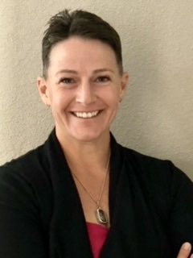
Amanda Salazar
SEPAC Parliamentarian
As a parent of three children with different learning styles and disabilities, as well as a goal of becoming a Special Education teacher, I am excited about being a part of SEPAC. As Parliamentarian, I will ensure that the rules and ethics are adhered to with equality and cooperation. I look forward to helping the NISD SEPAC make a positive impact on our local special education policy.

Slide 5
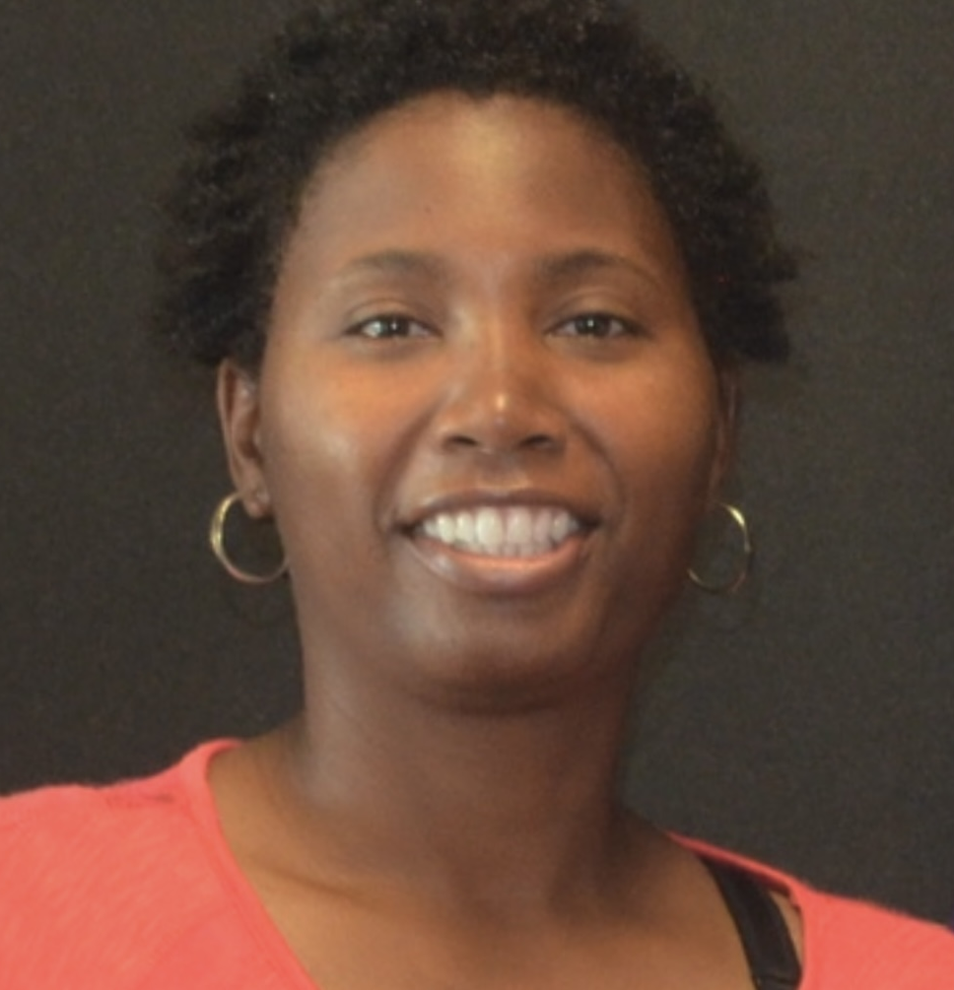
Erica Graham
SEPAC Launch Committee
My name is Erica Graham. I am the mother of three kids. I have one kid that attends Wilson Middle School and one kid that attends Sendera Ranch Elementary. I personally understand that communication between parents, students and the school district is very important. I hope I can help bridge the gap. I look forward to contribute my time helping with NISD special needs community in away I can.

Slide 6
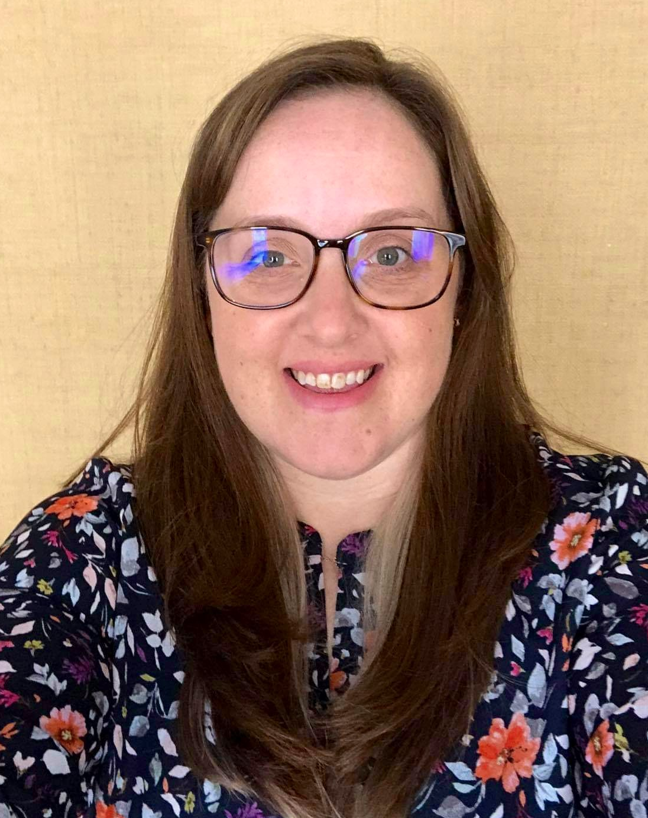
LeighAnn Stephens
SEPAC Launch Committee
LeighAnn is passionate about creating access to the community and quality educational opportunities for people with disabilities. She believes this begins with a presumption of competence for all individuals and is achieved by leading with dignity and respect in all interactions with people of all abilities. Professionally, she holds a Masters Degree in Special Education and Autism Intervention from the University of North Texas. She has worked with students with disabilities in a variety of educational and community settings and is currently an employee of NISD. Personally, LeighAnn and her husband are parents to five children, two of whom are neurodiverse.

