Slide 1
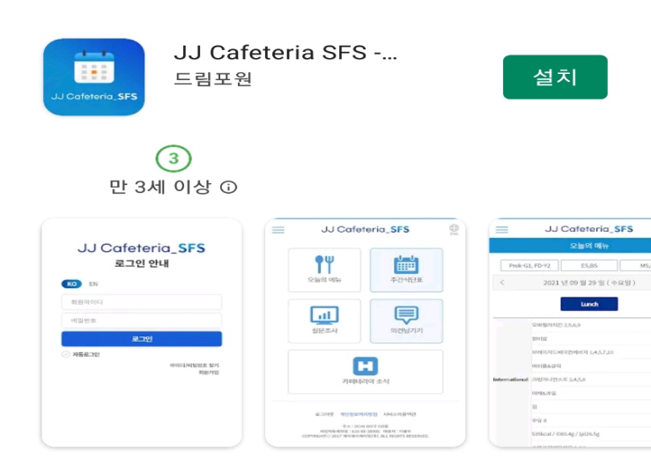
1
IOS users should click App Store and Android users should click Play Store.
2
Please enter jj cafeteria sfs in the search box.
3
Please click the ‘ Install(설치) ’ button.

Slide 2
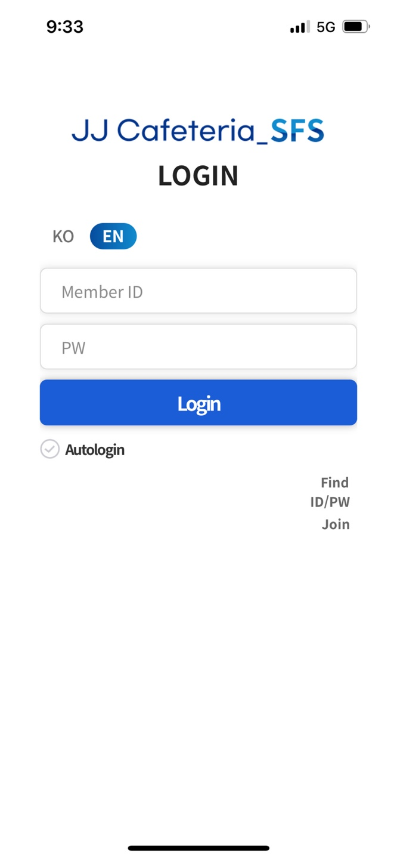
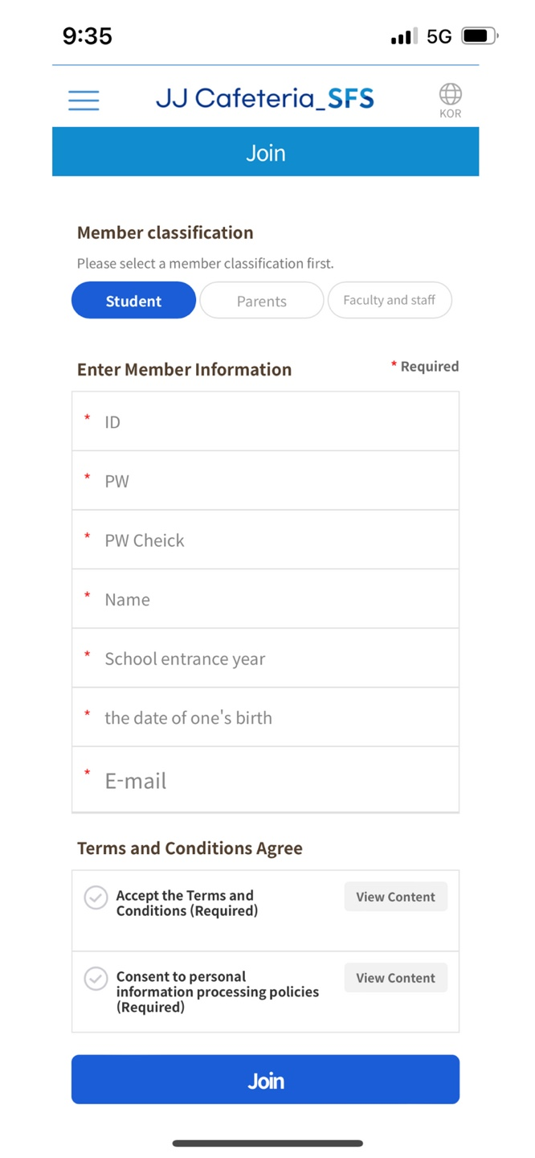
4
Please click the ‘ join ‘ button.
5
After selecting a member classfication, fill in the required fields and join.

Slide 3
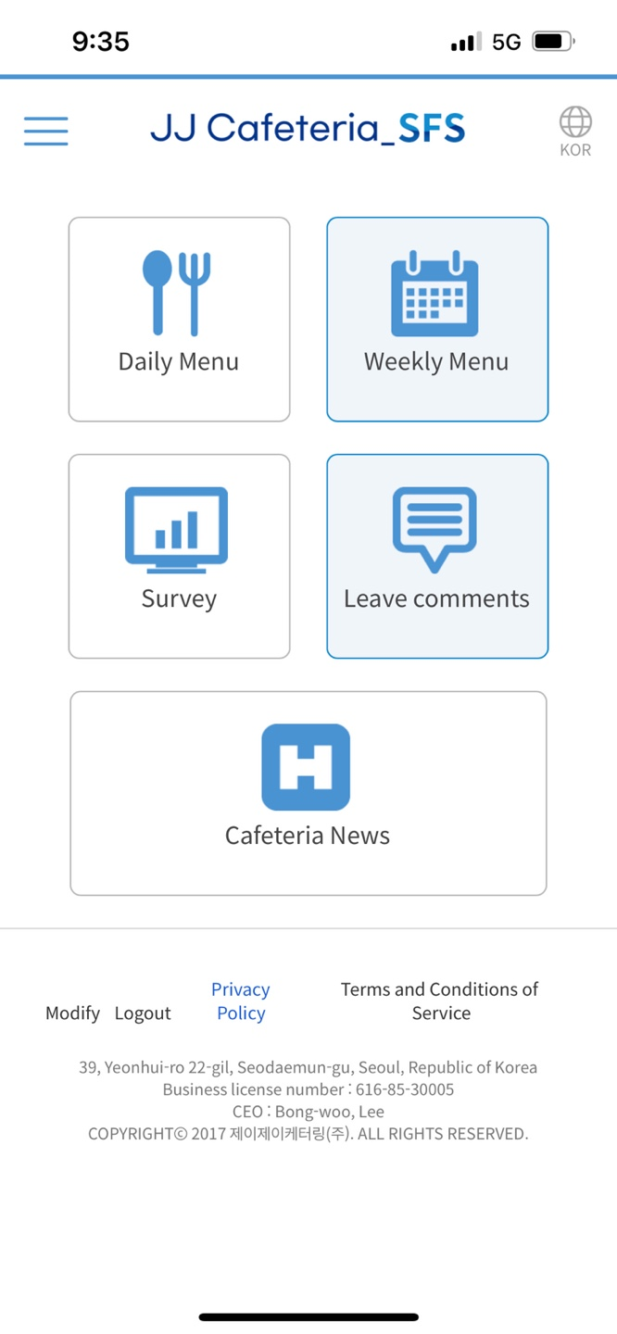
6
This screen appears when you log in after registering as a member.
7
You can use it immediately
after administrator approval.
*If you want to log out the button is here.

