Slide 1


WEST BLOOMFIELD SCHOOL DISTRICT
August 16, 2021
Notes:
Intro myself and Yvonne

Slide 2
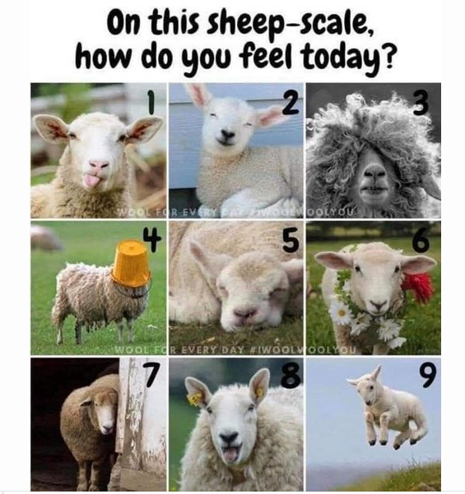
Notes:
Intro and sheep scale

Slide 3

Before We Begin…
Be Engaged
Listen for Understanding
Respect Others’ Viewpoints
PED’s Silenced
Respect Airtime
Others?

Slide 4
A Team is …
A group of people with different backgrounds, skills, personalities and styles with a common purpose, who are working together to achieve clearly identified goals.
“A Team is not a group of people that Work together. A Team is a group of people that Trust each other.”
Simon Sinek

Slide 5
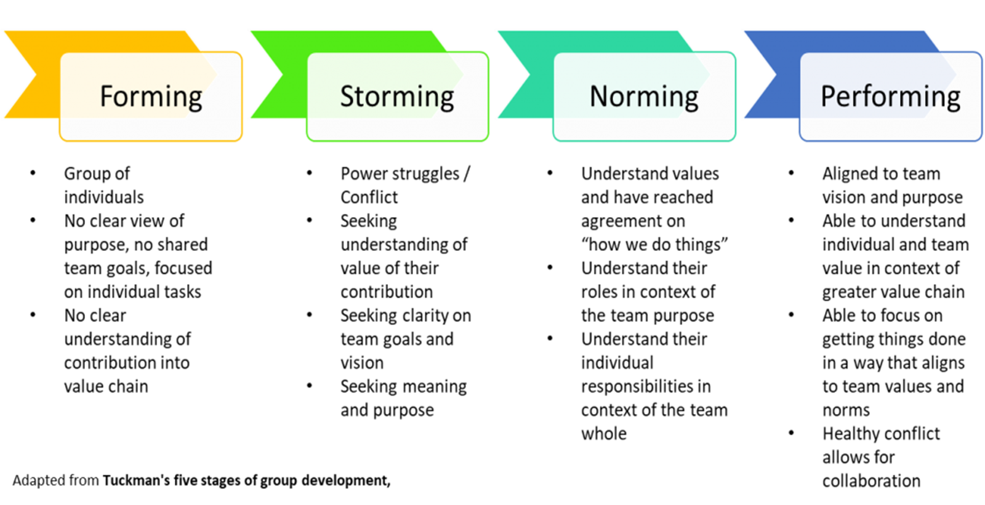
Stages of Team Development
Notes:
1977 Tuckman added a fifth stage – adjourning (for when the project ends) – by the very nature of your work the fifth stage will not be used
Ask each member where they think the group falls most often, what topics have moved them in one direction or another, etc.
Talk about the effect of new members joining the team. Talk about assuming positive intent.
Ask about the ways they can use to move/keep their team in the performing stage.
Giving grace is missing – at times like we find ourselves in it’s more important than ever. Your staff and community are looking to your team to ease their angst and uncertainties. They need to see the governance team as one that can differ on issues and yet come together on direction.
Notice that performing doesn’t say no conflict, it says healthy conflict – I find behavioral assessments like DISC to be really useful in helping teams perform at higher levels.

Slide 6

Team Temperature Check
Ready to Go!
Cautiously Optimistic
Anxious About Results
Nothing Will Change
Notes:
How are you feeling about the Strategic Planning Process in which you about to engage?

Slide 7
Why Strategic Planning?
    Strategic Planning is the process of determining what an organization wants to be at
    some point in the future and how it will get there.
Notes:
Strategic Planning is guided by an overall sense of direction.
Strengthens the Board/Supt leadership team.
Identifies a common purpose
Keeps the focus on student achievement
Helps the district focus on critical priorities
Guides the use of scarce resources
Addresses a primary role of the Board of Education – the Vision, Mission and Goals of the district
Strengthens the Board/Supt leadership team.
Provides data for superintendent and staff evaluations.

Slide 8
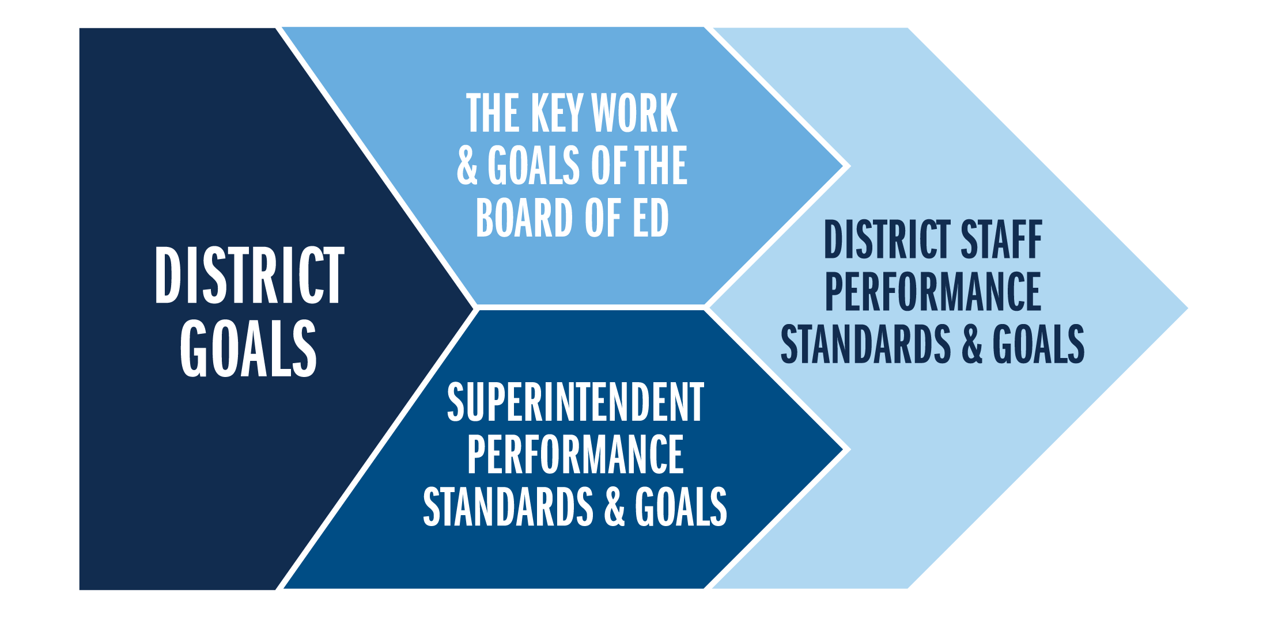
Turning the Plan Into Action
Notes:
How do you take the 4 pillars/key work of board’s and turn them into action?

Slide 9
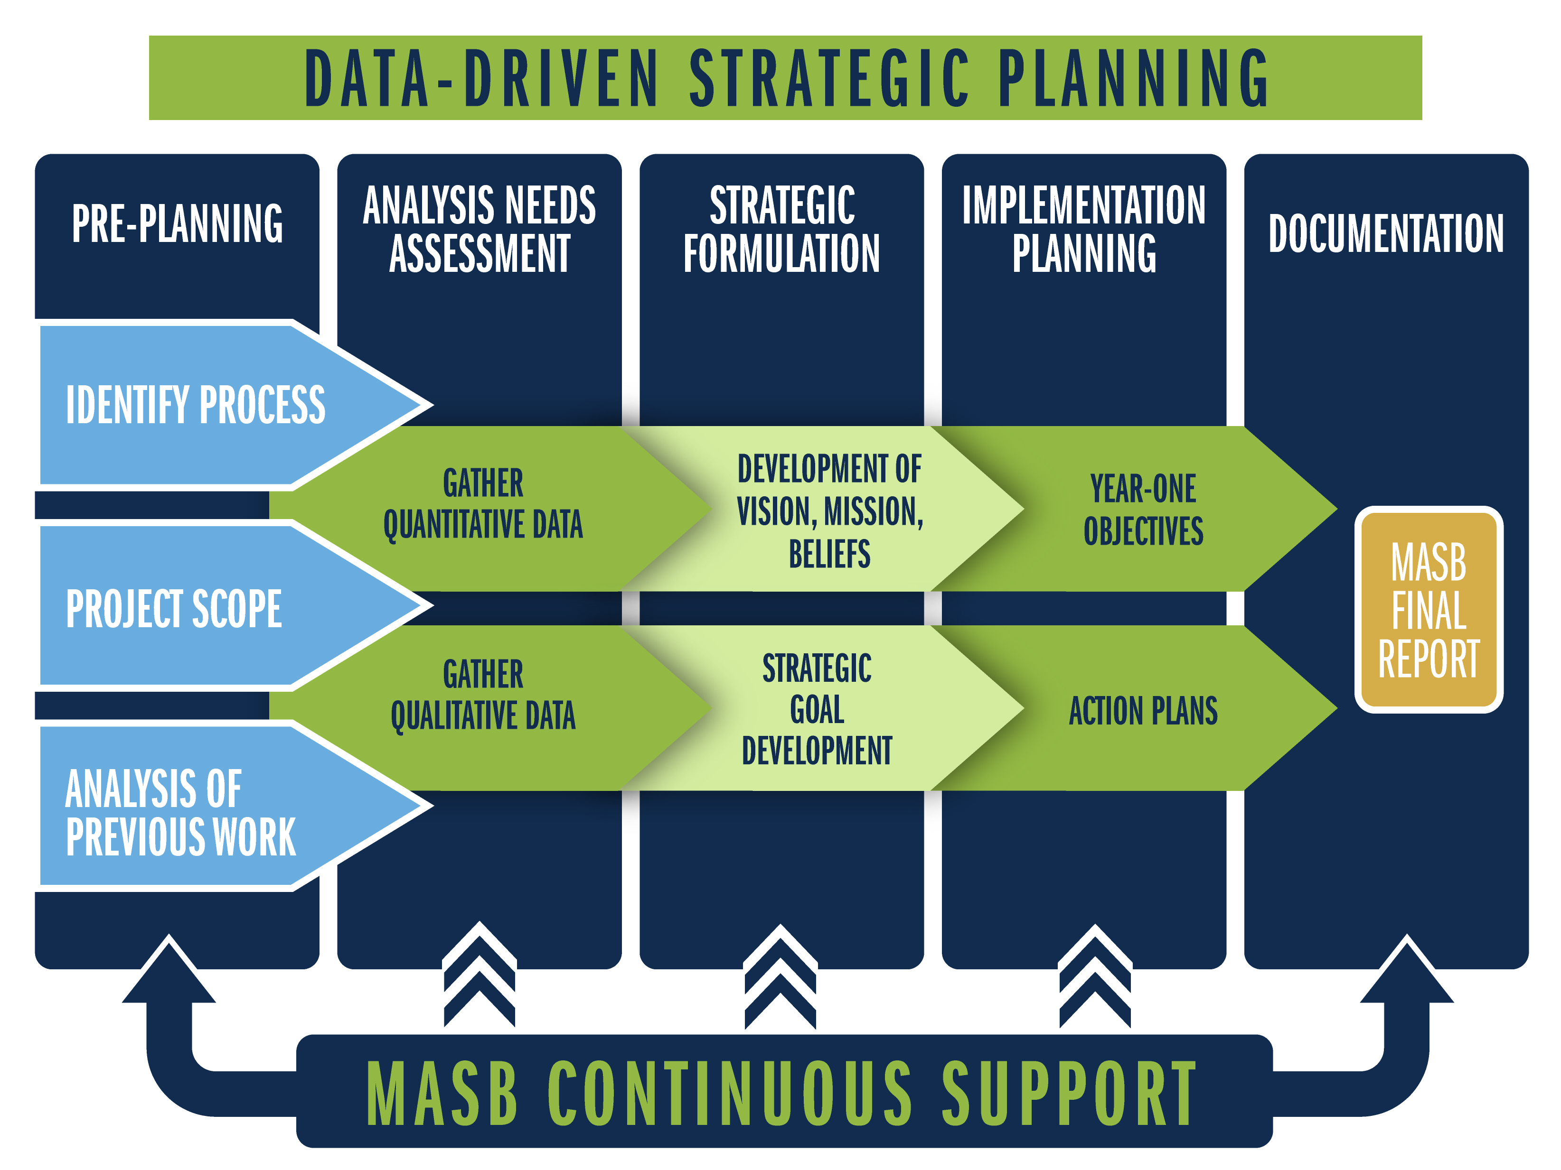

Slide 10

There's a S.M.A.R.T. way to write management's goals and objectives
George T. Doran, 1981
Notes:
Implementation Team

Slide 11

Notes:
Keeps the focus on student achievement – agenda development
Helps the district focus on critical priorities – regular updates
Guides the use of scarce resources – neve enough $
Provides the guideposts for decision-making at all levels – the Board should be asking themselves during deliberation - does this move us in the direction of our agreed upon vision?

Slide 12

What’s Your Role?
When you think about your role in the Strategic Planning Process, what do you imagine it to be?
Strategic
Planning
Notes:
Ask question
Time to think
Solicit Responses

Slide 13
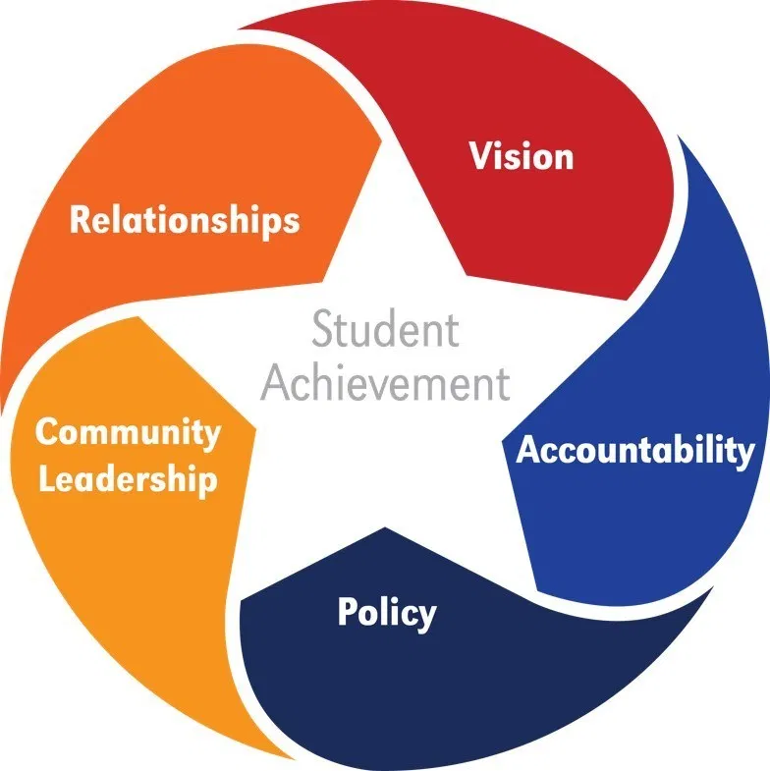
NSBA - Roles of the Board
Setting the direction
Ensuring accountability
Establishing structures
Demonstrating community leadership
Developing positive relationships
Notes:
Vision
Effective boards establish a clear vision with high expectations for quality teaching and learning that supports strong student outcomes.
Accountability
High academic standards, transparency, and accountability undergird a world-class education.
Policy
Policy is how a board sustainably exercises power to serve students. Through policy, school boards establish a set of cohesive guidelines to transform vision into reality.
Community Leadership
Through public advocacy and community engagement, school boards share their concerns and actions with the public.
Board/Superintendent Relationship
Both the school board and the superintendent have essential leadership roles that are interconnected but different.

Slide 14
Roles for Board, Administration and Teachers
Boards
Big Picture – 30K ft. view
Oversee the district organization and how parts relate to the whole
Focus on representing the community’s needs and interests
Look at the long term, 3-5 years
Provide overall structure through district goals
Set clear targets for improvement
Administration
Whole Picture – 10K ft. view
Oversee schools and departments; coordinate component parts of the organization
Focus working with constituent groups
Look 1-3 years ahead
Provide structure at district/school levels
Create and deploy plans that lead to improvement
Teachers
Localized view – point of impact with children
Oversee classroom, department, teaching team; coordinate specific parts of the organization
Focus on students
Looks at days, weeks, months ahead – 1 year
Provide classroom structure
Refine, adjust plans for improvement

Slide 15
Board’s Role in Strategic Planning
  Approve the strategic planning process
  Provide input
  Encourage participation
  Suggest participants for the planning retreat
  Participate in planning retreat
  Adopt the strategic plan
  Monitor district progress
Notes:
Recap the board’s role throughout

Slide 16

Stakeholder Input
In-person Sessions
Virtual Sessions
Online survey:
https://www.surveymonkey.com/r/WB2021SP

Slide 17
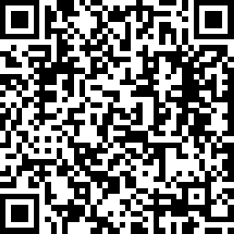
Stakeholder Input
Virtual Sessions
Online survey:
  QR Code:

Slide 18

Pandemic Response
Lessons Learned
How satisfied are you about how the district handled the pandemic?
Very Satisfied
Somewhat Satisfied
Neutral
Somewhat Dissatisfied
Very Dissatisfied
What did the district do well?
What could have been done better/differently?
Notes:
3-4 month process

Slide 19
Let’s Celebrate
What are we most proud of?
Notes:
3-4 month process

Slide 20
Opportunities
What things still need our attention?

Slide 21
Barriers
What limits our Improvement?

Slide 22
District Vision
What do we want our district to be known for in 5, 10, 15 years?

Slide 23
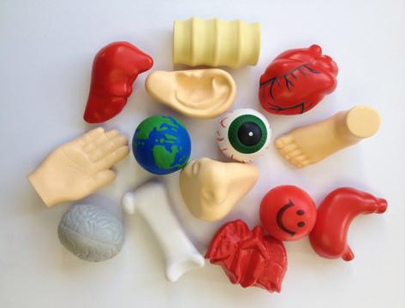
Notes:
Anyone inspired to share your thoughts about our time together today based on one of the images on the screen? You pick an image and I’ll give you your question.
Backbone – What one thing could be considered the foundation or the backbone of the work you do with the District?
Bone – What additional supports would help you do your work?
Brain- Tell the group something that you learned.
Ear- Describe something you heard, or something that was hard to hear.
Eye- Was there something today that gave you a vision for your work or something in particular that caught your eye?
Foot – What can you walk out of here with today and use moving forward ?
Hand- How did someone in the group support you? Or – who is someone in the group you’re willing to give a hand to?
Heart - Share how you felt about what we discussed today.
Liver - How do you plan to process or digest what you heard today?
Lung – What about today’s information or activities just seemed like hot air (or was a breath of fresh air)?
Nose – What part of today passed the sniff test?
Smiley Face- Tell the group something that made you smile.
Stomach - Which of these tactics would really take guts for you to do because it’s outside your Comfort Zone?

Slide 24
Debbie Stair
Assistant Director of Leadership Development
dstair@masb.org
517.327.5904
Yvonne Caamal Canul
Consultant
ycaamalcanul@aol.com
517.327.5904

