Slide 1
Bienvenidos!
Welcome!
DELAC
Diciembre, 2021
December, 2021
Notes:
GIo

Slide 2
Nuestro Por Que
Our Why
“To give our best so that those we serve are inspired and empowered to become their best”
“Dar lo mejor todos los días para que aquellos quienes servimos estén inspirados y empoderados para convertirse en su mejor versión”
Notes:
GIo

Slide 3
Aprobación de Minutas
Approval of Meeting Minutes
Notes:
Gio - https://drive.google.com/file/d/1Wk1elaoAc0TcJ5IBTXC5BhHBtN2XoBii/view?usp=sharing

Slide 4
Agenda
Zonia Sanchez
Electronic Cigarettes and vaping
Adult Education Counselors
Legislation AB 167
McKinney-Vento
Reclassification
Grades/End of Semester
AVUHSD Website
Resources - Mental Health
Important Dates
Raffle
Zonia Sanchez
Cigarrillos Electrónicos y el Vapeo
Consejeros de Educación para Adultos
Legislacion AB 167
McKinney-Vento
Reclassification
Fin de Semestre y Calificaciones
AVUHSD Sitio Web
Recursos de Salud Mental
Fechas Importantes
Rifa
Notes:
Barnett

Slide 5
Zonia Sanchez
Cigarrillos Electrónicos y el Vapeo
Electronic Cigarettes & Vaping
Notes:
Barnett
Zonia Sanchez

Slide 6
Elinor Kun & Kathleen Walters
Adult Education Counselors
Consejeros de Educación para Adultos
Notes:
Barnett
Zonia Sanchez

Slide 7
Antelope Valley Adult Education
Counselors: Elinor Kun, Kathy Walters
Note: Information in Presentation is subject to change

Slide 8
We offer five programs to help adult students achieve their goals.
Ofrecemos cinco programas
Para ayudar a los estudiantes adultos a alcanzar sus metas.
US Citizenship Course - Cursos de Ciudadania
English As a Second Language - Inglés como Segundo Lenguaje
High School Diploma - Diploma de Preparatoria
High School Equivalency - Equivalencia de Escuela Preparatoria
Career Technical Education - Educacion Tecnica Profesional
You must be 18 years or older to enroll.
Debe tener 18 años o más para inscribirse

Slide 9
Antelope Valley Adult Education has four locations
La Educación para Adultos del Valle del Antilope tiene cuatro ubicaciones
Lancaster Campus: Diploma, GED, HiSET, ESL, Citizenship 45110 3rd Street East Lancaster, CA 93535 Office: (661) 942-3042
Lancaster Campus: Career Classes 1220 West Ave. J Lancaster, CA 93534 Office: (661) 483-2302
Palmdale Campus: Diploma, GED, HiSET, ESL, Citizenship 1156 East Avenue S Palmdale, CA 93550 Office: (661) 575-1012
Rosamond Campus: Diploma, GED, HiSET, ESL Welding 2601 W Rosamond Blvd. Rosamond, CA 93560 (661) 256-5299

Slide 10
Diploma Program Information
Información del Programa de Diploma
Antelope Valley Union High School District diploma - Diploma del Distrito de las Preparatorias del Valle del Antílope
Attendance requirement: Minimum 2 hours per week online or in-person - Requisito de asistencia - minimo 2 horas por semana en línea o en persona
Work any time day or night, seven days a week in your classes - Trabajar a cualquier hora del día o de la noche, los sietes días de la semana en sus clases
Complete classes at your own pace - Completar las clases a tu propio ritmo
We start with credits from your high school credits - Comenzamos con los créditos de su escuela preparatoria
We accept foreign high school transcripts - Aceptamos expedientes académicos de escuelas preparatorias extranjeras
If you have no transcripts, you will complete all credits - Si no tiene expedientes academicos, completara todos los créditos

Slide 11
Diploma Requirements
Requisitos de Diploma
180 credits
40 credits of English:
English 9: 10 credits
English 10: 10 credits
English 11: 10 credits
English 12: 10 credits
10 credits Algebra 1
20 credits Math
10 credits Physical Science (Earth Science, Chemistry)
10 credits Life Science (Env Hort, Biology)
10 credits US History
10 credits World History
5 credits Health
10 credits Art/Foreign Language
5 credits Civics
5 credits Economics
45 credits Electives
We start with the credits you’ve earned so far - comenzamos con los créditos que ha ganado
We do not count PE - no contamos Educacion fisica
5 credits of Health instead of 10 (over 5 goes toward electives) - 5 créditos de Salud en lugar de 10 (5 se destinan a electivas)
45 elective credits instead of 70 - 45 creditos electivos en lugar de 70

Slide 13
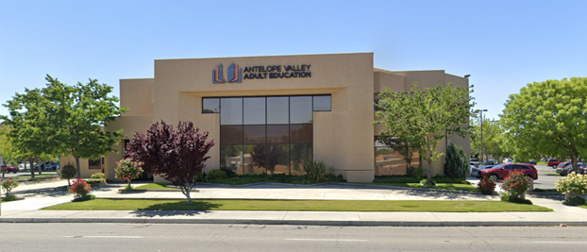
Career Technical Education
What is Career Technical Education (CTE) ?
Programs and courses designed to prepare you for an entry level position in a career.
Classes focus on skills with practice, hands-on experience and application tests making up most of the classroom work.
What are the benefits of Career Technical Education?
Career Focus - Classes are highly specific, taught to industry standards preparing you for industry-recognized certifications.
Financial Benefit - Cost of technical certification much less than a degree from a college.
The goal is to get you working!

Slide 14
AV Adult Education
Career Technical Education Programs
Computer Classes
Computer Basics
Keyboarding
Introduction to Computers
Microsoft Excel
Microsoft Outlook
Microsoft Powerpoint
Microsoft Word
Quickbooks
Certificates and Industry Certifications
Administrative Assistant
Bookkeeper
Computer Networking
Computer Repair Technician
Cyber Security
Dental Assistant
EMT
Medical Administrative Assistant
Medical Billing and Coding
Patient Care Technician
Personal Fitness Training
Phlebotomy
Welding

Slide 15
AV Adult Education Registration Information
Link for registration to all programs at AV Adult Education
https://www.avadulted.org/registration
Call For More Information
Lancaster Campus: Diploma, GED, HiSET, ESL, Citizenship Office: (661) 942-3042
Lancaster Campus: Career Classes (661) 483-2302
Palmdale Campus: Diploma, GED, HiSET, ESL, Citizenship (661) 575-1012
Rosamond Campus: Diploma, GED, HiSET, ESL, Welding (661) 256-5299
Visit our website to view our
online Career Guide
https://www.avadulted.org/career-guide

Slide 16
Legislation 167 - Legislacion
Allows a school district to exempt student in foster care from district graduation requirements when the pupil meets the following:
11th or 12 grade
transfers to a school within the school district or to another school district
the district makes a finding that the student is unreasonably able to complete district requirements by the end of the student's fourth year of high school
Students who qualify under AB167 will be eligible to use the state coursework requirements of 130 credits.
Permite que un distrito escolar exima al estudiante en cuidado de crianza temporal de los requisitos de graduación del distrito cuando el alumno cumpla con lo siguiente:
Grado 11 y 12
transferencias a una escuela dentro del distrito escolar o a otro distrito escolar
el distrito llega a la conclusión de que el estudiante es irrazonablemente capaz de completar los requisitos del distrito al final del cuarto año de escuela secundaria del estudiante.
Los estudiantes que califiquen bajo AB167 serán elegibles para usar los requisitos de cursos estatales de 130 créditos.
Notes:
Crotty

Slide 17
McKinney - Vento
Fixed? Estable?
Stationary, Permanent, & Not Subject to Change
Estacionario, permanente y no sujeto a cambios
Regular?
Used on a Regular Basis (i.e. nightly)
Adequate?
¿Adecuado?
Sufficient for Both Physical & Psychological Needs
Suficiente para las necesidades físicas y psicológicas
Notes:
Crotty
Definition of homeless : 1. individuals who lack a fixed, regular and adequate Nighttime residence.
fixed , regular and adequate.. Needs typically met in home environments
Definición de personas sin hogar: 1. Personas que carecen de una residencia nocturna fija, regular y adecuada.
fijo, regular y adecuado. Necesidades típicamente satisfechas en entornos domésticos

Slide 18
AN UNACCOMPANIED HOMELESS YOUTH
UN JOVEN SIN HOGAR NO ACOMPAÑADO
Definition:
A child or youth who meets the McKinney-Vento definition of homelessness and is not in the physical custody of a parent or guardian.
Definición:
Un niño o joven que cumple con la definición de McKinney-Vento de falta de vivienda y no está bajo la custodia física de un padre o tutor.
Notes:
Crotty

Slide 19
Reclasificacion/Reclassification
Se ha comenzado a reclasificar a estudiantes
Criterio:
4 en ELPAC
207 en NWEA
C+ en Inglés
Consentimiento de padres
Reclassification of eligible students has begun
Criteria:
4 on ELPAC
207 on NWEA
C+ in English Class
Parent consent
Notes:
Ana

Slide 20
Grades End of Semester
Calificaciones al Final del Semestre
9th Grade - 30 credits/creditos
10th Grade - 90 credits/creditos
11th Grade - 150 credits/creditos
12th Grade - 210 credits/creditos
Tutoria/tutoring
APEX - recuperar creditos/credit retrieval
Escuela de verano/summer school
Notes:
Mirna

Slide 21
Recursos/Resources
Plantel de la Escuela
Este es el listado en English pero, los daré en español.
12/21/21 Hora: 12:30pm Workshop: Suicide Prevention During COVID-19
12/28/21 Hora: 12:30pm Workshop: The Effect of the Pandemic on the Emotional Well-Being of the Community
Talleres para el mes de Diciembre, 2021
12/21/21 Hora: 12:30pm Tema:El Suicidio En la Comunidad Hispana
12/28/21 Hora: 12:30pm Tema:El efecto de la pandemia en el bienestar emocional de la comunidad
Notes:
Ana
Español
https://forms.office.com/Pages/ResponsePage.aspx?id=SHJZBzjqG0WKvqY47dusgXzli92atzpEh2Yx2_NN85RUOFA1NDFFMTE3WTdJMzdQMzZQTTlKVFAyMCQlQCN0PWcu
English
https://forms.office.com/Pages/ResponsePage.aspx?id=SHJZBzjqG0WKvqY47dusgXzli92atzpEh2Yx2_NN85RUMkxSR1pJQllIQzFHOVRZRkpIQ1NIUFBTSiQlQCN0PWcu

Slide 22
Important Dates ~ Fechas Importantes
12/17 - End of the Semester ~ Fin de Semestre
1/17 - Martin Luther King Jr
1/26 - Back to School ~ De Regreso a la Escuela
2/9 - DELAC
Notes:
Ms. Barnett

Slide 23
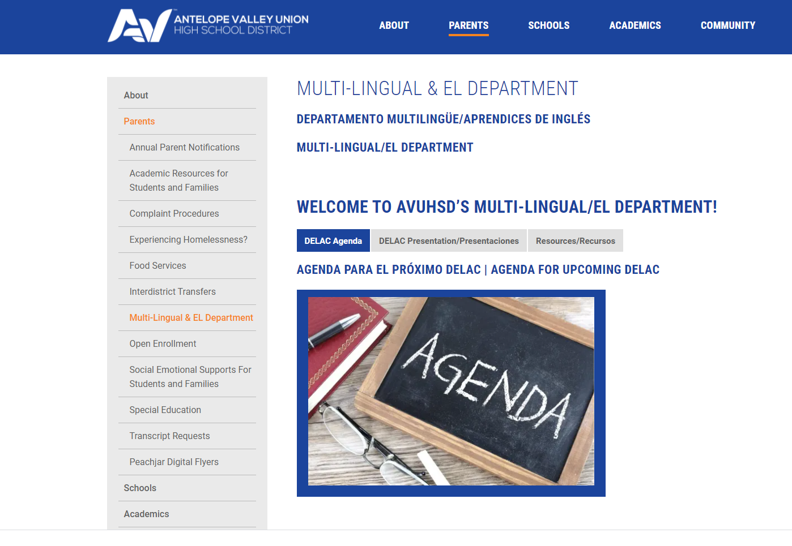
Departament De EL - AVUHSD Sitio Web/AVUHSD Website
AVUSHD
Notes:
Ana
https://www.avdistrict.org/

Slide 24
Temas Para la Siguiente Junta/Items for Next Meeting
Scholarships/Becas
Financial Aid
CPR Workshops
Attendance
Independent Study Information
Notes:
Ana
https://www.avdistrict.org/

Slide 25
Rifa!
Raffle!

Slide 26
Feliz Navidad!
Merry Christmas!

