Slide 1
Orange Unified School District Draft Plan
Educators Effectiveness Block Grant
December 15, 2021

Slide 2
Background
AB 167 - Section 9
Approved by the Governor on September 23, 2021
Funds are to be distributed to school districts, county offices and charter schools based on each LEA’s total staff FTE (certificated and classified).
While the dollars are generated by the entire staff, they are to be spent on professional development only for those staffers (certificated or classified) who work or interact with students, in 10 general areas of focus
On or before December 30, 2021, develop and adopt a plan delineating the expenditure of funds. The plan shall be presented in a public meeting of the governing board of the school district before its adoption in a subsequent public meeting.
Funding subject to audits and detailed expenditure information must be reported on a yearly basis.
OUSD’s allocation is $7,468,622, and funds must be expended by June 30, 2026.
Notes:
Plans can be revised subsequent to initial approval

Slide 3
Focus Areas
Funds can be spent in 10 focus areas
Professional learning for teachers, administrators, other certificated staff and paraprofessionals
Notes:
What we are providing you with tonight is our overarching plan. We will be analyzing student outcome data and surveys of staff and our educational partners to inform our work. We are currently in the process of analyzing our data, reviewing survey results that we have, and we will be surveying our classified staff that works directly with students, as well. This year is mainly a planning year for utilization of these funds. We want to make sure that our overarching plan is flexible enough that it may be adapted based on educator and student needs. But we also want to make sure that we are transparent with the use of these funds, so plan on providing ongoing updates to the board.

Slide 4
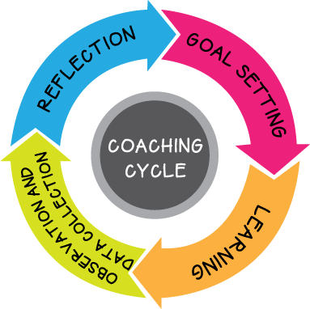
Coaching and Mentoring Support
Coaching support provided to educators
Cognitive Coaching Cycle
Notes:
Increase opportunities for coaching and mentoring support for teachers. Teachers and coaches will collaborate using the Cognitive Coaching Cycle, which includes co-planning and setting goals, in classroom support, and guided self-reflection. Follow-up professional learning will be provided as needed. Cognitive coaching enhances motivation, increases problem solving abilities, expands innovation, and promotes teacher self-reflection of practice.
$ 175,000.00
$ 178,500.00
$ 178,500.00
$ 182,070.00
$ 714,070.00

Slide 5
Professional Development to Support Academics
Professional learning for teachers, administrators, other certificated staff, and paraprofessionals
Standards aligned instruction, including best practices to improve literacy in all subject areas
To engage students in active and relevant learning, in order to increase success at meeting grade level standards
On grading practices that accurately reflect a student's academic level of performance
To effectively analyze data and implement necessary supports so that students effectively achieve on grade level standards
Notes:
Increase opportunities for coaching and mentoring support for teachers. Teachers and coaches will collaborate using the Cognitive Coaching Cycle, which includes co-planning and setting goals, in classroom support, and guided self-reflection. Follow-up professional learning will be provided as needed. Cognitive coaching enhances motivation, increases problem solving abilities, expands innovation, and promotes teacher self-reflection of practice.
$ 175,000.00
$ 178,500.00
$ 178,500.00
$ 182,070.00
$ 714,070.00

Slide 6
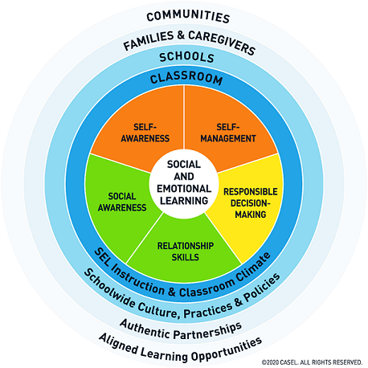
Social Emotional and Behavioral Professional Development
Professional learning for teachers, administrators, other certificated staff and paraprofessionals…
Will be provided to support social emotional learning, trauma-informed practices and suicide prevention through evidence-based practices.
Provide professional learning for educators that supports positive, preventative behavior management as part of a multi-tiered system of supports, including restorative practices and positive behavioral interventions and support
Notes:
Expanded professional learning opportunities for teachers, administrators, other certificated staff, and paraprofessionals will be provided on advancing social emotional learning, trauma-informed practices and suicide prevention through evidence-based practices. A meta-analysis done by the Collaborative for Academic, Social, and Emotional Learning (CASEL) in 2011 found that SEL interventions that address the five core competencies (self-awareness, self-management, social awareness, relationship skills, and responsible decision-making) increased students' academic performance by 11 percentile points, compared to students who didn't participate. The research analysis also showed that students participating in SEL showed improved classroom behaviors and an increased ability to handle stress and depression.
$ 69,552.00
$ 100,000.00
$ 100,000.00
$ 100,000.00
$ 100,000.00
$ 469,552.00

Slide 7
Professional Development to support students with exceptional needs and English language learners
Professional learning for certificated and classified educators to support…
Co-teaching and universal design for learning
Implementation of best practices for students with exceptional needs
Expand professional learning for teachers, administrators, other certificated staff and paraprofessionals, including Guided Language Acquisition and Design (GLAD) and Thinking Maps Path to Proficiency
Provide professional learning for secondary content teachers to incorporate integrated English Language Development best practices into core subject areas
Expand professional development opportunities for Dual Immersion teachers
Notes:
Provide increased professional learning on strategies to support inclusive practices including co-teaching and universal design for learning.
Provide professional learning for certificated and classified educators to support implementation of best practices for students with exceptional needs
$ 200,000.00
$ 200,000.00
$ 200,000.00
$ 200,000.00
$ 800,000.00
$ 50,000.00
$ 50,000.00
$ 50,000.00
$ 50,000.00
$ 200,000.00

Slide 8
Professional Development for early childhood education, or childhood development
Evidence based professional learning will be provided to early childhood certificated and classified educators on classroom management strategies and classroom structures that can turn everyday situations into learning opportunities

Slide 9
Other Professional Development
Teachers, administrators, other certificated staff, and paraprofessionals may identify additional topics of professional learning that meet their educator and pupil needs.
Increase awareness of the ethnic studies framework, including listening sessions with educational partners to define what ethnic studies means to our community
Notes:
Increase opportunities for coaching and mentoring support for teachers. Teachers and coaches will collaborate using the Cognitive Coaching Cycle, which includes co-planning and setting goals, in classroom support, and guided self-reflection. Follow-up professional learning will be provided as needed. Cognitive coaching enhances motivation, increases problem solving abilities, expands innovation, and promotes teacher self-reflection of practice.
$ 175,000.00
$ 178,500.00
$ 178,500.00
$ 182,070.00
$ 714,070.00

Slide 10
Next Steps
Questions?
Requesting approval of plan at this board meeting
Ongoing analysis of staff and student needs, including data
Follow-up presentations to board on details of how funding is being spent

Slide 11
Please keep this slide for attribution

