Slide 1
Issaquah High School Club Officers Training

Slide 2
People to Know
Activities Director Kurtis Evans (Activities Approval/General Q’s)
ASB Bookkeeper Margaret Pfeifle (Purchasing/Fundraising/Budgets)
Athletic & Activities Secretary Laura Couty (Facility Requests and Transportation)
Assistant Principals’ Secretary Makennah Little (Field Trips)
Student Activities Coordinator Chloe Feyerick (Activities Approval/General Q’s)

Slide 3
What Defines a Club?
Advisor Required
Approved by ASB Exec. Board, Activities Coordinator and Student Senate
President, VP and Treasurer required. Other Exec. Positions optional as needed
Elections should be held each year
10+ prospective members, regular participation
ASB membership required for all participants

Slide 4
Club Requirements
Club Execs Manage Club Folder
Attendance uploaded for each meeting
Club Constitution uploaded due 10/29
Meeting minutes uploaded when any financial decisions are discussed. Must include full date, ex. September 29, 2021 or 9/29/21
Clubs must be in compliance with ASB governing regulations to access funds and make purchases

Slide 5
Club Folders
Clubs Folders on the Google Drive will be shared with you
Do NOT delete past years’ records; archive all files

Slide 6
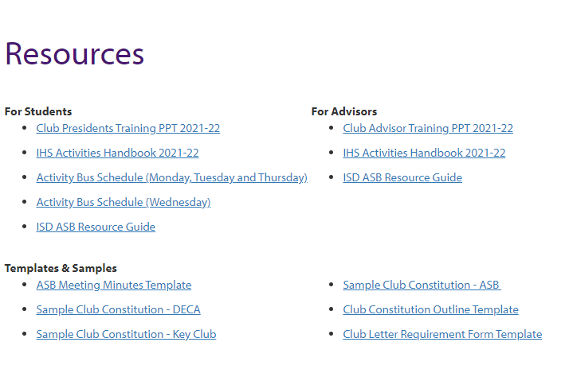
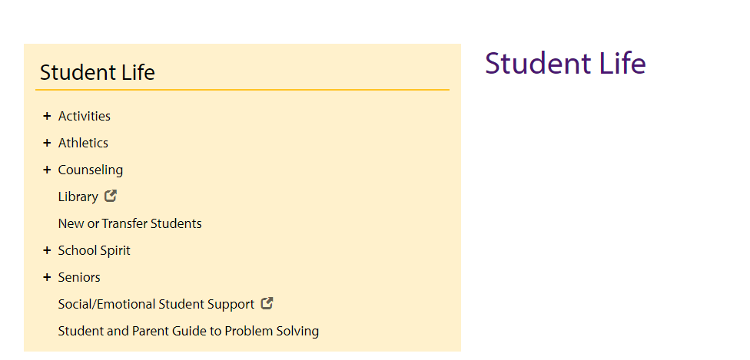
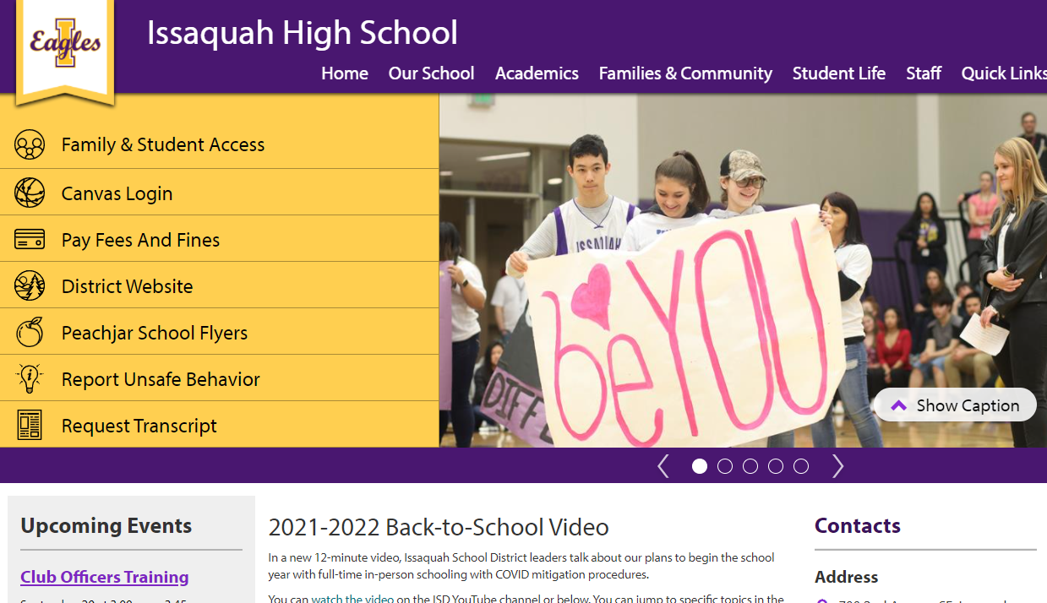
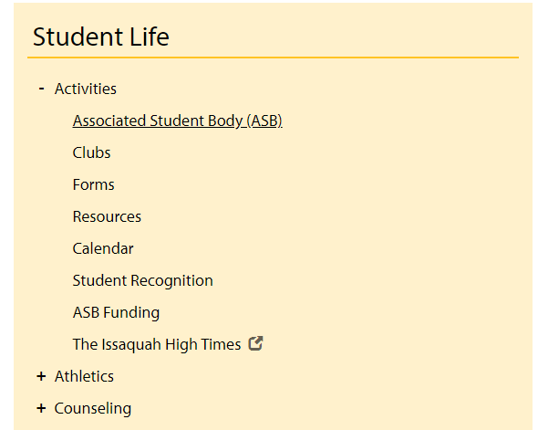
Templates

Slide 7
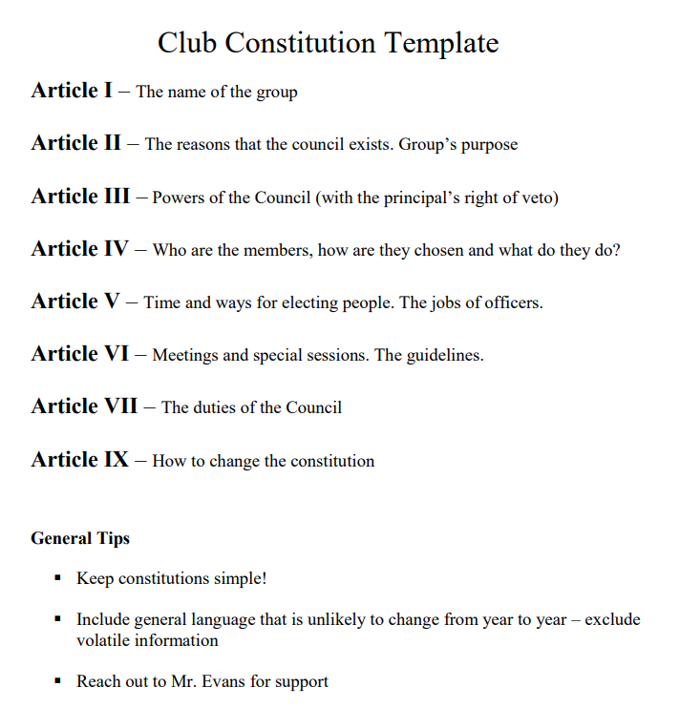
Constitution Template

Slide 8
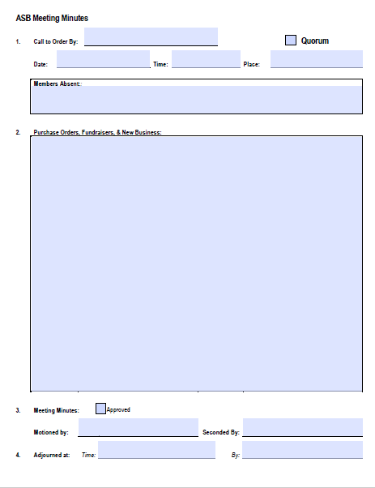
Meeting Minutes Template

Slide 9
Booster Club/PTSA
IHS Booster Club is available to support and fund clubs
Visit the Booster’s website and click on “Grant Requests”
Link to Booster’s website on the ASB homepage
Or, visit ihsboosters.org
Boosters can provide grants for travel, equipment, camps, etc.
Fundraiser $$$: Sign up to run concessions at an IHS home event
To request funds via Booster or PTSA:
First request ASB funds
ASB must deny request
Boosters and PTSA are then eligible to provide funds

Slide 10
ASB Finance
Review “Golden Rules of Finance for ASB Advisors” on page 8 of IHS Clubs Handbook

Slide 11
ASB Funding, Finance, Law, Rules and Regulations
All ASB money is public money
May be used only for Cultural, Athletic, Recreational, or Social, purposes AND must be for optional, non-credit related activities
Public money cannot be given away for private use. ex. gift card giveaways
Money raised during the school day, and/or on school property, and/or using school personnel, and/or school materials is public money and must be deposited within 24 hours!

Slide 12
ASB Funds-Purchase of Equipment and Supplies
All fund use requires ASB approval
Submit district Purchase Orders (POs) to ASB Bookkeeper
Submit invoice or packing slip to ASB Bookkeeper.
NEVER…
order directly from vendors without approval
accept donations from parent groups without approval.
sign or verbally agree to contracts without approval
Notes:
Items purchased with ASB funds become property of IHS

Slide 13
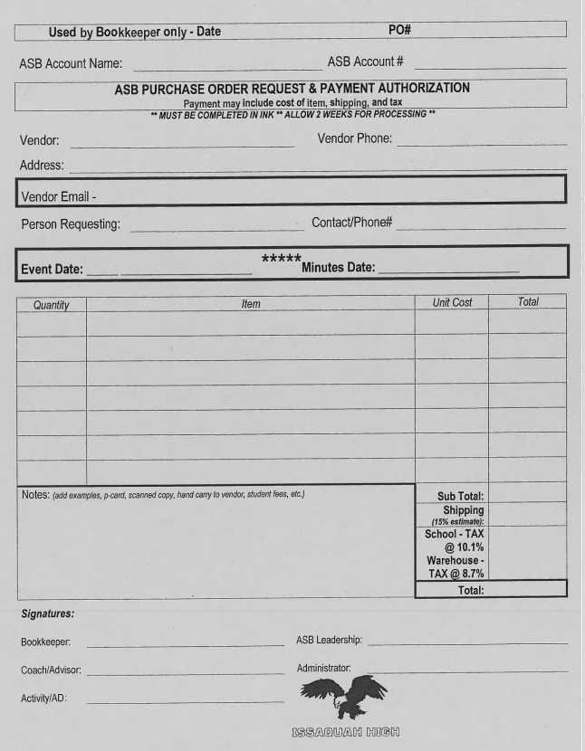
Purchase Order Form

Slide 14
Fundraisers
Fundraiser Reconciliation Form
Fundraising must be preapproved by ASB
Must be an optional, noncredit, and extracurricular event that is Cultural, Athletic, Recreational, or Social.
Turn money into bookkeeper
Daily
With a collection log or ticket sales report.
Submit POs and invoices to the Bookkeeper (the PO shall include a note that a fundraiser form has been approved).

Slide 15
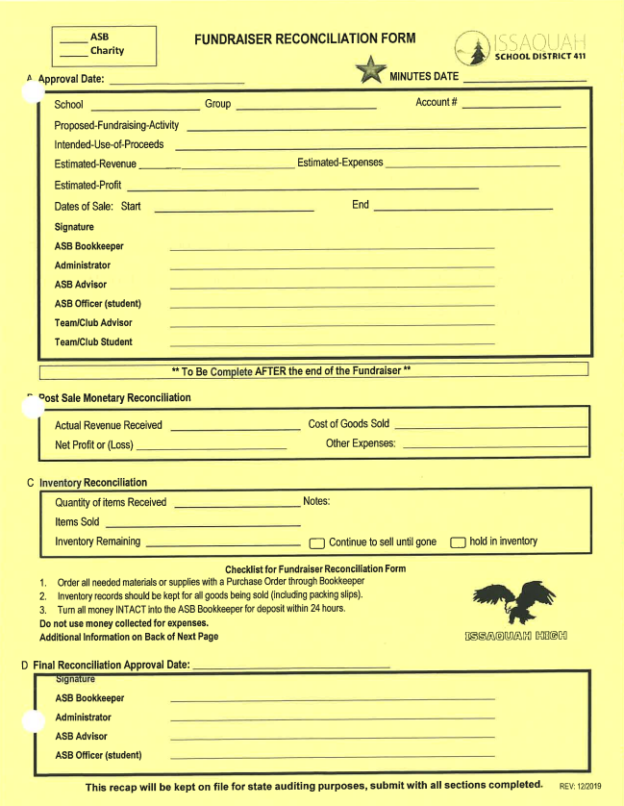
Fundraiser Form

Slide 16
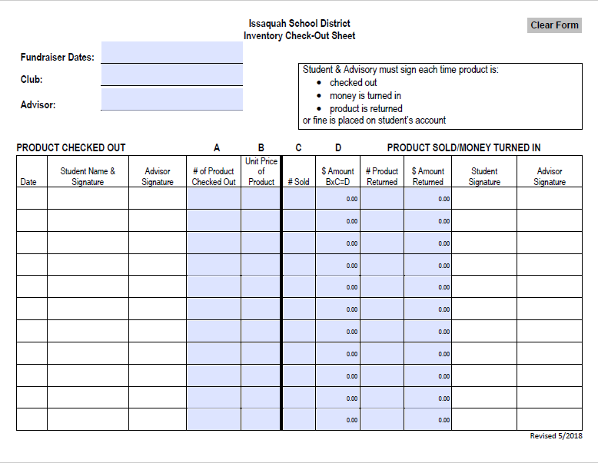
Use this form for example when selling Brown Bear Car Wash tickets, Jamba Juice, etc.

Slide 17
Cash Boxes
Submit cash box requests at least 3 academic days before date needed
Turn in ALL money to ASB Bookkeeper
Immediately (when possible)
24-hour window
Money CANNOT be taken home

Slide 18
Club Operations and Publicity

Slide 19
Reserving School Facilities
All school spaces must be booked for use
For Club meetings and club events
Email Laura Couty, coutyl@Issaquah.wednet.edu
For large crowds and/or food provisions:
Custodians is required
Paid via your club/organization’s ASB account
You are responsible for returning any used space to its state prior to your event

Slide 20
Publicity
Student announcements on IHS website
“Student announcement” button on main website to both view announcements and request to post info
Instagram—DM @issaquahasb to get information about your club posted on the ASB IG feed
iVision – send email announcement requests to issyivision@outlook.com
Subject Line: Start Date to End Date, Club, Title
Example: 9/22 – 10/6, DECA store open next week
iVision airs every Wednesday

Slide 21
Posters
Supplies available in closet outside ASB Room
NO glitter
Clean up, put away paint, clean paintbrushes, put away supplies and hang posters when done with space
BLUE PAINTER’s TAPE
Borrow from Main Office / ASB Room / Mr. Evans
Staples/tacks should be used on textured walls
Don’t place on railings
Activities Director approval is needed (stamp)
Posters must be removed by club at 2 weeks, or after approved timeline

Slide 22
Action Items

Slide 23
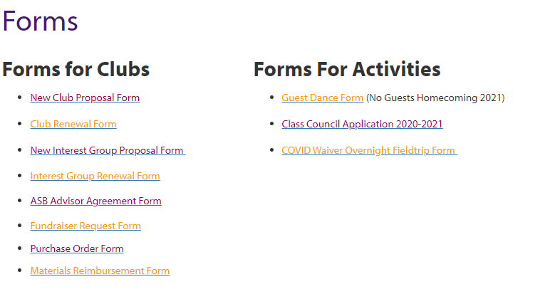
Required Forms
Reactivation forms for clubs due today 9/29

Slide 24
YEARBOOK
Club Roster
Due December 17th
must include first and last names
List of officers
Include positions
Head shot and quote from club president. The quote should be about the club
All club photos must include names of who is in the photo
Candid (un-posed pictures) of any club activity.
jarvinene@Issaquah.wednet.edu

Slide 25
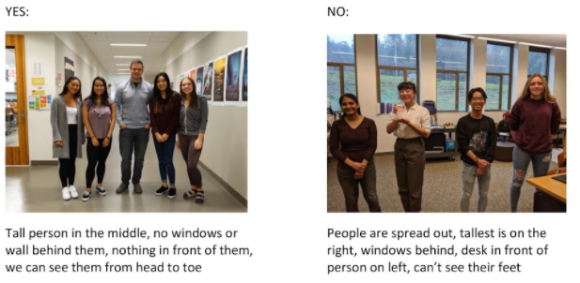

Slide 26
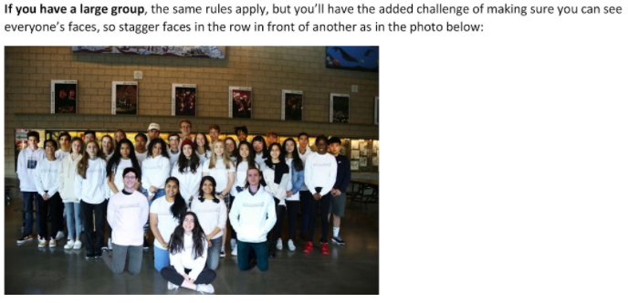
Yearbook
Send candid photos!
Any photo submitted should include a key and accurate spelling of all people photographed

Slide 27
Club Wall Fliers
Create a flier for the club wall
8.5” X 11” paper
Portrait orientation
Club Name
Day club meets
Room Location
Time
Optional : Club contact info or QR code

Slide 28
Club Wall Fliers
Fliers due 10/6 Turn in to Mr. Evans inbox or 1422

Slide 29
Club Fair
Wednesday, October 6th
NEST
Commons
VISUAL DISPLAYS and Sign-Ups
Poster, tri-fold, pamphlets, etc
Google form and QR Code sign up
Paper sign ups

Slide 30
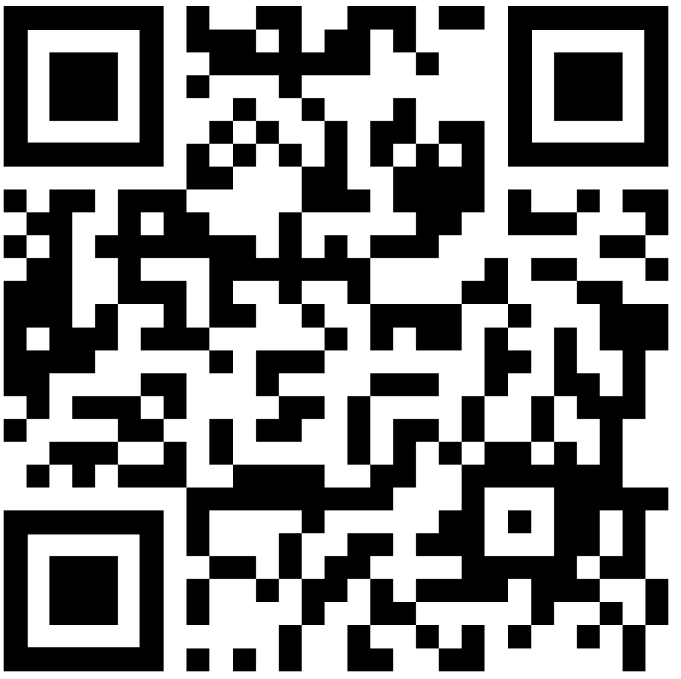
Club Fair RSVP

Slide 31
Ethics Laws and Regulations
RCW 42.22.030
– direct or indirect interest in contracts
RCW 42.23.070
– using your position for personal gain
WAC 180-87-050
– unprofessional conduct
District Regulation #5251:
Conflict of Interest
DEFINITION: A conflict of interest is any situation in which a District employee, either for himself/ herself or some other person(s), attempts to promote a private or personal interest which results or appears to result in the following:
1. an interference with the objective exercise of his/her District duties; or
2. a gain or an advantage by virtue of his/her position in the District.
Examples:
Advisor or family member owns a T-shirt company.
Advisor runs a for-profit club clinic.
Hiring friends, family, or parent’s services.

Slide 32
Resources
Issaquah School District Regulations & Procedures:
Conflict of Interest – Reg.# 5251
Gifts and Memorials – Reg.# 6114
Field Trips, Excursions, and Outdoor Education – Reg.# 2320
Nutrition and Wellness – Reg.# 6700
Purchasing – Bids and Contracts – Reg.# 6220
Reimbursement for Travel & Work-Related Expenses – Reg.# 6214
Student Awards and Incentives – Reg.# 6116
Student Fund Raising Activities – Reg.# 3530
Student Fund Raising for Charitable Purposes – Reg.# 3540
Volunteers Assisting a Club Advisor – Reg.# 5631P
All of the Issaquah School District Regulations, Procedures & Forms can be found here http://www.issaquah.wednet.edu/district/regulations
District Contacts
Shim, Jenny- District Accountant 425-837-7013
Justice, Jeri- Reimbursements 425-837-7015
Banasick, Moriah- Director of Finance 425-837-7139
Padilla, Donna Secretary to Director of Purch. 425-837-7071
Maybee, Sue- Director of Purchasing 425-837-7070
WASBO Resources
WASBO-ASB Manual

Slide 33
Thank You
Contact Chloe Feyerick with questions
ihsclubschair@gmail.com

