Slide 1
Issaquah High School Clubs Advisor Training

Slide 2
Key people/things to know
ASB Bookkeeper- Margaret Pfeifle (Purchasing/Fundraising)
Athletic and Activities Secretary- Laura Couty (Facility Requests and Transportation)
Assistant Principals’ Secretary- Makennah Little (Field Trips)
Activities Director- Kurtis Evans
Student Activities Coordinator- Chloe Feyerick
ihsclubschair@gmail.com
Activities Website
Forms, templates, clubs lists, handbook, resources etc.
Please review for accuracy

Slide 3
Interest Groups vs. Clubs “Who’s who”
Interest Group | Club
An advisor (staff member/teacher is required) Must be approved by ASB Executive Board and Activities Coordinator Must have one designated student representative in charge Minimum of 5 students participating regularly Everyone in the interest group must be a current student at IHS | An advisor Must be approved by ASB Executive Board, Activities Coordinator, and Student Senate Must have a governing board and elections each year (President, VP, Treasurer required) Minimum of 10 students participating regularly Everyone in the club must be a current student at IHS Governing board of club must have purchased ASB membership

Slide 4
Interest Groups vs. Clubs “What’s what”
Interest Group | Club
Must take regular attendance and submit attendance records to Activities Coordinator at the end of the school year. No meeting minutes required No fundraising, purchases, or any financials Meet a minimum of once a month | Attendance and financial meeting minutes MUST be uploaded to google folder within 72 hours of a meeting Can makes purchases, fundraise, or receive donations Have a minimum of bi-weekly meetings A current constitution must be approved and on file with ASB and the Activities Coordinator by October 4th or within 1 month of Senate approval

Slide 5
Advisor Responsibilities
Key Points
Follow all ASB, school, district, state policies
Supervise students at all times
Monitor all paperwork, scheduling, and events
If students can “letter” in your club per the constitution, keep track of who has met requirements for lettering
These names will be due around April
Keep a record of any “inventory” your club acquires
Arrange and coordinate elections for next year
Turn in “Summary of Club Activities” at the end of school year
Keep track of Club Hour Compensation and submit to Activity Coordinator

Slide 6
Student Supervision
Students need to be supervised at all times during any school activity or function
This includes when students are making posters in the ASB room
If the club advisor is unable to attend they must arrange for another ISD staff member to be present at the event
This includes regular meetings

Slide 7
Publicity
iVision- email issyivision@outlook.com
Subject line: Dates you want announcement read….what the subject of your announcement is
Ex: 10/14/21 - 10/15/21…Auditions for Musical
Posters
Supplies available in closet outside ASB Room
NO glitter
Clean up and push posters to side afterwards
Students must be supervised
Do not use tape on painted wall surfaces, wood surfaces or windows
Only use blue painter’s tape and put tape behind paper not on edges
Don’t place near fire censors (the main ones are in the commons)
Activity Coordinator Approval is needed (stamp)
Posters must be removed after 2 weeks

Slide 8
General Club Information
ASB Membership
All clubs members must purchase an ASB Card
Club Membership
Must be current Issaquah High School Students in grades 9-12
Informed Consent
Needed for any activity/club that involves physical activity and/or use of gardening tools
YAY!!! This is now a part of the required forms families fill out at the beginning of the year. If parents refused, they will need to be completed on a case by case basis
Check with Kurtis Evans for list of students who have NOT filled out form

Slide 9
After Hours Issues
If you find yourself at school after hours for a club please remember the proper security procedure for the school
When you come sign in and sign out
If you are the last person in the building you need to ARM THE SYSTEM
If when you attempt to arm the system, you receive a “NOT READY TO ARM” indication
Do NOT just leave
You can try and find the problem (usually a door has been propped open)
Otherwise, there is a list of emergency after hours contacts in the front of the sign in binder as well as on a piece of paper taped to the table
Please call the appropriate person and inform them of the situation

Slide 10
Lettering / Grad Cords
Lettering
Each club must come up with their own requirements for lettering
These requirements MUST be included in their CONSTITUTION

Slide 11
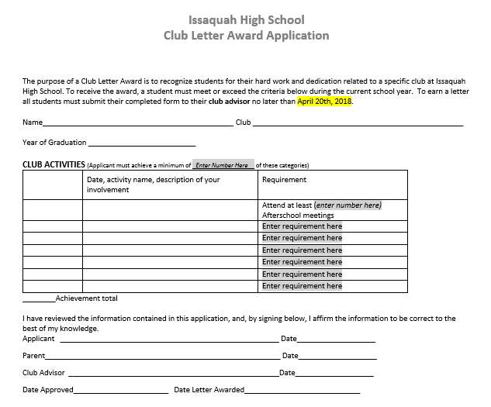
Letter and Cord Requirements and Application Template

Slide 12
Club Folders
Clubs Folders should will be shared with you and are on Google Drive – Please use full date (08-21-2021)on all items
Do NOT delete past years’ records, instead archive them
MUST upload Constitution, Meeting Attendance, and Financial Minutes regularly
Meeting minutes form template is available on Activities website

Slide 13
Recording Keeping and Google Drive
Each club must submit the following to Google Drive
Club Constitution
Attendance – with full date (08-21-2021)
Taken at every meeting and uploaded to Google Drive Folder
Financial Minutes (Minutes template on website)- with full date (08-21-2021)
MUST be recorded at any meeting where a financial decision is made
PO and fundraising request forms require the date of meeting minutes of approval
A club must have officer elections at least once a year
Minimum of a President, Vice President, and Treasurer

Slide 14
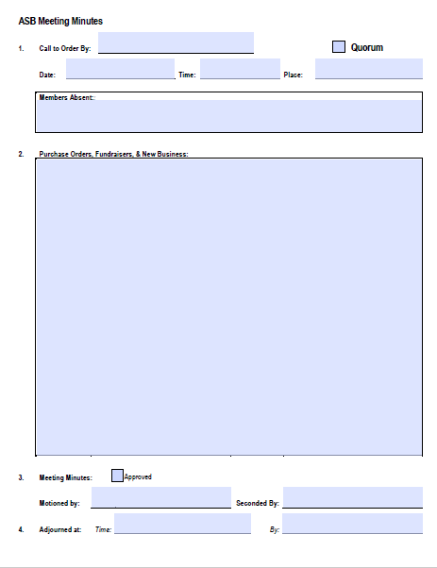
Meeting Minutes Template

Slide 15
ASB Finance
Review “Golden Rules of Finance for ASB Advisors” on page 8 of IHS Clubs Handbook

Slide 16
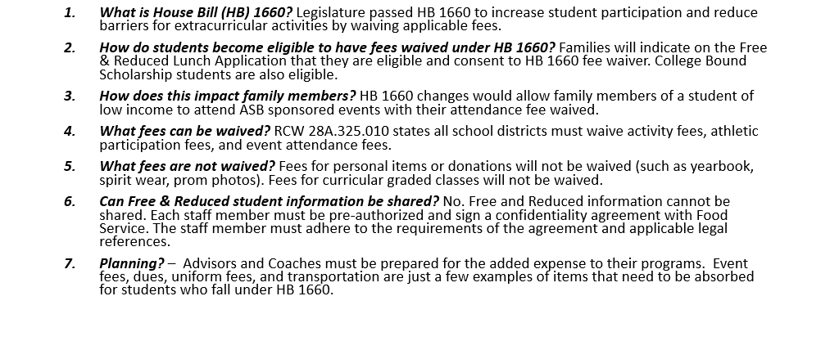
NEW: House Bill 1660

Slide 17
ASB Funding, Finance, Law, Rules and Regulations
ASB funds
Public money, generated by the students or in the name of students, may be used only for Cultural, Athletic, Recreational, or Social, purposes, which are optional, and non-credit.
Money raised during the school day, and/or on school property, and/or using school personnel, and/or school materials is public money.
ASB funds are restricted and cannot be used for curricular purposes.
Public money cannot be given away for private use.
Students and staff must collaborate on the generation and use of public money.
Taxpayers want to ensure public funds are used legally & appropriately.
ASB moneys must follow regulations and/or guidelines developed by the State Auditor and OSPI.
Money raised during the school day, and/or on school property, and/or using school personnel, and/or school materials is public money and must be deposited within 24 hours!

Slide 18
ASB Funds-Purchase of Equipment and Supplies
Advisors can only purchase items approved by ASB and for the amount that was approved at the budget meeting.
Obtain quote from vendor for items.
Submit district purchase order requisition with quote to ASB Bookkeeper, including sales tax and shipping.
Ship items to the district May Valley warehouse.
Once inventory is received, count inventory received against the quantity billed from vendor.
Submit invoice or packing slip to ASB Bookkeeper.
Advisors must place items in a designated secure location.
NEVER:
Order directly from vendor without approved purchase order and ASB approval.
Accept donations from parent groups without District approval.
Pick up items prior to having approved purchase order or purchase with personal funds.
Sign or verbally agree to contract such as Photographers/Videographers, outside contractors, consultants.. (Authorization to enter into any contract or professional services agreement may only come from the Superintendent or District designee, a PO entered, and agreement)
Expect Parents, volunteers and students to be reimbursed. On the rare occasion a parent or volunteer will need to be reimbursed, written permission must be granted ahead of time by Controller. If advance permission is not granted, then the parent or volunteer will have made a nice donation to your school.
Notes:
Items purchased with ASB funds become property of IHS

Slide 19
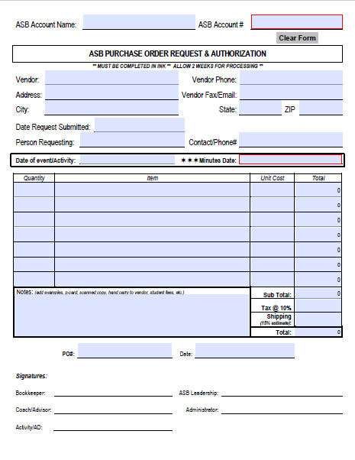
Purchase Order Form

Slide 20
Fundraisers
Important Fundraiser Procedures:
All fundraising activities must be requested and approved through the ASB Student Council and Building Administration PRIOR to beginning a fundraiser on a Fundraiser Reconciliation Form.
Must be optional, noncredit, and an extracurricular event that is Cultural, Athletic, Recreational, or Social.
If preapproved to collect money, the money must be turned into the ASB Bookkeeper each day immediately for deposit along with a collection log or ticket sales report.
Submit any purchase orders (PO) and/or agreement/contact with fundraising form to the Bookkeeper.
Do not sign contracts with vendors. All contracts must be signed by a Principal and the School District Business Office.

Slide 21
Common Fundraising Issues and Online Fundraising
Most common ASB Fundraising Issues:
Meeting minutes showing student approval were not completed.
Purchase orders were not approved before the fundraiser.
Fundraiser Reconciliations are not completed or supported.
Inventory and Cash Receipting did not agree.
Revenue Projections were not made.
ONLINE FUNDRAISING
Including but not limited to Snap-Raise, Go Fund me, Kickstarter, Donors Choose, Indigogo, Bandcamp, and etc. where donations are made through third-party vendors for the district are PROHIBITED. All online fundraisers and sales are prohibited unless pre-approved through the Finance department with a contract.
There is an option to collect fundraiser
donations online through our district website!
https://web.issaquah.wednet.edu/Touchbase/signin.aspx

Slide 22
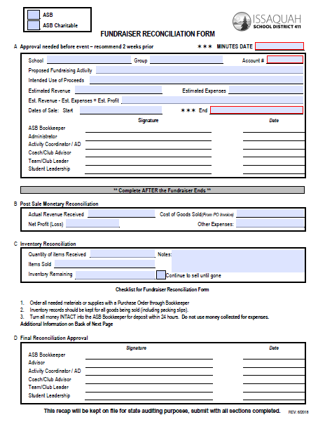
Fundraiser Form

Slide 23
Materials Reimbursements
Only ISD employees can be reimbursed for items purchased for clubs
Single purchases cannot exceed $350
Original itemized receipts must be submitted with Materials Reimbursement Form to ASB bookkeeper with in 3 days of purchase
Sign the itemized receipt
Receipts can only have items to be reimbursed on them, personal items will void reimbursement
Purchases must comply with ISD policies

Slide 24
Cash Boxes
Be sure to submit a cash box request at least 3 days ahead of date needed – set up time with bookkeeper, prior to event, to have your cashiers trained
Turn in ALL money to ASB Bookkeeper for deposit IMMEDIATELY following the event
All money collected must be dropped in cash drop within 24 hours
Cannot use Go Fund Me, Snap Raise, or similar fundraising sites
Money CANNOT be taken home

Slide 25
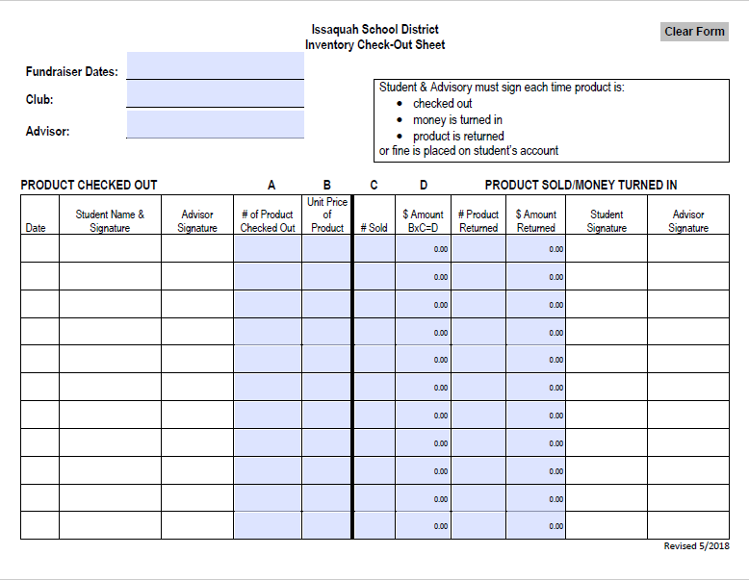
Use this form for example when selling Brown Bear Car Wash tickets, Jamba Juice, etc.

Slide 26
Requesting Funds and Donations
ASB Booster Club
ISF STEM Funding-Email Kurtis Evans
Links on websites for fund requests
Donations/Sponsorships
All donations (monetary or material become property of Issaquah High School)
Donations valued at $5000 or more must be approved by school board.
Monetary
Must be donated to the club’s account through the bookkeeper
Sponsorships and Advertising
Sponsorships less than $500 remain at school level, sponsorships greater than $500 go through the district’s Business Office to determine distribution
Any advertisement/sponsorship agreement must be recorded through ISD Form 4321 F
All sponsorship products, service, and ads must be consistent with district, state, and federal guidelines
Display ads on students/staff is prohibited and ads must be temporary in nature

Slide 27
Booster Club/PTSA
Booster Clubs and PTSAs are separate entities that operate to support and supplement school programs, activities, students and staff.
These entities are recommended to become 501(c) (3) non-profit organization and must register with the Secretary of State to legally solicit donations or fundraise.
Outside Organizations must carry liability insurance for all activities and abide by district regulations & procedures including Facility Use procedures.
The Booster club and PTSA must create, plan, implement, operate and manage their activity.

Slide 28
Booster Club/PTSA
They must provide the majority of the manpower and handle all financial aspects for the activity. Boosters or PTSA are responsible for their inventory, supplies and volunteers.
District employees (Advisors) are discouraged from holding an official position or having signature authority due to potential conflicts of interest (RCW 42.23 & District Regulation #5251).
Advisor should not use their work time for Booster or PTSA involvement.
Students and Advisors participating in Booster and PTSA events cannot wear their uniforms during private or personal events. (WAC 391-138-015)
Students should not collect money or be involved in the Booster or PTSA reconciling process.
Booster and PTSA members cannot sign contracts on behalf of the district nor obligate the district financially.
Advisors should verify Booster Club/PTSA fundraising is not an ASB activity. Money raised during the school day, on school property, using school personnel, or school materials is an ASB activity!

Slide 29
Reserving School Facilities
Email Laura Couty to see if space is available at least 2 weeks (or earlier) before event. Be flexible with dates – this is for any space wanted at IHS
coutyl@Issaquah.wednet.edu
If a large crowd is expected or perishable food items are served, a custodian is required and will be paid from your organization’s ASB account
Return everything to original state when event is finished

Slide 30
Field Trips/Travel
Plan ahead when making travel arrangements ( hotel, airline tickets, shuttle buses). Submit Po’s and take care of travel arrangements BEFORE school breaks while your bookkeeper is available!
Overnight Field Trip Forms
https://www.issaquah.wednet.edu/schools/fieldtrip
Still awaiting final approval for 2021-22 school year
If submitting overnight requests, DO NOT pay non-refundable deposits
IF overnight field trips are approved – additional steps required. Will be communicated on a need to know basis
Category 1 – Routine, one-day field trips (14 days in advance)
Category 2 – Extended (over 150 miles) and Overnight field trips (45 days in advance)
Category 3 – WIAA athletic field trips (in-season and post-season) (7 days in advance)
POs will not be approved nor travel costs paid for until the overnight fieldtrip form is signed by the superintendent, even if it means losing a reservation for a block of airline tickets or hotel rooms.
Notes:
Cat 1 -School sponsored, school chaperoned, conducted in 1 day in the greater Seattle area

Slide 31
Travel-Hotels
Hotel Rooms
Make a hotel reservation. It’s OK to secure the reservation with your personal credit card or with a school procurement card (p-card). Ask the hotel if they will invoice the district.
Do not book hotel rooms on travel websites such as Expedia.
Hotel reservations cannot include non-chaperones’ rooms (e.g. parents’ rooms)
If hotel issues a group contract/agreement, give contract to your bookkeeper to process. Club Advisors don’t have authority to sign the contract.
Give purchase requisition form with the hotel information (including reservation number) to your school ASB bookkeeper with a PO. Indicate how the hotel will be paid for such as by invoice or with a district travel p-card.
If checking out a district travel p-card, complete application and send it to Donna Padilla in the Purchasing Dept. She will set up an appointment for you to attend a 5 min. training, sign an MOU and check out the card. Use the travel p-card to pay for the room in person. Travel p-cards can only be used to pay for hotel rooms, not meals, tickets or transportation.
Upon checkout, ask the hotel to print out a receipt of all of the rooms.
Return Travel p-card and receipt to Donna Padilla.

Slide 32
Travel-Airfare
Airfare
If you have 10 or more people traveling on the same flight, call any major airline’s Group Desk and book a group of tickets. Make sure you put Sue Maybee’s name down as an authorized person on the reservation. Sue will call the airline and pay with her p-card but they won’t let her do so if she’s not an authorized person. Allow sufficient advance notice in case Sue is not in the office on the day a deposit or other payment is due. Airline tickets will not be paid for until the superintendent has signed off on the fieldtrip form, even if it means losing the “great deal” on a group set of tickets.
If you have less than 10 travelers, call Corporate Travel Management (CTM) to book your flights. There will be a $28/ticket fee. 800-433-2423. Ask for Mike Haslam.
Give information to your bookkeeper with a PO.

Slide 33
Travel-Vehicle Rental and Travel Advances
Vehicle Rental
Call Enterprise and give them account #GAR45B1. Ask for direct billing. The cost will be charged to the district account.
Vans must be 10 passengers or less (insurance requirement).
Give rental information, along with reservation number to your bookkeeper with a PO.
Upon returning the vehicle, obtain a receipt and give it to your bookkeeper.
Travel Advances
Complete the Advance Travel Request form, if applicable. You will receive a check for the amount and be responsible for collecting receipts and reconciling the purchases.

Slide 34
Travel-Reimbursements, Insurance, Other
Reimbursements
The reimbursement limit is $350. Written pre-approval from the Business Office is required if there are extenuating circumstances which require a reimbursement above $350.
Student Insurance
Overnight field trips require the purchase of student insurance. Submit the form and list of students with your PO to your bookkeeper.
Be sure to budget for the cost of the insurance.
Other Info
Unless a parent or family member is a chaperone, a non-chaperone’s airline ticket, hotel, etc. cannot be paid for by the district, even if they plan on reimbursing the district. The reservation for a group block of airline tickets or hotel rooms cannot include non-chaperones. They will have to make their own reservation and pay for their own travel costs.
Staff and chaperones should not bring spouses, children, family members or friends on the trip unless they’re also chaperones. District fieldtrips are not family vacations.
Do not let parents make the group’s travel reservations. They can call and get quotes, but they should not be booking hotels or airline tickets for students and advisors.

Slide 35
Ethics Laws and Regulations
RCW 42.22.030
– direct or indirect interest in contracts
RCW 42.23.070
– using your position for personal gain
WAC 180-87-050
– unprofessional conduct
District Regulation #5251:
Conflict of Interest
DEFINITION: A conflict of interest is any situation in which a District employee, either for himself/ herself or some other person(s), attempts to promote a private or personal interest which results or appears to result in the following:
1. an interference with the objective exercise of his/her District duties; or
2. a gain or an advantage by virtue of his/her position in the District.
Examples:
Advisor or family member owns a T-shirt company.
Advisor runs a for-profit club clinic.
Hiring friends, family, or parent’s services.

Slide 36
Resources
Issaquah School District Regulations & Procedures:
Conflict of Interest – Reg.# 5251
Gifts and Memorials – Reg.# 6114
Field Trips, Excursions, and Outdoor Education – Reg.# 2320
Nutrition and Wellness – Reg.# 6700
Purchasing – Bids and Contracts – Reg.# 6220
Reimbursement for Travel & Work-Related Expenses – Reg.# 6214
Student Awards and Incentives – Reg.# 6116
Student Fund Raising Activities – Reg.# 3530
Student Fund Raising for Charitable Purposes – Reg.# 3540
Volunteers Assisting a Club Advisor – Reg.# 5631P
All of the Issaquah School District Regulations, Procedures & Forms can be found here http://www.issaquah.wednet.edu/district/regulations
District Contacts
Shim, Jenny- District Accountant 425-837-7013
Justice, Jeri- Reimbursements 425-837-7015
Banasick, Moriah- Controller 425-837-7139
Padilla, Donna Secretary to Director of Purch. 425-837-7071
Maybee, Sue- Director of Purchasing 425-837-7070
WASBO Resources
WASBO-ASB Manual

Slide 37
COVID Updates - MASKS

Slide 38
COVID

Slide 39
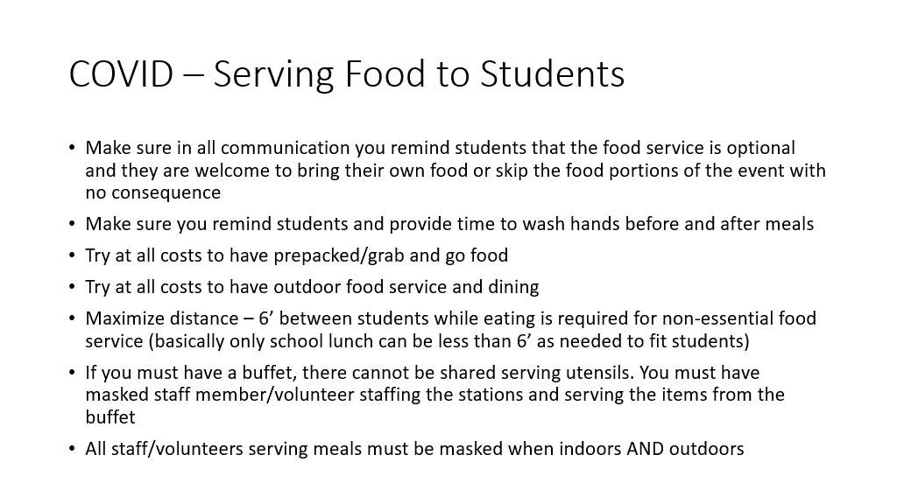
COVID – Serving Food
No snacks indoors

Slide 40
UPCOMING
Re-Application (or new application) forms Due 9/29
Club President Training – Week of 9/20
Senate Meeting 9/29

