Slide 1
What Do we Do next??

Slide 2
Be Kind to one another! Go Back to the Basics: Handwashing -20 seconds Social Distancing -3 feet/6feet Encouraging Mask Cohorting Lead by example

Slide 3
Covid-19
Communication is the key to keeping everyone safe and healthy
If you are sick or your student is sick, please inform the nurse immediately
Follow your seating chart
Do not deviate from Cohorts
Maintain a distancing of 3 feet between students and 6 feet from teacher to student
Lead by example!
Make this your goal, no close contacts in your class!

Slide 4
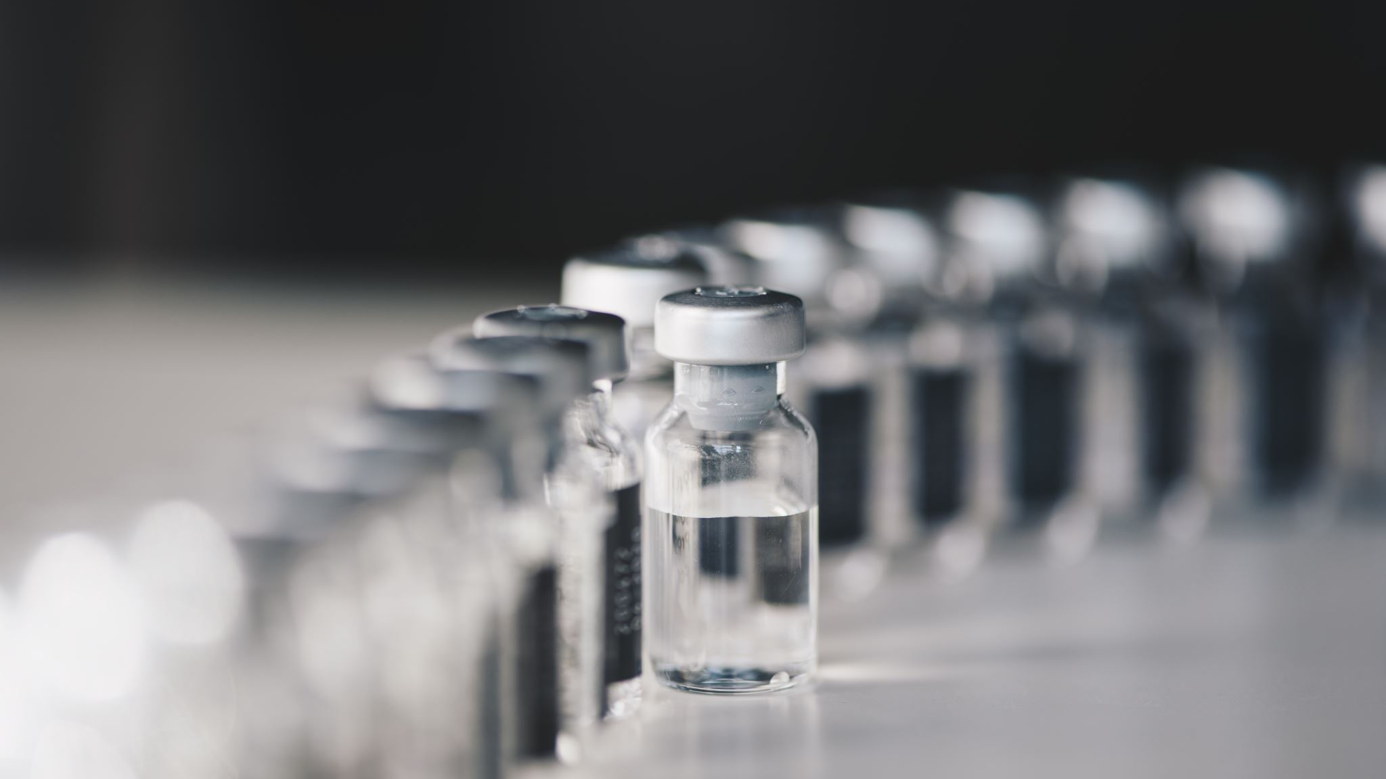
Student retention across BCSD during COVID
Developing trust and increasing vaccine confidence

Slide 5
I follow three rules: Do the right thing, do the best you can, and always show people you care. Lou Holtz
You are educators, role models and often heroes to our students.
State facts when asked.
Debunk myths when needed.
Increase confidence in vaccines with students and their families.

Slide 6
Pfizer mRNA Vaccine
Who can get it? Anyone 12 years and older
How is it given? In the deltoid muscle, 2 shots 21 days apart
What’s the cost? FREE
Where can they get the vaccine?
VaxLocator.dhec.sc.gov or call 1-866-365-8110
Health care providers
Local Hospitals
Pharmacies
Walmart
CVS
Publix
Walgreens
Kroger

Slide 7
Common myths
Will COVID-19 change my DNA?
No-COVID-19 vaccines do not change or interact with your DNA in any way. mRNA vaccines never enter the cell nucleus, where the DNA material lives.
The vaccine can cause infertility?
No-There is no evidence that fertility problems are a side effect of any vaccine.
Can someone who is pregnant or breastfeeding get the vaccine?
Yes-The American college of obstetricians and gynecologists recommends that COVID-19 vaccine. Getting sick with COVID-19 during pregnancy can increase the risk of severe illness and might increase the risk outcomes like preterm birth.

Slide 8
Common Myths
The vaccine contains metals, mercury, microchips and/or fetal tissues.
NO
The COVID-19 vaccines were developed too fast to be safe.
The technology used to develop the COVID-19 mRNA vaccines are not new, we did not start from square one.
mRNA vaccines have been studied, used in research, and data is decades old.
Increased collaboration, tens of thousands willing participants for trials, use of new technology and more funding meant that vaccine developers could worked quickly during this pandemic.
Getting the vaccine will impact a person’s immigration status.
NO-Getting the vaccine will not change whether you are able to stay in the US, get a green card, or get public benefits.

Slide 9
History Lesson
The United States has eliminated many diseases and virus.
Five from direct correlation to vaccines
Yellow Fever -1905
Smallpox – 1980 Eliminated By Vaccine First given in 1796
Malaria – 1950
Polio – 1979 Eliminated By Vaccine First given in 1955
Measles – 2000 Eliminated By Vaccine First given in 1968
Rubella – 2004 Eliminated By Vaccine First given in 1969
Diphtheria - 1940 Virtually Eliminated
Covid-19 -2021 Depends on You!

Slide 10
How could vaccines help students?
Immunity, 2 weeks after last vaccine.
School retention, No quarantine if deemed a close contact.
The more people who get vaccinated, the faster we can get back to normalcy.
It’s encouraging communities to have trust in the public health, medical and scientific community.

Slide 11
