Slide 1
Albemarle County Public Schools
Mountain View Preliminary Recommendation
November, 2021

Slide 2
Welcome & introductions
The planning team
RRMM
Virginia-based architectural firm retained by the Division to study potential options for Mountain View ES given its current design, capacity and population growth.
Cooperative Strategies
National planning firm and long-time partner of RRMM’s retained to create a housing and student yield study and co-facilitate the planning process to create a recommended strategy to address population growth in/around Mountain View ES.

Slide 3
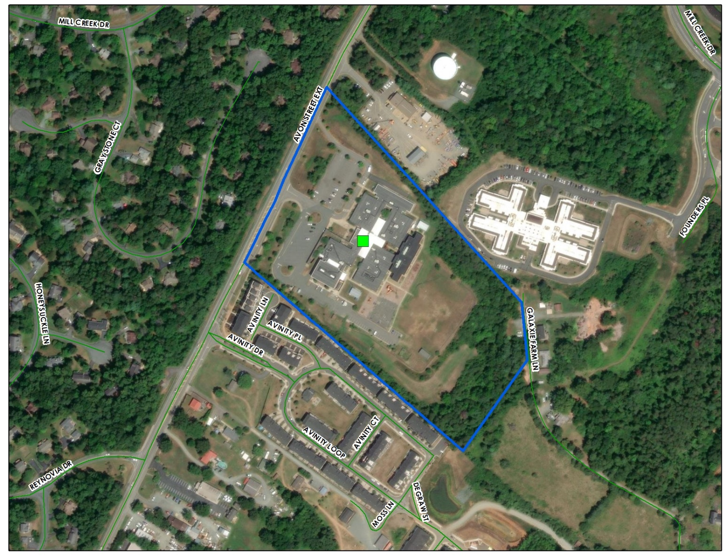
Background data
Area growth & Mountain View Impact
Mountain View ES
Built in 1990, expanded in 1996, 2007 & 2016
16.5 acres
91,000 sf
Capacity 624
2021/22 Enrollment: 677 (K-5), 38(Pre-K) = 715*Total
*Enrollment continues to be impacted by Covid-19

Slide 4
Background data
Enrollment growth
Image courtesy of ACPS Fall 2020
*The school also has about 45 preschool students. This increases the total enrollment for the school and should be considered for factors such as cafeteria size, parking etc. It does not impact the difference between the capacity and enrollment because the 624 building capacity figure does not include rooms which are utilized for PK programs.
**5 year projection calculated by ACPS using cohort survival methodology. The work of the consultant and this study may influence this projection to ensure we are capturing impact of future development.

Slide 5
Background data
Elementary School Capacity

Slide 6
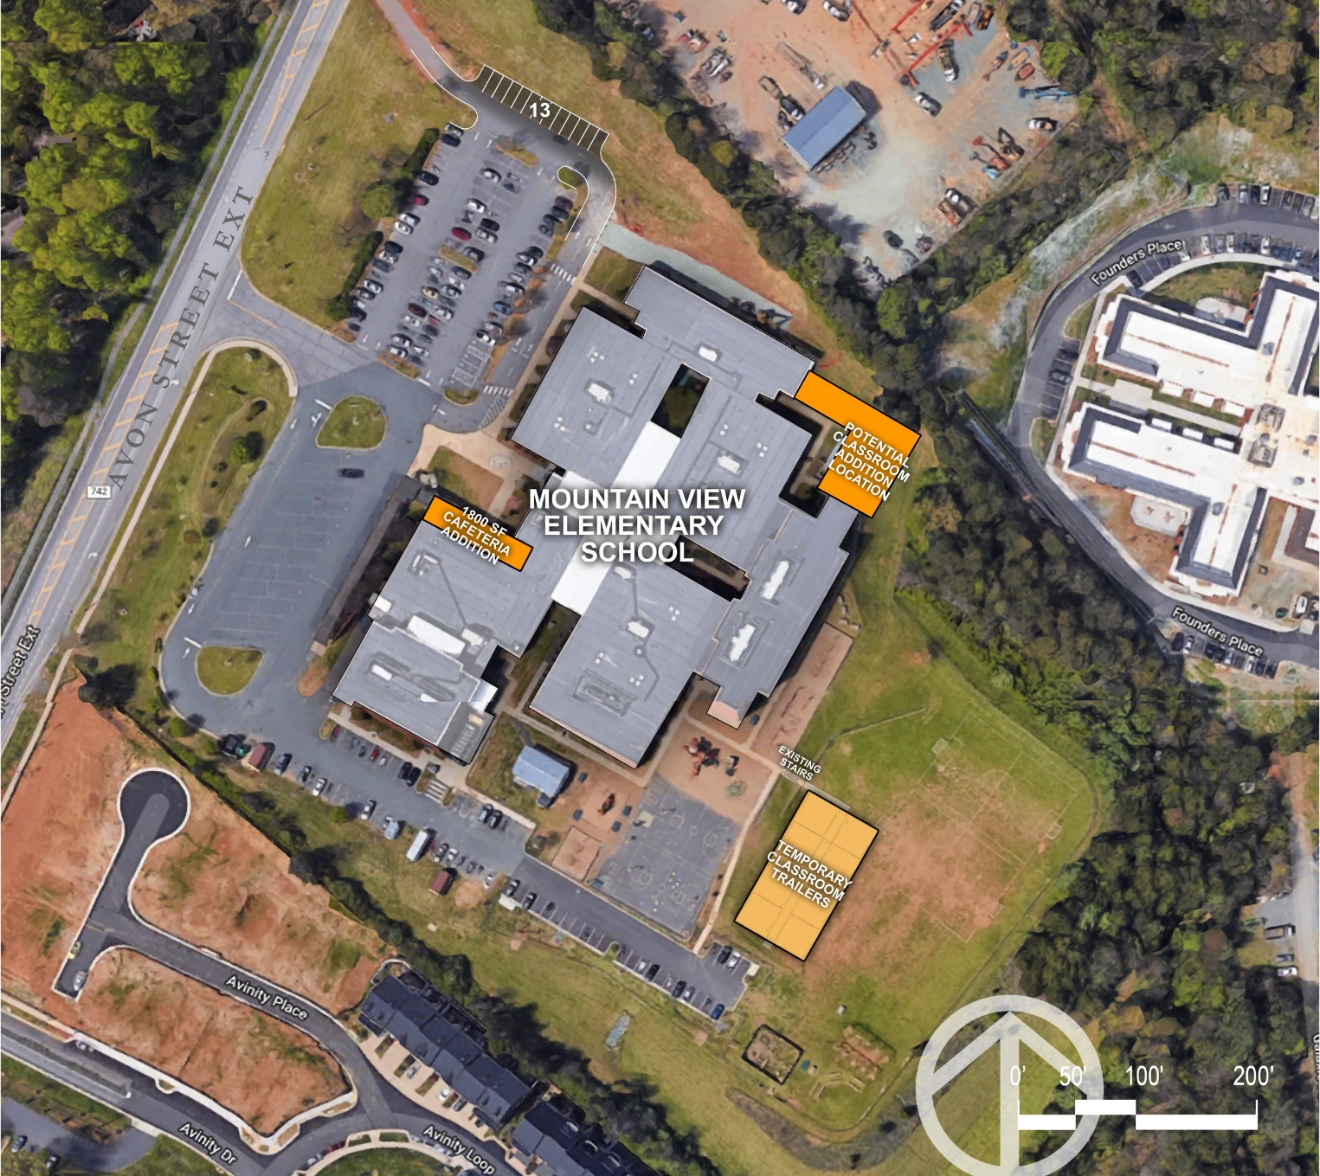
Background data
Planned additions

Slide 7
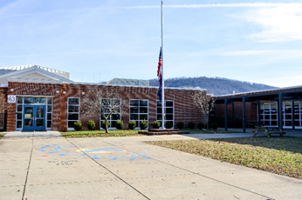
Process
Mountain view Planning & ACPS Yield Study
1
A Student Yield Analysis calculates division-wide student yields by housing type (single-family unit vs. multi-family unit) by dividing the number of students by the number of housing units. For example, 5 students / 10 homes = a student yield of 0.5 students per home.
How many kids are coming in the future?
2
A Facility Master Plan creates a plan for a school or group of schools based on area capacity, enrollment, condition and educational program needs.
How big should Mountain View become?
What are some viable options to consider to address capacity and future enrollment?

Slide 8
Process
Mountain view Planning & ACPS Yield Study
Current Housing Yields
X
Planned Development in Mountain View Attendance Zone
=
176 Students*
*Potential over the next 10+ years
Students from new housing may not all be new to the Division
Not a net gain of 176 students

Slide 9
TIMELINE
Mountain view Planning & ACPS Yield Study
May
Yield Study & FMP Data Collection
August - December
Finalize Yield Study
Teacher meeting 5/14
FMP Options Development
FMP Visioning-FMP
Consultant, School & Division Leadership
Community Mtg 5/18
FMP Options Review
Community Mtg
Online Survey
Staff Meeting
Board Updates

Slide 10
Staff & Community Feedback
Mountain view Planning

Slide 11
Additional Information

Slide 12
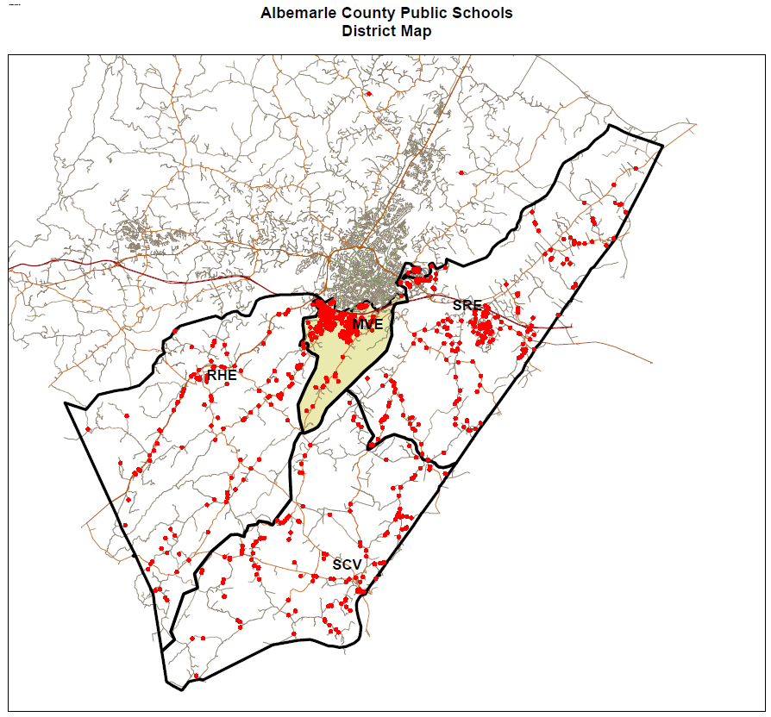
Additional information
Mountain view Planning
Image courtesy of ACPS

Slide 13
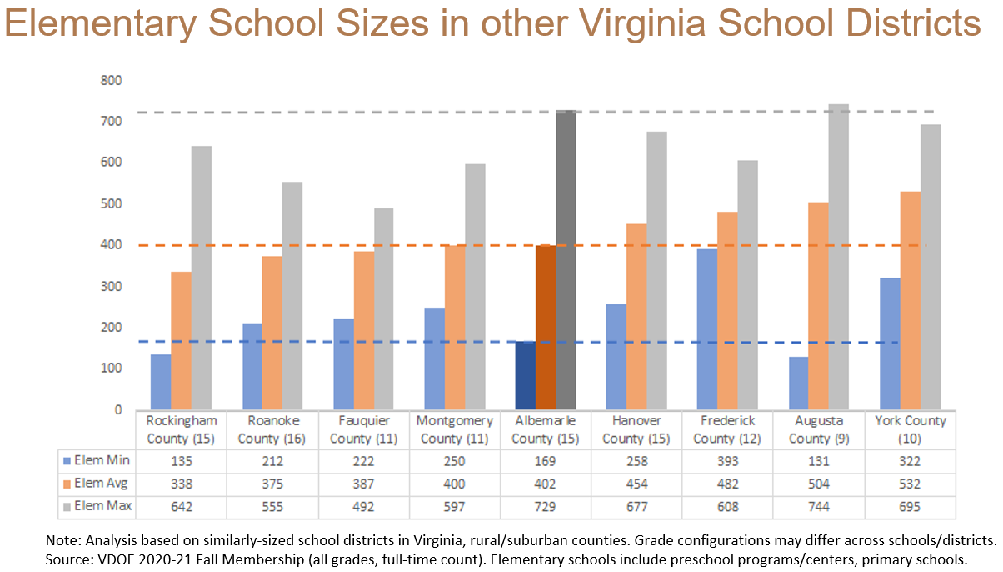
Additional information
Mountain view Planning
Image courtesy of ACPS

Slide 14
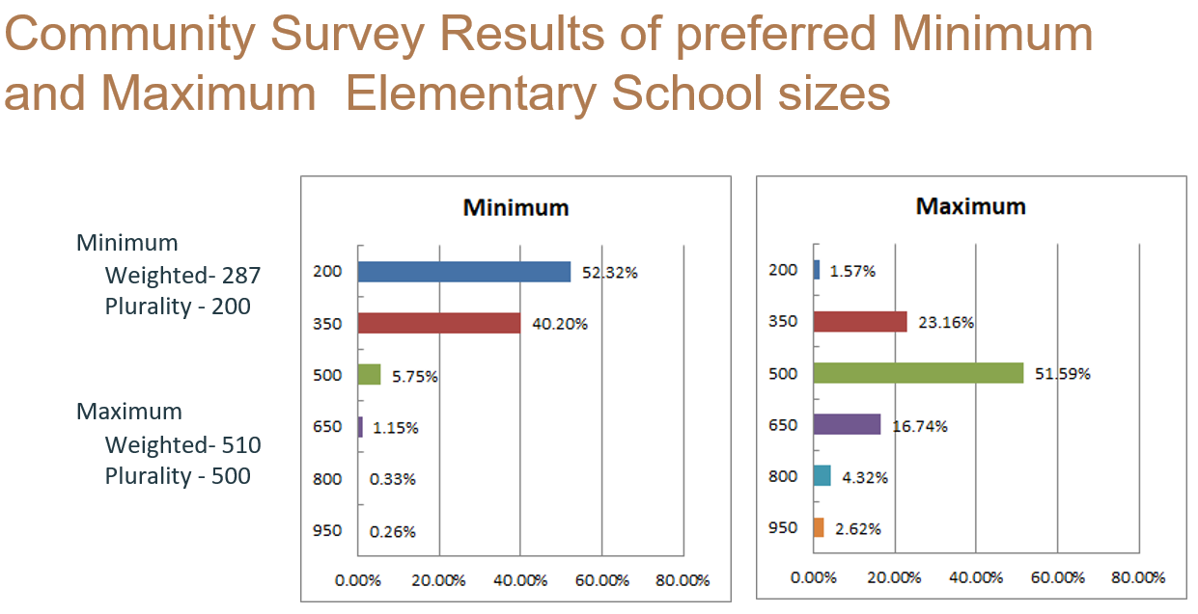
Additional information
Mountain view Planning
Image courtesy of ACPS

Slide 15
Additional information
Mountain view Planning
Image courtesy of ACPS

Slide 16
facility options

Slide 17
Facility options
Mountain view Planning & ACPS Yield Study
Main Options Considered but NOT Recommended
Build new Early Childhood (Pre-K and K) building on Founders Place Site
Move one or more grade levels from Mountain View to Walton MS
Build additions to increase capacity of Red Hill ES by 200 students and redistrict students from Mountain View to Red Hill
Build a new 400-500 seat PK-2 school in the Mountain View attendance zone. Current Mountain View becomes a 3-5 school
Build additions on to Mountain View to increase the capacity to 800-850 seats
Build a new 800-850 seat school to replace Mountain View on an acquired site

Slide 18
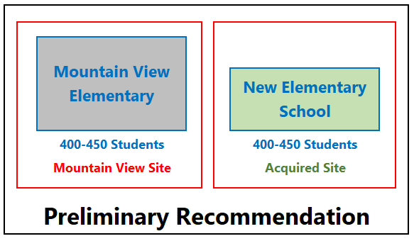
Facility options
Mountain view Planning & ACPS Yield Study

Slide 19
Facility options
Mountain view Planning & ACPS Yield Study
Preliminary Recommendation – New 400-450 Seat Elementary School at an Acquired Site Create two separate PK-5 Attendance Zones
Build a new school on an acquired site Create two separate PK-5 attendance zones from current Mountain View boundary
Benefits
Smaller school size for Mountain View and the new Elementary School Reduces overcrowding at current Mountain View ES Provides additional building capacity for long term growth Both schools will have adequate playgrounds, parking, and parent drop-offs
Challenges
Cost: New building construction and potential land acquisition Redistricting required; new boundaries needs to be created for new school Increased operational overhead Difficult to hire staff to expand the immersion and discovery programs Will take 3+ years after site acquisition to design and build a new school

Slide 20
Proposed ADDITIONS

Slide 21
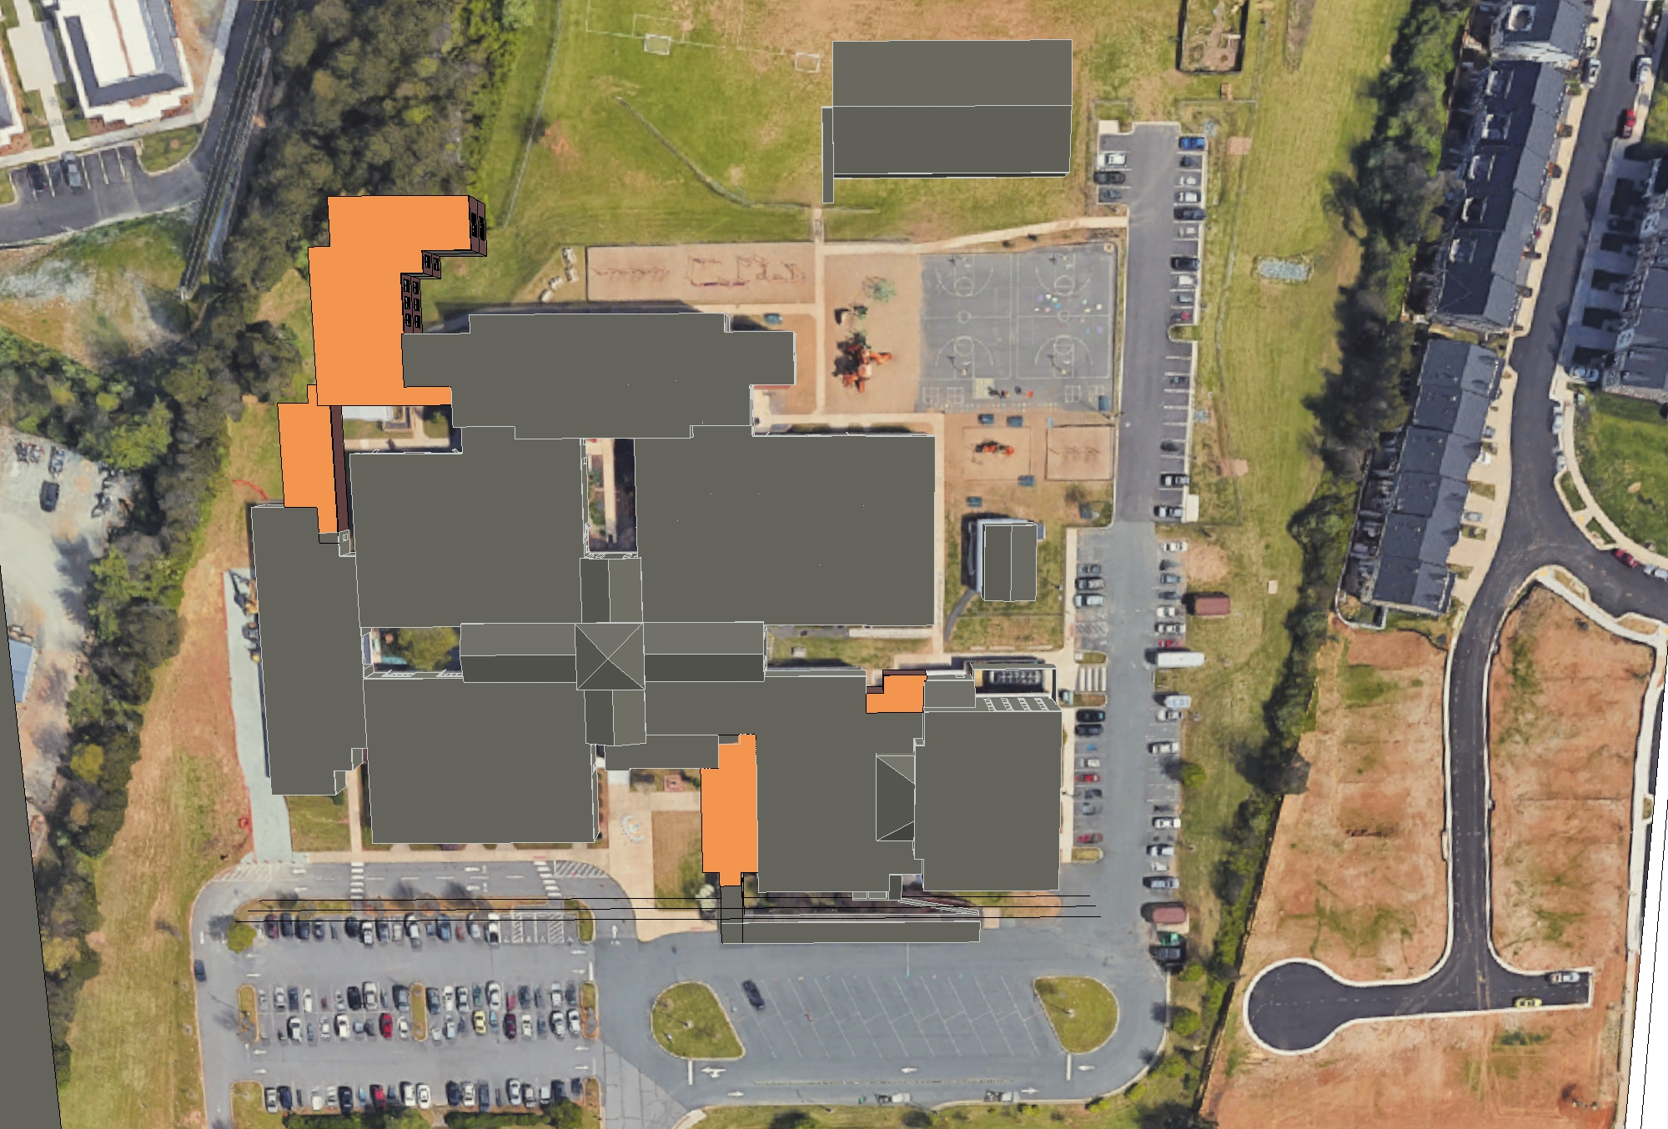

Slide 22
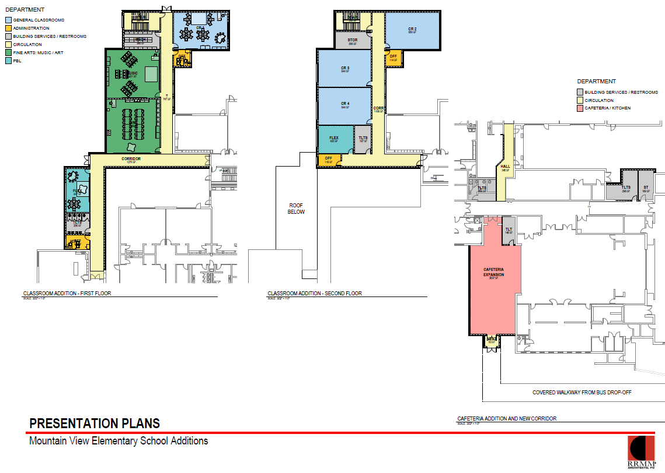

Slide 23
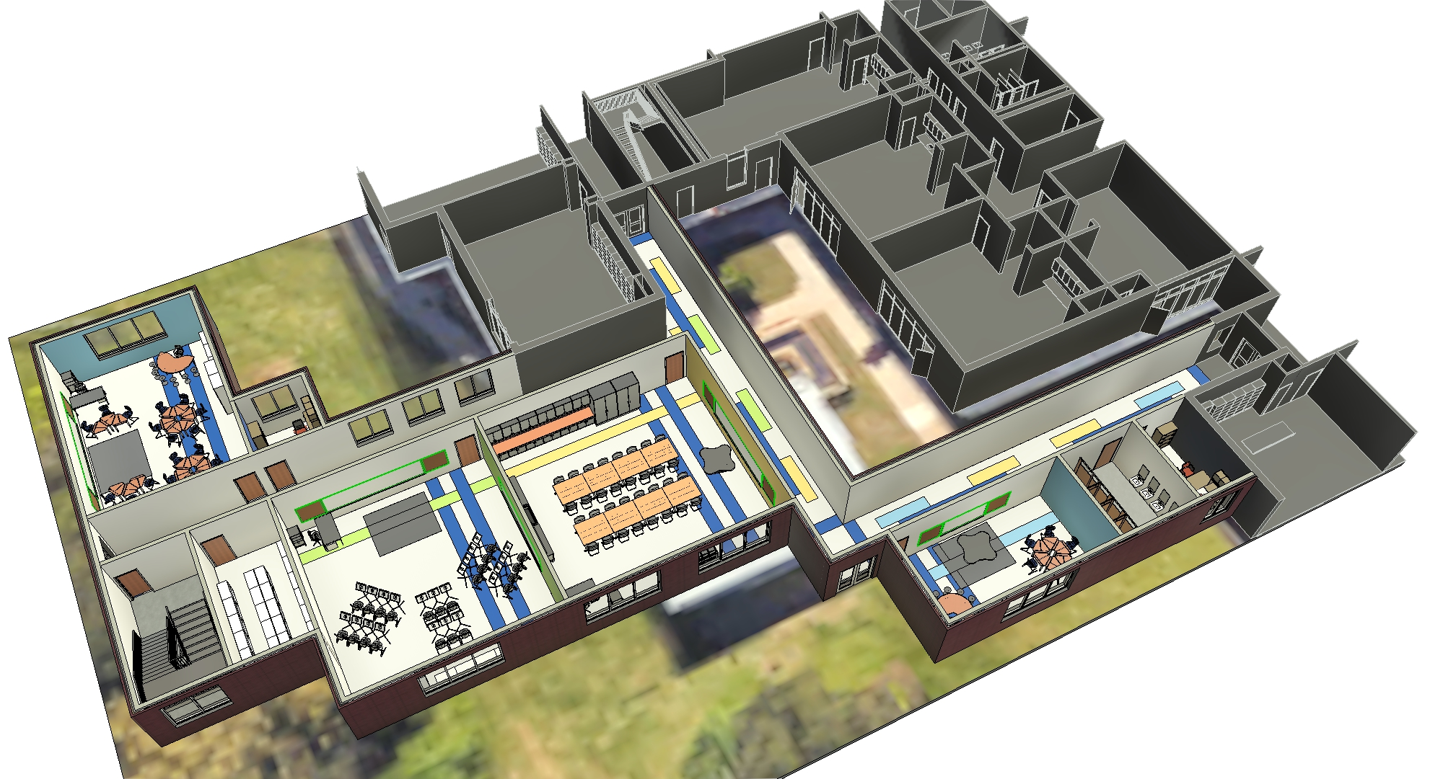

Slide 24
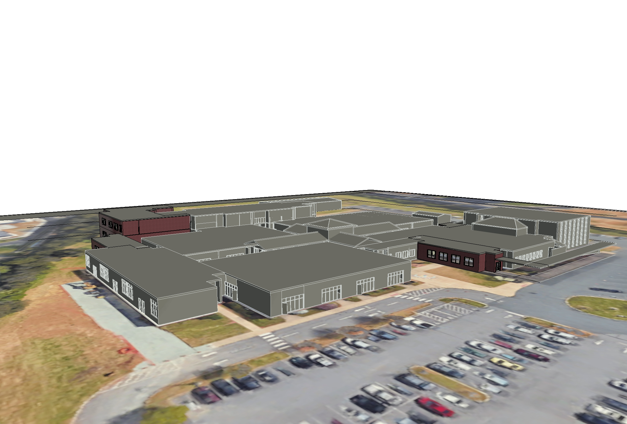

Slide 25
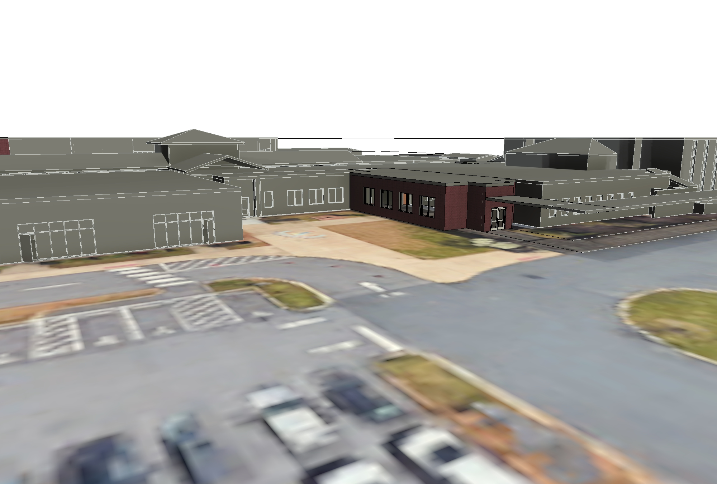

Slide 26
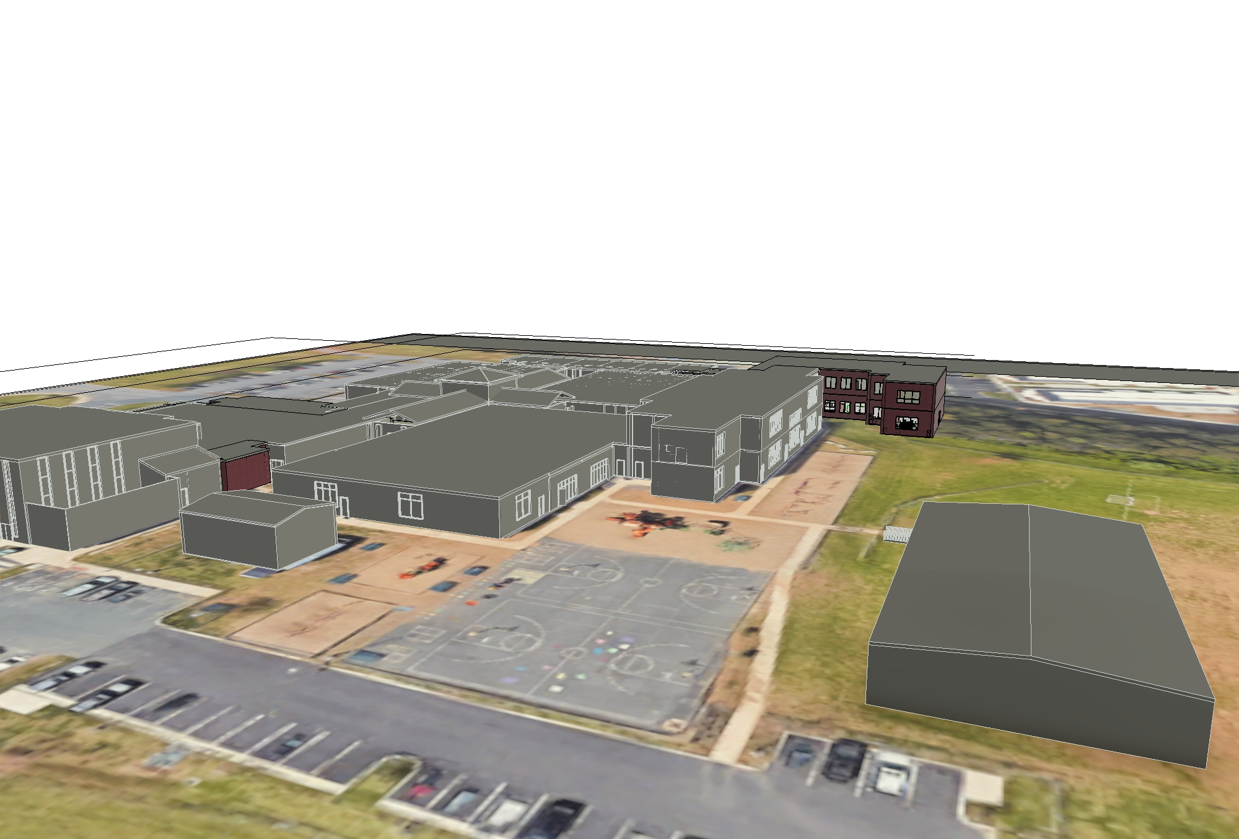

Slide 27
Thank you

