Slide 1
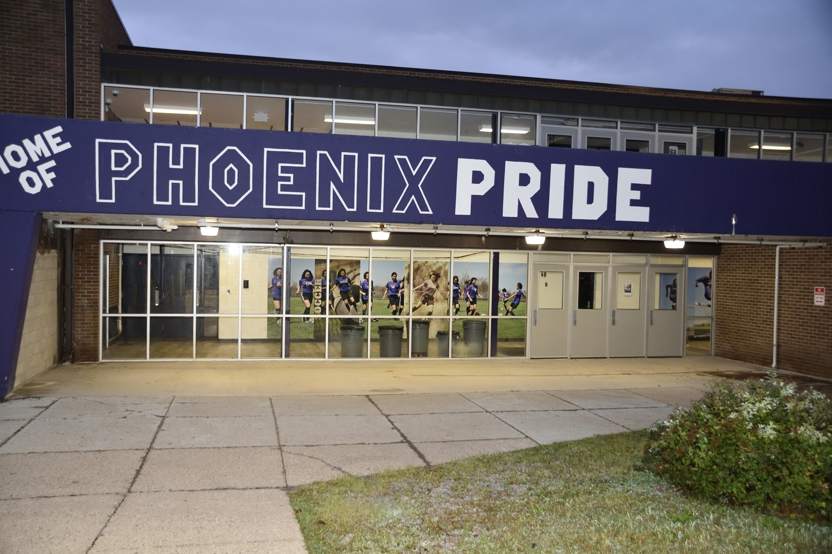
PRESENTED BY
David R. Youngstrom, CPA
Taylor Diener, CPA
School District of the City of Pontiac
June 30, 2021

Slide 2
Audit Results
Financial Statements:
Unmodified Opinion
Highest level of assurance
School's financial records and statements are fairly and appropriately presented, and in accordance with accounting principles generally accepted in the United States of America; this includes the design, implementation, and maintenance of internal control relevant to the preparation and fair presentation of financial statements that are free from material misstatement, whether due to fraud or error.
1

Slide 3
Balance Sheet-Governmental Funds
2

Slide 4
Statement of Revenues, Expenditures and Changes in Fund Balances
3

Slide 5
General Fund Comparison to Budget Year Ended June 30, 2021
4

Slide 6
General Fund Revenue (including Other Financing Sources) Year Ended June 30, 2021
5

Slide 7
General Fund Expenditures (includes Other Financing Uses) Year Ended June 30, 2021
6

Slide 8
General Fund – Fund Balance (Deficit) Year Ended June 30, 2021
7

Slide 9
Internal Controls and Compliance
Financial Statements:
Material Weaknesses
Audit Adjustments
No Material Noncompliance
No Significant Deficiency
Federal Awards:
Major Programs – Unmodified Opinions
Coronavirus Relief Funds
Education Stabilization Funds
No Material Weaknesses Identified
No Significant Deficiencies Identified
No Material Noncompliance
8

Slide 10
Governance Letter
Required Communication
Management Comments
Prior Year – None
Current Year – None
9

Slide 11
Future Challenges
COVID-19/Virtual Learning
Compliance/Planning of Federal and State Grants
Staffing Shortages
Enrollment Trends
Net pension obligation of over $84 M
Net post-employment benefits of over $12 M
10

Slide 12
CONNECT with Us:
yeoandyeo.com
Thank you!
David R. Youngstrom, CPA
davyou@yeoandyeo.com
Taylor Diener, CPA
taydie@yeoandyeo.com

