Slide 1
The SMPSB Parents’ Guide to
Google Classroom

Slide 2
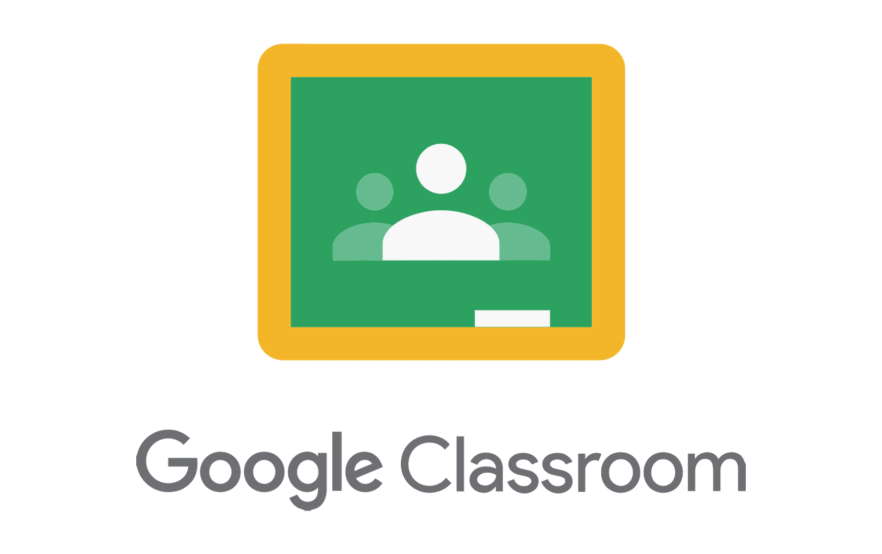
What is
Google Classroom?
Think of Google Classroom (GC)
as your child’s digital link to learning.
Teachers use GC to share assignments, homework, newsletters, and much more with students AND parents!

Slide 3
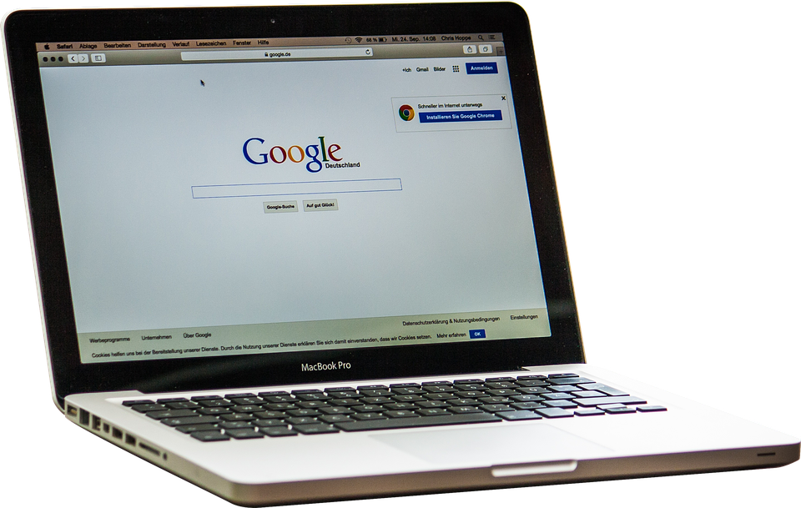
Getting Started
Your child was provided with a school-issued Chromebook.
After powering on the Chromebook, you will be asked to provide your child’s email address.
If you and your child do not have this information, it can be found in the Parent Command Center.
Once you enter the email address, you will be asked for the password.
The password is a lowercase “s” followed by your child’s student identification number.
The student identification number can also be found in the Parent Command Center.

Slide 4
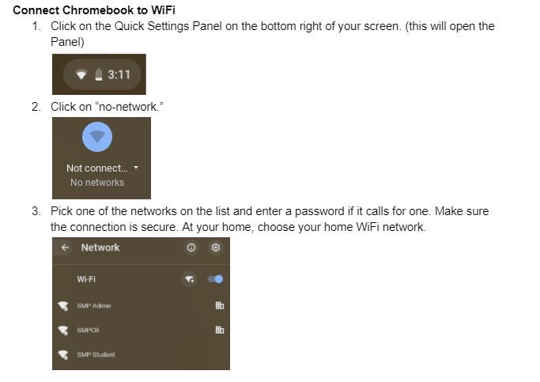
CONNECTING YOUR CHROMEBOOK (OR PERSONAL DEVICE) TO WiFi
You must be connected to WiFi in order to access Google Classroom from your child’s Chromebook
FOR ADDITIONAL CHROMEBOOK TIPS CLICK BELOW:
CHROMEBOOK QUICK TIPS
Google Classroom can be accessed from all of your own home devices as well.

Slide 5
Getting Started
After logging into your Chromebook, click on the Google Chrome browser icon shown here on the left.

Slide 6
Getting Started
Type https://www.saintmartinschools.org/students
into your web address bar (or click the hyperlink above)

Slide 7
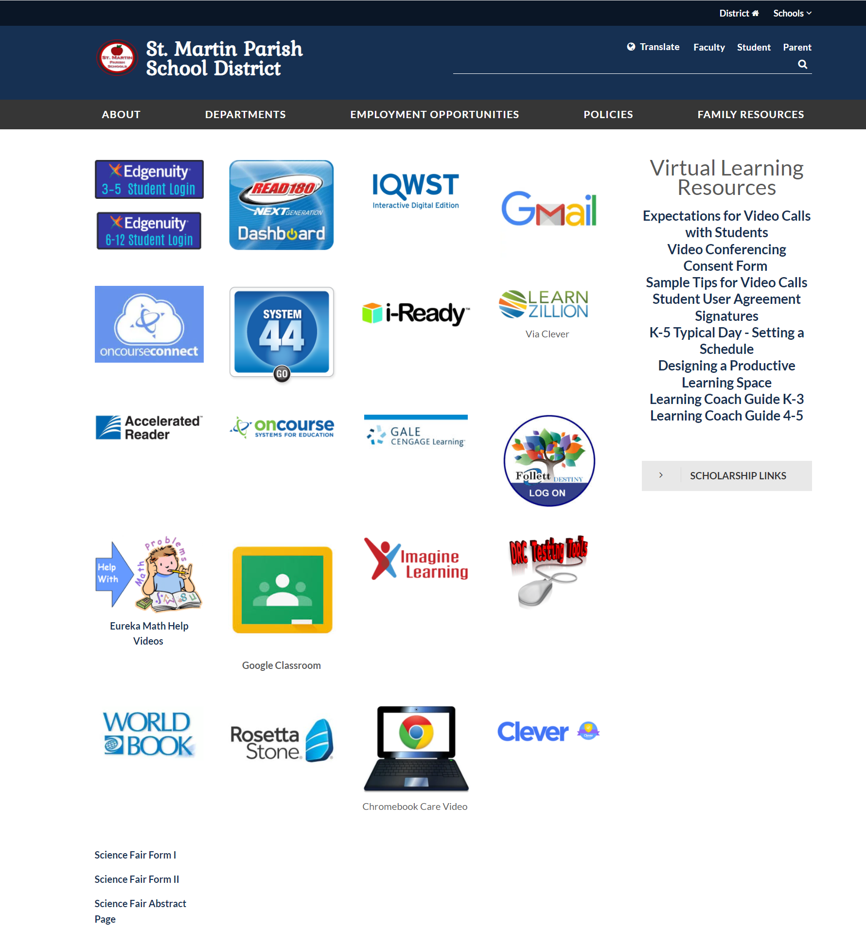
Getting Started
Find the Clever App on the webpage and click it to access all your child’s online resources for the school year, including Google Classroom.

Slide 8
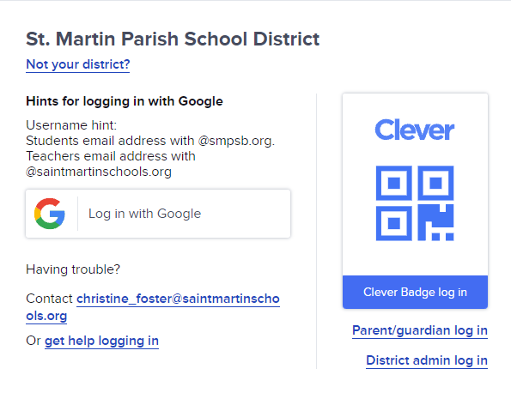
Getting Started
Once you click on the Clever icon, you will be taken to the Clever login page (shown here on the right).
You will then click Log in with Google.

Slide 9
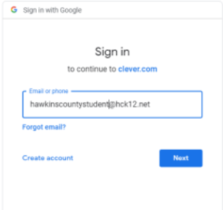
Getting Started
Enter your child’s Google username and click on the “Next” button.
This information will be provided by your child’s teacher.
Info Provided By Your Child’s Teacher

Slide 10
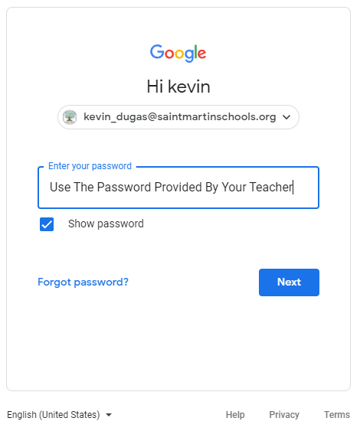
Getting Started
Verify that your name is displayed.
If correct, then enter your password.
Remember: Use the password provided by your child’s teacher. The password is a lowercase “s” followed by your child’s Student Identification (SID) number. The SID number can be found in the Parent Command Center.
Once you enter your password, click Next.

Slide 11
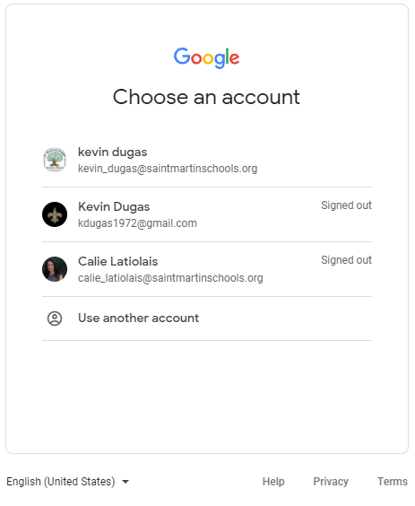
Getting Started
Important Note!! If you are signed into Google with a personal account, you will need to log out before logging into Clever. You will also need to click on “Use another account” and log in as above.

Slide 12
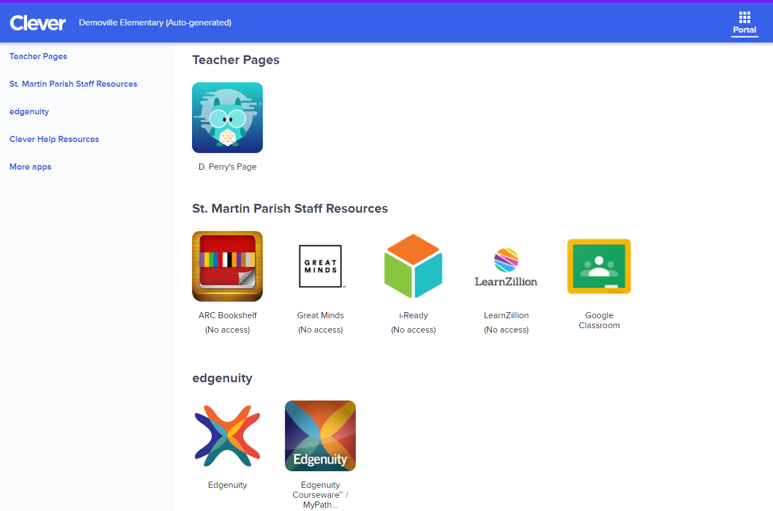
Getting Started
After you are logged into Clever you will have access to your Google Classroom and other online resources available in your portal which will be specific to the student and school.
Click on the Google Classroom icon to access the Google Classrooms that you are assigned to for the school year.

Slide 13
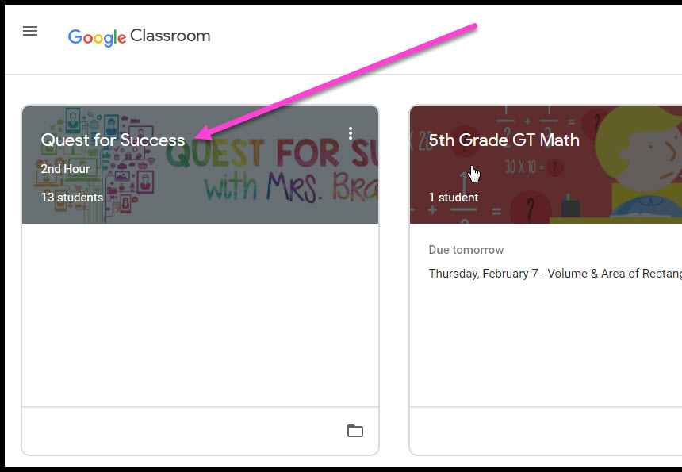
Navigating Classroom
Once you are in Google Classroom, click on the class you wish to view.

Slide 14
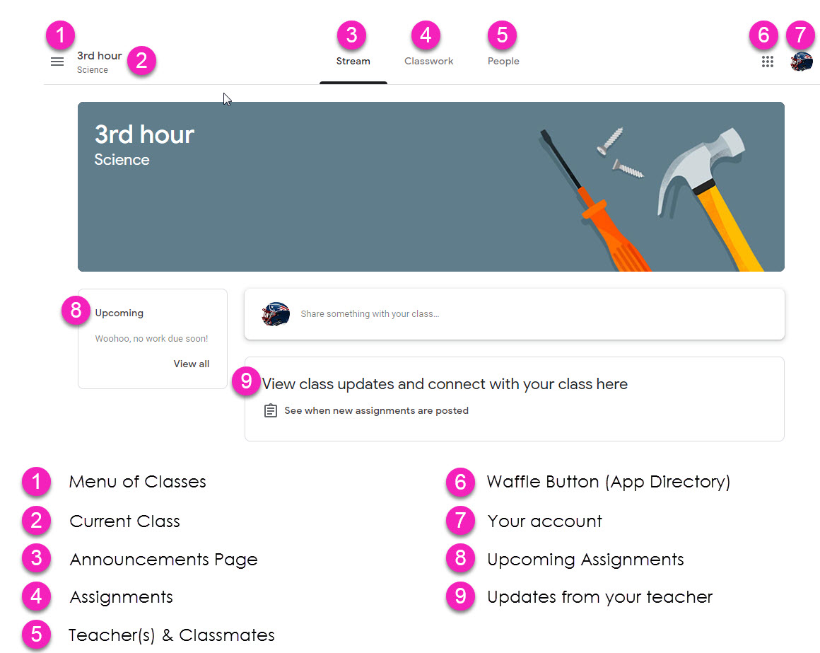
Navigating Classroom
= High Interest for Parents
Page tools
(Left side)

Slide 15
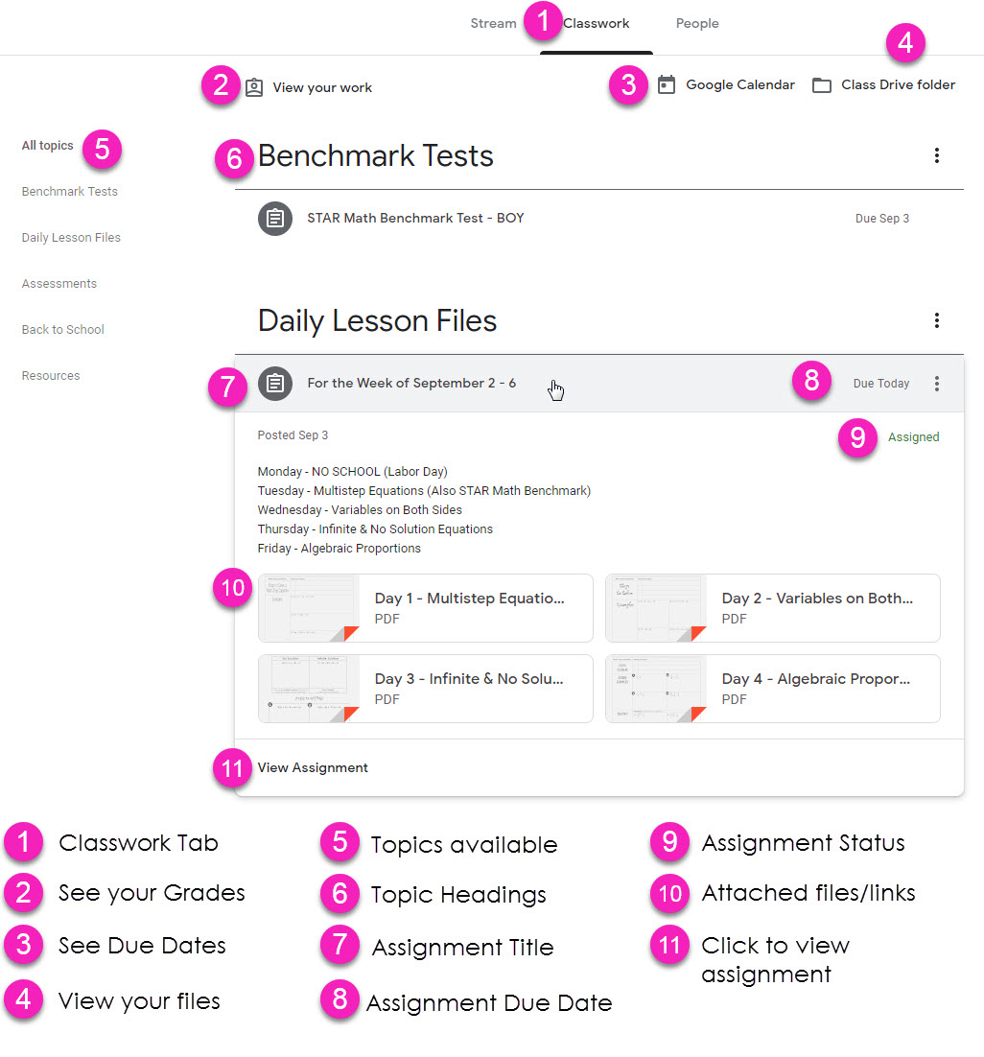
Navigating Classroom
Assignment details

Slide 16
VIDEO TUTORIAL
https://www.youtube.com/watch?v=lMOLD3CNZaU

Slide 17
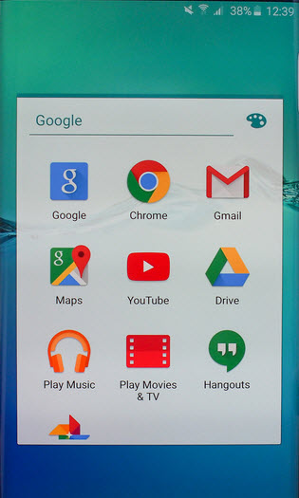
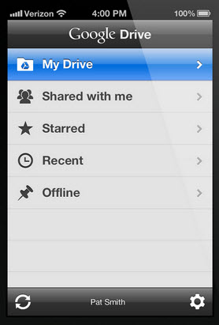
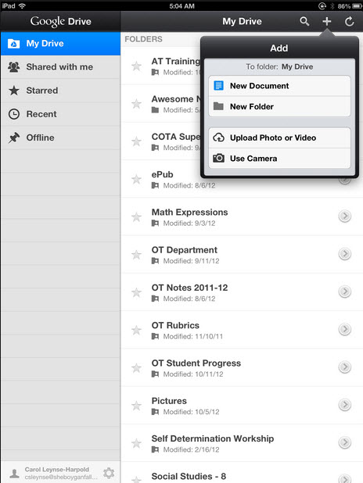
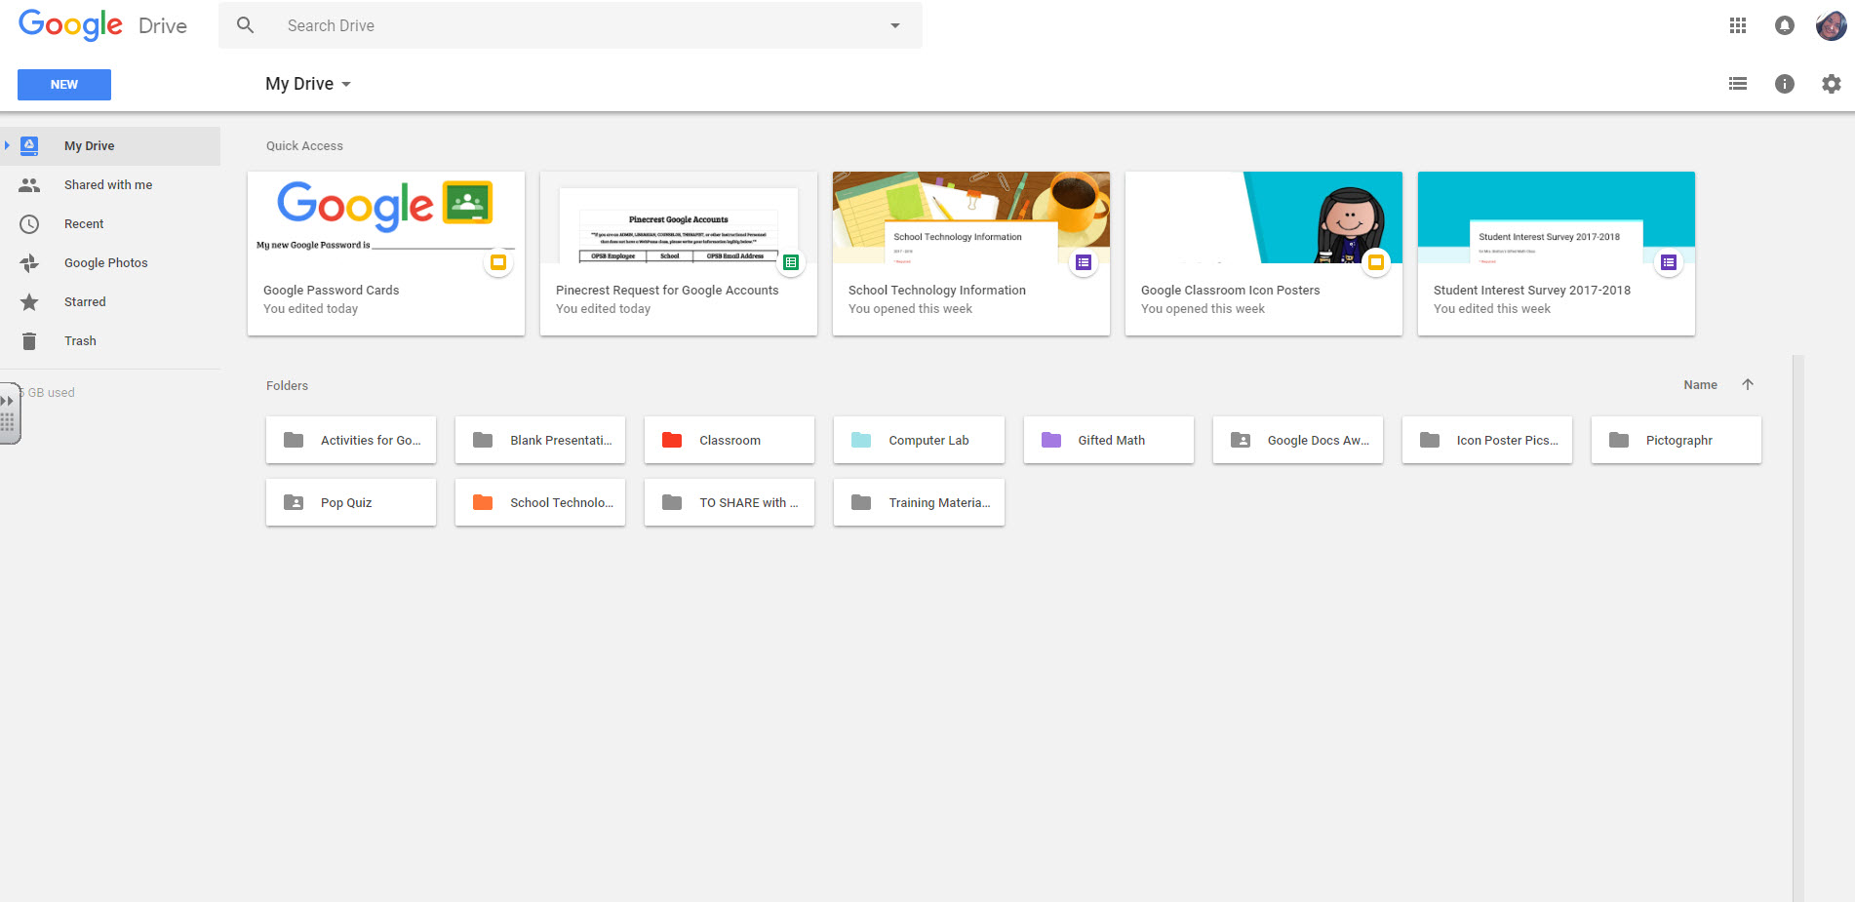
access
anywhere
Android
Iphone
Tablet
desktop

Slide 18
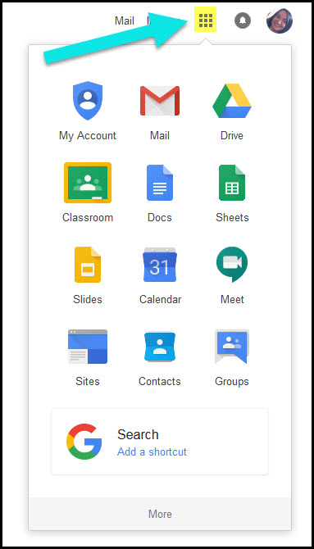
Google
suite
Click on the 9 squares
(Waffle/Rubik’s Cube) icon in the
top right hand corner to see
the Google Suite of Products!

Slide 19
GOOGLE APPS
allow you to edit Google assignments from
any device that is connected to the internet!

Slide 20
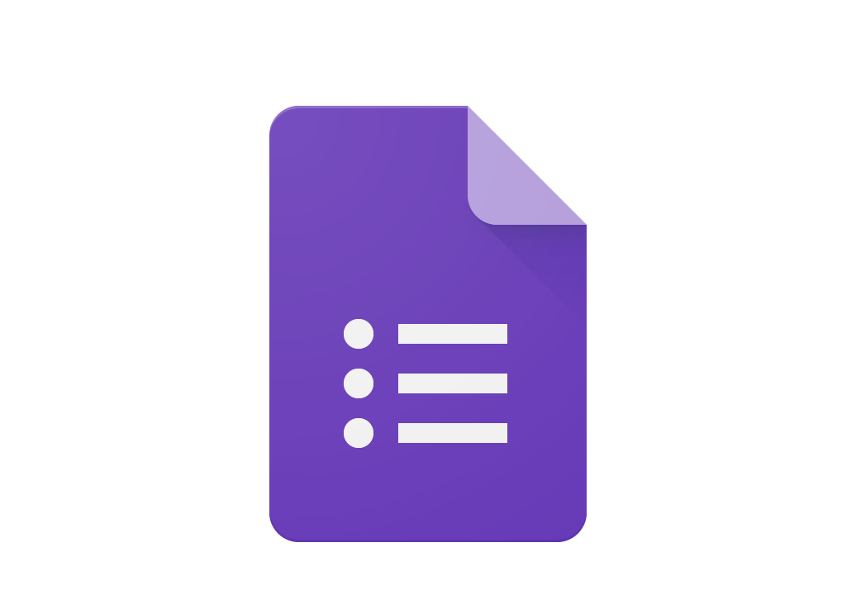
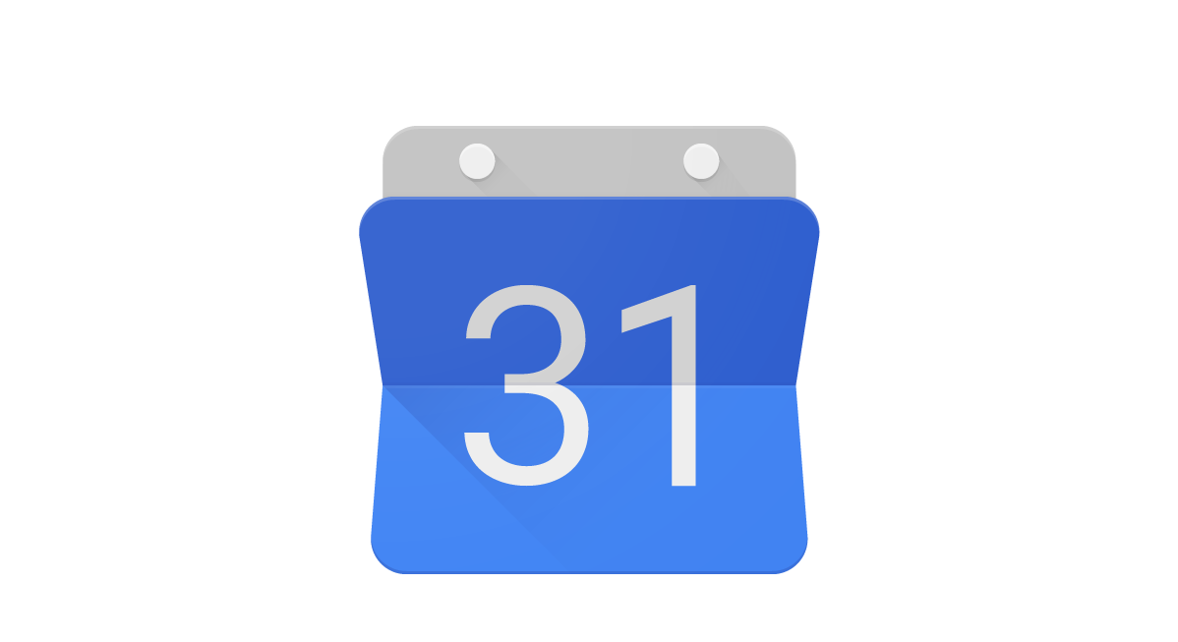
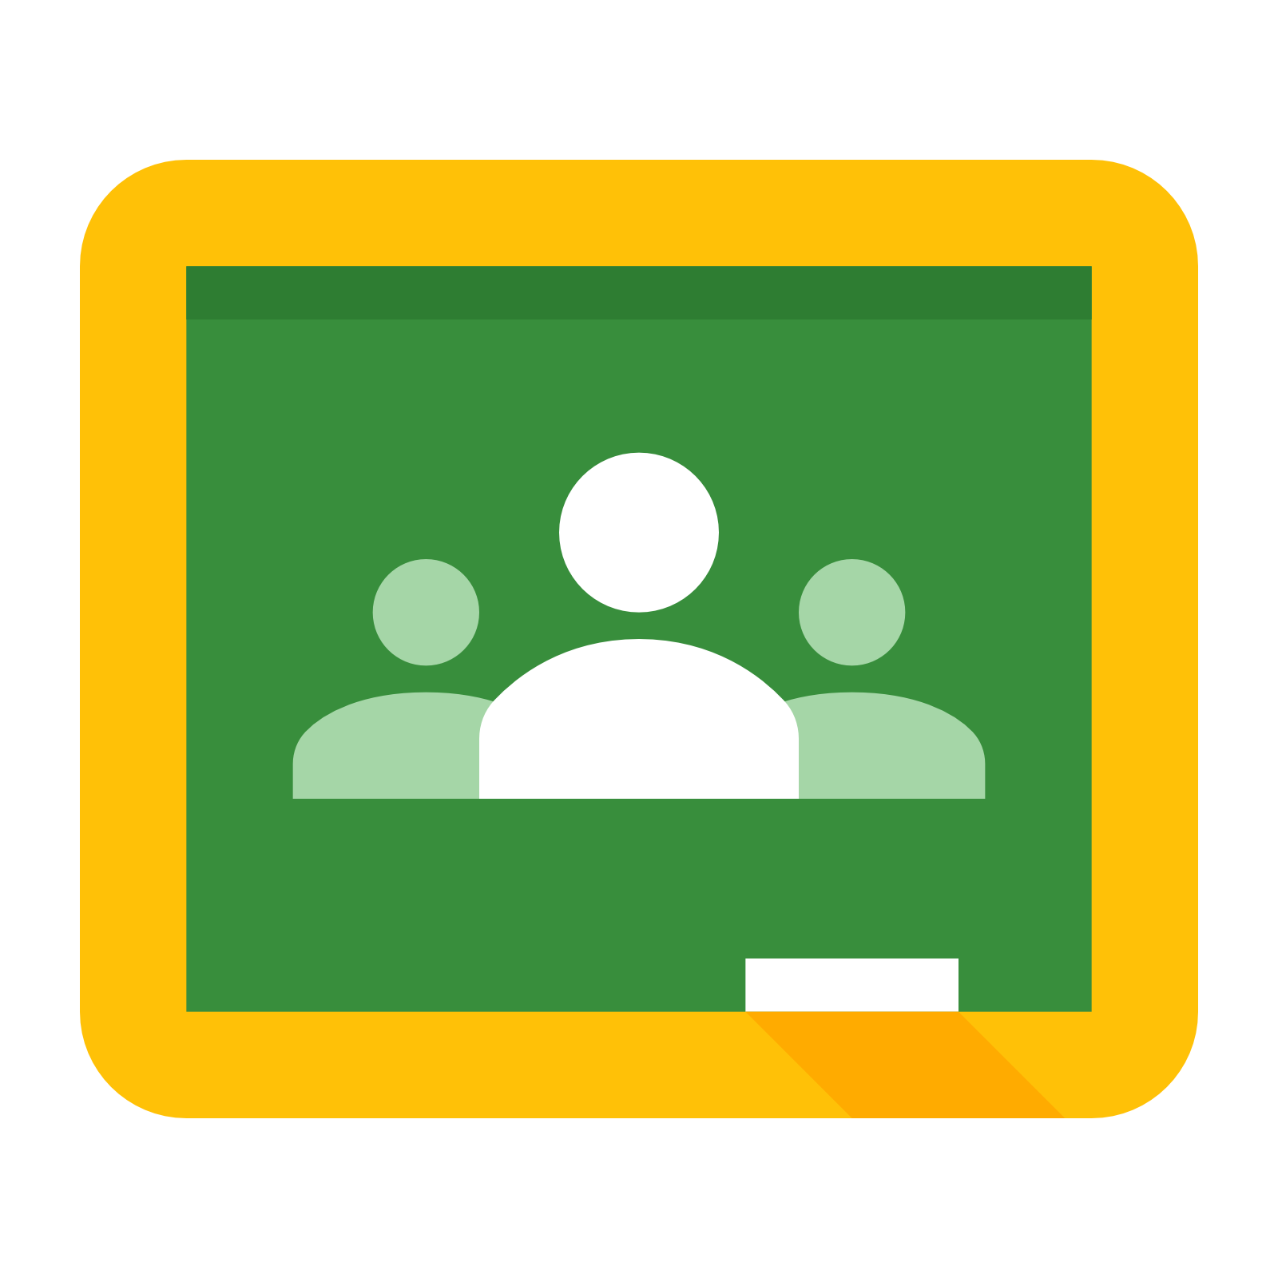
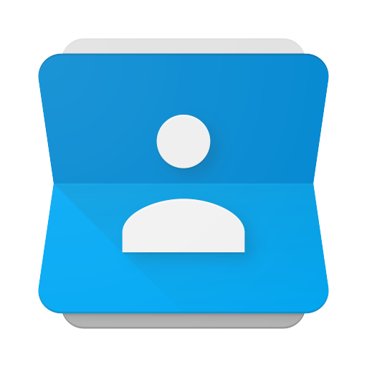
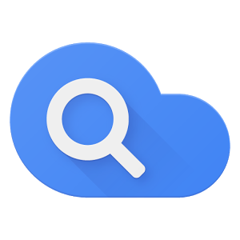
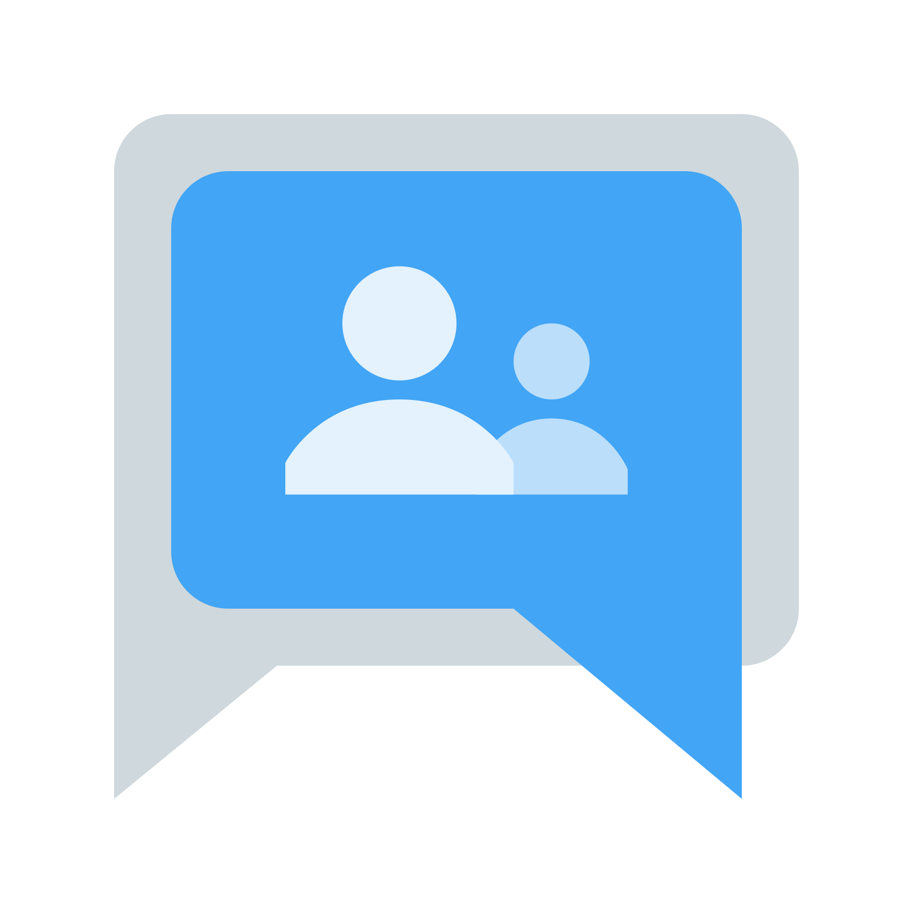
GOOGLE ICONS to recognize:
CHROME DOCS DRIVE SLIDES SHEETS FORMS CALENDAR
GMAIL PHOTOS MAPS KEEP CLASSROOM MEET HANGOUTS
SITES CONTACTS CLOUD CLOUD SEARCH YOUTUBE NEWS VAULT
MY ACCOUNT GROUPS

Slide 21
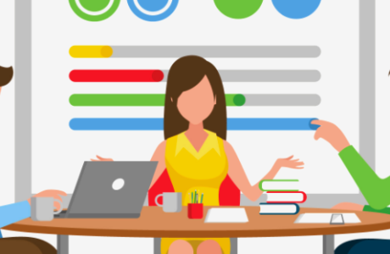
questions?
Contact your child’s principal or school librarian/technology coordinator for assistance.

