Slide 1
Marion L. Steele High School
College Information
Night for Parents
September 30th - 6PM
Notes:
Joe

Slide 2
School Counselors
Mrs. Loushin
Last Names A-K
Grades 9-11
Ms. Rigda
Last Names L-Z
Grades 9-11
Ms. Santos
Seniors
College & Career
Notes:
Joe

Slide 3
Thomas Diller
Cleveland State University Admissions Counselor for Lorain County and Southwest Ohio

Slide 4
What does it take to graduate high school?
Step 1: Cover the Basics
Step 2: Show you are ready
English | 4 Units
Math | 4 Units
Science | 3 Units
Social Studies | 3 Units
Health | .5 Units
Phys Ed. | .5 Units
Financial Literacy | .5 Units
Fine Arts | 1 Units
Electives | 5.5 Units
Total Credits = | 22 Units
Complete one of the following
A cumulative passing score of 18 points on 7 end of course exams. (Algebra I, Geometry, English I, English II, Biology, A.M History & A.M Government
Industry credential & workforce readiness (JVS)
College & Career Readiness Test ( ACT & SAT)-Earn Remediation Free Score

Slide 5
Factors to Consider
What should students’ focus on when researching college?
Location & size
Cost & Financial Aid
Majors & educational programs
Admissions requirements
Campus environment & opportunities
Support Services

Slide 6
College Comparison
Private
Tuition & fees are the primary source of funding
Public
local & state funded, usually offer lower tuition rates
2-year Colleges
Offer 2-year associates degree or certificate program, includes community colleges, vocational-technical, and career colleges
4-Year Colleges
Offer 4-year degrees, bachelor's degree & beyond

Slide 7
College Visits
Students & parents are highly encouraged to plan college visits
Visits can be scheduled through each college website
Students are allowed (3) certified absences to complete college visits
As an excused absence students must pick up and return a filled out Planned Absence Form from attendance
College admissions representatives will be visiting Marion L. Steele High School on Tuesdays & Thursdays at 9:15am
Please encourage students to sign up through their Naviance accounts

Slide 8
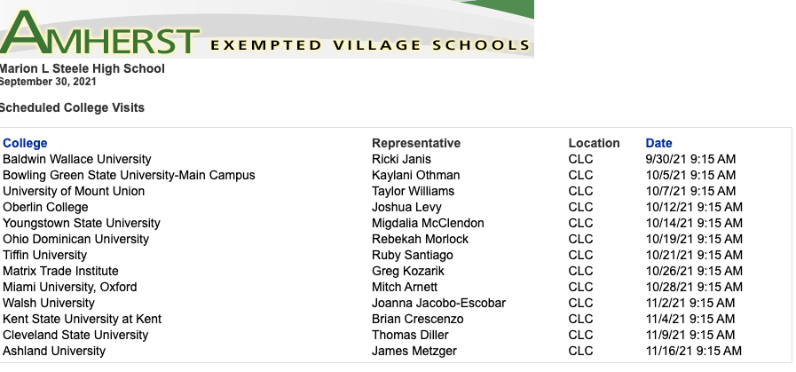

Slide 9
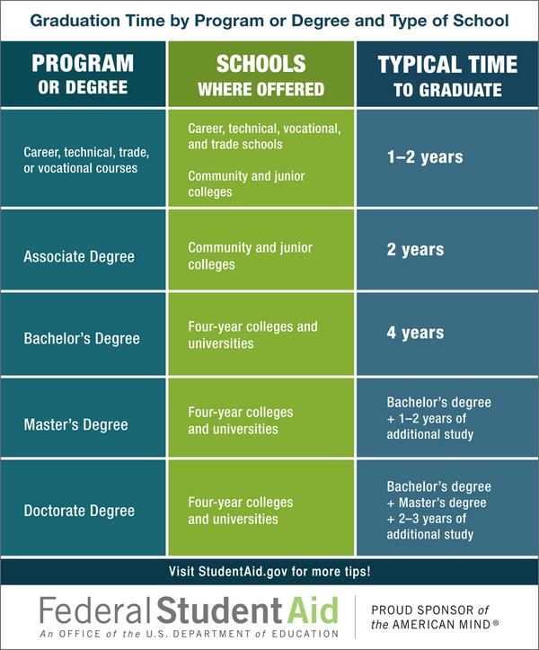

Slide 10
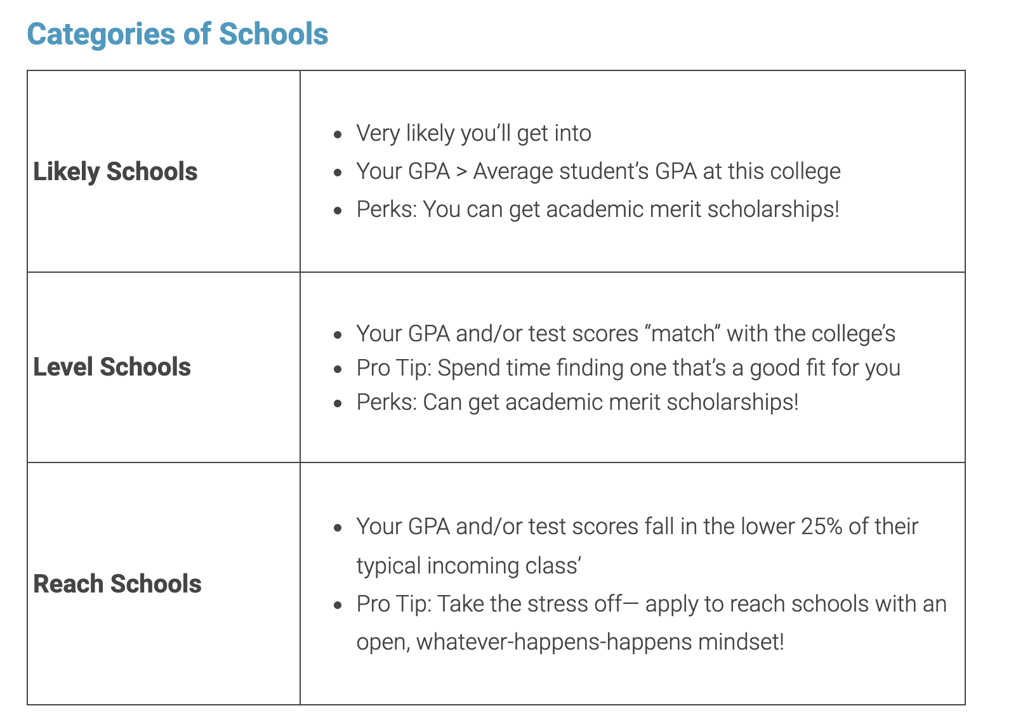
Determining College Choices
It is recommended that students aim to apply to 3-5 Colleges

Slide 11
Components of a College Applications
Completed Application
Official High School & LCCC Transcripts
SAT/ACT Scores
Essays
Letters of Recommendations
Interviews (Selective Schools)
Application Fee

Slide 12
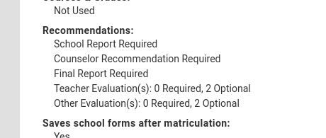

Slide 13
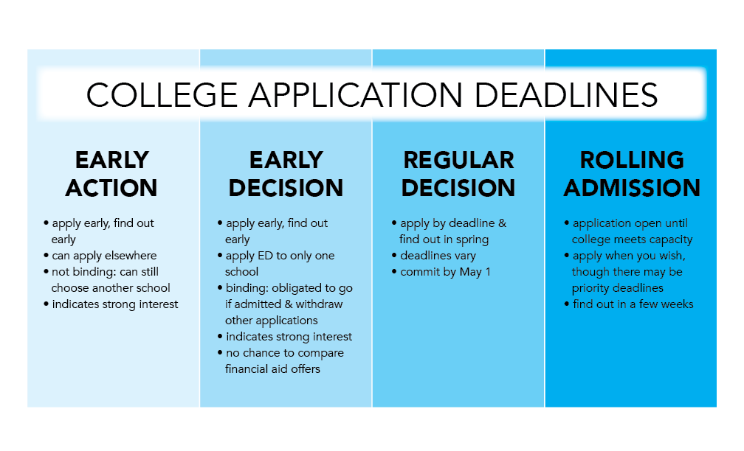

Slide 14
Naviance
What is Naviance?
“The Naviance Readiness Solution is a comprehensive toolset that helps you assess and develop essential competencies students need to be successful after high school.”
What do we use Naviance for at Marion L. Steele High School?
College Search Transcript Request Letter of Recommendation Request
Scholarship Search Resumes Career Assessments
College Visits Data
Naviance Log-In
Username: School Email

Slide 15
SAT & ACT Registration
Registration deadlines are around a month in advance - plan accordingly !
Registration - ACT.Org
Test Dates
December 11th
February 12th
April 2nd
June 11th
July 16th
Registration - SAT.org/Register
Test Dates
November 6th
December 4th
March 12th
May 7th
June 4th

Slide 17
Test Optional - College Admissions
Test optional offers students the choice to apply with or without their standardized test scores
Considerations:
Merit based scholarship
Specialized program entry requirements
The weight of supplemental application materials

Slide 18
Financial Aid
FAFSA (Free Application for Federal Student Aid)
Opens Oct. 1st of Senior Year
Will provide financial aid based on need
FAFSA offers three types of financial aid:
Grants: Financial aid that generally doesn’t have to be repaid.
Loans: Borrowed money for college or career school; your loans must be repaid with interest.
Work-Study: A federal work program through which undergraduates and graduate students at participating schools earn money to help pay for school.
Visit FAFSA.Gov for more information

Slide 19
itsforyou.org

Slide 21
Scholarships
Merit Based Scholarships
Colleges will offer merit based scholarships which are based on academic achievements, typically based on GPA and or ACT/SAT scores
Most colleges and universities will have opportunities listed on their website, and may require additional materials for awards
Honors Colleges
Students can explore criterias to their schools honors college which often comes with a renewable 4-year scholarship pending criteria satisfaction
Local & Community Scholarships
Students will be made aware of our local & community scholarships here in Amherst in December of their senior year
Naviance Scholarships Database

Slide 22
Parental Support
As a parent, how can you support your student transitioning from high school to college?
College Visits
ACT & SAT Registration
Organization
Deadline Awareness
FAFSA Application
Financial Breakdown
Post-acceptance Steps

Slide 23
College Admissions Representative
Q & A
Thomas Diller - Cleveland State University

Slide 24
College Planning Resources
Common App Support
College Board - Applying to College 101
The Admissions Essay
Sending ACT Score
Sending SAT Score
After the Acceptance Letter
College Admission Terminology

Slide 25
Communication: Follow Us on Twitter
@SteelePrincipal (Steele Principal)
@MrToney2 (Assistant Principal for 9th and 10th Grade)
@aharigan (Assistant Principal for 11th and 12th Grade)
@StevenASayers (Amherst Superintendent)
@MLS_Counseling (Counselors)
@SteeleComets (MLS Athletics)
@SteeleNewsLive1 (Steele News Live)
Notes:
Nick

