Slide 1

PARENT MENTORS OF OHIO PROGRAM
Guiding Families Through the
Special Education Process
Notes:
Read as written

Slide 2

Do you need help navigating the
special education process?
You have come to the right place!
Notes:
read slide then - The world of special education can be overwhelming and confusing. A Parent Mentor is here to help.

Slide 3

Who are Ohio’s Parent Mentors?
A Parent Mentor is a parent of a child with a disability
who collaborates with local education agencies and educational service centers to assist school districts and families by providing training, support and resources.
Notes:
Read slide

Slide 4

Notes:
Narrate picture- Ohio's parent mentors come from a wide array of backgrounds and experiences. Most parent mentors have been involved with their school districts and have one very important thing in common - they are all parents of children with disabilities and have first -hand experience with their own school districts and communities.

Slide 5
Parent Mentors Of Ohio Program
Vision Statement
Districts have a responsibility to develop, support and
implement a system of education services for all students.
The basis of the Parent Mentor Program is the expectation
that students with disabilities will be ensured appropriate
and meaningful education if parents and educators
communicate effectively. The parent mentor helps convey
the family perspective to the educational team.
Notes:
Don’t read the title. Read fly-ins

Slide 6
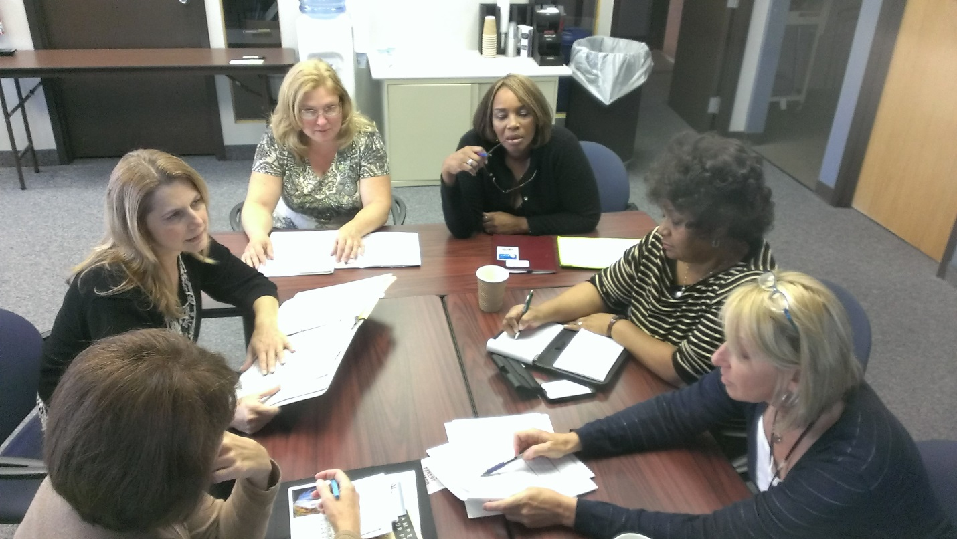
Notes:
Narrate picture with: “Promoting partnerships between parents and educators is the common goal of every parent mentor project. In their dual role as a parent and liaison, mentors work to encourage continuous, positive communication between families and educators”.

Slide 7
Parent Mentors of Ohio Program
Mission Statement
The mission of the Ohio Parent Mentors is to provide the necessary supports and resources to families of children with disabilities and the professionals that serve them.
Notes:
Don’t read the slide title. Read slide then note. Parent Mentors are trained by the Ohio Coalition for the Education of Children With Disabilities and supported by the Ohio Department of Education. Parent Mentors offer guidance to families to enable them to effectively and collaboratively advocate for their children.

Slide 8

Parent Mentors of Ohio Services
All Parent Mentor services are provided at no cost to
families.
Ohio Parent Mentor projects are funded through
grants from the Ohio Department of Education, Office
for Exceptional Children (ODE/OEC).
Notes:
Read as is

Slide 9
Parent Mentors of Ohio Provide:
Guidance to families through the special education process to help them understand rights and responsibilities of the student, parent and school district.
Information and resources to families and school personnel on education laws, district programs and services, and community support.
Support by attending Individualized Education Program meetings and other meetings related to the services of the child that parents and school district staff might request.
Notes:
Read as written-fly in is 10 seconds

Slide 10
Parent Mentors of Ohio Provide:
Informational sessions and workshops based on the needs of families and professionals.
Assistance in strengthening and/or building a collaborative partnership between families, schools and communities to benefit students with disabilities.
Individualized and confidential support to families and educators.
Notes:
For the title: please say, “Additionally, Parent Mentors provide

Slide 11

Notes:
Narrate Picture with: The parent mentor offers and facilitates family-centered support groups, serves as a confidential "listening ear" for parents and staff and if problems do arise, works to resolve differences through consultation and conflict resolution while maintaining a positive, collaborative focus on the student.

Slide 12
How to Contact the Parent Mentor in
Your District:
Rose Kahsar
Mt. Healthy City Schools
513-522-1612
rkahsar@mthcs.org
(please wait for the next slide after the pause)
Notes:
This is the contact information for your parent mentor.

Slide 13

Additional Information and Resources
To access the Parent Mentors of Ohio website go to:
www.ocecd.org/index.php
Ohio Coalition for the Education of Children With Disabilities
165 W. Center St., Suite 302
3rd Floor, Chase Bank Building
Marion, Ohio 43302
T (800)-374-2806
F (740) 383-6421
ocecd@ocecd.org
(please wait for the next slide after the pause)
Notes:
For additional information you can call or visit the website for the Ohio Coalition.

Slide 14
Additional Information and Resources
To access the Ohio Department of Education website go to:
http://education.ohio.gov/
Ohio Department of Education
Office of Exceptional Children
25 South Front Street
Mail Stop 409
Columbus, Ohio
43215-4183
(P) 877-644-6338
(please wait for the next slide after the pause)
Notes:
(not necessary to read the slide – just say) Additional resources are also available on the Ohio Department of Education website.

