Slide 1
Teacher Bios
For the STEAM @ Stipe Website Revamp
Please contact Michelle Link
mlink@ogsd.net
with questions or support

Slide 2
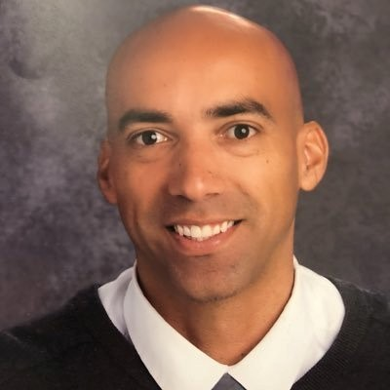
Mr. Tayo Enna
Mr. Enna has been teaching Kindergarten at Stipe for the past 15 years. His goal is to guide students as they begin their journey as lifelong learners. His use of humor and energy ensures that his classroom is rich with engagement, laughter, and a joy of learning. Mr. Enna grew up locally in Santa Cruz, California. He received his Associates of Arts Degree from San Jose City College, where he had the honor of playing basketball for Hall of Fame Coach Percy Carr. He went on to receive his Bachelor’s Degree in Social Science and a Master’s Degree in Educational Leadership from San Jose State University. Basketball has been a part of Mr. Enna’s life since he was young, and the valuable lessons that he has learned on and off the court have helped him create a classroom environment where students are part of a diverse team. He is proud of his biracial identify, and through this lens he provides a committed focus to Culturally Responsive Pedagogy and Closing the Achievement Gap.
Tayo Enna
Kindergarten Teacher Twitter: @MrEnna79

Slide 3
Mariceña Hernandez
Mrs. Hernandez was born and raised in East San Jose. Her parents were immigrants from Mexico and placed a high value on education. Her love for education rooted from the encouragement of her parents and the motivation from her teachers. She graduated from Santa Clara University with a Bachelor’s degree in Accounting and worked in corporate tax at a public accounting firm for a few years. She then went on to receive her multiple subject teaching credential from San Jose State. She has been teaching at Stipe Elementary for 13 years and absolutely loves the diverse culture that exists at Stipe. She sees herself in her students and wants to ensure that they receive the same encouragement and support she received as a student. Education is life changing to her and it is so rewarding to watch her students fall in love with learning and witness the constant ah-ha moments. The excitement her students experience in her classroom is contiguous and her daily goal is for her students to end the day thinking they had the best day ever.

Slide 4
Sandy Carranza

Slide 5
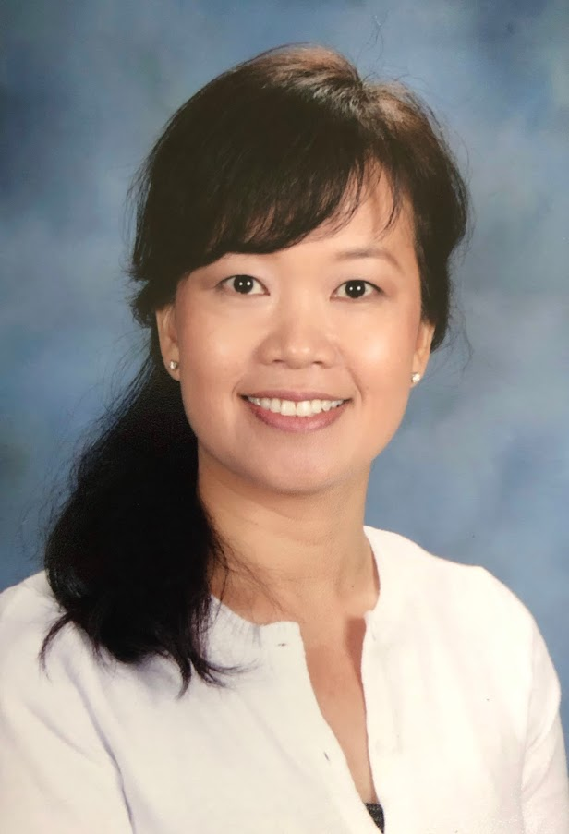
Gina Nguyen
Mrs. Nguyen has been a teacher in the Oak Grove School District since 1991
after completing her Bachelor of Arts Degree and Teaching Credential from California State University, Sacramento. She also holds a Bilingual, Cross-Cultural, Language and Academic Development (BCLAD) certification. As a first-generation imigrant born and raised in Vietnam, Mrs. Nguyen is proud to share her experience, language, and cultural background with her students. Mrs. Nguyen’s goal is to provide a fun, safe, and enriching environment that promotes academic and social growth. She holds high expectations for her students and believes that everyone learns best with encouragement and motivation. She wants her students to take pride in their individuality while respecting the cultural diversity of others around them. She also hopes that her students will embrace the important values of kindness, hard work, and perseverance in their quest to become happy, confident, and lifelong learners. She believes in building a strong home-school partnership for all students to thrive and blossom into contributing members of our community. She is happy to be part of Stipe and looks forward to the implementation of STEAM @ Stipe this coming school year.

Slide 6
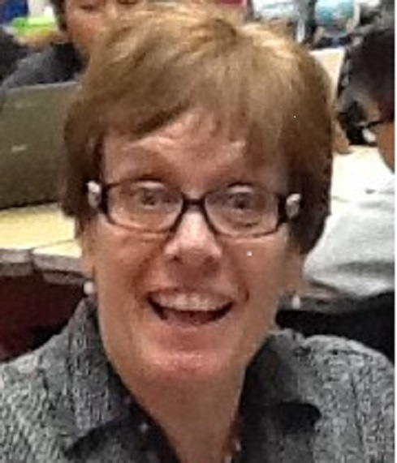
Ms. Dedra Downing
Ms. Downing is a 26 year veteran teacher. She believes that all of us continue to be teachable. She is always a student herself and loves learning new things. She hopes to pass on this love of learning to her own students, so they will be able to adjust and grow in our changing world. Ms. Downings grew up in the Oak Grove School District. She has a Bachelor's Degree in Child Development and a Master's Degree in Educational Administration. She has a California General Education Teaching Credential as well as a Special Education Credential, along with additional training in Reading Recovery, Language Acquisition, and Mathematics. She has also received training from the Krause Innovation Center in Digital Teaching, Game Based Learning, NGSS Science Standards, and Project Based Learning. #Merit19 and is a SEAL certified educator. Her mission is to validate student identity, to affirm their gifts and talents, and to build trust and rapport in order for students to become life long, independent learners who create transformational change in this world.

Slide 7
Nicole Piligian

Slide 8
Joshua Schmidt

Slide 9
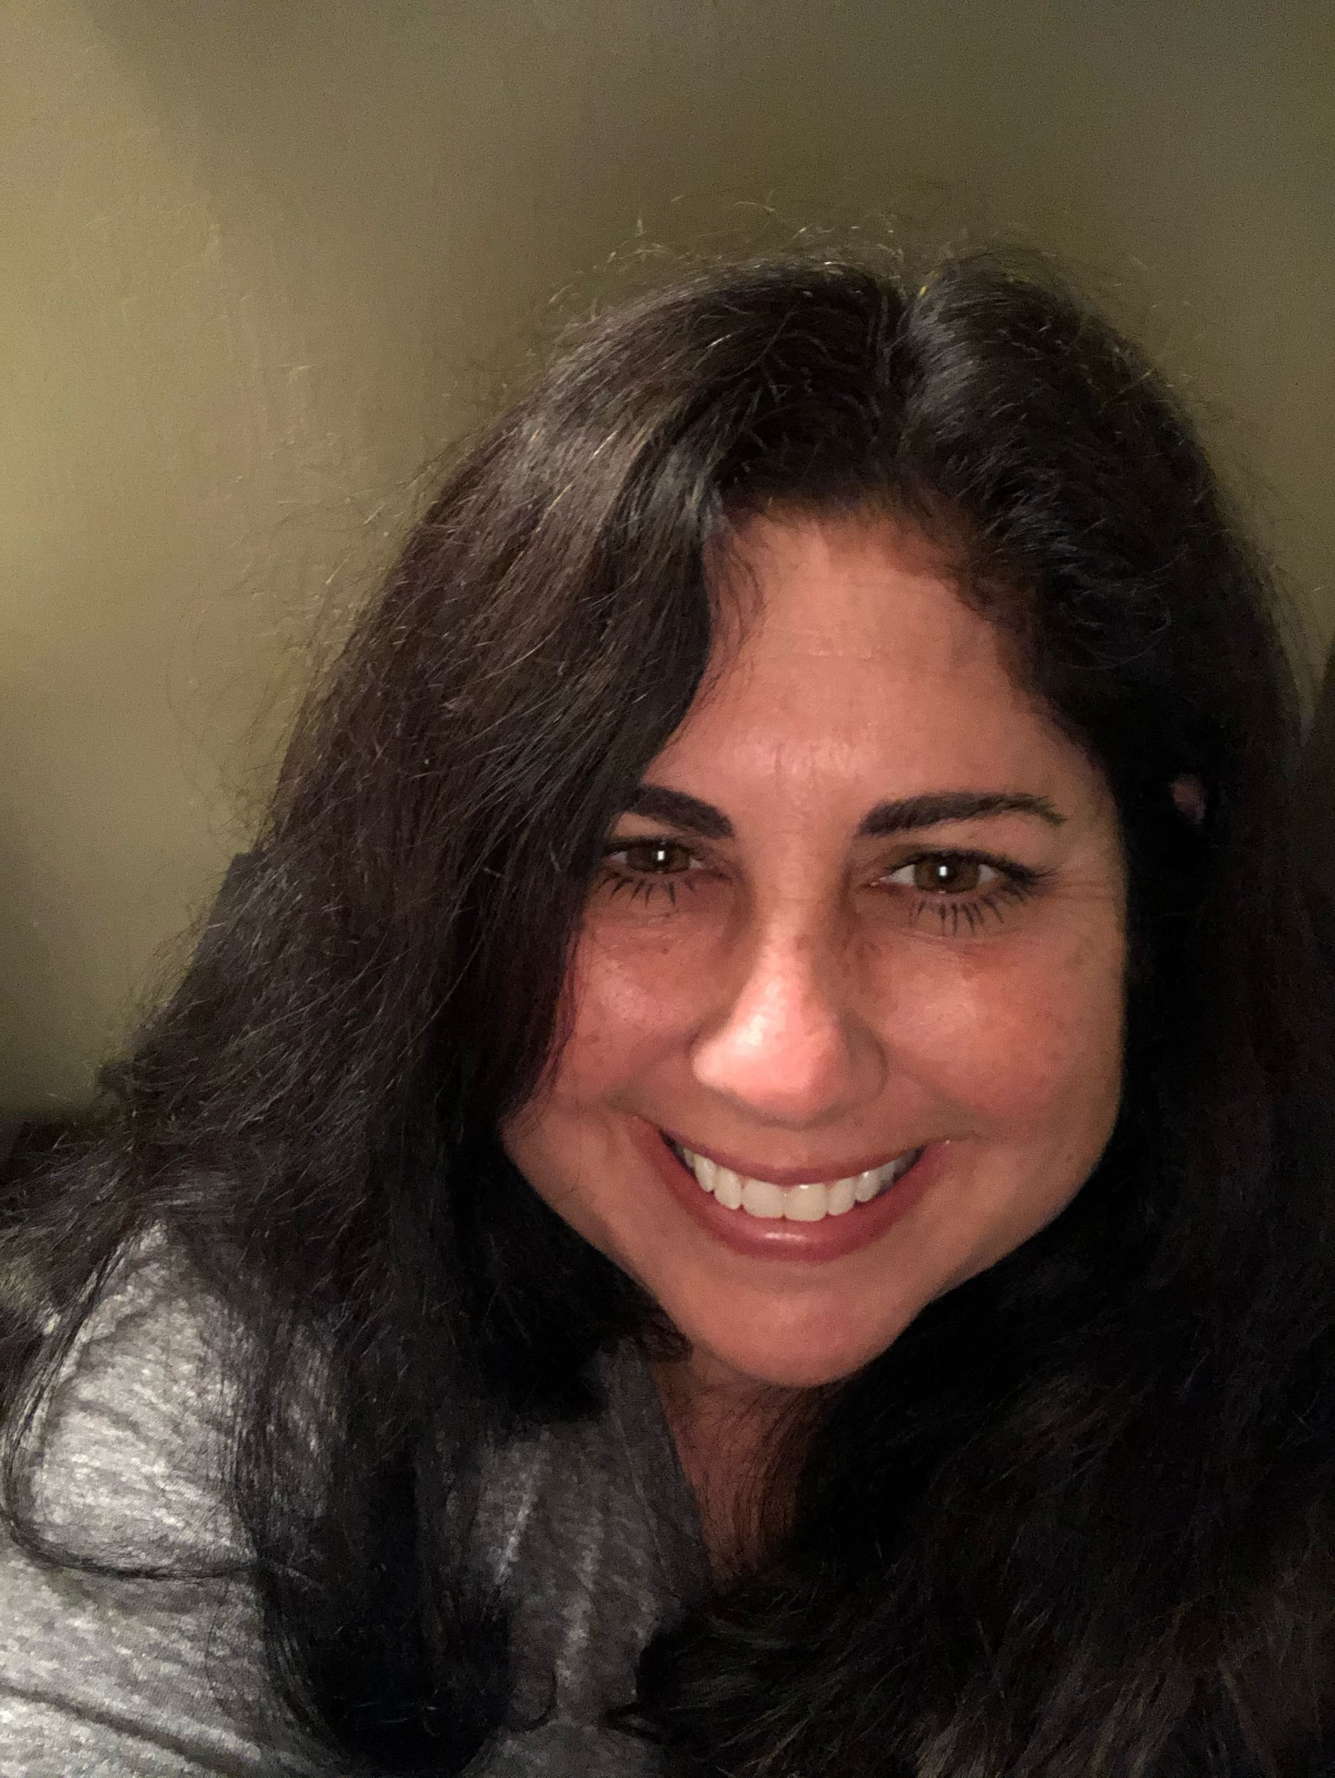
Laurie Loforti
My name is Laurie LoForti. I was born and raised in San Jose, attended both Miner and Hayes, as well as Herman Intermediate School, and Oak Grove High School, so I consider myself “homegrown.” I’m extremely proud of that. After completing my credential at CSUF I returned home, to San Jose, and started working for the Oak Grove School District. Later, I earned a Master’s Degree at SJSU. I am currently in my 24 year of teaching at Stipe School and with all sincerity, I can say, I still truly enjoy my job. Since I’ve been at Stipe my entire career, the students, the families, and the community have become an integral part of my life. Stipe has been a second family and home to me. As I look ahead, to the future of Stipe, I am excited to carry on the traditions that make Stipe such an amazing place while welcoming new ideas and ways of doing things.

Slide 10
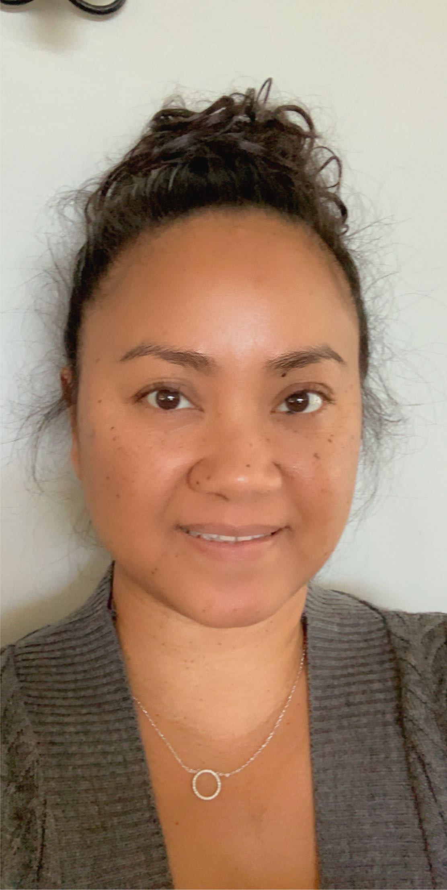
Chi Ratsythong
Chi Ratsythong is a refugee from Laos. She came over during the Vietnam War. She has lived in Illinois and Texas. She came to California in 1983. She got her BA from CSUS of Stanislaus and her MA from San Jose State University. She was a substitute teacher for four years. She has been teaching for 16 years in the Oak Grove School District. She has taught kindergarten, second grade, and third grade. She is married and has two daughters. She enjoys cooking, gardening, hiking, and reading. Her hope is to help students become a successful, productive, and kind citizens. She promotes a positive mindset and a healthy lifestyle.

Slide 11
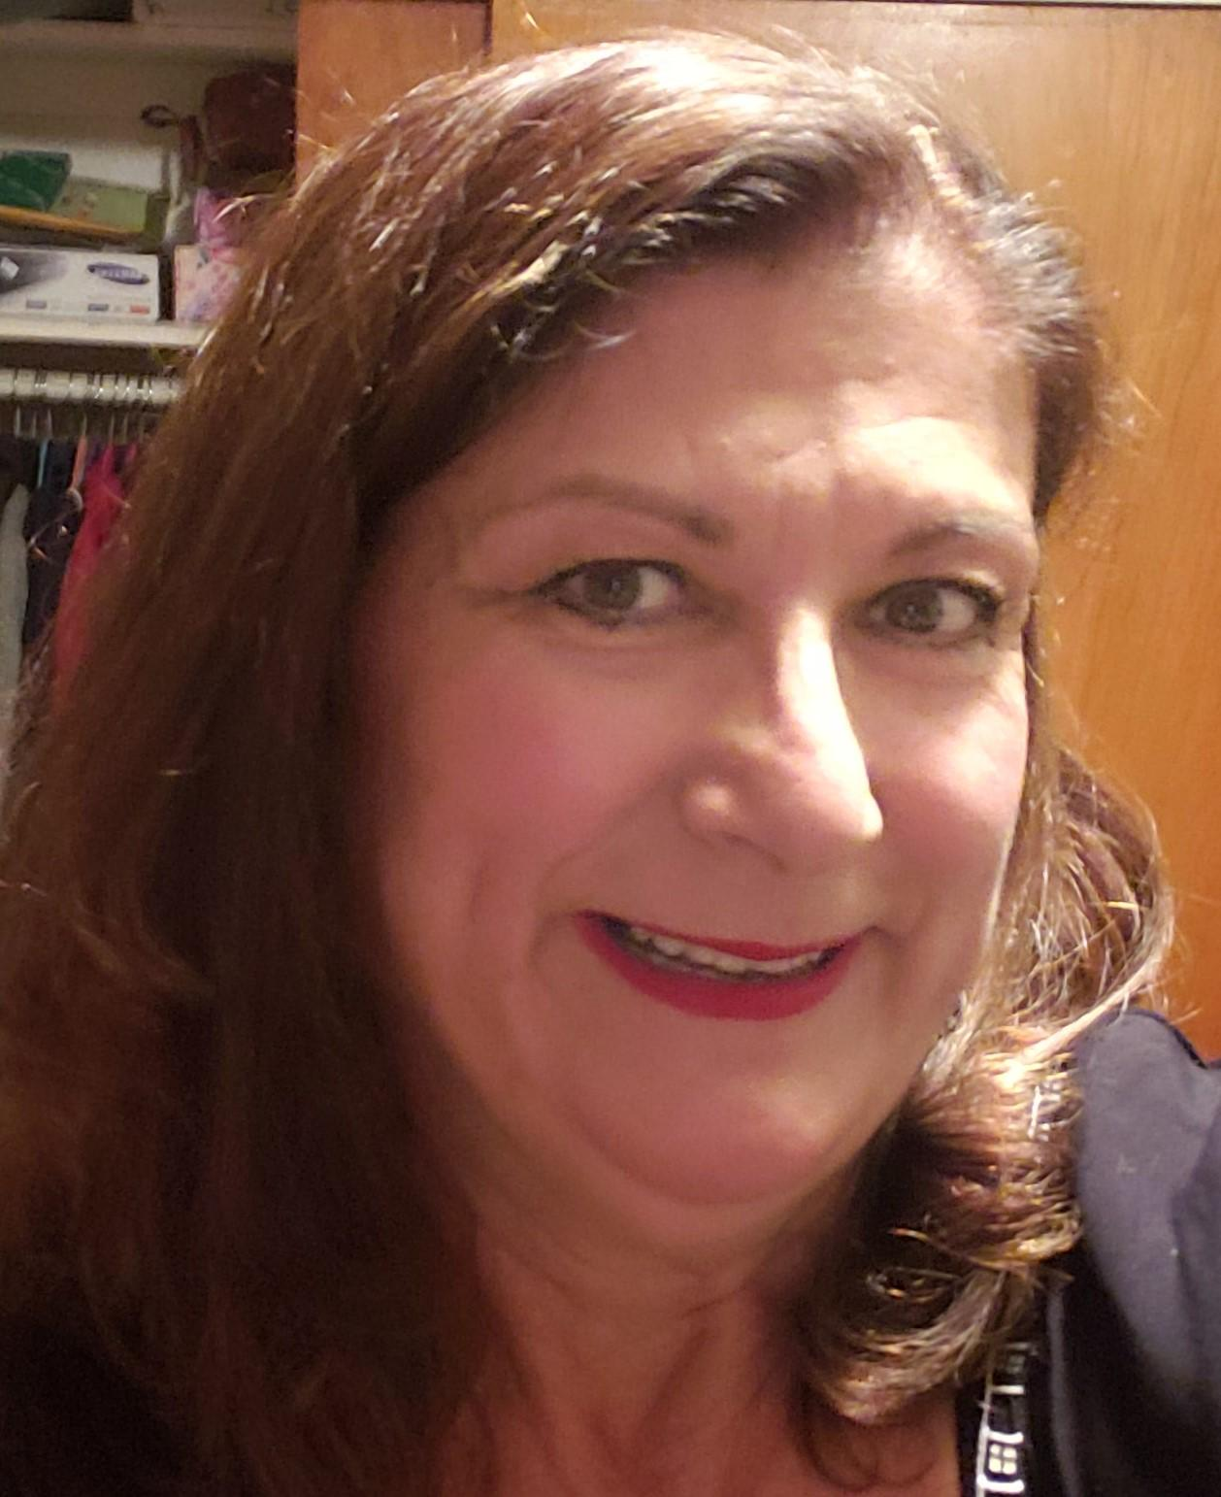
Shirley Herrera
Ms. Herrera is a first generation American and loves being a bilingual teacher. She has worked with Kindergarten age students for more than 13 years preparing them to be successful bilingual students. She has taught 1st and 2nd graders as well as 3rd and 5th graders. Her experience includes being a school principal and administrator. She grew up in Santa Barbara, CA. and graduated from UC Santa Barbara. As a life-long learner, she has accomplished a Bilingual Cross Cultural Credential, a Masters in Bilingual Special Education, a Masters in Educational Administration, an Adm. Credential and a post- graduate study in parental involvement with an ABD (all but the doctorate). Her purpose in life is to work directly with students and help them achieve their academic goals and continue believing in themselves. She feels privileged to teach and work with all her students everyday. Being at Stipe has made her heart full by developing relationships with staff, students and their families. Her love of reading is a favorite past time and reading aloud in class is enjoyable to her and her students. She is absolutely one of those born to teach and enjoys the journey….

Slide 12
Catalina Hernandez

Slide 13
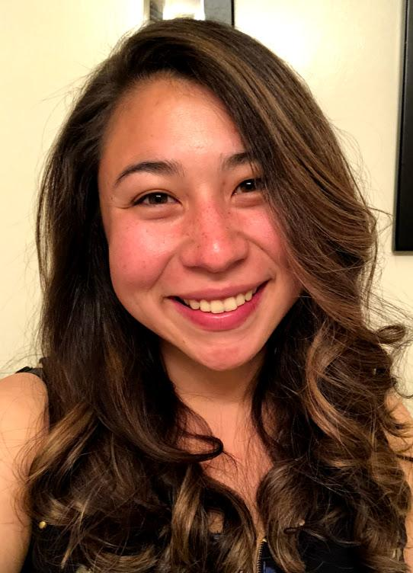
Megan Apana
Mrs. Apana (formerly Ms. Cheney) has been a teacher for 6 years and has taught at Stipe for the past three years. She earned her Bachelor’s degree and Multiple Subjects Teaching Credential at California State University, Monterey Bay. Mrs. Apana is committed to fostering an engaging classroom environment where all students are encouraged to reach their utmost potential in becoming life-long learners. Her goal is to provide a culturally responsive classroom that validates each student’s identity and background, while also celebrating the diversity in our community. She absolutely loves being a part of the Stipe community, and is excited to see Stipe grow and evolve as we embark on the journey of STEAM @ Stipe!

Slide 14
Monica Duran
Mrs. Duran has been teaching for 13 years at Stipe. She earned her Bachelor's Degree in Liberal Studies at San Diego State University. She then earned her Teaching Credential from San Jose State University. During her time at Stipe she has taught third through sixth grade with the majority of her experience in fifth grade. Mrs. Duran believes in facilitating student learning and academic growth through building trusting relationships that honor each individual child. It is her goal to encourage students to think critically, inquire and take ownership of their education. Her belief is that it is of the utmost importance that student's cultural strengths are identified and nurtured to foster a sense of well being and overall academic success.

Slide 15
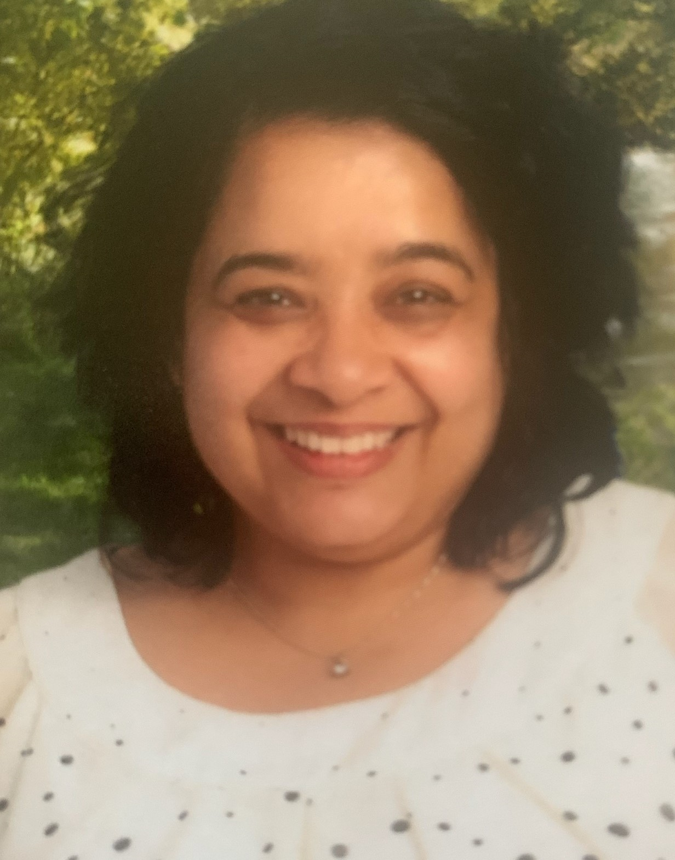
Pratibha Adamo
Mrs. Pratibha Adamo has been part of the Oak Grove School District’s family since August 2008. She has taught at two other schools in the District before joining the team at Stipe in 2018-19. She believes that classrooms are spaces of transformation and empowerment. She is passionate about creating platforms for students that is based on cultural responsiveness, restorative practices and community engagement. Drawing upon her own educational experiences in various international settings,
Mrs. Adamo brings an unique perspective that builds agency and advocacy in her students.
Mrs. Adamo holds a Bachelors in Child & Adolescent Development and a Masters in Education from San Francisco State University. When not rocking out to Guns N’ Roses, she enjoys reading and being outdoors.

Slide 16
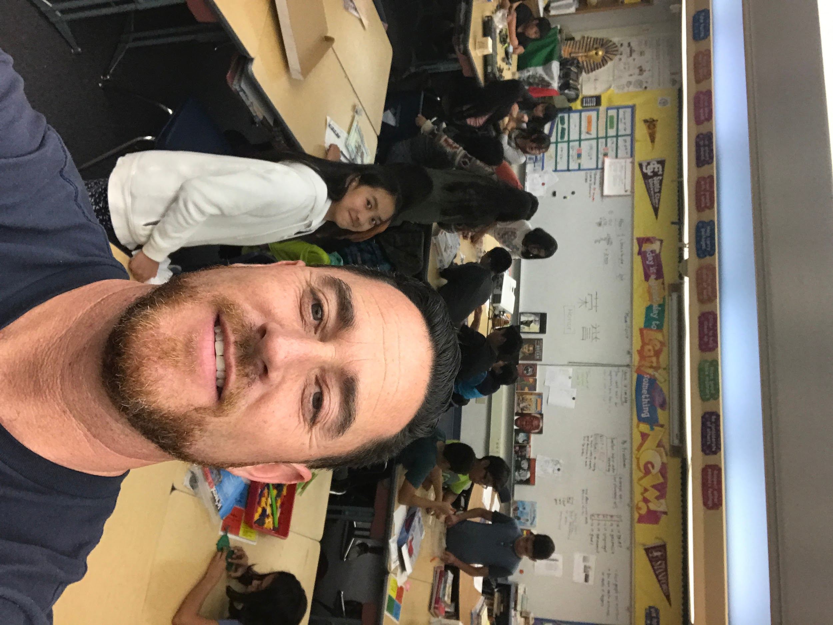
Jeff Friedman
Mr. Friedman grew up in Palo Alto, California. School was always extremely challenging and he always struggled to learn with ADD and ADHD. After failing over and over again, he felt inferior to his peers and believed that he would never have a bright future. However, in 1989 he lived in Oaxaca, Mexico. This experience changed his life as he immersed himself in the Mexican culture, traditions, and language. In 1994, he had the opportunity to study abroad in Seville, Spain at the University of Sevilla. He learned academic Spanish and became quite fluent. In 1995 he launched his first teaching assignment at Cesar Chavez Academy in East Palo Alto. For the first time in his life, he had a purpose: to encourage, to teach, to counsel, and to train students for their own bright futures. Mr. Friedman is married to the beautiful Isabel Chipana Friedman and has two energetic and compassionate sons named Joshua and Caleb. Mr. Friedman is a licensed minister and leads a Spanish Ministry called Libres en Cristo and leads mission trips to Peru every summer. His passion is to bring the best out of his students and guide them towards their own exciting destinies.

Slide 17
Kristina Daluddung

Slide 18
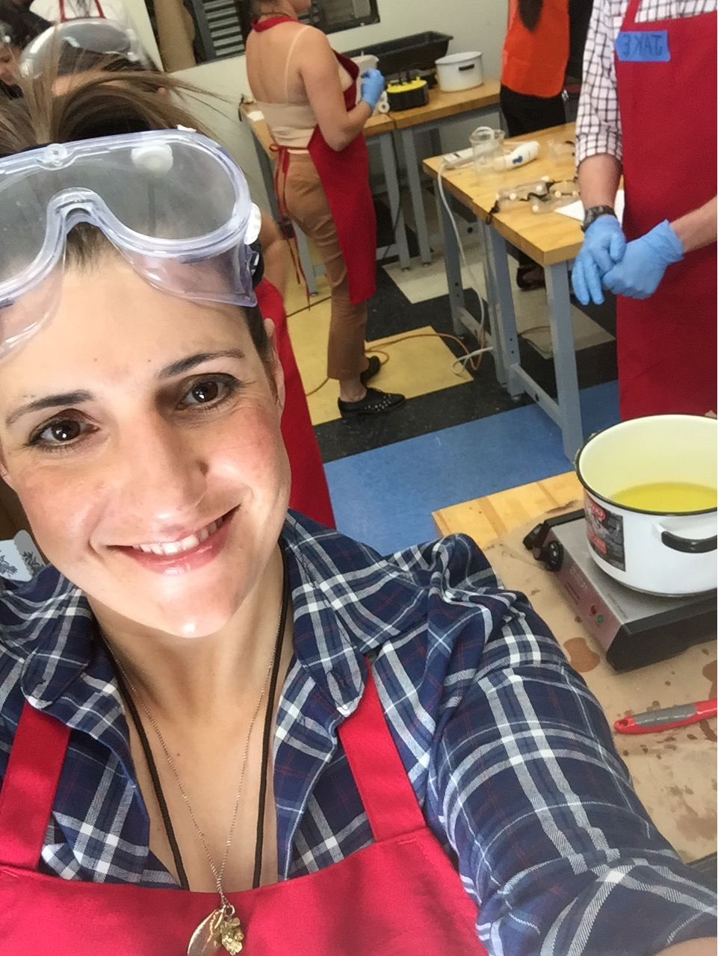
Michelle Link- STEAM Coach
Ms. Link is new to STEAM@Stipe this year after 13 years in Oak Grove teaching 4th through 6th grades at Miner, Christopher, and AdVENTURE STEM schools. Ms. Link arrives at Stipe with her Maker Certificate from Sonoma State, a Multiple Subjects Credential from San Jose State, and a Bachelors in Literature from University of California, Santa Cruz, and years of dedicated work around student literacy, equity, and agency using Project Based Learning, Design Thinking, hands on learning in the Makerspace. After building a Makerspace and Makerspace Program at AdVENTURE STEM, Ms. Link is ready to support teachers and students in building mindsets around Making, teaching Media Literacy, designing systems and teaching Skillbuilders for using Makerspace tools and materials, finding exciting and innovative learning opportunities for teachers, and supporting students in the design and building out of their creative ideas in the new STEAM@Stipe Makerspace.
@michelleelink

Slide 19
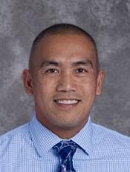
Vern Caruz
Mr. Caruz has spent the last eighteen years of his educational career focusing on socioeconomically disadvantaged and ethnically diverse communities. He believes that schools are centers of their communities. While schools primarily provide academic guidance, they also ensure that student’s basic needs are met, including social and emotional care. Prior to his tenure at Stipe, Mr. Caruz held positions as a teacher where he presented at multiple conferences in employing Exercise Physiology instruction within the Physical Education curriculum. Previously as Academic Dean and Assistant Principal, his areas of foci were the implementation of Early College High School programs and transformational Small Learning Communities. Mr. Caruz received his Bachelor’s and Master’s degrees in Kinesiology from San Jose State University, and a Master’s degree in Educational Leadership from the Principal Leadership Institute at the University of California, Berkeley. He is a current doctoral student of International Educational Leadership at East Carolina University.

Slide 20
Kelly Flores

