Slide 2
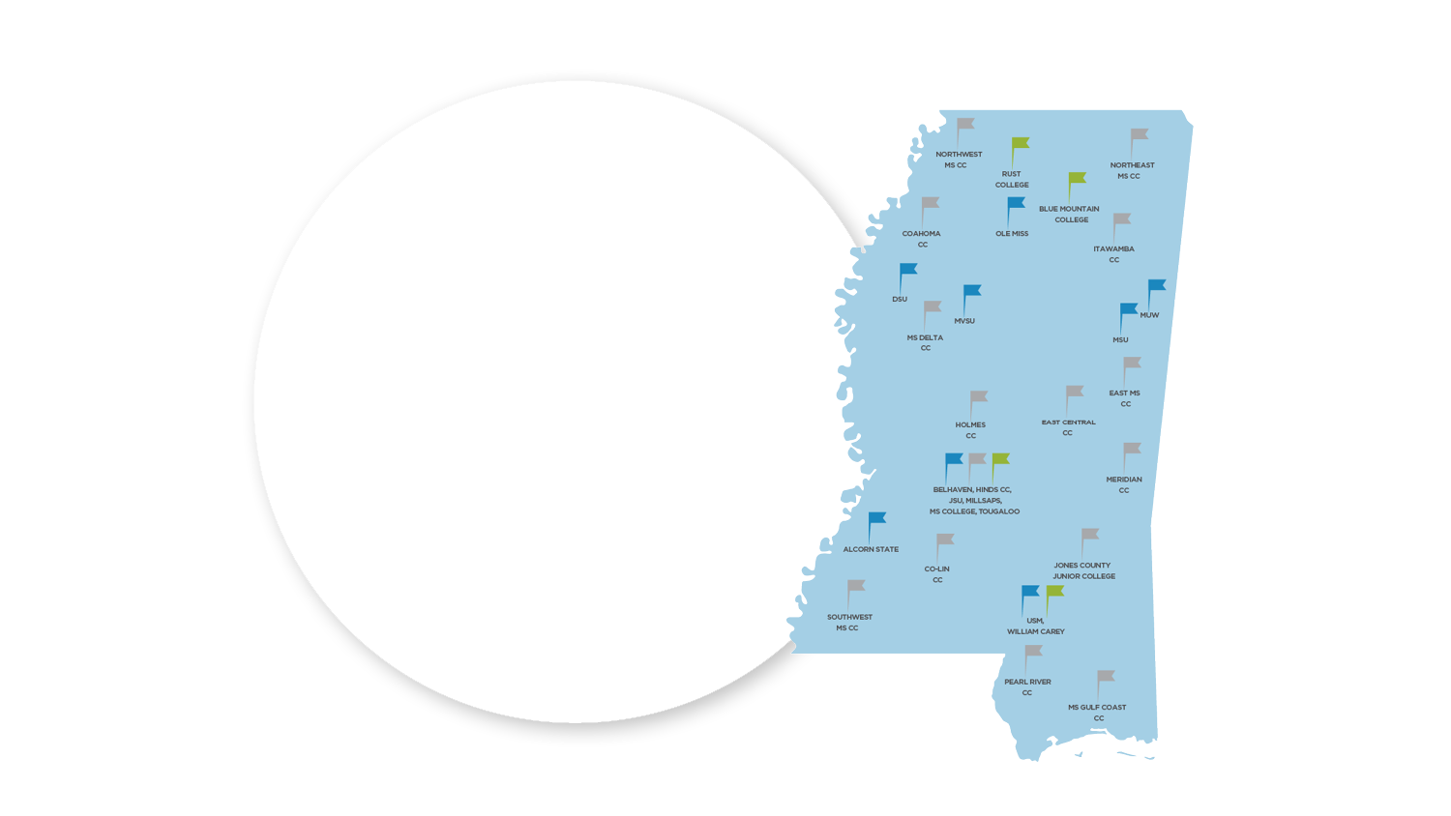
YOU HAVE
OPTIONS
Private
College
Public
College
Community
College

Slide 3
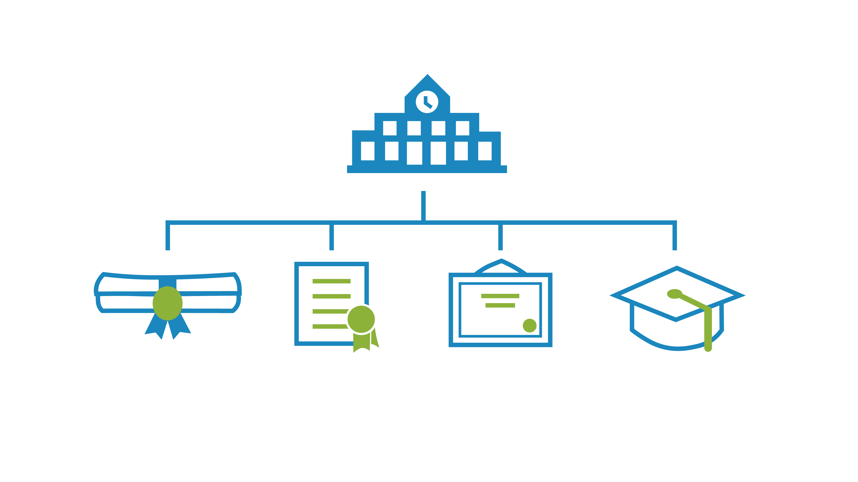
YOU HAVE
OPTIONS
Career &
Technical
Certificate/
Credential
Associate
Degree
Bachelor’s
Degree

Slide 4
FIND YOUR
COLLEGE FIT
2-year or 4-year
Programs Offered
Campus Resources
Affordability
Size/Student-to-faculty ratio
Location & Housing
Extracurricular Activities

Slide 5
Talk to college reps
Attend college fairs
Make campus visits
Career Exploration

Slide 6
APPLICATIONS
Public MS Schools
High school transcript
Application fee or fee waiver
ACT/SAT scores
Other colleges may need
Letter of recommendation
Essays
Resume
Interview
Applications open as
early as June 1st for
high school seniors.

Slide 7
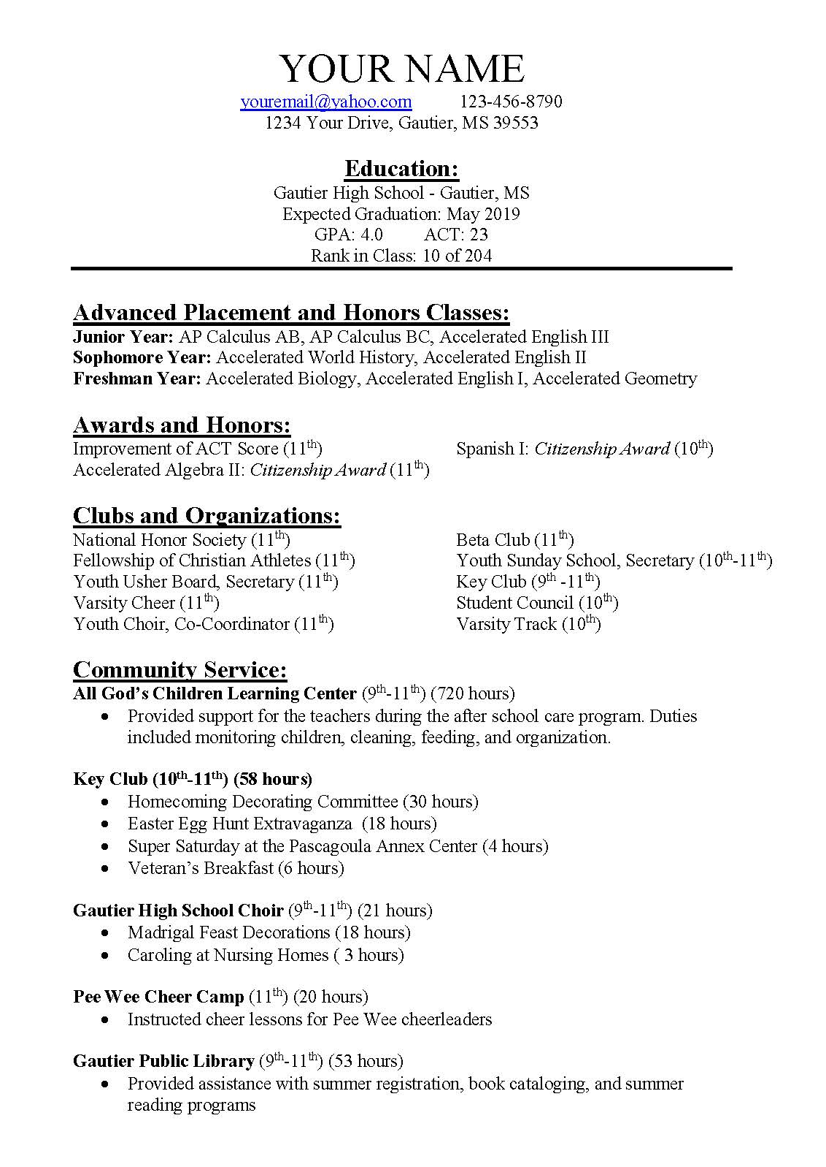
RESUME

Slide 8
HOW DO COLLEGES
USE MY SCORES?
Determine Admissibility
Scholarship Money
Class Placement

Slide 9
ADMISSION REQUIREMENTS
For the eight 4-year universities in Mississippi
16+
18+
ACT
ACT
2.5 GPA
3.2 GPA
2.0 GPA
minimum
minimum or
top 50% of class
minimum
CPC
CPC
CPC
NCAA
College Preparatory
Curriculum
College Preparatory
Curriculum
College Preparatory
Curriculum
National Collegiate Athletic Association

Slide 10
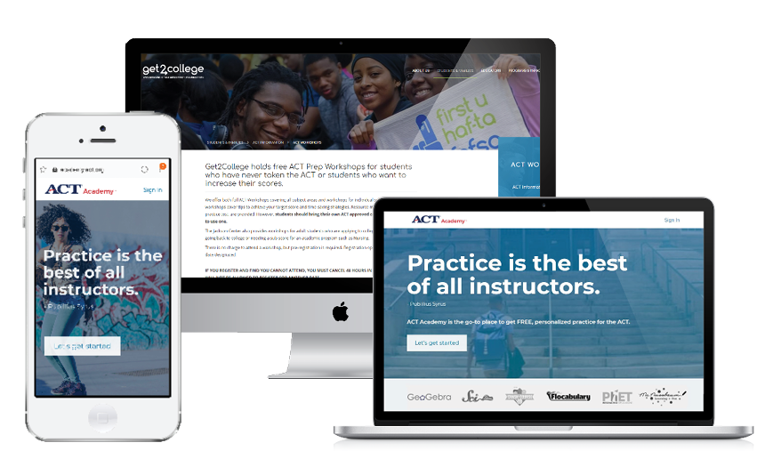
STUDY TOOLS For the ACT

Slide 11
THE COST OF COLLEGE &
HOW TO PAY FOR IT

Slide 12
COST OF ATTENDANCE Net Price Calculator
$12,935
Avg. annual
Cost of attendance
$23,550
Avg. annual
Cost of attendance
$3,120 - $3,870
Annual tuition (2021-22)
$7,045 - $9,220
Annual tuition (2021-2022)
Community Colleges
In Mississippi
Public Universities
In Mississippi

Slide 14
OUTSIDE AID
Counselor/School Website
Online Databases
Local businesses
Community Organizations
Newspaper
Scholarship Search tool (Resource on our website)

Slide 15
COLLEGE AID
Merit-based Scholarships
Academic Merit
Leadership
Sports
Arts/Music
Community Service
Need-based Grants/Scholarships

Slide 16
PHI THETA KAPPA
“Students in Mississippi can't afford to pass up an opportunity to join Phi Theta Kappa”
Lynn Tincher-Ladner
President & CEO
Phi Theta Kappa
*Transferable hours may vary between
colleges to receive transfer scholarships

Slide 17
FEDERAL AID
Federal Aid = FAFSA, fafsa.gov
Application for federal grants, work-study and student loans
The FAFSA will be available starting October 1 of senior year and it will be based on the prior prior year’s taxes

Slide 18
LOAN TYPES
DIRECT
SUBSIDIZED
LOANS (Undergraduate)
3.73%
DIRECT
UNSUBSIDIZED
LOANS (Undergraduate)
4.53%
DIRECT
UNSUBSIDIZED
LOANS (Graduate)
5.28%
DIRECT
PLUS
LOANS (Graduate & Parents)
6.28%
2021-2022 Interest Rates

Slide 19
MISSISSIPPI FINANCIAL AID
HELP
HIGHER EDUCATION
LEGISLATIVE PLAN
20 ACT
2.5 GPA
IHL CPC
Income
Requirements
MTAG
MS TUITION
ASSISTANCE GRANT
15 ACT
2.5 GPA
MESG
MS EMINENT
SCHOLARS GRANT
29 ACT
3.5 GPA

Slide 20
4. MISSISSIPPI FINANCIAL AID
Covers full tuition and required fees at any public school in Mississippi for 4 years or 8 semesters
Special circumstances for private schools
Application deadline March 31 and additional documents April 30
HELP
HIGHER EDUCATION
LEGISLATIVE PLAN
20 ACT
2.5 GPA
IHL CPC
Income
Requirements

Slide 21
Students must enroll in and earn at least 15 credit hours to receive Mississippi Aid
Students will receive aid from only one state grant program
msfinancialaid.org

Slide 22
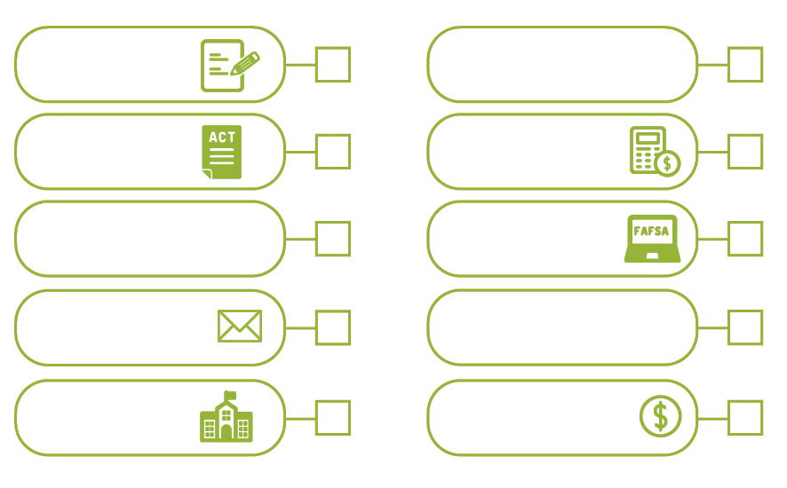
COLLEGE PLANNING CHECKLIST
JOB- SHADOWING/
INTERNSHIPS
APPLY
ACT
NET PRICE
CALCULATOR
HIGH SCHOOL
RESUME
FAFSA
CONTACT
RECRUITERS
STATE AID
APPLICATION
CAMPUS
VISITS
SCHOLARSHIPS

Slide 23
ACTION STEPS
Sign up for text messaging
Register for ACT Prep
Schedule an appointment with Get2College

Slide 24
Text “College”
to
601-996-7015

Slide 25
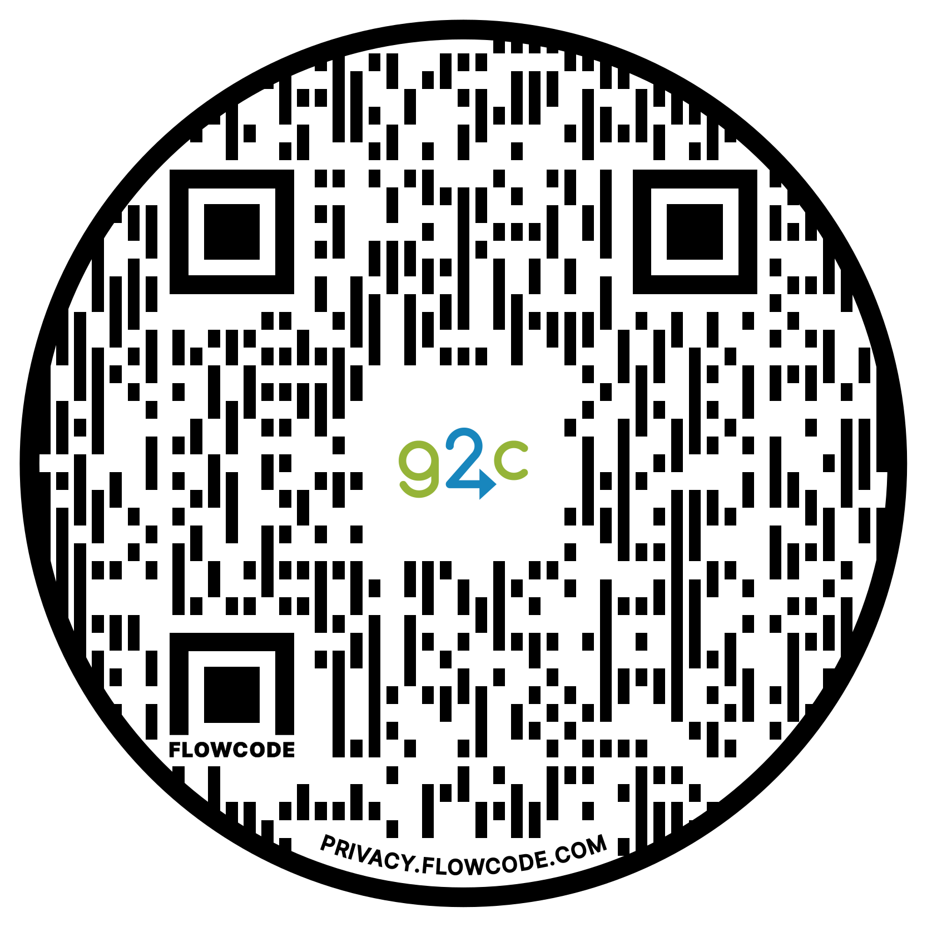
get2college.org
Stephen Brown

