Slide 1
SCHOOL LUNCH REMINDERS

Slide 2
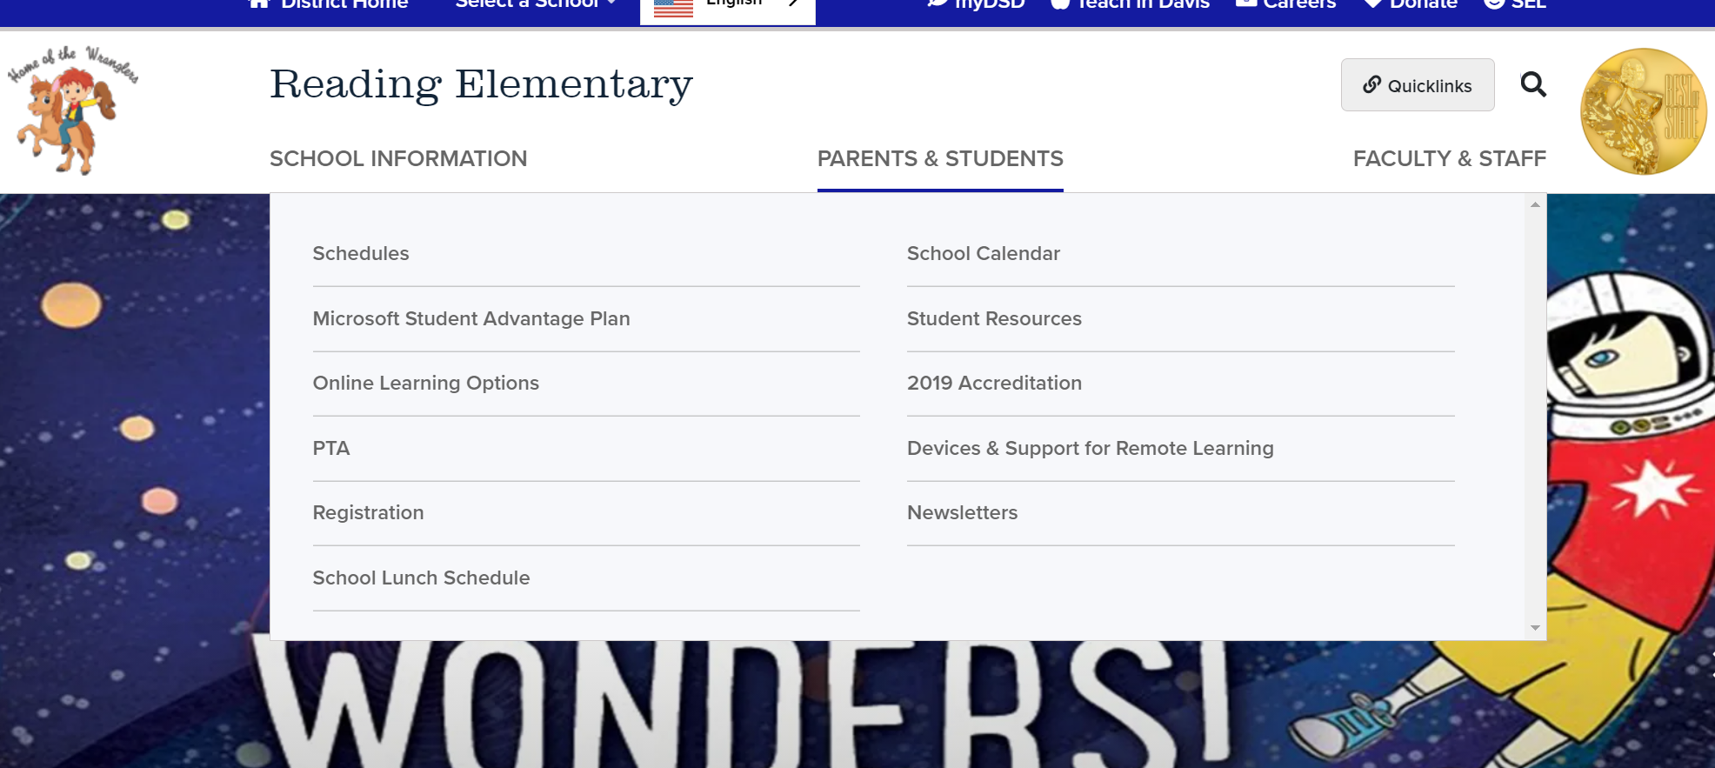
It is helpful to know your choices
before you come to lunch.
Link on School Website In the Newsletter

Slide 3
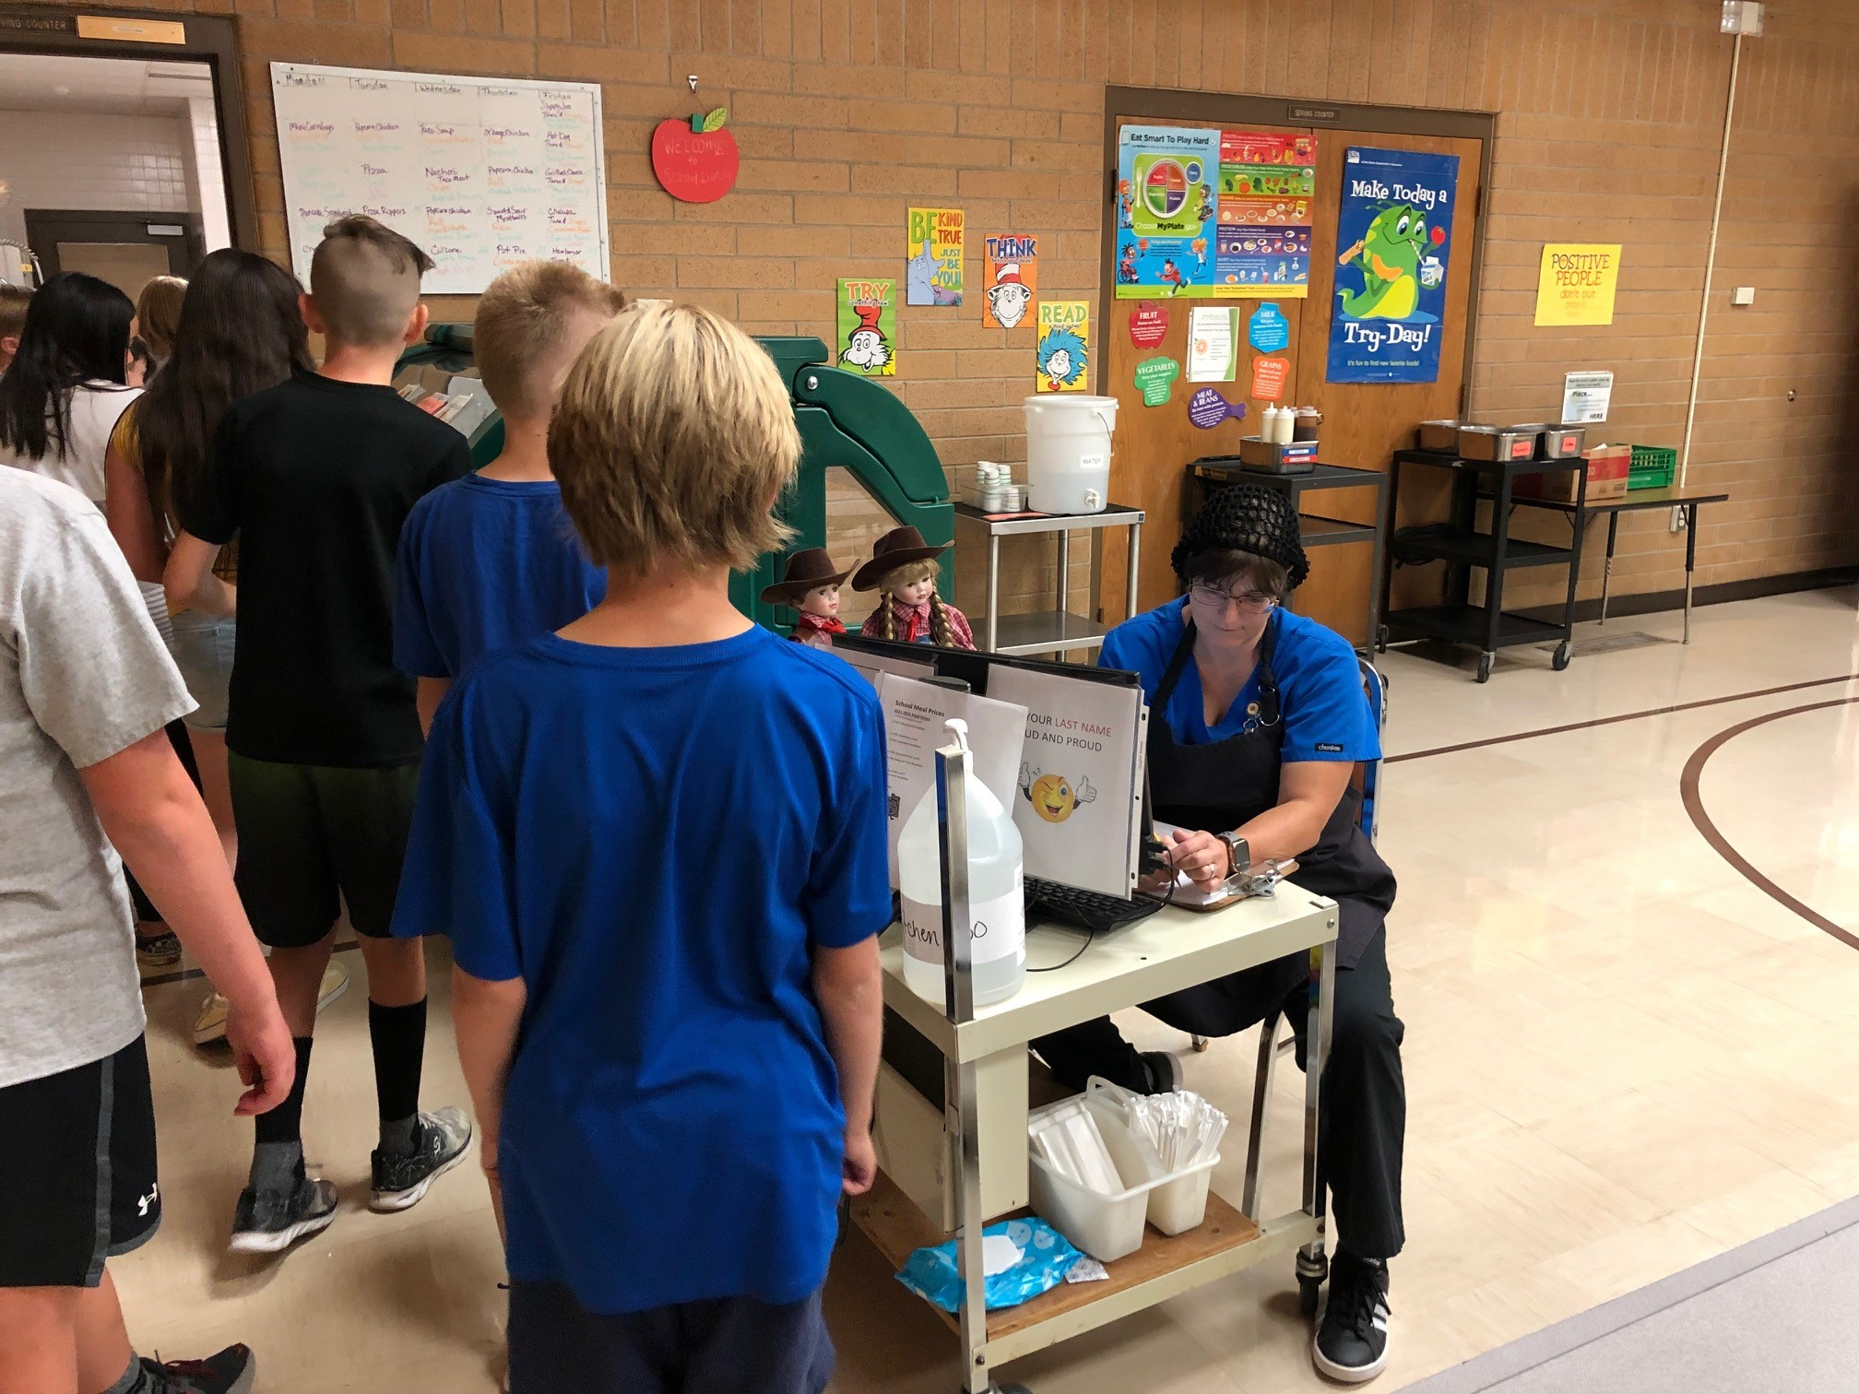
When you reach Mrs. Munson,
say your last name loudly and clearly.

Slide 4
You should
choose
at least
3 different
items.

Slide 5
One item MUST be a fruit (red star)
or a vegetable (green star).
Please take a full serving.
You can choose more than 1 if you will eat it.

Slide 6
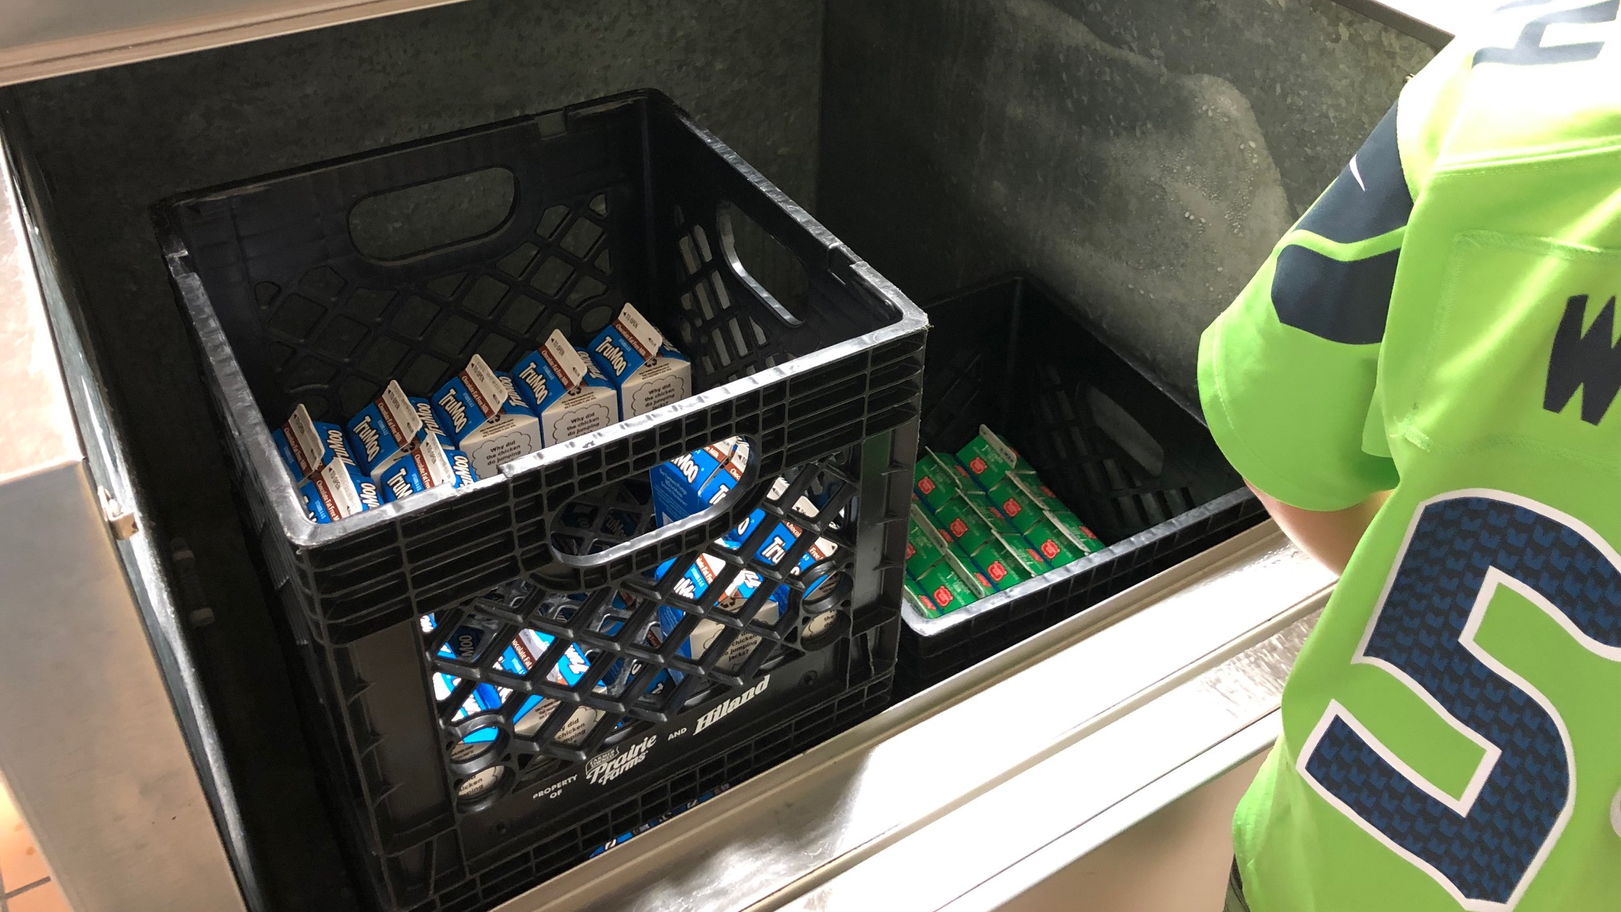
You can choose a milk from the cooler…
Chocolate Milk
Skim Milk
1% White Milk

Slide 7
Weird Rule:
If you eat a free school lunch, milk is included.
If you bring a lunch from home, you need to pay 50 cents for the milk.
Why? We receive reimbursement only for complete meals.

Slide 8
Put Your Milk
in the Middle
Carry Your Tray
With Both Hands!

Slide 9
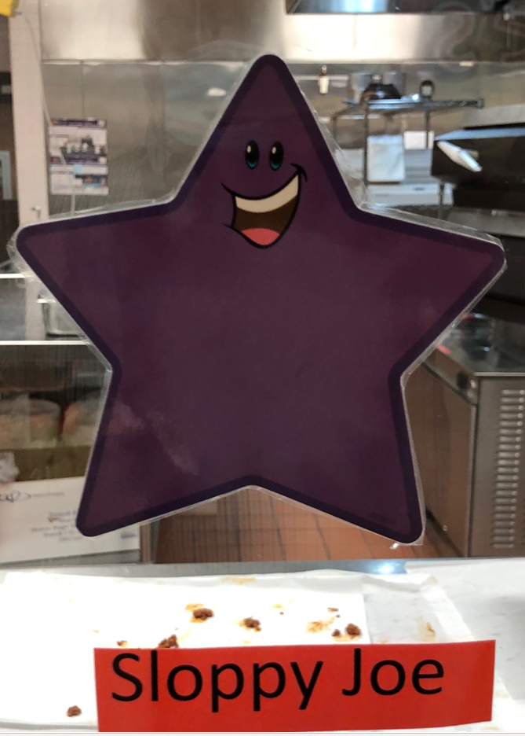
You may choose one
protein item with a purple star. The main entrée changes daily.
These choices are available every day:
Chicken Patty
Peanut Butter & Jelly Sandwich
String Cheese
Yogurt Cup

Slide 10
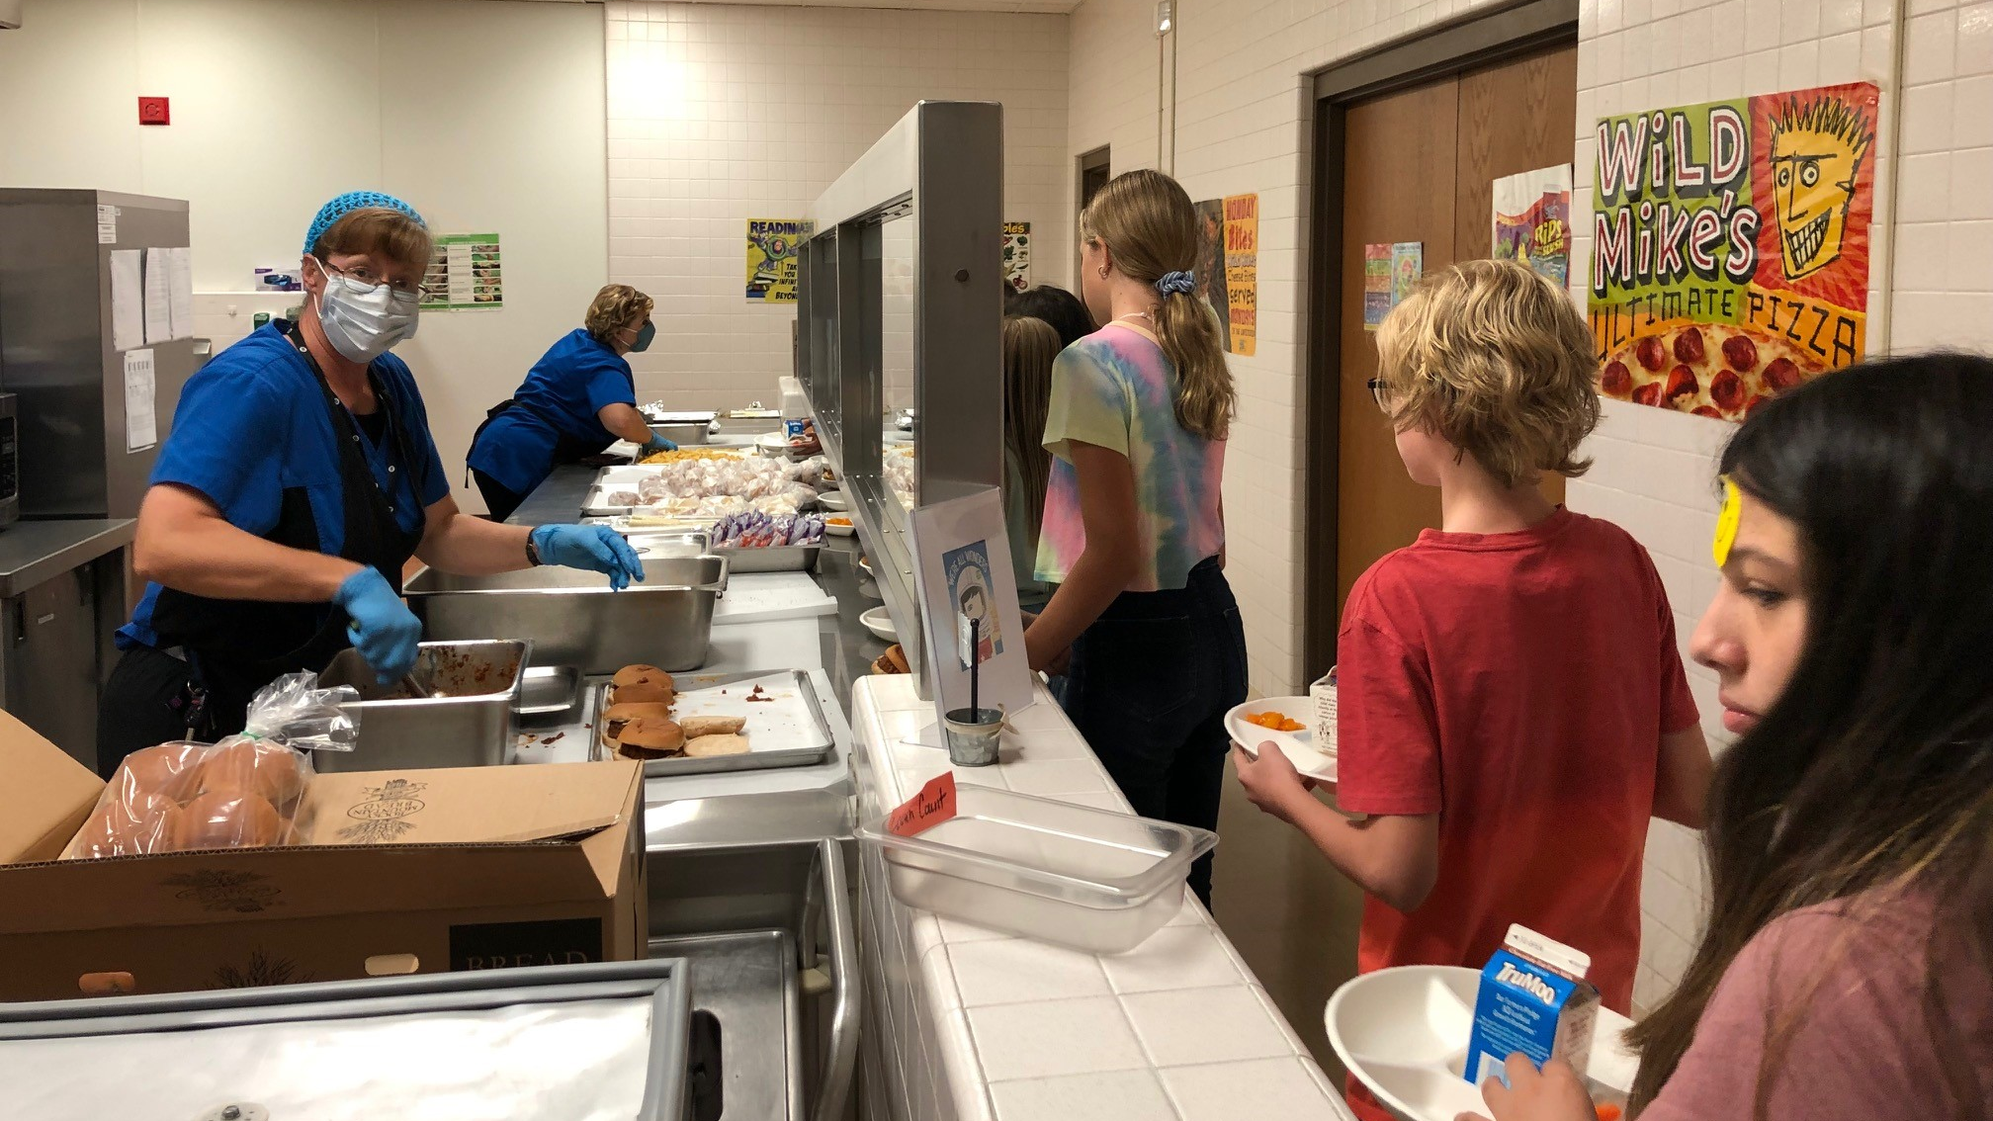
Be respectful as you move down the line.
Make your choices.
Aim an empty part of your tray at the server.
Sliding your tray down the line helps the servers.
Take items you will eat.
Say “Thank You!” as you leave.

Slide 11
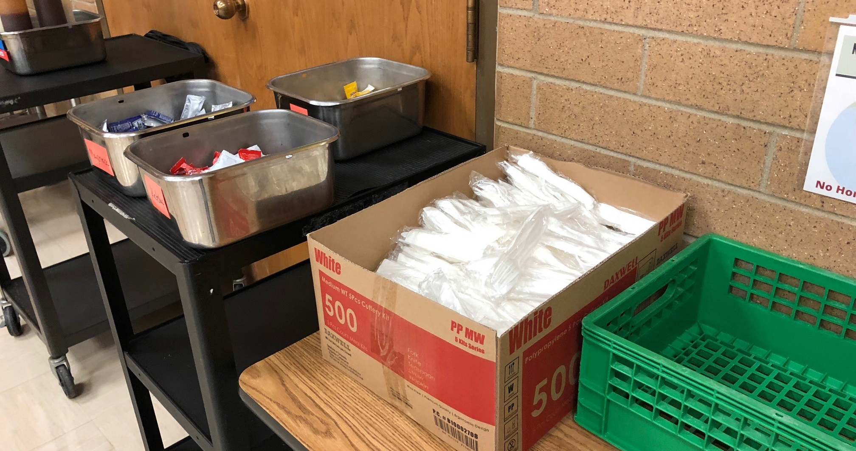
Remember to get a fork, napkin and
condiments like ketchup or ranch
before you sit down!

Slide 12
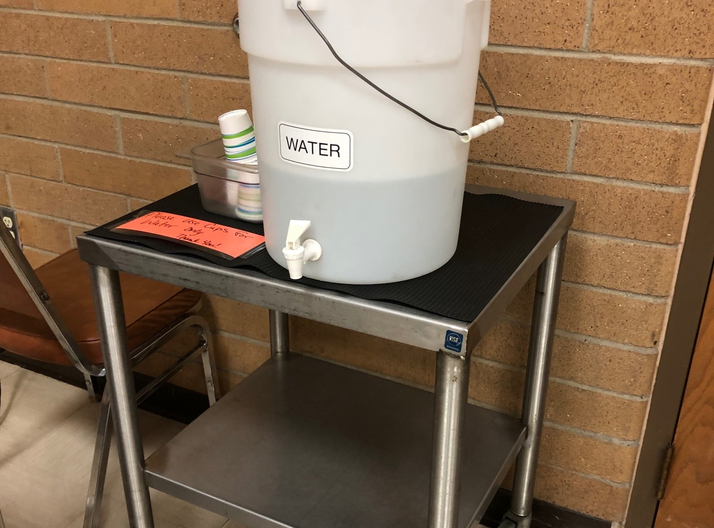
Water is always available.

Slide 13
Don’t rush through lunch. Your #1 priority
is to eat so you have energy for the afternoon.
You get three recesses, but only one lunch.

Slide 15
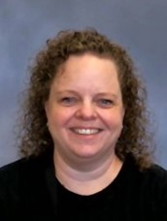
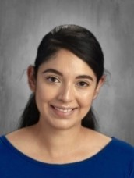
If you need any help at lunch, just ask!
Raise your hand to be excused!

Slide 16
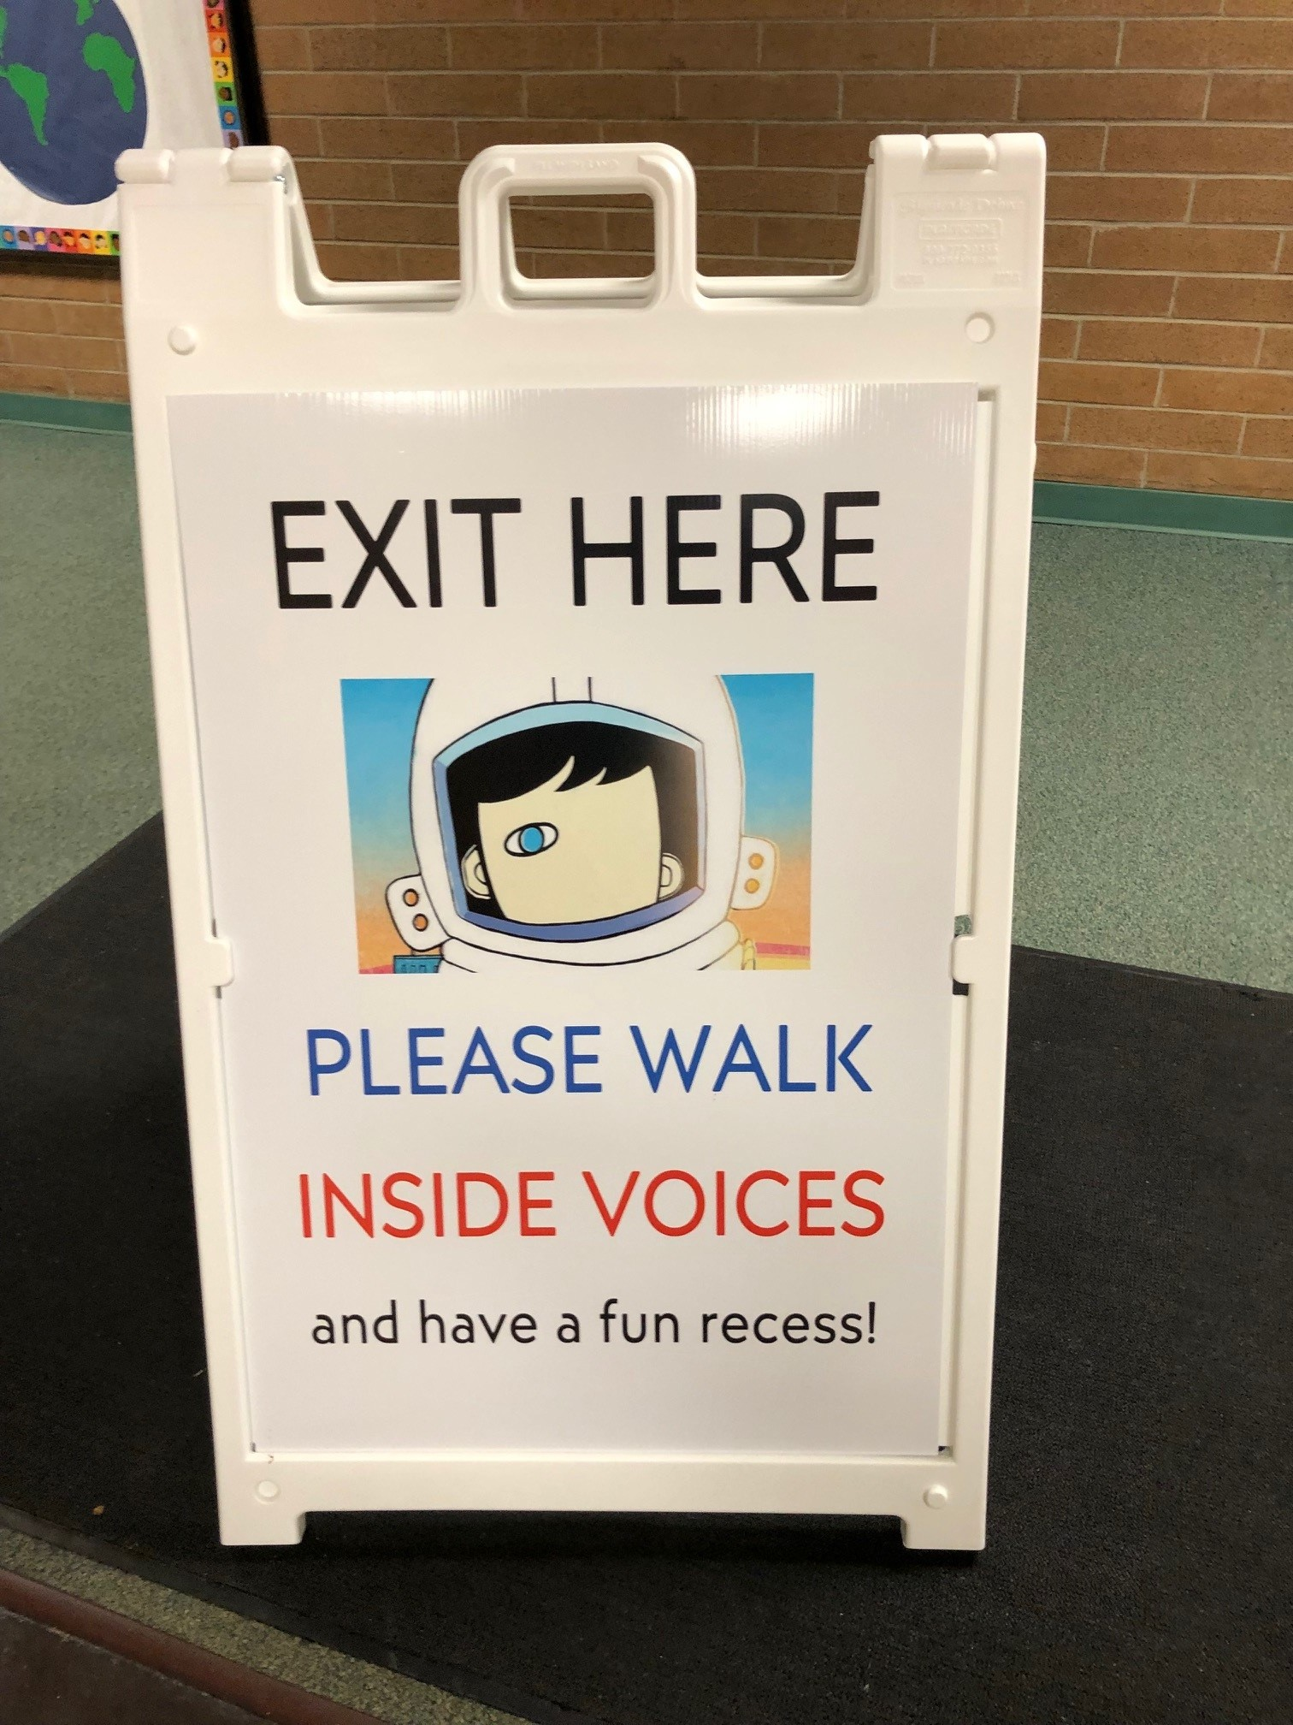
After you are excused, exit out the correct door.
Walk.
Inside voice.
Have a good recess!

