Slide 1
Getting to Know Your New Polycom VVX 411 Phone

Slide 2
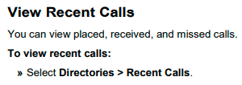
View Recent Calls

