Slide 1
Short OVERVIEW Video

Slide 2
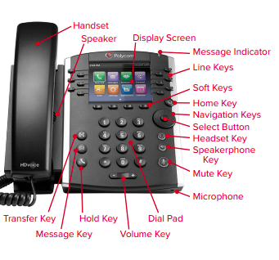
Polycom VVX BUTTONS

Slide 3
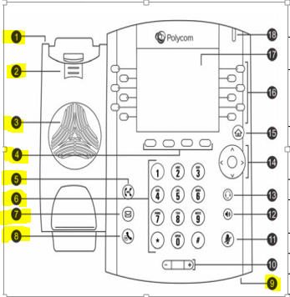
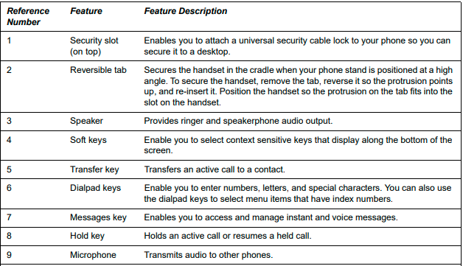
Polycom VVX Explained

Slide 4
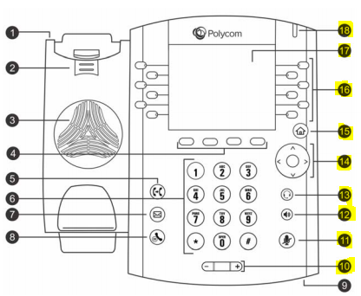
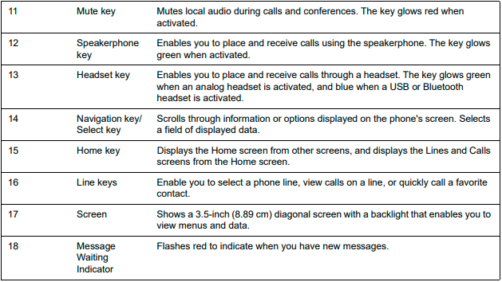
Polycom VVX Explained (Continued)

