Slide 1
CTE Long Range Facility Planning LRFP Committee | Recommendation
Presentation
to SBISD
Board of Trustees
July 19, 2021

Slide 2
CTE Long Range Facilities Planning| LRFP Committee Recommendation
Agenda: Presentation to SBISD Board
CTE LRFP Committee Charge
CTE LRFP Committee Member’s Feedback
LRFP Committee Engagement Timeline
LRFP Committee Engagement Activities:
– Meeting #1 = Establish Framework: CTE Instruction + CTE Ed Specs + CTE Facility Assessment
– Meeting #2 = Individual Input: Improvement Tier Strategy
– Meeting #3 = Group Consensus: Improvement Tier Strategy + Timeline
– Meeting #4 = Committee Consensus: Improvement Tier Strategy + Timeline
LRFP Committee Recommendation:
- LRFP Recommendation: Improvement Tier Strategy
- LRFP Recommendation: Implementation Timeline
Questions
1
2

Slide 3
CTE Long Range Facilities Planning| LRFP Committee Charge
CTE Long Range Facility Plan Committee - Charge
The SBISD Board of Trustees will appoint a Career and Technical Education (CTE) Long Range Facilities Committee (The Committee) comprised of parents, students, staff, community members, business representatives, and administrators to participate in the development of the SBISD CTE Long Range Facilities Plan.
The Committee will function in an advisory capacity to the SBISD Board of Trustees, Superintendent and Senior Staff. The Committee will consider the District’s vision for the future of CTE, the conditions and capacities of its existing classrooms, labs, and facilities, and future CTE-related facility needs.
The Committee will present recommendations to the Board of Trustees by __________. The Board of Trustees will receive and review the Committee’s recommendations. The Board of Trustees will be responsible for final approval of a CTE Long Range Facilities Plan and its execution.
CTE Long Range Facility Plan Committee – Scope of Work
Develop and present to the Board of Trustees a CTE Long-Range Facilities Plan to serve the district as a baseline for the next 10 years. The Plan should include recommendations related to upgrades, renovations, and/or expansions to existing classrooms, labs, and facilities to align with the CTE Program of Studies, and where appropriate, identify facilities to be replaced or added to the portfolio.
CTE Long Range Facility Plan Committee – Refrain from
Recommendations regarding specific design of schools or district facilities, location(s) of schools or district facilities or boundaries of district facilities,
Recommendations regarding instructional arrangements and/or educational pedagogy and district policy as the CTE Long Range Facilities Plan is developed

Slide 4
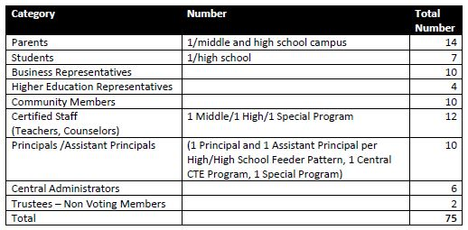
CTE Long Range Facilities Planning| LRFP Committee Composition
CTE Long Range Facility Plan Committee – Composition
The composition of the Committee will be as outlined below. The membership of the Committee will represent all geographic areas of the community. Efforts should be made to include members on the Committee who participated in the CTE Task Force, while also including individuals with expertise in the areas aligned with our CTE program. Individuals accepting membership should be able to attend at least 80 percent of the scheduled meetings.
Ed Valicek
Shannon McNary
2 Co-Chairs
CTE LRFP Committee:
75 Participants
45 = Parent, Student + Community Reps
SBISD Secondary Campuses Higher Education + Business Community
22 = SBISD Secondary Campus Staff
Leaders + Instruction
08 = SBISD Administrator + Trustees

Slide 5
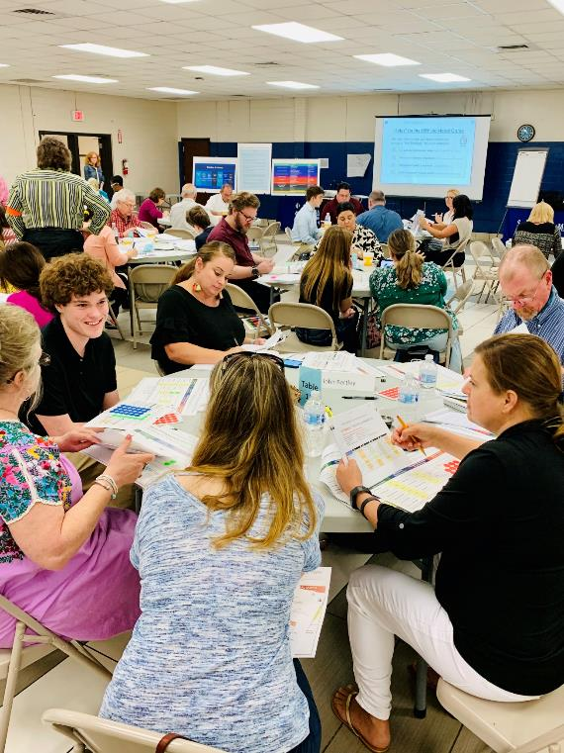
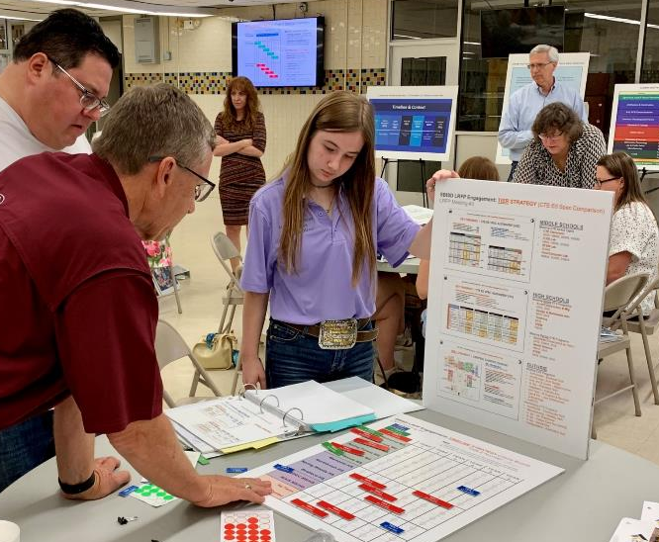
CTE Long Range Facilities Planning| LRFP Committee Composition
CTE Long Range Facility Plan Committee – Member’s Feedback
75 Participants
2 Students
2 Co-Chairs
Eva Pluchino
Jack Weatherly
Ed Valicek
Shannon McNary

Slide 6
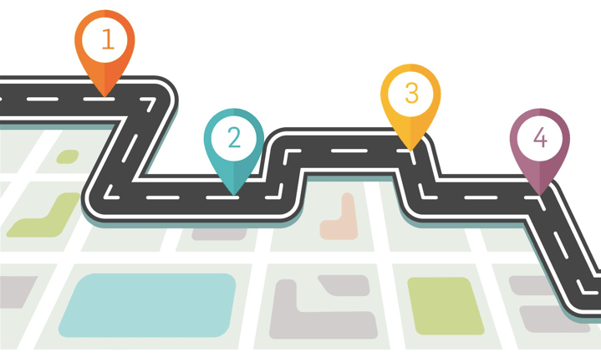
ESTABLISH
FRAMEWORK
Item 1
DEVELOP
OPTIONS
EXPLORE
CONCEPTS
REFINE /
FINALIZE
LRFP Committee Meetings: Organized Path Focused on Consensus

Slide 7
CTE Long Range Facilities Planning| CTE LRFP Meetings Schedule – WHAT to EXPECT NEXT
LRFP #1
May 18th (SHS)
LRFP #2
June 8th (SBMS)
LRFP #3
June 24th (SFMS)
LRFP #4
July 8th (SWHS)
1
Meeting
Objective
LRFP Charge
Information | Data:
LRFP Framework CTE History / Instruction Ed Spec / Assessment
INITIAL Input:
CTE Facilities Assessment
Final Report Summary
DEVELOP Plan:
Long Range Plan Confirm Tier Strategy Create LRFP Timeline
REFINE / FINALIZE Plan:
Long Range Plan
Recommended Option
2
Topics
Discussed
BASELINE DATA:
(Instruction / Facility)
CTE Task Force
CTE Curriculum
CTE Education Spec
CTE Assessment: (April Status Update)
INPUT / FEEDBACK:
(Initial Option)
Individual Report Card
Improvement Strategy
(Tier 1 + Tier 2 + Tier 3)
Organized by Building Type
CTE LRFP: (Develop Options)
12 Tables → 4 Tables
Improvement Strategy
(Tier 1 + Tier 2 + Tier 3)
Timeline Order Priority (Building Type)
CTE LRFP: (Refine Plan)
Group Discussion
Improvement Strategy
(Tier 1 + Tier 2 + Tier 3)
Timeline Order Priority (Building Type)
LRFP Recommendation
SBISD Board – July 19, 2021
3
Informed
Direction
Individual / Group UNDERSTANDING:
CTE Curriculum CTE Education Spec
CTE Assessment + Improvement Strategies
Individual
INPUT / FEEDBACK:
CAMPUS TIER STRATEGY
(MS, HS, Specialty and Central Facilities)
Small + Medium Group
INPUT / FEEDBACK:
CAMPUS TIER STRATEGY
+
BLDG TIMELINE
Large Group
RECOMMENDATION:
Campus Tier Strategy + Bldg. Priority
Presentation Outline
FOCUS:
FRAMEWORK
EXPLORE
DEVELOP
REFINE / FINALIZE
OVERVIEW
BUILD + SEEK CONSENSUS

Slide 8
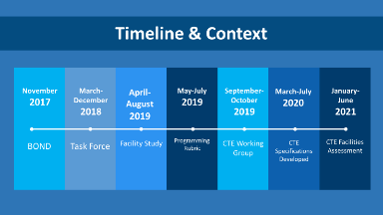
CTE Long Range Facilities Planning| CTE LRFP Meeting#1 – RECAP
LRFP #1
May 18th (SHS)
LRFP Committee Mtg #1 Recap:
Reminder of what we covered….
1
Meeting
Objective
LRFP Charge
Information | Data:
LRFP Framework CTE History / Instruction Ed Spec / Assessment
Timeline:
2017 Bond
2018 Task Force
2019 Work Group
2020 Ed Spec
2021 F. Assessment
CTE Instruction: Timeline, History, Context & Programs
2
Topics
Discussed
BASELINE DATA:
(Instruction / Facility)
CTE Task Force
CTE Curriculum
CTE Education Spec
CTE Assessment: (April Status Update)
3
Informed
Direction
Individual / Group UNDERSTANDING:
CTE Curriculum CTE Education Spec
CTE Assessment + Improvement Strategies
CTE Task Force (Vision, Action Plan) CTE Working Group (Programs, Facilities)
CTE Curriculum Structure:
Coherent Sequence
Programs of Study Career Cluster
FOCUS:
FRAMEWORK
OVERVIEW

Slide 9
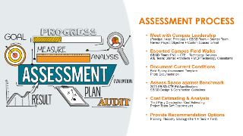
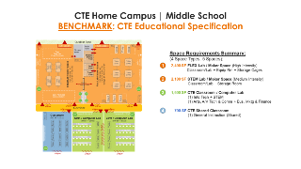
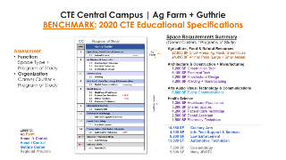
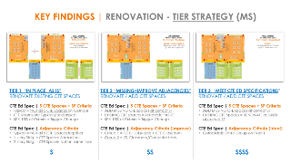
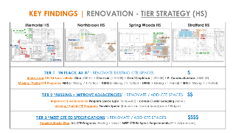
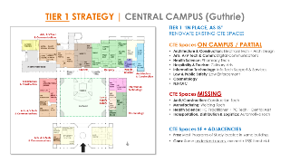
CTE Long Range Facilities Planning| CTE LRFP Meeting#1 – RECAP
LRFP #1
May 18th (SHS)
LRFP Committee Mtg #1 Recap:
Reminder of what we covered….
1
Meeting
Objective
LRFP Charge
Information | Data:
LRFP Framework CTE History / Instruction Ed Spec / Assessment
CTE Facilities Assessment : Assessment Process, CTE Ed Spec Benchmark, Assessment Status Update
2
Topics
Discussed
BASELINE DATA:
(Instruction / Facility)
CTE Task Force
CTE Curriculum
CTE Education Spec
CTE Assessment: (April Status Update)
Middle School + High School + Guthrie
3
Informed
Direction
Individual / Group UNDERSTANDING:
CTE Curriculum CTE Education Spec
CTE Assessment + Improvement Strategies
MS CTE Ed Spec + HS CTE Ed Spec + Guthrie CTE Ed Spec
FOCUS:
FRAMEWORK
OVERVIEW
MS Tier Strategy + HS Tier Strategy + Guthrie Tier Strategy

Slide 10
CTE Long Range Facilities Planning| CTE LRFP Meeting#2 – RECAP
LRFP Committee Mtg #2 Recap:
CTE Student Experience….
MIDDLE SCHOOL
Explore Interests
Increase Exposure
Provide Opportunities
HIGH SCHOOL
Broad Based Experience
Course Sequence
(HS) + (HS → Central)
CENTRAL FACILITIES
Specialized Experience
Certification
Work Experience

Slide 11
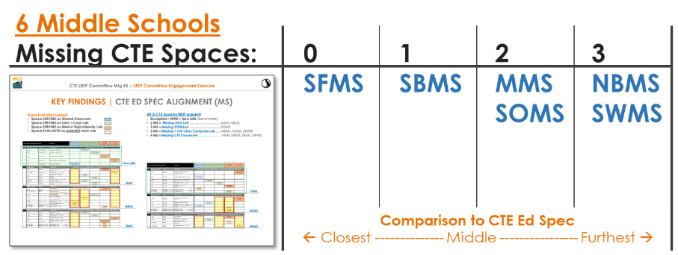
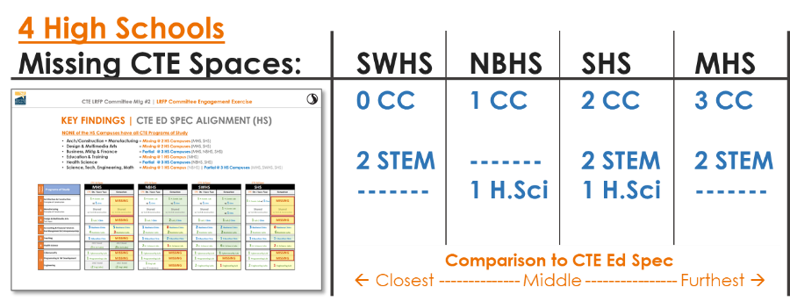
CTE Long Range Facilities Planning| CTE LRFP Meeting#2 – RECAP
LRFP Committee Mtg #2 Recap:
Facilities Assessment Findings….
Campus “Snapshots”

Slide 12
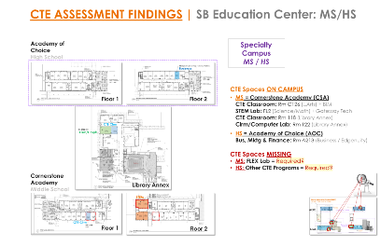
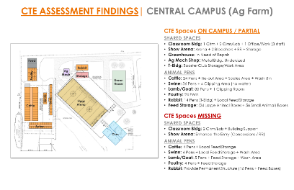
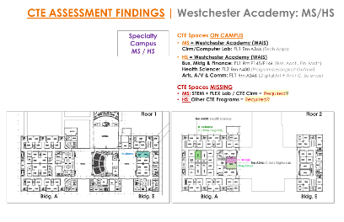
CTE Long Range Facilities Planning| CTE LRFP Meeting#2 – RECAP
LRFP Committee Mtg #2 Recap:
Facilities Assessment Findings….
Campus “Snapshots”
2 Specialty MS / HS
2 Central Facilities
SBEC = MS / HS
Missing: N/A
Ag Farm
Missing: 2 Classrooms
Arena Entry Upgrades
Added Animal Pens
WAIS = MS / HS
Missing: N/A
Guthrie Center
Missing: New Programs
+ Expand Existing Programs

Slide 13
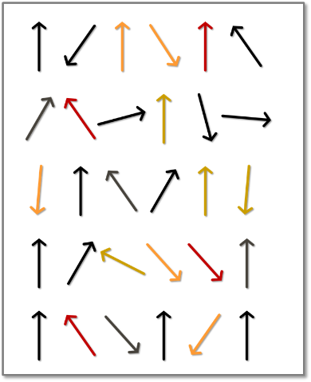
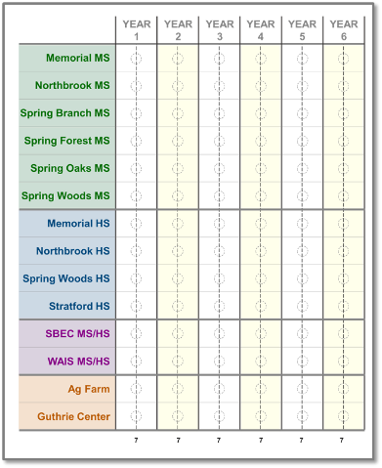
CTE LRFP Committee | Engagement Activity Summary
Individual Input → Group Consensus → Committee Consensus
A
B
C
LRFP Mtg#2: Individual
55 Individual Input
Tier Strategy
LRFP Mtg#3: Group
12 Table Consensus Tier Strategy + Timeline
04 Group Consensus Tier Strategy + Timeline
LRFP Mtg#4: Committee
“Recommendation”
Tier Strategy + Timeline

Slide 14
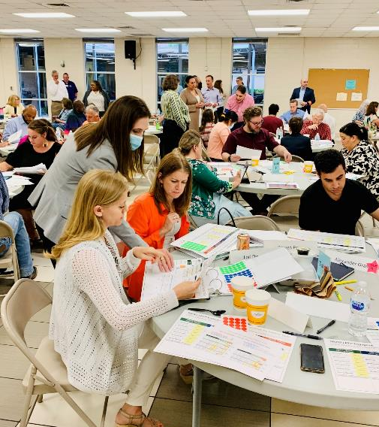
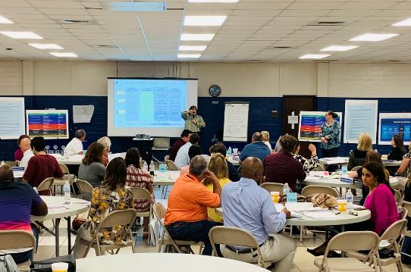
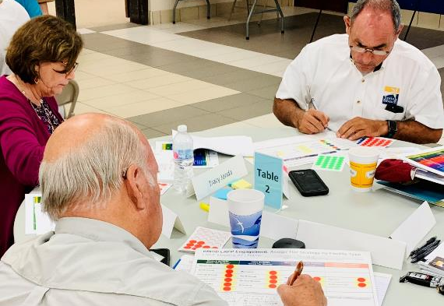
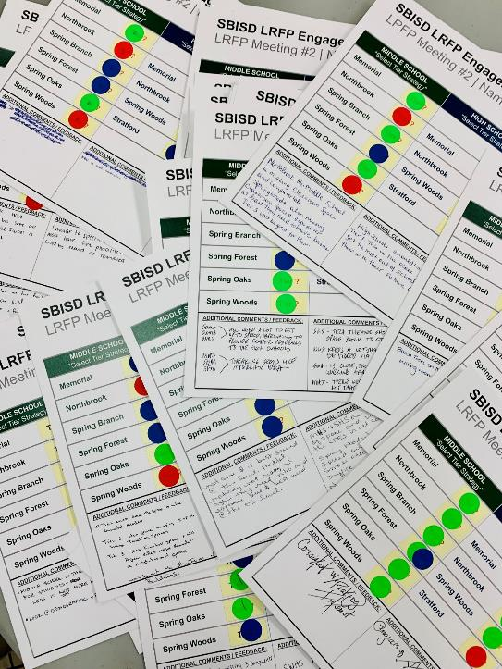
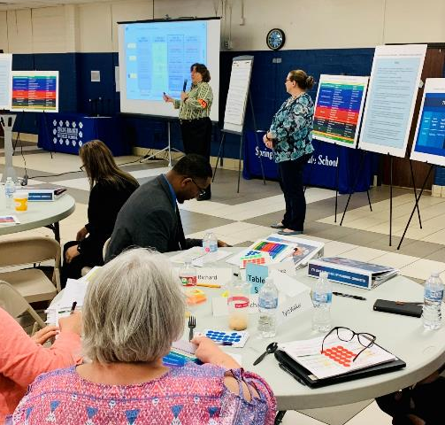
LRFP Mtg#2 Engagement | Individual Input: Tier Strategy

Slide 15
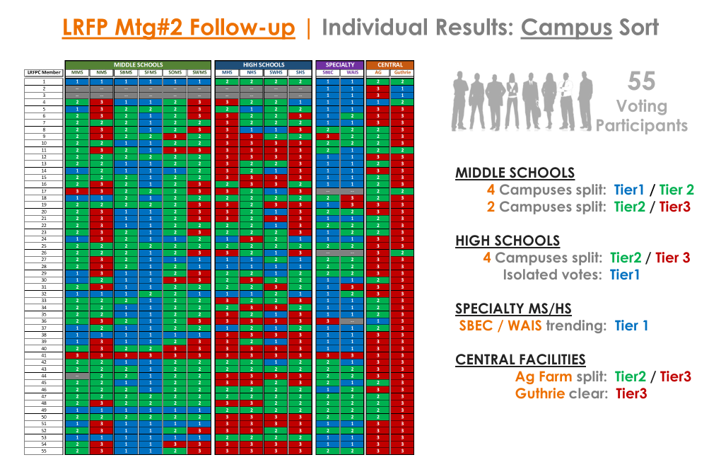
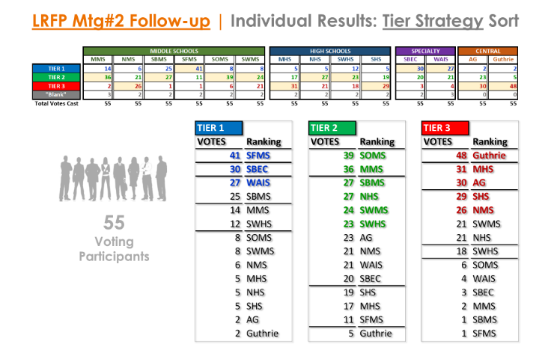
CTE Long Range Facilities Planning| CTE LRFP Meeting#2 - Results
LRFP Committee Mtg #2 Results:
Mtg #2 Engagement…. Tier Strategy
Individual Input Results
CAMPUS SORT
55 Committee Member’s Input
Tier Strategy Assigned for Each Campus
TIER STRATEGY SORT
55 Committee Member’s Input
Campus Ranking under each Tier Strategy

Slide 16
CTE Long Range Facilities Planning| CTE LRFP Meeting#3 – New Data
LRFP Committee Mtg #3 New Data:
Facilities Assessment Findings….
Project Cost Data
COST ASSUMPTIONS
Soft + Hard Cost = TOTAL Project Cost
Current Cost = $$ Yr2021

Slide 17
CTE Long Range Facilities Planning| CTE LRFP Meeting#3 – New Data
LRFP Committee Mtg #3 New Data:
Facilities Assessment Findings….
Project Cost Data
SUMMARY TOTALS
Tier Strategy = Tier 1, Tier 2, Tier 3
Building Type = MS, HS, MS/HS, Central
COST DATA
PROVIDED FOR
INFORMATIONAL
PURPOSES ONLY

Slide 18
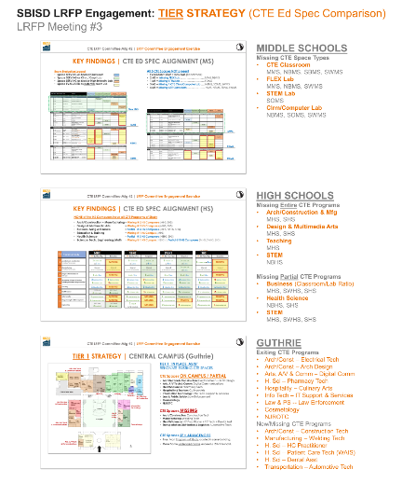
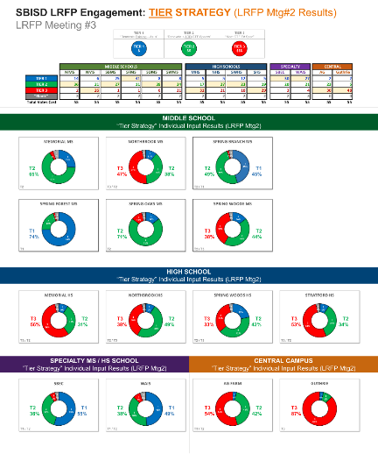
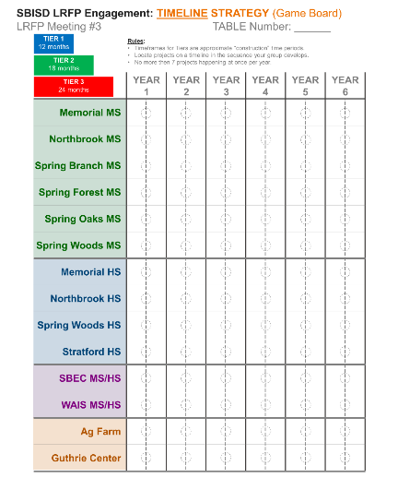
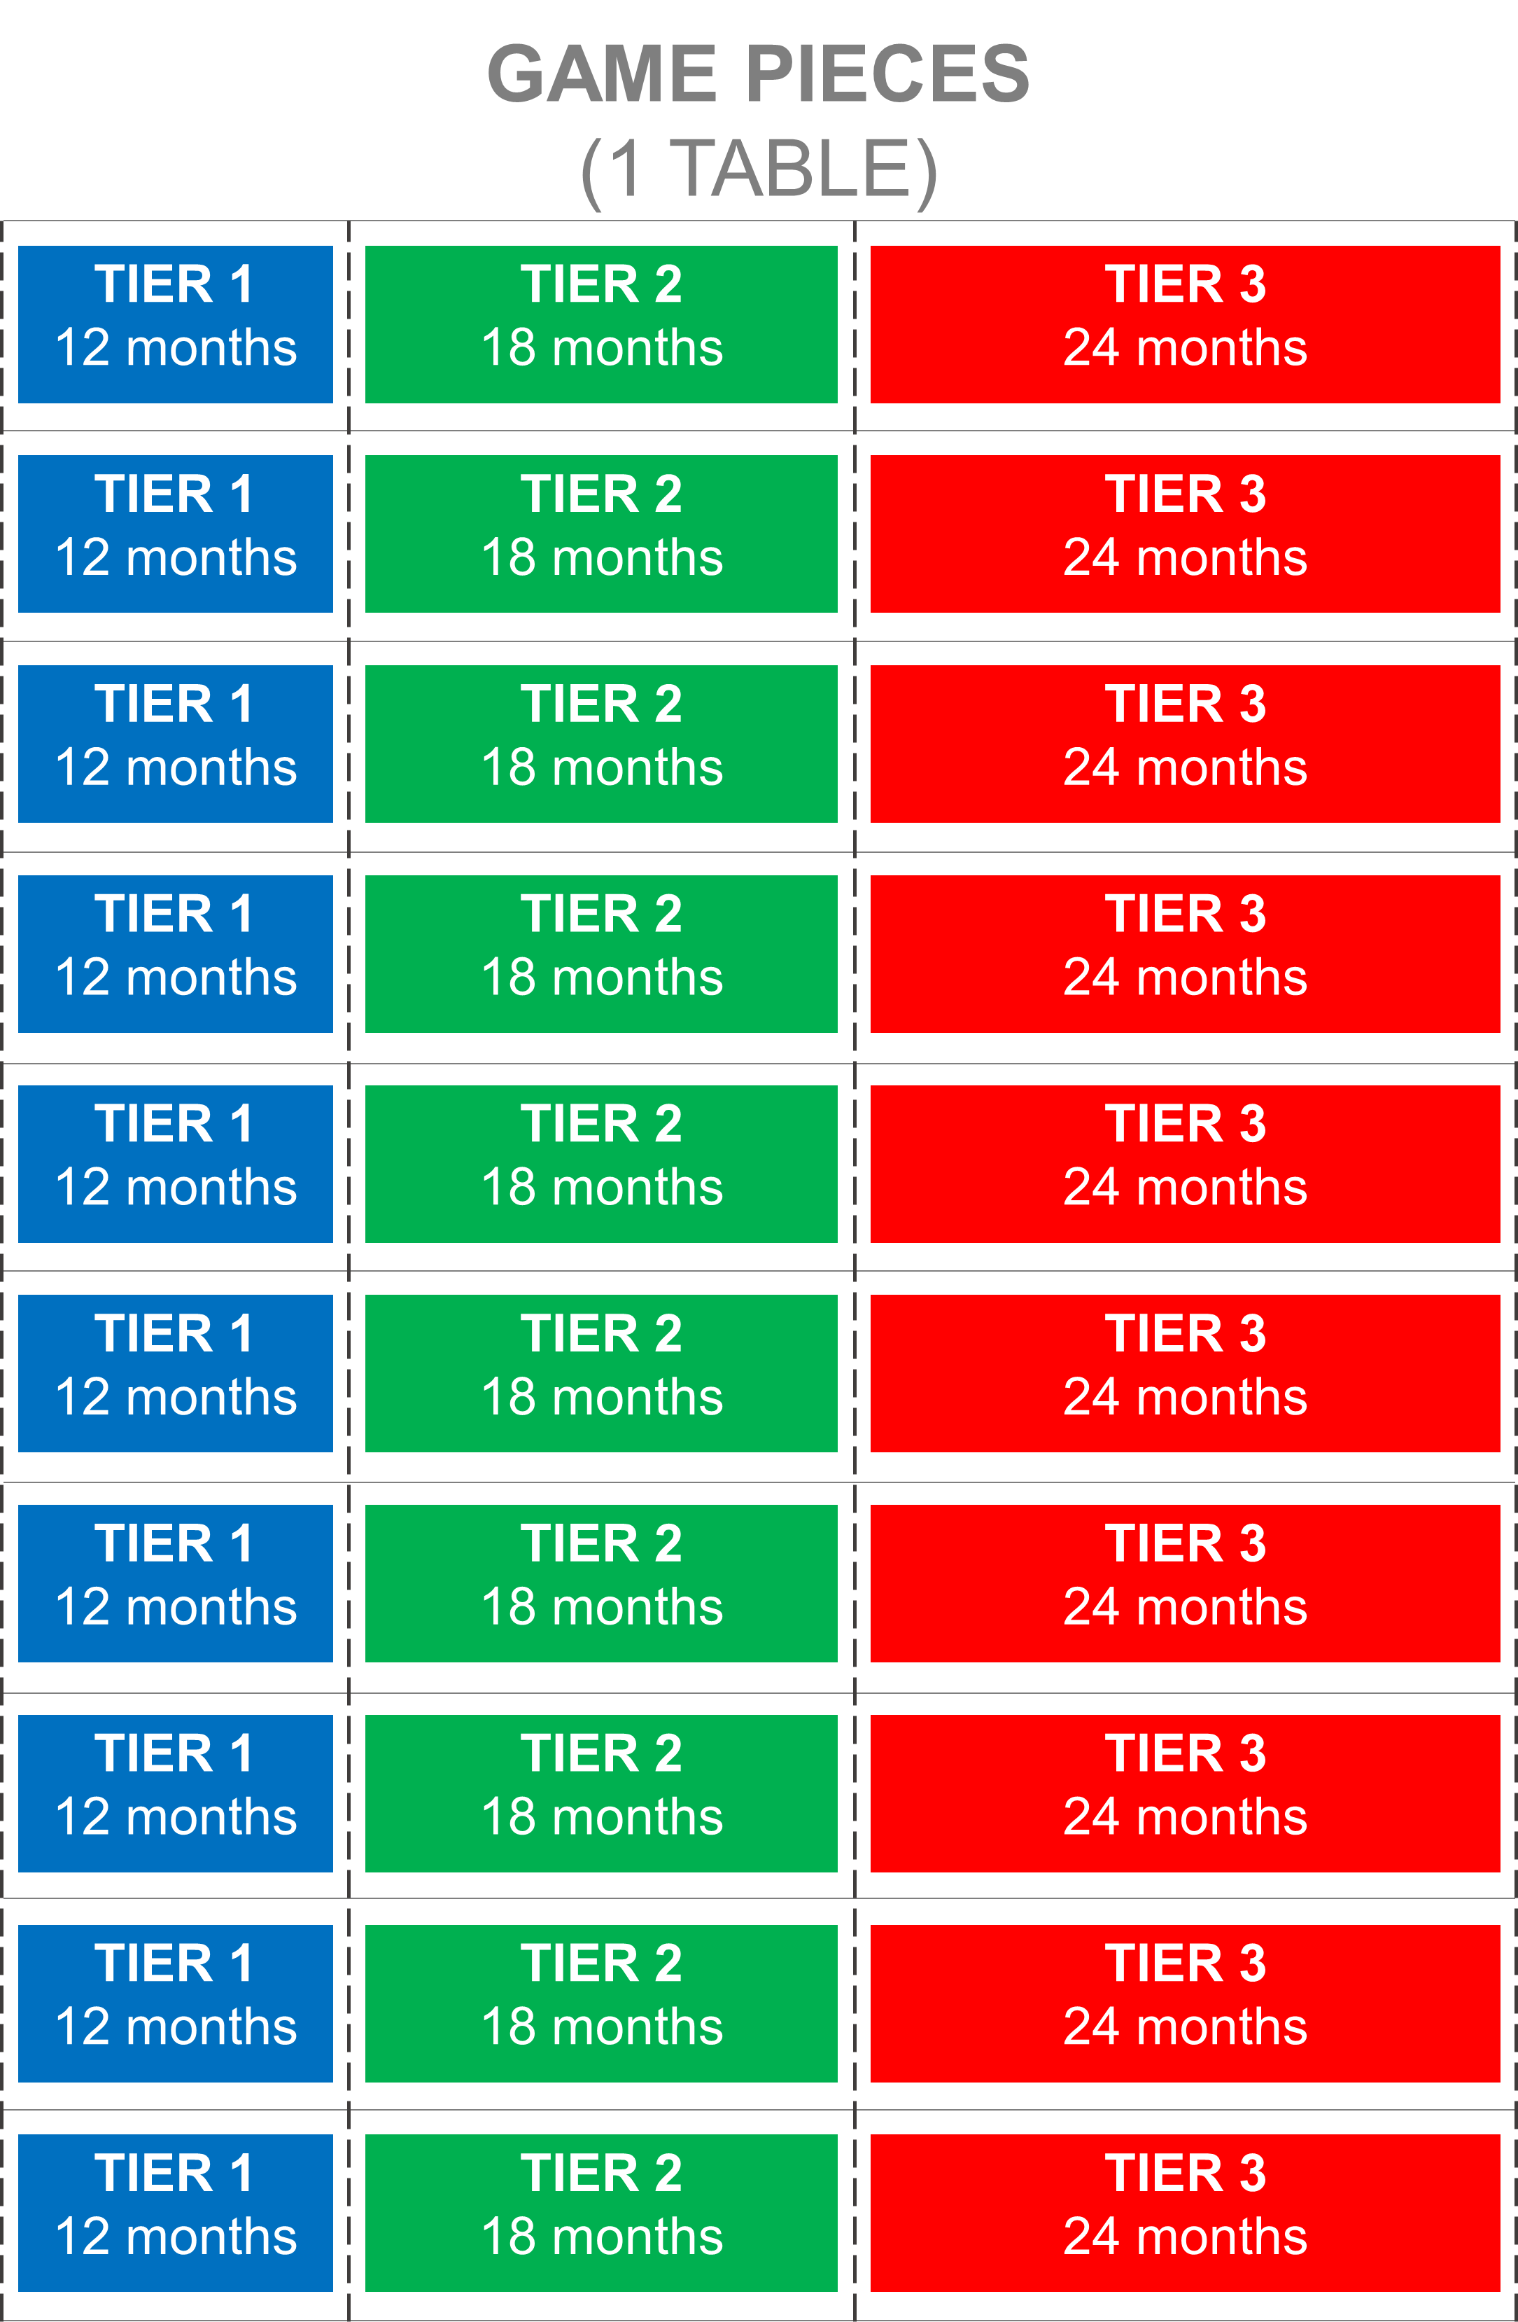
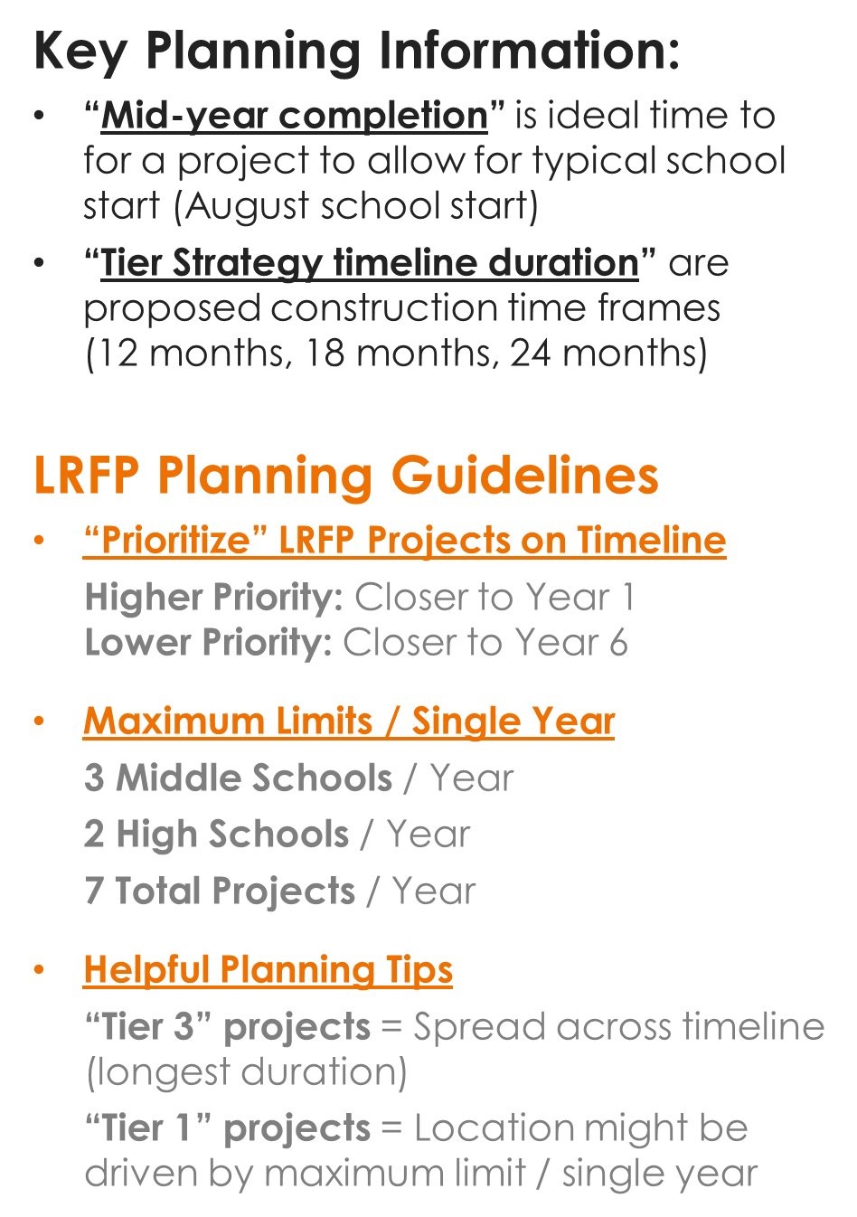
CTE Long Range Facilities Planning| CTE LRFP Meeting#3 – Engagement Activity
“Tools” for the LRFP Table Consensus
CTE Ed Spec Comparison Data
Reference Information
Tier Strategy Gameboard
Agree on Campus Tier
LRFP Timeline Gameboard
Prioritize Project Timing

Slide 19
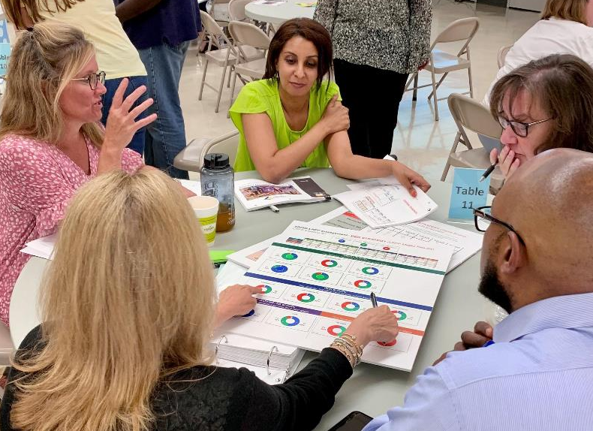
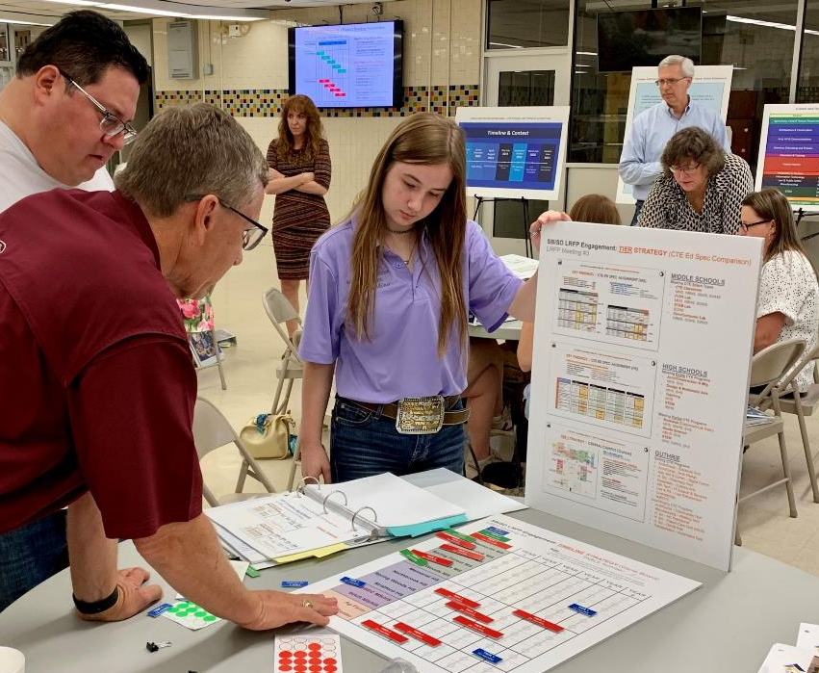
LRFP Mtg#3 Engagement | Consensus: 12 Tables

Slide 20
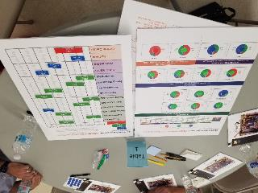
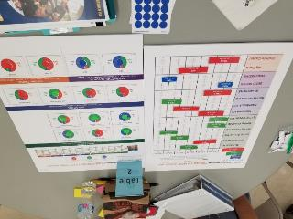
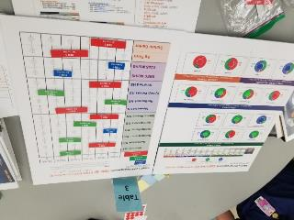
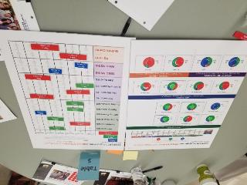
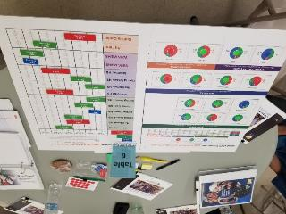
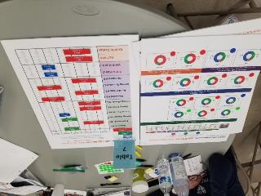
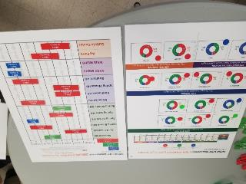
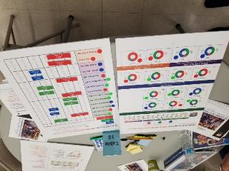
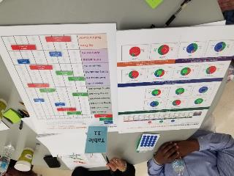
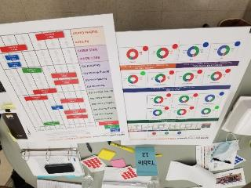
CTE Long Range Facilities Planning| CTE LRFP Meeting#3 – RESULTS
LRFP Committee Mtg #3 RESULTS:
Mtg #3 Engagement Activity….
TABLE Consensus
Table 1
Table 2/4/9
Table 3
Table 5
Table 6
Table 7
Table 8
Table 10
Table 11
Table 12

Slide 21
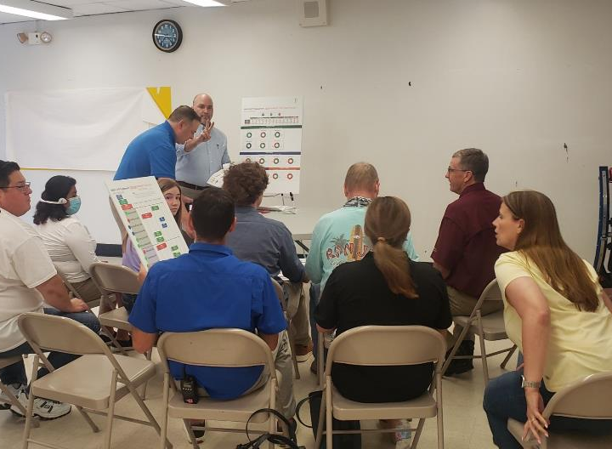
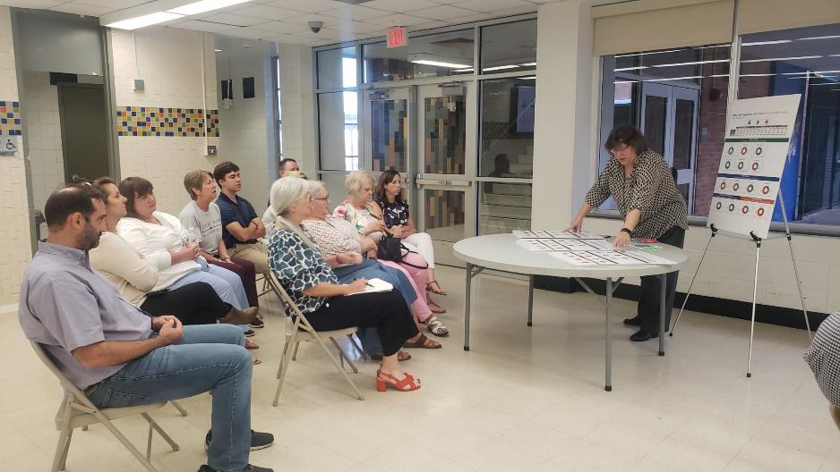
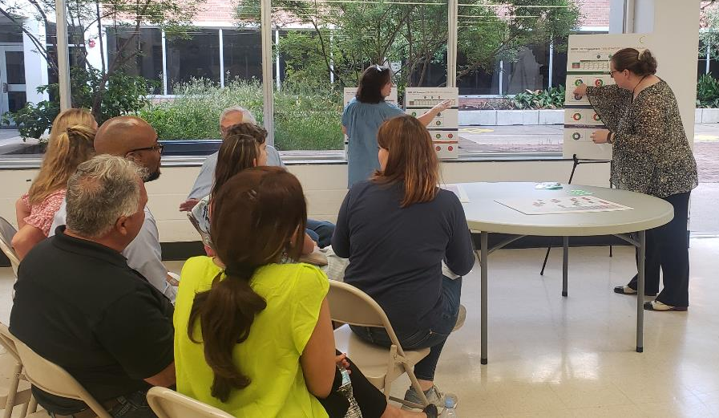
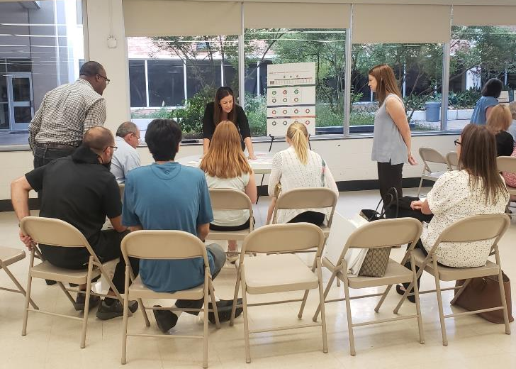
Group D
Group A
Group C
Group B
LRFP Mtg#3 Engagement | Consensus: 4 Groups

Slide 22
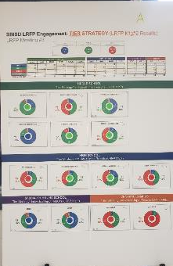
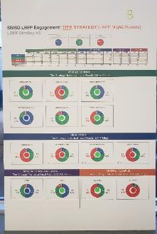
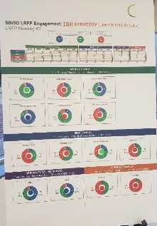
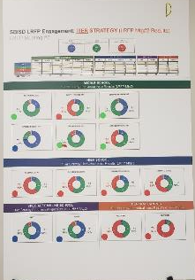
CTE Long Range Facilities Planning| CTE LRFP Meeting#3 – RESULTS
LRFP Committee Mtg #3 RESULTS:
Mtg #3 Engagement Activity….
GROUP Consensus
Group A
Tables 1, 3, 5
Group B
Tables 2, 4/9, 6
Group C
Tables 7, 11
Group D
Tables 8, 10, 12

Slide 23
LRFP Mtg#4 Engagement | Consensus: Committee

Slide 24
Item 2
Consensus
LRFP-C Recommendation: Consensus Based Recommendation

Slide 25
CTE LRFP Committee| Final Recommendation
CTE LRFP Improvement Tier Strategy
Middle Schools
(T2) Memorial
(T3) Northbrook
(T2) Spring Branch
(T1) Spring Forest
(T2) Spring Oaks
(T2) Spring Woods
High Schools
(T3) Memorial
(T3) Northbrook
(T2) Spring Woods
(T3) Stratford
Specialty MS/HS
(T1) SBEC MS/HS
(T1) WAIS MS/HS
Central Campus
(T3) Ag Farm
(T3) Guthrie
TIER 1 “IN PLACE, AS IS” RENOVATE EXISTING CTE SPACES $
TIER 2 “MISSING+IMPROVE ADJACENCIES”
RENOVATE / ADD CTE SPACES
$$
TIER 3 “MEET CTE ED SPECIFICATIONS”
RENOVATE / ADD CTE SPACES $$$$

Slide 26
CTE LRFP Committee| Final Recommendation
MIDDLE SCHOOLS CTE LRFP Timeline
Timeline Development Notes:
Follow Planning Guideline 3 MS/ Year Max Limit 7 Projects/Year Max Limit
3 MS = “Priority” Yr1 Start Northbrook MS Spring Oaks MS Spring Woods MS
2 MS = “Maximize” Yr3 Impact Spring Branch MS Spring Forest MS
1 MS = “Year 4” Memorial MS

Slide 27
CTE LRFP Committee| Final Recommendation
HIGH SCHOOLS CTE LRFP Timeline
Timeline Development Notes:
Follow Planning Guideline 2 MS/ Year Max Limit 7 Projects/Year Max Limit
2 HS = “Maximize” Yr1 Impact Northbrook HS Spring Woods MS
2HS = “Yr3 + Yr4” Start Stratford HS Memorial HS

Slide 28
CTE LRFP Committee| Final Recommendation
SPECIALTY MS/HS + CENTRAL CAMPUS CTE LRFP Timeline
Timeline Development Notes:
Follow Planning Guideline 7 Projects / Year Max Limit
Specialty MS/HS WAIS = Higher priority in all 4 Groups SBEC = Follows based on Consensus
Central Campus Guthrie = Yr1 for all 4 Groups Ag Farm = Follows based on Consensus

Slide 29
CTE LRFP Committee| Final Recommendation
CTE Long Range Facility Plan - Timeline Summary

Slide 30
CTE LRFP Committee| Final Recommendation
CTE Long Range Facility Plan - Tier Strategy Summary
Middle Schools
(T2) Memorial
(T3) Northbrook
(T2) Spring Branch
(T1) Spring Forest
(T2) Spring Oaks
(T2) Spring Woods
High Schools
(T3) Memorial
(T3) Northbrook
(T2) Spring Woods
(T3) Stratford
Specialty MS/HS
(T1) SBEC MS/HS
(T1) WAIS MS/HS
Central Campus
(T3) Ag Farm
(T3) Guthrie
TIER 1 “IN PLACE, AS IS” RENOVATE EXISTING CTE SPACES $
TIER 2 “MISSING+IMPROVE ADJACENCIES”
RENOVATE / ADD CTE SPACES
$$
TIER 3 “MEET CTE ED SPECIFICATIONS”
RENOVATE / ADD CTE SPACES $$$$

Slide 31
CTE LRFP Committee| Final Recommendation
Consensus Achieved!
29 CTE LRFP Members Present at Mtg4
28 Members Voted in Support of LRFP-C Recommendation

Slide 32
CTE LRFP Committee| Informational Cost Data
Order of Magnitude Cost = Current $$ Yr2021
Applying the “Tier Strategy”
Recommended by the
LRFP Committee…
This chart illustrates the associated “Order of Magnitude Cost”
In current $$ Yr2022.
“Future Cost” Data will need to be adjusted to account for escalation at the appropriate time.
THE PROJECT COST DATA IS PROVIDED FOR INFORMATIONAL
PURPOSES ONLY.

Slide 33
THANK YOU!
CTE Long Range Facility Plan
Recommendation
July 19, 2021

