Slide 1
Food Allergy
Information
Albemarle County
Public Schools 2018

Slide 2
How to CARETM for kids with food allergies
From FAAN and safe@schools partners
Comprehend Food Allergy Basics
Avoid the Allergen
Recognize a Reaction
Enact an Emergency Action Plan!

Slide 3
Comprehending Food Allergy Basics
The role of the immune system is to protect the body from germs and disease. A food allergy is an abnormal response by the immune system to a food protein. When the food is eaten, the immune system thinks the food is harmful and releases histamine and other chemicals to “attack” the enemy.

Slide 4
Comprehending Food Allergy Basics Continued
Symptoms can involve the skin, respiratory and cardiovascular systems. One or more symptoms may occur shortly after eating (within minutes to usually 2 hours, rarely 4 hours later).
Anaphylaxis is a serious reaction that is rapid in onset and may cause death. Individuals with food allergy plus asthma are at greatest risk for a life-threatening reaction.

Slide 5
Comprehending Food Allergy Basics Continued
There is no cure for food allergies. Complete and strict avoidance is the only way to prevent a reaction because ingestion of a small amount of an allergen can trigger a reaction.
Once a reaction begins, there is no way to know how severe it will become, therefore take all food allergy reactions seriously.
Epinephrine (adrenaline) administration is key to surviving anaphylaxis. Fatalities result from a delay/failure to give epinephrine (prescribed as Epi-Pen auto-injectors). Antihistamines are not life saving medicines.

Slide 6
Avoiding the Allergen
Read every label every time as formulations can change without warning. The 8 most common allergens (milk, egg, peanut, tree nut, shellfish, fish, wheat, and soy) will be clearly labeled on products except for USDA products. “May contain” statements are voluntary.
Clean to avoid reactions from trace amounts of food protein left behind:
  Liquid soap, bar soap, or commercial wipes for hands not antibacterial gel sanitizers
  Dishwashing detergent and hot water for cooking utensils and cutting boards
  Common household cleaners for counters, tables, and other surfaces. Do not reuse rags, cloths or wipes to clean more than one surface. *

Slide 7
Recognizing a Reaction
Mouth - Itching, tingling, or swelling of lips, tongue, mouth
Nose - Hayfever-like symptoms: runny, itchy nose, sneezing, watery/red eyes
Skin - Hives, itchy rash, swelling of the face or extremities, flushing
Gut - Nausea, abdominal cramps, vomiting, diarrhea
Throat* Hacking cough, tightening of throat, hoarseness, difficulty swallowing
Lung* Shortness of breath, repetitive cough, wheezing
Heart * Thready pulse, low blood pressure, fainting, pale, blueness
*All above symptoms can potentially progress to a life-threatening situation

Slide 8
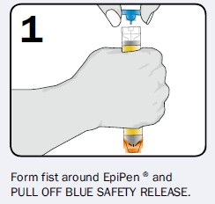
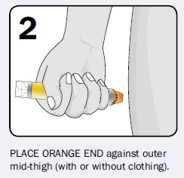
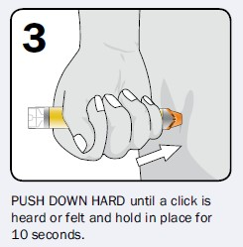
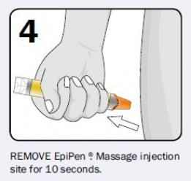
Give Epinephrine !
Call 9-1-1 report anaphylaxis emergency and epinephrine given
Provide care: have student lie down and elevate legs
Monitor closely
May give second dose in 5 to 15 minutes if no improvement or if symptoms return
Give used injector(s) to EMS personnel
Ensure parents have been notified

Slide 9
Enacting Emergency Action Plan!
Accidents are never planned, keys to being prepared:
    Medication must be immediately available at all times
    Know how to recognize symptoms
    Contact school nurse if allergic reaction is suspected
    Administer medication quickly. Call 911 if epinephrine is given and alert the operator that you have an allergic emergency

Slide 10
School’s Epinephrine
The following slides are for administering epinephrine to student believed to be having an anaphylactic reaction for whom epinephrine has not been provided.

Slide 11
Anaphylaxis Algorithm

Slide 12
Standing Order for Epinephrine
Based on symptoms, determine that an anaphylactic reaction appears to be occurring. Act quickly. It is safer to give epinephrine than to delay treatment.
If you are alone and are able to provide epinephrine, call out for help as you immediately go get the epinephrine. Do not take extra time seeking others until you have provided the epinephrine.
If you are alone and do not know how to provide epinephrine, yell for help. If someone is available to help you, have them get the personnel trained to provide epinephrine and the epinephrine while you dial 911 and follow the dispatcher’s instructions. Advise 911 operator that anaphylaxis is suspected and epinephrine is available. Your goal is to get someone (EMS or trained personnel) to provide epinephrine and care as soon as possible

Slide 13
Standing Order Continued
4. Select appropriate epinephrine auto-injector to administer, based on weight:
Dosage:
0.15 mg Epinephrine auto-injector (Jr.) if student is less
than 66 pounds
0.30 mg Epinephrine auto-injector if student is 66 pound
or greater
Frequency: If symptoms continue, a second dose should be administered 5 to 15 minutes after first dose.
5. Inject epinephrine via auto-injector: Pull off safety release cap. Form fist around device. Swing and firmly push orange tip or needle side of device firmly into upper, outer thigh, (through clothing if necessary) until it clicks. Hold in place for 10 seconds to deliver medication and then remove. Massage the area for 10 more seconds. Note the time.
6. Call or have a bystander call 911 immediately or activate the Emergency Medical System (EMS). Advise 911 operator that anaphylaxis is suspected and epinephrine has being given.

Slide 14
Standing Order Continued
7. Keep the individual either lying down or seated. If he/she loses consciousness, check for breathing and pulse. If not, begin CPR (cardiopulmonary resuscitation), call out for help and continue CPR until the individual regains a pulse and is breathing or until EMS arrives and takes over.
8. Call school nurse or front office school personnel and advise of situation.
9. Stay with the individual until EMS arrives, continuing to follow the directions in step #7 above.
10. Provide EMS with Epinephrine auto injector labeled with name, date, and time administered to transport to the Emergency Department with the student.

