Slide 1


MEDICARE
101
Sponsored by UCare Medicare Group

Slide 2

ABC&D
the
of Medicare

Slide 3
  Original Medicare has Two Parts
Part A
hospital coverage
Inpatient hospital stays,
skilled nursing,
hospice care
Part B
medical coverage
Doctor visits, tests,
lab work, X-rays, outpatient procedures, chemotherapy,
medical equipment

Slide 4
Part C and Part D – Private Coverage
Part C
Medicare Advantage plans
Part D
outpatient prescription drug coverage

Slide 5
Medicare Part A ‒ Hospital insurance
Most people do not pay a premium
Services (copays, deductibles and coinsurance apply):
  Hospitalization: $1,484 for first 60 days
    $371/day for days 61–90
    $742/day for days 91–150
    (lifetime reserve days)
  Skilled nursing facility care: Days 1–20 paid in full
    $185.50/day for days 21–100
  Home health care
  Hospice care

Slide 6
Medicare Part B ‒ Medical insurance
Premium for 2021: $148.50 per month for most beneficiaries
  You will pay more if your income is more than $88,000
  as a single person or $176,000 as a couple
Services ($203 annual deductible and 20% coinsurance apply):
  Physician services (including office visits, surgery and consultation)
  Outpatient surgeries and procedures (including therapies)
  Ambulance
  Durable medical equipment (DME)
  Part B drugs

Slide 7

Not covered by Original Medicare
Preventive dental and most other
dental services
Routine eye exams and eyeglasses
Routine hearing exams and hearing aids
Routine physical exams
Fitness club memberships
Skilled nursing facility care without
a three-day qualifying stay
Outpatient prescription drugs
Care received when traveling
outside the United States

Slide 8
Medicare Part C - Medicare Advantage Plans
Health plans that contract with Medicare to
administer Medicare Part A and Part B benefits
Plans must provide all Medicare Part A
and Part B covered benefits
Most offer additional coverage that
may include:
  Medicare Part D
  Vision
  Dental
  Fitness
Part C
Part A
Part B
Part D

Slide 9
Medicare Part D - Prescription Drug Coverage
You can enroll if you have Medicare Part A or Part B
Enrollment is voluntary
Medicare penalty for late enrollment
  A penalty would not be applied if you:
    Qualify for Extra Help for Part D
    Maintained other creditable drug coverage with an Employer Plan
    Maintained other creditable coverage with the VA

Slide 10
Medicare Part D plans
Offered by private companies that contract with Medicare
  Medicare Advantage plans with Part D (MA-PDs)
  Stand-alone prescription drug plans (PDPs)
Monthly premiums vary by plan
Deductible, copays and formulary differ among plans
Extra Help for Medicare Part D is a program to help people with limited income and resources

Slide 11
Standard Medicare Part D benefit
Initial coverage stage
Deductible: $445
25% coinsurance until $4,130 in annual prescription drug costs reached (Your cost plus plan’s cost)
Coverage Gap
stage
25% on generics
(Your plan pays 75%)
25% of the cost of brand-name drugs (Drug manufacturer discounts 70% of brand-name drugs, and your plan pays 5%)
Catastrophic coverage stage
If your annual out-of-pocket costs reach $6,550, you pay the greater of:
$3.70 copay or
5% coinsurance
on generics
$9.20 copay or
5% coinsurance on brand-name drugs

Slide 12
Eligibility and Enrollment

Slide 13
Eligibility for Medicare
If you or your spouse worked more than 10 years
(40 Social Security credits), you are eligible for Medicare starting the first day of the month of your 65th birthday.
Exceptions
If your birthday falls on the first day of the month, your Medicare starts on the first day of the previous month
It may start before age 65 in certain circumstances

Slide 14
Enrolling in Medicare at age 65
Already drawing Social Security benefits, you will automatically receive your Medicare card approximately three months before your birthday month.
  If you want Part A and B to start, do nothing
  If you want to waive Part B, return the card
Not yet drawing Social Security benefits and you want Medicare to start at age 65, you must enroll in Part A and Part B through Social Security.
  You can enroll up to 3 months before your birthday:
    Online at ssa.gov
    By phone at 1-800-772-1213
    Via mail

Slide 15
Delaying Medicare Enrollment
You can delay your Part A or Part B beyond age 65 if:
You or your spouse are actively employed
You or your spouse have employer group coverage
You are not collecting Social Security (SS)
Note:
If you or your spouse plan to work for three or fewer months beyond age 65, work closely with SS to ensure that your Part B can take effect on the desired date
If you are contributing to an HSA, be sure to talk with your financial consultant before enrolling in Medicare and retiring as all contributions must cease when you have Part A

Slide 16
When your employer coverage ends
Notify Social Security – up to 3 months before
Your Medicare Part A will start six months prior to the
date of notification
You may enroll in Medicare Part B to start any future month without penalty*
  You need to complete an Application for Enrollment in Medicare Part B
  Have the employer complete a Request for Employment Information form
* Note You have an eight-month window to apply for Part B without penalty. However, you only have a two-month window to enroll in a Part D plan without penalty.

Slide 17
Health plan options and how to compare

Slide 18
Medicare Health plan options
Original Medicare covers about 50% of your
overall health care costs
To help cover the remaining costs, you can
enroll in a:
  Medigap/Medicare Supplement plan
  Private Medicare health plan
If you are a veteran:
Contact the local Veteran Service Office
to determine eligibility for benefits
The VA cannot bill Medicare for services
Part A
Hospital Insurance
Coverage Gaps
Part B Medical Insurance

Slide 19
Medigap or Medicare Supplement Plans
  Medicare supplements
    Help pay for costs of Medicare-covered services (coinsurance, copayments and deductibles)
  Medicare Select plans
    You must use health care providers within the plan’s network to be eligible for full benefits, except in an emergency

Slide 20
Medigap/Medicare Supplement features
Pay after Medicare and only pay on Medicare-approved services
Billing statements/paperwork sent from Medicare and from the supplement plan
Sold by private insurance companies
Medicare Part D coverage not included, must purchase separately for an additional premium
Different premiums for rural versus urban, smoker versus non-smoker
Health screening if enrolling after first six months on Medicare Part B
Regulated by the MN Department of Commerce (not Medicare)

Slide 21
Private Medicare plans
Medicare Advantage:
  Coordinated Care Plans
  Private Fee-for-Service (PFFS) Plans
Medicare Cost:
  Available in a few outstate Minnesota counties

Slide 22
MA Plans - Coordinated Care Plans
Health Maintenance Organization (HMO)
  You must use the plan’s network of providers, except in an emergency
Health Maintenance Organization with Point-of-Service (HMO-POS)
  Use a provider network
  Out-of-network coverage for emergency coverage and certain non-emergency care
  Example: UCare Medicare plans
Preferred Provider Organization (PPO)
  Use a provider network
  You are allowed to see any doctor or provider that accepts Medicare (usually at a higher cost)
  Example: EssentiaCare

Slide 23
MA Plans-Private Fee-for-Service Plans
Commonly known as PFFS
Use a provider network
You are allowed to see any doctor or provider that agrees to accept the PFFS plan fee allowance and will bill the plan for the service received
Providers can decide at each appointment whether they will accept the plan’s terms

Slide 24
Most Medicare Advantage plans:
Cannot health screen
Do not require physical exam to enroll
Cover emergency care in-and out-of-network, worldwide
Include an Annual out-of-pocket maximum on Part A and Part B services
Do not have a lifetime coverage limit

Slide 25
Advantages of Medicare Advantage Plans
Provide “all-in-one” coverage
Offer many affordable choices to meet your needs that include Medicare Part D for no additional premium
May have Free basic memberships at health clubs
May have dental coverage
May waive the 3-day qualifying hospital stay for skilled
nursing benefits
May cover an annual routine physical exam, eye exam
and hearing test
May have a large network of providers and do not require referrals
May include national coverage for some services at in-network cost

Slide 26
When can I enroll, change or leave Medicare health plans?

Slide 27
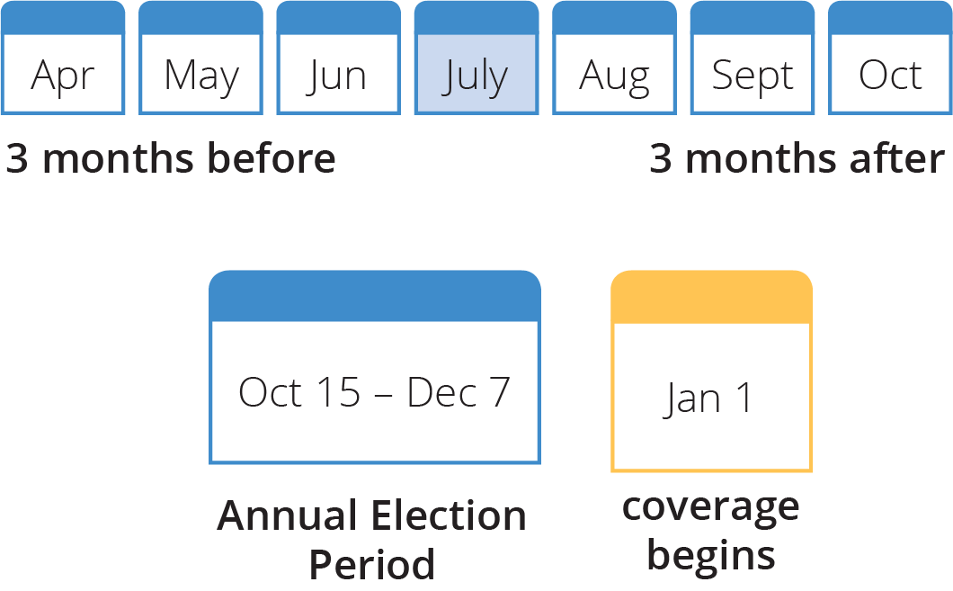
  When can I enroll?
Initial Coverage Election Period (ICEP)
If you are new to both Medicare Part A and Part B, you may enroll during the three months before, month of, and the three months after you are eligible for Medicare.
Example
Birthday is July 4
If you have Part A already, and are applying for Part B, the ICEP is limited to the three months prior to your enrollment in Part B

Slide 28
  When can I make changes to my Medicare coverage?
Annual Election Period (AEP)
From October 15 to December 7 for a January 1 effective date.
Employer Groups may have different enrollment periods.
Medicare Advantage Open Enrollment Period
January 1st thru March 31st
Those enrolled will be able to make one change to their coverage, to a different Medicare Advantage Plan or go back to Original Medicare.

Slide 29
  When else can I make changes to my Medicare coverage?
Special Election Periods (SEPs)
Exceptions that allow you to make changes during the year, including if you are:
Leaving an employer group health plan
Receiving Extra Help for Part D or losing eligibility for this program
Moving permanently to a new location, and a MA or Part D plan is available in your new area
Enrolled in a plan terminating its contract with Medicare
  Note: Enrollment time limits vary between SEPs

Slide 30

Good news for when you retire!
Rosemount-Apple Valley Schools offers a UCare Medicare Group plan:
Available to Medicare-eligible retirees and spouses
______________________________________________
Contact Group Sales to learn more
612-676-6900 Groupsales@ucare.org Toll free 877-598-6574

Slide 31
Thank you for attending!
If you have additional questions, please feel free to contact us at:
612-676-6900 or
1-877-598-6574 toll free
8 a.m. to 5 p.m. daily
GroupSales@UCare.org
If you have a hearing impairment,
call TTY 711 toll free

