Slide 1
UCare Medicare Group
For District 196 Retirees and Spouses

Slide 2
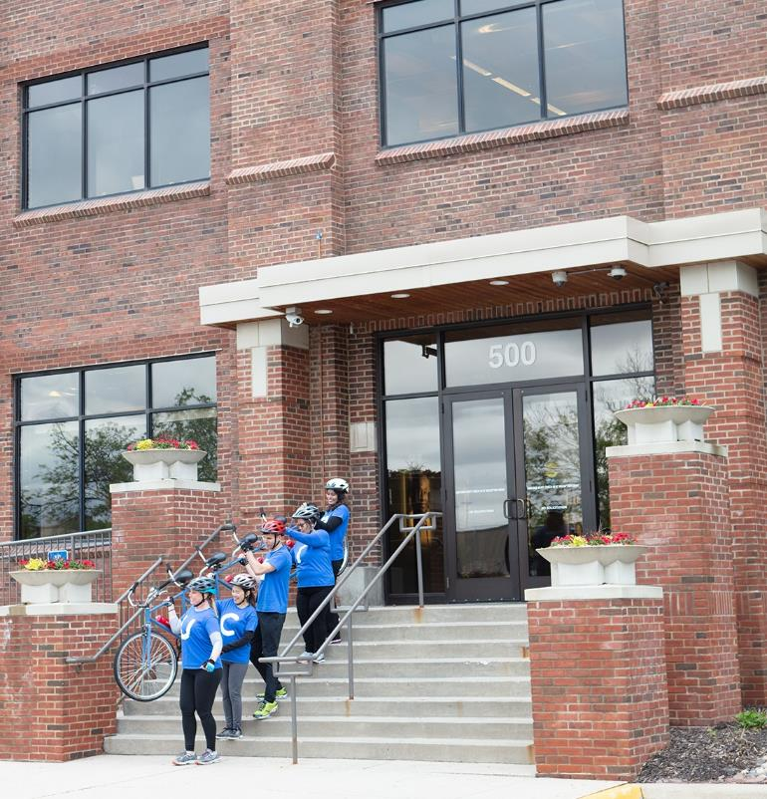
People Powered Health Plans
Our people powered teams are real
UCare employees helping communities across Minnesota
350 community relation events/fairs/expos
20 UCare Healthmobile free screenings
12 UCare Mobile Dental Clinic sites
60+ UCare Group Medicare Meetings and Employee Benefit Fairs
We go the extra mile (sometimes in our
five-seat bicycle) to simplify health coverage, advocate for members and respond to
their needs

Slide 3

Our members speak for themselves
100K
96%
20+
People on Medicare trust us to provide health care coverage
Of our Medicare members stay with us year after year
Years we’ve been offering Medicare Advantage plans
UCare was the first to offer Medicare Advantage Plans in Minnesota

Slide 4
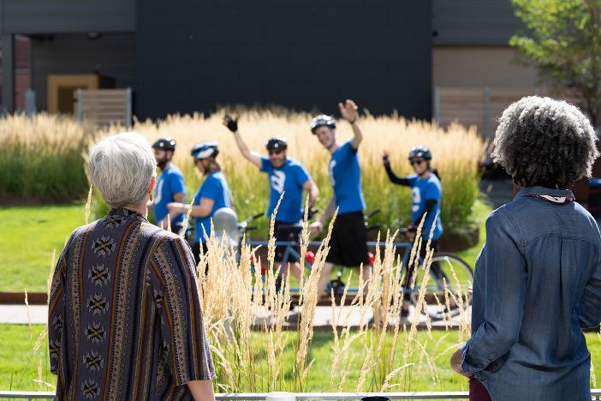
Advantages of UCare Medicare Plans
Network
We have a large statewide network including Mayo Clinic
Choice
Three plan option to fit your needs and
your budget
Customer Service
We are local — just call to talk with us
Convenience
Medical and Medicare Part D all in one plan
Lots of extras
Over-the-counter allowance, dental, vision
and hearing benefits and fitness programs

Slide 5
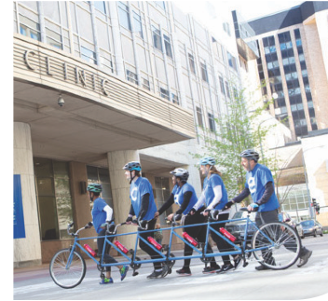
96% of all MN providers in network
Allina Health
CentraCare
Entira Family Clinics
Essentia Health
M Health Fairview
Mayo Clinic
North Memorial Health
Park Nicollet
Sanford Health
St. Luke’s
Stillwater Medical Group
University of Minnesota
Voyage Healthcare
Winona Health
and many more with no referrals needed

Slide 6
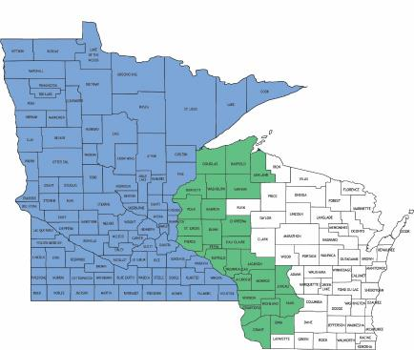
Who can join UCare Group Medicare?
Retirees and their spouses who:
  Have Medicare Part A and Part B
  Continue to pay Part B premium
  Live in Minnesota or within 26
  counties in Wisconsin

Slide 7
UCare Medicare Group Premium Rates
High
$350
Core
$177
Basic
$79
Rates are per member, per month
through 12/31/21

Slide 8
UCare Medicare Group Plans Include
Preventive Services– $0 copay
  Annual Physical, Routine Tests
Preventive Dental – 100% coverage
  3 cleanings, 2 exams, annual bitewing X-rays
Prescription Drug coverage – Medicare Part D
Medical Out-of-Pocket Maximum – $3400

Slide 9

Primary Doctor Visits
Choose a Primary Care Clinic
  Keep your doctor, your clinic
  Find in Primary Care Clinic Listing
  Change clinic anytime
  Just a home base
  Primary Office Visit
  $15 copay on all plans
Notes:
Almost every primary care clinic is in our network! Your chosen clinic is just a home base – your doctor does not have to approve, refer, or sign off on anything for you to see whoever you want. Yes, ALMOST every primary care clinic, the few primary care clinics of HealthPartners are not within our network, but the specialty and urgent care HealthPartners clinics are. For those that use the internet, it’s best to click Find a Doctor on UCVare.org to search for your doctor in the network. Choose UCare for Seniors as your plan.

Slide 10

Specialist Doctor Visits
See any Specialist
  No referral needed
  Simply make an appointment
  Use Find a Doctor tool
  Specialist Office Visit
  High - $15 copay
Core - $30 copay
  Basic - $40 copay

Slide 11

Inpatient Hospital
Covered at 100% after copay
  High – $100 copay per admission
  Core – $125 copay per admission
  Basic – $400 copay per admission
We coordinate with all providers,
no paperwork

Slide 12

Outpatient Services and Skilled Nursing
Skilled Nursing Facility Care
  No three-day in-patient hospital stay requirement
  $0 for days 1 through 20
  $100 per day for days 21 through 100
Outpatient Services
  High – $200 copay
  Core – $250 copay
  Basic – $250 copay

Slide 13


YES! Coverage when you travel
UCare AnywhereSM travels with you in the U.S.
Some services with same copays as in network
Coverage for other non-ER services
Emergency coverage worldwide
Travel out of area up to 6 consecutive months
No need to notify us of your coming and goings

Slide 14


Are my prescription drugs covered?
Find your drugs
Search online
See list of covered drugs
4 tiers of coverage
Shingrix moved to Tier 1
-must be done at pharmacy to be covered
Fill your prescriptions
60,000 pharmacies:
Preferred and Mail Order
You can get a 90 day supply for 2 copays.
Standard
Access to an additional 42,000 local and nationwide chain pharmacies, including Fairview Pharmacies

Slide 15
Initial Coverage Stage
From $0 to $4,130 in annual prescription drug costs | High | Core | Basic
Annual deductible Tier 1 – Generic Tier 2 – Preferred Brand Tier 3 – Non-Preferred Tier 4 – Specialty Drugs | none $10 copay $30 copay $60 copay $60 copay | $200* $12 copay $45 copay $100 copay 25% coinsurance | $400* $12 copay $45 copay $100 copay 25% coinsurance
*Tier 1 Generic drugs are not subject to meeting the deductible

Slide 16
Coverage Gap Stage – Donut Hole
Once you have reached $4,130 in annual prescription drug costs | High | Core | Basic
 | This plan has Gap Coverage Continue to pay copays as usual | Continue to pay Tier 1 copays as usual You pay 25% of the cost of brand name drugs | You pay 25% of the cost of generic drugs You pay 25% of the cost of brand name drugs
Once you reach $6,550 in out of pocket costs: Catastrophic Coverage
You pay a low copay or 5% coinsurance, whichever is greater

Slide 17


Additional Benefits – Vision and Hearing
  Routine Vision exam – $0 copay
  Diagnostic exam - $0 to $40 copay
  $150 eyewear reimbursement
  each calendar year
  Routine Hearing exam – $0 copay
  Diagnostic exam - $0 to $40 copay
  Two TruHearing hearing aids per year:
  $599/$699 for Advanced Hearing Aid
  $899/$999 for Premium Hearing Aid

Slide 18
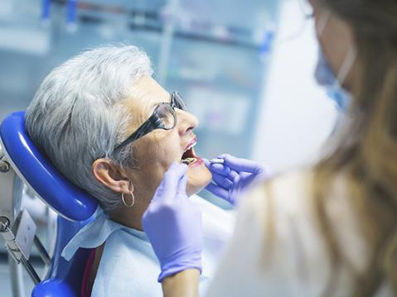

Additional Dental Benefits
Preventive dental included
  3 cleanings, 2 exams, and x-rays
Additional dental coverage for
$25 per month
  Coverage for fillings, crowns, implants
  $50 deductible
  $2500 annual maximum

Slide 19


Fitness Benefits
  SilverSneakers®
  Free basic fitness membership at
  more than 16,000 locations nationwide
  SilverSneakers FLEXTM fitness classes
  At-home fitness kit options for stress
  relief, strength, walking, and yoga
Health Club Savings
Health club not in Silver Sneakers?
$20 reimbursement of your club fees each month
Check for participating health clubs
  .
Notes:
SilverSneakers Fitness Program
Use at any nearby participating location, and even when traveling.
Includes:
• A free basic fitness membership at more than 16,000 locations in the SilverSneakers network
• Online support
• SilverSneakers FLEXTM fitness classes
• At-home fitness kit options for stress relief, strength, walking, and yoga
Health Club Savings
Join a class, work with weights, swim some laps, or try something new. Health Club Savings offers the variety you want and the flexibility you deserve. If you belong to a participating health club that is not in the SilverSneakers network, you can receive a reimbursement of up to $20 in your monthly health club membership fees.

Slide 20
More Additional Benefits
  Over-the-Counter Benefit
  $50 bi-annually toward over the counter items.
  Purchase online or at Walmart or CVS
  Use or lose within 1/1- 6/30 and 7/1- 12/31 window
  Minnesota Community Education Discount
  Get up to a $15 discount on most Minnesota community education classes, like fitness, cooking or learning new language.
  3 discounted classes each year.
Notes:
SilverSneakers Fitness Program
Use at any nearby participating location, and even when traveling.
Includes:
• A free basic fitness membership at more than 16,000 locations in the SilverSneakers network
• Online support
• SilverSneakers FLEXTM fitness classes
• At-home fitness kit options for stress relief, strength, walking, and yoga
Health Club Savings
Join a class, work with weights, swim some laps, or try something new. Health Club Savings offers the variety you want and the flexibility you deserve. If you belong to a participating health club that is not in the SilverSneakers network, you can receive a reimbursement of up to $20 in your monthly health club membership fees.

Slide 21
How to join UCare Medicare Group
Retirees and Spouses
  May enroll when Medicare-eligible and retired
  Each fills out and application and plan choice form
Enrollment Folders
  Includes 2 applications and 2 plan choice forms
  Mail forms in the green envelope provided
Contact Us to Have Enrollment Folder sent to you.
612-676-6900
Toll Free 877-598-674
groupsales@ucare.org

Slide 22
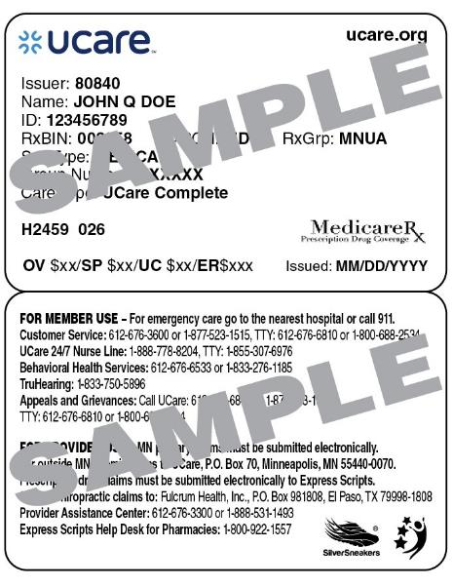
Welcome to UCare!
Confirmation of enrollment
Member ID card
Customer Service
UCare 24/7 Nurse Line
Disease Management
Programs
Member Portal at UCare.org

Slide 23
Questions about UCare Medicare Group
Contact us:
Amy Sundem – Group Sales Representative
Debbie Holt – Group Sales Manager
  Phone: 612-676-6900
  Toll Free: 1-877-598-6574
  Email: groupsales@ucare.org

Slide 24


THANK
YOU
Happy Retirement!
www.ucare.org

