Slide 1
3R Initiative
An Update on the Ongoing Efforts to Meet the Objectives of the 3R Initiative

Slide 2
Some Background: State Diversity Requirements
The State of Connecticut requires each school within a district to be “diverse” relative to its population. The state uses a formula based on the total percentage of non-white students in the district. Every school must be within 25% of the district average.
In Hamden, compliance with the above state diversity requirement is only a concern at the elementary level, since we have multiple elementary schools. All students in grades 7-12 attend school together in the same school (either HMS or HHS).
Notification from the State of CT
Since 2010, Hamden has been notified several times that one or more of our schools are in imbalance or pending imbalance (within 1% of being imbalanced).

Slide 3
Enrollment by School - Then and Now
June 2019 and April 2021 (Note: 2020-21 “COVID Enrollment”)
2019 / 2021 | Total Students | White Students | Non-White Students | % Non-White Students
Alice Peck * | 184 / 166 | 56 / 20 | 128 / 146 | 70% / 88%
Bear Path * | 445 / 407 | 240 / 192 | 205 / 215 | 46% / 53%
Church St. * | 310 / 263 | 32 / 24 | 278 / 239 | 90% / 91%
Dunbar Hill * | 298 / 285 | 66 / 60 | 232 / 225 | 78% / 79%
Helen St. * | 328 / 334 | 40 / 60 | 288 / 282 | 88% / 84%
Ridge Hill * | 327 / 313 | 88 / 98 | 239 / 215 | 73% / 69%
Sh. Glen | 302 / 322 | 58 / 63 | 244 / 259 | 81% / 80%
Spring Glen | 442 / 401 | 277 /251 | 165 / 150 | 37% / 37%
West Woods* | 357 / 331 | 182 / 135 | 175 / 196 | 49% / 59%
HMS | 915 / 858 | 322 / 260 | 593 / 598 | 65% / 70%
HHS | 1464 / 1630 | 524 / 529 | 940 / 1101 | 64% / 68%
HCLC | 52 / 67 | 15 / 16 | 37 / 51 | 71% / 76%
District | 5424 / 5377 | 1900 / 1708 | 3524 / 3677 | 65% / 68%
Numbers include pre-K students at Church Street, Dunbar Hill, Helen Street and Alice Peck
* Includes IIC Classrooms
(IIC classes are self-contained Special Education classrooms that are assigned based on need, not attendance zone.)
1

Slide 4
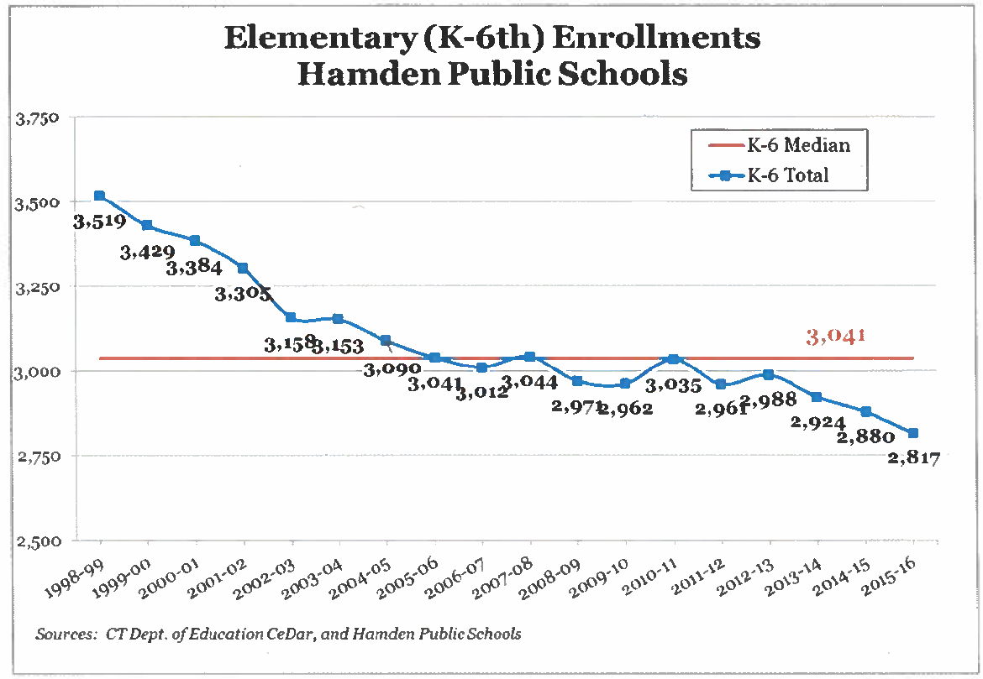
Background on Enrollment

Slide 5
Update on Enrollment

Slide 6
Financial Historical Data

Slide 7
Hamden’s Economic Layout*
*As measured by percentage of Free and Reduced Lunch Students, 2019-20
Cheshire
20%
West Woods
25%
68%
Bear Path
Shepherd Glen
52%
26%
Dunbar Hill
Spring Glen
Note that the distribution of wealth in Hamden is clearly divided North/South, with sections nearest New Haven being the most economically disadvantaged
Church Street
82%
75%
Helen Street
Ridge Hill
New Haven
65%

Slide 8
Some Background: Construction Costs

Slide 9
Hamden’s Past Efforts to Comply with CT’s Diversity Formula when in “Imbalance”
2011-12 School Year: Targeted shifting borders of attendance zones at West Woods and Bear Path to come into compliance with state regulations on diversity
2013-14 School Year: Targeted shifting borders of attendance zones at Church Street and Helen Street to come into compliance with state regulations on diversity
2015-2016: Decision to “Renovate as New” Shepherd Glen and make the building into a centrally located magnet school. This was the district’s first strategy provide open seats to students from other schools and draw from a diverse student population from throughout the district.

Slide 10
More Comprehensive Approach to Achieving Balanced Elementary Schools in Hamden
Starting in 2017, rather than addressing an “imbalance” issue by solely targeting the shifting of attendance zone borders, the Board of Education pursued a more strategic/comprehensive approach to addressing needs across the district.
The district examined/is examining options (Scenarios) for new attendance zones that not only meet state guidelines but also our own benchmarks for diversity.
Through multiple public sessions and electronic information gathering, we have learned that families:
Want their schools to be diverse
Love their neighborhood schools, teachers, principals and staff
Want the least number of transitions for their children as possible
Don’t want changes to impact one part of our community more than others
Think we should make every effort to minimize the number of children who are moved to new attendance zones/schools
The Board of Education is working to define diversity and broaden the state’s definition, and use that as a basis for decision making.

Slide 11
School closure options help with financial sustainability, but no scenario addresses even half of the projected SY21-22 budget gap.
Summary of Scenarios
draft
Status Quo
 |  |  | 18-19 | 19-20 | 20-21 | 21-22 | 22-23
LEA Revenue: |  |  | $ 87,600,000 | $ 86,912,715 | $ 86,832,062 | $ 86,932,035 | $ 87,017,550
LEA Expenditures: |  |  | $ 87,600,000 | $ 90,926,362 | $ 92,638,322 | $ 94,329,211 | $ 95,814,072
(Gap) / Surplus: |  |  | $ - | $ (4,013,647) | $ (5,806,259) | $ (7,397,176) | $ (8,796,522)
Scenario 8 – Incorporate Wintergreen, 6th Grade to HMS, Close Church St and Dunbar Hill
LEA Revenue: |  |  | $ 87,600,000 | $ 87,985,115 | $ 88,201,611 | $ 88,336,255 | $ 88,439,217
LEA Expenditures: |  |  | $ 87,600,000 | $ 91,186,772 | $ 90,815,232 | $ 92,567,227 | $ 94,181,694
(Gap) / Surplus: |  |  | $ - | $ (3,371,405) | $ (2,608,404) | $ (4,225,657) | $ (5,738,006)
Scenario 9 – Incorporate Wintergreen, 6th Grade to HMS, Close Church St. and Shepherd Glen
LEA Revenue: |  |  | $ 87,600,000 | $ 87,985,115 | $ 88,201,611 | $ 88,336,255 | $ 88,439,217
LEA Expenditures: |  |  | $ 87,600,000 | $ 91,339,644 | $ 90,879,302 | $ 92,520,778 | $ 93,901,836
(Gap) / Surplus: |  |  | $ - | $ (3,354,529) | $ (2,677,692) | $ (4,184,524) | $ (5,462,619)
Scenario 10 – Incorporate Wintergreen, 6th Grade to HMS, Close Helen St and Dunbar Hill
LEA Revenue: |  |  | $ 87,600,000 | $ 87,985,115 | $ 88,201,611 | $ 88,336,255 | $ 88,439,217
LEA Expenditures: |  |  | $ 87,600,000 | $ 91,147,687 | $ 90,882,090 | $ 92,474,386 | $ 94,338,390
(Gap) / Surplus: |  |  | $ - | $ (3,162,572) | $ (2,680,479) | $ (4,138,132) | $ (5,899,174)
Note: All dollar values shown in nominal dollars, i.e. these are the expected numbers for each year’s budget in the dollars of that year

Slide 12
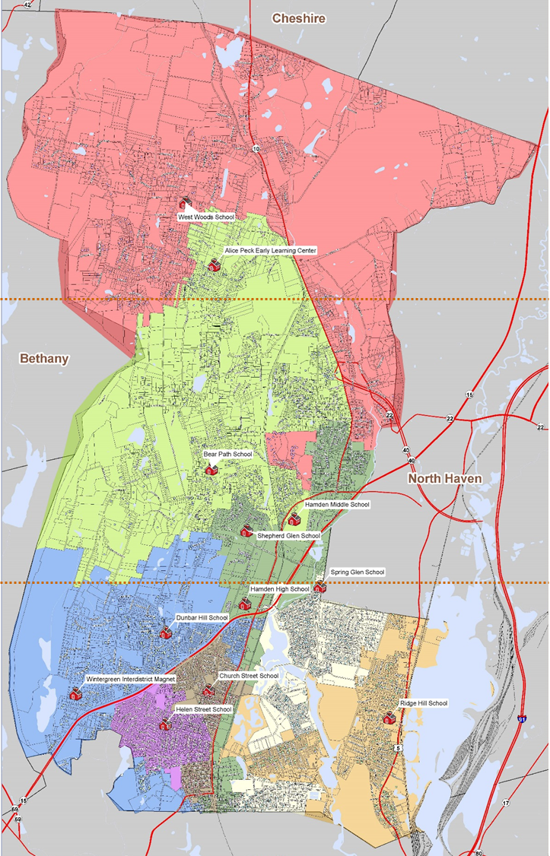
Geographical School Building Distribution
Two schools in Northern third
West Woods
Alice Peck
Two schools in Central third
Bear Path
Shepherd Glen
Six schools in Southern third
Dunbar Hill
Church Street
Wintergreen
Helen Street
Ridge Hill
Spring Glen
Notes:
Note HHS and HMS are near – above / below the lower third line and are not counted in the 10 ES.
This map is good visual reference of the locations of three sets of schools in roughly 11 square mile sections. The obvious concentration of the six schools in the southern third is the result of the population concentration (density) and neighborhood schools, built in the 1950s, 60s, and 70s.
Today we see an opportunity to consolidate here, see board goal # 2.

Slide 13
These 3 new scenarios achieve many of the key goals and priorities for Hamden’s future.
Scenarios 8, 9 and 10 & Goals
 | School Closures and Construction | Incorporate Wintergreen | Move 6th Grade to HMS | Goal #1: Financially Stable | Goal #2: School Diversity | Goal #3: Minimized student movement
8 | Close Church St. and Dunbar Hill | ☑ | ☑ | Somewhat |  | 822 students moving
9 | Close Church St. and Shepherd Glen | ☑ | ☑ | Somewhat |  | 932 students moving
10 | Close Helen St. and Dunbar Hill | ☑ | ☑ | Somewhat |  | 922 students moving
Scenario
Transportation cost increases have also been considered:
Scenario 8 – 1 additional bus ($50,000)
Scenario 9 – 4 additional buses ($200,000)
Scenario 10 – 6 additional buses ($300,000)

Slide 14
School Size, Area/Population Possibilities
< 40,000 SF
Helen Street
Alice Peck
Push pin indicates each school. Circle indicates area it could service based on the total SF area.
Shepherd Glen
Dunbar Hill
Spring Glen
< 50,000 SF
Ridge Hill
Bear Path
Church Street
< 60,000 SF
Wintergreen
West Woods
< 80,000 SF
Notes:
The square foot area / total number of classroom is now use to visually analyze the school in four groups shown as scaled circles. The center of the circle is set by a “push pin” at each school location.
Please note the heavy overlap of 8 schools in one oval shape at the “centroid” of the elementary schools. This colorful “spirograph” is a scaled diagram and highlights the redundancy and helps us focus potential school repurposing or closures.
So, what schools can be removed from this diagram?

Slide 15
3R Goals (2018)
After gathering input from stakeholders electronically and in multiple public sessions, the Hamden BOE established the following goals:
Move 6th grade from elementary to middle school To ensure Hamden students receive the broad offerings of a secondary experience, particularly in lab science and world language, our students will be better served by a grades 6-8 middle school, as is the practice in most CT middle schools.
Scale use of facilities to address declining enrollment trends; Use resources more efficiently Some of our elementary schools are becoming underutilized resulting in the opportunity to consolidate. Shifting locations and resources will provide a greater chance to allocate existing resources for improved programming and services to students.
Incorporate Wintergreen School into Hamden Public Schools This beautiful building and property, owned by the Town of Hamden, could be a great asset for our school system. Some of our existing school buildings are not as modern in their design, which limits our use of them, and others currently require significant and costly structural improvements.
Provide opportunities for greater financial sustainability – The Hamden Board of Education is committed to proactively addressing the impact of declining enrollment, less State and Federal funding, and the higher level of needs of students and families. If we take the necessary steps to address these trends head on, we will be in a position to allocate dollars to improve programs and buildings across the district.
Create sensible attendance zones that more closely reflect our demographics and meet state regulations for diversity The current attendance zone map for Hamden elementary schools has not had significant changes in more than twenty years, while populations have shifted over this same period of time. As a result, our attendance zones no longer meet state requirements and our own benchmarks for diversity.
Although the 3R initiative deals with many efforts beyond school diversity, we will focus on this goal for the purpose of this presentation

Slide 16
Board of Education Decisions
In 2018, the Board of Education unanimously voted to approve the following steps forward:
Close Two Schools (Church Street and Shepherd Glen) – to meet declining enrollment
Acquire Wintergreen School – will be incorporated as an elementary school as well as used for other programs. Wintergreen can also be used as “swing space” while Alice Peck building is undergoing construction
Add 6th Grade to HMS – add wing onto middle school
Change Attendance Zones (redistrict) – after construction has been completed, so that students transition to a new school only once. Most likely timeframe is 2021-22 or 2022-23 SY.

Slide 17
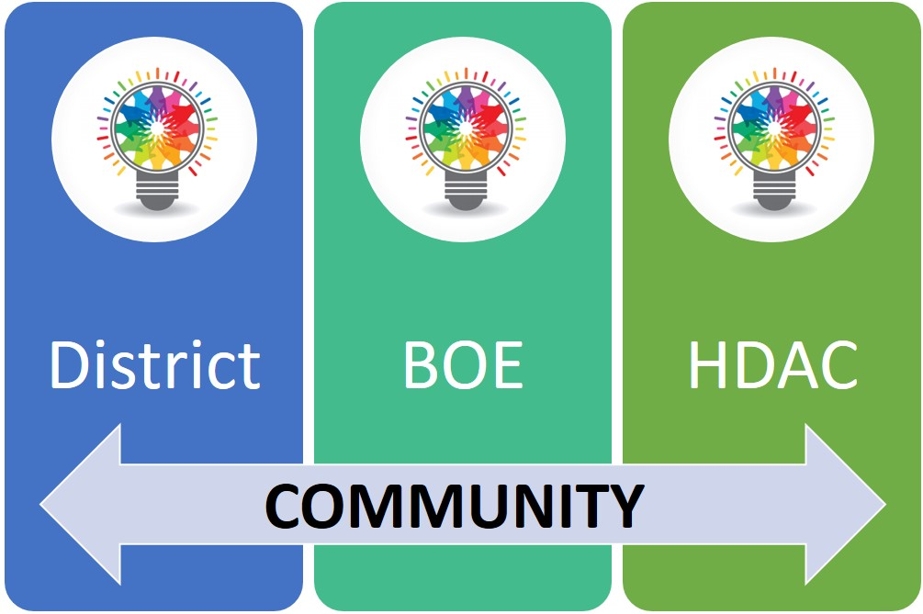
Hamden’s Definition of Diversity
In 2018, the BOE and administration began the process of defining what the “ideal diversity” of an elementary school population might look like in Hamden.
Although no final definition was determined in 2018, BOE discussions centered around looking at the feasibility of attendance zones that enable all elementary schools to be +/- ~10% to 15% of the district average on several demographic factors such as:
Free and Reduced Lunch Eligibility (District average: 52% )
Black (District average: 30%)
White (District average: 35%)
Hispanic (District average: 22%)
English Learners (District average: 6%)
Asian (District average: 7%)
Two or More Races (District average: 5%)
In an effort to provide a much broader voice and a structured way to move forward, the Hamden Diversity Advisory Council (HDAC) was formed in January 2019 and continued work throughout the Pandemic. Presently, HDAC has established task forces to fulfill their goals and policy statement.
Note that percentages shown are from 2018-19 school year

Slide 18
So what is the Hamden’s 3R Initiative?
Development of a Strategic Planning Framework to Ensure a Future of Educational Excellence for all Hamden Students

Slide 19
Hamden’s 3R Initiative
In 2018, Hamden's 3R Initiative was created to address these important issues:
Decreasing state funding to towns for education
Declining enrollment (similar to other communities in CT)
Meeting state guidelines for diversity
Incorporating our own community's values around diversity and inclusiveness.
The Hamden Board of Education and administration began examining how to reorganize our educational system in a way that can be sustained in the future while being mindful of these issues stated above.
We continue to see this important work as an opportunity to optimize programming and reallocate resources to maximize opportunities for our students, while at the same time creating conditions for a long-term sustainable school system of excellence.

Slide 20
3R Methodology and Commitments for Diversifying Hamden Schools
Redefine attendance zones to meet state guidelines and our own benchmarks for diversity
Create more contiguous attendance zones, as much as possible
Minimize the number of students moved
Minimize the number of transitions for students
Impact all sections of the community; not just some
Provide parent choice through magnet school options at some schools
Provide parent choice by making “open seats” available to families throughout the town

Slide 21
Parent Choice: Exploration of Magnet Schools
In March 2019, the Board explored the feasibility of providing Magnet schools in some of our elementary schools. The goal would be to diversify schools by providing families with choices for attending school in different locations in Hamden.
Magnet school focus was determined based on school characteristics and perceived family interests:
Global Studies and Citizenship (Ridge Hill)
Environmental Sciences (Bear Path)
Career Pathways / Extended Day Magnet (Helen Street)
STEAM Magnet (Dunbar Hill)
Magnet schools would add significant costs to the district budget (start up and to sustain programs).

Slide 22
3R Plan: Previously Projected Timeline
3R community information and input sessions: November 2019 – March 2020
Redistricting plan finalized by BOE: April 2020
Redistricting plan shared with all HPS families: April-December 2020
“PAT” (Positive Adjustment Teams) Transition Planning Efforts: January – August 2021
Middle school construction completed: August 2021
HMS becomes a 6th – 8th grade middle school: August 2021
Elementary attendance zones change (redistricting) districtwide: August 2021
Note: Elementary attendance zone changes are directly tied to completion of middle school construction. If that is delayed, redistricting will occur one year later, with the 2022-23 SY.

Slide 23
3R Plan: Previously Projected Timeline impacted by COVID, State and Town Committees
3R community information and input sessions: November 2019 – March 2020
Redistricting plan finalized by BOE: April 2020
Redistricting plan shared with all HPS families: April-December 2020
“PAT” (Positive Adjustment Teams) Transition Planning Efforts: January – August 2021
Middle school construction completed: August 2021
HMS becomes a 6th – 8th grade middle school: August 2021
Elementary attendance zones change (redistricting) districtwide: August 2021
Although the Pandemic and state and local committees have delayed our plans, HDAC continued to meet, and is helping us determine next steps
State of Connecticut
School Construction Department
Town School Building Committee Delays
Legislative Council Funding Approvals
Hamden School Building Committee

Slide 24
From 2018: What We Planned to Do Next
Develop plans for diversifying our elementary schools
Develop plans for implementing Pre-K in each elementary school
Move forward with preparations for school closures
Continue work, including construction, so that 6th grade can move to HMS

Slide 25
May 2021 - TODAY: Where Do We Go From Here?
Review 3R Plan and decide if elements of the plan need to be altered to meet current needs and sentiments (How does our recent Diversity/Equity/Inclusion work inspire or change our previous plans to achieve school diversity?)
.

