Slide 1
Functional Behavior Assessment
A process TO IDENTIFY

Slide 2
IDEA
The 2004 reauthorization of the Individuals with Disabilities Education Improvement Act mandates that schools conduct a Functional Behavioral Assessment in two situations:
1. When a student’s behavior impedes his/her learning or that of others.
2. When the students ARD committee conducts a manifestation determination and determines that there is a link to the student’s disability.

Slide 3
What is a FBA?
Functional Behavioral Assessment (FBA) is a process that identifies specific target behavior, the purpose of the behavior, and what factors maintain the behavior that is interfering with the students educational process or that of others.
The Local Education Agency (LEA) must obtain parent/guardian consent BEFORE conducting a Functional Behavioral Assessment (FBA).
The FBA process may lead to the development of intervention plans to teach acceptable alternative behavior.
The resulting intervention plan focuses on teaching new behavior and social skills, but usually also requires modification of the school or classroom environment and activities, adaptation of curriculum and instructional delivery, and changes in the teacher/student relationship that maintain the undesirable behavior.
Functional behavioral assessment should be integrated, as appropriate, throughout the process of developing, reviewing, and, if necessary, revising a student’s IEP.

Slide 4
The Process Five Main Components
A clear description of the problem behavior.
Identification of the times, events, and situations that predict when the problem behavior will and will not occur throughout the typical day.
Identify the possible function that the behavior serves and the outcomes or reinforcers maintaining them in that situation.
Identification of the consequences that maintain the behavior.
Collection of data that supports the summary statements that have been developed.

Slide 5
Steps for completing a Functional Behavioral Assessment
Step One: Collect/ Analyze Data
Step Two: Define the Behavior
Step Three: Identify the Antecedent
Step Five: Determine the Function
Step Four: Identify the Consequences
Step Six: Develop Hypothesis Statement

Slide 6
STEP 1 Collect/Analyze Data
The team will collect measurable and observable data by direct observation of the target behavior in the environment in which it occurs.
The data will include:
Evaluations/Assessments
Psychologicals
Discipline referral forms
Counselor recommendations
Attendance records
Data collected through observation
Functional Assessment Interview Forms
Behavior graphs/tally sheets
Point sheets
Behavior logs
Previous FBAs/BIPs

Slide 7
STEP 2 Define the Behavior
Define the behavior in observable factual terms:
Give the behavior a name, and describe the behavior.
Example:
B1-Refusal to work: pushes away work, puts head down, cries, tears up assignments, and/or breaks pencil points.
B2- Verbal aggression: raises voice, uses profanity in English and Spanish directed towards adults or authority figures.
Target the behaviors that are the most critical for student success.

Slide 8
STEP 3 Identify the Antecedent
Antecedent- Internal and or External Factors that typically precede the behavior.
Internal Factors
Learning Styles
Disabilities
External Factors
Time
Setting
Communication Difficulties
Anxieties
Activity
Events
People
Physiological Needs

Slide 9
STEP 4 Identify the Consequences
Consequence- a result or effect of an action or condition.
Identify what typically follows the behavior:
Positive social reinforcement from others
Corrective feedback
Discontinuing or removing something undesired by student
Removal from the classroom
Sent to principals office
ISS
Suspension
AEP
Other

Slide 10
STEP 5 Determine the Function
Identify the purpose the behavior serves. (What does the student get or avoid, what message is being communicated.)
Attention
Expression of anger
Frustration
Seeking power / control
Intimidation
Sensory stimulation
Relief of fear or anxiety
Peer acceptance
Note: There is rarely more than one purpose for the behavior

Slide 11
STEP 6 Develop Hypothesis Statement
Develop a functional hypothesis for each targeted behavior.
(Based on the data collected)
HYPOTHESIS MUST INCLUDE
Antecedent
Behavior
Consequence
Function

Slide 12
FBA *** IEPPlus

Slide 13
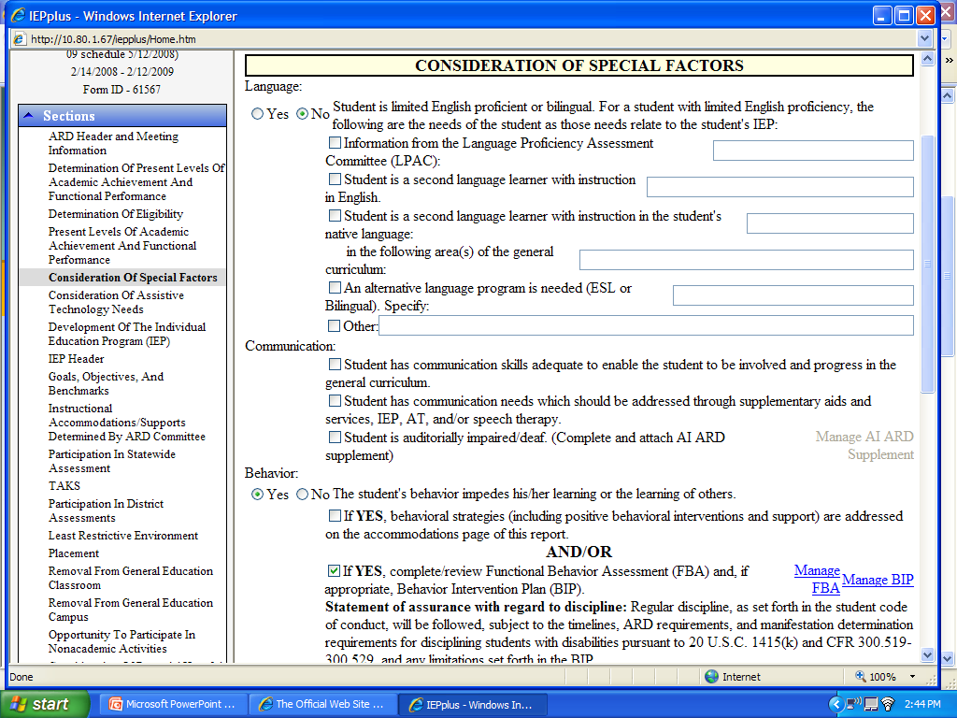

Slide 14
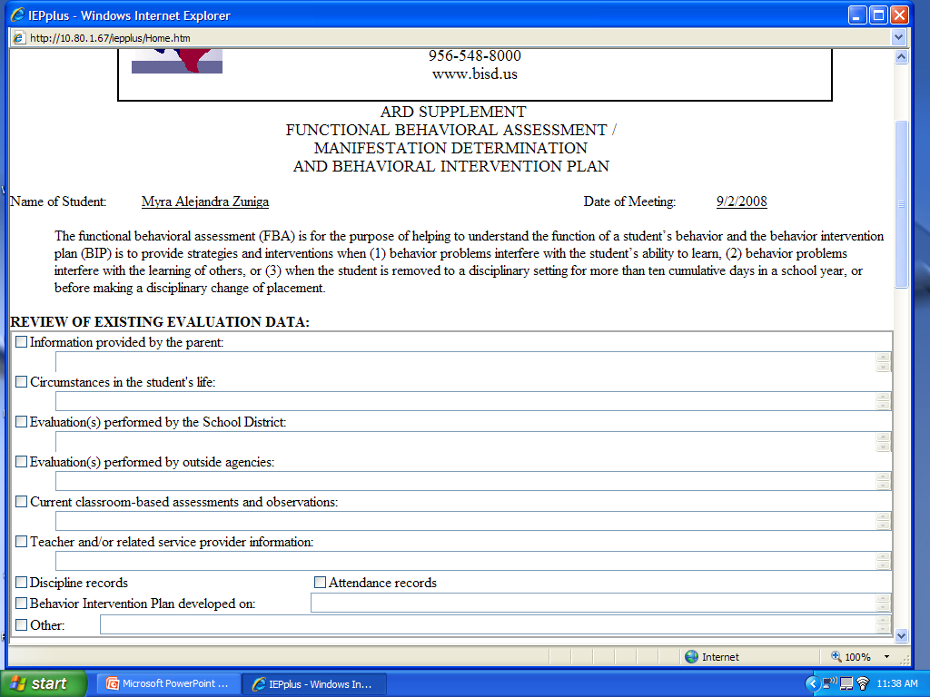
Must be based on documented data.
Any information the parent share or none indicated
Leave blank
List all evaluations you reviewed and the date of the evaluation
List any outside evaluations you reviewed and the date of the evaluation
Check discipline and attendance if reviewed and note in other.
Short synopsis of data: point sheets, FBA questionnaire, behavior logs, etc.
Information provided by teachers, counselors, OT,PT, etc.
Date of BIPs reviewed
Synopsis of discipline referrals and attendance records.

Slide 15
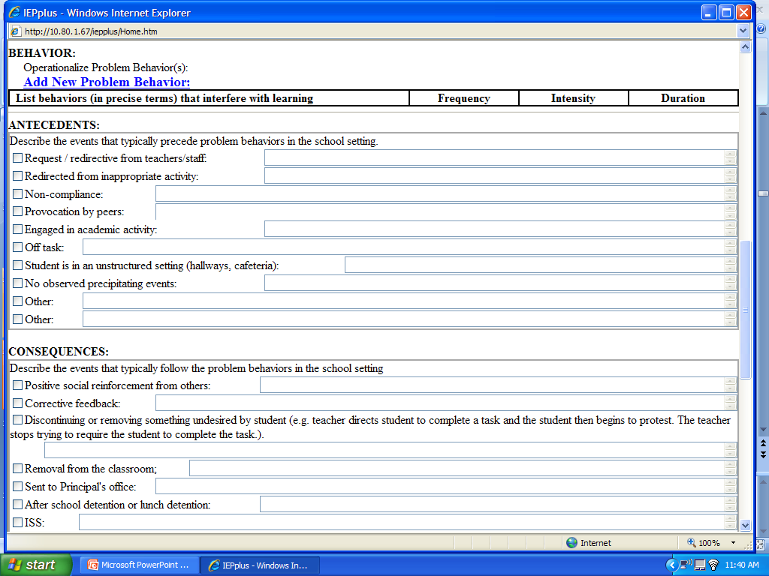
Identify, number, and describe target behaviors
How often?
Mild Moderate
Severe
Minutes
Check the appropriate box and note the corresponding behavior.

Slide 16
Antecedent is based on data analysis!
Every antecedent must be addressed on the BIP.

Slide 17
Choose the consequence that appears to reinforce the negative behavior.

Slide 18
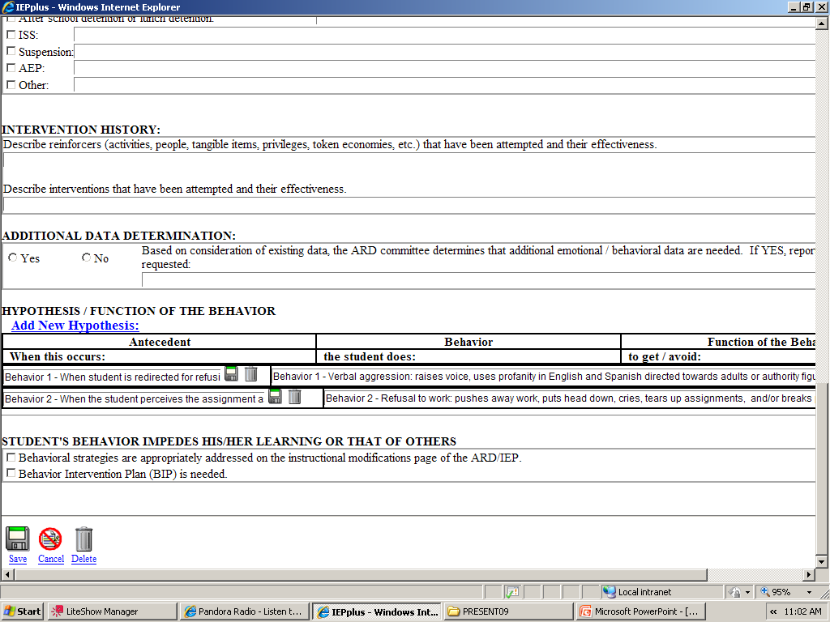
Effective
Somewhat Effective
Not Effective
List any reinforcers or interventions that have not been tried and might be effective
DO NOT LEAVE BLANK
Insert antecedent from above.
This will pop up.
Insert the function of the behavior.
Check appropriate box(es).

Slide 19
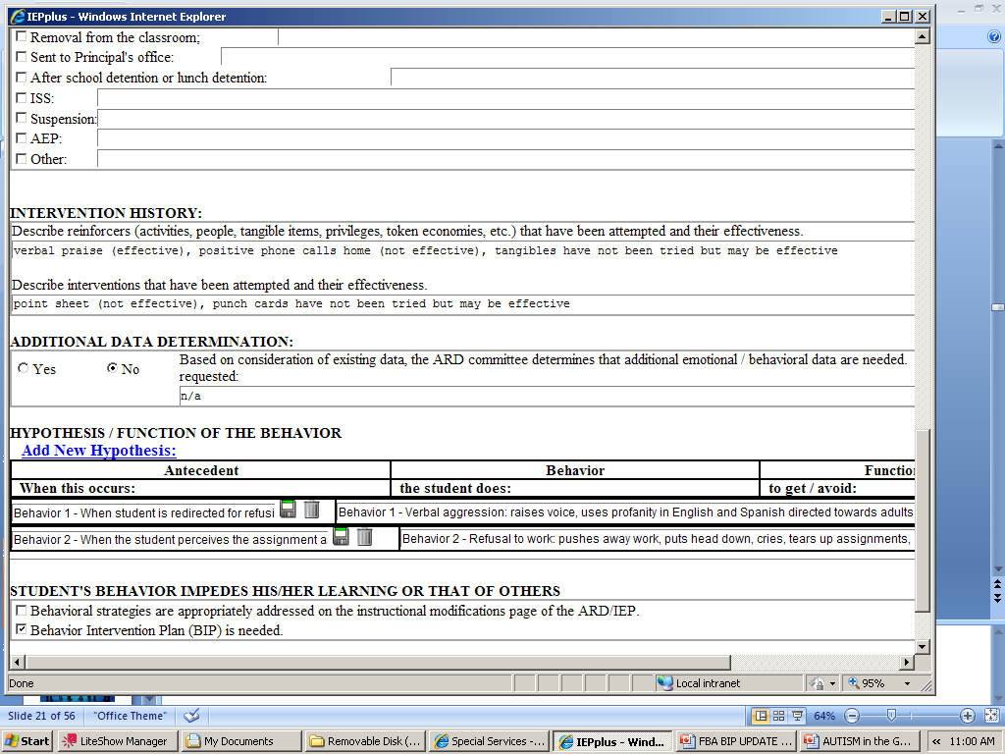
Sample!!!

Slide 20
Behavior Intervention Plan BIP

Slide 21
IDEA
The 2004 reauthorization of the Individuals with Disabilities Education Improvement Act mandates that schools develop a Behavior Intervention Plan when a student’s behavior impedes his/her learning or that of others.
The Behavior Intervention Plan should include positive behavioral interventions, strategies, and supports to address the behavior(s).

Slide 22
The Behavior Intervention Plan
Once the Functional Behavior Assessment is complete, and the ARD committee has a clear understanding of the antecedents and consequences that maintain the function of the behavior, the ARD committee must determine if there is a need for a Behavior Intervention Plan.
If the ARD committee determines that there is a need for a Behavior Intervention Plan proceed to the goals and objectives portion of the IEP.
Using the information that has been collected and analyzed in the Functional Behavioral Assessment identify specific goals and objectives that directly address the prioritized behaviors.

Slide 23
BIP Components
Proactive teaching strategies and replacement skills
Intervention Strategies
General Education Reinforcers
General Education Consequences
Special Education Reinforcers
Special Education Consequences
BIP TEMPLATE
can be found under FORMS on Special Services
website.

Slide 24
Proactive Teaching Strategies Replacement Skills
Identify the information or knowledge the student needs in order to make informed choices.
We need to explicitly teach expected desired behaviors rather than take the risk or expect that student “should know” or that they will figure out on their own.
Identify specific replacement skills that correlate with the function of the behavior.
Our tendency when students don’t follow behavior expectations is to punish students rather than teach students.
BE PROACTIVE

Slide 25
Intervention Strategies
The Intervention MUST
Outline how the student will be monitored
Identify who will be responsible for monitoring the student
Include a continuum of positive and negative consequences
Determine the criteria for positive and negative consequences
Detail when/where/how the student will be reinforced
Include strategies for documenting the outcome of the intervention
Criteria for reinforcers must be explained in the intervention!

Slide 26
Reinforcers and Consequences
General Ed. Reinforcers / General Ed. Consequences:
Identify which reinforcers and consequences the General Education Teacher will be responsible for.
Special Ed. Reinforcers / Special Ed. Consequences:
Identify which reinforcers and consequences the Special Education Teacher will be responsible for.
Reinforcers and consequences must be specifically explained.

Slide 27
REMEMBER…..
In order to effectively change a student’s behavior, you must develop a Behavior Intervention Plan that incorporates the following:
Proactive teaching strategies
Replacement behaviors that serve the same function as the inappropriate behavior
A clear plan of action
A continuum of both positive and negative consequences
The content of the plan must be based on the information gained through the Functional Behavioral Assessment

Slide 28
BIP/IEPPLUS

Slide 29
Insert consider….

Slide 30
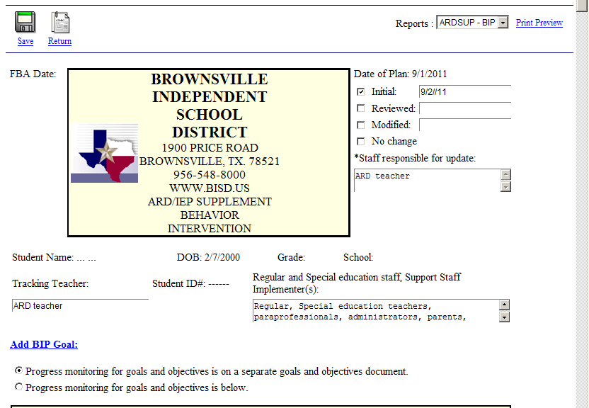
ARD Date
x
x

Slide 31
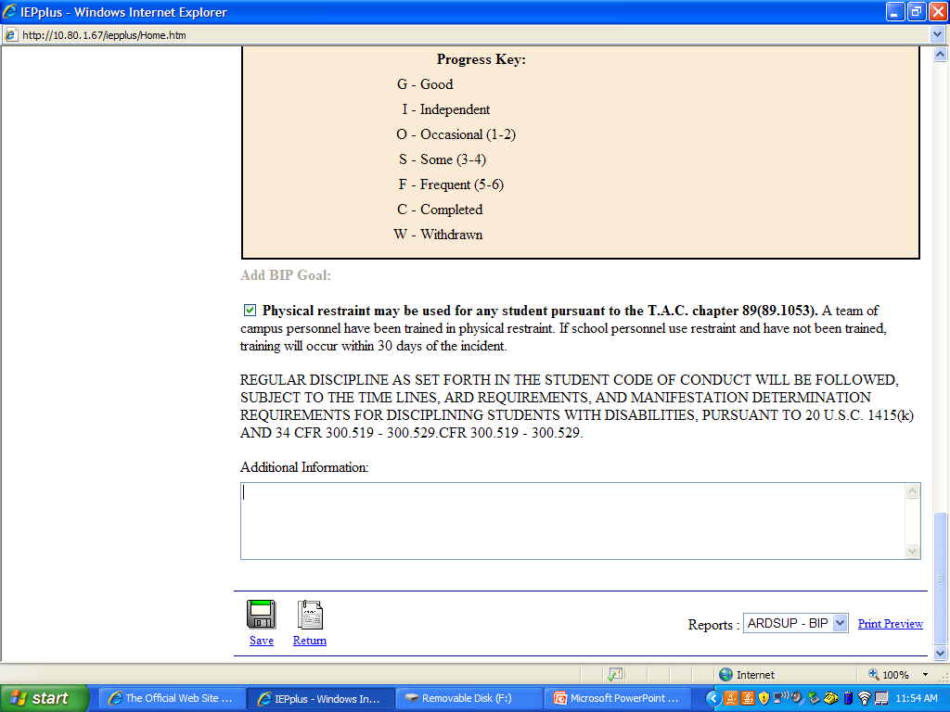
Always check this!

Slide 32
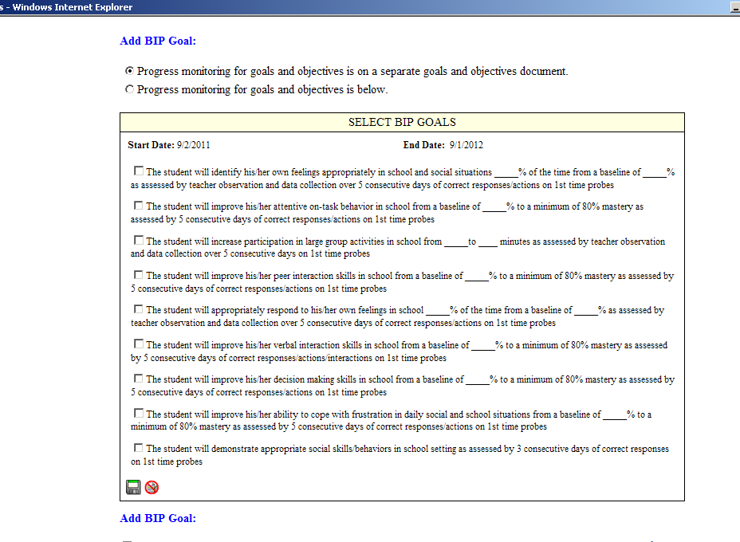
X
Revise goals to include four components of IDEA
Timeframe
Condition
Behavior
Criteria

Slide 33
Examples
Goal
Timeframe | Condition | Behavior | Criteria
By the next annual review, | With the use of verbal and physical prompting, visual cues, daily social skills ,and a use of a daily point sheet | Seth will demonstrate an understanding of classroom routines and procedures, increase compliant behaviors by following teacher directives | with a mastery level of 80%.
Objective
Timeframe | Condition | Behavior | Criteria
By the end of the 2nd 6 weeks, | With the use of verbal and physical prompting, visual cues, daily social skills ,and a use of a daily point sheet | Seth will increase appropriate classroom behavior (staying in assigned seat/area, actively participating and completing assigned tasks/assignment) within school environment | with a mastery level of 80%.

Slide 34
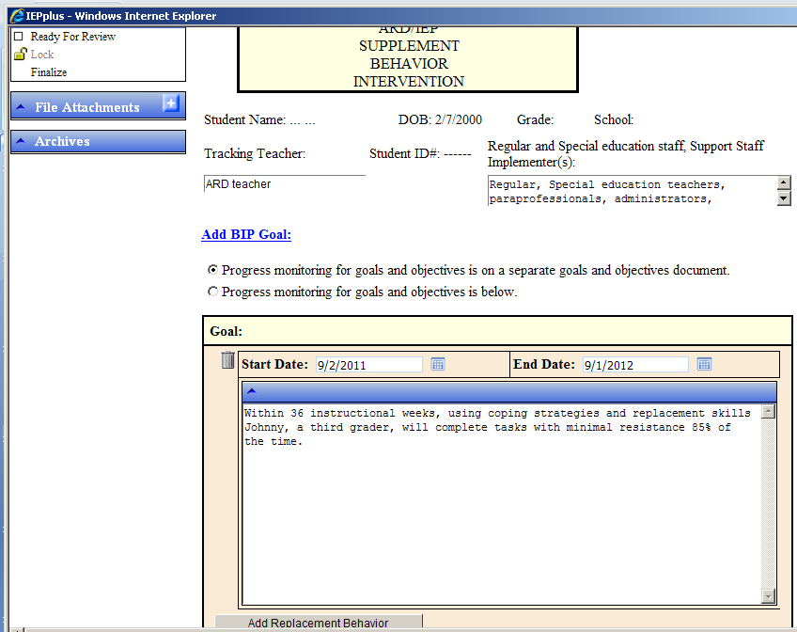

Slide 35
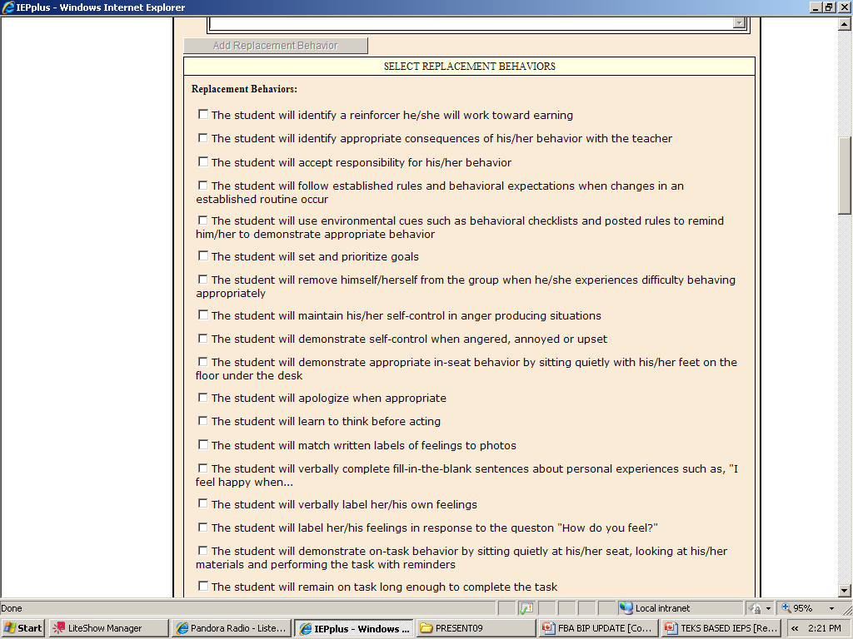
Objectives

Slide 36
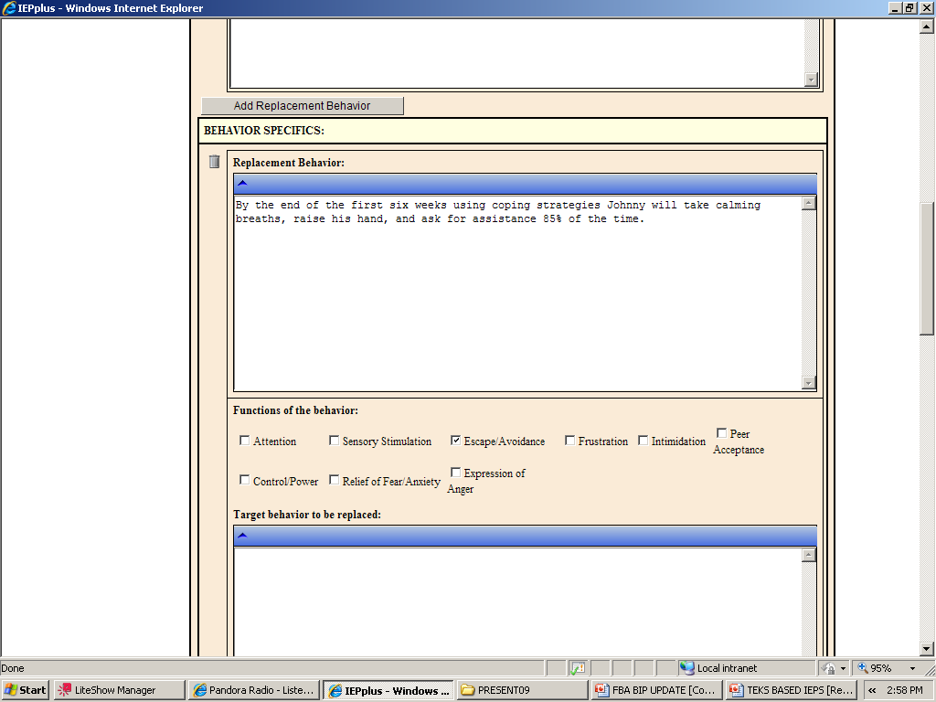
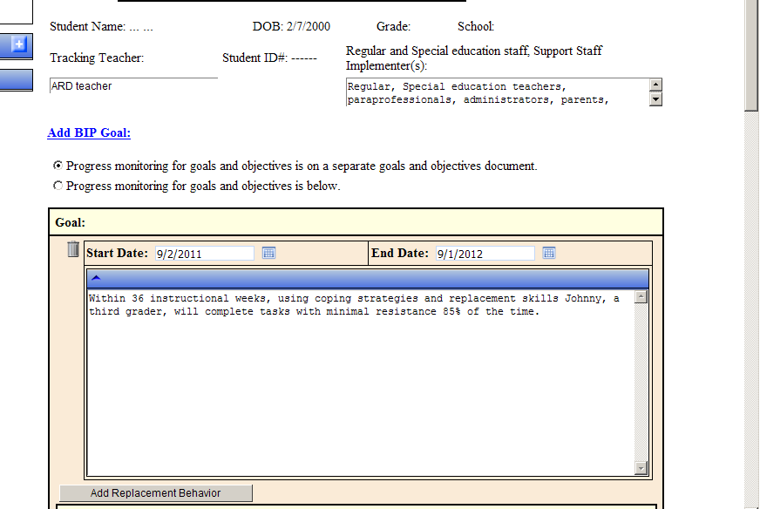
Objective

Slide 37
Sample!
Insert function from FBA

Slide 38
Sample!

Slide 39
Sample!

Slide 40
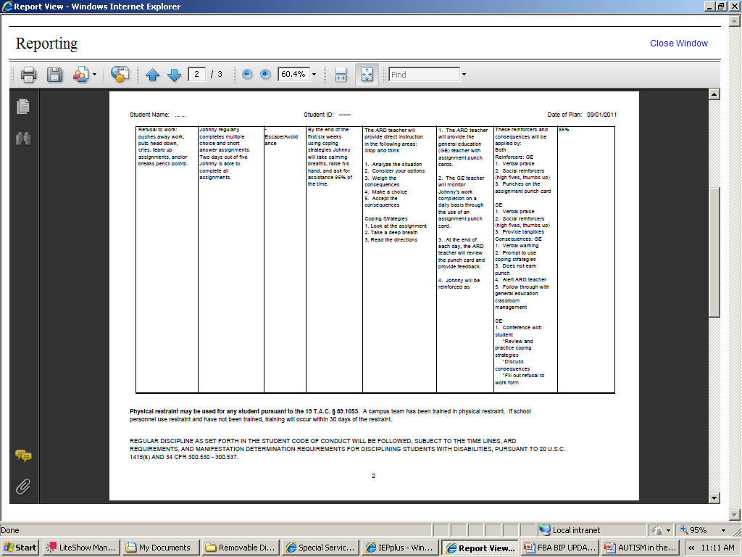
Note: Examples are for training purposes only.
FBA and BIP’s should be individualized.

Slide 41
REMEMBER…..
When writing the plan, it is important to make sure that everything is spelled out clearly and specifically so that the plan can be used by everyone involved with the student.
The team should make sure that the interventions included are ones that they have the resources and ability to implement consistently.
It is very important that, once the team agrees on a Behavior Intervention Plan, EVERYONE involved must agree to implement it consistently.
Inconsistent application of any intervention is likely to result in an increase of the inappropriate behavior or result in the presentation of new inappropriate behaviors.
BE PROACTIVE !

Slide 42
BEHAVIOR POINT SHEETS

Slide 43
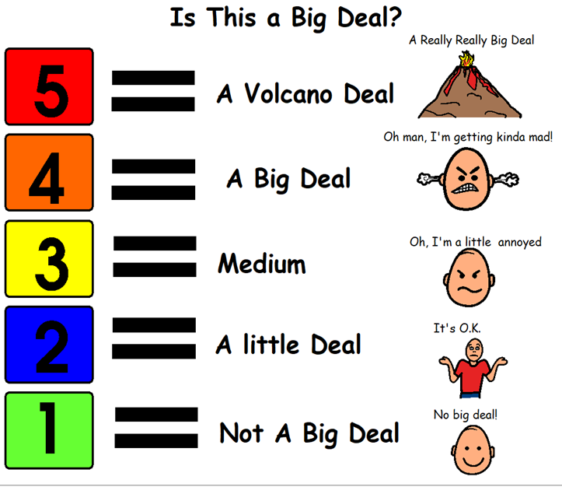
5-Point Scale

Slide 44
Behavior Contracts

Slide 45
Punch Cards

Slide 46
STOP and THINK

Slide 47
First and Then

Slide 48
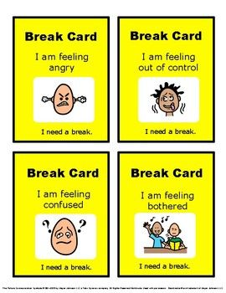
Break Cards

Slide 49
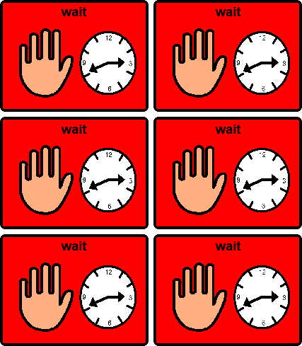
Visual Reminders

Slide 50
Social Stories

Slide 51
INCENTIVES HOMEWORK PASS

Slide 52
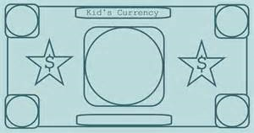
DAILY TRADING

Slide 53
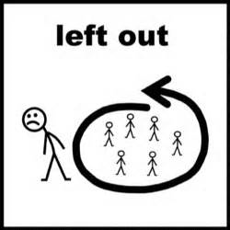
Teach Appropriate Behavior Through Role Play

Slide 54
Presented by Behavior Specialist(s) Hanna Cluster-Debby Mancillas Lopez Cluster- Christopher Jude Cortez Pace Cluster-Karen Alvarez Porter Cluster-MaryLinda Gracia Rivera Cluster-Melinda Ottolino Veterans Cluster- Manuel Rocha

