Slide 1
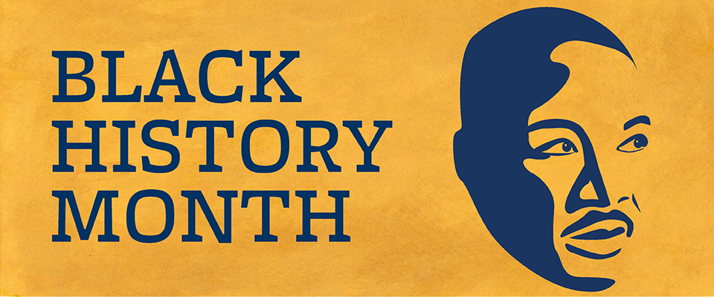
Black History Month
Few of the inspiring amazing people
Domilove Buissereth
Kennedy School
Grade 4 – Mrs. Roche
Room 203

Slide 2
Martin Luther King Jr.
Martin Luther King Jr was born on January 15, 1929 in Atlanta. Sadly King Jr got assassinated by James Earl Ray . He stopped segregation. Martin Luther King Jr. was an African American Baptist minister and activist who became the most visible spokesperson and leader in the Civil Rights Movement from 1955 until his assassination in 1968.

Slide 3
“If you can’t fly then run, if you can’t run then walk, if you can’t walk then crawl, but whatever you do you have to keep moving forward.”
- Martin Luther king jr.

Slide 4
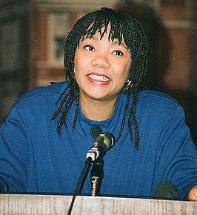
Yolanda King
Yolanda King was born on November 17, 1955 .Yolanda Denise King was an African American activist and first-born child of civil rights leaders Martin Luther King Jr. and Coretta Scott King. She was also known for her artistic and entertainment endeavors and public speaking.
This Photo by Unknown Author is licensed under CC BY-SA

Slide 5
“To do peace, you must up off your apathy.”
-Yolanda King

Slide 6
George Washington Carver
George Washington Carver was born on January 1, 1864 and died on January 5, 1943. George Washington Carver was an American agricultural scientist and inventor who promoted alternative crops to cotton and methods to prevent soil depletion. He was the most prominent black scientist of the early 20th century.
\

Slide 7
“Education is the key to unlock the golden door of freedom.”
-George Washington Carver

Slide 8
Jackie Robinson
Jackie Robinson was born on January 31, 1919 and died on October 24, 1972 .Jack Roosevelt Robinson was an American professional baseball player who became the first African American to play in Major League Baseball in the modern era. Robinson broke the baseball color line when he started at first base for the Brooklyn Dodgers on April 15, 1947

Slide 9
“I’m not concerned with your liking or disliking me All I ask is that you respect me as a human being.”
-Jackie Robinson

Slide 10
John H. Johnson
John H. Johnson was born on January 19, 1918 and died on August 8, 2005.. John Harold Johnson was an American businessman and publisher. Johnson was the founder of the Johnson Publishing Company, headquartered in Chicago, Illinois. Johnson's Ebony and Jet magazines were among the most influential African-American businesses in media beginning in the second half of the twentieth century.

Slide 11
“Failure is a word I simply don’t accept.”
-John h. Johnson

Slide 12
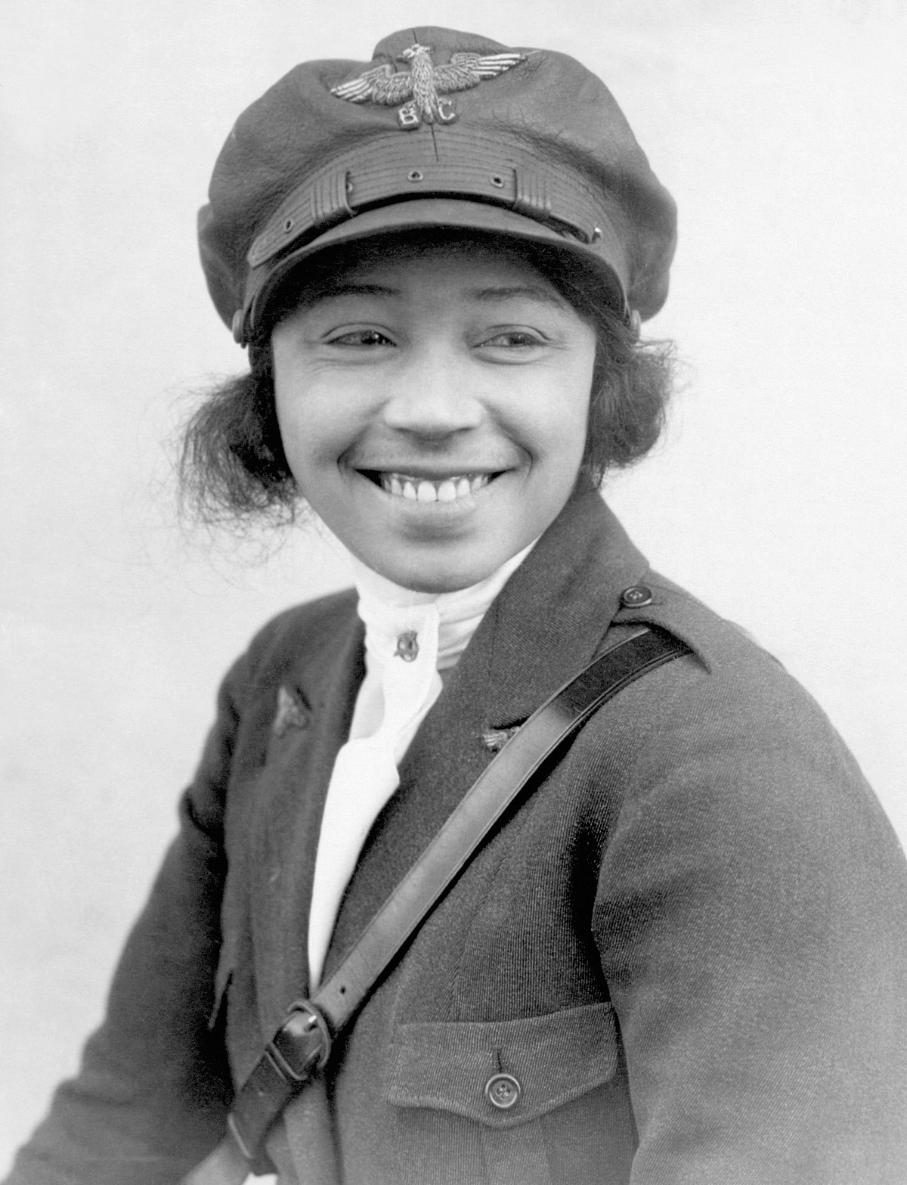
Bessie Coleman
Bessie Coleman was an early American civil aviator. (January 26, 1892 – April 30, 1926). She was the first African American woman and first Native-American to hold a pilot license. She earned her pilot license from the Fédération Aéronautique Internationale on June 15, 1921 and was the first black person to earn an international pilot's license.
This Photo by Unknown Author is licensed under CC BY-SA
This Photo by Unknown Author is licensed under CC BY-SA

Slide 13
“Tell them that as soon as I can walk, I'm going to fly!”
-Bessie Coleman

Slide 14
Ruby Bridges
Ruby Nell Bridges Hall is an American civil rights activist. She was born on September 8, 1954. She was the first African-American child to desegregate the all-white William Frantz Elementary School in Louisiana during the New Orleans school desegregation crisis on November 14, 1960

Slide 15
“Don’t follow the path. Go where there is no path and begin the trail.”
-Ruby Bridges

Slide 16
Harriet Tubman
Harriet Tubman was born Dorchester County, MD and died March 10, 1913 .Harriet Tubman was an American abolitionist and political activist. Born into slavery, Tubman escaped and subsequently made some 13 missions to rescue approximately 70 enslaved people, including family and friends, using the network of antislavery activists and safe houses known as the Underground Railroad. She had 8 siblings.

Slide 17
“Every great dreams begin with a dreamer. Always remember you have within you the strength, the patience, and the passion to reach for the stars.”
-Harriet Tubman

Slide 18
Rosa Parks
Rosa Parks was born on February 4, 1913,Tuskegee, AL and died October 24, 2005 .Rosa Louise McCauley Parks was an American activist in the civil rights movement best known for her pivotal role in the Montgomery bus boycott. The United States Congress has called her "the first lady of civil rights" and "the mother of the freedom movement“ Rosa Parks was in jail for roughly a day.

Slide 19
“Each person must live their life as a model for others.”
-Rosa parks

Slide 20
James Baldwin
James Arthur Baldwin was born August 2, 1924.James Arthur Baldwin was an American novelist, playwright, essayist, poet, and activist. His essays, collected in Notes of a Native Son, explore intricacies of racial, and class distinctions in the Western society of the United States during the mid twentieth-century.

Slide 21
“Love takes off masks that we fear we cannot live without and we know we cannot live within.”
-James Baldwin

Slide 22
Otis Boykin
Otis Boykin was born on August 29, 1920, Dallas, TX and died on March 13, 1982 .Otis Frank Boykin was an American inventor and engineer. His inventions include electrical resistors used in computing, missile guidance, and pacemakers.

Slide 23
“Gold is a living god and rules in scorn, All earthly things but virtue.”
-Otis Boykin

Slide 24
Mae C. Jemison
Mae C. Jemison was born on October 17, 1956, and she is still alive to this very day. Mae Carol Jemison is an American engineer, physician, and former NASA astronaut. She became the first black woman to travel into space when she served as a mission specialist aboard the Space Shuttle Endeavour.

Slide 25
“Don’t let anyone rob you of your imagination, your creativity, or your curiosity. It’s your place in the world, its your life. Go on and do all you can do with it and make it the life you want to live.”
-mae c. Jemison

Slide 26
Richard Allen
Richard Allen was born on February 14, 1760 and died March 26, 1831, .Richard Allen was a minister, educator, writer, and one of America's most active and influential Black leaders. In 1794, he founded the African Methodist Episcopal Church, the first independent Black denomination in the United States. He opened his first AME church in 1794 in Philadelphia, Pennsylvania.

Slide 27
“Just learn from your mistakes and forgive yourself and better yourself.”
-Richard Allen

Slide 28
Marie Van Britten Brown
Marie Van Britten Brown was born on October 30, 1922 and died on February 2, 1999. Marie Van Brittan Brown was a nurse and an inventor. She was the inventor of the home security system in 1966, along with her husband Albert Brown. In the same year, they jointly applied for a patent, which was granted in 1969. Brown was born in Jamaica, Queens, New York, she died there at the age of 76.

Slide 29
“There was no found quote from her, but she still was an awesome person.”
-DOMILOVE ￣︶￣

Slide 30
Black History Month Flag
Did you see the flag at Yolanda’s King biography? Oh, you did. Well, that flag’s colors represent something. Red is the color of blood which men must shed for their redemption and liberty. Black is the color of the noble and distinguished race to which we belong. Green is the color of the luxuriant vegetation of our Motherland.

