Slide 1
Brockton High School Scholarship Program
2020-2021
Notes:
Hello Seniors and welcome to the Brockton High School Scholarships Workshop. In this presentation you will be shown and explained how to navigate the BHS Scholarship section of the website so you can apply for many local scholarships.
We highly encourage everyone to apply to these local scholarships so they can help you pay for textbooks and additional college-related expenses. Students who have applied in the past have been able to receive up to 5 or $6,000 in scholarships. These scholarships are ONLY for seniors who have already applied to two or four-year colleges.

Slide 2
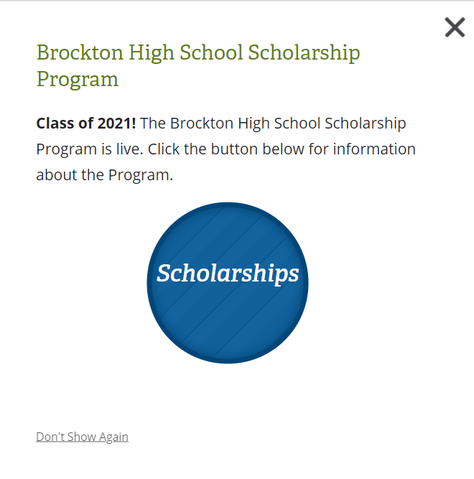
Where to Find
*Go to bpsma.org and follow the pathways below*
1. Our Schools > Brockton High School
2. Brockton High School > Guidance
3. Guidance > Brockton High School Scholarship Program
Notes:
*Finding the Scholarship Book online is easy. Let’s look at the process.
On the BPS website, if a pop-up box with scholarship information does not appear, do the following:
Go to the OUR SCHOOLS section and scroll down to BROCKTON HIGH SCHOOL.
Further down on the Brockton High School page, click on the round icon GUIDANCE.
Once you click on the GUIDANCE icon, look for the BROCKTON HIGH SCHOOL SCHOLARSHIP PROGRAM on the left-hand side and click.

Slide 3
Notes:
The BHS Scholarship Program page will contain links to the following:
The Scholarship Book
An online general application
A checklist to help you stay organized
A Financial Statement form
All Special Applications

Slide 4
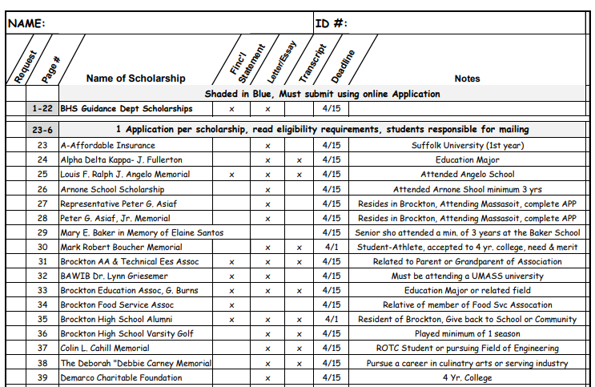
Scholarship Checklist
Notes:
Let’s look more closely at the checklist. The Scholarship Checklist provides a brief summary of scholarships, requirements, and deadlines. It is important to view the scholarship book, read the complete eligibility requirements, and apply for only the scholarships you are qualified for. You will notice that the checklist is organized in order of the scholarships and what additional information is requested, such as Financial Statement, a letter or essay, a transcript and the application deadline.
Place a check mark on the checklist next to all scholarships you are eligible for. After completing the checklist, leave the form with the Guidance Office Secretary to receive required paperwork, such as a copy of your transcript and any special applications.
If you are not present in the building, you may scan and email the checklist to your counselor or the guidance secretaries.
The three different types of scholarships will be covered in forthcoming slides.

Slide 5
Read
Read each scholarship and pay close attention to the eligibility requirements
Track
Track the scholarships you are eligible for using your Scholarship Checklist
Calculate
Calculate how many copies of your transcript and supporting documents are required
Identify
Identify the deadline for each scholarship application
Notes:
As you read the scholarship entries, it is important to keep the following in mind:
READ each scholarship carefully and pay close attention to what additional documents they request.
Use the checklist provided to help you keep track of which scholarships you may be eligible for.
After you complete the checklist with which scholarships you are eligible for, count how many copies you will need of your transcript and supporting documents. Please remember: YOU ARE RESPSONSIBLE FOR MAKING COPIES OF ALL DOCUMENTS YOU NEED TO SUBMIT with the applications.
Carefully keep in mind the deadlines for each of the scholarships you plan to apply for. Work accordingly with those deadlines.

Slide 6
Brockton High Scholarships # 1-22
Must complete online application
Write one-page essay
Submit Parent Financial Statement Form
Deadline: April 15, 2021
Reminder: Students who have completed a FAFSA and have made a decision about their post-secondary plans will be given the high consideration.
Please mail documents to:
BHS Guidance Dept.
Brockton High School
470 Forest Ave
Brockton, MA 02301
OR
Drop-off in Scholarship Box in Main Office
Notes:
Now you are ready to view the scholarships and determine which ones you are eligible to apply for. Scholarships 1-22 are sponsored by individuals, organizations, and various other entities in the Brockton area. Recipients of scholarships 1-22 are selected by a scholarship committee at Brockton High School. In order to determine if you qualify, you will need to carefully view the online description of each scholarship and read about the eligibility criteria. It is best to make a list of all of the scholarships that you qualify for because next you will need to fill out the online application which is on the website. On the application you will check off the scholarships that you are applying for. After you complete the application, you will submit it online. You will then receive a confirmation email that guidance department has received it. You must also write a one-page essay on why you should be considered for a scholarship and ask your parent or guardian to fill out the financial statement which you will print off of the website. Once you have completed your essay and filled out your financial statement, you will need to drop them off in a box labeled “Scholarships” at the main office here in school. Another option is to mail your essay and financial statement to: BHS Guidance Department, Brockton High School, 470 Forest Ave, Brockton MA 02301. Your application should be submitted, and your essay and financial statement received no later than April 15, 2021.
Again recipients of these scholarships are selected by the Brockton High School Scholarship Committee consisting of teachers, counselors, and administrators. A rubric is used in the decision making process. Students who have completed a FAFSA and have made a decision about their post-secondary plans will be given the high consideration.

Slide 7
Online Application #1-22
Notes:
Here is a visual of the online application for scholarships 1-22

Slide 8
Private Scholarships # 23-86
Print the General Application (link to form on website)
Complete the General Application
Mail scholarship application to the address listed on corresponding page
Students are responsible for mailing and postage
Notes:
Scholarships 23 to 86 are private scholarships. In order to apply for these, you will need to print a blank application from the website. Next carefully read over the criteria for each scholarship and determine if you are eligible. Use the checklist and check off the names of the scholarships that you qualify for. We recommend that you fill out the paper application once, and leave the top line blank. Once you have determined how many private scholarships you are applying for, make as many copies of the original copy as you need. Write the name of the scholarship on the top line where it says “scholarship application for”. Use the checklist to determine if you will need to include a transcript, essay and financial statement. If you need a copy of your transcript, please email your counselor or contact them on Teams. It is your responsibility to mail the applications, and the accompanying materials to the private donors. Instructions and addresses as to where each scholarship is to be mailed, are clearly indicated on the scholarship description page. You will need to pay close attention to the deadlines and pay for the postage. Recipients of scholarships 23 to 86 are selected by their private scholarship committees using their own selection criteria.

Slide 9
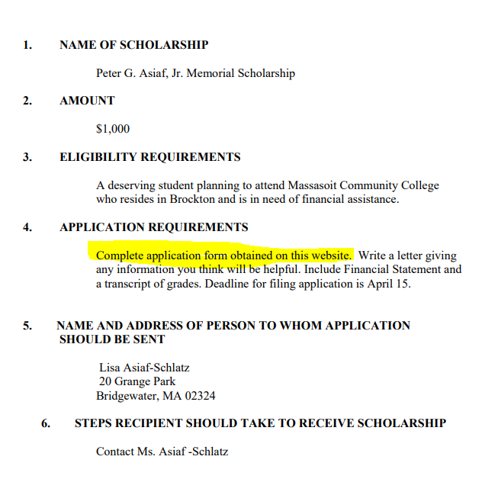
General Application
Notes:
Here on the right side is a visual of the general application which you will find on the website. On the left side is a sample of a private scholarship. As you can see, students applying to this scholarship must be planning to attend Massasoit Community College. The name and address to whom this application must be sent are clearly indicated under # 5.

Slide 10
Special Application Scholarships #87-106
After you submit your checklist, your special applications will be available for pickup within a few days.
There are links to some special applications on the website
Please pay attention to due dates, most are April 15th but not all
Complete applications neatly and accurately
Take note of application requirements (Financial statement, letter or essay, transcript)
Reminder: Many applications/forms in this section need to be mailed to the donor address listed in the scholarship book
Notes:
The special applications can be found on pages 87-106
These applications are considered special because the donor has a specific application that they require you to fill out, many (all) of which can be filled out on the website.
Many of these scholarships have a variety of due dates, some as early as March 13th
Please complete the applications neatly and accurately and remember that you are responsible for mailing all the required documents (financial statement, letter or essay or transcript) to the addresses listed in the scholarship book.

Slide 11
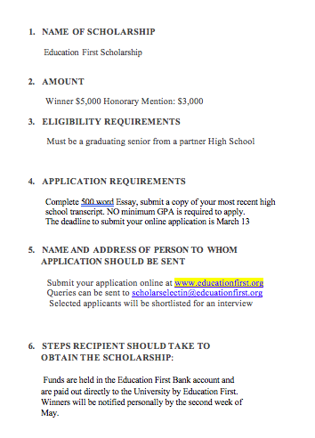
Special Scholarship Example:
Education First Scholarship
Page 88
Notes:
Shown here is an example of a special application. Please take note of the name of the scholarship, the eligibility requirements, the application requirements and the steps to take if awarded the scholarship

Slide 12
Helpful Tips and Reminders
Print out the general application and fill it out leaving the top line blank. Make several copies and fill in scholarship(s) name afterwards.
Parent Financial Statement is required for many scholarships. Make multiple copies.
Write one essay and make multiple copies.
Reminder: You are responsible for making your copies (staples, envelopes, stamps, etc.).
Write a thank you note and send it to the organization or individual that awards you a scholarship.
Notes:
Before you head off to begin the scholarship process, we wanted to just go over some general helpful tips and reminders one last time to assist you during this process.

