Slide 1
CITIZENS ADVISORY COMMITTEE
MEETING #2
Tuesday, October 1, 2019
Friendswood ISD Board Room

Slide 2
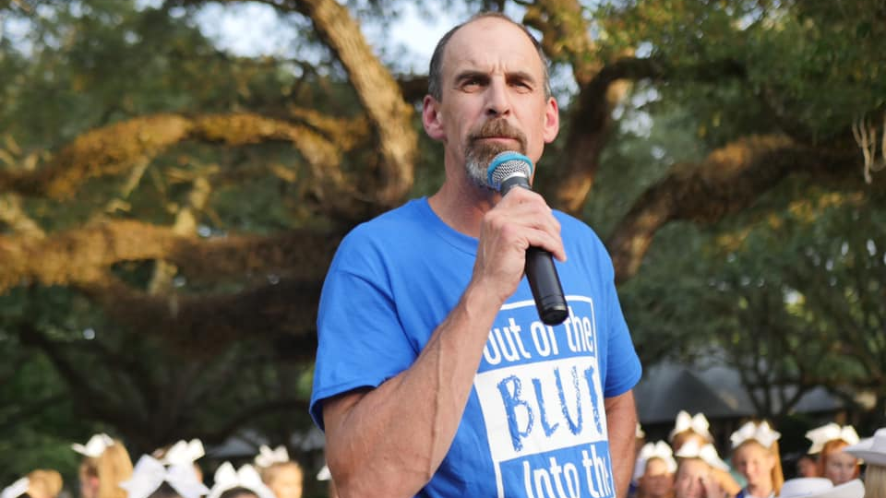
WELCOME

Slide 3
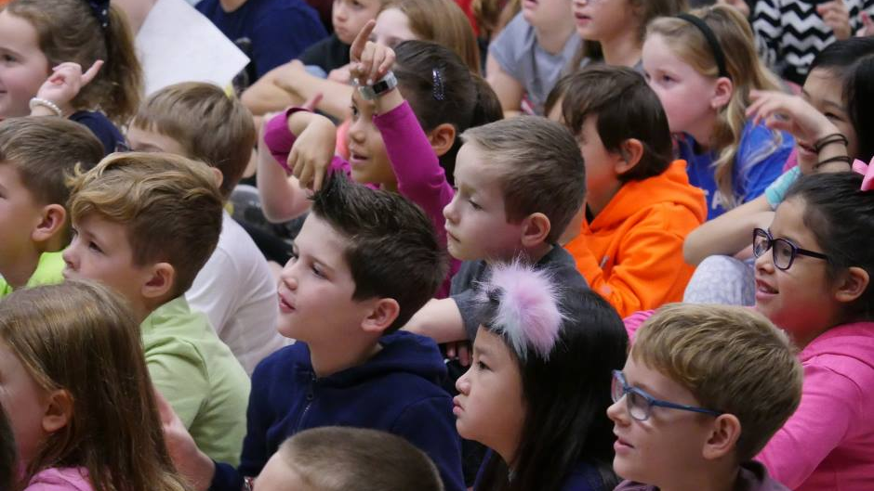
FRIENDSWOOD ISD DEMOGRAPHICS

Slide 4
PROJECTION PROCESS
Annually we roll each grade level cohort and apply a growth factor based on historical trends.
This information is used to allocate staff and budget for the upcoming school year.
Consult experts when large changes are on the horizon.

Slide 5
HISTORICAL ZONING
In 1999 Windsong Intermediate was opened and for the first time FISD had two elementary boundaries.
It was at this time that Cline and Westwood became K-3 and Bales and Windsong became 4-6.
Over the next 15 years boundaries were shifted slightly around the 518/528 intersection, but for the most part remained stable.
With the buildout of The Forest of Friendswood (2005) and development of West Ranch (2007), FISD began experiencing slight growth in the south zone (Cline/Windsong)

Slide 6
HISTORICAL ZONING
In 2015-16 in order to ease overcrowding at Cline and utilize space at Windsong, the south zone 3rd grade class was split and approximately 100 students moved to Windsong. This same year 3rd grade was moved from Westwood to Bales.
In 2018-19 in order to balance building use, the north/south were redrawn using guidance from the school board and recommendations from the zoning committee. The result was moving approximately 250 students to north zone.

Slide 7
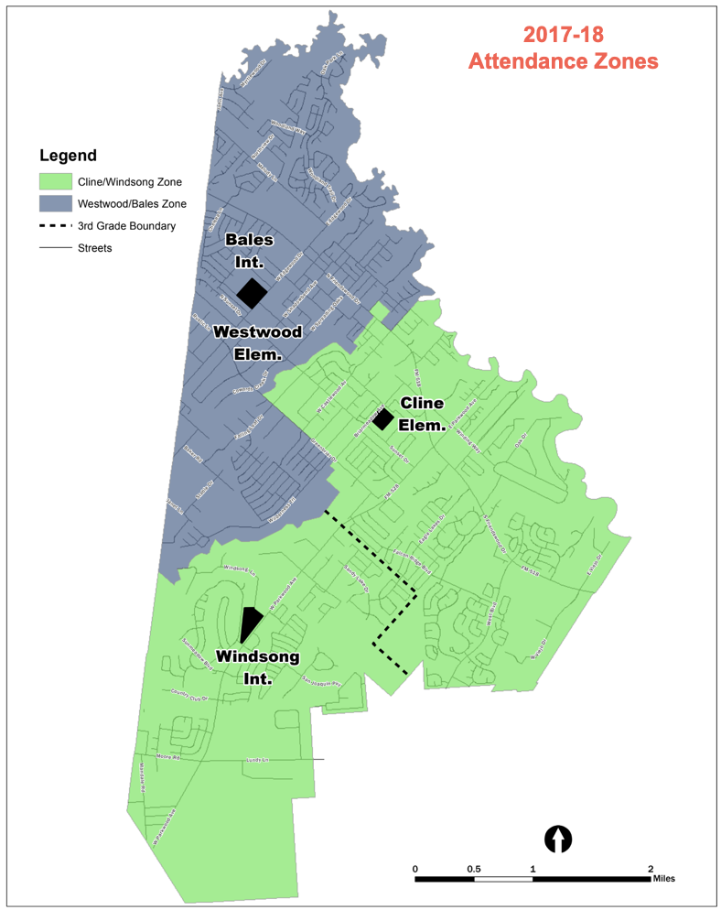
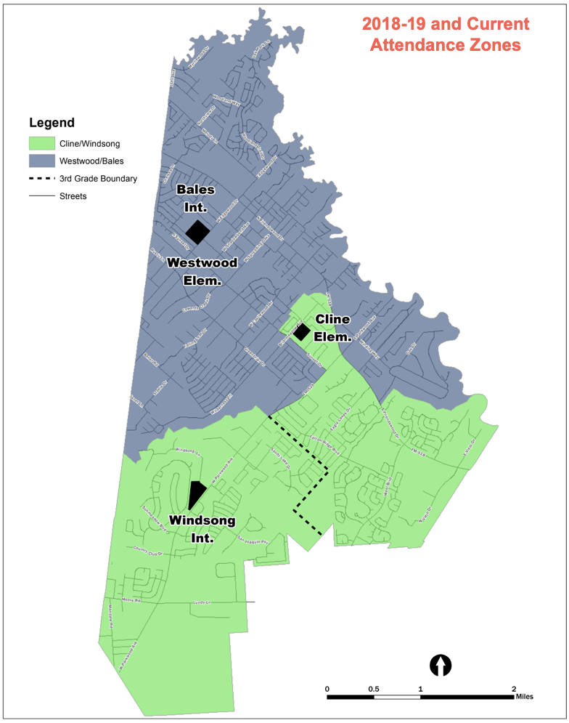

Slide 8
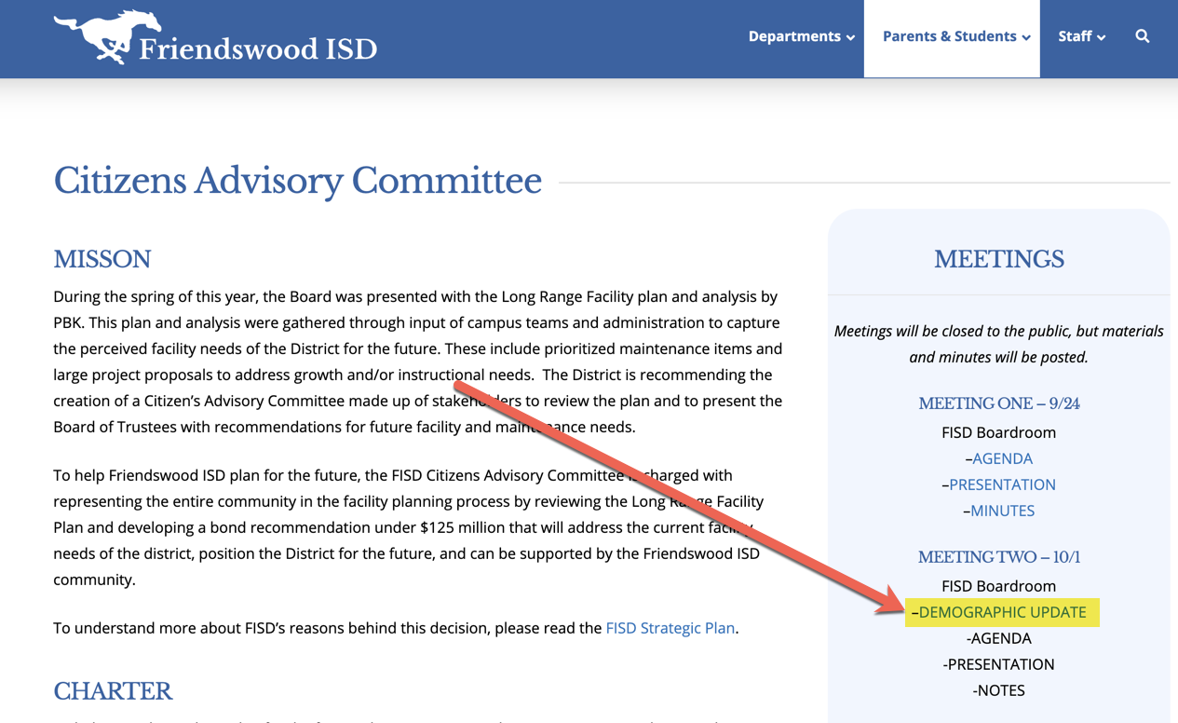
PASA - DEMOGRAPHERS
RESOURCES
Presentation on website
Handouts
POPULATION AND SURVEY ANALYSTS (PASA)
Dr. Stacey Tepera, Ph.D.
Justin Silhavy, M.U.P.

Slide 9
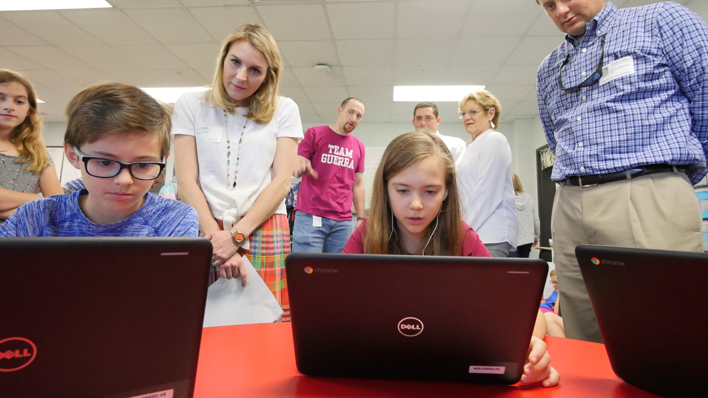
TEACHING & LEARNING IN FRIENDSWOOD ISD
Learning Spaces Addressing
Current and Future Learners’ Needs
Notes:
Diane Opener- Appreciate this opportunity to talk Teaching and Learning.
Student desks- what kind of learning do you envision when you see these students in these desks?

Slide 10
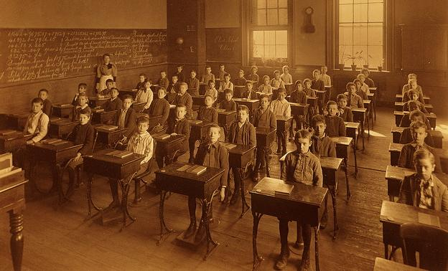
Notes:
Lauren - Think back to your classroom as a student… perhaps your memories don’t go back this far
Factory model- students were empty tanks to be filled up. The teacher was the keeper of all knowledge whom imparted this knowledge to students.
Times have changed dramatically… what we know about how students learn has changed how we teach, therefore our learning environments must do the same...

Slide 11
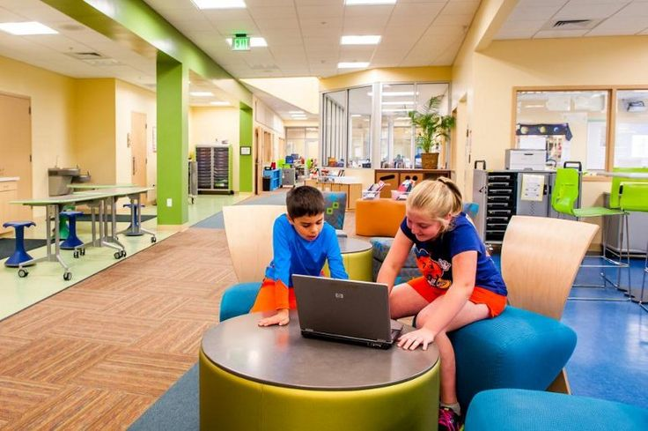
TEACHING & LEARNING
“Balanced with high content knowledge, the learning environment is one of the most important determinants of high quality teaching-learning exchanges.”
(Mind Brain and Education Science 220)
Notes:
Lauren http://thelearningmind.com/21st-century-classroom

Slide 12
WHAT FRIENDSWOOD ISD BELIEVES ABOUT LEARNING
That learning is meaningful, relevant and ever-evolving which motivates students, educators, parents, and community members to be lifelong learners.
Education for the future provides for the ability to learn and problem solve.
All students will be engaged in authentic learning experiences in and beyond the classroom.
Communication, collaboration and real-world connections lead to profound learning.
Relevant, authentic, engaged learning provides the best opportunity for true growth.
Notes:
Lauren - Point out words: meaningful, relevant, ever-evolving, engaged, authentic, communication, collaboration, real-world connections.
Table talk and share out - What do teachers roles look like based on FISD beliefs about learning?

Slide 13
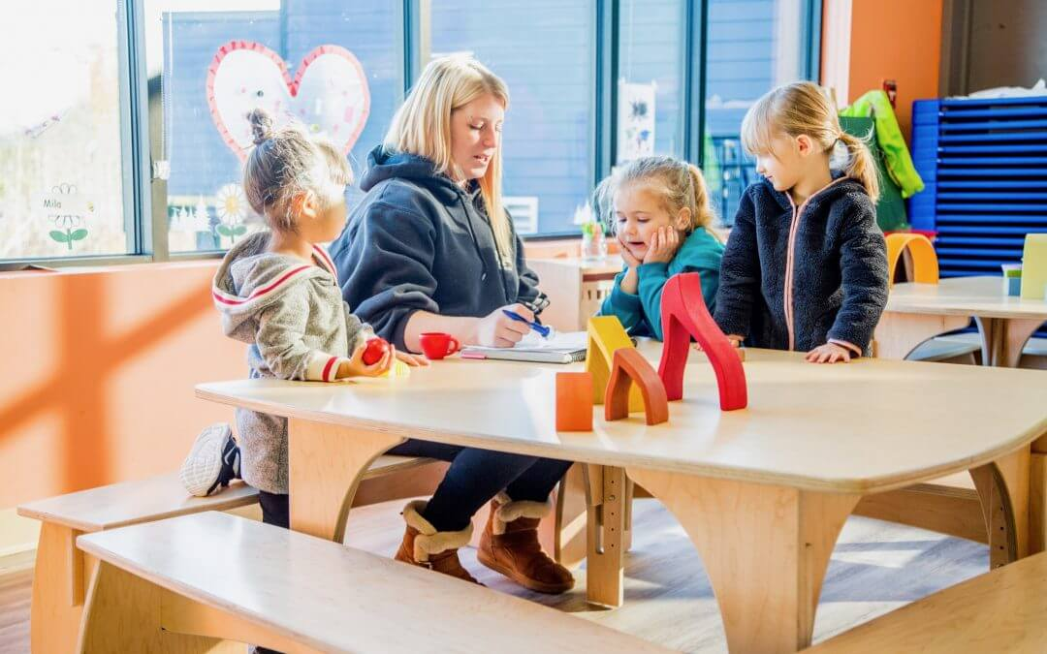
TABLE TALK…
What do the roles of teachers look like based on Friendswood ISD beliefs about learning?
Notes:
Lauren

Slide 14
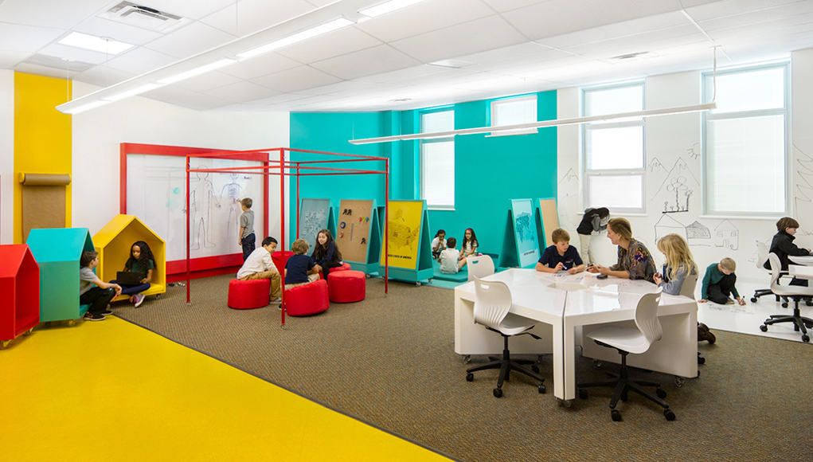
CHANGES IN INSTRUCTIONAL STRATEGIES
Collaboration/Cooperative Group Work
Inquiry/Discovery
Movement
Ability to create
Real world connection
Personalized/Small Group Instruction
Notes:
Lauren - Collaboration/Cooperative Group Work- laptops and ipads enhance digital discourse with global connections
Movement- Station/Rotation Model
Create- Maker Spaces
Mobile desks and chairs allow for groups to be flexible in size based on the scope of the project or work

Slide 15
CHANGES IN INSTRUCTIONAL STRATEGIES
Teacher Centered to Student Directed Learning
Reciprocal (Peer Teaching)
Project Based Learning
Notes:
Lauren - The teacher is moving from the front of the room to facilitating learning alongside students
Need for independent work stations

Slide 16
WHAT FRIENDSWOOD ISD BELIEVES ABOUT STUDENTS
Education has a responsibility to value and support all students’ dreams and aspirations.
Learning is unique to an individual’s passions and needs.
All students engage in meaningful authentic learning every day appropriate to their unique path.
Notes:
Diane - point out words: all students’ dreams, aspirations; individual’s passions and needs, unique path.
Table talk and share out - What do learning spaces look like which support FISD beliefs?
What do learning opportunities look like based on these beliefs?

Slide 17
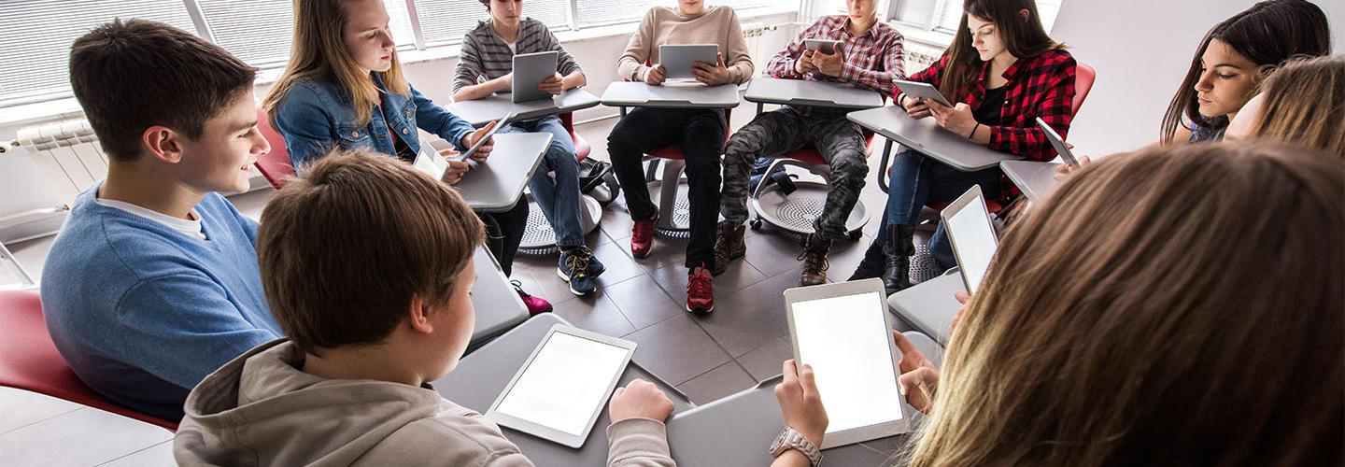
TABLE TALK…
What do learning spaces look like that support Friendswood ISD beliefs?
What do learning opportunities look like based on these beliefs?
Notes:
Diane

Slide 18
CURRENT LEARNING OPPORTUNITIES
CORE SUBJECTS
English, Math, Science, Social Studies
FINE ARTS/ELECTIVES
Athletics/Athletic Training, Art, Band, Choir, Dance, Debate, Health, Physical Education, Speech, Theatre, World Languages
CAREER AND TECHNICAL EDUCATION (CTE)
Agriculture, Arts/Audio/Visual and Communications, Business and Finance, Hospitality, Marketing, Education and Training, Health Science, Law/Public Safety/Corrections/ Security, STEM (Science, Technology, Engineering, Mathematics), Computer Science and Tech Applications
Notes:
Learning opportunities to support individual interest/passions. Goal to bring authentic learning experiences to all areas. CTE courses naturally lend themselves to hands-on, authentic learning opportunities.
CTE offerings begin in Junior High. Even though there are many CTE offerings, still not the complete package in all areas offered, will get to an example..

Slide 19
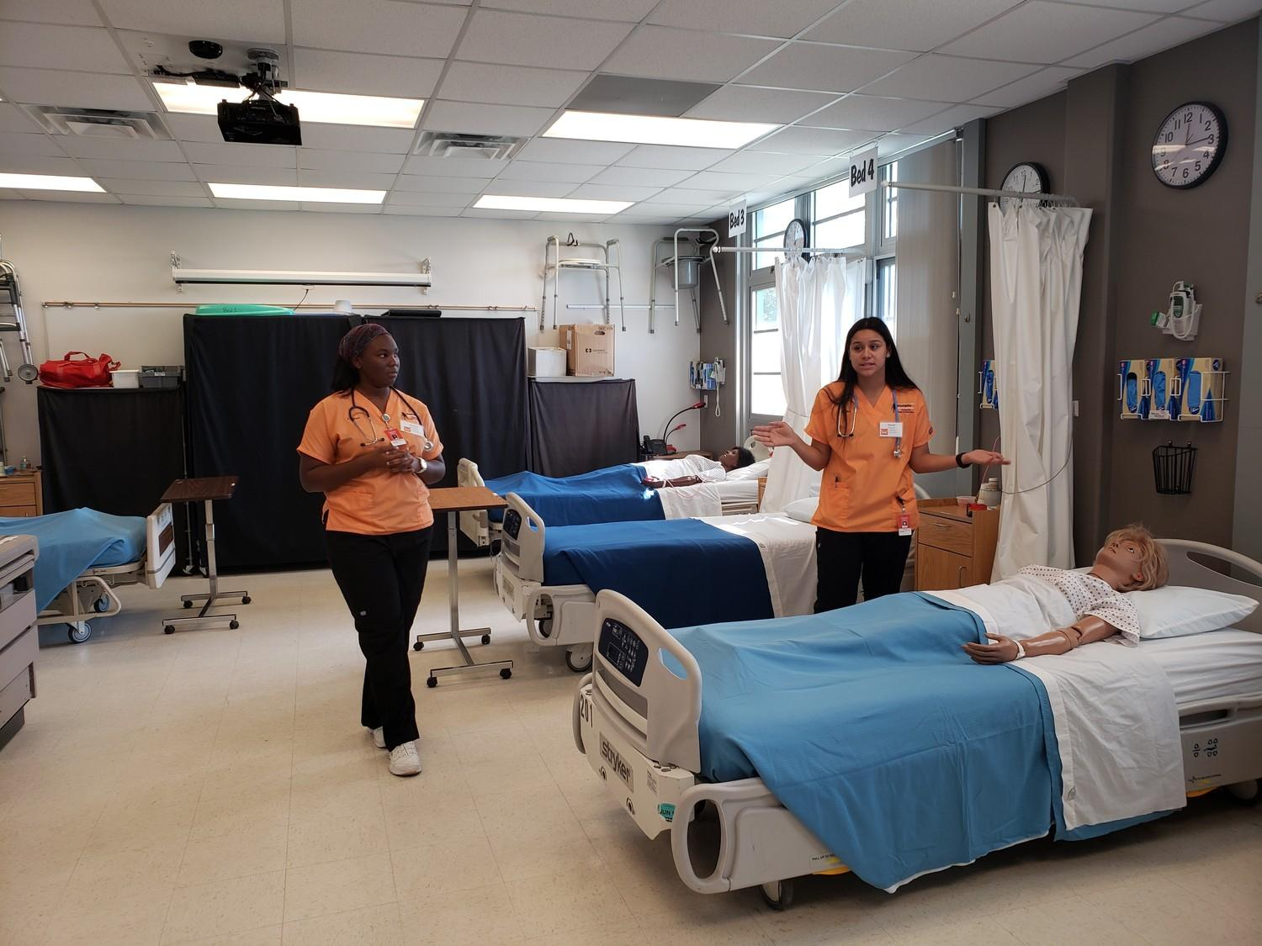
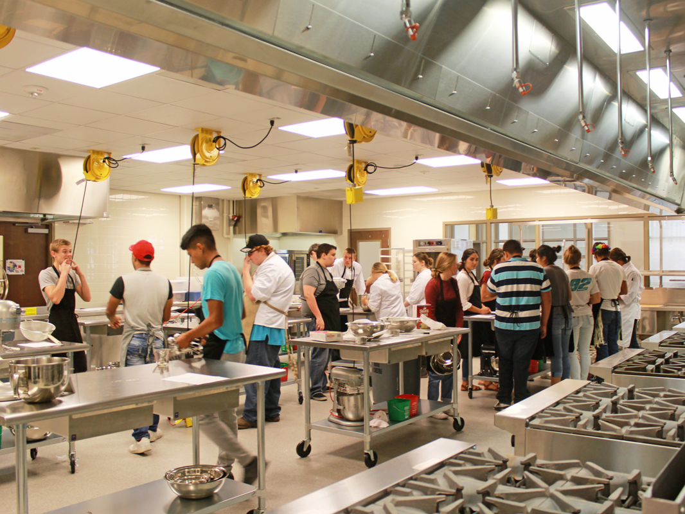
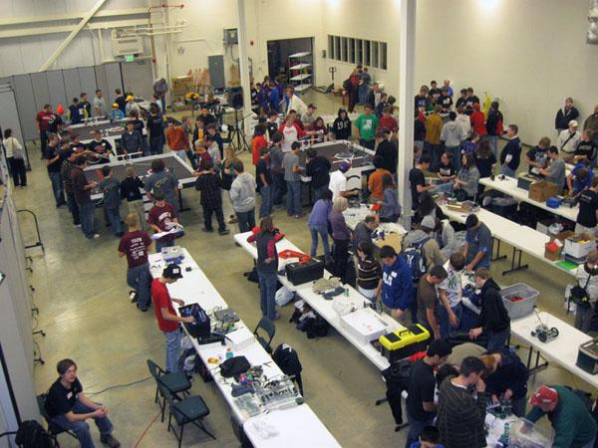
CURRENT PATHWAYS LIMITED BY SPACE
HEALTH SCIENCES
CULINARY
ROBOTICS
Culinary
Notes:
Susan - Limited space can mean several things or the combination - Students having to make other elective choices due to space. Space limits the enhancements of the program. Limited equipment, experience opportunities.
Currently have robotics, incubatoredu and engineering in same classroom. Strict limits because of space, example only room for so many computers, only room for so many students in current floral lab.
Health Science - space for labs, hospital clinic simulations. BioMed lab has to be set up and torn down, many labs need to sit for time (ie. growing cultures). Storage for equipment.
Culinary - Turned away 3 sections of kids to Intro to Culinary. If not their chosen pathway or they are still exploring, right now kids cannot take Intro to Culinary. Current sections are at capacity. Sections are split into the kitchen and learning lab, 2 lesson stations going on in each period, shared facility during each period. Industrial stove, kitchen stations, refride and freezers, store front.

Slide 20
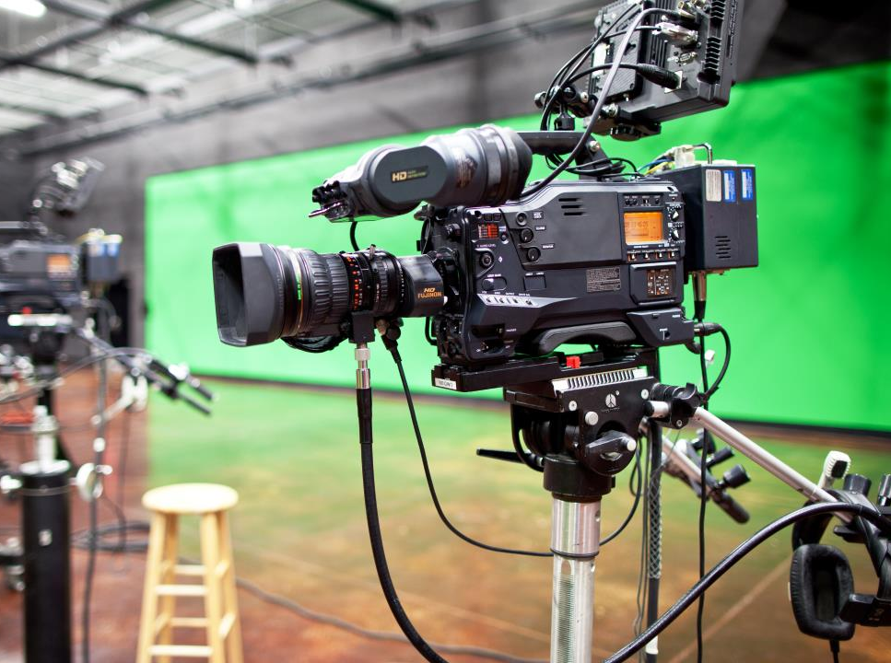
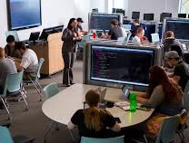
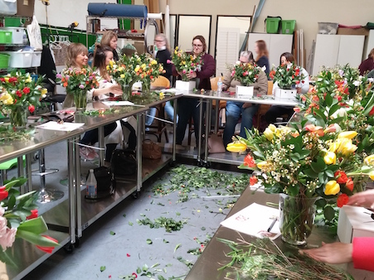
CURRENT PATHWAYS LIMITED BY SPACE
AUDIO/VISUAL PRODUCTION
COMPUTER SCIENCE
FLORAL DESIGN
Culinary
Notes:
Audio/Visual - limited on space which inhibits lightening setup/teardown, set creation (which inhibits forms of production, like interviews) control room, limited shots, storage (which limits equipment).
Computer Science - limited collaboration space bc the room is full of computers to allow more students to enroll. Students had to make second choice, and the courses are closed for new students enrolling.
Floral design - Storefront for floral design,
Programs not listed however dreams of expansion, small animal expand to dog grooming, socialize foster/service rescue animals.

Slide 21
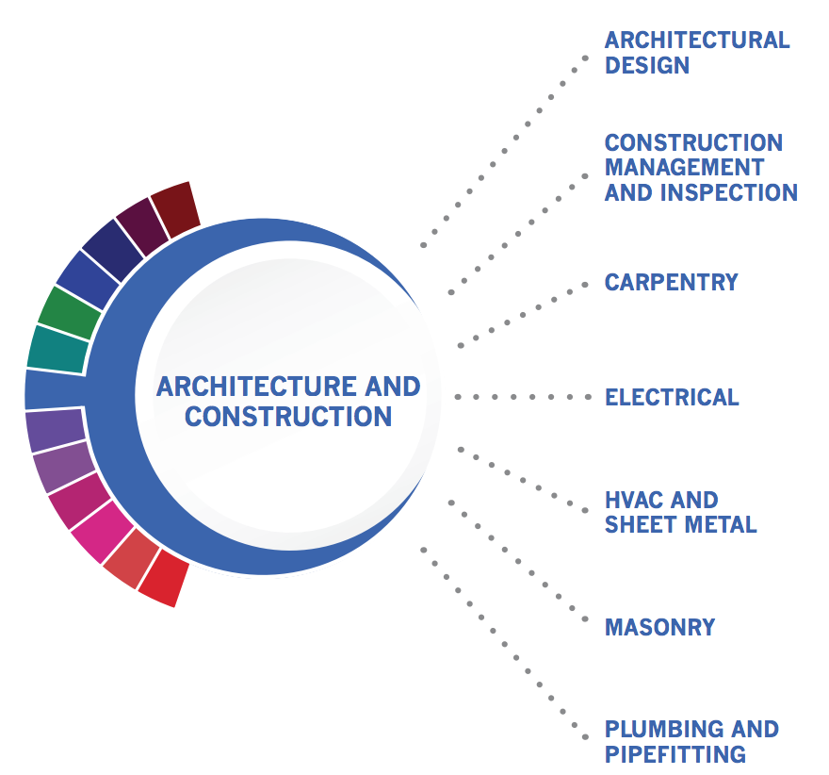
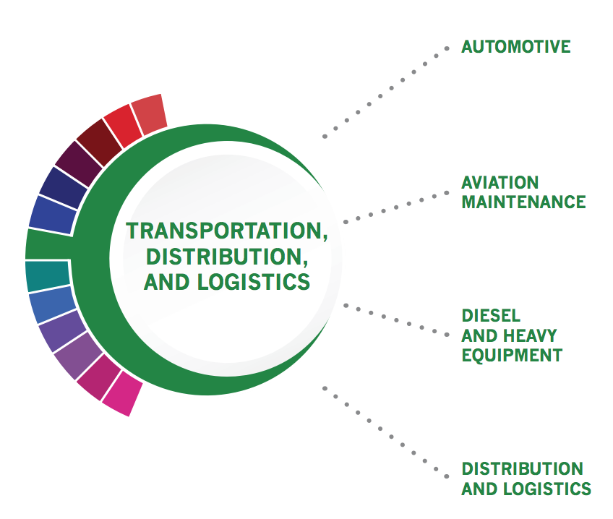
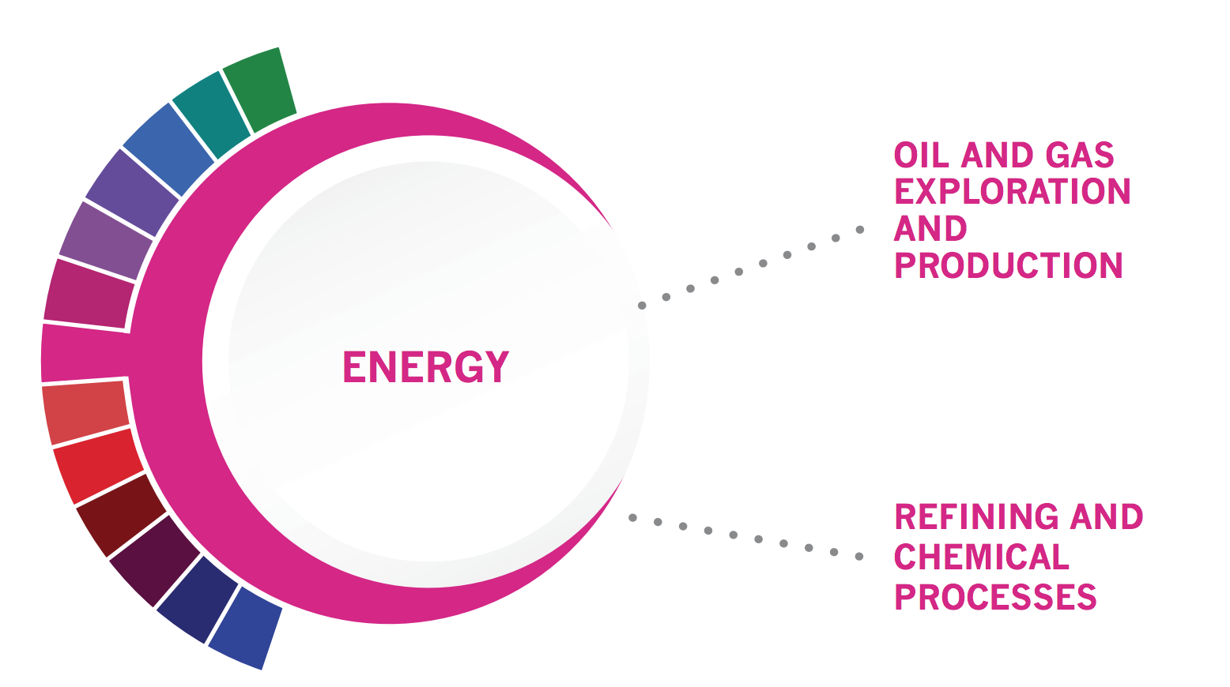
LIMITED FACILITIES, LIMITS PROGRAM OFFERINGS
Statewide Programs of Study Based On...
High Skill, High Demand, High Wage Occupations
Notes:
Susan Programs of study not offered in FISD. High demand in this area.

Slide 22
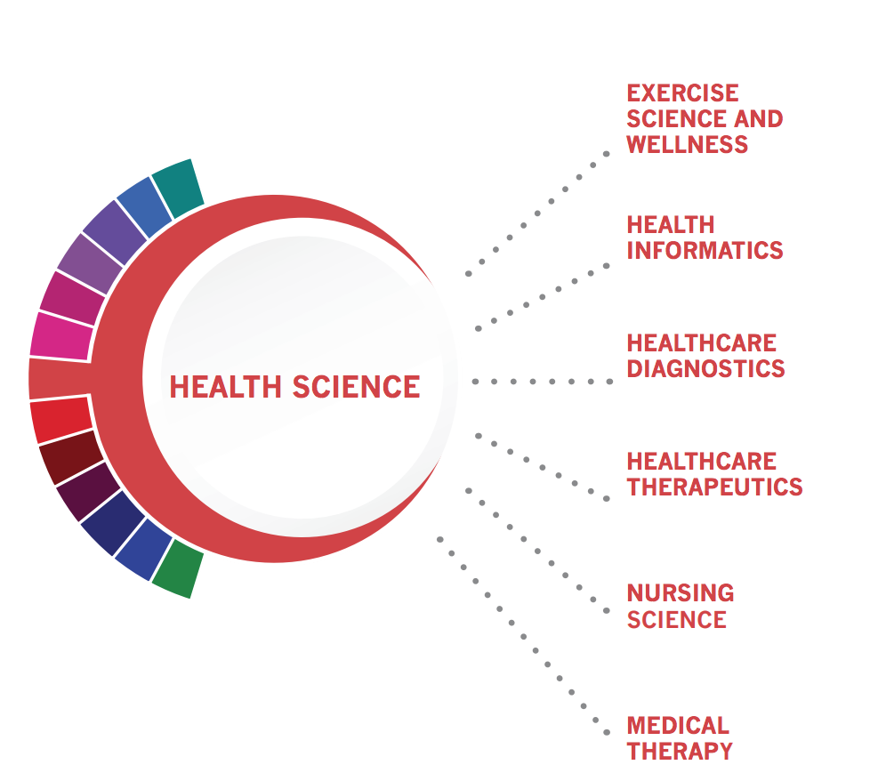
LIMITED FACILITIES, LIMITS PROGRAM OFFERINGS
Notes:
One good example - Current courses focus on Healthcare diagnostics, therapeutic, nursing science.
We offer Health Science pathway. So even though we offer the practicum, the courses where the learning takes place are not offere.

Slide 23
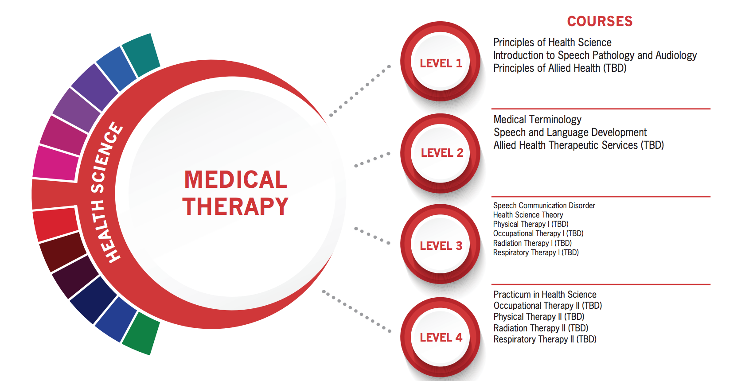
LIMITED FACILITIES, LIMITS PROGRAM OFFERINGS
Notes:
Level 3 and Level 4
We offer Health Science pathway. So even though we offer the practicum, the courses where the learning takes place are not offered.

Slide 24
IMPACT OF FACILITIES ON TEACHING & LEARNING
Expanding opportunities for every student to explore, choose, succeed and BE READY!
Notes:
Tying Bond back to this teaching and learning information.

Slide 25
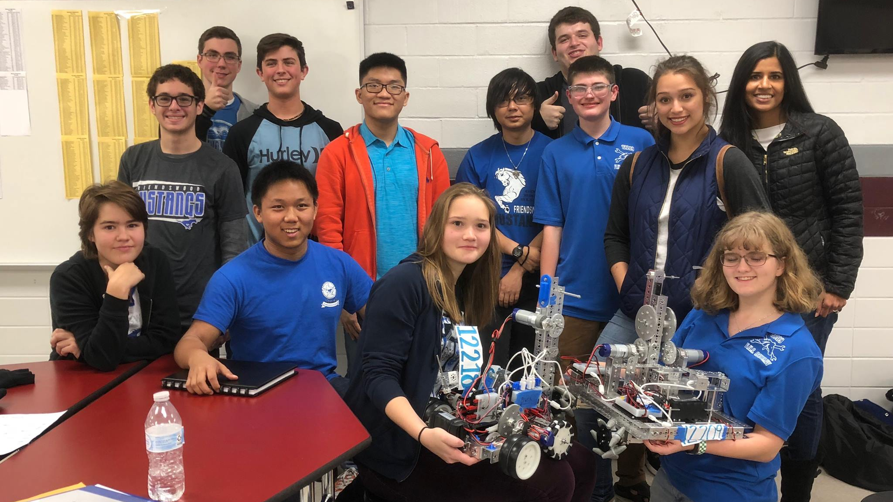
PROPOSED BOND PROJECT MATRIX

Slide 26
BOND PROJECT MATRIX

Slide 27
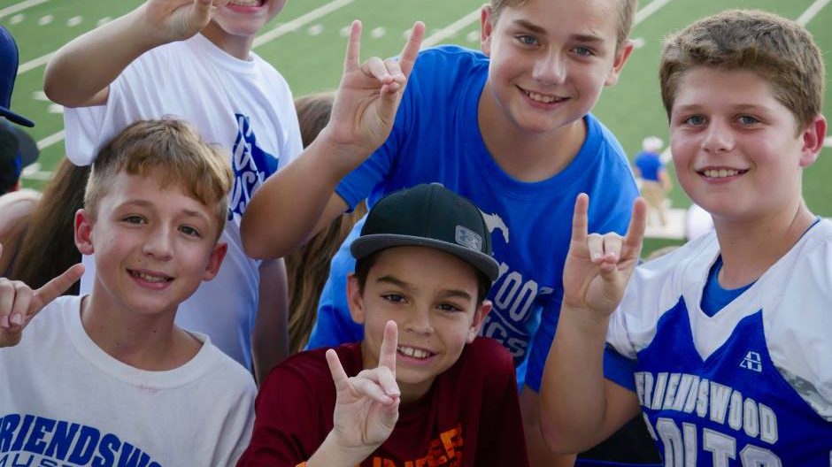
QUESTIONS?

Slide 28
SEE YOU NEXT TIME!
MEETING #3
Tuesday, October 15, 2019
Cline Elementary School

