Slide 1

2020 FISD Bond Project Kick-Off
Monday, November 16, 2020

Slide 2
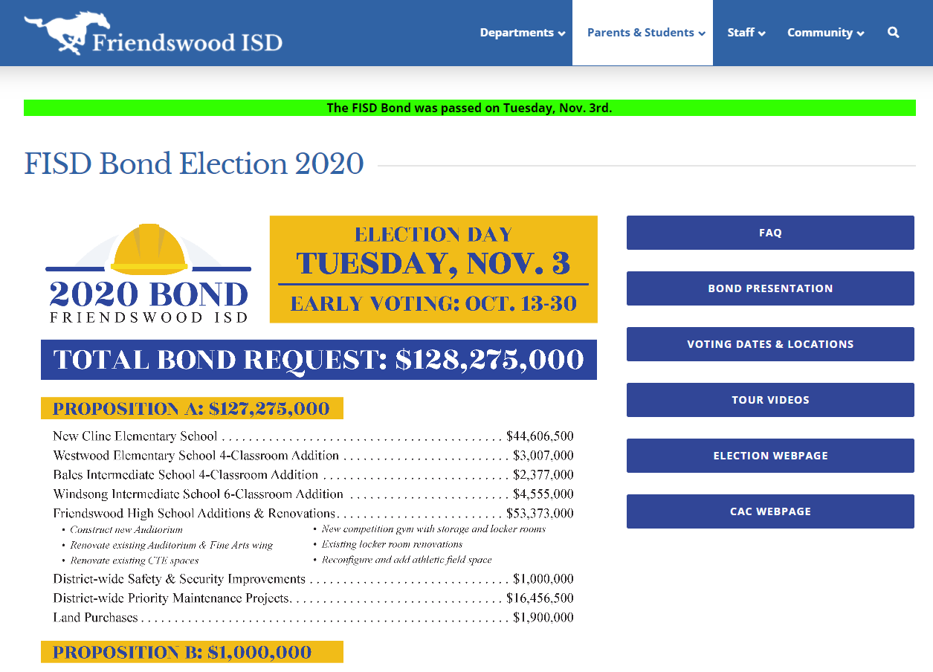
THE BOND PASSED!
Where do we go from here?

Slide 3

RFQ for Professional Services
November
Testing – Material, Geotechnical, etc.
Surveying
January
Commissioning Agent
Asbestos Removal

Slide 4
Cline Project Schedule
Programming & Planning | November 16, 2020 – January 4, 2021
CSP Delivery Method to Board of Trustees | December 14, 2020
Schematic Design – Departmental meetings & presentations | January 5 – March 8, 2021
SD Presentation to the Board of Trustees | March 8, 2021
Design Development – Departmental meetings & presentations | March 9 – May 10, 2021
DD Presentation to the Board of Trustees | May 10, 2021
Construction Documents (Milestones at 25%, 50%, 75%, 95% Issue for CSP) | May 11 – December 17, 2021
Bidding Phase (Advertisements, Pre-proposal conference, receive proposals, bid evaluation) | December 18, 2021 – February 1, 2022
CSP Recommendation to Board of Trustees | February 14, 2022
Construction Administration | February 15, 2022 – May 10, 2023
Substantial Completion | May 11, 2023

Slide 5
Friendswood High School Project Schedule
CM@R Delivery Method to Board of Trustees | December 14, 2020
2-Step Process: Release RFQ, Advertise, Receive Qualifications, Interviews, Short List, Receive Proposals, Evaluate, Negotiations, BOT Approval | December 15, 2020 – February 8, 2021
Programming & Planning – Detailed program for project | January 11 – February 15, 2021
Schematic Design – Departmental meetings & presentations, GMP Estimate from CM@R | February 16 – April 12, 2021
SD Presentation to the Board of Trustees | April 12, 2021
Design Development – Departmental meetings & presentations, GMP Estimate from CM@R | April 13 – June 14, 2021
DD Presentation to the Board of Trustees | June 14, 2021
Construction Documents (Milestones at 25%, 50%, 75%, 95% Issue for CSP), GMP Estimate at each milestone | June 15, 2021 – January 14, 2022
GMP Development Phase (CM@R) | January 15 – February 30, 2022
GMP Recommendation to Board of Trustees | March 14, 2022
Construction Phases (Multi-Phase) | March 15, 2022 – June 30, 2023
Substantial Completion Auditorium | July 15, 2023
Substantial Completion Gymnasium | July 15, 2023
Substantial Completion CTE/Renovation | January 6, 2024

Slide 6
Bales IS, Westwood ES & Windsong IS Project Schedule
Programming & Planning | March 15 – April 30, 2022
Schematic Design – Departmental meetings & presentations | May 1 – June 13, 2022
SD Presentation to the Board of Trustees | June 13, 2022
Design Development – Departmental meetings & presentations | June 14 – August 8, 2022
DD Presentation to the Board of Trustees | August 8, 2022
Construction Documents (Milestones at 25%, 50%, 75%, 95% Issue for CSP) | August 9 – November 8, 2022
Bidding Phase (Advertisements, Pre-proposal conference, receive proposals, bid evaluation) | November 9 – 29, 2022
CSP Recommendation to Board of Trustees | December 12, 2022
Construction Administration | December 13, 2022 – June 30, 2023
Substantial Completion | July 1, 2023

Slide 7
Cline Project Schedule
Programming & Planning | November 16, 2020 – January 4, 2021
CSP Delivery Method to Board of Trustees | December 14, 2020
Schematic Design – Departmental meetings & presentations | January 5 – March 8, 2021
SD Presentation to the Board of Trustees | March 8, 2021
Design Development – Departmental meetings & presentations | March 9 – May 10, 2021
DD Presentation to the Board of Trustees | May 10, 2021
Construction Documents (Milestones at 25%, 50%, 75%, 95% Issue for CSP) | May 11 – December 17, 2021
Bidding Phase (Advertisements, Pre-proposal conference, receive proposals, bid evaluation) | December 18, 2021 – February 1, 2022
CSP Recommendation to Board of Trustees | February 14, 2022
Construction Administration | February 15, 2022 – May 10, 2023
Substantial Completion | May 11, 2023

Slide 8
Cline Project Schedule
Programming & Planning
Meet with key stakeholders, campus and district administration
Define campus and community programs and capacities

Slide 9
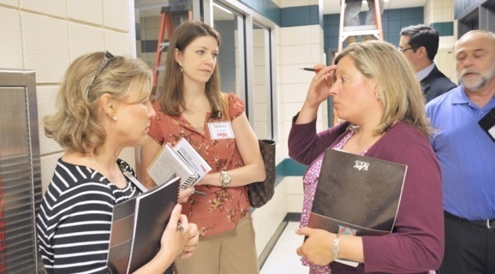
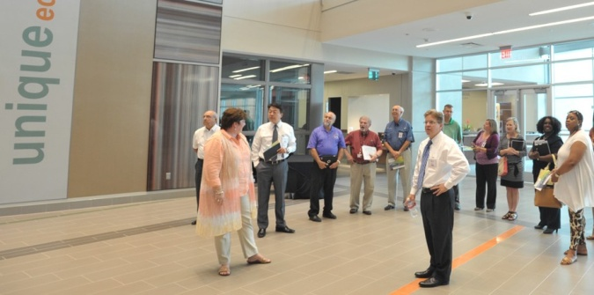
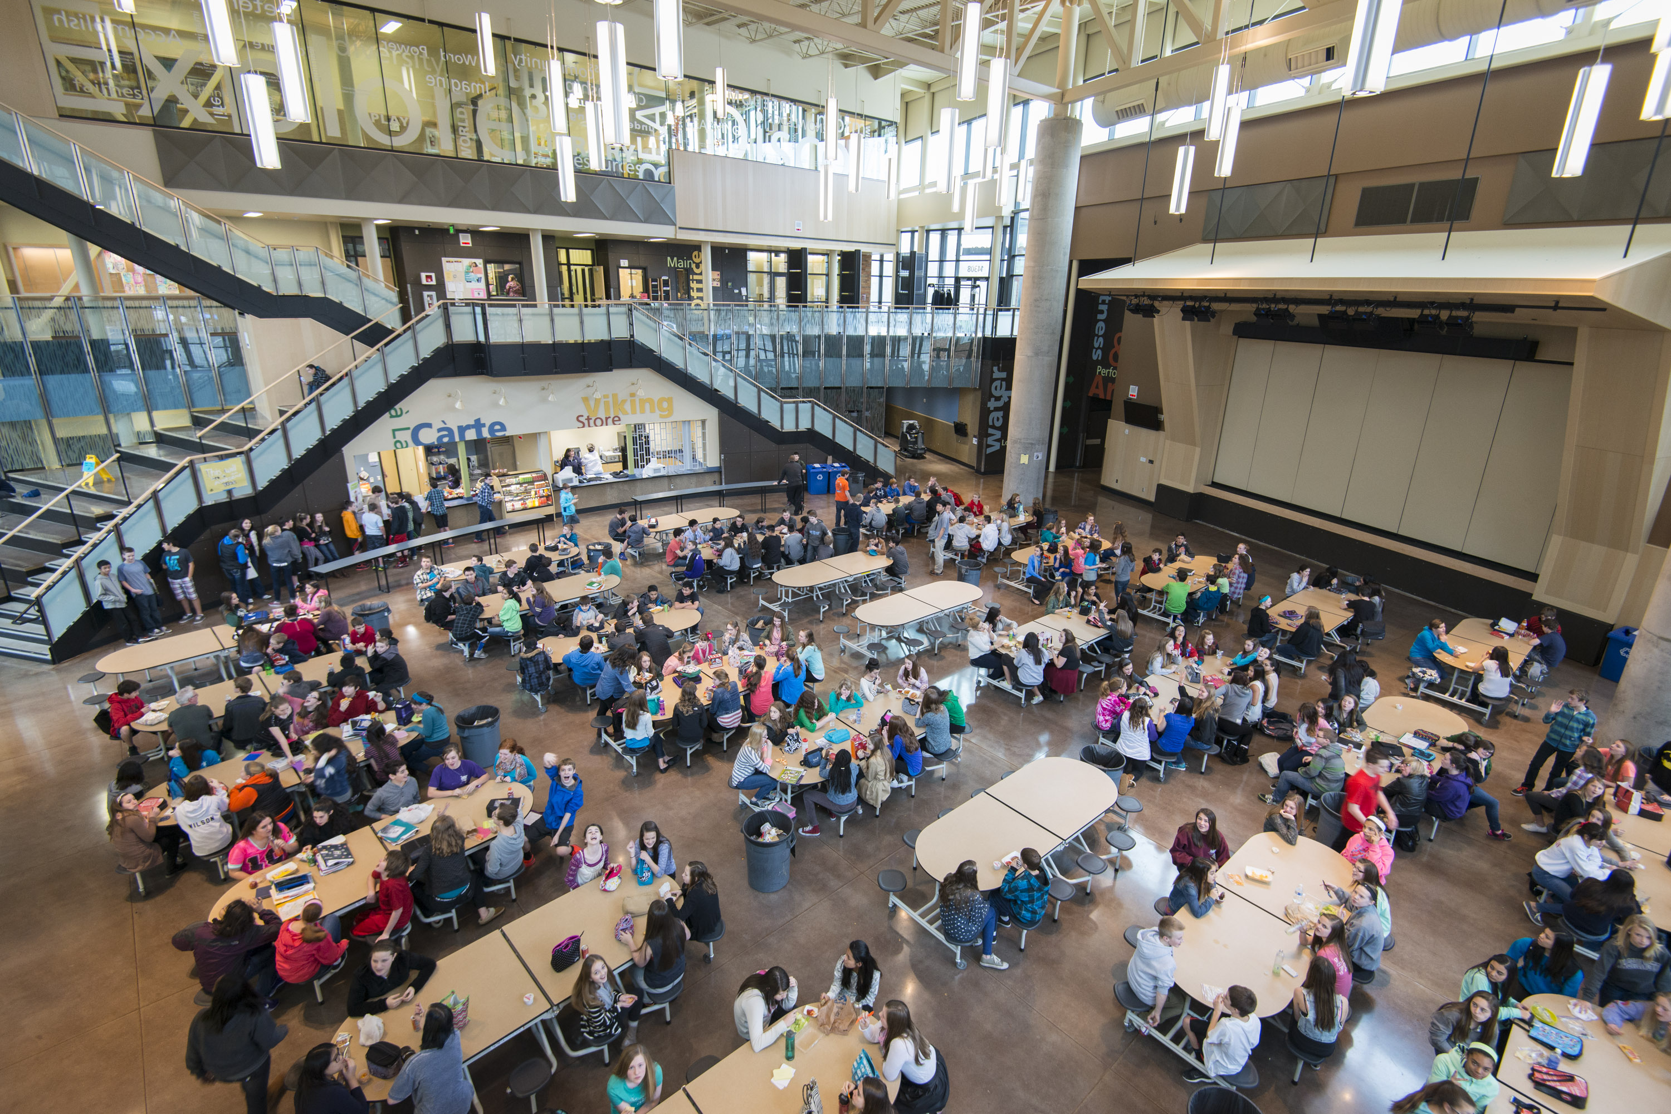
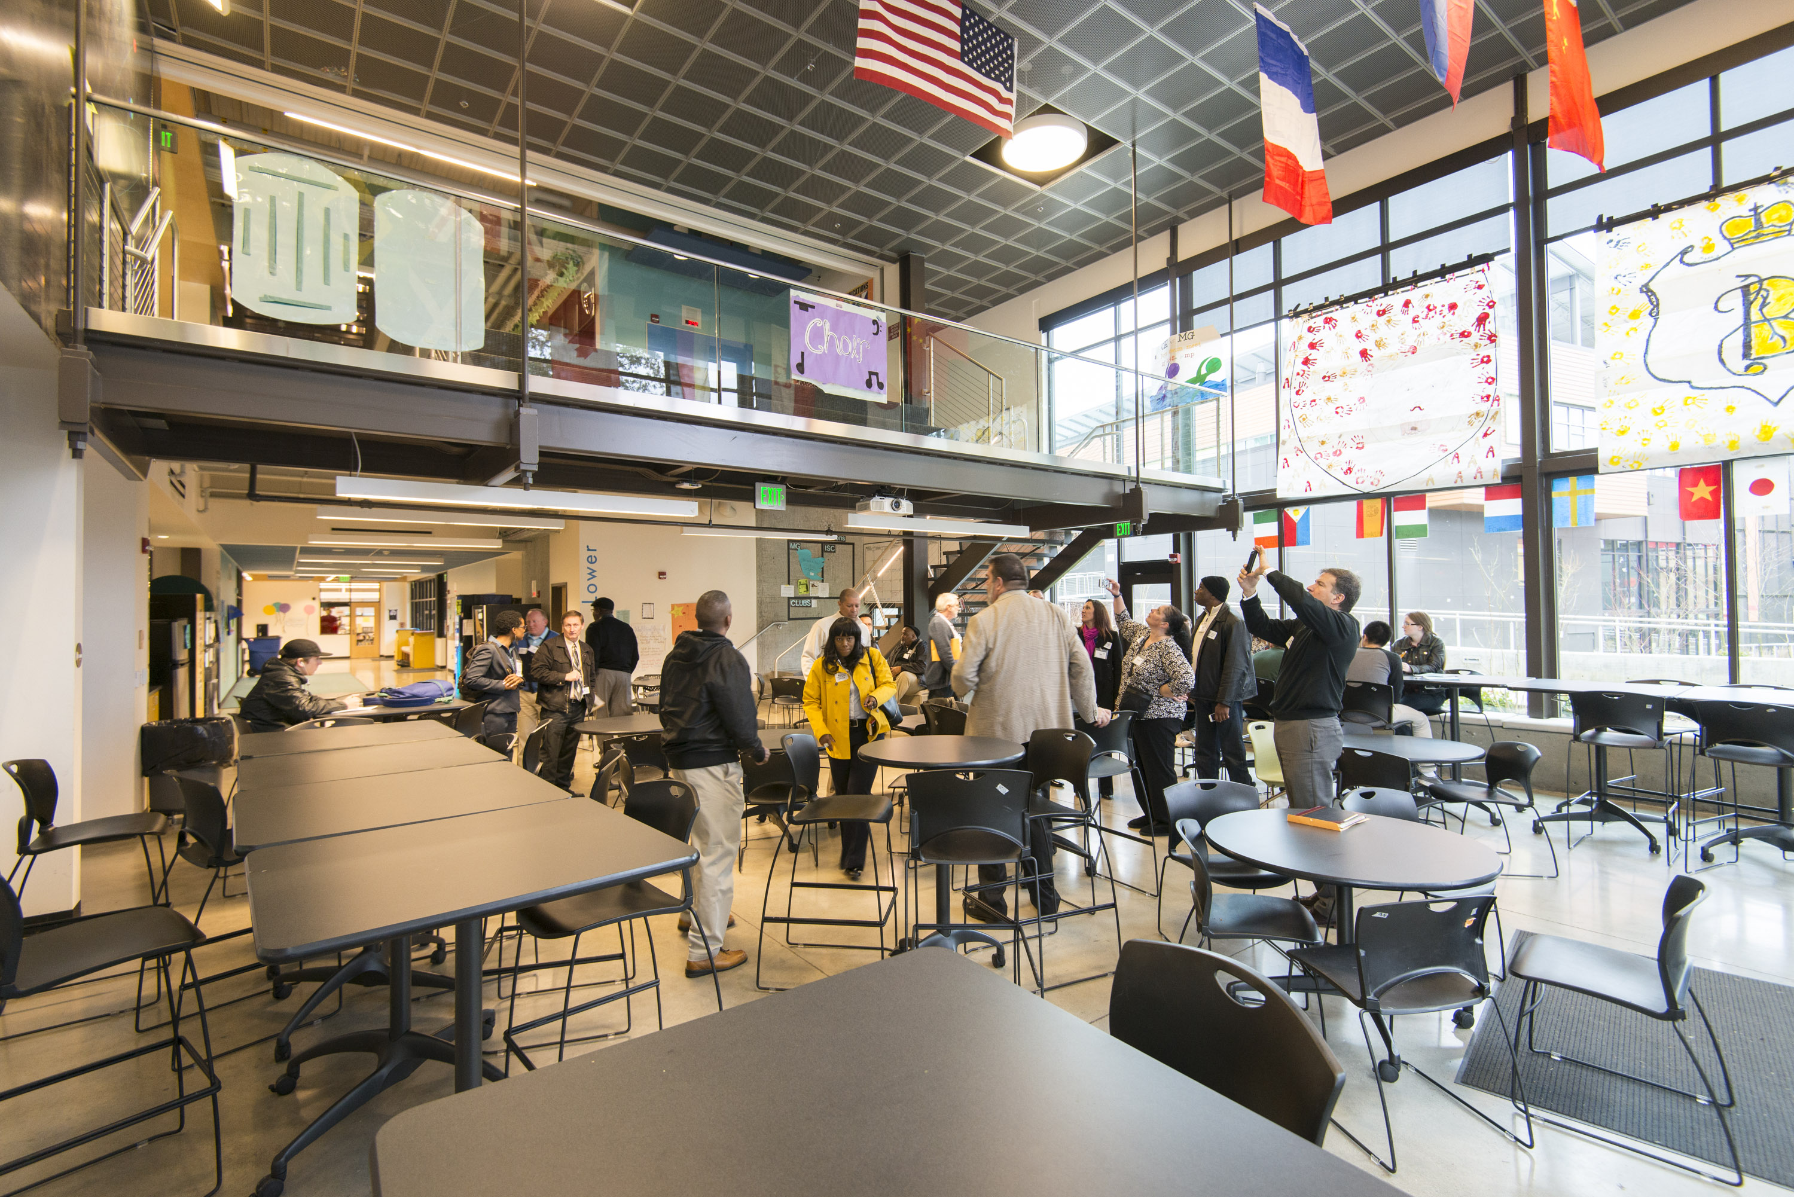
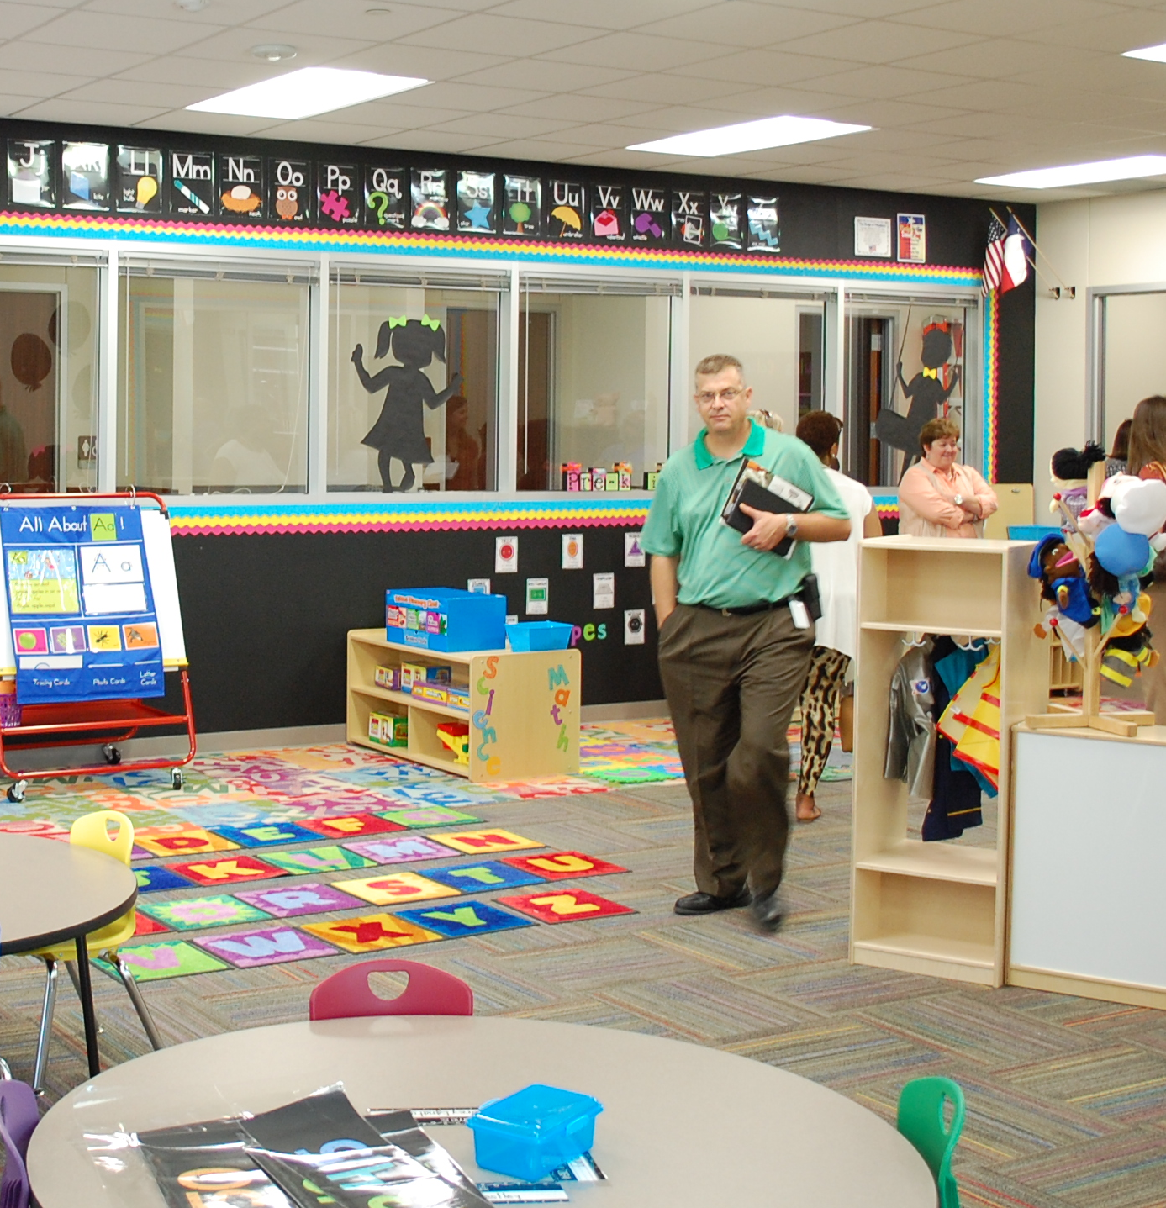
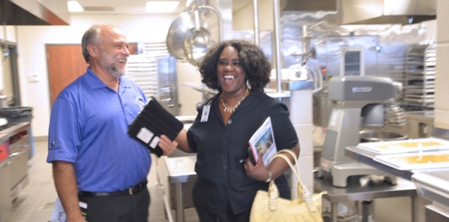
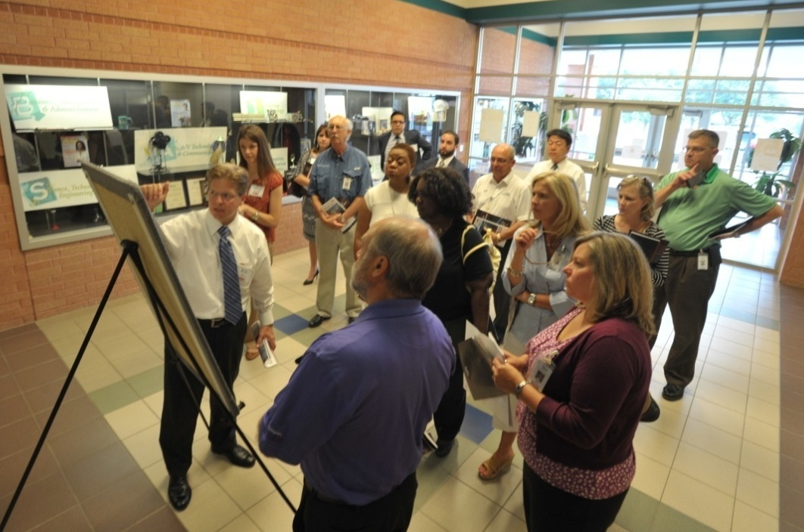
Project Schedule
Schematic Design - Benchmarking Tour
Tour schools and campuses
Define likes and dislikes

Slide 10
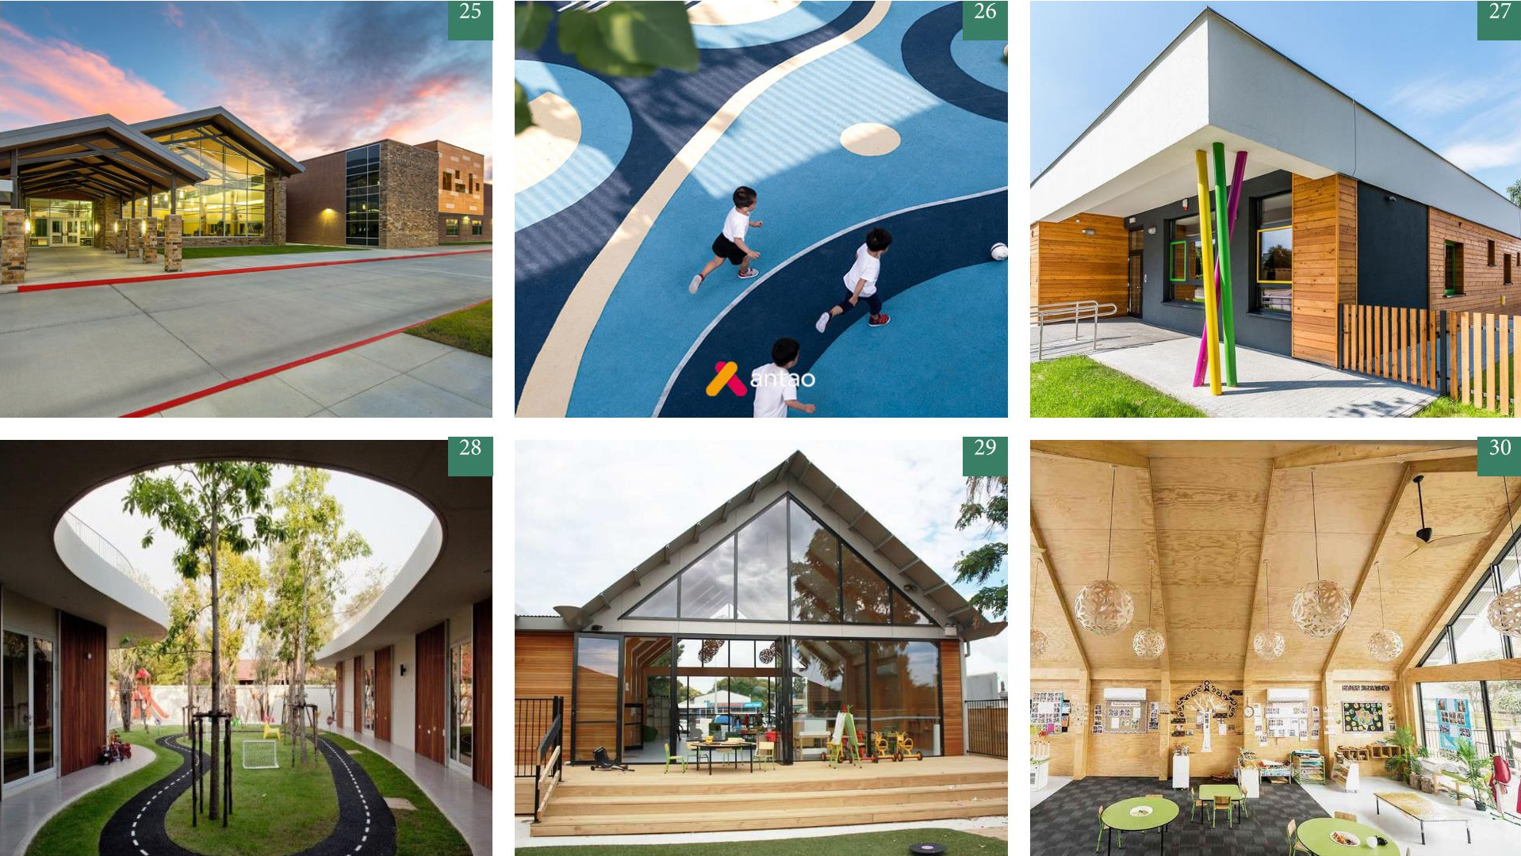
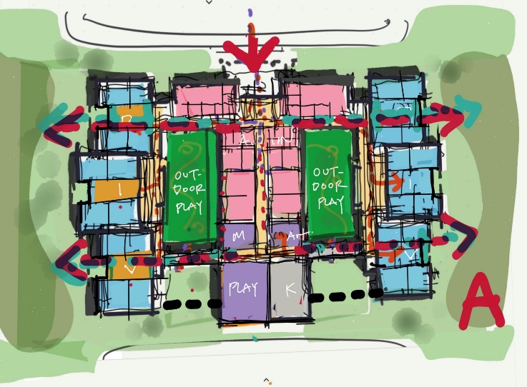
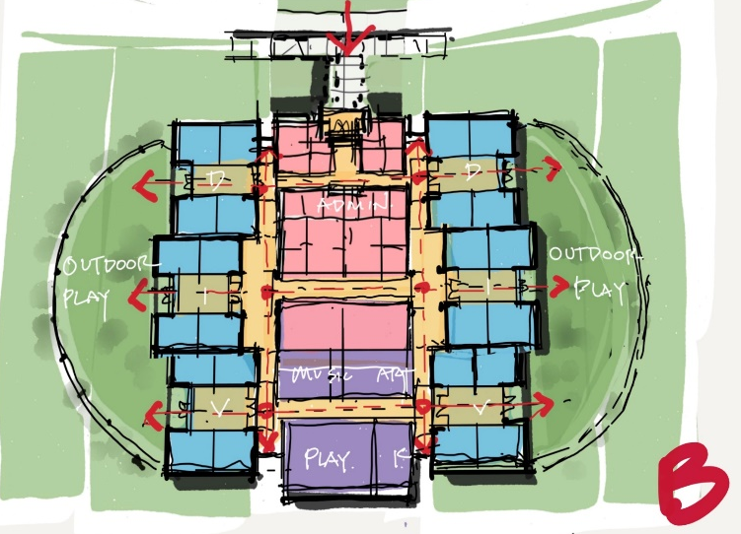
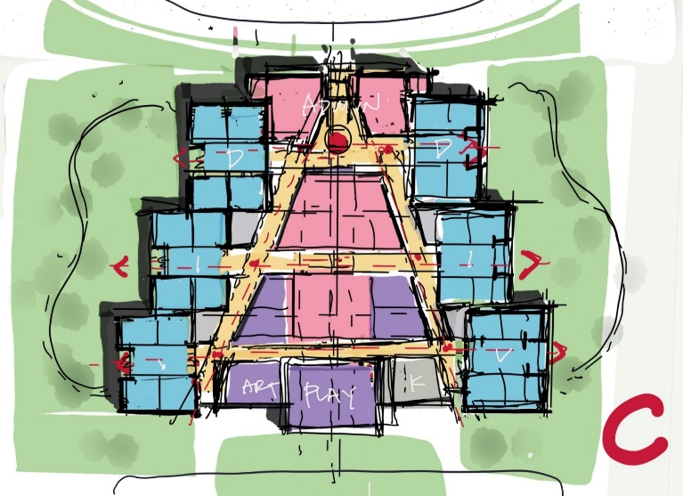
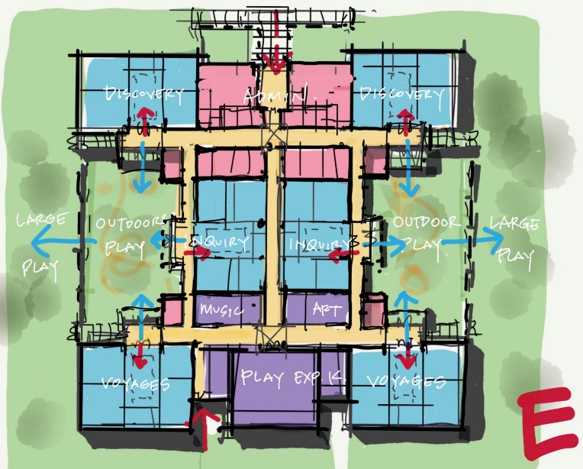
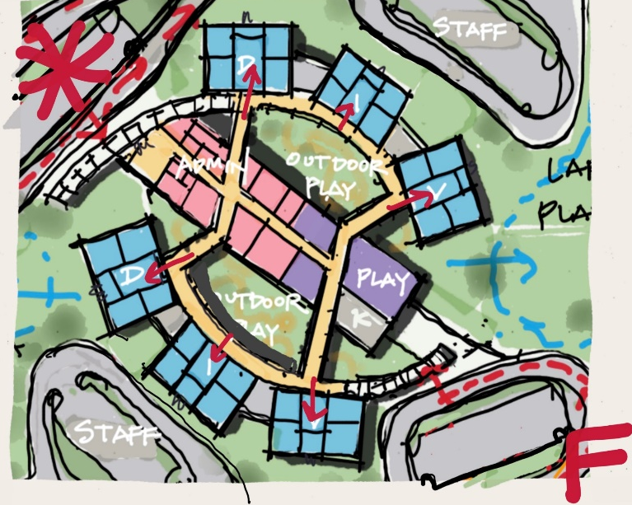
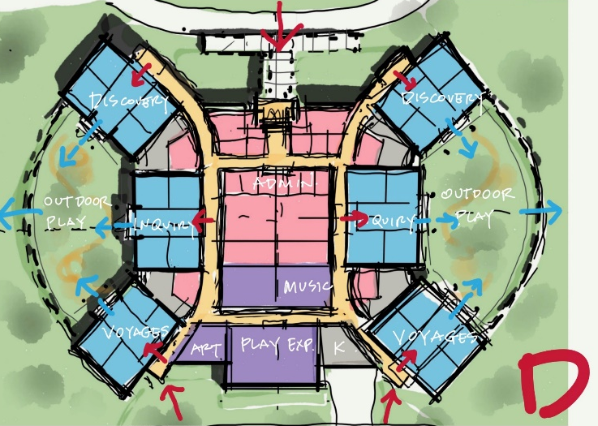
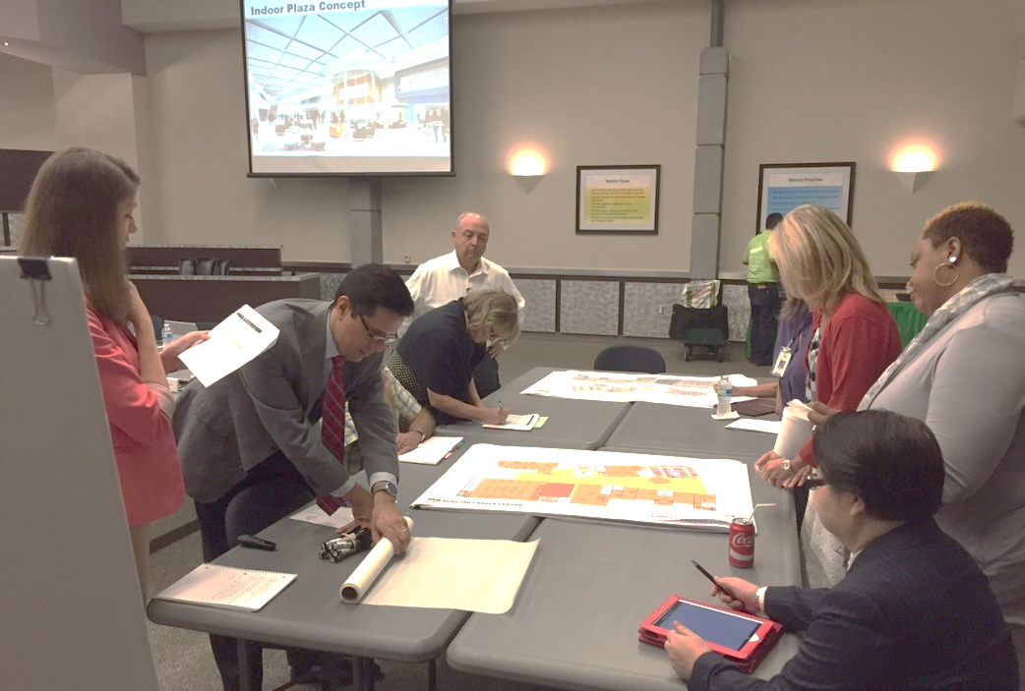
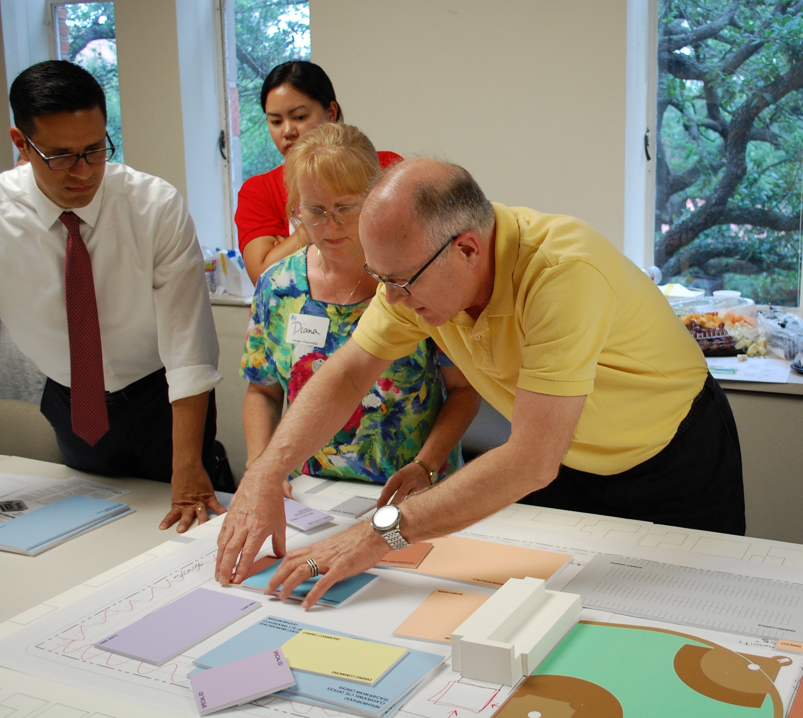
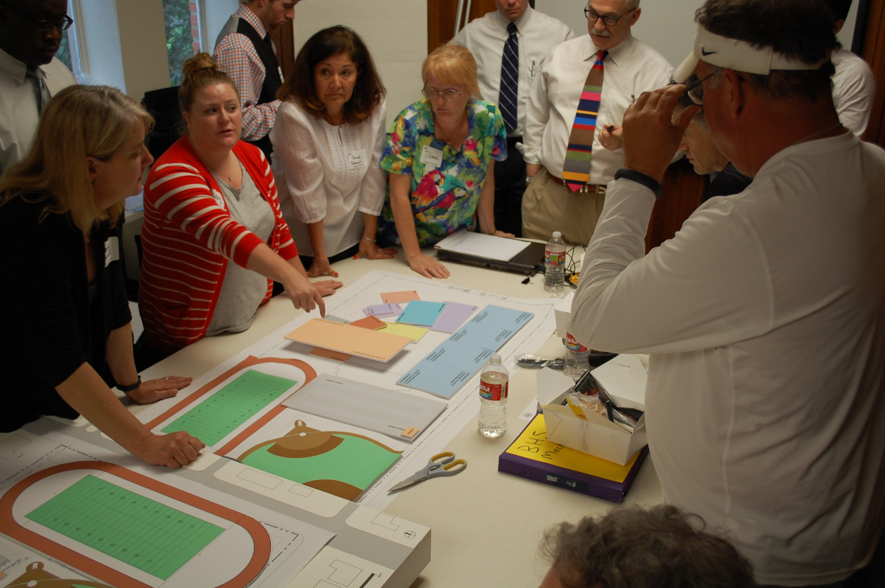
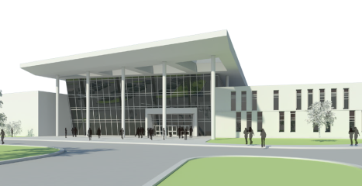
Project Schedule
Schematic Design – Design Charrette
Tour of Industry
Strengths and Opportunities identified from tour
Establish goals for the project

Slide 11
CSP vs. CM@Risk
CSP
CM@RISK
No Contractor Input During Design.
Architect creates budget and phasing schedule with owner input during design phase.
Select General Contractor based on Qualifications and Price after Design Phase.
General Contractor includes all subcontractor bids with bid package so limited Owner input on Sub Selection.
On a complex project with multiple phases, each phase must be bid out and the same GC would need to be ranked most qualified every phase to stay on the job for the duration or it all must be bid as one large package.
Select General Contractor based on Qualifications and Price before or during Design Phase.
Contractor Input on Project Costs and Constructability during the Design Phase.
Contractor gives Guaranteed Max Price at 90% Drawings.
Contractor creates project phasing schedule with architect and district input during Design Phase.
General Contractor solicits subcontractor bids for each scope of work and Owner has a good amount of input on Sub Selection.
On a complex project with multiple phases, the same GC can bid out multiple packages over a number of years if required.

Slide 12
Potential Construction Delivery Method
CSP
CM@RISK
Cline
Bales, Westwood & Windsong
Priority Maintenance Items
Friendswood High School

Slide 13






Other School Districts utilizing CM@Risk
Other School Districts
Numerous projects in Cy-Fair ISD including Additions and Renovations to Cy-Fair High School.
Additions and Renovations to Clear Lake High School, Clear Creek High School, and Districtwide Security Upgrades.
All projects in Conroe ISD including Additions and Renovations to Conroe High School.
Additions and Renovations to Pearland High School and Dawson High School.
Additions and Renovations to Klein Oak High School in Klein ISD.
Additions and Renovations to Northbrook and Stratford High Schools in Spring Branch ISD.
Additions and Renovations to Humble High School and Quest Early College in Humble ISD

Slide 14
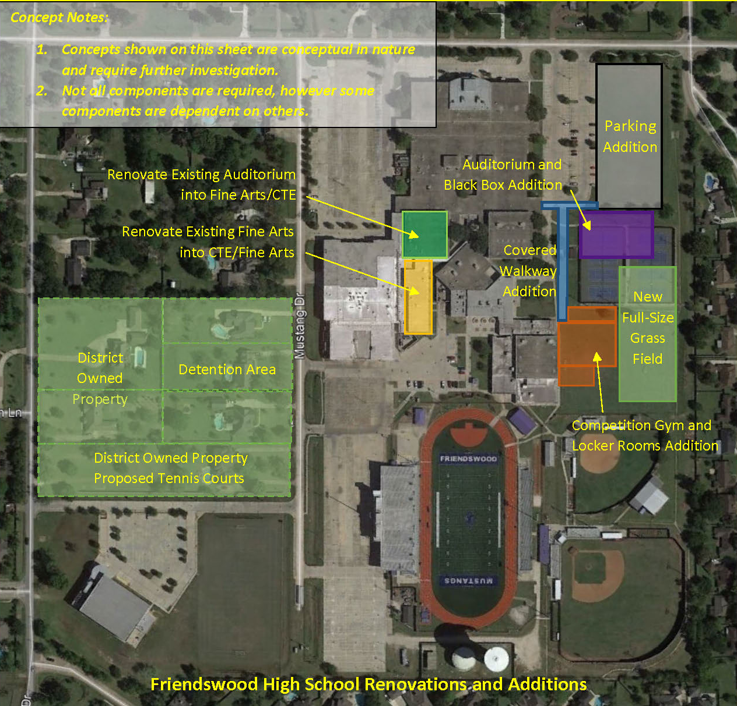

Slide 15
Next Steps
Programming & Planning | November 16, 2020 – January 4, 2021
CSP Delivery Method to Board of Trustees | December 14, 2020
Schematic Design – Departmental meetings & presentations | January 5 – March 8, 2021
SD Presentation to the Board of Trustees | March 8, 2021
Design Development – Departmental meetings & presentations | March 9 – May 10, 2021
DD Presentation to the Board of Trustees | May 10, 2021
Construction Documents (Milestones at 25%, 50%, 75%, 95% Issue for CSP) | May 11 – December 17, 2021
Bidding Phase (Advertisements, Pre-proposal conference, receive proposals, bid evaluation) | December 18, 2021 – February 1, 2022
CSP Recommendation to Board of Trustees | February 14, 2022
Construction Administration | February 15, 2022 – May 10, 2023
Substantial Completion | May 11, 2023

Slide 16
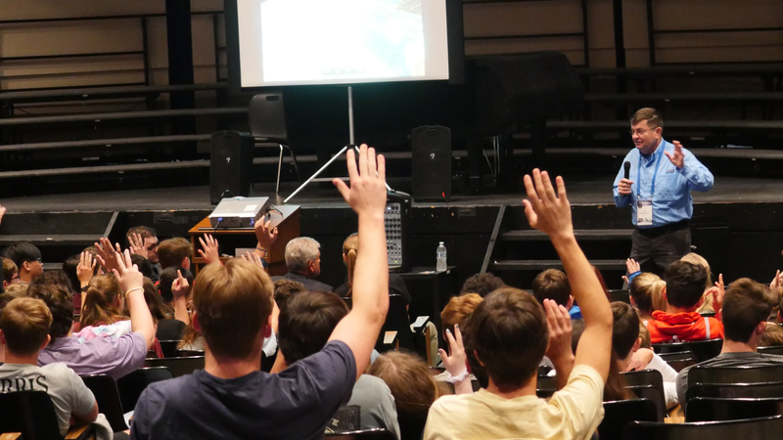

QUESTIONS?

