Slide 1
The Teen Brain
Under Construction….
Bridget Veale, RN
Mindy Wade, RN
November 3, 2020

Slide 2
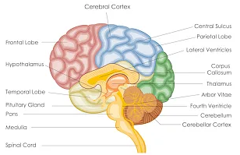
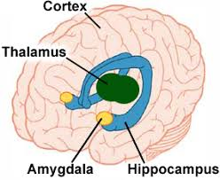
Brain Anatomy
Some people like to think of the brain in 4 parts:
The spinal cord and the base of the brain delivers messages to and from all parts of the body and controls what happens in the parts you don’t have to consciously think about like the heart, lungs, and digestion.
The cerebellum controls and coordinates movement and other brain processes.
The amygdala and hippocampus that control emotion and memory.
The cortex which connects up all the senses and thinking part, including the prefrontal cortex which is involved in fine judgement and control.

Slide 3
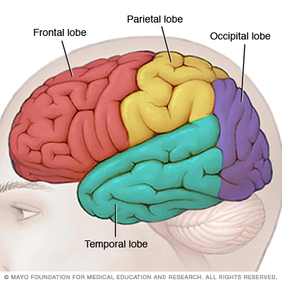
Different Lobes of the Brain
4 different lobes on each side of the brain, each having different functions.
Frontal Lobe: cognitive functions and control of voluntary movement or activity
Parietal Lobe: processes information about temperature, taste, touch and movement
Occipital Lobe: primarily responsible for vision
Temporal Lobe: processes memories, integrating them with sensations of taste, sound, sight and touch

Slide 4
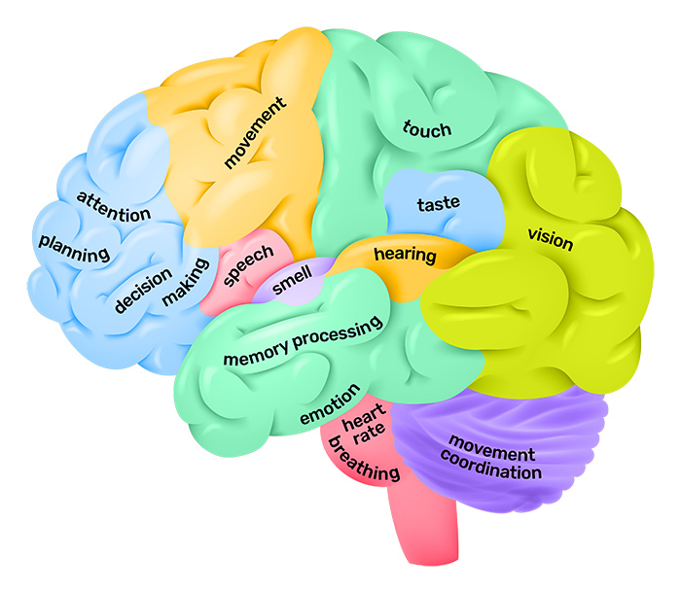
There are 2 halves to your brain connected by the corpus callosum. While many areas of the brain are working together constantly, certain areas tend to take on the bulk to certain functions.

Slide 5
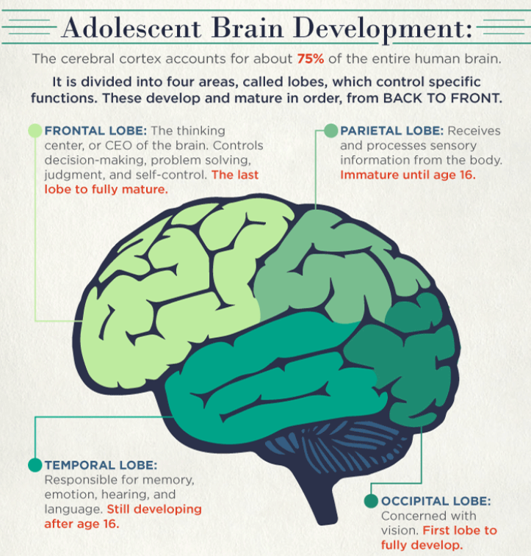
Notes:
The Limbic System, a group of brain structures that plays a central role in emotional responses (which includes the thalamus, hypothalamus, and basal ganglia) matures earlier. So as a teen, you may be neurologically more inclined to respond to situations with emotion vs logic given your still developing prefrontal cortex

Slide 6
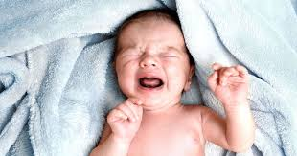
Consider baby sea turtles hatching on the sand and then somehow finding their way to the ocean or newborn giraffes being able to walk on their own within hours of birth...
It’s been stated that a human fetus would have to undergo a gestation period of 18 to 21 months instead of the usual 9 to be born at a neurological and cognitive development stage comparable to that of a newborn chimpanzee!
Despite being born so helpless, humans eventually have the largest adult-sized brain.
So, needing that extra time for our brains to develop is the trade-off for having highly developed brains capable of managing complex reasoning, communication and social skills, alongside the physical requirements and capabilities of our adult bodies.
Did you know that humans are the only animals that are born completely helpless?
Notes:
If we were born with a fully developed adult brain, our heads wouldn’t fit through our mother’s hips.
Brain development that continues after birth allows for adaptation to the environment and increased survival.

Slide 7
Brain Development
The teenage brain has been defined as one’s brain between the onset of puberty until the time an individual becomes an independant, working member of society
Scientists used to believe that all of our brain development was completed by the end of early childhood but, with the use of MRI imaging we see that areas of the brain continue to grow in the teen years.
Scientists can see images of the GREY matter in the brain and specifically the synapses or connections between the GREY matter.
The environment you live in and the stimulus that your brain is getting from the environment you live in can either STRENGTHEN the synapses or WEAKEN them

Slide 8
How a teenage brain differs from an adult brain
An area of the brain called the pre frontal cortex is not yet fully formed in adolescents. This explains ALOT about teen behavior!!!
This pre frontal cortex allows humans to properly make decisions, it helps you determine how to act in certain social situations and controls your inhibitions in social situations. Based on this knowledge we can see why teens are often look at as “risk takers” they may appear to be more moody, self conscience or embaress easily. Most importantly a teenage brain doesn’t have the ability to reason out behaviors that may be too risky. Teens often do thinks to impress their friends that older adults could reason as being too unsafe or socially inappropriate- ALL BECAUSE THEIR PRE FRONTAL CORTEX IS NOT YET FULLY FORMED

Slide 9
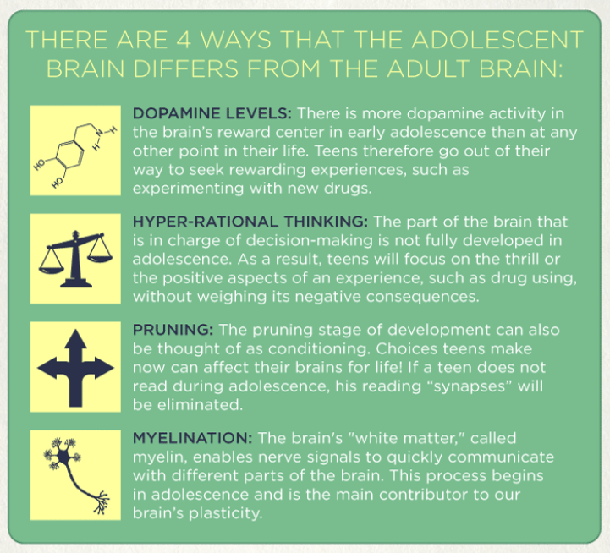

Slide 10
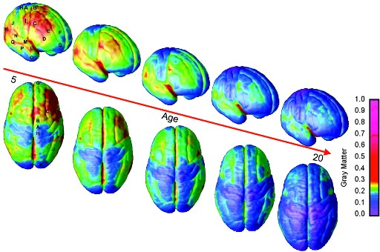
The Developing Brain
The brain doesn’t change much in size between ages 5-20, but the neural connections expand.
In this picture you’ll see increased areas of blue as this brain ages which denotes the enhanced brain connections being formed.

Slide 11
7 Things to Know about the Teen Brain
The brain reaches its biggest size in early adolescence, around age 14.
The brain continues to mature even after it’s done growing.
The teen brain is ready to learn and adapt. It has lots of plasticity, so challenging mental tasks, physical activity, and creative endeavors all help the brain mature and learn.
Many mental health disorders first present in adolescence. All the physical, emotional, and emotional changes that teens are undergoing may be why we see these diagnoses often develop around this time.
Institute of Mental Health (2020): https://www.nimh.nih.gov/health/publications/the-teen-brain-7-things-to-know/index.shtml#:~:text=3.-,The%20teen%20brain%20is%20ready%20to%20learn%20and%20adapt.,the%20brain%20mature%20and%20learn.

Slide 12
7 Things to Know continued…
5) Teen brains may be more vulnerable to stress. Because teen brains are still developing they may respond differently to stressors and thus can be more vulnerable to things like anxiety and depression.
6) Teens need more sleep. Research shows that melatonin (the “sleep hormone”) levels in the blood are naturally higher later at night and drop later in the morning in teens than in most children and adults. This difference may explain why many teens stay up late and struggle with getting up in the morning. Teens should get about 9 to 10 hours of sleep a night, but most teens do not get enough sleep.
7) The teen brain is resilient. Adolescence is a vulnerable time, but most teens go on to become healthy adults.
National Institute of Mental Health (2020): https://www.nimh.nih.gov/health/publications/the-teen-brain-7-things-to-know/index.shtml#:~:text=3.-,The%20teen%20brain%20is%20ready%20to%20learn%20and%20adapt.,the%20brain%20mature%20and%20learn.

Slide 13
Teen Brain Development
https://www.youtube.com/watch?v=EpfnDijz2d8&feature=youtu.be

Slide 14
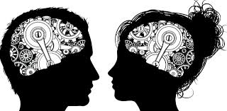
Are there differences between male and female brains?
Maybe? But does it really matter?
Male brains tend to be 9-12% larger
Female brains mature earlier.
Some studies have suggested the following differences:
Females are more prone to experience depression and PTSD.
Males are more likely to be diagnosed with schizophrenia, dyslexia, and autism. Males are more likely to become alcohol or drug-dependent.
Individual brain regions that have most consistently been reported as different in males and females include the basal ganglia, hippocampus, and amygdala.
There are differences in white matter development during adolescence
(https://stanmed.stanford.edu/2017spring/how-mens-and-womens-brains-are-different.html#:~:text=In%20a%202014%20study%2C%20University,activity%20was%20more%20tightly%20coordinated https://www.psychologytoday.com/us/blog/so-happy-together/201904/male-and-female-brains https://www.sciencedaily.com/releases/2019/09/190909113023.htm https://www.ncbi.nlm.nih.gov/pmc/articles/PMC2818549/ )

Slide 15
Difference between male and female brains?
Some researchers argue that the brains of men and women are wired differently. The male brain is wired from front to back, with few connections across the two hemispheres. Women, on the other hand, tend to have more wiring from left to right, so the two hemispheres are more interconnected. The female brain also tends to have more wiring in the areas that play a role in social cognition and verbal communication, which may be why women tend empathize better with others, have a better sense of what’s going on around them, and provide richer verbal descriptions.
Some studies have suggested different sexes perform better on certain tasks, likely due to differences in brain wiring.
Females tended to perform better with: multi-tasking, attention, social cognition, word memory, and facial memory
Males tended to perform better with: spatial processing, sensorimotor speed, tracking moving objects, and aiming projectiles.
However, keep in mind that there is no conclusive evidence that these strictly sex-related differences with one’s brain are truly significant in our everyday lives.

Slide 16
Neurosexism
Neurosexism is a term related “the practice of claiming that there are fixed differences between female and male brains.”
The idea of a “male” and “female” brain is essentially flawed and not that binary.
Our abilities and behaviors are more than just our biology; they are impacted by so many factors such as our environment, culture, values & beliefs…..
So, don’t ever let anyone tell you that you can’t do something based on antiquated gender roles or stereotypes.
(https://www.nature.com/articles/d41586-019-00677-x , https://theconversation.com/how-neurosexism-is-holding-back-gender-equality-and-science-itself-67597, https://www.newsweek.com/sexism-brains-female-male-neurosciences-feminism-determinism-514426)

Slide 17
Factors that can enhance your cognitive maturity
A healthy sense of autonomy and self-reliance
Perspective-taking: Being able to consider the big picture and having concern for others
Temperance: being able to limit impulsivity and have self-control
These 3 factors have been linked to “maturity of judgment” and can help lead you toward more responsible and beneficial decisions.

Slide 18
Alcohol & Drug Use and Abuse
Substances essentially infiltrate the brain’s communication system and tamper with the way nerve cells normally send, receive, and process information causing short-term and long-term consequences. They can trigger the reward center and unnaturally increase dopamine levels which then essentially starts telling your brain, you need this drug/drink more than you need food, sleep, work, friendships, etc…
Drugs and Alcohol mainly affect 3 parts of the brain:
The Brainstem - affecting functions our body needs to stay alive
The Limbic System - linked to our emotional response, so good feelings will trigger you to repeat a behavior
The Cortex - affecting our ability to think, plan, solve problems, and make decisions
Drugs and alcohol can lead to dramatic changes in the brain and these changes can even persist after the person stops using the substance. More pronounced changes can happen with increased and repeated use of drugs or alcohol.

Slide 19
Heightened Risks for Teens
Since the teen brain is still developing, substances like drugs and alcohol can have even more significant effects, so you are at increased risk for more long-term consequences.
The brain is undergoing massive and rapid changes and developments in adolescence, so what you do now to “feed” your brain can be a big deal.
But everybody must be doing it…. Not really. According to the CDC (2017)
3.2% of kids aged 12-17 smoked cigarettes in the past month
9.9% used alcohol in the past month

Slide 20
Long-term risks…..
Long-term drug use can cause long-term brain changes and increases the risk for addiction. Drinking at a young age can lead to alcohol dependence as an adult.
Teen who begin to use any addictive substances prior to age 18 are 6.5x more likely to develop a substance use/abuse disorder
Research has shown that marijuana use during the teenage years can cause attention, behavior, and impulse control problems in adulthood.
When the frontal cortex is presented with cannabinoids during adolescence, the development of the prefrontal cortex is slowed. Negative effects on the frontal cortex can lead issues with decision-making, changes in personality, behavioral difficulties, and more.

Slide 21
If you are concerned about your own or a loved one’s drug or alcohol intake, check out the following resources:
Substance Abuse and Mental Health Services Administration (SAMHSA):
https://www.samhsa.gov/find-help/national-helpline, 1-800-662-HELP
Family brochure: https://store.samhsa.gov/product/Alcohol-and-Drug-Addiction-Happens-in-the-Best-of-Families/SMA12-4159
The Massachusetts Substance Use Helpline: https://helplinema.org/for-parents/
MA Department of Mental Health Young Adult Resource Guide:
https://www.mass.gov/info-details/department-of-mental-health-young-adult-resource-guide-substance-abuse-resources
You can also check out the Keefe Tech Virtual Nicotine Vaping Group. Contact Ms. Fairclough for more info: jfairclough@jpkeefehs.org
If you or a family member are experiencing a mental health or substance use disorder crisis, the Emergency Services Program/Mobile Crisis Intervention (ESP/MCI) is available 24 hours a day, 7 days a week, 365 days a year. Anyone may contact ESP/MCI for assistance. Call toll-free at 1-877-382-1609, anytime, day or night: https://www.mass.gov/guides/finding-mental-health-support-in-massachusetts#-getting-24-hour-emergency-and-crisis-support---1-(877)-382-1609-

Slide 22
Teen Mental Health
*Trigger warning*
In the next few slides we will be discussing suicide. If this topic is too upsetting for you, feel free to step away or message us privately. Following this topic we will move on to other health-related topics.

Slide 23
Teens and Suicide Risk
According to the CDC (2017) the top 3 leading causes of death for teens are:
Accidents (unintentional injuries)
Suicide
Homicide
One of the most common causes of suicide is mental illness, most prominenetly diagnoses like depression, bipolar disorder, schizophrenia, and substance use disorders.
Additional risk factors include: psychosocial stressors (life stress, bullying, etc.), impulsivity, and aggression. Traits such as difficulties with emotional regulation and temperament can also increase risks.
Neurobiology can also play a role such as brain abnormalities and differences in how neurotransmitter and brain chemicals function.
Notes:
Rates of suicide attempts appear to be relatively the same over the years but statistics seem to show that individuals are using more lethal methods so suicide deaths have appeared to increase. However, the overall mortality rate for adolescents have lowered.
A risk factor is defined as some variable that increases the likelihood of an event occurring. A risk factor does not necessarily cause the event rather; the presence of the risk factor makes the event more likely than it would be if the risk factor was absent.
Additional immediate risks are: current plan, past suicide attempt, availability to lethal means, hx of sexual/physical assualt, family hx of completed suicide, and family history of mental illness.
Impulsiveness and aggression are significant factors linked to adolescent suicide.
The pandemic, for many Americans, has exacerbated already-stressful scenarios -- deaths of loved ones, illnesses, loss of income, isolation, etc. So we all need to be extra mindful of caring for ourselves and others and not being afraid to ask for help.

Slide 24
Suicide Warning Signs
According to the American Association of Suicidology, the following observable signs and symptoms indicate the need for immediate medical intervention:
Someone threatening to hurt or kill himself or herself
Someone looking for ways to kill himself or herself
Someone seeking access to pills, weapons, or other means for the purpose of suicide
Someone talking or writing about death, dying, or suicide
Additional factors that can increase our concerns can be:
Suicide notes Hopelessness, depression Rage/anger Acting reckless or engaging in risky activities Feeling trapped (like there is no way out) Increasing alcohol or drug use Withdrawing from family friends/family/society | Agitation or intense anxiety Dramatic mood changes No reasons for living / no sense of purpose in life Giving away possessions or saying goodbye Dramatic behavior changes Self-harm
Notes:
“A suicide warning sign is the earliest detectable sign that indicates heightened risk for suicide in the near term (i.e., within minutes, hours, or days) A warning sign refers to some feature of the developing outcome of interest (suicide) rather than to a distinct construct (risk factor) that predicts or may be related to suicide.” (American Association of Suicidology)

Slide 26
What can I do if I am worried about my friend or loved one?
Hearing someone talk about suicide can be very upsetting and you may not know what to do - Always opt to take action and seek help.
Suicide is preventable. By listening, talking, and acting you could save a life.
Know the warning signs!
Do not be afraid to talk to your friends. Listen to their feelings. Make sure they know how important they are to you, but don't believe you can keep them from hurting themselves on your own. Preventing suicide will require help from adults.
Make no deals. Never keep a friend's suicidal plans or thoughts a secret. You cannot promise that you will not tell-you have to tell to save your friend!
Tell an adult. Talk to your parent, your friend's parent, your school's psychologist or counselor-- any trusted adult. Don't wait! Don't be afraid that the adults will not believe you or take you seriously-keep talking until they listen! Even if you are not sure your friend is suicidal, talk to someone. This is definitely the time to be safe, not sorry!
Talk to one of the Helpers at our school. There are many KT staff who are here to support you, especially during a time of crisis. ((https://www.nasponline.org/assets/Documents/Resources%20and%20Publications/Resources/Crisis/PrevetingYouthSuicide_TeenVersion_FINAL.png) )
Notes:
If you're a teenager who's concerned that a friend or classmate may be considering suicide, take action.
Ask the person directly about his or her feelings, even though it may be awkward. Listen to what the person has to say, and take it seriously. Just talking to someone who really cares can make a big difference.
If you've talked to the person and you're still concerned, share your concerns with a teacher, guidance counselor, someone at church, someone at a local youth center or another responsible adult.
It may be hard to tell whether a friend or classmate is suicidal, and you may be afraid of taking action and being wrong. If someone's behavior or talk makes you think he or she might be suicidal, the person may be struggling with some major issues, even if not considering suicide at the moment. You can help the person get to the right resources.

Slide 27
How To Help
Encourage the person to seek treatment.
Offer to help the person take steps to get assistance and support.
Encourage the person to communicate with you.
Be respectful and acknowledge the person's feelings. Don't try to talk the person out of his or her feelings or express shock. Remember, even though someone who's suicidal isn't thinking logically, the emotions are real. Not respecting how the person feels can shut down communication.
Don't be patronizing or judgmental. For example, don't tell someone, "Things could be worse" or "You have everything to live for." Instead, ask questions such as, "What's causing you to feel so bad?" "What would make you feel better?" or "How can I help?"
Offer reassurance that things can get better.
Encourage the person to avoid alcohol and drug use.
Remove potentially dangerous items from the person's home, if possible. If you can, make sure the person doesn't have items around that could be used for suicide — such as knives, razors, guns or drugs. If the person takes a medication that could be used for overdose, encourage him or her to have someone safeguard it and give it as prescribed.
Remember, you aren’t alone. Always ask for help and keep asking until you and your friend get the help that’s needed.
( https://kidshealth.org/en/teens/talking-about-suicide.html#catbody-basics, https://www.mayoclinic.org/diseases-conditions/suicide/in-depth/suicide/art-20044707 )
Notes:
A suicidal or severely depressed person may not have the energy or motivation to find help. If the person doesn't want to consult a doctor or mental health provider, suggest finding help from a support group, crisis center, faith community, teacher or other trusted person. You can offer support and advice — but remember that it's not your job to substitute for a mental health provider.
For example, you can research treatment options, make phone calls and review insurance benefit information, or even offer to go with the person to an appointment.
Someone who's suicidal may be tempted to bottle up feelings because he or she feels ashamed, guilty or embarrassed. Be supportive and understanding, and express your opinions without placing blame. Listen attentively and avoid interrupting.
Reassurances: When someone is suicidal, it seems as if nothing will make things better. Reassure the person that with appropriate treatment, he or she can develop other ways to cope and can feel better about life again.

Slide 29
How To Get Help
If a friend or loved one talks or behaves in a way that makes you believe he or she might attempt suicide, don't try to handle the situation alone. Get help right away. Tell a trusted adult.
Get help from a trained professional as quickly as possible. The person may need to be hospitalized until the suicidal crisis has passed.
Helplines:
The National Suicide Prevention Lifeline at 800-273-TALK (800-273-8255) to reach a trained counselor, or text the Crisis Text Line (HELLO to 741741), https://suicidepreventionlifeline.org/
Samariteens Helpline (800) 525-8336, or (800) 525-TEEN 3 p.m.–9 p.m. weekdays/9 a.m.–9 p.m. weekends
The Trevor Project (For LGBTQ Young People), 1-800-850-8078
IM Hear: Online instant messaging program of Samaritans, Inc. dedicated to providing support to high school students.

Slide 30
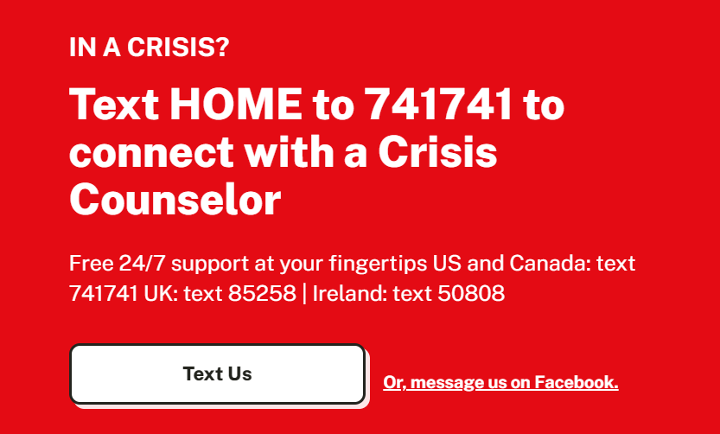
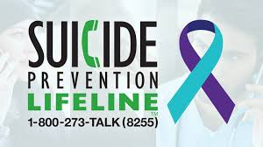
In an Emergency:
If someone has attempted suicide, don’t leave the person alone.
Call 911 right away.
Try to find out if he or she is under the influence of alcohol or drugs or may have taken an overdose.
Tell a family member or friend right away what's going on.
Crisis Text Line: crisistextline.org

Slide 31
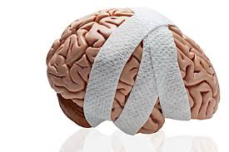
Concussions
Type of traumatic brain injury (TBI) caused by a bump, blow, or jolt to the head or by a hit to the body that causes the head and brain to move rapidly back and forth.
Observable Signs of Concussion | Reported Concussion Symptoms
Loses consciousness (even briefly). Can’t recall events prior to or after a hit or fall. Appears dazed or stunned. Forgets an instruction, is confused about an assignment or position, or is unsure of the game, score, or opponent. Moves clumsily. Answers questions slowly. Shows mood, behavior, or personality changes. | Headache or “pressure” in head. Nausea or vomiting. Balance problems or dizziness, or double or blurry vision. Bothered by light or noise. Feeling sluggish, hazy, foggy, or groggy. Confusion, or concentration or memory problems. Just not “feeling right,” or “feeling down”.
CDC: https://www.cdc.gov/headsup/basics/concussion_symptoms.htm l
Notes:
Can cause the brain to bounce around or twist in the skull, creating chemical changes in the brain and sometimes stretching and damaging brain cells.

Slide 32
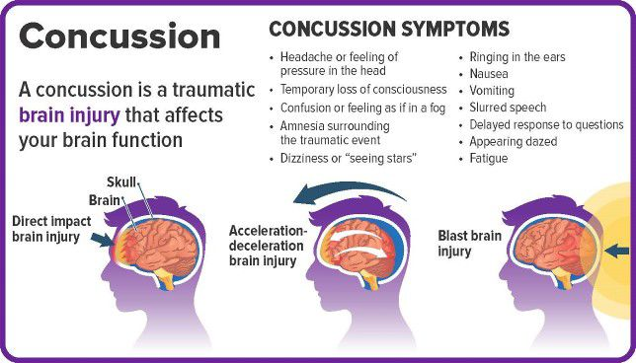
https://www.chroniclejournal.com/life/care-for-concussions/article_c51d36d4-abe8-11ea-a5f1-8f0518d85e05.html

Slide 33
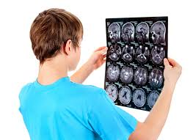
Concussions and Teens
Being an adolescent is a risk factor for worse outcomes after a concussion.
Additional risk factors include: prior concussion (biggest factor), being female, history of mental health diagnoses, greater acute symptoms within the first 72 hours, history of migraines, severe post-injury headaches
High school students tend to report more/increased severity of challenges compared to younger or college-level students. Psychosocial considerations for adolescents:
Social restrictions
Loss of identity with restricted activities, loss of engagement in meaningful tasks, etc.
Pressure to “be normal” can lead to a push to return before the student/brain are ready which can cause further setbacks and/or a longer recovery period.
Academic pressure and fear of falling behind.

Slide 34
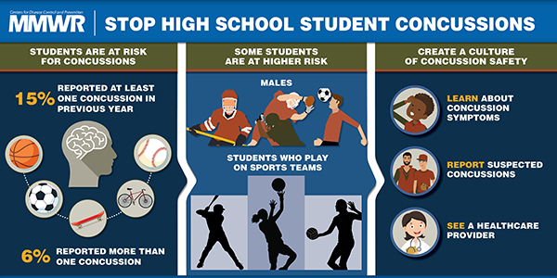
Concussion and Teens
Sports is the most common cause of concussion for teens. The risk is highest for those who play football, ice hockey, soccer, lacrosse, and field hockey. Additional causes include: Car or bike accidents, fights, and falls
CDC: https://www.cdc.gov/mmwr/volumes/67/wr/mm6724a3.htm

Slide 35
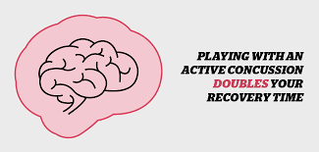
Strategies to Improve Recovery & Concussion Outcomes
See medical care immediately when a concussion is suspected.
Follow the medical provider’s guidance for return to everyday activities.
Most people are able to return to school/work within
Most individuals fully recover within ~4 weeks (70%), so be patient. Concussion recovery is a slow and steady process.
Listen to your symptoms and don’t push yourself “back to normal” too fast.
If your recovery is prolonged or complicated, communicate with your medical provider.
Physical symptoms usually improve before cognitive symptoms, so if you’re still struggling with academics or work activities, let your family, teachers, and doctors know.
CDC: https://www.cdc.gov/headsup/basics/concussion_recovery.html
Notes:
Basic tips: Good sleep; try not to nap during the day after the first 72hrs into recovery; good nutrition/hydration; reduce/limit screen time; physical activity as prescribed by MD; built in breaks; no alcohol/no drugs; limit caffeine.

Slide 36
Migraines
Migraines are described as an unprovoked headache lasting 4-72 hours that are severe enough to markedly restrict or even prohibit routine daily activity and often accompanied by nausea/vomiting and/or sensitivity to light/ sound.
After puberty, girls are more affected by migraines than boys and this continues into adulthood.
About 8-15% of high school students experience migraines.
Causes of Migraines: Still be studied and not fully understood - Combo of biology and environmental components. Basically a brain malfunction that affects the nerves and blood vessels, affected in part by Serotonin. Many recent studies suggest a genetic hypersensitivity of neurons. About 60-70% of people who experience migraines have a family member with a migraine history too.
Migraine triggers can include: hormones (especially for women), drinks (caffeine, alcohol),sensory stimuli, poor sleep, stress, intense physical activity, medications (birth control), food (aged cheese, salty foods, missing meals or fasting, MSG), travel (motion sickness), illness.
https://www.mayoclinic.org/diseases-conditions/migraine-headache/symptoms-causes/syc-20360201, https://my.clevelandclinic.org/health/diseases/9637-migraines-in-children-and-adolescents

Slide 37
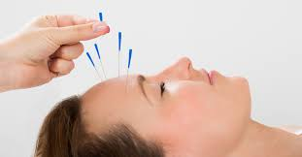
Tips to Prevent & Treat Headaches and Migraines
Drink plenty of water
Get adequate sleep
Watch your screen time and reduce sensory stressors/triggers. Go to a quiet, dark room when a headache/migraine starts.
Caffeine: too much can be a trigger for some; caffeine withdrawal can be a trigger for others; and drinking some caffeine may help others with a migraine.
Avoid alcohol/drugs
Cold packs (may help reduce inflammation and pain)
Essential oils (peppermint and lavender)
Ginger: some studies have found that people with chronic migraines saw improved/lessened symptoms with ginger consumption likely due to ginger’s antioxidant and anti-inflammatory properties. Follow-up with your medical provider before starting any new supplements
Medications (OTC or prescription): Follow up with your doctor if your headaches are worsening, especially if they do not go away or interfere with your day-to-day

Slide 38
Additional Migraine Tips
Regular exercise (at least 30 minutes 3x/week)
Keep a migraine diary - Try to pick up on what your triggers are. Certain foods? Certain work conditions? Menses? Poor sleep? Dehydration? Certain sensory stimuli?
Add relaxation techniques into your day
Try yoga
The Migraine Trust: Advice for Teens https://www.migrainetrust.org/living-with-migraine/coping-managing/young-people/advice-for-teens/
HealthyChildren.org: https://www.healthychildren.org/English/health-issues/conditions/head-neck-nervous-system/Pages/Migraine-Headaches-in-Children.aspx
Migraine Research Foundation: https://migraineresearchfoundation.org/about-migraine/migraine-in-kids-and-teens/

Slide 39
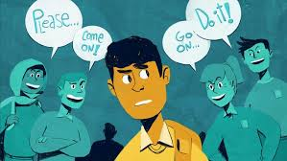
Teens, Problem-Solving, and Decision-Making
Problem-solving and decision-making are an important part of growing up. Better decisions can lead you on a more success life path and promote overall wellness.
A lot of learning can be trial and error, but if you have insight into how your brain is developing along with what makes you tick, you can hone these critical life skills.
One way to gain insight, can be by taking a personality test to learn more about what makes you unique, what are some of your strengths, and what might be some weaknesses or areas for growth: https://www.16personalities.com/free-personality-test
Factors that can lead to poor decisions: peer pressure, stress, heightened emotions, the desire to seek attention from peers, and brain development and psychosocial immaturity.

Slide 40
Decision-Making - A Lesson from Alice in Wonderland
Alice: Would you tell me, please, which way I ought to go from here?
Cheshire Cat: That depends a good deal on where you want to go.
Alice: I don't much care where.
Cheshire Cat: Then it doesn't matter which way you go.
Alice: So long as I get somewhere.
Cheshire Cat: Oh, you're sure to do that, if you only walk long enough.
If you don’t know your preferences and what is important to you, you can’t make a good decision….
https://www.marshall.usc.edu/sites/default/files/2020-02/Teaching-Teens-How-to-Make-Good-Decisions.pdf

Slide 41
Decision-Making and Problem-Solving
6 Basic Steps for problem-solving and decision-making:
Define the problem and note what an optimal outcome/goal would be.
List options/alternatives. Be non-judgmental; you’re just gathering your ideas. Consider all angles.
Evaluate the options. Pros/Cons, consequences, etc.
Consider: Is it hurtful? Is it unkind? Is it unfair? Is it dishonest? Is it in line with your goal? Aim for Win-Win scenario.
Choose your option.
Steer clear of a decision that creates another problem for someone else if possible.
Make a plan and do it.
Evaluate your plan and outcome.
This is an important part of the learning process. What caused the problem? How can I avoid this problem in the future? How can I handle it better in the future?
You don’t live in a solo bubble. It’s helpful to have at least a few trusted confidantes you can freely bounce your thoughts and ideas off of, especially when you’re in a challenging situation. Cooperative problem-solving may help you see the problem in a new way and lead you to a different solution that works better for your end goal.
Notes:
We make decisions everyday, big and small. Developing good problem-solving and decision-making skills is an important part of growing up. Since as teens your brains are still essentially developing, it would be beneficial to actively consider where your skills stack up in these areas so you can see where you have room to grow.

Slide 42
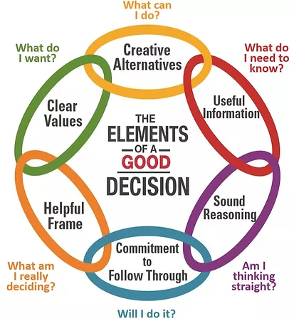
The Decision Education Foundation:
Better Decisions ~ Better Lives
A decision is only has good as the weakest component in “The Decision-Making Chain”
I’m making a good decision if I’ve fully satisfied myself of EACH of the following six things:
I am clear on the problem that I am solving.
I have identified what I truly want.
I have generated a good set of alternatives.
I have gathered the relevant information needed.
I have evaluated the alternatives in light of the information to find the one that gets me the most of what I truly want.
And I am committed to follow through on my choice.
https://www.decisioneducation.org/decision-chain-framework

Slide 43
Problems-Ideas-Plan (PIP): A Creative Problem-Solving Model
Problem: What’s on your mind? What do you need help with?
B) Rephrase the problem you had above in 3 different ways: How do I…. How do I…. How do I….
C) From the above list, select the most important question
D) Divergent Thinking: Generate a list of at least 6 ideas for how to solve the above problem 4. 2. 5. 3. 6.
E). Convergent Thinking: From the list above, choose the best idea and create a solution statement that begins with the phrase “What I see myself doing is …”
F) Action Plan: List the steps to achieve your goal. Consider Who?,Does What?, By When? - Do I need help? Who can help me?
Divergent Thinking = the process of creating many unique solutions in order to solve a problem. Spontaneous and free-slowing
Convergent Thinking = systematic and logical approach to determine what is the single best solution
Notes:
Often times, we’ll have a problem and feel overwhelmed with where do I go from here. This PIP model can help give you a framework to break down how to tackle a challenge you’re facing.

Slide 44
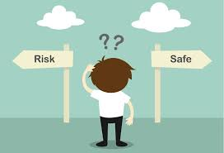
Additional Tips for Good Decision-Making
Pre-plan for difficult scenarios: If you know you’re going into a challenging situation, talk it through with a trusted advisor ahead of time and come up with how you’ll approach different situations.
Stop & Think when you’re “in the moment”: Consider removing yourself temporarily from the situation away from direct pressures so you can think more clearly.
Snap decisions can often lead to riskier behavior
Decision Compass: Who is your decision compass? Ask yourself would I want my mom/dad/grandma/coach/boss to know what I’m about to do? Would they be proud of this decision? Will I be proud of this decision?
HELP! - It’s ok to ask for help. You never have to make a decision totally alone, especially when it comes to major life issues.
Mistakes help us learn: So don’t beat yourself up. Learn from poor choices and commit yourself to doing better the next time.
What are my emotions behind this decision?
Negative emotions can cloud your ability to see the big picture

Slide 45
Decision-Making Skills Resources
PIP worksheets: https://www.adolescentwellness.org/wp-content/uploads/2011/06/PIP-worksheet-script-sports-example.pdf,
https://clubrunner.blob.core.windows.net/00000101303/en-us/files/page/resources-ragmhi-toolkits/pip-creative-problem-solving/RAGMHI-Toolkit---PIP-Creative-Problem-Solving.pdf
Additional Resources on decision-making & problem-solving:
https://ohioline.osu.edu/factsheet/HYG-5301
https://www.ncbi.nlm.nih.gov/books/NBK224102/
https://www.marshall.usc.edu/sites/default/files/2020-02/Teaching-Teens-How-to-Make-Good-Decisions.pdf
http://www.bluestemcenter.com/articles/How%20to%20Teach%20Decision%20Making%20Skills%20to%20Adolescents.pdf
https://theconversation.com/a-parents-guide-to-why-teens-make-bad-decisions-88246
https://robeson.ces.ncsu.edu/2014/08/decision-making-skills-a-key-to-surviving-teen-years/
http://actforyouth.net/youth_development/professionals/sel/decision_making.cfm

Slide 46
References
https://www.aacap.org/AACAP/Families_and_Youth/Facts_for_Families/FFF-Guide/The-Teen-Brain-Behavior-Problem-Solving-and-Decision-Making-095.aspx
https://www.stanfordchildrens.org/en/topic/default?id=understanding-the-teen-brain-1-3051
https://www.urmc.rochester.edu/encyclopedia/content.aspx?ContentTypeID=1&ContentID=3051
https://www.healthychildren.org/English/ages-stages/teen/Pages/Whats-Going-On-in-the-Teenage-Brain.aspx
https://raisingchildren.net.au/pre-teens/development/understanding-your-pre-teen/brain-development-teens
https://www.sciencenewsforstudents.org/article/teenage-brain

Slide 47
References
https://www.livescience.com/54605-why-are-babies-helpless.html
http://headsup.scholastic.com/sites/default/files/NIDA6-INS4_Stu_Mag.pdf
https://kidshealth.org/en/teens/brain-nervous-system.html?WT.ac=ctg#catbody-basics
https://www.ncbi.nlm.nih.gov/books/NBK224102/
https://www.drugabuse.gov/drug-topics/adolescent-brain
The ABCD Study: https://www.icaf.org/ABCDStudy/ , https://www.drugabuse.gov/drug-topics/adolescent-brain/longitudinal-study-adolescent-brain-cognitive-development-abcd-study

Slide 48
References
NIH: https://teens.drugabuse.gov/drug-facts/brain-and-addiction
DEA: https://www.getsmartaboutdrugs.gov/consequences/how-drugs-alter-brain-development-and-affect-teens
https://www.turnbridge.com/news-events/latest-articles/drugs-and-brain-development
https://www.turnbridge.com/news-events/infographics/developing-adolescent-brain-its-vulnerability-substance-abuse-and-benefit
CDC Adolescent Health Stats: https://www.cdc.gov/nchs/fastats/adolescent-health.htm
Pandey and Dwivedi study, Neurobiology of Teen Suicide (2012): https://pubmed.ncbi.nlm.nih.gov/23035280/
The Mayo Clinic, suicide and what to do if someone is suicidal: https://www.mayoclinic.org/diseases-conditions/suicide/in-depth/suicide/art-20044707

Slide 49
References
National Association of School Psychologists: https://www.nasponline.org/resources-and-publications/resources-and-podcasts/school-climate-safety-and-crisis/mental-health-resources/preventing-youth-suicide/save-a-friend-tips-for-teens-to-prevent-suicide , https://www.nasponline.org/resources-and-publications/resources-and-podcasts/school-climate-safety-and-crisis/mental-health-resources/preventing-youth-suicide/save-a-friend-tips-for-teens-to-prevent-suicide , https://www.nasponline.org/assets/Documents/Resources%20and%20Publications/Resources/Crisis/PrevetingYouthSuicide_TeenVersion_FINAL_ES-US.png
Teenmentalhealth.org
Teenhealth.org
American Academy of Children and Adolescent Psychiatry: https://www.aacap.org/AACAP/Families_and_Youth/Youth_Resources/Home.aspx?hkey=58aaf61e-36ea-4a84-9a4c-58b2a434c869
Ted Talk, The Mysterious Workings of the Adolescent Brain: https://www.ted.com/talks/sarah_jayne_blakemore_the_mysterious_workings_of_the_adolescent_brain?language=en#t-9185
Ted Talk, A Map of the Brain: https://www.ted.com/talks/allan_jones_a_map_of_the_brain#t-1618

