Slide 1
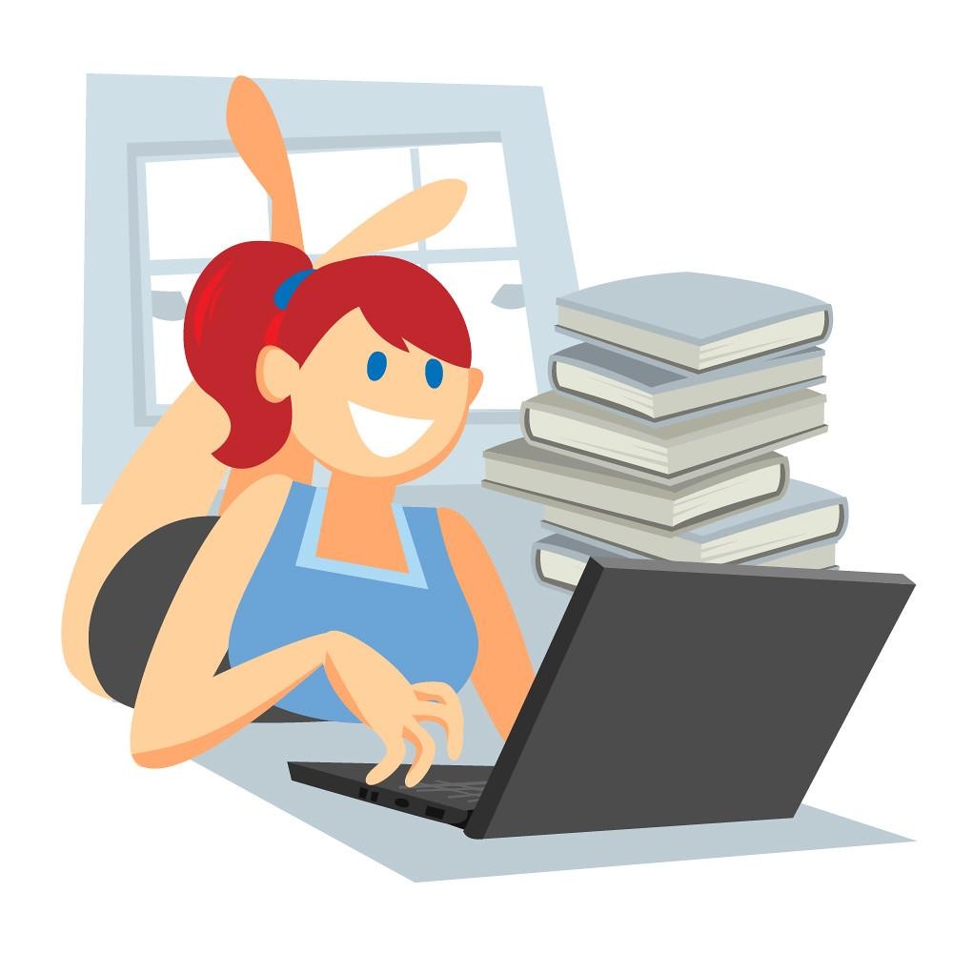
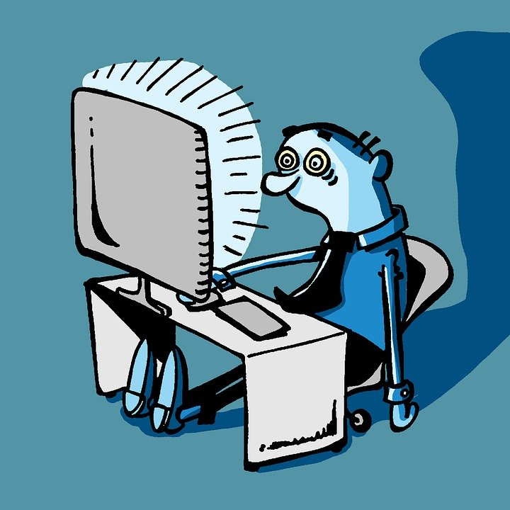
Teens & Screens
Healthy Habits for Managing Increased Screen Time
Bridget Veale, RN
Mindy Wade, RN
October 14, 2020

Slide 2
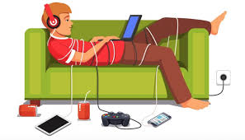
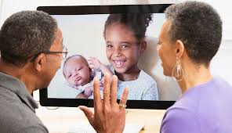
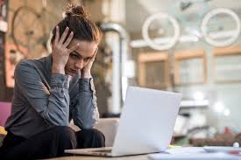
Screen Time during the COVID-19 Pandemic
Studies have reported that screen time has increased as much as 500% during the pandemic!! Yikes!
Some Potential Causes:
Quarantining at home, boredom, cabin fever
Remote/Online Learning
Limited in-person social opportunities
Less access to extracurricular activities
Unprecedented access to media

Slide 3
Typical Screen Time Habits
Prior to COVID-19, teens typically used screen media for over 7 hours a day, not necessarily including time spent for school activities. That’s a lot of time! And you’re spending way more time now on screens now with online learning.
Cell phone alone use is so common! As of 2019, 20% of 8-year-olds had smartphones and by age 12 over 70% of kids had smartphones.
Age | Max Screen Time Recommendations | Real Life Screen Use
0-18 months | none* (video chatting can be ok in small doses) | 42 minutes
18-24 months | Very Limited use as long as parent is joining in | 42 minutes
2-5 years | Less than 1 hour daily | 2 hours, 39 minutes
6-8 years | No specific limit as long as it doesn’t interfere with physical activity and sleep | ~3 hours
8-12 years | No specific limit as long as it doesn’t interfere with physical activity and sleep | ~5 hours
13-18 years | No specific limit as long as it doesn’t interfere with physical activity and sleep | >7 hours
As Recommended by the American Academy of Pediatrics, 2017

Slide 4
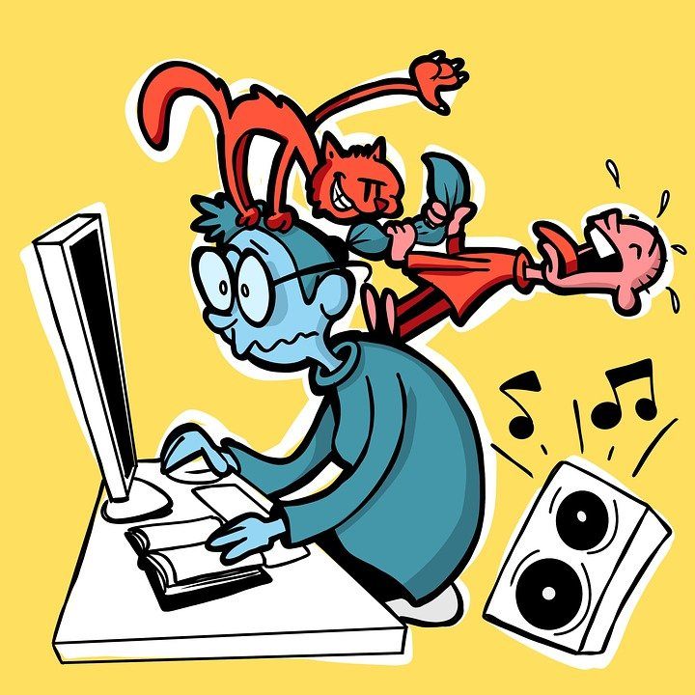
Effects of Too Much Screen Time
Vision Issues: eye strain, dry eyes, blurred vision, headaches
Chronic neck and/or back pain
Social-Emotional and psychological health concerns
Weight gain & obesity
Increased screen time can contribute to a sedentary lifestyle and increased health risks for developing diabetes and cardiovascular issues.
Poor sleep
The blue light from digital devices can suppress the sleep-promoting hormone, melatonin, and can therefore interfere with your ability to get restful sleep.
Impaired cognitive function
Less healthy or overuse of screens can affect how the brain functions
Long-term health risks.
Significant screen time has been associated with negative effects cardiovascular health and increased mortality risk.

Slide 5
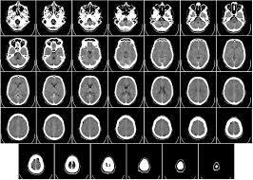
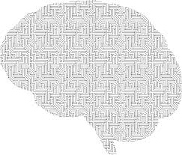
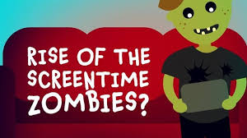
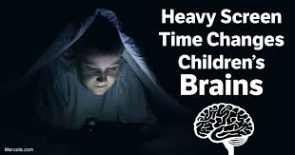
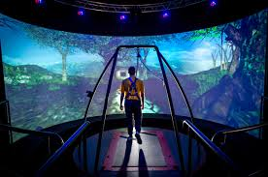
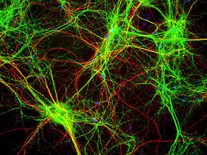
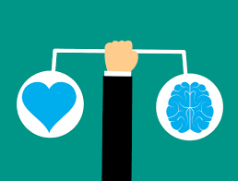
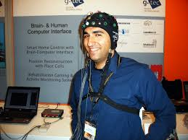
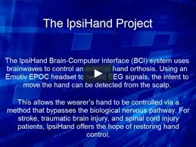
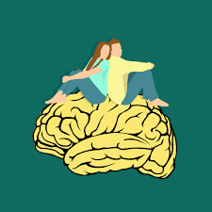
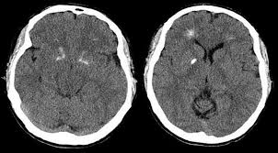
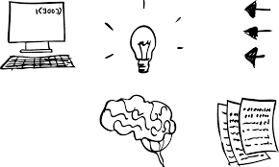
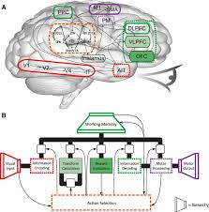
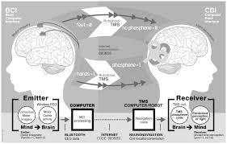
Screen Time, Psychological Health, and Effects on the Brain
There isn’t a linear, direct relationship between technology and mental health.
“Bidirectional relationship,” just one factor that can affect an individual
Increased screen time has been associated with higher incidences of depression, anxiety, and lower self-esteem
Social media can invite comparison which can affect self-image and anxiety levels
Screen time can affect how neural pathways develop
You need a healthy combo of online and offline experiences for healthy brain development. Creativity and Imagination happen when your brain can wander. It’s ok to embrace the boredom sometimes!
Good sleep affects how your brain develops.
Teen brains may be more sensitive to stress.
Your brain keeps developing and maturing into your mid to late 20’s

Slide 6
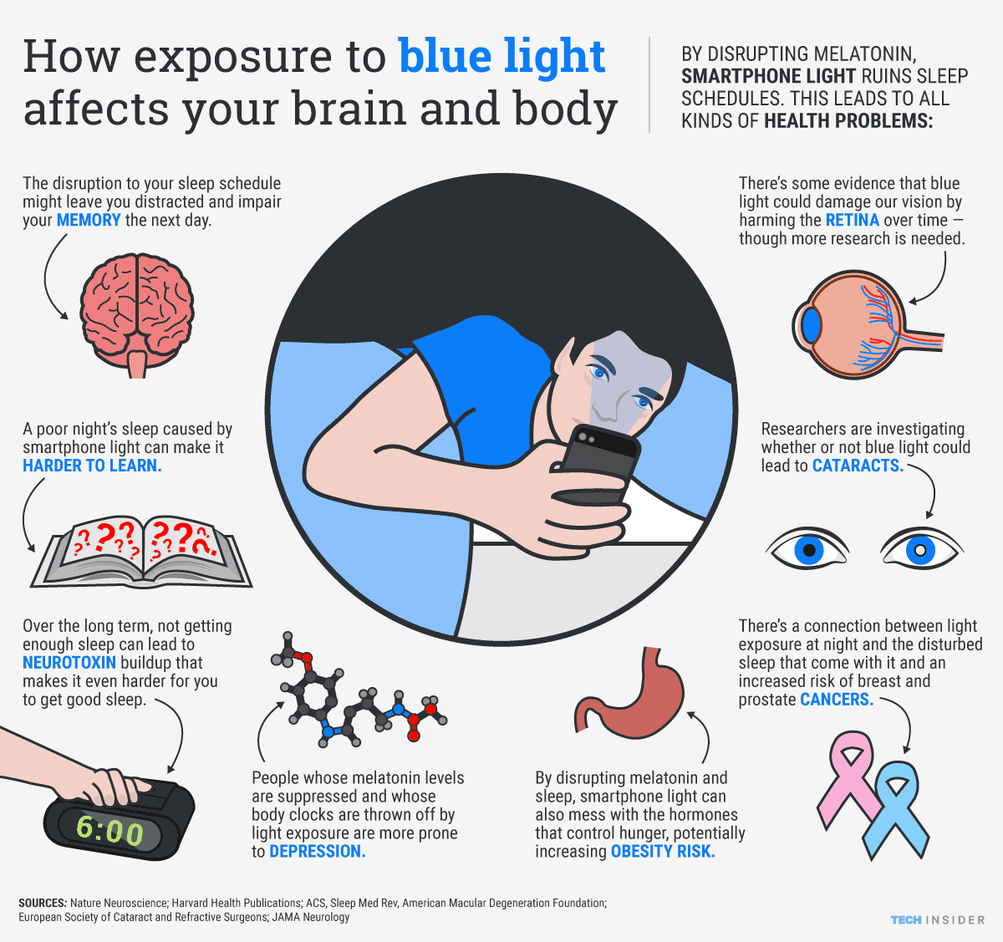
https://www.digitalinformationworld.com/2019/02/too-much-screen-time-affects-our-bodies-and-brains.html

Slide 7
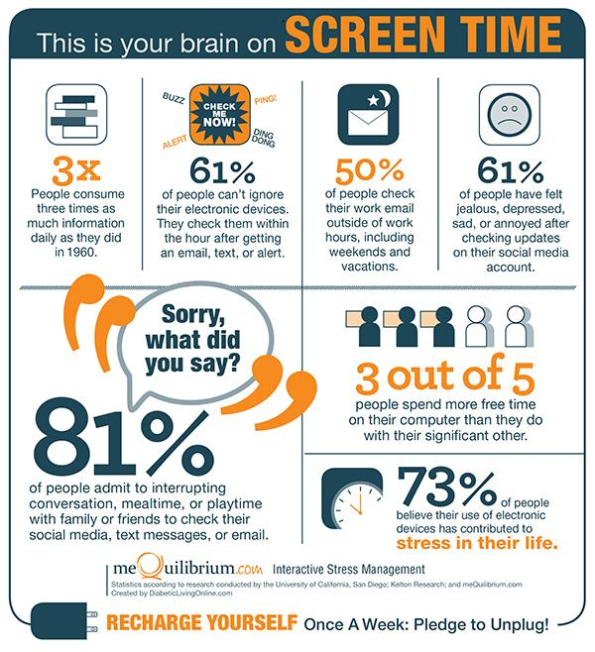
How does your device use affect you?
Are you having physical symptoms from too much screen time?
Do you have a hard time paying attention to others because you’re too drawn into your on-screen activities?
Do they affect how much time you’re spending with others?
Are you getting enough physical activity during the day?
Do you have an emotional reaction to too much time on-screen/scrolling?
Are you getting enough sleep?
Are you making real connections with friends too?
Are you making good media choices?
Does your use of technology negatively affect your life?
Are you having a hard time controlling, regulating, or limiting your use of technology?

Slide 8
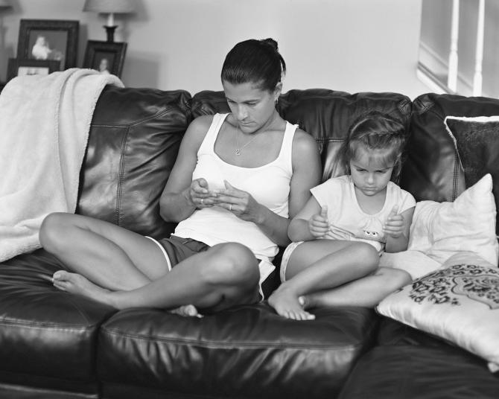
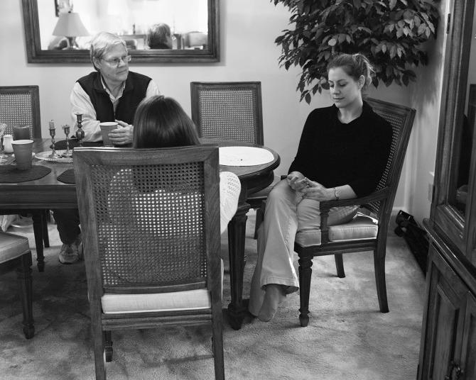
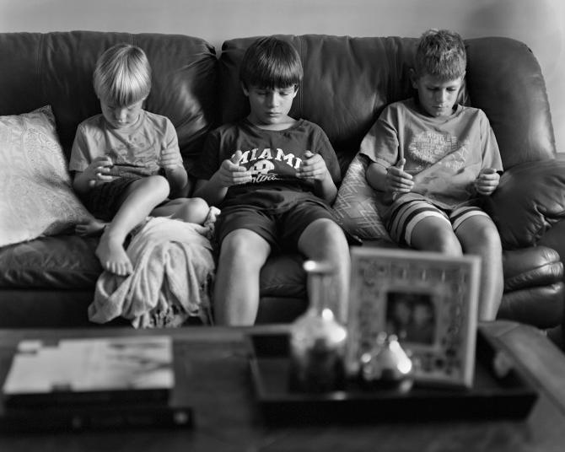
Technology use has become such a major component of our everyday lives, especially with cell phone use. We often do not realize how much we use our phone and the effects it has on our lives and personal connections with others.
Photographer, Eric Pickersgill, created a photo series called “Removed” in which he edited out cell phones from the hands of people to demonstrate how disconnected we can become from our real lives.
https://qz.com/523746/a-photographer-edits-out-our-smartphones-to-show-our-strange-and-lonely-new-world/

Slide 9
Screen Time and Technology Isn’t All Bad!
Your devices are portals to employment and education, ways to keep you inside and build community...a reminder you’re not alone
you could get on a video chat with people from around the world to read aloud, “Harry Potter”
Most doctors say it’s ok to have more screen time now-just focus on the QUALITY kind
Scientists have identified two kinds of screen time—active and passive. Active screen time involves the child engaging either mentally or physically with the content like playing a game on their xbox or watching a documentary versus passive screen time, which is sedentary and mindless, is probably not the best idea.

Slide 10
STAY POSITIVE - WE’RE IN THIS TOGETHER
The entire Keefe Community is facing a transition period due to COVID-19 and remote learning. Together we are all adapting to new ways of learning and interacting with our world.
This new way of life creates new challenges. As school nurses we’d like to help you face those mental and physical challenges as a team.
Let’s look at our new remote-learning lifestyles from the perspective of a school nurse and try to diagnosis common problems that we’re all facing.
Problem #1 Sedentary Lifestyle due to increased screen time sitting in one place at home all day, decreased/ lack of after school sports.
Problem #2 Headaches/Mental Fatigue/Eye Strain due to increased screen time, forgetting to take brain breaks, using cell phones/video games to connect with friends even after learning remotely all day
Problem #3 Anxiety/Mood Swings due to change in schedule, not seeing friends/socializing during lunch/sports
What are some ways you can tackle these problems/challenges?

Slide 11
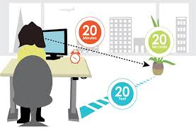
Simple Tips
20-20-20 Rule
Take a break from your screen every 20 minutes by looking at something 20 feet away for 20 seconds
You can set a reminder on your chromebook for vision breaks
Distance Matters!
Aim to sit about 25 inches from your computer
Adjust the screen brightness and contrast to match the light around you.
A screen that’s brighter than your surrounding light can increase eye strain.
Try to reduce the brightness of your screen by 50%.
Reduce the blue light setting on your computer. Opt for a warmer setting, like pink tones.
Try blue-light blocking glasses which can help reduce eye strain.

Slide 12
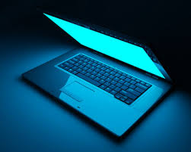
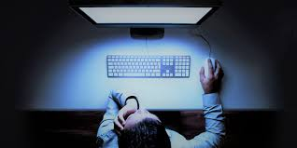
How to Adjust Blue Light Settings
On your chromebook in your Settings, you can turn on Night Light Mode and then adjust the amount of blue light being displayed.
Open the Start Menu.
Click the gear icon to bring up the Settings Menu.
Choose System.
Select Display.
Toggle the Night light switch to On.
Click Night light settings to adjust the level of blue displayed, or determine the time for Night Light to activate automatically.
https://support.google.com/chromebook/answer/9145848?hl=en

Slide 13
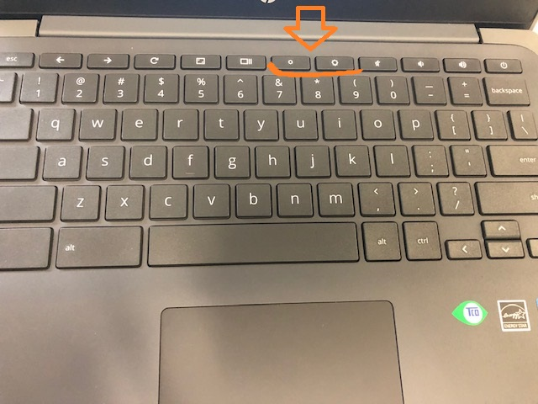
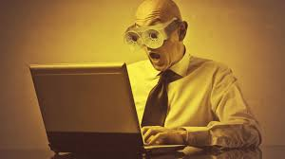
Adjust the Brightness
Adjust the brightness on your chromebook using the brightness keys.

Slide 14
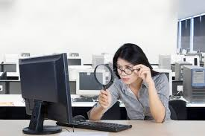
Simple Tips
Modify text size and color
Text size should ideally be 3x the smallest text you can read.
(https://www.w3.org/WAI/meta/customize/
https://www.howtogeek.com/288986/how-to-increase-the-size-of-text-on-a-chromebook/)
On your Chromebook you can try the following:
Once signed in on a Chromebook, select the bubble around the time and wifi connection, which will bring up a pop-up.
On the top right of the pop-up, select the Gear icon to open settings.
Select Device on the left side of the screen, followed by Display.
Here, the Display Size and Night Light can be edited to the user's preference.
To edit Font size, open Chrome and enter chrome://settings/appearance. There the Font size and Page Zoom can be edited.

Slide 15
Simple Tips
Don’t lunch where you crunch!
Eating at your workspace can cause you to eat more and think less. With working from home, the lines between work and life are even more blurred. Make an effort to separate the two, take breaks when you need them, and break bad habits.
Palming
This is a simple relaxation technique for your eyes. You simply rub your palms together until they’re warm and then place them over your closed eyes. The warmth can help your eyes relax.
Good ahead and roll your eyes (but not at your teachers!)
This is a simple exercise you can do anywhere. Take a moment to move your eyes, left/right, up/down, and around 15-20 times
Step away from your screen
Just 5 minutes of physical activity outside has been shown to boost your productivity.

Slide 16
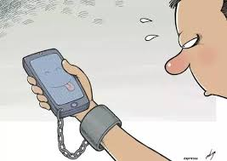
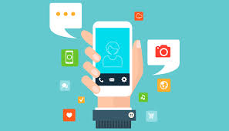
Simple Tips
Stick a matte filter onto your computer screen to reduce glare.
Track your screen time.
You might be surprised at home much time your spending on your phone and on certain apps/sites. Apps like Moment and Offtime can help you look into this.
Add an app to your smartphone that blocks your use of social media or certain sites to help increase your productivity and limit excessive screen time, like Flipd or AppBlock
https://www.reviewed.com/smartphones/features/10-apps-that-block-social-media-so-you-can-stay-focused-and-be-more-productive)
Turn off your notifications so your phone isn’t always buzzing and drawing you back in

Slide 17
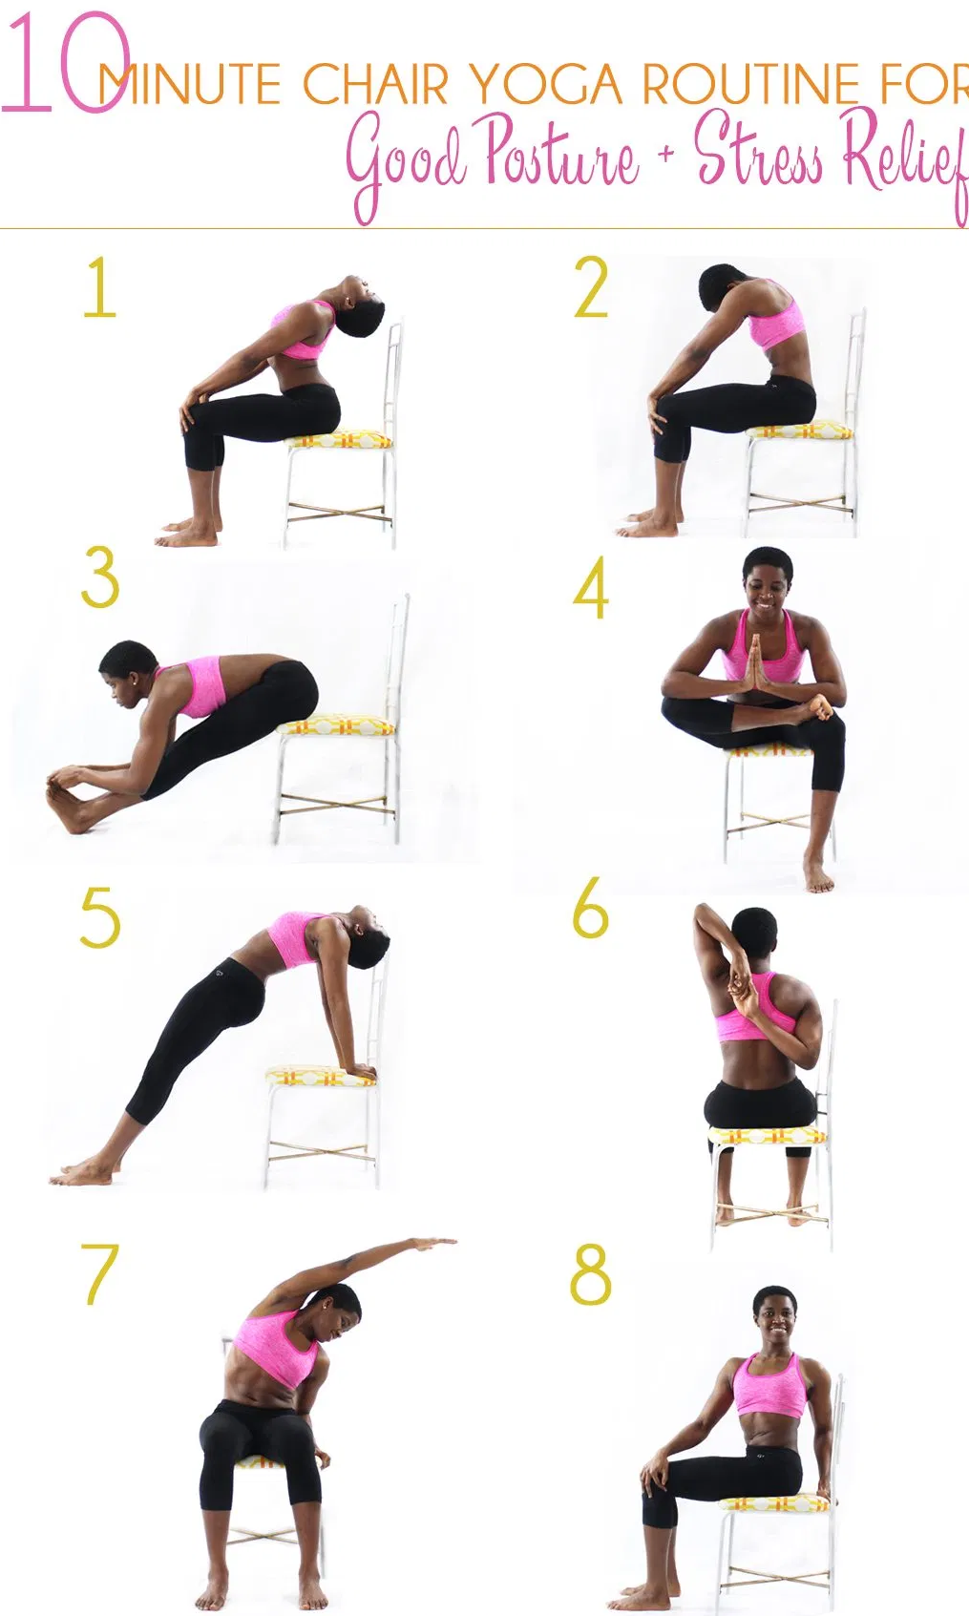
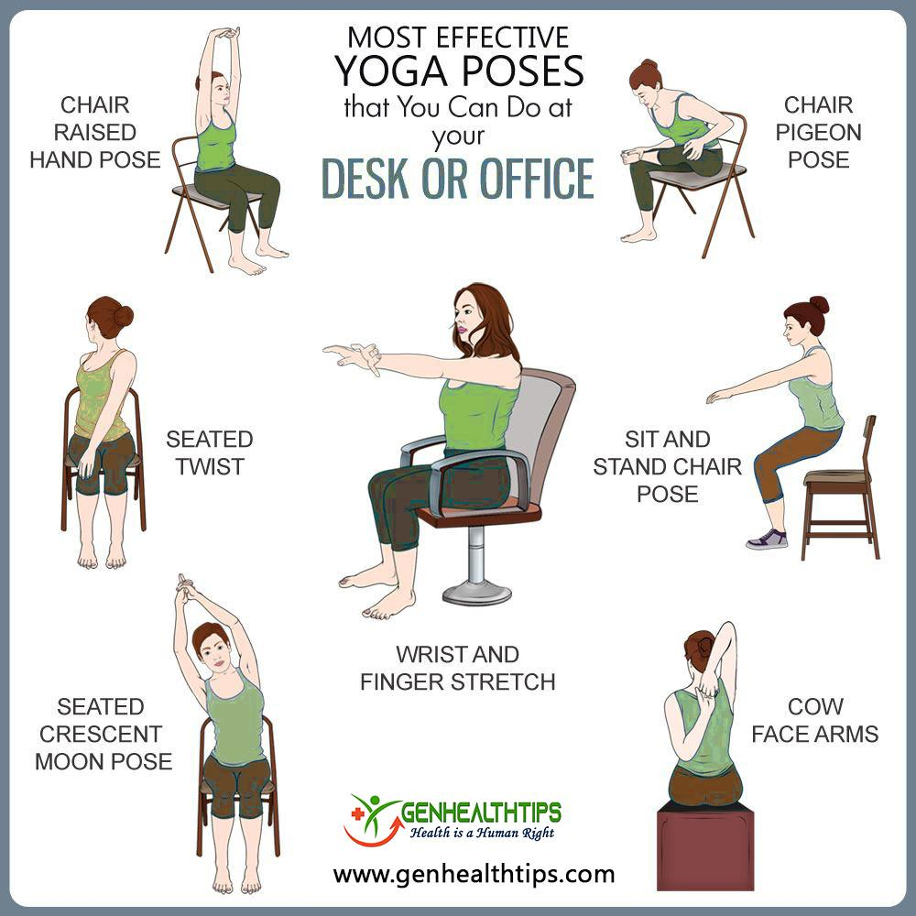
Simple Tips
Chair Yoga
Incorporate some easy poses/stretches into your day. This could help your posture, muscle strains, and overall relaxation.
https://www.verywellfit.com/chair-yoga-poses-3567189
https://www.yogacirclestudio.com/wp-content/uploads/2015/01/Chair-Yoga-.pdf

Slide 18
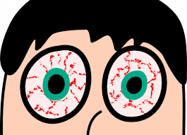
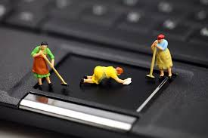
Simple Tips
Blink, Blink, Blink
Blinking helps keep our eyes hydrated. Sometimes we get so overly focused on our screens and this can lead to dry eyes, so don’t forget to add some extra blinking into your routine.
Clean that Screen!
Dust and fingerprints can affect how light is reflected to your eyes.

Slide 19
Simple Tips
Have Screen-Free spaces to help you be more present in your day-today and also reduce the urge to pick up that smart phone.
Encourage kids to turn off their electronics at least an hour before bed. A good night’s sleep does wonders for mood and anxiety. – Dr. Dale Peeples, Associate Professor at the Medical College of Georgia at Augusta University
Parents should insist on regular breaks, both for their kids and themselves. – Professor Patti M. Valkenburg, University of Amsterdam
“Roughly nine-in-ten teens view spending too much time online as a problem facing people their age, including 60% who say it is a major problem.”
Set a YouTube app on your phone so that YouTube automatically shuts off after watching for 15 minutes
Set up mental speed bumps so you are forced to think for a second before engaging with your phone. Put a rubber band around the device, for example, and changed the lock screen to one that showed three questions to ask before unlocking: “What for? Why now? What else?”

Slide 20
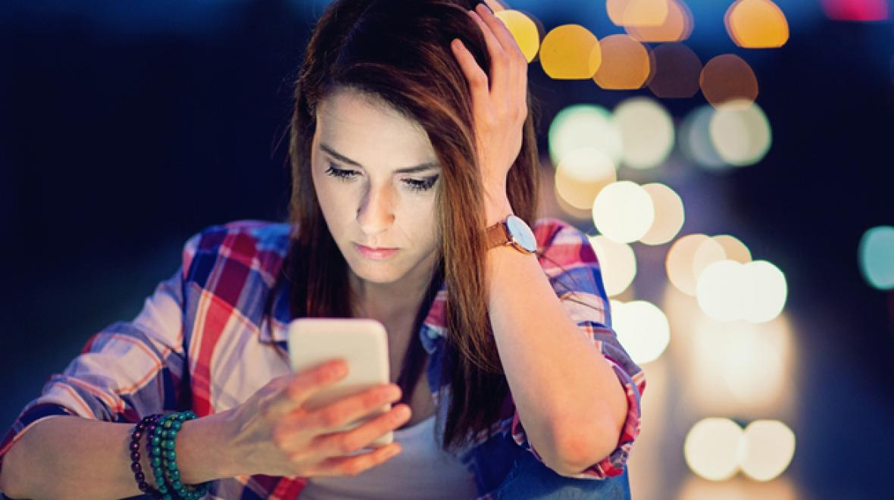
What some teens are saying
Now that I have a cell phone….
“I will be cool and if I have a cell phone I can look busy in awkward situations.”
“If I’m always looking at my screen I can avoid things”
** leads to reduced eye contact
**reduced genuine conversations with people
Growing up in a digital age is not easy. Gaining self-control and responsible, balanced habits now with screen time will help you manage on your own someday in the workplace.
Be more present in your personal life.
Set a good example for the little ones in your family.
Plus, think about how it affects your developing brain!

Slide 21
Additional Useful Resources
Screenagers: https://www.screenagersmovie.com/
Documentary about teens and screen time. Their website has lots of resources on topics like screen balance, sleep, mindfulness, skills for anxiety/depression, and a weekly blog you can sign up for.
Internet Matters: https://www.internetmatters.org/resources/screen-time-tips-to-support-teens/
Unicef: Strategies for teens to support mental health during COVID-19 https://www.unicef.org/coronavirus/how-teenagers-can-protect-their-mental-health-during-coronavirus-covid-19

Slide 22
References
Harvard Medical School - Screen Time & the Brain: https://hms.harvard.edu/news/screen-time-brain
NIMH 7 Things to Know about the Teen Brain: https://www.nimh.nih.gov/health/publications/the-teen-brain-7-things-to-know/index.shtml
Technology Addiction: https://www.hazeldenbettyford.org/articles/fcd/teen-technology-addiction
Health Matters - Screen Time & Children’s Brains: https://healthmatters.nyp.org/what-does-too-much-screen-time-do-to-childrens-brains/
KidsHealth - Screen Time Guidelines for Teens: https://kidshealth.org/en/parents/screentime-teens.html
American Academy of Ophthalmology: https://www.aao.org/eye-health/tips-prevention/screen-use-kids
Harvard Pilgrim - How to Handle Screen Time during the COVID-19 Pandemic: https://www.harvardpilgrim.org/hapiguide/how-to-handle-screen-time-during-the-covid-19-pandemic/
Children and Screens - 12 Tips from Experts for Parenting Teens on Screens during COVID-19: https://www.childrenandscreens.com/media/press-releases/12-tips-from-the-experts-for-parenting-teens-on-screens-during-covid-19/

Slide 23
References
American Academy of Child & Adolescent Psychiatry - Media Habits during COVID-19: Children & Teens on Screens in Quarantine: https://www.aacap.org/App_Themes/AACAP/Docs/resource_libraries/covid-19/Screen-Time-During-COVID.pdf
Center for Parent and Teen Communication - Teens and Screens, the Latest Research: https://parentandteen.com/teens-and-screen-time-the-latest-research/#:~:text=Here%20are%20some%20of%20the,YouTube%20and%20Twitch)%20every%20day.
Greater Good Science Center, University of California, Berkeley: Is Screen Time Toxic for Teenagers?: https://greatergood.berkeley.edu/article/item/is_screen_time_toxic_for_teenagers
Johns Hopkins - Screen Time Guidelines for Teens: https://www.hopkinsallchildrens.org/Patients-Families/Health-Library/HealthDocNew/Screen-Time-Guidelines-for-Teens
Twenge & Campbell research article (2018), Preventive Medicine Reports, Associations between screen time and lower psychological well-being among children and adolescents: https://www.sciencedirect.com/science/article/pii/S2211335518301827

