Slide 1
Athletic Compliance Educational Session
Chaska High School
Chanhassen High School
October 26, 2020

Slide 2
Athletic Compliance Educational Session
NCAA Initial Eligibility and Recruiting
Kevin Gomer
Assistant Director of Athletic Compliance
University of Minnesota
kjgomer@umn.edu

Slide 3
Athletic Compliance Educational Session
Guide to the College Bound
Student-Athlete
Covers Recruiting and Eligibility
Download at www.ncaa.org (pdf.)
High school academic information (Divisions I, II, III)
NCAA Eligibility Center registration (Divisions I & II)
Google “NCAA Eligibility Center”
Sample questions to ask in the recruiting process

Slide 4
Athletic Compliance Educational Session
NCAA Eligibility Center
Located in Indianapolis, IN and run by the NCAA
Review high school transcripts and test scores for all Division I and II prospects
Register during your junior year in HS
Costs $90 to register ($150 for internationals)
SAT/ACT scores must be sent directly to the Eligibility Center by marking code 9999
Work closely with your HS counselor to determine core courses

Slide 5
Athletic Compliance Educational Session
NCAA Core Course
One full year of academic credit, taught at grade appropriate level.
The NCAA approves core courses, NOT the high school
Each high school has an approved core course list on the Eligibility Center’s website.
If the course is not on your high school list at the NCAA, it will not count as a core course
If a course title on your transcript does not match the title on the NCAA’s list, it will not count as a core course
Meet with high school academic counselor to review your enrollment and your planned courses

Slide 6
Athletic Compliance Educational Session
Determining Initial Eligibility
Academic Component:
Graduation;
Complete the minimum number of core courses;
Minimum core grade point average; and
ACT or SAT test score (sliding scale);
Amateurism Component:
Complete amateurism questionnaire

Slide 7
Athletic Compliance Educational Session
Division I Core-Course Requirements – 16 core courses needed:
4 years of English
3 years of Math (Algebra I or Higher)
2 years of Natural/Physical Science (one lab)
1 year of additional English, Math or Science
2 years of Social Science
4 years of Additional Core courses
*** Need to plan for this – not just graduate!

Slide 8
Athletic Compliance Educational Session
10 Core courses must be completed prior to start of senior year in HS; 7 of 10 must be in the following areas:
English
Math (Algebra I or Higher)
Natural/physical science (one lab)
** The 10 core courses utilized to meet this rule may not be replaced by a course taken in the senior year.
NCAA sliding scale (handout) utilizes ACT/SAT score and high school core course GPA to determine minimum academic qualifications.

Slide 9
Athletic Compliance Educational Session
Test Score
NCAA uses sub scores to determine minimum test score needed
ACT Sum (add each sub score below)
English
Mathematics
Reading
Science
SAT Sum (add each sub score below)
Critical Reading (Verbal)
Mathematics

Slide 10
Athletic Compliance Educational Session
Test Score Examples
ACT composite (22) with sum scores: E (25), M (20), R (23), S (20)
NCAA would use total of sum scores (88)
Admissions would use composite (22)
If student took 2nd ACT (23) with sub scores: E (26), M (19), R (25), S (22)
NCAA would use best sum scores from the two tests (93)
Admissions would use the best composite score (23)
SAT scores are calculated the same
Critical Reading (Verbal)
Mathematics

Slide 11
Athletic Compliance Educational Session
Division II –16 core courses needed:
3 years of English
2 years of Math (Algebra I or Higher)
2 years of Natural/Physical Science (one lab)
3 year of additional English, Math or Science
2 years of Social Science
4 years of additional core courses
Division II Test Score / GPA Requirements
Core grade-point average must be at least 2.000
Minimum test score of 820 on the SAT and 68 sum score on the ACT

Slide 12
Athletic Compliance Educational Session
Division II: Current Standards
Core grade-point average must be at least 2.000
Minimum test score of 820 on the SAT and 68 sum score on the ACT
Division II: Initial Eligibility Standards for Fall 2018
Moving to sliding scale for initial eligibility
Student-Athlete must now earn at least a 2.20 grade-point average to be a qualifier
Student-Athlete must now earn at least a 2.00 grade-point average to be a partial qualifier

Slide 13
Athletic Compliance Educational Session
Qualifier, Academic Redshirt, Non-qualifier
Qualifier
Athletic scholarship, practice and competition in your first year in residence
Four years to compete
Academic Redshirt
Athletic scholarship and practice only in your first year in residence
Four years to compete
Non-Qualifier
No scholarship, practice or competition in your first year in residence
Only three years to compete, with ability to regain 4th

Slide 14
Athletic Compliance Educational Session
COVID-19 Waiver for Fall 2021/Spring 2022 Enrollees
Alternative Standard | Division I | Division II
Qualifier: athletics aid, practice, & competition | 10/7 before 7th semester, 16 core courses in required subject areas, >2.30 core gpa, proof of graduation, no test score | 16 core courses in required subject areas, > 2.20 core gpa, proof of graduation, no test score
Early Qualifier: athletics aid, practice, & competition | Pre-7th semester: 14 core courses in required subject areas, > 3.00 core gpa, no test score | Pre-7th semester: 14 core courses in required subject areas, > 2.50 core gpa, no test score
Academic Redshirt: athletics aid (1st year) and practice (1st term) | 16 core credits in the required subject areas, > 2.00 core gpa, proof of graduation, no test score | N/A
Partial Qualifier: athletics aid and practice | N/A | 16 core credits in the required subject areas, > 2.00 core cpa, proof of graduation

Slide 15
Athletic Compliance Educational Session
COVID-19 Waiver for Fall 2021/Spring 2022 Enrollees
Distance learning, hybrid learning, and e-learning options will not require a separate evaluation by the Eligibility Center
Pass/Fail courses: if issued a grade of Pass, the EC will apply the credit earned. If If the core gpa would increase by assigning a 2.30 to the course, the gpa will be assigned, but if it will hurt the core gpa, the gpa will not be assigned, but the credit will still be issued.
Both of these policies will apply to other classes (e.g. sophomores, juniors, and seniors).

Slide 16
Athletic Compliance Educational Session
College Admission Process vs. NCAA Eligibility
Two separate determinations
Being a NCAA qualifier does not automatically mean you will be admitted to an institution
Being admitted to an institution does not mean you are eligible under NCAA requirements

Slide 17
Athletic Compliance Educational Session
Amateurism – Final Step
Prospects jeopardize NCAA amateur status by:
Formally declaring into professional contract, compete with a professional team in hockey or skiing, or accept a salary
Accepting prize money that exceeds expenses for an athletic event
Entering into agreement or accepting benefits from agents

Slide 18
Athletic Compliance Educational Session
General Recruiting Concepts
Rules are designed to protect the HS students
ASK QUESTIONS!!

Slide 19
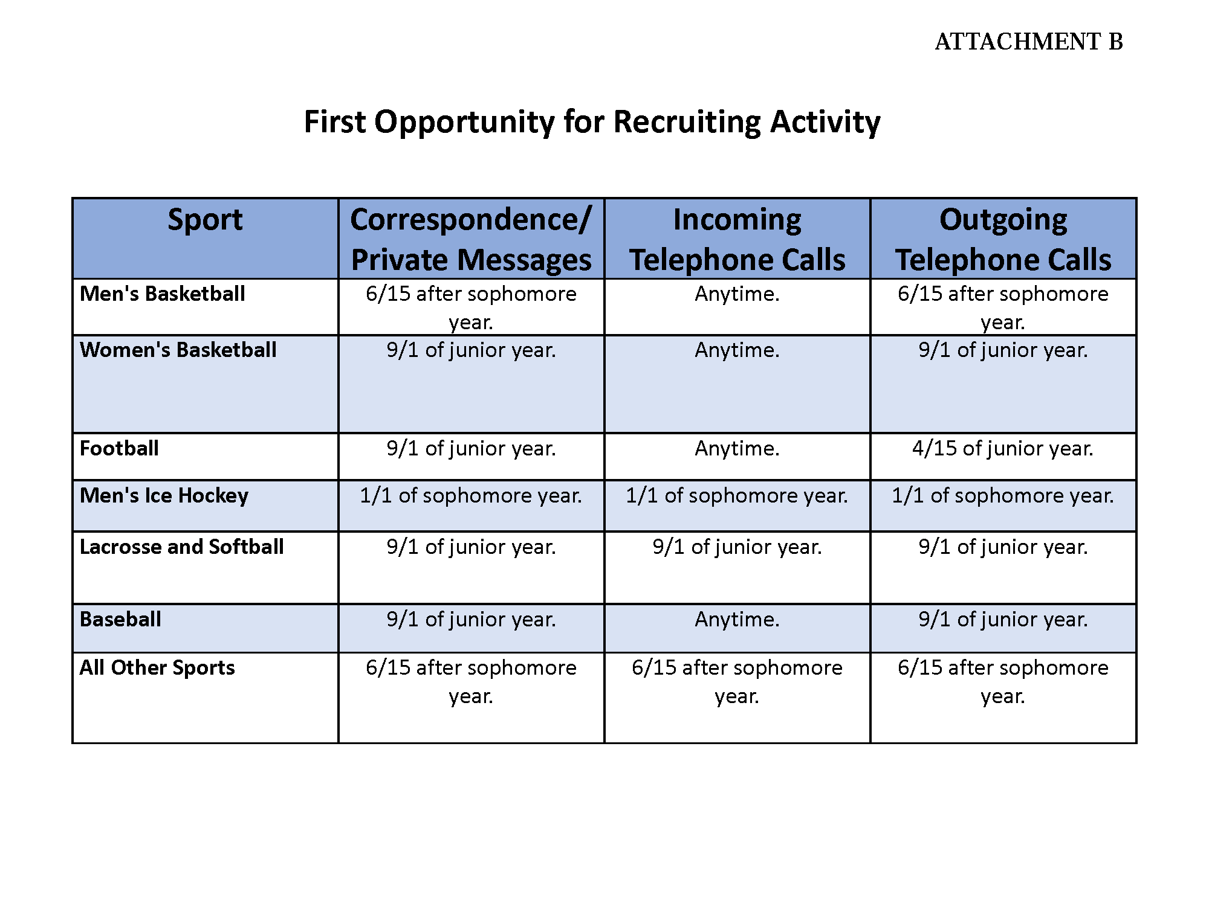
Athletic Compliance Educational Session
General Recruiting Concepts

Slide 20
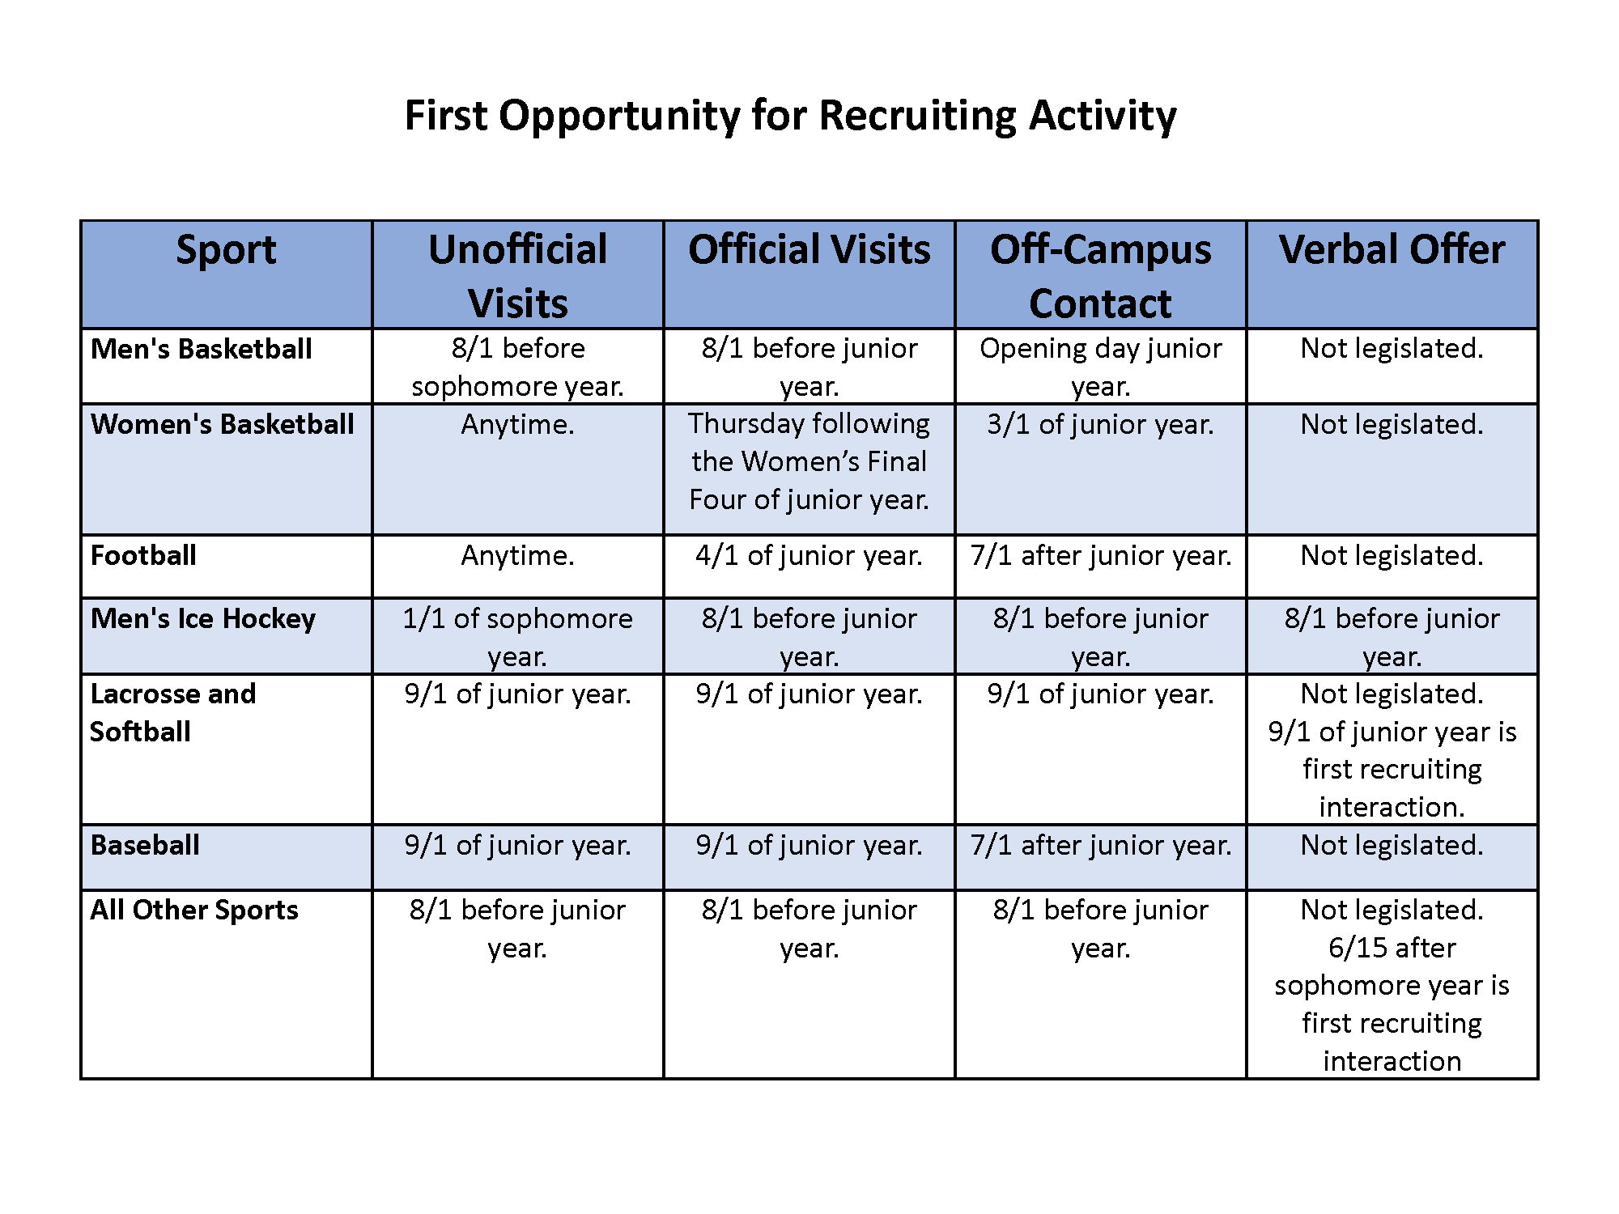
Athletic Compliance Educational Session
General Recruiting Concepts

Slide 21
Athletic Compliance Educational Session
Financial Aid / Scholarship Basics
DIII schools do not offer athletic scholarships
Other financial aid packages may be available
NLI is a contract between athlete and college (DI & DII)
Scholarship offer must accompany the NLI
Athletic scholarships may be multi-year agreements between prospect and institution. This is at the offering institution’s discretion.
Full Scholarship = tuition & required fees, room & board, books, and cost of attendance
Summer aid: potentially available for scholarship athletes
Fifth-year (exhausted eligibility) athletic aid to graduate may be available

Slide 22
Athletic Compliance Educational Session
Division I Financial Aid / Scholarships
Some sports are “all or nothing” scholarships (Head Count Sport)
Football (85)
M Basketball (13)
W Basketball (15)
W Gymnastics (12)
W Volleyball (12)
W Tennis (8)

Slide 23
Athletic Compliance Educational Session
Division I Financial Aid / Scholarships
Some sports are able to divide scholarships (Equivalency Sports)
Hockey (18)
M Track/CC (12.6)
W Track/CC (18)
M Lacrosse (12.6)
W Lacrosse (12)
Wrestling (9.9)
Softball (12)
Baseball (11.7)
M Golf (4.5)
W. Golf (6)
M Tennis (4.5)
M Soccer (9.9)
W Soccer (14)
Rowing (20)
M Swimming/Diving (9.9)
W Swimming/Diving (14)

Slide 24
Athletic Compliance Educational Session
Questions??
Kevin Gomer
Assistant Director of Athletic Compliance
University of Minnesota
kjgomer@umn.edu
Follow us on Twitter!
@GopherGuardian

