Slide 1

Emergency Procedures Review
EAST HIGH SCHOOL

Slide 2
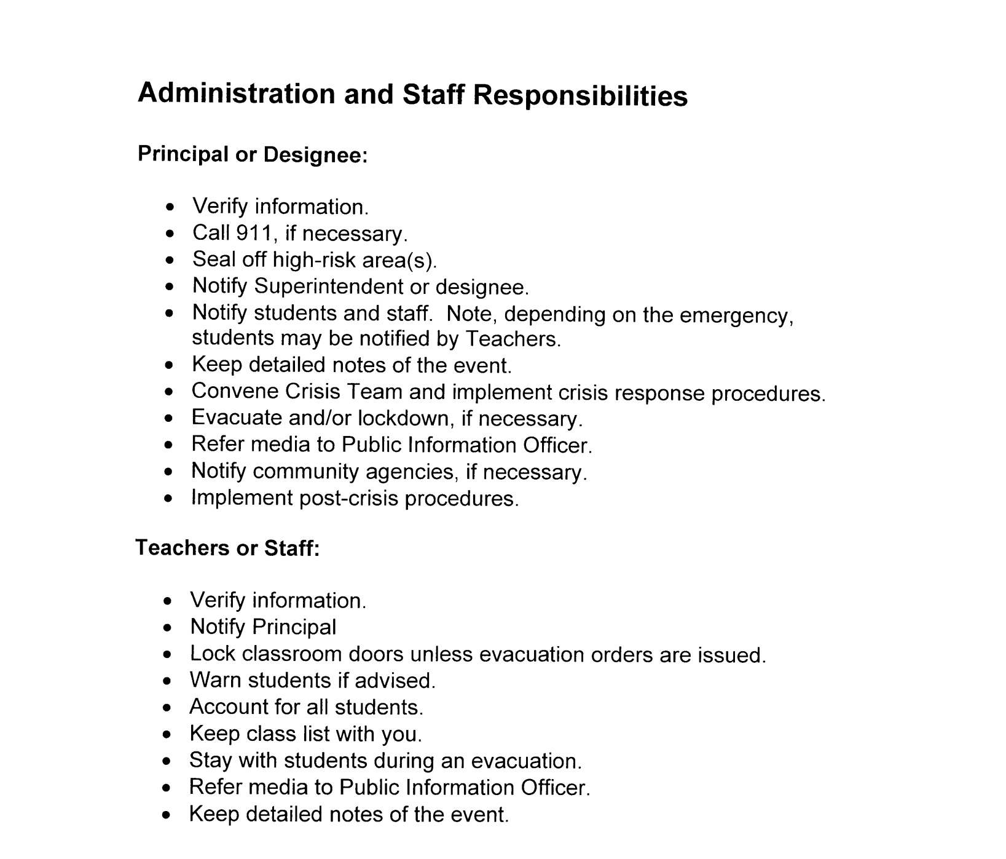

Slide 3
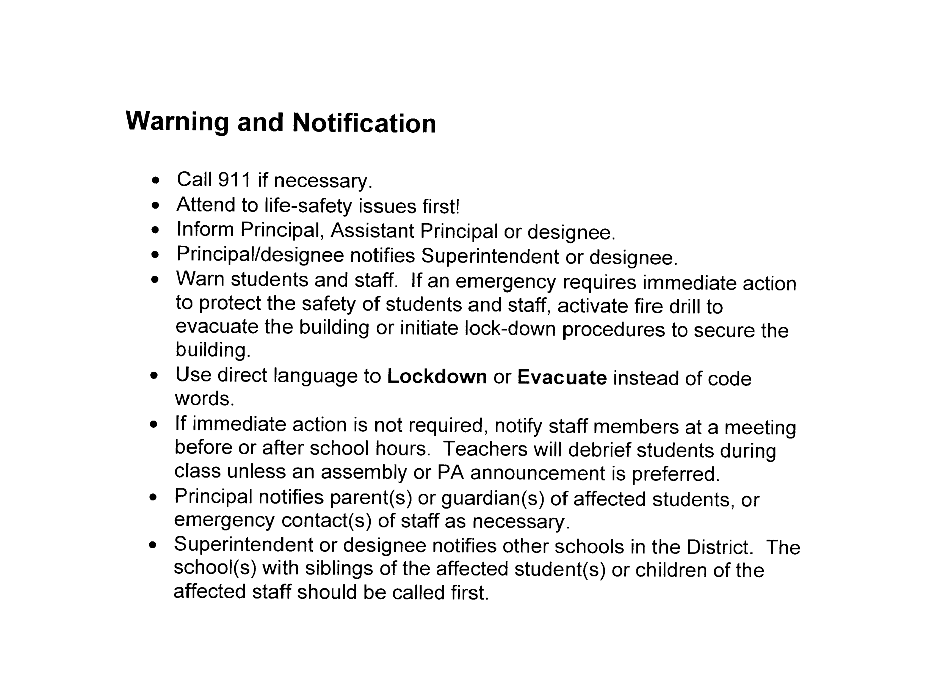


Slide 5


Slide 7
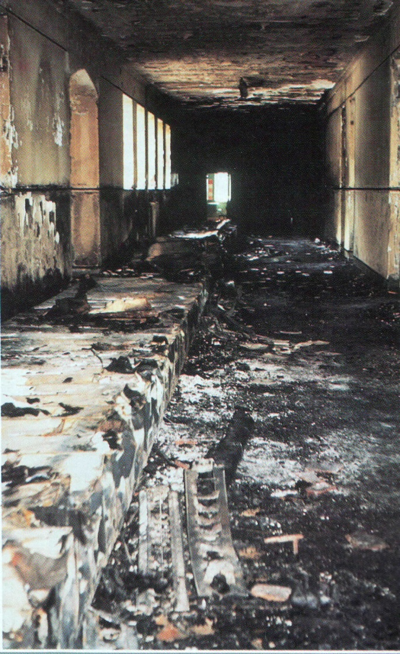

Slide 8
Calling Tree
Principal Calls
  Assistants Calls
    Department Heads call
      Department Members

Slide 9
Serious Injury / Death
If incident occurs at school or facility:
• Call 911.
• Notify First Aid/CPR-certified persons in school building(s) of medical
emergencies (see Crisis Team).
• Isolate affected student(s) and staff member(s), if possible.
• Notify Principal; Principal notifies Superintendent or designee.
• Activate school Crisis Team. Designate staff person to accompany ill
or injured person(s) to the hospital.
• Call Student Services.
• Principal notifies parent(s) or guardian(s) of affected student(s), or
emergency contact(s) of affected staff member(s).
• Direct witness(es) to school psychologist/counselor(s). Contact
parents if student is sent to psychologist/counselor.
• Determine method to notify students, staff members and parents.
• Refer media to Public Information Officer.

Slide 10
If incident occurs outside of school or facility:
• Activate school Crisis Team.
• Call Student Services.
• Notify staff members before normal operating hours.
• Determine method of notifying students and parents.
• Announce availability of counseling services for those who need
assistance.
• Refer media to Public Information Officer.

Slide 11
Post-crisis intervention:
• Meet with counselor(s) and Student Services staff to determine level
of intervention needed for students and staff.
• Designate rooms as private counseling areas.
• Escort affected student’s siblings, close friends, and other highly
stressed individuals to counselors.
• Assess stress level of staff; recommend counseling to those overly
stressed.
• Follow up with students and staff receiving counseling.
• Designate staff person(s) to attend funeral(s), if any.
• Allow for changes in normal routines or test schedules to address
injury or death.

Slide 12

Severe Storm
Severe wind, rain, snow, hail, thunderstorms and flash floods are not
uncommon in Utah. Tornadoes, while not common, do occur as well.
Procedures for dealing with these threats are similar.
• Be alert for weather warnings. Monitor Emergency Alert Stations or
NOAA Weather Stations (National Weather Service, WeatherChannel).
• Bring all students and staff inside building(s). Move to safe areas.
• Review “duck and cover” procedures if tornadoes threaten.
• Close windows and blinds; avoid windows and outside walls.
• Take class list; account for all students.
• Be ready to move quickly if flooding threatens.
• Remain in safe areas until warning(s) expire or emergency personnel
have issued all-clear advisories.

Slide 13
GET READY TO SHAKEOUT!
You are invited to join thousands of people who will Drop, Cover, and Hold On at 10:15 a.m. on April 17th* in the 2013 Great Utah ShakeOut!
More than 12.5 million people were registered to participate in ShakeOut drills worldwide in 2011. Participating is a great way for your family or organization to become better prepared to survive and recover quickly from big earthquakes.
http://www.shakeout.org/utah

Slide 14
Earthquake
During an Earthquake:
• Stay calm.
• Stay put. If you are indoors, stay there. If outdoors, stay there.
• Take cover. If indoors, take cover under a desk, table or bench,
stand in a supported doorway, or alongside an inside wall or corner.
• Avoid windows, bookcases, hanging fixtures, or outside walls until the
shaking stops.
• If no protection is available, drop to the floor and cover your head with
your hands. Make sure students are in “duck and cover” positions.
• The electricity may go out and/or the fire alarms and sprinklers may
activate.

Slide 15
Immediately After an Earthquake:
• Keep students safe and calm. Carefully evaluate the situation.
• Use caution when moving students and staff to safe area(s).
• Make sure everyone is all right. Take class list and account for all
students.
• Administer first aid if necessary.
• Don’t move the seriously injured unless they are still in danger.
• Do not attempt to turn off the natural gas service, electrical service or
the water main(s). District facilities are fitted with seismic gas valves
which automatically turn off the natural gas in the event of an
earthquake.
• The Custodian will check natural gas, water and electrical lines and
report any damage to the appropriate utility and/or Facility Services.
• Do not use the telephone, light switches, matches, candles, or other
open flame unless you are absolutely certain there is no natural gas
leaking.
• Do not touch electrical power lines or broken electrical equipment.
• Be prepared for aftershocks.

Slide 16
Emergency Release of Students
Release of students in grades K-8, other than the regularly scheduled
hours, is prohibited unless a parent or another authorized responsible
person has been notified and has assumed responsibility for the child.
Students in grades 9-12 may be released without such notification if the
Principal or designee determines that the child is reasonably responsible
and notification is not practical.
• Principal will contact the Superintendent or designee for authorization
to cancel school or close school early.
• If cancellation or closure is approved, Principal will initiate blockcalling
plan to contact as many parents and other authorized persons
as possible using the school calling tree.
• Principal will determine and communicate the pick up point or
alternate pick up point for bus drivers and parents.
• Principal will notify Support Services to arrange for
bus transportation and Food Service support as needed.

Slide 17
Evacuation / Relocation Procedures
Evacuation To On-Site or Near-site Locations:
• Call 911 if necessary.
• Principal orders evacuation if students and staff should be moved outside of school building(s) to Primary or Secondary Evacuation Assembly Points (See Emergency Directory).
• Direct students and staff to follow fire drill procedures and route. If
normal route is too dangerous, follow an alternate route.
• Close all windows, turn off lights, electrical equipment, gas, water
faucets, air conditioning, heating and ventilation, if possible.

Slide 18
Teachers:
• Direct students to follow normal fire drill procedures unless
Principal alters route or normal route is too dangerous.
• Take class list.
• Close classroom doors and turn out lights.
• When outside building, teachers account for all students. Inform
Principal immediately if students are missing.

Slide 19
Relocation To An Off-site Location:
• Principal determines relocation procedures after consulting with
Superintendent or designee.
• Principal orders evacuation if students and staff are to be moved to
Emergency Relocation Center (See Emergency Directory).
• Principal notifies Emergency Relocation Center.
• Designated Crisis Team member coordinates transportation if
students are evacuated to Emergency Relocation Center. District
Transportation Supervisor is contacted by the Crisis Team member
and informed that relocation is taking place.
• If students are moved to the Emergency Relocation Center, stay
with your class. Take roll again when you arrive at the Emergency
Relocation Center.

Slide 20
Lock-Down
Lock-down procedures may be implemented in situations involving
dangerous intruders or other incidents that may result in harm to persons
inside the school building(s).
• Principal will issue lock-down notification by announcing a warning
over the PA system.
• Announcement will be a basic alert (see Warning and Notification).
Do not use code words.
• Direct all students, staff and visitors into classrooms.
• Lock classroom doors.
• Close blinds or cover windows of classrooms. If it is impossible to
cover windows, stay out of view as much as possible.
• Move all persons away from windows or doors.
• Allow no one outside of classrooms until an all-clear signal is given by
the Principal or the Salt Lake Police Department. Ask officers to slip
badge under your door to verify.

Slide 21
Lock Down tips
Calmly inform students as to what is happening - they may panic if they don’t know.
Always have a contingency plan, never “lock” yourself into one plan
Secure the classroom doors. Staff will gather any students in the hallway prior to securing their door. Barricade the doors if possible.
Turn off the lights, seat students on the floor in the safest area of the room, away from doors/windows.
If teachers and their class are in transition in the hallway, they will enter the nearest classroom.
Take attendance.
Do not call the office for general information.
Call the office only with vital information, such as reporting the number and severity of injuries. Never identify your room number unless asked to do so.
No restroom breaks allowed.
Do not allow the use of a radio/TV within the classroom.
Do not use cell phones - history shows that these calls may be aired live on TV and intruders may find where you are.
Be patient as possible. Law enforcement should be equipped with master keys to unlock classroom doors when it is safe.
Staff should never make the determination it is safe and they can exit the classroom.
Remember, in an intense crisis situation such as an active shooter, classrooms may be locked down for hours before the school can be cleared by law enforcement. Patience and strictly following your school’s rapid response lockdown procedures will save lives.

Slide 22
Hazardous Materials / Chemical Spill
Incident in School or Facility:
• Call 911.
• Notify Principal; Principal notifies Superintendent or designee.
• Seal off area of leak/spill.
• Take charge of area until Fire Department or Hazmat personnel
contain incident.
• Fire Officer in charge will recommend evacuation actions.
• If directed, turn off building ventilation and exhaust systems.
• Follow plans and procedures for sheltering or evacuation.
• Resume normal operations after consulting with Fire or Hazmat
officials.

Slide 23
Hazardous Materials / Chemical Spill
Incident near School or Facility:
• Monitor KSL television or radio or NOAA radio Emergency Alert
System for emergency information.
• Fire, Police or Hazmat personnel will notify Superintendent or
designee.
• Superintendent or designee will notify Principal.
• Fire Official in charge of scene will recommend sheltering or relocate
actions.
• Follow plans and procedures for sheltering or evacuation.
• Notify parents if students are relocated.
• Resume normal operations after consulting with Fire or Hazmat
Officials.

Slide 24
Hostage
Hostage Situation:
• If hostage taker is unaware of your presence, do not intervene.
• Call 911 immediately. Provide details of situation, ask for assistance.
• Seal off area near hostage scene.
• Notify Principal; Principal notifies Superintendent or designee.
• Give control of scene to Police and hostage negotiation team.
• Keep detailed notes of events and actions.
If Taken Hostage:
• Follow instructions of hostage taker.
• Ask permission to speak; do not argue or make suggestions.
• Try to keep calm. Calm students if they are present.
• Treat the hostage taker as normally as possible.
• Be respectful to hostage taker.

Slide 25
Intruder
Intruder - An unauthorized person who enters school or facility property.
• Politely greet intruder and identify yourself.
• Ask intruder the purpose of his/her visit.
• If purpose is not legitimate, ask intruder to leave.
• Inform intruder that all visitors must register at the main office.
• Notify Principal, as appropriate.
• Ask another staff member to accompany you before approaching
intruder, if feasible.
• Accompany intruder to exit.

Slide 26
Intruder
If Intruder Refuses To Leave:
• Warn of consequences for staying on school property. Inform
intruder that Police will be called.
• Notify Police and Principal if intruder refuses to leave. Provide full
description of intruder.
• Walk away from intruder if he/she indicates potential for violence. Be
aware of actions, location, weapons or packages, etc.
• Principal issues lock-down procedures.
• Principal notifies Superintendent or designee.

Slide 27
Student Unrest
• Notify Police if necessary.
• First ensure the safety of students and staff members.
• Contain area of unrest - seal off as appropriate.
• Move students involved in disturbance to an isolated area.
• Notify Principal; Principal notifies Superintendent or designee.
• Advise staff; Principal may issue lock-down (see Lock-Down
Procedures).
• Meet with student representatives to address issues, as appropriate.
• Document incidents with a camera, tape recorder or take detailed
notes.
Teachers:
• Keep students calm.
• Lock classroom doors.
• Do not allow students outside of classroom until you receive an all
clear signal from the Principal.
• Make a list of any students absent from the classroom.
• Document all incidents.

Slide 28
Weapons
• Immediately notify Principal or Teacher.
• Identify by name the individual suspected of bringing weapon; type of weapon; where the weapon is located; if the suspect has threatened anyone; and any other details that may prevent the suspect from hurting someone or themselves.
• If Teacher suspects that the weapon is in the classroom, a neighboring Teacher should be confidentially notified. The Teacher should not leave the classroom. Send a student with note to neighboring Teacher.

