Slide 1


SENIOR WORKSHOP
CLASS of 2021
Notes:
Welcome to the Senior Workshop presented by the Brockton High School Guidance Department.
Most of you who have studied here at BHS for the past three years and have attended our annual workshops and most likely realize that each year is an important one for very specific reasons. Your senior year is not different and, in many ways, is the MOST IMPORTANT year you will experience in high school.
As a senior, you need to make some very important decisions that will start the road for your future, whether you decide to take the employment route, the military one, or the technical or college road.
Today, we will go over information that will assist you in your decision process during the next few months, particularly if you plan to apply to college. CLICK

Slide 2
AGENDA
Part One
. Postsecondary Options
. How to Research Options and Resources
Part Two
. Academic Requirements
. Choosing the Right College
. College Admission Testing
Notes:
Before we start we would like to give you an overview of the topics that will be addressed. Because of the amount of important information we have for you today, we would like you to take notes. Please take out a piece of paper to take notes and write down any questions you may have during this presentation.
Part One will address “Postsecondary Options” and “How to Research these Options and Resources.”
Part Two will address “Academic Requirements”, “How to Choose the Right College” and “College Admission Testing”. CLICK

Slide 3
AGENDA
Part Three
College Application Process
College essay
Recommendation
Interviews
Part Four
Financing your education
Scholarships
Loan and grants
Notes:
In Part Three we will look at the actual “College Application Process” including the “College Essay”, “Recommendations” and the “College Interview.”
Part Four concludes with “How to Finance your Education”, the types of “Scholarships” that are available and how to apply for “Loans and Grants”.
Click

Slide 4
Part One
Postsecondary Options
How to Research Options and
Resources
Objectives
Students will be able to research a topic
To gather information use skills learned to locate and use resources for research
Notes:
Note: Counselor go over Content and Literacy Objectives
Now lets begin with Part One, “Postsecondary Options” and “How to Research Options and Resources”. One of the skills necessary is to be able to Research Topics and Gather Information in order to make an informed decision regarding your future after graduation. Click

Slide 5


Postsecondary Options
TWO - YEAR
FOUR - YEAR
COLLEGE
Massasoit Community
College
ASSOCIATE’S
DEGREE
Bridgewater
State University
BACHELOR’S DEGREE
Notes:
Many students decide to attend college where they can pursue a particular major leading to a particular career. As you know, there are two major types of colleges, four year and two year. CLICK
At a two-year or a community college, such as Massasoit, CLICK you will receive an Associate’s Degree and then you may go into the work force or go on to a four-year college. Many students choose to begin their college career at a two-year college and transfer to a four year college. It is important to remember that every year completed at a community college lessens the amount of time you will need to spend at a four year college, if you decide to transfer. For example, if you complete two years at a college like Massasoit, you will normally only need to complete two more years at a four year college.
There are several good reasons to attend a two-year college. Many students pursue careers that only require a two year degree, while others begin at a two year college in order to improve their GPA. If you have not met the entry requirements at your four-year college of choice, a two year college can help you qualify for admission to that school. If you are not sure what to major in, you may want to take courses at a community college to help you decide before applying to a four-year college. Another good reason to attend a community college is to save money on tuition before transferring to a four-year college CLICK such as Bridgewater State University. CLICK
Students may wish to participate in Mass Transfer through the Commonwealth Commitment Program available to students who attend a Massachusetts State Community College and maintain a GPA of 3.0 while enrolled. Upon transfer to a four year Massachusetts State Institution, the tuition and fee rates in place at the respective community college, shall be the rates Commonwealth Commitment students will be charged for each year the student remains in the program, provided that said student maintains program eligibility, including full-time attendance.
CLICK

Slide 6




COLLEGE EXPLORATION
Attend virtual college tours
Research colleges, majors and careers through portals like mefaPathways and CollegeBoard
Check your BPS email frequently for important college updates and info
Access local agencies, like Talent Search, for assistance.
Notes:
If attending college is your goal, your exploration should take you through the following steps: CLICK
Most colleges will offer virtual college tours, these are your best option right now . These are wonderful opportunities for you to speak virtually with faculty and administrators. CLICK
B) Use helpful websites such as CollegeBoard or MEFA Pathways to help you search for majors, careers, and colleges. MEFA Pathways additionally have some useful inventories to help you figure out which career or majors you may be best suited for CLICK
C) Your guidance counselor will be sending you updated information through email and Teams. Please make sure to review all information and check in if you have any questions or need any assistance.
D) One local agency, called Talent Search, can offer a wealth of information as you plan out your future, along with financial aid help.
CLICK

Slide 7

COLLEGE EXPLORATION
Help right in your backyard
Education Advisor: Mr. Pace
Phone: 617-448-7989
Email- mpace@asa.org
Notes:
Talent Search is offering many workshops through Zoom this year. Typically their office is in the Access Center, but for the time being please contact them through email or by phone. Please take a second to copy Mr. Pace’s information.

Slide 8
Part Two
Academic requirements
Choosing the Right College
College Admission Testing
Objectives
Students will identify postsecondary
options consistent with interests and
achievement.
To create, interpret and explain a
table, chart or graph.
Notes:
Note: Counselor should review Literacy and Content Objectives.
This next part of the presentation will address the “Academic and Testing Requirements” necessary for college. In addition, in order to choose the best college for yourself you may need to be able to interpret and/or create charts and graphs to help you make the best decision to suit your needs.

Slide 9

WHAT SHOULD I BE DOING NOW?
Four Year College Requirements
What courses and grades are needed for admission to a four-year college or university?
Notes:
One thing you should be asking yourself now is, “ How can I prepare myself for a 4 year college?”
Please take a minute to think about the following question before moving on to the next slide.
WHAT COURSES AND GRADE REQUIREMENTS WILL I NEED FOR ADMISSION TO A FOUR-YEAR COLLEGE OR UNIVERSITY?
CLICK

Slide 10



What should I be doing now?
Choose 4 to 6 Schools
1 or 2 reach schools
3 or 4 target schools
1 or 2 probable schools
Notes:
In order to make certain you are applying to appropriate schools according to your academic background, you should choose between 4 to 6 schools which include: CLICK
1 or 2 reach schools
Reach schools are colleges requiring high GPA’s and SAT scores that are very competitive and selective. These are schools where your chances of admission are less than 50%. CLICK
3 or 4 target schools
Target schools are schools that are looking for a candidate similar to you in terms of your GPA, SAT scores, and extra-curricular activities. These are schools where the chances of admission are 50/50. CLICK
1 or 2 probable schools
Probable schools are schools where the chances for admission are strong and might include 2-year community colleges just in case you don’t meet the eligibility requirements of other schools you applied to. You can always transfer to another 2-year program once you complete your associate’s degree. In your packet is a “College Comparison Worksheet” which will help you make a well thought out decision regarding your choice.
You may have these categories based on finances as well

Slide 11



Register for SAT/ACT’s/Send Scores
What should I be doing
now?
Notes:
*SATs are not offered at BHS this year, only in Boston at local hotels. Some colleges will be SAT optional in light of COVID, you will need to check individual college websites for specific information.

Slide 12

English as a Second Language Students - TOEFL
What should I be doing
now?
Notes:
Students whose native language is not English (CLICK)
may be required to take the Test of English as a Foreign Language (TOEFL). You must determine if the school you are applying to requires the TOEFL. If so, you will need to register as soon as you can. (CLICK)
You may find information about the TOEFL through your guidance counselor or at the Educational Testing Services website: www.ets.org and click on TOEFL. CLICK

Slide 13
Part Three
College Application Process
College Essay
Recommendations
Interviews
Objectives
Students will gather information from a
variety of sources, analyze and evaluate
the quality of the information obtained
and use it to answer their own questions.
To develop an expository essay with a
formal structure.
Notes:
Note: Counselors should review the literacy and content objectives.
After you have identified all the colleges that seem to fit your criteria, you must then begin the actual “Application Process”. This next section will address the “College Essay”, “Recommendations” and “Interviews” that you may need. However, be aware that depending on your career choice you may need to schedule an audition or prepare a portfolio.
Click

Slide 14

Obtain College Applications and Begin Completing
What should I be doing now?
Read the instructions carefully
Meet with your guidance counselor
Keep in mind admission deadlines
Attend a Common App Workshop for a quick tutorial
Notes:
College applications will be most commonly obtained online through the Common App website or through the specific school’s website. The Common App or “The Common Application is one application that can be sent to thousands of colleges. The guidance department will offer a mini-workshop about this. The workshop will be sent to you by October 7th through Teams.
When you receive your applications you should: CLICK
1. Read the instructions carefully. CLICK
2. Meet with your guidance counselor to go over any doubts or queries you may have. CLICK
3. Keep in mind the admission deadlines. CLICK

Slide 15
OFFICIAL TRANSCRIPT
What colleges look for:
Cumulative GPA/Class rank
Grades in classes
Level of classes (IB/AP, Honors, CPA, etc.)
Challenging senior schedule
Upward trends
Notes:
Official Transcript
Students applying to college are required to send their official high school transcript. This is a record of all of the courses you have taken since the ninth grade.
It includes CLICK
the name of the class CLICK
the academic level. CLICK
All final grades CLICK
and the amount of credits earned.
Everyone in this room currently has a transcript including courses from freshmen, sophomore and junior year. It is really important to do well in your senior year as well. In fact, colleges look very closely at the first term grades in all subjects.
Also included on your transcript…. CLICK
is your grade point average …..CLICK
and class rank.
Your grade point average or GPA is a number that represents the grades that you have earned through the years. The person with the highest GPA is ranked #1 in the class. CLICK

Slide 16
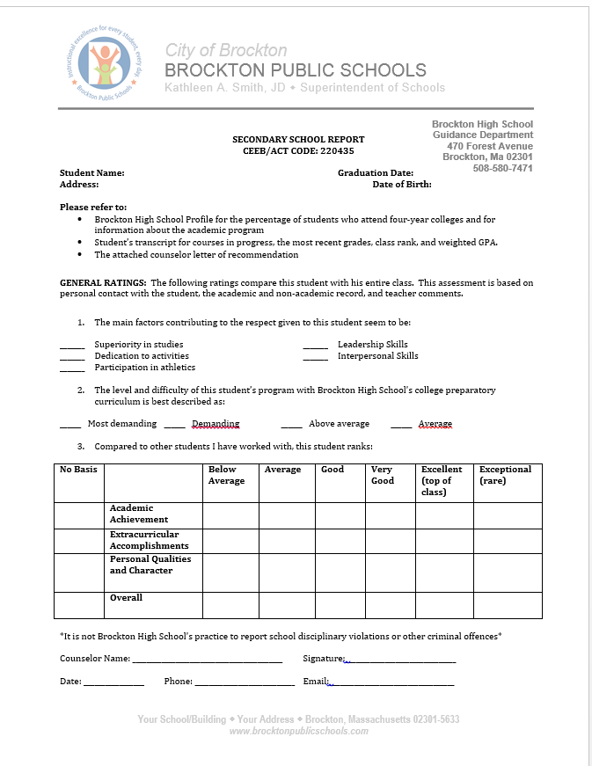
Secondary School Report
Notes:
Included with the mailing of the official transcript is the BHS Secondary School Report and your counselor’s letter of recommendation.
Your counselor will need from you: Click to next slide

Slide 17
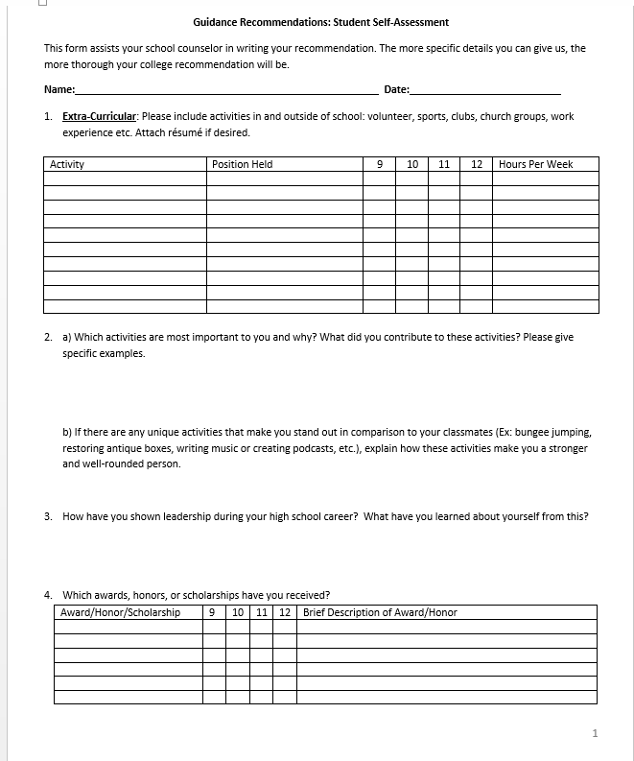
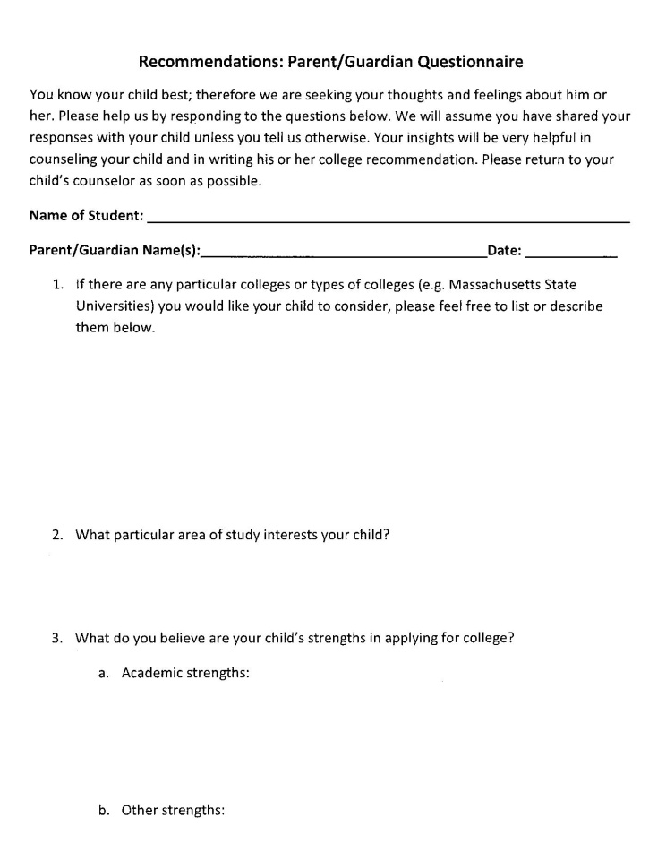
Counselor Recommendation
Student Self-Assessment
Parent Questionnaire
ACTIVITY SHEET
Notes:
Student Self-Assessment and Parent Questionnaire
In order to write your recommendation, counselors will refer to a Student Self-Assessment Form and a Parent Questionnaire . Your guidance counselor will send you these through online questionnaires. Please make sure that you fill this out as completely and accurately as possible including things like the activities you have been involved in, the sports team you may have played on and your hobbies and interests. The Self-Assessment form and the parent questionnaire require you and your parents to reflect on your personal qualities and areas of strength. This is very helpful in the recommendation process.
CLICK

Slide 18
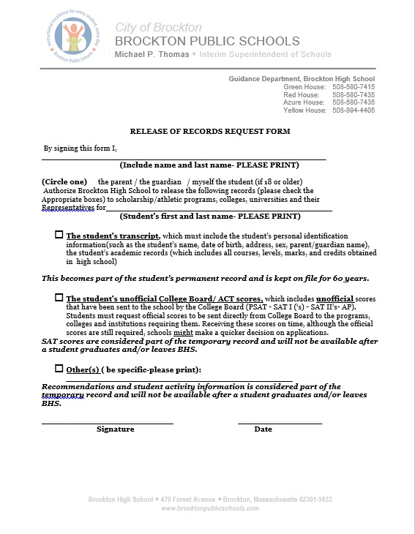
Release of Records
Notes:
Release of Records
In order for your counselor to send your official transcript we must have your permission. Your grades, GPA and class rank are confidential and we can not release this information without authorization. If you are eighteen years of age or older you may sign the release form. If you are under eighteen, your parent or guardian must sign. Without a signature we are not authorized to release any of your information. Please make it a priority to return this to your counselor as soon as possible. You will receive an electronic copy within the next few weeks. CLICK

Slide 19
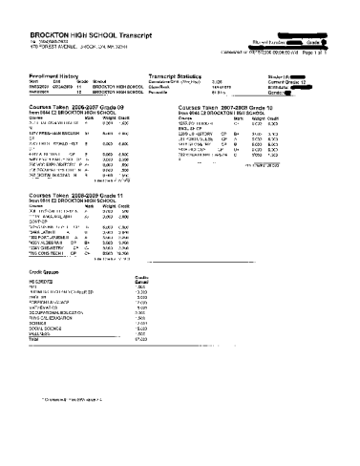
College Application Process
Official
Transcript
Mid-
Year
Grades
$3.00
Notes:
It is the responsibility of your guidance counselor to send your official transcript to all of the colleges you are applying to.
CLICK
There is a $3 fee per school. This will cover the processing. As we mentioned earlier, applications and transcripts need to be sent on a timely basis so always keep your deadlines in mind. Keep your counselor informed about any colleges that you have applied to online so that your transcript can be forwarded. The $3 processing fee per school will be collected at a later date. Sometime in the spring, each senior will receive an invoice.
CLICK
Often times the college will request a copy of your mid year grades. This includes your term two and semester one grades. Therefore, at the end of January you may need to see your counselor to request that an updated transcript be sent to the colleges. The schools usually notify the applicants if it will be necessary for mid-year reports to be sent. After graduation, Brockton High School will send your final transcript to the college of choice. Keep in mind that the admissions offices will be taking a look at your final grades for the year. So do your best all year. Counselors should tell students that their admission status can be rescinded due to poor or failing grades.

Slide 20



ESSAYS & PERSONAL STATEMENTS
College Application Process
Notes:
Essays/Personal Statements
In order to write the college essay you must know how to develop the formal structure required for it.
Determine what essay topics the schools you are applying to require. Often, a general essay will suffice for most schools, but you need to read carefully what each school is requiring.
Work on several drafts and ask your teacher to look it over for mistakes, writing congruency, etc.
Remember, the essay will be yet another image of yourself, therefore, you want to send in an essay that, not only reflects you personally, but that is well written and void of mistakes and typographical errors.
COMMON APP CAN ONLY BE ACCESSED THROUGH GOOGLE CHROME
CLICK

Slide 21



LETTERS OF RECOMMENDATION
College Application Process
Notes:
Letters of Recommendation
Teachers, as you know, are very busy people, therefore, they need to be asked for letters of recommendation with advance warning.
Choose no more than two teachers that have gotten to know you through your hard work and good grades.
Also consider asking teachers that teach subjects related to your intended major, if you have already chosen one.
Don’t forget to assign teachers and counselors when using the Common Application.
To assign a Teacher or Other Recommender follow these steps:
1. Scroll down until you see the Teacher or Other Recommender section.
2. Click on the box to select the teacher or Other Recommender you want to assign. Note that you may need to click "Add Another" for optional recommendations.
3. Click on the "Assign" button to assign that recommender.
Give teachers about 3 weeks and check back with them. If your letter has not been written, let the teacher know you understand but that you would appreciate it within a week due to the deadlines you are working with. CLICK
Make certain to thank your teachers for writing you a letter with a thank you note. They will certainly appreciate it and you will be looked upon even more positively.

Slide 22

INTERVIEWS
Some college will require an interview
to get to know you better. These interviews may be virtual this year. Check individual college websites to get more information.
Notes:
Interviews
Most colleges are not able to conduct interviews due to the large numbers of candidates, however, if you apply to an Honors Program, or other specific or specialized program, an interview is usually standard.
Top caliber and ivy league schools will usually request an interview also. Check with the application instructions and/or the admissions office.
Interviews shed more light on who you are, what you feel your strengths and weaknesses are, and what specific reasons attracted you to the school. It is another tool for final selection.
CLICK

Slide 23
Part Four
Financing your education
Scholarships
Loans and Grants
Objectives
Students will assess and modify
their educational plan to support
career and financial goals.
To develop and evaluate inferences
and predictions based on data.
To understand a concept and
construct meaning.
Notes:
Note: Counselors should review the literacy and content objectives.
After you have been accepted to your chosen colleges, you must consider how to finance your education.
In Part Four we will look at ways of paying your tuition and of obtaining scholarships, loans and grants. The ability to determine how much funding you will actually need and being competent at managing your money wisely are two very important skills required so that you are sure to be able to graduate from college without too much debt . Click

Slide 24
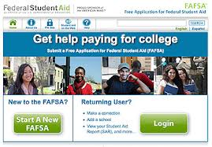
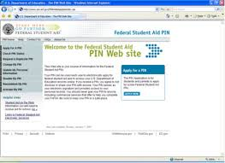
FINANCIAL AID
https://fafsa.ed.gov/
https://fsaid.ed.gov/
Notes:
The first step in applying for financial aid is to complete a “FAFSA” which stands for “Free Application for Federal Aid.”
The application for 2020-2021 is not available until October 1st, 2020.
However, before you even fill out this form, CLICK you and your parent/guardian EACH must obtain a Federal Student Aid ID. This number will be used as an electronic signature when signing your FAFSA.
You should obtain your FSA ID now, waiting until December or January could delay getting your FSA ID by up to 2 weeks. Simply go online to the FAFSA website
https://fafsa.ed.gov. and follow the directions for obtaining a FSA ID. Within a few days you will receive your FSA ID in an e-mail. You will be asked to use this number throughout the FAFSA application process. CLICK

Slide 25
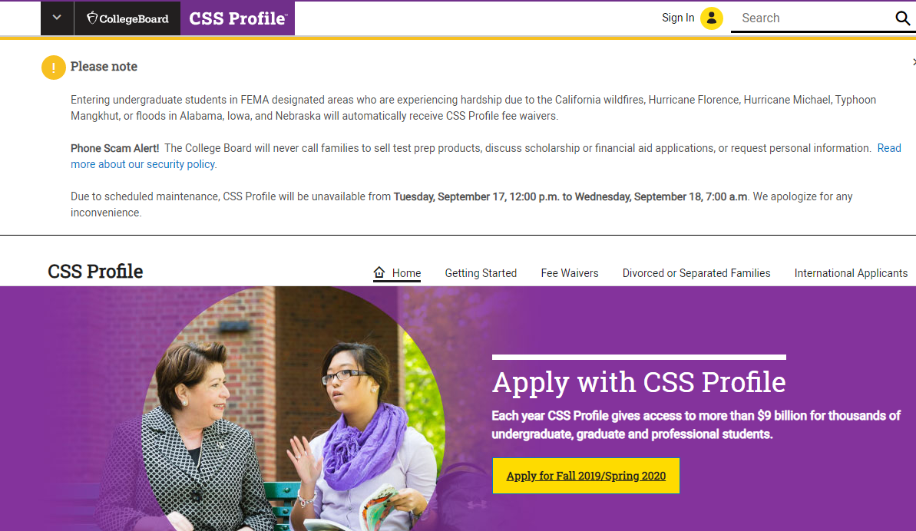
FINANCIAL AID
CSS PROFILE
Check to see if your schools require the CSS Profile
Apply on-line :
collegeboard.com/CSS Profile
Collects financial information (similar to FAFSA)
There is a fee for each school you send this application to
There are early deadlines
Notes:
Another financial aid form that many private colleges require is the CSS Profile. CLICK
Before you complete a CSS Profile, you should check to see if you are applying to a school that requires you to complete it. CLICK
If you are applying to a school (s) that does require the CSS Profile, then you will have to complete this form online. Basically the CSS Profile asks for the same financial information as the FAFSA, however, there is a fee for each school that you send it to. It is usually necessary to complete this form to be eligible to receive institutional student aid funds from colleges and scholarship programs. CLICK

Slide 26


FINANCIAL AID
Local Scholarships
SCHOLARSHIP
BOOK
Scholarship Binder in each Guidance Suite
Notes:
Another source of financial aid are local scholarships. CLICK
After the first of the year, the guidance department will post the local scholarship book on the Brockton Public Schools website. These scholarships are made available from local businesses, organizations and other various sources. You must apply for these scholarships individually as each scholarship may have different requirements. Some may even require interviews. You will learn if you have received any of these scholarships prior to graduation. CLICK
In addition to the previously mentioned sources, there is a scholarship binder in each of the guidance suites. These binders contain scholarships which are sent to Brockton High from State and National Organizations. Hopefully by the Spring, we will be in person and everyone will have access to these binders. Otherwise, we will determine a safe and effective way to get this important scholarship information to each of you. CLICK

Slide 27
3. From October 1st , 2019 on:
Fill out FAFSA: https://fafsa.ed.gov
FINANCIAL AID RESOURCES
AT YOUR FINGERTIPS
WHAT TO DO NOW
1. Begin Applying for Scholarships
MassCIS- intoCareers
https://masscis.intocareers.org
2. Obtain your FAFSA ID:
https://fsaid.ed.gov
Notes:
Ask students to take out their phones or pads and enter these important links:
Suggest them to enter a reminder for the FAFSA for October1st

Slide 28


CLASS of 2021
Notes:
On the reverse side of your foldable, write three things that you need to do now in order to begin this process.
In conclusion, the guidance department hopes that this workshop has been helpful for all seniors. Please remember that this is your future and you need to plan carefully. Include your parents or guardians in your plans. If you need help making your decision see your counselor and talk to teachers whom you have a good relationship with. Although we tried to cover many topics today, please keep in mind that we have much more information available to you in the guidance office. See us individually if you need assistance on career research, information about technical schools, the world of work, or if you need help narrowing down your college choices. Also stay on top of your course work during your senior year. You still need to fulfill graduation requirements so stay focused.
Please schedule a virtual appointment for a senior interview with your counselor. Keep your graphic organizer and action plan and bring it to your interview .

