Slide 1


Freshmen Seminar
What You Need To Know
To Be Successful at BHS
Notes:
Welcome to the Freshmen Seminar
What you need to know to be successful at Brockton High School

Slide 2
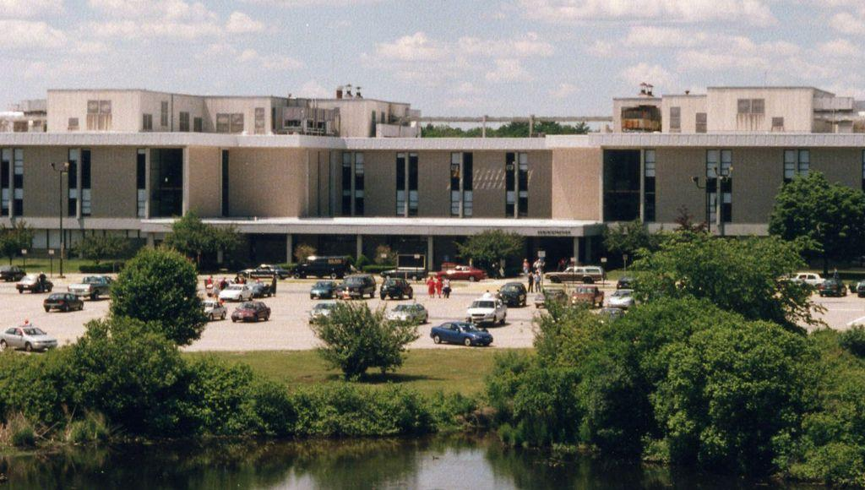
Part One
Support Services
Guidance and Adjustment Counselor Services
Part One Objectives
To understand the benefits of education
To explain the logic of an argument or solution
To identify attitudes and behaviors which lead to successful learning
Notes:
Say this…"As you watch this presentation, you may want to have a pen and paper handy for note taking. There are four sections. Your notes will help you answer the questionnaire at the end. "
(Read the slide about Part 1 and the objectives)

Slide 3
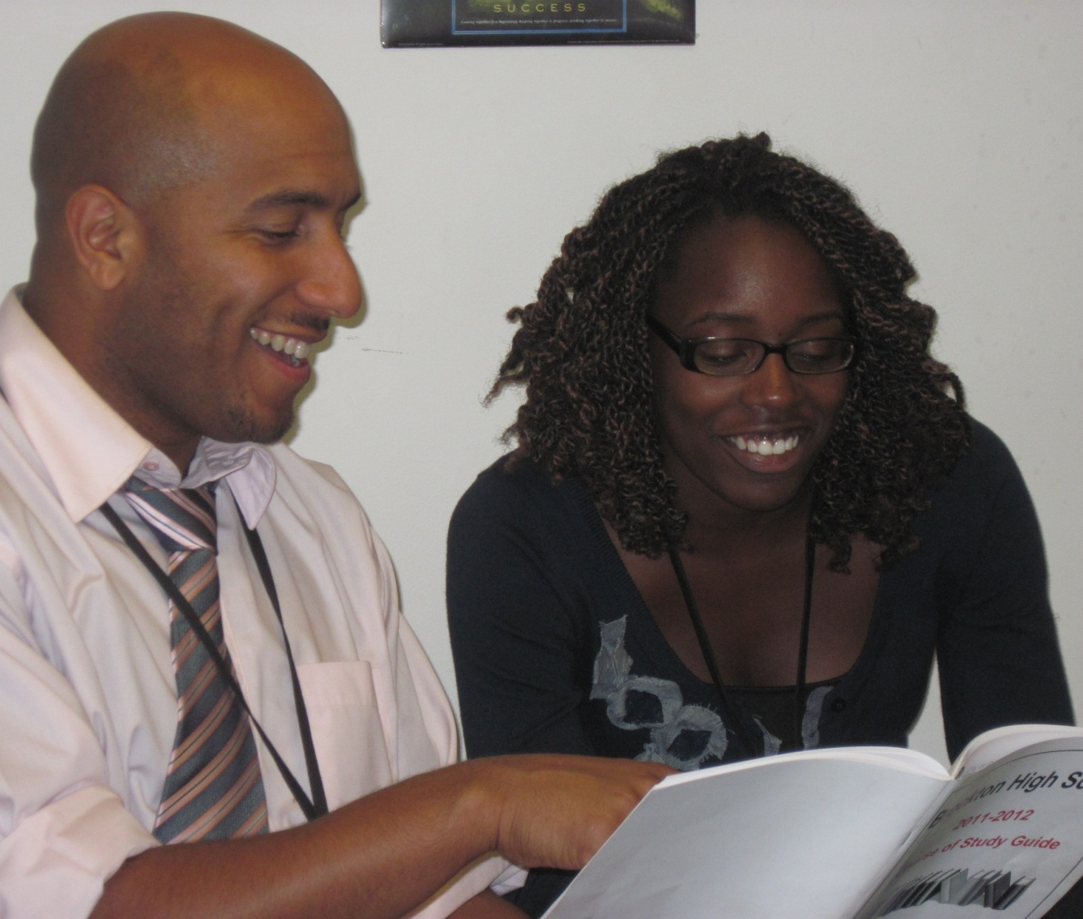
The Role of Guidance
Notes:
The Role of Guidance
Guidance Counselors help students choose classes, prepare for a successful high school experience and guide students in the development of a long-term plan. We are here to support your academic and personal development. you overcome any challenges you come up against to ensure that you are successful here at Brockton High. We also help you to prepare for life after graduation by assisting you with college and career planning. If you have a question and are not sure who to ask, come see us in the guidance office. Guidance counselors can direct students to whomever may be helpful in solving a problem or answering a question.
CCLICK

Slide 4

Guidance Support Services
Questions or Problems
Scheduling
Career Counseling
Referrals
College Applications
Other
Guidance
Virtual Procedure:
You can connect to your counselor via Microsoft Teams. Utilize the chat feature or set up a video call with them!
You can also reach out by email.
Procedure for seeing your guidance counselor
- Obtain a pass from your counselor or DA teacher
- Stop in during your lunch to get a pass
Notes:
These are some of the services that you could reach out to your guidance counselor for. (read above)

Slide 5
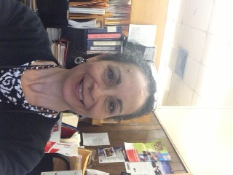
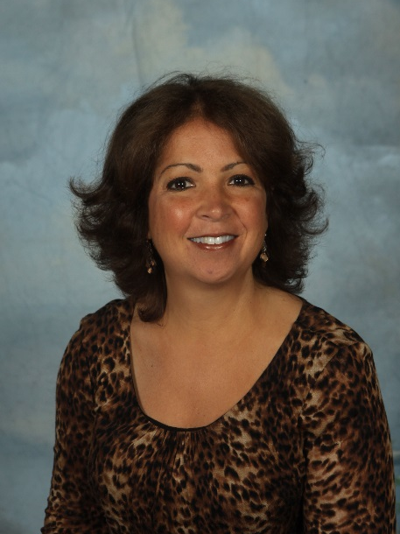
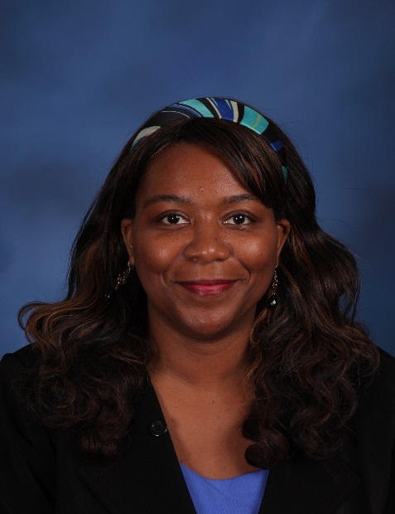
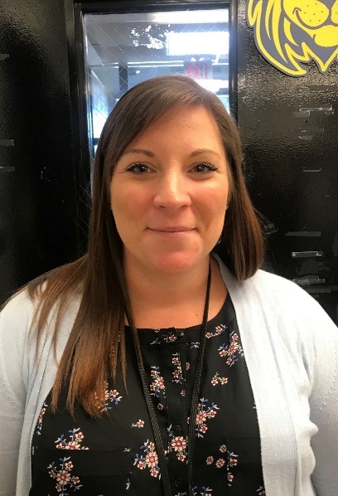
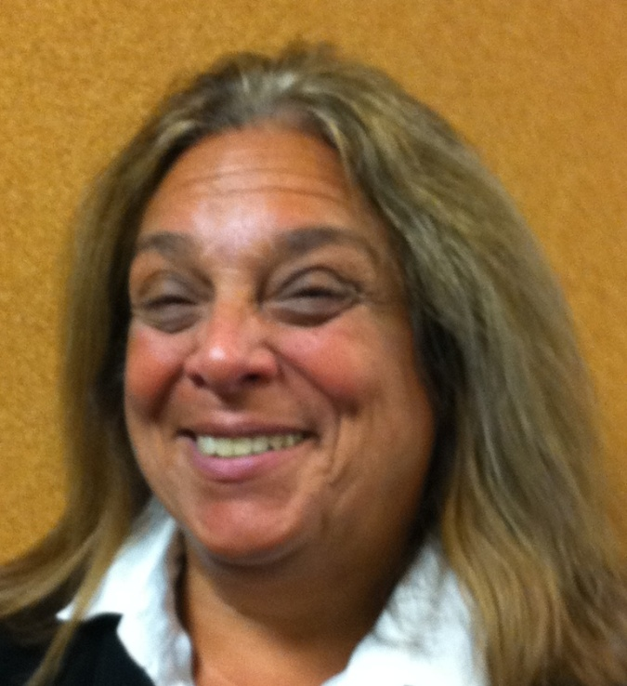
Azure
Ms. Rubilar
Ms. Defaria
Dr. McNeil-Pleasant
Mrs. Williamson
Ms. Downey

Slide 6
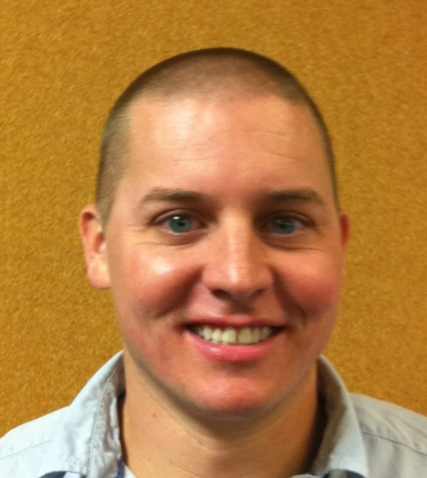
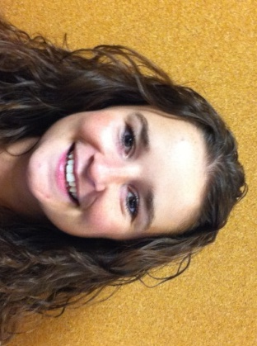
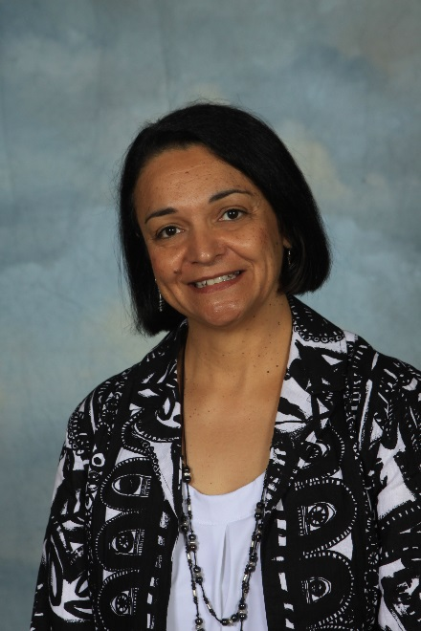
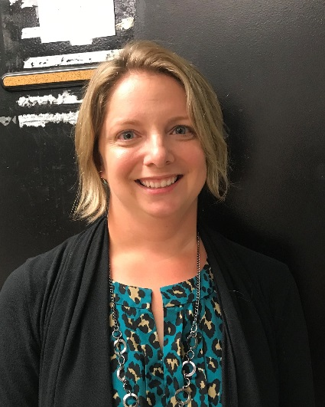
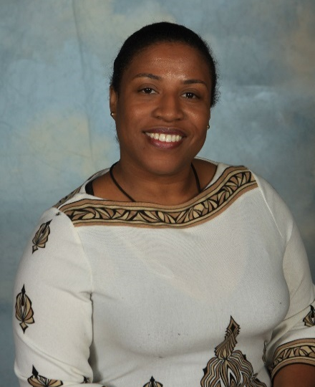
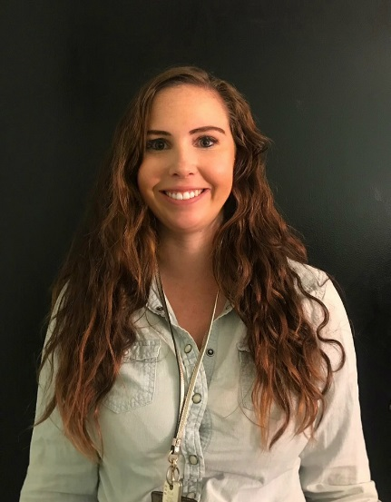
Green
Mr. Rea
Mrs.Ortiz
Dr. Mascarenhas
Mrs. Arrighi
Mrs. Cajuste
Ms. Pelton

Slide 7
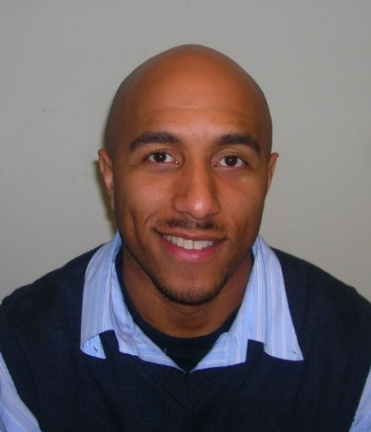
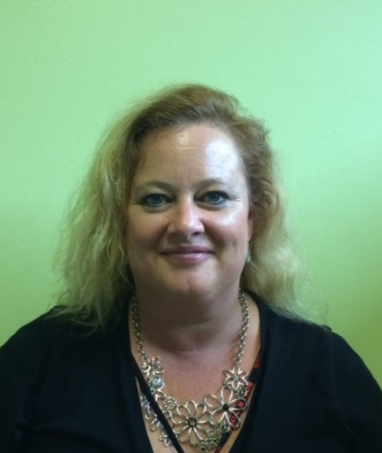
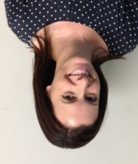
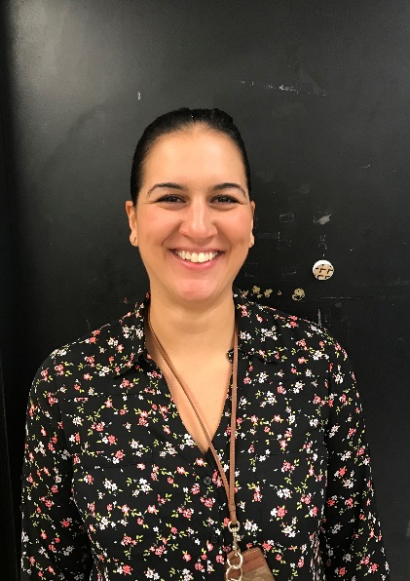
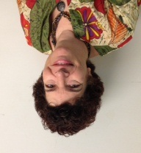
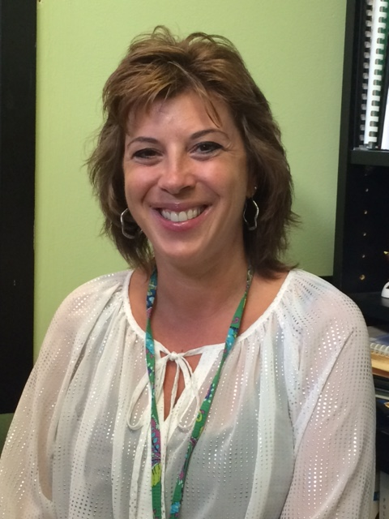
Yellow
Mr. Debarros
Ms. Anderson
Ms. McDonough
Ms. Palantzas
Mrs. Neary
Mrs. Bamford

Slide 8

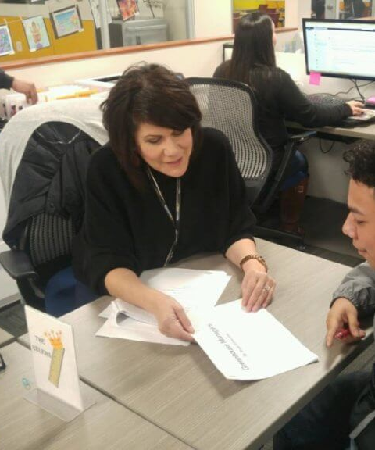
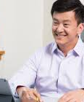
Adjustment Counselors
Confidentiality Statement, per Massachusetts law:
All Adjustment Counselor/student communication will remain confidential unless a student discloses the following:
A desire/attempt to hurt self or someone else;
A desire/attempt to kill self or someone else;
Someone is going to hurt self/someone else;
Student under the age of 16 years old discloses sexual activity.
Notes:
School Adjustment Counselors are available to assist students with a variety of personal issues. Students may refer themselves or be referred by a teacher, guidance counselor, administrator or a parent. Issues may require one or more visits. Some issues may be referred for outside counseling. Adjustment counselors also run groups (on self-esteem, study skills, anger management, etc). All services are confidential except when a student is at risk of hurting him or herself or others. There is one school adjustment counselor per building and if English is not your first language, we have bilingual adjustment counselors for you to talk to. Please take a moment to read the confidentiality statement on the slide.

Slide 9
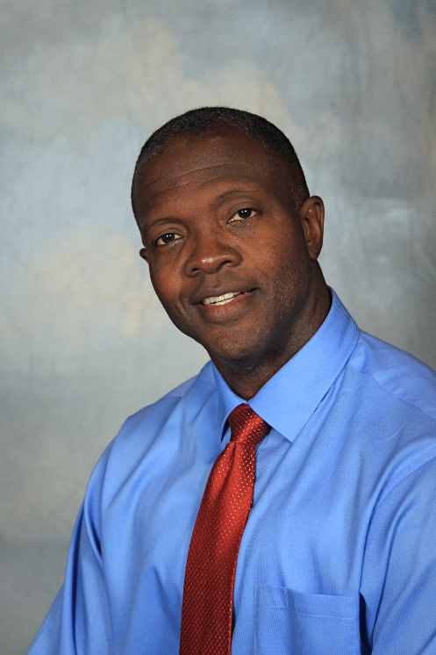
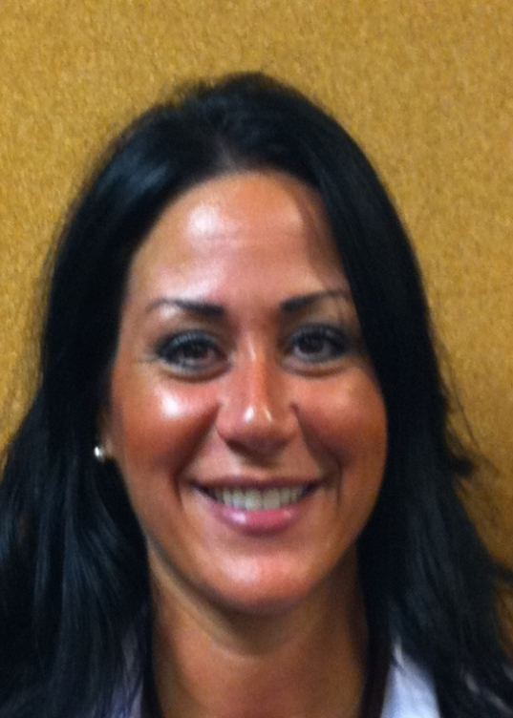
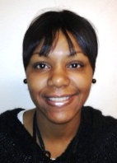
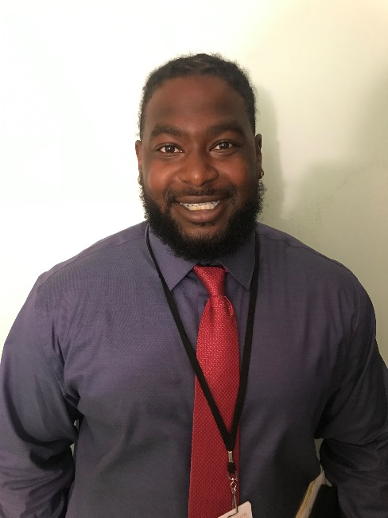
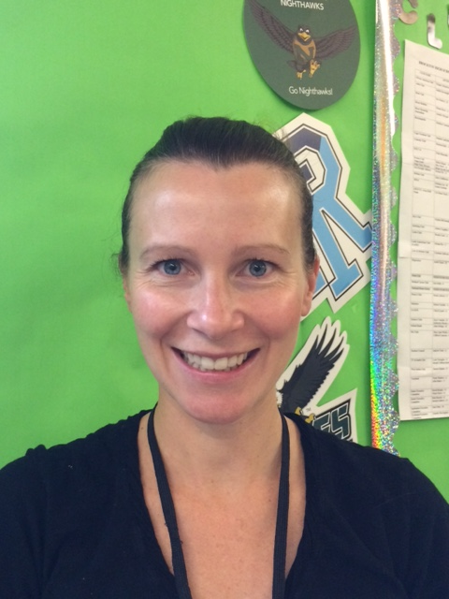
Adjustment Counselors
Mr. Guilloteau (RED)
508-580-7404
jeandguilloteau@bpsma.org
Ms. Mitchell (YELLOW)
508-894-4434
mauramitchell@bpsma.org
Ms. DaCosta (GREEN)
508-580-7941
kimberlyddacosta@bpsma.org
Mrs. Goldsboro (AZURE)
508-580-7942
tenykagoldsboro@bpsma.org
Mr. Weaver
508-580-7619
carlitoweaver@bpsma.org
Notes:
All counselors will be available for communication from 7:10 A.M. – 2:23 P.M. every weekday. You may reach your adjustment counselor by calling them on their school phone or emailing them. If you need immediate assistance, you may also reach out to your guidance counselor or house administrator to be connected to your school adjustment counselor. All counselors will be conducting sessions through Microsoft Teams. Referrals via phone or email will inform counselors to invite students to Team sessions. (read their names)

Slide 10
Wellness Resources
Family Center
1367 Main Street Brockton 508-857-0272
Connects students and families to area resources; services available in English, Spanish, Haitian Creole, Cape Verdean Creole and Portuguese
Mobile Crisis Intervention
56 Cherry Street 3rd Floor Brockton 508-580-0801
Provides 24-hour mental health crises services
911 – 24 hour all emergency number for police, fire and ambulance
211 - Provides resource contact information
Suicide Hotline 1-800-273-8255
Provides 24-hour assistance for persons who are feeling suicidal
Notes:
Here are some helpful resources that your school adjustment counselors wanted all new freshmen to be aware of. Take a picture of this slide or write down this information so you can have it if you need it. Remember, if you aren't feeling well, it helps to talk about it. Please reach out to someone for help. (Give pause for them to be able to take a picture.)

Slide 11
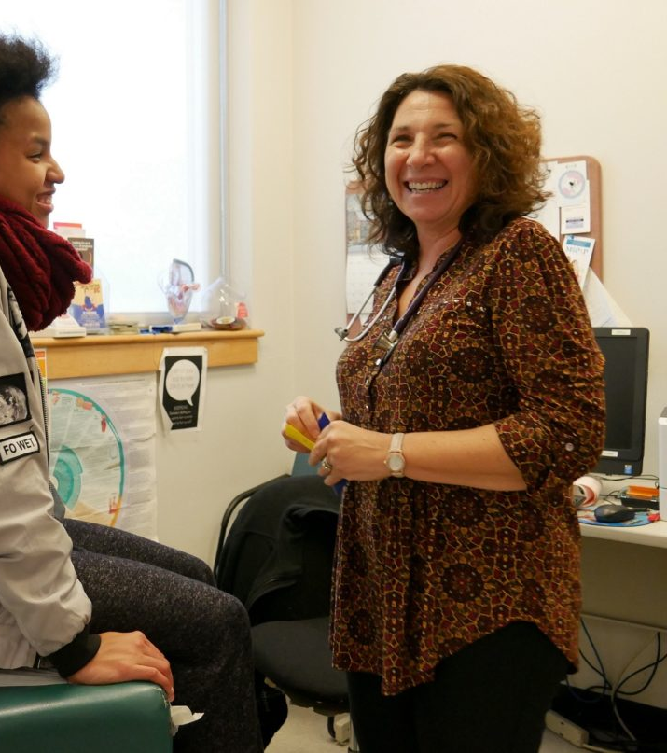
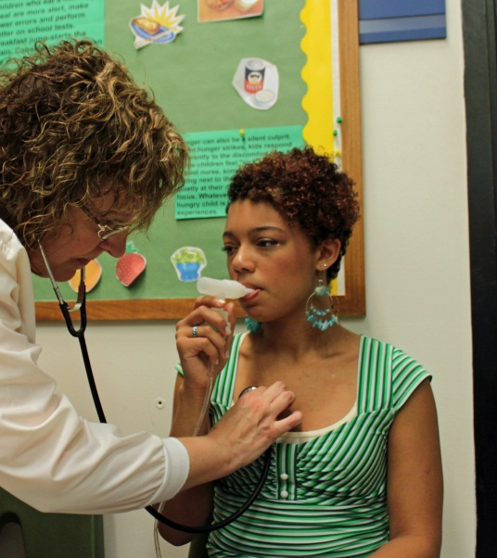
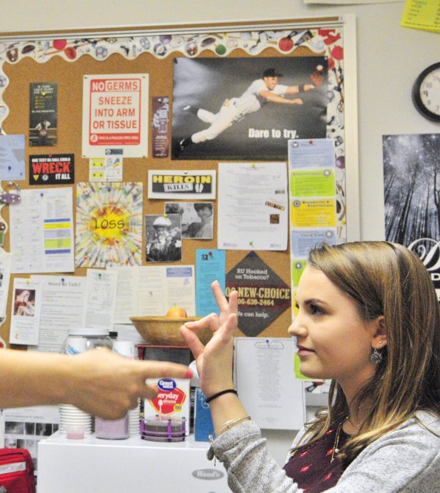
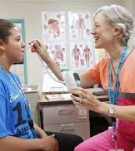
School Nurses
Obiajulu Cheretakis, MSN, RN​
Obiajulucheretakis@bpsma.org
Rachel Nazon, BSN, RN​
Rachelnazon@bpsma.org
Ann Nardelli, BSN, RN​
Annnardelli@bpsma.org
Jennifer Golden, BSN,RN​
jennifergolden@bpsma.org
Joanna Hrenko, Paraprofessional/Health Aide
​joannahrenko@bpsma.org
Nurses are available during school hours. You may call them directly with any medical questions or concerns you may have. They are available on Microsoft Teams if you would like face to face communication. You may send doctors notes to them by fax or by uploading a photo of the note and email or scan it to them.
508-580-7691​
508-580-7692
FAX 508-894-4271
Notes:
Please see contact information above…..read the above outloud.
Students may seek medical care (including aspirin) from the school nurse. School nurses maintain and distribute all medications (including all over the counter medications) for all students. Any student needing to visit the nurse must first obtain a pass from his or her academic teacher, except in an emergency. The nurses’ office is located next to the main office.

Slide 12
Part Two
Graduation Requirements and Credits
Academic Levels
GPA/Class Rank
Part Two Objectives
Students will understand the importance of planning
To identify a pattern, explain a pattern,
and/or make a prediction based on a pattern
Notes:
In order to be successful in your future, you’ll need to plan in advance.
Our literacy objective for this section is to:
identify a pattern, explain a pattern and make a prediction based on a pattern.
In part two, we will go over graduation requirements and credits. Also, we’ll discuss academic levels and GPA, which will take a part in predicting your path after high school

Slide 13




Graduation Requirements
Freshman
Sophomore 27
Junior 49
Senior 72
104 Credits Required to Graduate
MCAS
Notes:
In order to graduate from Brockton High School, you must earn a certain number of credits each year.
To be promoted from a freshman to a sophomore, you must earn a total of at least 27 credits.
To be promoted from a sophomore to a junior, you must earn a total of at least 49 credits.
To become a senior you must earn a total of at least 72 credits by the end of your junior year.
And to graduate you must earn a total of at least 104 credits by the end of your senior year.

Slide 14
What are Credits?
Credits are like a paycheck. You earn them by passing a course.
Credits are not proportional to your final grade in a course. They are proportional to the length and number of days you spend in a course.
6 Credits, 3 Credits, 1.5 Credits
Notes:
What are credits?
Simply put, credits are like a paycheck. You earn them for passing a course. You must complete the course in order to get credits.
Some courses are worth 6 credits, some are worth 3 and some are worth 1.5 credits.

Slide 16
BHS MINIMUM
REQUIREMENTS FOR GRADUATION
Subject | # of Credits | Length
English | 24 Credits | 8 Semesters
Math | 18 Credits | 6 Semesters
Science | 15 Credits | 5 Semesters
Social Sciences | 15 Credits | 5 Semesters
Wellness | 6 Credits | 4 Semesters
Electives | 26 Credits
TOTAL | 104 Credits | 4 Years
Notes:
Brockton High School requires that students earn a certain amount of credits in all major subject areas in order to graduate.
You already know that you need 104 credits to graduate. However, you can not earn all of your credits taking elective courses.
You must earn 24 credits in English. This requires taking and passing English during all four years of high school.
You must earn 18 credits in Math, 15 credits in Science, 15 credits in Social Science, 6 credits in Wellness.
You will also have the opportunity to choose electives which are worth anywhere from 1.5 to 6 credits. Passing all major subjects and your electives will earn you the 104 credits that you need to graduate.
In addition, by the end of your senior year you must pass the MCAS test. You will be receiving more detailed information about the MCAS test during your sophomore year. However, it’s important to let you know now that studying hard and getting good grades this year will help you pass MCAS next year.

Slide 17



The length of the course and the number of days you attend a class determines how many credits you receive when passing a course
S | E | M | E | S | T | E | R | 1 | S | E | M | E | S | T | E | R | 2 | CREDITS
A | B | A | B | A | B |  |  |  | A | B | A | B | A | B
A | B | A | B | A | B
A | B | A | B | A | B
6
3
1.5
Notes:
The number of days that a class is scheduled for determines how many credits you will earn. CLICK
If a class meets every day for the entire year, both semesters, you will earn 6 credits when you pass it. CLICK
If a class meets every day for half the year (one semester) you will earn 3 credits when you pass it. CLICK
And if a class meets on Day A or Day B for half the year you will earn 1.5 credits when you pass it. CLICK

Slide 18
The Successful Student
Do your best academically!
It’s all about credits & academic levels!
HONORS (H)
  4 YEAR COLLEGE +
COLLEGE PREPARATORY ADVANCED (CPA)
  4 YEAR COLLEGE
COLLEGE PREPARATORY (CP)
  2 OR 4 YEAR COLLEGE
Notes:
We just went over the minimum requirements for graduation, but in order to be accepted to college, you need to go beyond the minimum.
There are three academic levels for major subjects.
HONORS, which is the most demanding, will prepare you for a competitive four year college.
The COLLEGE PREPARATORY ADVANCED level will prepare you for a four year college.
The COLLEGE PREPARATORY level will prepare you for a two or four year college.
In order to move up a level you must earn at least a B or higher. See your counselor with specific questions regarding level changes.

Slide 19
What is GPA?
For example a ‘B’
Honors
3.5 points
College Prep Advanced
3.2 points
College Prep
3.0 points
*YOUR GPA OR GRADE POINT AVERAGE IS DETERMINED BY YOUR GRADES
*EACH GRADE CORRESPONDS TO A CERTAIN NUMBER OF POINTS
*THE HIGHER THE CLASS LEVEL, THE MORE POINTS YOU EARN.
Notes:
When you apply to college, one of the first things they’ll look at is your GPA.
G P A stands for grade point average. Grade point average is determined by the grades you earn as well as the academic level of your classes.
What this boils down to is that you need to be in the highest level you can handle and earn A’s and B’s.

Slide 20


What is Class Rank?
Your Grade Point Average will determine your order within your entire class.
The highest class rank will correspond to the person who has accumulated the most points during his or her high school career.
Notes:
Your grade point average will determine your order or rank within your class.
The highest class rank will correspond to the person who has accumulated the most points or highest grade point average during his or her high school career.
Your GPA and class rank are calculated at the end of every school year.

Slide 21
Part Three
How Can I Be a Successful
Student ?
Part Three Objectives
To identify attitudes and behaviors which lead to successful learning
To respond to what one has viewed or heard

Slide 22
Do Your Best Academically
If you need help:
•Use agenda/planner to write down all assignments.
•Complete at least 30 minutes of homework per subject per day.
•It is your responsibility to make up work.
Speak to your teacher directly or email them to setup a time to meet.
You can also go online and access free resources that provide you with extra academic support.
Notes:
Do your best in all of your classes.
Use a planner to write down all assignments and keep track of due dates, homework assignments, tests and quizzes. You should develop a habit of doing homework at least 30 minutes per subject per day.
Remember, if you are absent, it is your responsibility to make up the work.
If you feel you need extra help, you should discuss this with your teacher and ask them for extra help. During the after school hours of 1:50 to 2:23, you are able to receive support and connect with your teachers and counselor virtually via teams.

Slide 23
Online
Academic Support
KHAN ACADEMY
  Khan Academy isn't really just a tutoring company; it's meant to supplement a child's education, with curriculum materials designed to either bolster classroom lessons or teach something entirely new. There isn't any live or one-on-one instruction (just videos that students watch at their own pace), but the materials are 100% free.
Hippo Campus
  HippoCampus.org is a free website that offers rich multimedia academic content — videos, animations, quizzes, and simulations. The site offers more than 5,700 free videos collected from various academic institutions in 13 subject areas, including algebra, geometry, calculus, earth science, biology, physics, history, and English.
Ask Dr. Math
  "Ask Dr. Math" is a nonprofit forum managed by Drexel University. The site may look dated, but it's still helpful and relevant. The list of math FAQs covers many popular topics, such as dividing by zero, types of fractions, learning to factor, and how to round numbers. You can also browse for answers by age group (elementary, middle, or high school) or search the archive by keyword.
Notes:
For additional support you can go online and access multiple online platforms that provide free help like: Khan Academy, Hippo Campus and Ask Dr. Math. These are all free and will help support you on your path to learning and getting good grades.
Remember if you are having a hard time with any academic subject, it is important to get EXTRA help right away so you don’t fall behind.

Slide 24
BPS Remote Log-in Instructions
Go to www.bpsma.org and click on the Clever Log In
Your username is your 6-digit ID #@bpsma.org
Your password is your date of birth followed by bps2021
  Example: for January 1st, 2009 password is 01012009bps2021
Once in Clever, you have access to:
  Microsoft Teams
  Infinite Campus
  Schoology
  And more
Notes:
Just a reminder on how to log in to school remotely. Start with the Clever account and it will guide you to all of the learning platforms.

Slide 25

Virtual Learning Expectations
Sit in a quiet spot with limited distractions and appropriate background.
Turn off music, TV, and videos.
Come prepared with class materials and computer charger.
Dress in 'school appropriate' clothing.
Be on time.
Turn on video at the start of your class meeting.
Keep yourself on MUTE until it's your turn to talk.
Use the 'raise hand' button or chat bar for questions or comments. One voice at a time.
Keep discussion class related. No private or personal comments.
No photos or recording class meetings.
Be kind, patient, and respectful of others.
Notes:
We understand the challenges of virtual learning and want to support you in creating a manageable and organized learning experience. Following these expectations will help students successfully participate in virtual classrooms. Note that school rules regarding appropriate clothing, language, attendance, and behavior continue to apply to the virtual learning environment.

Slide 26

Attendance
Daily attendance will be taken regardless of the model of instruction as follows:
In-Person
Students attending school in-person will follow the traditional attendance procedures as outlined in the applicable BPS handbook.
Hybrid
Students are required to attend school in-person on the days assigned. On the remote days, attendance will be taken through the login to the remote learning platform, at the beginning of each class and through completed daily assignments, and by attendance at virtual classes and/or meetings. Appeals of assigned in-person and remote days must be made in writing directly to the building principal.
Remote
Attendance for the remote instruction will be taken daily as student are required to login to the remote learning platform and attend all scheduled classes, including video conferencing. Also, attendance will be taken at the beginning of each class and will be monitored through completion of assignments and participation in lessons.
Students who are unable to attend school due to illness or quarantine will be counted absent unless they are actively accessing the remote learning platform and participate in remote instruction as set forth above.
Camera Use
Students will be asked to turn their cameras on briefly while teachers take attendance at the beginning of the school day and at the beginning of each class period or content time. Students will not be mandated to keep their cameras on the whole class period.
Notes:
Attending class every day is crucial when it comes to maintaining good grades. If you know you are going to be absent, it is a good idea to email your teachers ahead of time to let them know. If you have a medical appointment, you should plan on emailing a note from the physician's office to our school nurses. Again, regular attendance is key to academic success. A waiver may be granted with proper documentation for medical reasons, death in the family, religious holiday, school sponsored activity, court appearance, unavoidable accidents, and military obligations.

Slide 27
Part Four
Extra Curricular Activities/Sports
Community Service
Lifeline
Part Four Objectives
Students will employ strategies to achieve
future career goals with success and satisfaction
To generate a response to what one has read,
viewed or heard.
Notes:
Read it

Slide 28
Extracurriculars and
Life Activities
Drama Club
Dance Club
Amnesty International
Key Club
Empower Yourself
Gymnastics
Math Club
Golf
Tennis
Boxer Buddies
Volleyball
Notes:
Here at Brockton High School we have many extra curricular opportunities that we encourage you to take part in because these activities help you decide what you may want to do later in life. Just the exposure alone to different areas of interest can help a student choose a career or major for college. That is why we also call these Life Activities .
It is important to get involved for many reasons. Students who are thinking about going to college after graduating from high school should really consider joining a club, playing sports or participating in community service. Colleges first like to see good grades and commitment to education, but, they also like to see students who have been involved in various activities during high school. They look at whether or not you have been a member of a sports team or a club or if you have volunteered your time to a good cause. Involvement in extra curricular activities enhances your high school resume and helps the admissions representatives learn more about you and your interests.
When we return to school, make sure you listen to announcements and look at the TV screens in the cafeterias to learn when different clubs are meeting. Late buses are available after school Mondays through Thursdays (with the exception of staff meeting days). See your counselor or the office for help finding your late bus.
During the remote learning period we will be offering virtual clubs and select sports. More details are forthcoming.

Slide 29

Your choices and decisions made in high school will affect your future!
Notes:
Yet, it is during this time that you will make some important decisions.
These decisions involve whether after you graduate you will go on to college, into the military, to a technical school or to work. Whatever your decision, it will affect whether you are able to later live comfortably in a lifestyle you want,
or you will be just getting by in a job you really don’t enjoy.
You must realize that your future is determined by the decisions you make during your four years of high school! So remember to use the time that you are here wisely. Study hard, make good choices, get involved, ask for help when you need it, and you will succeed in having the life that you want and deserve.
*** Hand out Ticket to Leave. Collect if time allows or have teacher collect. Tickets should be returned to the appropriate counselors

